Slide 1
Foundations, Other Careers in Medicine, and Trying to Influence Policy
Steven A. Schroeder, MD
TICR Course, August 14, 2014

Slide 2
General Career Categories
Foundations*
Journalism
Government
Non-government organizations
Administration
Business
Other
* special emphasis

Slide 3
Foundations Are Uniquely American
Less role for government
Opportunity to create great wealth
Larger role of private associations

Slide 4
My Personal Experiences with Foundations
RWJF, 1990-2002 (12 ½ years)
Chaired American Legacy Foundation board
Currently sit on four large foundation boards, plus small Schroeder family foundation
Past and current support from multiple foundations

Slide 5
Foundation Governance
Self-perpetuating boards
Issue of family members
Issue of founder (“dead hand”)
First vs. subsequent generations of trustees
The mission

Slide 6
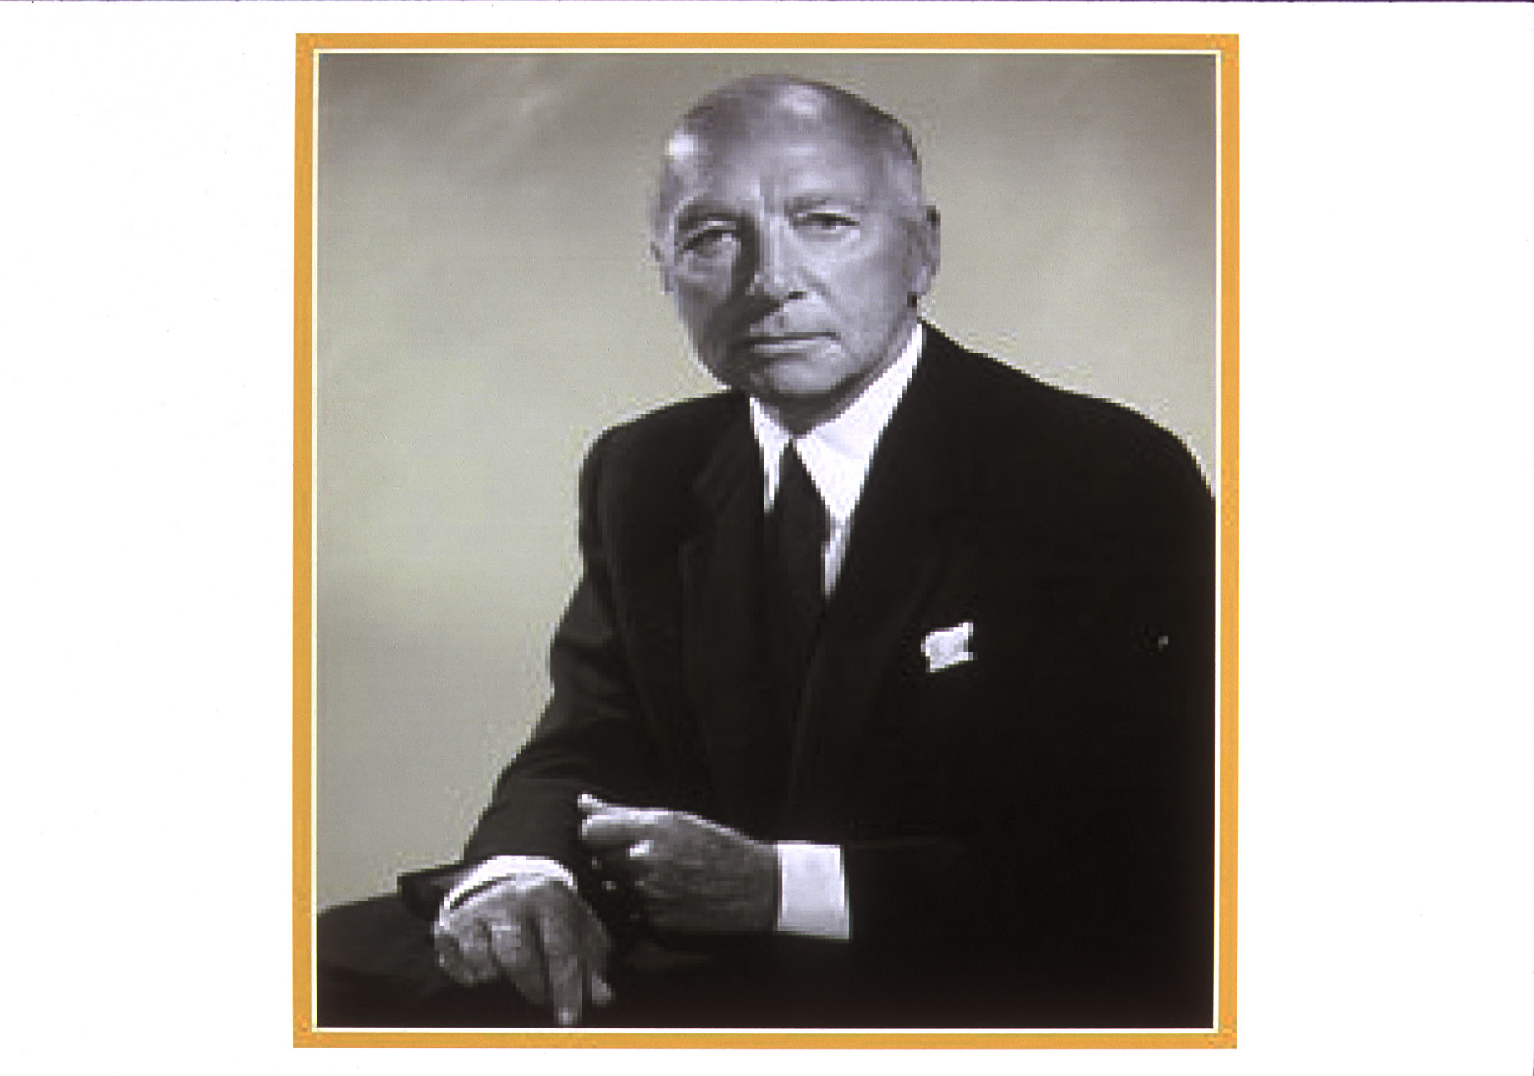
Robert Wood Johnson

Slide 7
Robert Wood Johnson Foundation
Founding mission (1972):
“To improve health and health care for all Americans”

Slide 8
Highlights 1990-2002 era*
Asset growth $4 billion in grants
Staff growth; new facility
Board diversification
Developing and institutionalizing programs in “health”
* Schroeder as president

Slide 9
Five Brief RWJF Case Studies
Covering the uninsured
Smoking
Care at the end of life
Childhood obesity
Changing physician reimbursement (as an RWJF grantee through SGIM)

Slide 10
Foundation Options
Private or corporate
National or local
Breadth vs. depth
Linkage to source of wealth
Political slant

Slide 11
Foundation Finances
5% minimal payout
3 ½ % minimal for operating foundations (e.g., Howard Hughes)
Perpetuity or spend-down?
Geographic focus: global, national, state

Slide 12
Big 5 Foundations*
Gates--$40 billion (plus Buffet’s $28 b)
Howard Hughes--$18 b
Cargill--$11 b
Ford--$11 b
Getty--$10.5 b
RWJF--$10 b
(Packard fell from $17b to $3b; now back to about $6.5b)
*Estimated 2014 worth, but note lag time and market volatility

Slide 13
Motivations to Form Foundations
Give back
Protect the stock
Avoid estate taxes
Shield heirs from excess wealth
Conversion of public entities to for-profit
Legal arrangements (e.g., MSA)

Slide 14
Principles of Effective Philanthropy
Fidelity to mission
Take on important problems
Make a difference
Don’t duplicate work of others

Slide 15
Principles of Philanthropy (2)
Leverage leadership position
Measure impact
Learn from experience

Slide 16
Sample Interventions
Training
Research
Bio-molecular
Health services
Health policy
Population health
Policy analysis
Communications
Support advocacy
Evaluation
Community demonstrations
Polling
Commissions

Slide 17
Criticisms of Private Foundations
No accountability
Violate donor intent
Arrogance
Don’t spend enough
Perquisites too lavish
Too risk-averse

Slide 18
Foundations Can Take Risks That Government Can Not
Tobacco
Alcohol
HIV/AIDS—needle exchange, condom use
Gun violence
Reproductive issues
Stem cell research
Can be less orthodox than NIH

Slide 19
Lessons I Learned Since 2003
Watch out for strategy infatuation
The challenge of supporting advocacy. Better to give established champions a voice than to try to create champions
Boards really matter

Slide 20
Health-Oriented Foundations
California Wellness ($800m)
California Endowment ($4b)
California Health Care ($800m)
Kellogg ($8b)
Gates ($36b)
Gordon and Betty Moore ($5b)
Multiple disease oriented foundations: ACS the largest at $160m/year

Slide 21
Sample List of Health-Oriented Foundations (2)
Soros/ Open Society ($1.1b)
Commonwealth ($700m)
Kaiser ($500m)
Hartford ($ 500m)
Grant ($300m)
Pharma—SCLC example with Pfizer

Slide 22
Foundations Interested in Health Policy
Kaiser
Commonwealth
RWJF
Macy ($150m) (health professionals/ conferences)

Slide 23
Foundations Interested in Improving Health
Legacy Foundation ($1.1b) (smoking)
Bloomberg ($3b)
Annie Casey (3.6b) (children)
Wm Clinton ($2.5b)
Gates—global health
Grant—children
Hewlett (7.3b; mainly non-health, but support reproductive health)

Slide 24
Foundations Improving Health (2)
MacArthur—global reproductive health; domestic research networks—aging, depression, primary care, mental health
Gordon and Betty Moore—patient care—nursing
Packard—reproductive health
Rockefeller ($3.5b)—global health
Atlantic/ Hartford/SCAN--aging

Slide 25
California Foundations
California Endowment ($3.6b)—healthy communities
California Healthcare Foundation ($800m)—health policy
California Wellness ($800m)—diversity, violence, teenage pregnancy, women’s health
San Francisco Foundation ($1.1b)
Marin Community Foundation ($1.3b)

Slide 26
Guidelines for Approaching Foundations
Know their priorities and procedures
Tailor your proposal accordingly
Introductions from senior leaders help
Connections to foundation staff help
Keep trying!

Slide 27
Three Foundation Resources
The Foundation Center
www.fdncenter.org
Council on Foundations
www.cof.org
Grantmakers in Health
www.gif.org

Slide 28
Journalism
Professional (NEJM—Rosenbaum; JAMA, Annals of IM; JAMA IM—Redberg; JGIM—Feldman; J Hospitalist Med--Auerbach)
Lay (NY Times)
Television
Consumer health (e.g., web-based)
Perils and opportunities of transition away from print media
Blogs (Bob Wachter, Alex Smith)

Slide 29
Government
Federal (many former UCSFers)
  Agency (NIH, CDC, CMS, FDA, HRSA)
  Legislative staff (Bindman)
State (Health department, specific agency)
Institutional (VA, prison health)
Local (County health dept-Katz-, hospital)

Slide 30
UCSF in the Nation’s Service
Director of the NIH
Assistant Secretary of Health (twice)
Assistant Secretary of Planning and Evaluation
Director of FDA (two different people)
Director of the CDC
Surgeon General
Founding Director of Health Care Financing Administration (now CMS)
Director, Social Security Administration
President, National Academy of Sciences
Who is next?

Slide 31
Global Health
WHO
World Bank
PAHO
IMF
Doctors without borders
Gates Foundation

Slide 32
NGOs
American Cancer Society, AHA, ALA, etc.
Professional societies (AMA, ACP, SGIM)
Advocacy organizations—national and local
Think tanks: RAND, Urban Institute, Brookings, AEI, Mathematica Policy Research,etc.

Slide 33
Health Care Administration
Hospitals
Clinics
HMOs
Quality assurance
Information Technology

Slide 34
Business Ventures
Health insurance companies
Medical directors of companies
Consulting
Biotech and big pharma
Dot.com/ medical applications
Devices
IT
Medical benefits consulting (HR, PBGH)
Head hunting—(big industry)

Slide 35
Issues to Consider re Alternate Careers
When to enter: early? midcareer? late?
How and when to exit
Self knowledge of skills, interests, tolerance of frustration, etc. (Goodness of fit between self and real work)
Importance of mission
Impact on family

Slide 36
How to Position Yourself for Alternate Careers
Get good training
Work at visible institutions
Publish
Network
Treat people well
Nourish your passion and make it evident
Scout for role models

