Slide 1
CARE Study Demonstration
Mike Jarrett
Sept 11, 2014

Slide 2

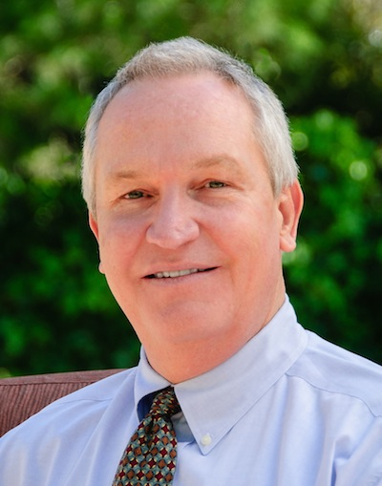
Michael Jarrett
President and CEO
QuesGen Systems, Inc.
CEO and Founder, QuesGen Systems, Inc.
Since 2004, QuesGen has been has been providing academic research institutions a flexible, web-based solution for managing research data. Over the last several years, we have been focused significantly on Traumatic Brain Injury.
We have worked with leading investigators at UCSF
Working with One Mind for Research to develop a sharing model through their portal platform

Slide 3
UCSF Client Studies
Airway Research Group
Mesemchymal Stem Calls for ARDS (Start Study, Michael Matthey)
Predictors of Sepsis in ED Arrivals (EARLI Study, Carolyn Calfee)
Ovarian Aging (OVA Study, Marcelle Cedars)
Transfusion Related Acute Lung Injury (TRALI Study, Pearl Toy)
Differing Surgical Approaches for Hernias (Hobart Harris)
Endometriosis Bank (Linda Giudice)
Lung Transplant, Granuloma, Scleroderma (TIGRS Study)
Victims of Violence Intervention (Wraparound, Rochelle Dicker)
Multi-center study of TBI (TRACK-TBI, Geoff Manley)
Many Others

Slide 4
CARE Study Data Structure

Slide 5
CARE Study Data Structure

Slide 6
Study Management Concepts
eCRFs are forms that are tracked for completion and correctness
CRFs can be collected into Milestones (e.g. Baseline Milestone, Injury Milestone)
Rules can be implemented to ensure that elements are complete and correct
Coordinating center can review progress and provide reminders to complete forms and milestones on a timely basis
Each site will see only their data

Slide 7
More Information?
Contact:
Mike Jarrett
415-738-8452
mike.jarrett@quesgen.com

