Slide 1

Program Evaluation for Real-world Implementation
Alice Gandelman, MPH
California Prevention Training Center (CA PTC)
Notes:
Preface- limitations, or “about me and my biases and/or perspectives!”
I come from the “practice” world, but have been funded to implement and direct national programs to conduct training and technical assistance on how to implement evidence-based interventions for over 25 years.
I work with a multidisciplinary team of biomedical, behavioral, and social scientists, as well as public health and community professionals.
I am very interested in the field of implementation science, as well as planning models used to improve our programs, as this is what our programs have been doing for the last few decades, but not formalized via “implementation science” until recently
About the CA PTC (Part I, II, III PTCs); CBA for HDs , PREP, (MCAH)

Slide 2
Agenda
Importance of planning models (e.g., PRECEDE-PROCEED) in practice
How they are used in
  program implementation and evaluation
  for developing programs/interventions to add to the evidence base
Combination prevention programs
  biomedical, behavioral, social, structural-level
  next phase of implementation science?
Questions- discussion
Notes:
Talk about a variety of issues that are relevant for public health prevention as it relates to practice issues—
Describe several planning models that have been used, including P-P.
Somewhat of an eclectic (but relevant!) discussion of common themes
Important links in many of these areas

Slide 3
If we want more evidence-based practice, we need more practice-based evidence.*
Lawrence Green (Author, PRECEDE-PROCEED)
http://www.lgreen.net/precede.htm
Notes:
As I was reviewing the literature, I was reminded of the value of many of these planning models—we use some, in our work, but could do better!
You’re learning about PRECEDE – PROCEDE in this course; I learned about it in the early 80s when I was in graduate school! Wanted to check to see if changes had occurred since I leaned about it
Didn’t find many changes, but found this quote on the website; assume this is from Larry Green; SLIDE (really resonated with me)
An ultimate goal of research is to bring efficacious research to practice (so the benefits of research can be realized) (e.g. technology transfer often used to connote this—bringing science to the field or bringing science to practice)
Through implementation science, we’re learning that it’s more complex than that … Once EBIs are in the field they take on a life of their own , due to many factors, speak more about this later
Green’s PRECEDE –PROCED model addresses some of these issues

Slide 4

Implementing EBIs –
Both Art and Science
Research Efficacy
  Study or research that demonstrates an intervention “works”, or brings about desired results
  Implemented with fidelity in controlled settings
  The science
Intervention Effectiveness
  Extent to which intervention is effective in practice or “real-world” settings
    Several things may influence fidelity, and intervention outcomes
  The art
Notes:
1st bullet
Important, because we want to implement programs that work.
2nd bullet
Even with the best-laid plans, we know that program settings are not predictable, which is why there is often a healthy tension, or balance between these two concepts, and why I refer to this as both an art and a science
--The science is in the research; the art is in the implementation
--Implementation Science acknowledges the intersection between evidence-based practice and practice-based evidence

Slide 5
Planning Models – Important Tools for Implementation Science
Help guide effective program implementation and evaluation activities
  PRECEDE-PROCEED
  Logic Models
  Performance Improvement Frameworks
  RE-AIM
  UNAIDS Organizing Framework for M&E
Notes:
Planning models are particularly helpful when developing program goals, objectives, activities, and performance measures for programs.
Similar to blueprints for a house (start at the beginning of what you want your house to look like and what you need to consider (1 or 2 story, windows, doors, plumbing, etc)
Good planning models help to envision how programs, interventions are to be implemented, as well as how to measure whether the outcomes were achieved

Slide 6

Planning Models – Important tools for evaluation
PRECEDE-PROCEED model
  Predisposing, reinforcing, enabling factors of priority populations affecting health
  Policies, resources, organizational factors that
    must be in place to enact effective interventions, including evaluating their outcomes
  Intended, vs. real program outcomes
    Gaps between planned (desired) vs. actual implementation outcomes
Notes:
1) PRECEDE: Predisposing, Reinforcing, and Enabling Constructs in Educational/Environmental Diagnosis and Evaluation.
--represents the process that precedes, or leads up to, an intervention (e.g. assessment)
2) PROCEED : Policy, Regulatory, and Organizational Constructs in Educational and Environmental Development
--guides the process during implementation
3) Important tenets/characteristics of the Precede-Proceed Model are :
Health and health risks are caused by multiple factors; because of this
Behavioral, environmental, and social determinants must be addressed
Activities must be multidimensional, and participatory (stakeholders!)
Addresses both population and organizational factors
Addresses both intended vs. real program outcomes (talk more about this next)
This has become an increasingly important issue in the implementation of EBIs, which I’ll discuss later on.

Slide 7
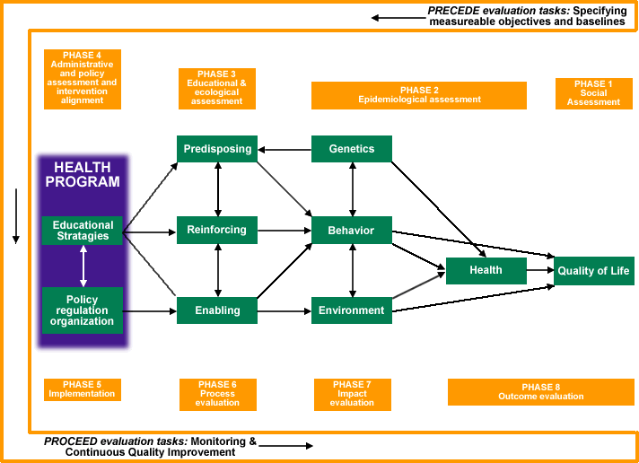
PRECEDE – PROCEDE Program Planning Model
L. Green and M. Kreuter. (2005). Health Promotion Planning: An Educational and Ecological Approach (4 th Ed.). Mountain View , CA : Mayfield Publishers
http://ctb.ku.edu/en/table-contents/overview/chapter-2-other-models-promoting-community-health-and-development/section-2
Notes:
PRECEDE begins at the end (with the desired outcome) - 4 initial (assessment) phases (1st 3 are external; 4th is internal):
Phase 1: Identifying the ultimate desired result (outcomes)
Phase 2: Identifying behavioral and environmental determinants that
impact achievement of outcomes, such as
behavioral and environmental conditions that must be addressed to achieve desired outcomes
Phase 3: Identifying the predisposing, enabling, and reinforcing factors affecting behavioral and environmental conditions
Phase 4: Identifying the administrative and policy factors that influence or determine what can be implemented.
PROCEED also has 4 phases that address implementation and evaluation of the intervention:
Phase 5: Implementation: intervention design and delivery
Phase 6: Process evaluation: is int. being implemented as intended/planned?
Phase 7: Impact evaluation*: Is the intervention having the desired impact on the target population?
Phase 8: Outcome evaluation*: Is the intervention leading to the outcome (the desired result) that was envisioned in Phase 1?

Slide 8
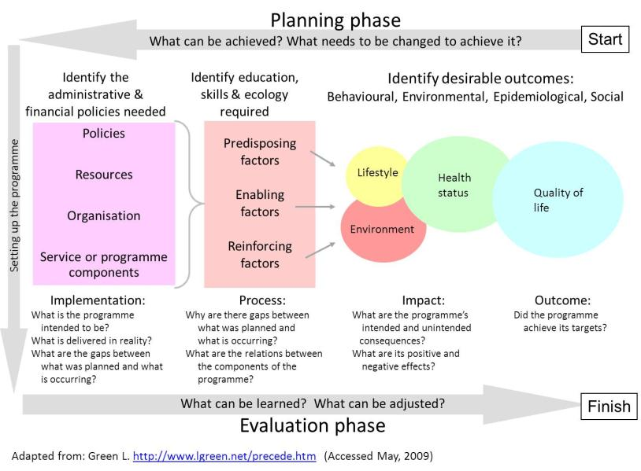
Canadian Adaptation of PRECEDE - PROCEDE
Notes:
this version of the PRECEDE – PROCEDE model does a nice job emphasizing implementation issues (CQI), as well as process, outcome, and impacts
Implementation-related issues don’t often get enough attention, but are related to successful outcomes (i.e. desired, vs actual implementation)
(will define types of evaluation next, as they may seem out of order).

Slide 9
Evaluation Definitions
Formative evaluation
Assessment activities to inform program development
Process
(Outputs)
# of services delivered to target population; how services were delivered
Outcomes (immediate and intermediate)
Changes in target population as a result of intervention or services delivered
Knowledge, beliefs, skills, practices, or health conditions
Impacts
Changes in morbidity or mortality disease rates
Notes:
definitions – Janet may have already covered
You may notice that these terms are in a different order than those in the PRECEDE-PROCEDE framework (impacts after outcomes)
Over time these terms have been defined differently by different disciplines. If you notice differences in your understanding, check with your funder or contact.
(I like phase 1, 2, and 3!)

Slide 10
Linkages Between Monitoring and Evaluation Activities
Assessment
(Formative evaluation)
Process
(Delivered services or interventions)
Outcomes
(changes in biomed, beh, soc or structural conditions )
Impacts
(disease trends, morbidity mortality rates)
Notes:
Another helpful way to look at this is that evaluation is a continuous iterative process, beginning with the assessment phase (or formative eval) through identifying short and long-term program outcomes, and how those influence health conditions over time (impacts) CA PTC
Also depicted similarly in the PRE/PRO model, although it is STAET- Finish. Could close the loop in the diagram and illustrate as a circular model like this

Slide 11
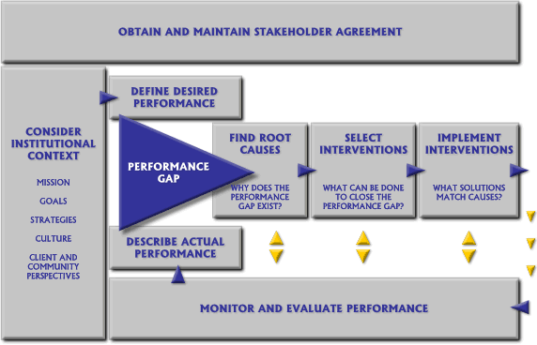
Performance Improvement Framework
Prime II Performance Improvement: www.prime2.org
Notes:
This is another model that was developed as part of a an international program funded by USAID, www.prime2.org.
Complimentary to PRECEDE-PROCEED, particularly in phases 5-8; nice follow-up to the Canadian version which describes implementation issues and gaps between desired, and actual performance outcomes
This framework can be used as a continuous quality improvement (CQI) activity to further inform needed program modifications
Mission (Safety Counts ex)
Culture, client-comm. perspectives (Introduction of DEBIs not welcome)

Slide 12
Logic Models
Typically Include
  A problem statement related to a priority population
  Conditions affecting the problem among the population
    Risk determinants affecting health conditions
      (biologic, behavioral, social, and/or structural)
    Program activities or strategies (resources) to address them
    Inputs
    Outputs
    Outcomes associated with the program
Notes:
Logic models are used more frequently for program planning and implementation, and are often required when preparing FOAs or RFPs
If not required in funding applications, they are frequently provided as a planning tool from the funders to illustrate the short, intermediate and long-term outcomes

Slide 13
Logic Model for RESPECT
RESPECT is an evidence-based behavioral intervention conducted with patients in clinic settings to reduce HIV acquisition and transmission
  Aims to increase personal perception of risk, increase self efficacy for risk reduction practices
  Based on several behavior science theories
    Health belief model
    Social learning theory
Notes:
evidence-based program used in public health programs today, RESPECT
Many health departments and other organizations throughout the country receive funding by CDC to implement RESPECT
talk a bit more about evidence-based interventions shortly

Slide 14
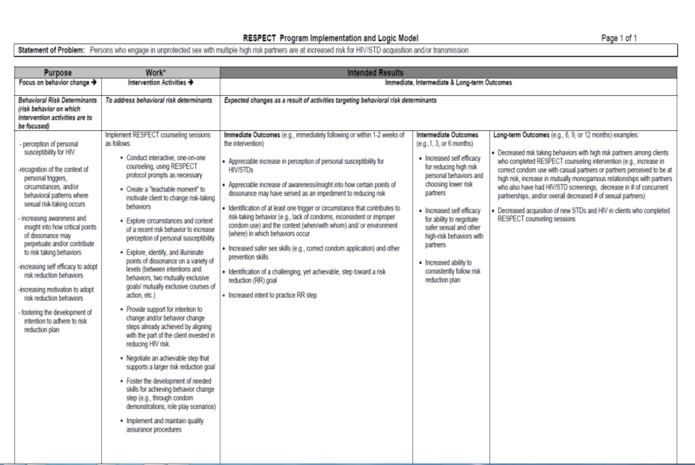
http://216.197.105.225/Files/RESPECT_Logic_Model_rev09-1124.pdf
Notes:
Here’s an example of a logic model used for the RESPECT EBI.
Starts out with a problem statement
The theoretical basis for the intervention is described in the first column under behavioral risk determinants
(personal perception of risk, triggers for risk behaviors, self efficacy, development of RR plan) from HBM, SLT
The activities (2nd column) address the behavioral determinants, and include immediate and intermediate outcomes (as found in the research studies).
Researchers developed this logic model for implementation based on the theories used and the evidence or outcomes
Part of an effort to bring efficacious science to programs DEBI program – largest national EBI diffusion efforts for beh. EBIs- prior to effective biomedical strategies – will talk more about this later

Slide 15
Notes:
Here’s another example of a logic model that is formatted slightly differently from the previous examples.
Major difference is that it uses Conditions, rather than a problem statement in the priority population;
An example of how LMs and planning models have evolved, to illustrate multiple, complex conditions that contribute to public health problems
You’ll notice that the program implementation activities (e.g. what the program does) go from top to bottom (vertical)
The program evaluation activities (i.e. performance measures or desired outcomes to be achieved to address conditions) go from left to right (horizontal)
This shows how both program and evaluation elements intersect and work together

Slide 16
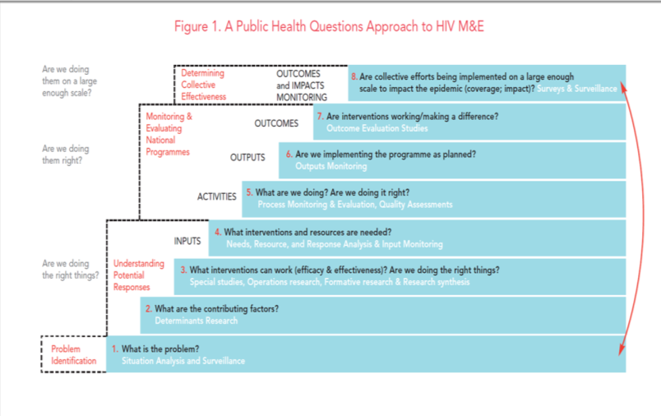
UNAIDS Organizing Framework for Monitoring and Evaluation
Notes:
UNAIDS Organizing Framework for Monitoring and Evaluation
Although it is laid out differently, you can also see the similarities in this, and other frameworks
Step 1 – identify problem
Step 2—determine contributing factors/determinants
Step 3 –identify interventions to address problems or conditions
Step 4– inputs
Steps 5-6 – process and output monitoring /evaluation (what is being delivered? How many are being served? is int. being conducted correctly, and as planned?)
Step 7 – are they making a difference (addressing the problem or conditions?- intermediate outcomes)
Step 8 – are they making a difference in disease rates? – long-term outcomes

Slide 17
Problem Statement (includes identification of population):
Logic Model for Combination Prevention Interventions
Determinants
Activities
Inputs
Outputs
Immediate Outcomes
Intermediate Outcomes
Impact
.
Behavioral
--------------------------------------------------------------------------------------------------------------------------------------------------------------------------------------------------------------
Bio-Medical
--------------------------------------------------------------------------------------------------------------------------------------------------------------------------------------------------------------
Social
--------------------------------------------------------------------------------------------------------------------------------------------------------------------------------------------------------------
Structural
.
Formative…………….Monitoring……………….Evaluation…………………Impact
Notes:
Logic model that encompasses combination prevention approaches—used in a course we have taught in Africa for the PEPFAR program over the last few years.
A bit more complex than the previous model. Still addresses one problem or issue in a priority population, but recognizes that there are more than one way to approach it.

Slide 18
Problem Statement : Men who travel outside of Harare for work are at high risk of HIV acquisition/transmission due to unprotected sex with multiple partners.
 | Determinants |  | Activities |  | Inputs |  | Outputs |  | Immediate Outcomes | Intermediate Outcomes | Impact
Behavioral | --Low perceived perception of risk for HIV acquisition or transmission --poor attitudes toward condom use |  | Distribute --ed. materials to ↑HIV knowledge --role model stories to change negative attitudes towards condoms |  | Printing materials condoms, trained community outreach, ed, and behavioral staff |  | --500 ed Brochures, role model stories Distributed --75 counseling sessions conducted |  | --Increase in individual perception of risk for HIV --changing attitudes regarding condom use | Decrease in high risk sex | Decrease in new HIV infection among women ages 15-24 in Harare
Bio-Medical | Increased susceptibility to HIV due to being uncircumcised |  | Build capacity for medical male circumcision (MMC) programs |  | Hire medical staff, conduct MMC training, Obtain clinic space |  | 100 medical providers trained |  | --100 MMC completed each week in township | Decrease in HIV susceptibility
Social | Norms around --condom use and male circumcision --importance of providing for family financially |  | Conduct marketing campaigns to -- ↑condom use --↑awareness of microfinance loans |  | Posters, billboards Peer incentives, training regarding importance of condoms and microfinance loan availability |  | --50 posters or billboards disseminated --20 microfinance peer advocates trained |  | --Positive change in attitudes about condom use --↑awareness of microfinance programs | Increase in condom use
Structural | Lack of access to –condoms --male circumcision --available jobs in local area |  | ---Provide free condoms --↑MMC programs --↑microfinance loans |  | --↑availability, accessibility, and acceptability of condoms --train staff on how to obtain microfinance loans |  | --Condom machines in 20 clubs, - distribute 300 microfinance loan apps. --↑availability of MMC programs |  | --Increase in condom use --100 men circumcised/ week --100 microfinance apps completed and granted | --↑ in protected sex --↓susceptibility to HIV --↓ in sex partners due to not traveling out of town for work
 | Formative Monitoring Evaluation Impact
Notes:
Here’s an example of the logic model for comb interventions completed.
We typically have participants identify 2 types of interventions (for time purposes)
Now that PrEp is gaining more exposure and evidence has shown it can significantly reduce HIV acquisition, we are seeing a move toward biomedical approaches (Treatment is Prevention, etc); the above determinant regarding lack of knowledge or negative attitudes toward condom use could be changed to PrEP…
Note: behavioral interventions are often prioritized when there are no effective biomedical treatments/interventions
Effective ART, PEP and PrEP are changing that

Slide 19
HIV Interventions Typically Don’t Use Combination Approaches
Behavioral interventions –focus of HIV prevention funding during the last decade
  (DEBIs)
New Emphasis – High Impact Prevention (HIP)
  Biomedical interventions
    HIV testing
    ART
    PEP, PrEP
Fewer use social or structural-level interventions

Slide 20
Many Determinants Affect Health and Well-Being
Individual health determinants:
  Genetic, Biological
  Psychosocial/Behavioral
Social/Structural health determinants
  Social
  Economic
  Environmental
  Political
Notes:
1) To better understand how SLIs work, it’s important to understand the spectrum of determinants that affect health
2) -Many different frameworks have been used to describe the social determinants of health, including an ecologic perspective.
-3) Important to note that one type of determinant alone, does not influence health and health outcomes, but many often working in concert affect health conditions

Slide 21
Spectrum of Determinants Affecting Health
Macro Social/Structural
Community/Social
Psychosocial/
Behavioral
Biologic/Genetic
Intermediate Social/Structural
Notes:
Another depiction of the range of determinants affecting health, and the reach of various interventions.
Generally speaking, interventions that impact biologic or behavioral determinants, have a narrower reach. Those that address community, intermediate or macro social or structural determinants can have a larger impact. They are often referred to as up-stream interventions.
Generally speaking because biomedical interventions, (such as vaccines), can have far-reaching effects on disease rates among populations, but they typically involve structural-related changes in policies, practices or programs, in the larger environment to have a broad-scale, wider effects in large population groups.
SLIs tend to be broader in their reach (can affect more people)
Are non-personal in nature (e.g. Condom Dist as SLI assumes people know how to use correctly, etc, but don’t have access to them)

Slide 22
Limits of Some Interventions
Many public health interventions emphasize individual (biologic or behavioral risk) factors
Do not typically address broad social, economic or environmental factors that also impact health
  laws that prevent risk reduction practices
  economic conditions, such as poverty, that prevent persons from accessing health services
  societal attitudes and beliefs (e.g., stigma, racism , etc)
Must also be addressed for prevention efforts to be successful
Notes:
2) Some of these factors were described in the previous example
3) More recently, there has been an increased focus on health disparities and development of strategies to address these inequities. (goal 3 of NHAS)
4) We know if we can reduce some of the HIV-related disparities and inequities, we can also reduce new HIV infections

Slide 23
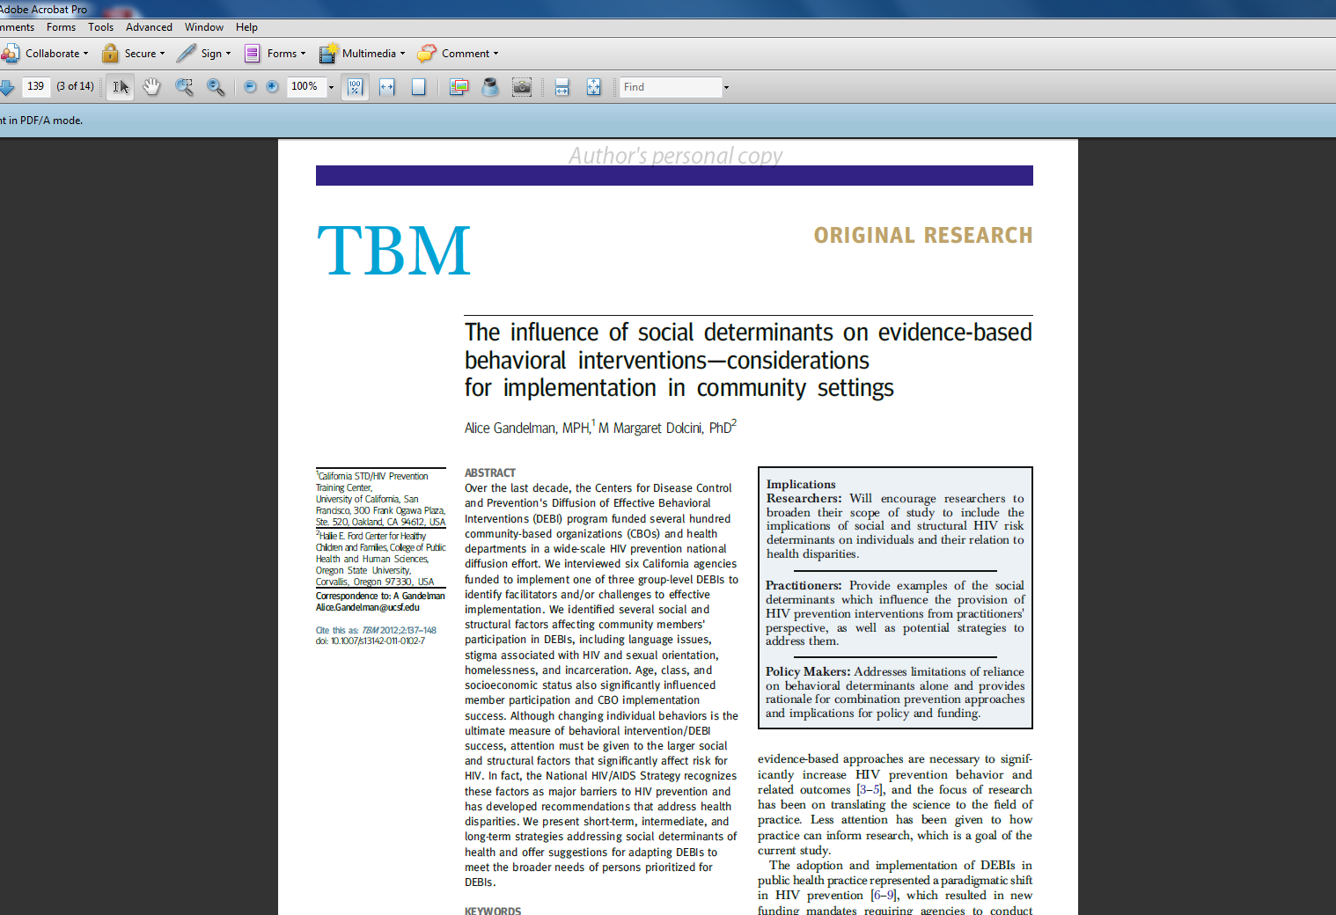
Notes:
We recently published an article about these issues, as an addition to the article you may have a copy of (CBO’s exp. Implementing DEBIs)
We pointed out that behavioral determinants are only a small part of the conditions that influence Hic acquisition and transmission
Now that biomedical interventions are being prioritized, this is still the case
(next slide with continuum)

Slide 24
Factors Affecting Implementation
Many DEBI implementation challenges related to social and structural barriers
  Recruitment and Retention often affected by
    Stigma
    Racism
    Homophobia
    Drug Use
    Homelessness
    Poverty
Referred to as social determinants of health (SDH)
Notes:
Several years ago, we conducted a small qualitative study with CBOs to identify barriers and facilitators to DEBI implementation.
We found that Recruitment and Retention issues-- (ability to attend and complete all intervention sessions) were significantly impacted by soc/structural barriers, including, ….(read above list)
They also present challenges for other types of interventions (accessing and staying in medical care, etc)

Slide 25
Social Determinants of Health (SDH)
Conditions in which people are born, grow, live, work and age
  shaped by distribution of money, power and resources at global, national and local levels
SDH mostly responsible for health inequities - the unfair and avoidable differences in health status seen within and between (populations) and/or countries
World Health Organization
Notes:
With SDH, there is recognition that many health conditions are shaped by broad, impersonal factors or forces that are that often beyond the control of the individual
One important goal of the NHAS is to reduce HIV-related health disparities and associated racism, stigma, and homophobia.
Important relationships between Health Disparities, SDH, and inequities
Health disparities are often caused by inequities, which are related to SDH
Camara Jones- CDC – Inequities: conditions that create unfair advantages for some persons and unfair disadvantages for others.

Slide 26
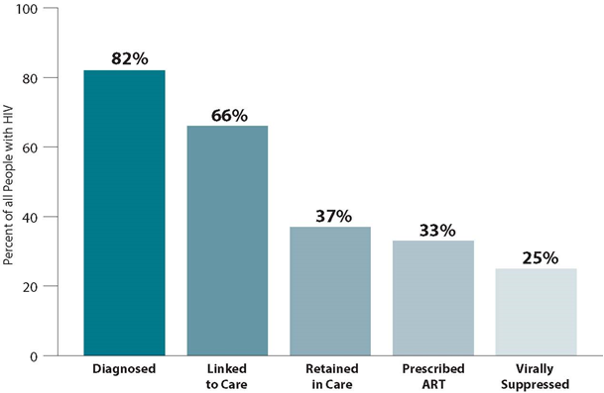
Notes:
This is a slide some of us may be familiar with. Uses a biomedical framework to map or depict national HIV goals
The # of persons represented on this slide who know their status, are linked to and retained in care, and medically adherent, decrease through the continuum,
The gaps increase throughout the continuum (18%, 33% not linked, 63% not retained, 67% not prescribed art or medically adherent)
What are some of the social and/or structural factors that might contribute to the gaps? (Think non-personal)
This slide can be developed with any disease, and the gaps would remain throughout the continuum. Although the diseases or health conditions are different, the factors affecting the gaps are the same (SDH).

Slide 27
Structural-Level Interventions (SLIs) Used to Address SDH
  an intervention designed to implement or change laws, policies, physical structures, social or organizational structures or standard operation procedures to affect environmental or societal change at an external level outside of individual control.
(Witt & Ellen, 2004) Structural Changes to Prevent HIV
Notes:
Unlike individual interventions which focus on behavioral determinants, SLIs address broader, political, environmental, economic, and social factors, and often require major changes in policies, laws, or complex social structures
--take a long time to fully implement
--require working with may partners and stakeholders
SIs are less focused toward individual behaviors and risk factors, however they do influence individual health conditions;

Slide 28
Structural-level Interventions Impact
Acceptability
Increasing social norms re: condom use
Changing attitudes toward syringe legalization
Accessibility
Placing condoms in physically accessible locations
Enrolling HIV+ persons in health insurance (ACA) -ART
Availability
Increasing availability of condoms in comm settings (e.g., schools, jails)
Increasing availability of clean syringes
Notes:
Generally speaking, most SLIs attempt to change 3 contextual factors that affect health: availability, accessibility, or acceptability. (Blankenship, 2000)
Availability: ints. that change (↑, ↓) the things (behaviors, tools, materials, or settings) that can act as barriers or facilitators for risk reduction
Slide examples
Accessibility: ints. that alter structures or conditions to increase resources or power to improve health conditions
Slide examples
Similar colors, because something may be available, but not accessible (could also purchase bikes to increase exercise)
Acceptability: interventions that alter social norms; recognize that the health is influenced by societal values, culture and beliefs
slide example

Slide 29
Types of Structural Interventions (SIs)
  Jobs training
  Recruitment into Health insurance
  Cigarette taxes
  College loans
  Social Marketing
  Media Advocacy
  Social Media
Economic
Social
Policy
Environ-mental
  Seat Belt Laws
  Minimum drinking age
  Supreme Court ruling on Prop 8, DOMA
  Providing housing for homeless persons
  Stricter air quality laws
  Condom distribution in schools
Notes:
SLIs can be categorized in 4 different types
Economic- ints – aim to change the economic conditions that influence risk, such as poverty and homelessness: --slide examples– recruiting persons into health insurance to access services/meds, job training to , or financial aid programs
Policy- changes to policies, laws, political conditions that influence risk --slide example—laws mandating seat belt use, minimum drinking age, Supreme Court Ruling on Prop 8, DOMA, removing barriers to marriage equality, etc
Social –Community – ints that change group, community, or societal norms, values cultures or beliefs --slide examples - social marketing activities promoting condom use, changing attitudes about same sex marriage;
Environmental – making changes in the environment to increase or decrease availability or access of things that affect health conditions
--slide examples– housing for homeless persons to increase medication adherence, fluoridating water, making condoms available in schools
*** There is often overlap in the different types of SIs; in fact, most social, economic or env. changes require policy actions, laws, or other legislation to be enacted (inner cyclical arrows)

Slide 30
Move From Behavioral to Biomedical Approaches
High Impact Prevention
  Increase HIV testing
  Link HIV-positive persons to medical care
  Retain patients in care
  Ensure they are medically adherent (i.e., ART)
  Decrease viral load (reduce transmission to others)

Slide 31
Planning Models Can…
Ensure that evaluation is considered at the beginning of a program
Provide a framework to guide program implementation
Can address multiple types of determinants (i.e., biologic, behavioral, social, structural) that influence health conditions
Can guide planning for multiple types of interventions (biomedical, behavioral, social, structural)
Notes:
As I said earlier, many planning models are out there, and I’ve just shown you several!
Easy to get confused about which model is the best
While you can see the similarities, each may have a best fit
Performance improvement framework is good to evaluate or determine gaps in program performance, may help explain why outcomes are not achieved
PREEDE-PROCEED addresses, external conditions (biologic, beh, environmental), and internal programmatic considerations
As the field of public health evolves and becomes more complex, older models may not work or need to be modified

Slide 32
HIV Prevention – Shared Individual and Social Responsibility
Successful HIV prevention requires a shared responsibility, balancing
  personal responsibility
    Identifying sound behavioral and biomedical approaches to maximize health, with
  social responsibility
    Recognition of external factors (social, economic, political) beyond the control of an individual that directly impact health conditions
Notes:
Encompasses both individual-level and population-level risk factors and disease-specific information and approaches.
Echoing Healthy People 2020 framework--that individual-level and population-level solutions are complementary elements of an integrated, comprehensive strategy for disease prevention and health promotion in the United States.
As we develop more complex prevention approaches, social determinants of health will continue to play an important role.

Slide 33
Questions?

