Slide 1
Biostat 200
Lecture 4 Review

Slide 2

Binomial Distribution

Slide 3
Recap of binomial distribution
The binomial distribution describes the probability of x successes in n independent trials, each with probability p of success
The possible number of “successes” will be 0 to n, because there are n “trials”
Often “successes” are number of people with a disease, “number of trials” is the number of people in the sample
The distribution will be symmetric when p=0.5, skewed right when p<0.5, and skewed left if p>0.5

Slide 4
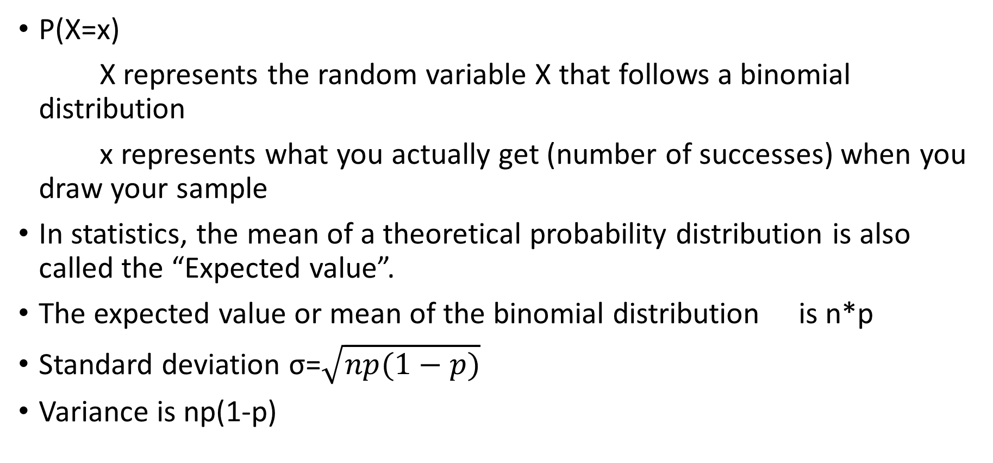
Binomial Distribution
P(X=x)
X represents the random variable X that follows a binomial distribution
x represents what you actually get (number of successes) when you draw your sample
In statistics, the mean of a theoretical probability distribution is also called the “Expected value”.
The expected value or mean of the binomial distribution is n*p
Standard deviation σ=$\sqrt{np(1−p)}$
Variance is np(1-p)

Slide 5
Binomial Probability Example 1
P(X=x) = P(exactly x successes occurring)
example: n=20, p=.05, x=2 P(X=2)?
** using binomialp(n,k,p)
di binomialp(20,2,.05)
.1886768

Slide 6
Binomial Example 2
P(X≥x) = P(of x or more successes occurring)
example: n=20, p=0.05, x=2
P(X≥ 2) =1 - ( P(X=0) + P(X=1) )
using binomialp(n,k,p)
di 1 - binomialp(20,0,0.05) - binomialp(20,1,0.05)
.26416048
using binomialtail(n,k,p)
di binomialtail(20,2,.05)
.26416048
Notes:
2 ways of doing it: take 100% probability and subtract the exact probabilities that are less than your minimum value of interest (we are looking for the probability of 2 or more successes, so subtract the exact probabilities of zero or 1 successes) with the binomialp command
Or calculate it directly with the binomialtail command

Slide 7
Binomial approximation to normal distribution
Considered valid when np≥5 and n(1-p) ≥5
The true population proportion p is estimated by , where x = number of events & n=the number of observations
Central limit theorem applies: if n is large enough, p̂ will follow a normal distribution, with mean p & standard deviation , also called standard error.
Use continuity correction (subtracting 0.5 from x) and normal distribution will calculate probabilities based on Z-score and normal distribution
Example: P(X>=60; n=100, p=.45): di 1-normal( (59.5-45)/4.975)
(Or just use binomialtail function from prior slide)
Use ci varname, binomial to calculate confidence intervals
Notes:
Why use it?
It is easier to use the normal distribution than to use table A.1.
Although in Stata the binomialtail function does actually give you P(X≥x)

Slide 8
Normal distribution
Z~N(0,1) is a normal distribution with mean 0 and standard deviation 1
P(Z > a big z) is small, e.g. P(Z>3)
di 1-normal(3)
.0013499
P(Z < a big z) is close to 1
di normal(3)
.9986501
But if z is negative, it is the converse
P(Z>-3)
di 1-normal(-3)
.9986501
P(Z<-3)
di normal(-3)
.0013499
Notes:
The standard normal distribution has a mean of zero and a standard deviation of 1.
If you want to find out the probability of a value that is greater than a given z-score, you use the command display (di) 1-normal, followed by the z-score of interest in parentheses.
If you want to know the probability of a value less than a given z-score, you use di normal and specify the z-score of interest.

Slide 9
Recap of normal distribution
We do not calculate P(X=x) or P(Z=z)
  Probability of individual values are 0
We do calculate P(X>x) or P(X<x) or the probability of a range of values (e.g. -1.96, 1.96)
It does not make a difference if we use the notation P(X>x) or P(X ≥x) because we just said P(X=x)=0

Slide 10
Sampling
When we cannot measure the entire population we take a sample
We estimate the population characteristics, i.e. the mean and variance of our data, using the sample mean and variance (formulae in Lecture 1)
Increasing size and number of our samples will allow us to more closely approximate the population characteristics

Slide 11
Central limit theorem
If you have a random variable that comes from a distribution with mean=µ and standard deviation=σ, the following is true for the sampling distribution (i.e. the distribution of all possible sample means) from samples of size n
  If n is large enough, the shape of the sampling distribution will be approximately normal
  The mean of the sampling distribution is µ
  The standard deviation of the sampling distribution is σ/√n

Slide 12
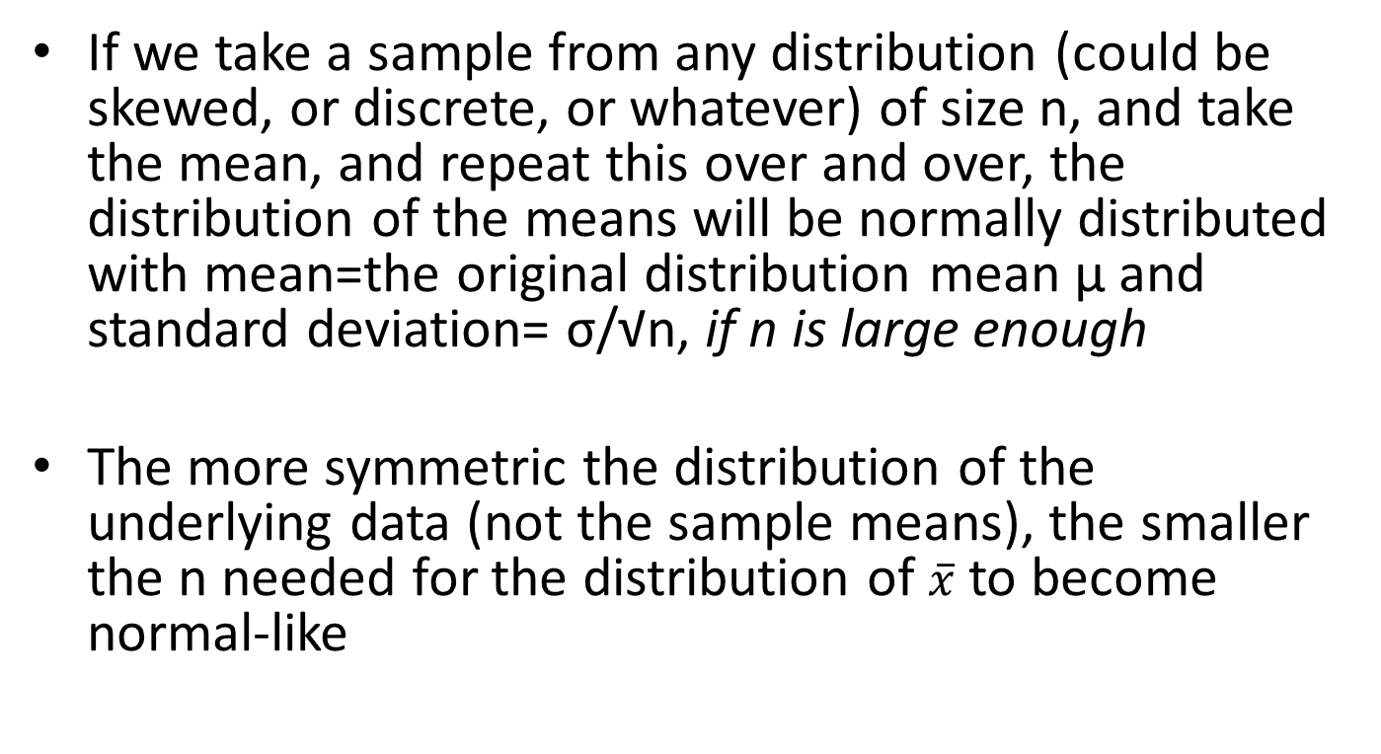
Central limit theorem
σ/√n is the standard error of the mean
Notes:
Central limit theorem examples will prove this to you: command clt in Stata (after you install it)

Slide 13
Central limit theorem defines confidence intervals
Over many repetitions of the study (with different samples) it is expected that 95% of the 95% confidence intervals will include the true (population) value
  More on this in your clinical epi class

Slide 14
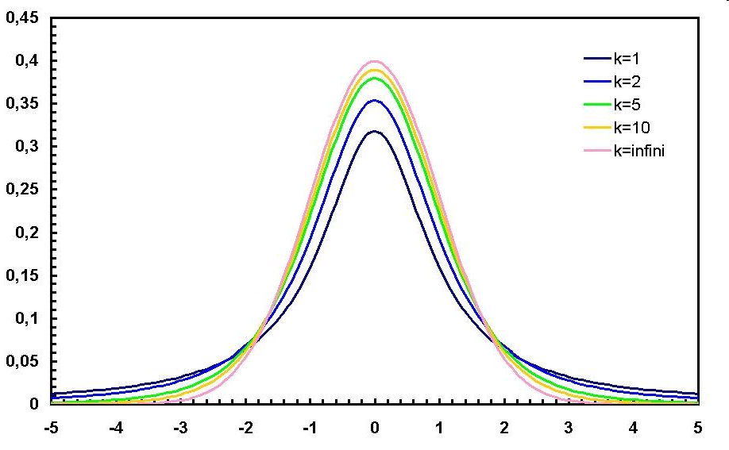
Confidence intervals for means: Student’s t distribution
If X is normally distributed, and a sample of size n is chosen, then follows a Student’s t distribution with n-1 degrees of freedom
This is denoted t_{n-1}
The shape is like a normal distribution but
with fatter tails – it approximates a normal
distribution with increasing n
Notes:
The t-distribution is very robust, so if n is large, say >30, and the distribution isn’t too far from normal, it’ll work.
See http://people.virginia.edu/~rwm3n/pdf/When%20do%20you%20use%20the%20t%20distribution.pdf for a discussion of this.

Slide 15
Third distribution of this lecture: Student’s t distribution
The code is ttail(df,t)
Example: P(T>1.96) n=20
  display ttail(19,1.96)
  .03241449
Want to find a t cutoff value?
Example: t at which probability that T>t
is 0.025
  display invttail(19,.025)
  2.0930241

