Slide 1
Lab 5
Hypothesis testing (mean or proportion)
  One sided
  Two-sided
Type I error
Type II error

Slide 2
Hypothesis testing – Key Points
First specify your null and alternative hypotheses:
  Null hypothesis H₀ : µ = µ₀
  Alternative hypothesis : H_{A} : µ ≠ µ₀
  H₀ (the null) and H_{A} (the alternative) must be MUTUALLY EXCLUSIVE
Run your test statistic
  P-value: probability of getting results as or more extreme as the results in the observed sample
    If smaller than your preset significance level α then you reject the null
    If p-value is ≥ α then you fail to reject the null
Decide if you are going to either:
  Reject the null
  Fail to reject the null
  Don’t know the truth so NEVER ACCEPT THE NULL

Slide 3
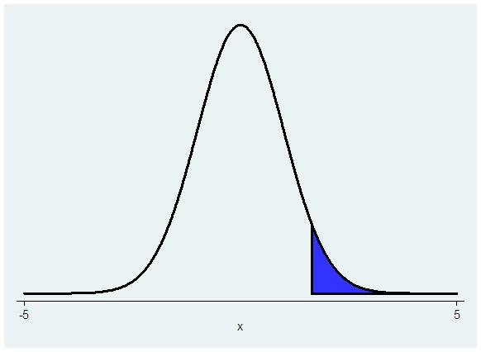
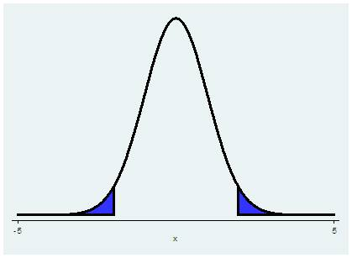
One-sided versus Two-sided
One-sided
  Null hypothesis: H₀: μ≥μ₀ or H₀: μ≤μ₀
  Alternative hypothesis: H_{A}: μ<μ₀ or H_{A}: μ>μ₀
  P(Z>z) to be <0.05 (your typical α), the test statistic z_{stat} must be >1.645
Two-sided
  Null hypothesis: H₀: μ=μ₀
  Alternative hypothesis: H_{A}: μ≠μ₀
  P(Z>z_{stat})+P(Z<-z_{stat}) = 2*P(Z>z_{stat}) <0.05
  more evidence is needed to reject the null for a one sided test in a two sided test
Notes:
Use t statistic if your

Slide 4
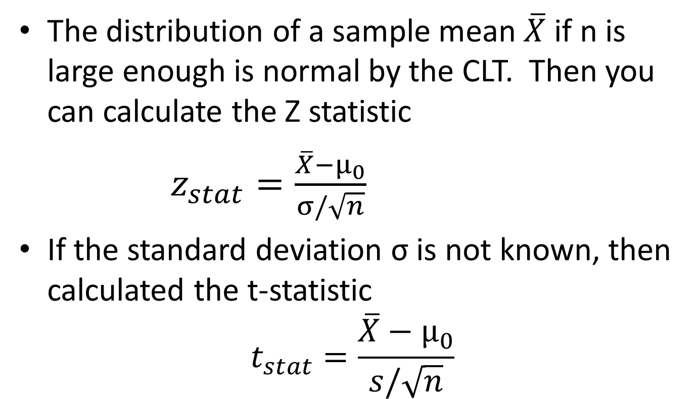
Test of one mean

Slide 5
Commands to test your hypothesis
For means
    ttesti samplesize samplemean samplesd hypothesizedmean
    ttest varname== hypothesized value
For proportions
    prtesti samplesize observedp hypothpr
    bitesti samplesize observed_proportion hypoth_proportion

Slide 6
Example:
  Null hypothesis: The mean prevalence of obesity in states is < 26% .
  Alternative hypothesis: Mean prevalence of obesity in states is ≥ 26%.
ttest obesity == 26
One-sample t test
------------------------------------------------------------------------------
Variable | Obs Mean Std. Err. Std. Dev. [95% Conf. Interval]
---------+--------------------------------------------------------------------
obesity | 50 26.748 .4252177 3.006743 25.89349 27.60251
------------------------------------------------------------------------------
mean = mean(obesity) t = 1.7591
Ho: mean = 26 degrees of freedom = 49
Ha: mean < 26 Ha: mean != 26 Ha: mean > 26
Pr(T < t) = 0.9576 Pr(|T| > |t|) = 0.0848 Pr(T > t) = 0.0424
ttesti 50 26.748 3.006743 26
One-sample t test
------------------------------------------------------------------------------
| Obs Mean Std. Err. Std. Dev. [95% Conf. Interval]
---------+--------------------------------------------------------------------
x | 50 26.748 .4252177 3.006743 25.89349 27.60251
------------------------------------------------------------------------------
mean = mean(x) t = 1.7591
Ho: mean = 26 degrees of freedom = 49
Ha: mean < 26 Ha: mean != 26 Ha: mean > 26
Pr(T < t) = 0.9576 Pr(|T| > |t|) = 0.0848 Pr(T > t) = 0.0424

Slide 7
Hypothesis test of a proportion
Therefore we can test that a sample proportion is equal to, greater than, or less than some hypothesized p₀ using the z statistic

Slide 8
prtesti 50 0.26748 0.26
One-sample test of proportion x: Number of obs = 50
------------------------------------------------------------------------------
Variable | Mean Std. Err. [95% Conf. Interval]
-------------+---------------------------------------------------------------- x | .26748 .0625994 .1447874 .3901726
------------------------------------------------------------------------------ p = proportion(x) z = 0.1206
Ho: p = 0.26
Ha: p < 0.26 Ha: p != 0.26 Ha: p > 0.26
Pr(Z < z) = 0.5480 Pr(|Z| > |z|) = 0.9040 Pr(Z > z) = 0.4520
. bitesti 50 0.26748 0.26
N Observed k Expected k Assumed p Observed p
------------------------------------------------------------
50 13 13 0.26000 0.26000
Pr(k >= 13) = 0.553851 (one-sided test)
Pr(k <= 13) = 0.573877 (one-sided test)
Pr(k <= 13 or k >= 14) = 1.000000 (two-sided test)
Example of testing for difference in proportions:
  Null: Proportion of states with obesity is < 0.26 Alternative: ≥ 0.26
Notes:
Prtest command uses normal approximation; bitest command uses binomial distribution so answers are not exactly the same

Slide 9
Types of error
1-β = power = the probability that you will reject the null hypothesis when you should
  Increase power by increasing N or increase α
  Usually at least want power to be 80%
α= significance = probability of a type I error
  In most cases will be 0.05 with two-sided tests
 | True state
Decision | H₀ is true | H₀ is false
Fail to reject H₀ | Correct | Type II error=β
Reject H₀ | Type I error=α | Correct

