Slide 1

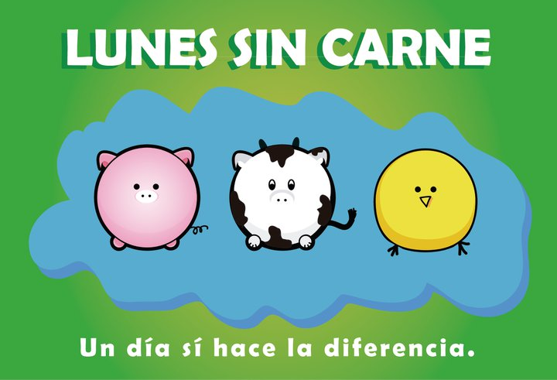
Sara Ackerman, PhD, MPH
Assistant Adjunct Professor
Dept. of Social and Behavioral Sciences
UCSF
Social Marketing: An Introduction

Slide 2
What is Social Marketing?
The use of concepts and strategies
from commercial marketing to influence individual and social behavior,
with a goal of improved human or
environmental health
Notes:
SM promotes voluntary behavior by offering benefits, reducing barriers, and using persuasion to motivate participation in desired behavior.
Premise: health is not the only motivation for healthy behavior; other goals may be more important

Slide 3

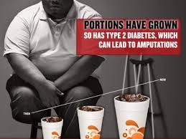
Social marketing vs. commercial marketing
NYC Dept. of Health anti-obesity campaign
Notes:
NYC dept. of health anti-obesity campaign (Bloomberg)

Slide 4
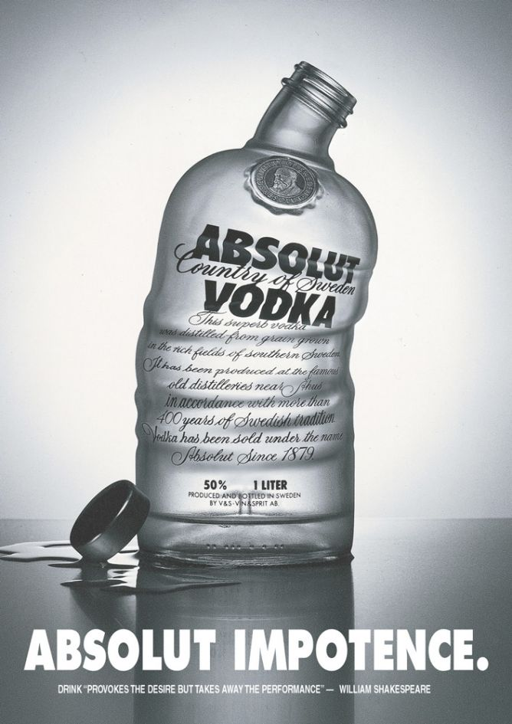
Social marketing in dialog with commercial marketing
Adbusters.org
Notes:
Adbusters

Slide 5
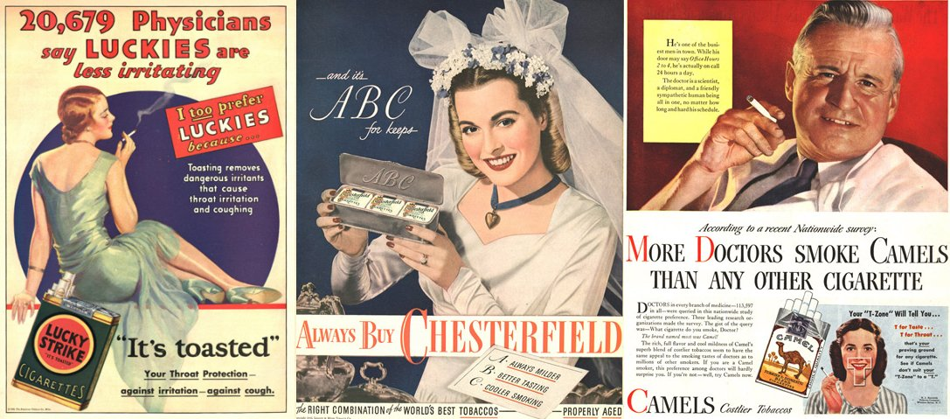
Brief history of
smoking-related marketing
Notes:
Advertising and social marketing can tell us a lot about the zeitgeist/predominant cultural values of the time

Slide 6
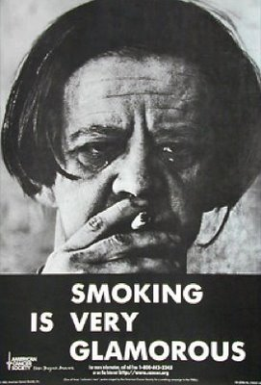
Notes:
1970s
How does this campaign use persuasion?
WARN

Slide 7
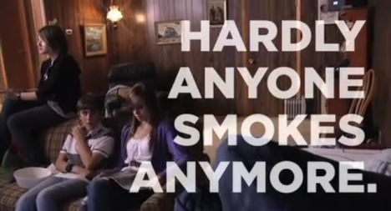
Changing social norms
Notes:
Target audience?
Message: if you smoke, you won’t fit in; if you don’t smoke, you will fit in
This SM campaign understands that health is not the only motivation for healthy behavior

Slide 8
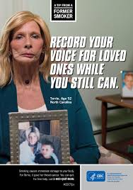
Tips from Former Smokers
Notes:
Early 21st century; still warning/fear-based; testimonials shown to be more effective than info such as stats; target audience?

Slide 9
Anti-smoking campaigns: from PSA to social marketing
fear
desire

Slide 10
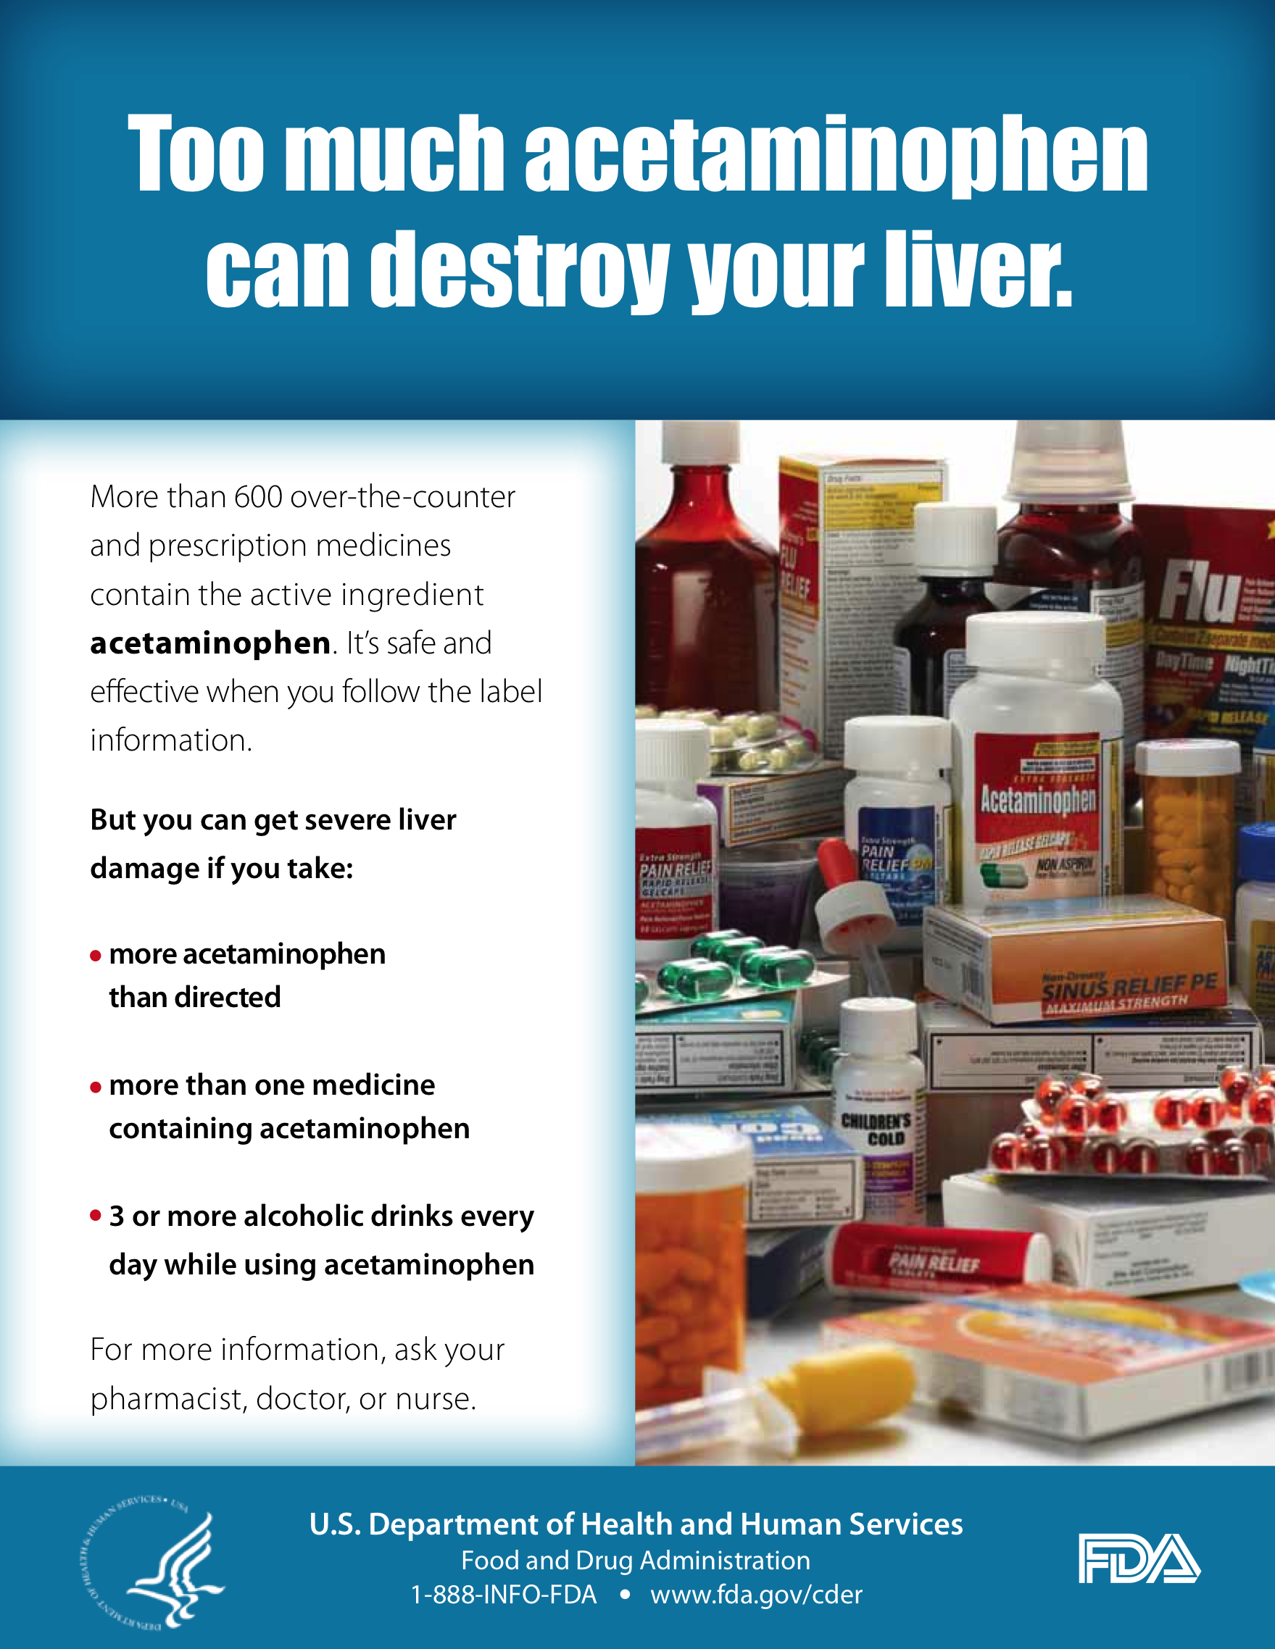
Why is social marketing often less effective than commercial marketing?
Notes:
Traditional health ed model: give people information and they will change behavior
Assumption is that knowledge will lead to beh change

Slide 11
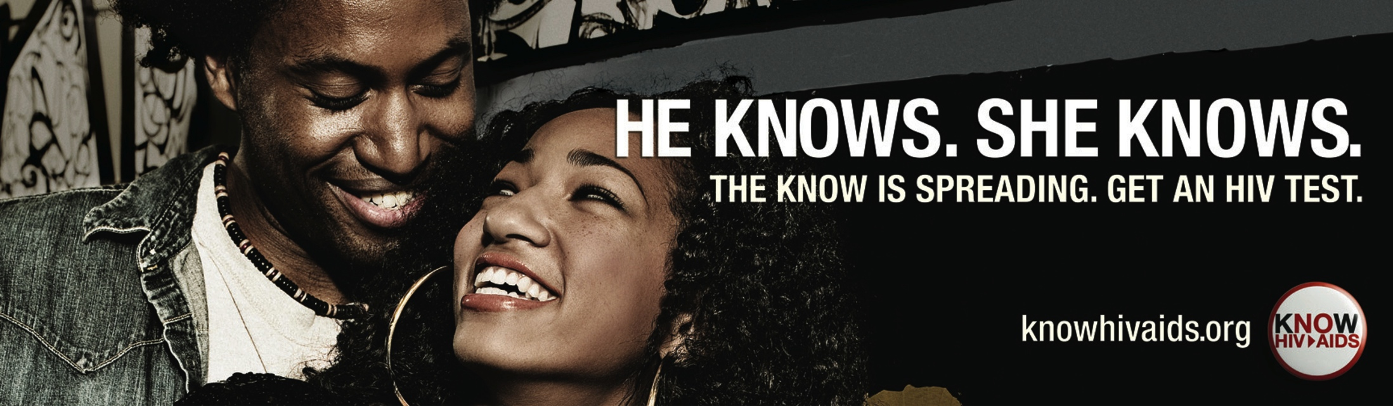
You’re trying to influence people to do things they are uncomfortable with, don’t want to do, or can’t do
Notes:
e.g. give up addictive behavior; resist peer pressure, be uncomfortable, establish new habits, hear bad news, give up looking good (sunscreen), remember something
Shift from fear-based to positive, promising message.
What does the campaign promise? How does it sell HIV testing? How is this approach different from more conventional approaches?
*health is not only motivation! Here, intimacy, belonging are offered.
Iknowhiv.org
SF campaign

Slide 12
Social marketing can be used to influence:
individual behaviors
social interactions and norms
policies
institutional practices
Notes:
Most target individual behaviors by way of social norms

Slide 13
What are social marketing strategies used for?
Communication campaigns
Educational materials
and are often used in conjunction with…
Re-design of structural/environmental conditions to make it easier for people to adopt specific behavior
Notes:
communication: the examples I’m showing in the first part of this presentation are communication strategies - the most commonly used SM method.
However, multi-level approaches are increasingly popular, and we’ll look at some examples later if we have time

Slide 14
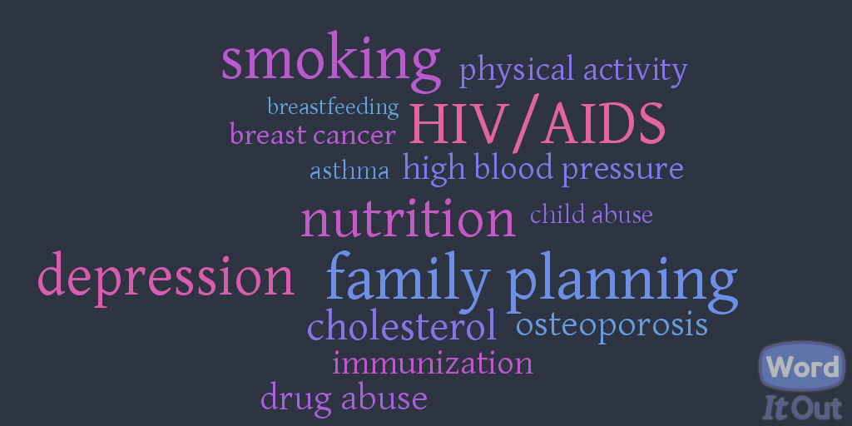
Some health topics that have been addressed by social marketing:

Slide 15
social marketing principles and methods

Slide 16
audience exchange marketing mix

Slide 17
audience
do you really know what’s best
for your audience?
important to engage and understand your audience in order to create a program focused on their values, priorities, and circumstances
Notes:
Not expert driven. You may think you know what your audience’s needs are, but if they don’t agree, your program is unlikely to succeed.

Slide 18
audience insight
Gain a deeper understanding of the values, priorities, practices, and social and structural conditions that shape the behavior of people in your intended audience
Methods:
formative and evaluation research using both qualitative and quantitative methods
Notes:
Emphasis on social and structural drivers of behavior is still less common in social marketing

Slide 19
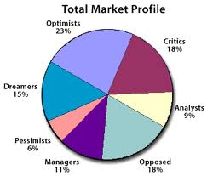
audience segmentation
one size fits all solution rarely works for complex behaviors
move away from conventional epidemiological categories (race, age, sex) towards “psychographics”:
values
interests
activities
opinions
geographic location
Notes:
all behaviors have complex determinants, i.e. different social, economic, structural factors can influence the same behavior
What might be some of the limitations of audience segmentation?

Slide 20

‘Age is not a condom’ campaign

Slide 21
Imaging Intimacy project with
Andy Chen
http://vimeo.com/15992485

Slide 22
your audience could be
one, or a combination, of:
people whom you want to change
people/institutions/environments/policies that can make it easier for them to change
people/institutions/environments/policies that can make it harder for them to change
Notes:
i.e. target may not necessarily be the people whose behavior you want to influence, but those around them who have influence on their behaviors
Examples?

Slide 23
exchange
people act when they get something they value or desire, or when the benefits of a practice are outweighed by its costs (physical, social, financial)
what am I willing to give up for perceived benefits?
Notes:
i.e. how can you integrate interests of audience with those of sponsor
- upcoming examples shift away from protect and warn strategy and use value exchange instead

Slide 24

Notes:
Campaigns promoting condom use are among the most creative social marketing strategies
How is the concept of exchange used in this ad? What does the boy get for using/having a condom, in addition to preventing pregnancy and STIs?

Slide 25
Appealing to teenagers to prevent diabetes

Slide 26
Luke Taylor’s ‘By any sweets necessary’, Bigger Picture campaign

Slide 27

individual vs. social benefit
Fairfax County, Virginia: http://www.fairfaxcounty.gov/hd/flu/
Notes:
Concept of exchange usually emphasizes individual agency. However, social, environmental, and structural conditions also shape exchange. In this example, the goal is to persuade people to trade their individual wants for the greater good

Slide 28
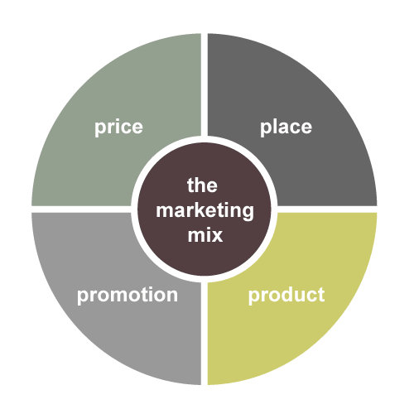
“Marketing Mix”/4Ps
PRODUCT and its presumed benefit
Notes:
4ps are used for program planning.
a. product: condom; -service: medical exam; -practice: breastfeeding, eating healthy diet; -feeling: hope, fun, social acceptance
TIDES product: benefits resulting from successful implementation

Slide 29
“Marketing Mix”/4Ps
PRODUCT and its presumed benefit
PRICE, or what audience has to do to obtain product
Notes:
2. price/cost may be monetary or may involve time, effort, or risk of embarrassment or disapproval. Requires knowledge of audience’s perception of costs and benefits
TIDES: financial and time cost to implemented site, clinicians, staff

Slide 30
“Marketing Mix”/4Ps
PRODUCT and its presumed benefit
PRICE, or what audience has to do to obtain product
PLACE, or how product
reaches audience
Notes:
3. Place: requires knowledge about activities and habits of target audience, including where/when they might think about issue
TIDES: computerized or interpersonal mechanisms by which intervention can be provided to indiv patients

Slide 31
“Marketing Mix”/4Ps
PRODUCT and its presumed benefit
PRICE, or what audience has to do to obtain product
PLACE, or how product reaches audience
PROMOTION, or strategy to
create and sustain demand for product
Notes:
4. promotion can include advertising, public relations, promotions, media advocacy, environmental/structural change, institutional change, policy
TIDES: range of techniques used to communicate with target audiences

Slide 32

Community Based
Social Marketing
behavior change via direct engagement with communities and reducing barriers to desired behavior
Less focused on influencing attitudes, beliefs, knowledge, which are difficult to change and often poor predictors of behavior.
http://www.cbsm.com/public/world.lasso
Notes:
based on an understanding that programs that rely primarily on media advertising can be effective in creating public awareness and understanding of an issue, but are limited in their ability to foster behavior change. SM focuses too much on INDIVIDUAL behavior, not enough on CONTEXT that shapes behaviors: e.g. social and structural determinants of health
2. used most often to promote environmentally sustainable behaviors, e.g. reducing energy consumption and waste, recycling, driving less

Slide 33
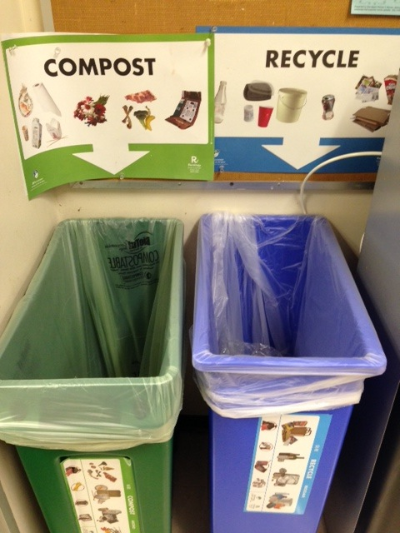
Community Based
Social Marketing
Notes:
based on an understanding that programs that rely primarily on media advertising can be effective in creating public awareness and understanding of an issue, but are limited in their ability to foster behavior change. SM focuses too much on INDIVIDUAL behavior, not enough on CONTEXT that shapes behaviors: e.g. social and structural determinants of health
2. used most often to promote environmentally sustainable behaviors, e.g. reducing energy consumption and waste, recycling, driving less

Slide 34

Another example of redesigning the environment to promote behavior change
Notes:
Other examples: speed bumps, bike lanes,

Slide 35
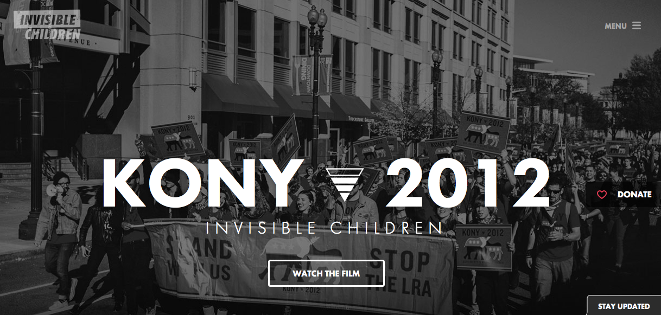
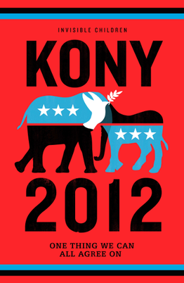
‘Kony 2012’ campaign

Slide 36
Social marketing and implementation research

Slide 37
theories/models used in social marketing individual social/structural
Social Cognitive Theory
Theory of Planned Behavior
Stages of Change
Diffusion of Innovations
Precede-Proceed
social network analysis
Participatory Action Research
social capital
disparities/social and environmental justice
Notes:
Indiv theories often do not account for complex, relational, contingent nature of behavior, and may be particularly inapplicable to communities that are not white, educated, middle class.

Slide 38
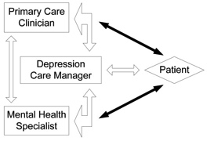
Case Study 1:
Veterans Health Admin.
TIDES Depression
Collaborative Care Model
Translating Initiatives for Depression into Effective Solutions (TIDES) model of collaborative care for depression. Source: TIDES Fact Sheet.
Luck et al. Implementation Science 2009 4:64

Slide 39
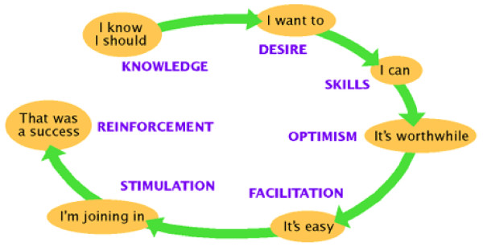
Case Study 1:
VHA TIDES Depression Collaborative Care Model
Sequential model of behavioral and social change. Source: Robinson, L,
"The Seven Doors Social Marketing Approach," 1998.
Luck et al. Implementation Science 2009 4:64
Notes:
7 steps through which marketing can affect behavior change
SM used to instill desire
Facilitation: social modeling

Slide 40
Case Study 1:
VHA TIDES Depression Collaborative Care Model
behavior change goal
audience research at all stages
audience segmentation
attractive, motivational exchanges
attention to competition
Notes:
7 steps through which marketing can affect behavior change
SM used to instill desire
Facilitation: social modeling

Slide 41
Case Study 2:
Hand-washing in Nepal
Benefits and risks of social marketing
“prevention paradox”
value of qualitative (incl. ethnographic) methods
Source: A health equity critique of social marketing: where interventions have impact but insufficient reach. Langford & Panter-Brick, Social Science & Medicine 83, 2013.

Slide 42

Case Study 3:
Condom social marketing in Mozambique
• structural determinants of risky behavior unaddressed
• lack of community engagement/participation
• clash of messages
• focus on product, not process
• harmful consequences
Notes:
Pfeiffer article:
AIDS prevention and condom advertising campaign clashed with Pentecostal churches
Structural determinants of risky behavior: deepening social inequality and economic uncertainty as a result of structural adjustment resulted in increased reliance on sex work for survival
among poor
Campaign’s message interpreted as promoting promiscuity and immorality; church communities not included in development of campaign
SM is one-way communication

Slide 43
Evaluation of Social Marketing Campaigns
  Process evaluation:
  - insight into deviations from plan
  - understand what produced observed outcomes
  - unintended consequences
  Outcome evaluation:
  - did you reach target audience?
  - did desired outcome occur?
  - is effect sustainable?
  - is campaign acceptable?
  - does campaign reduce or exacerbate disparities?

Slide 44
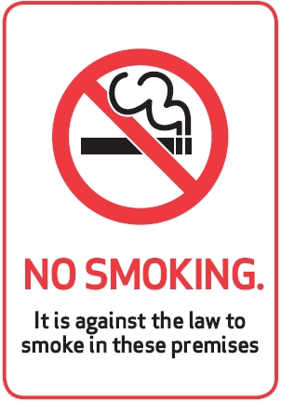
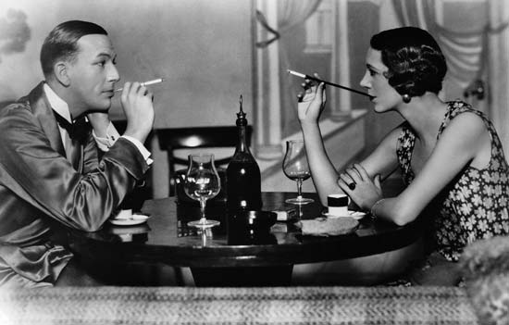
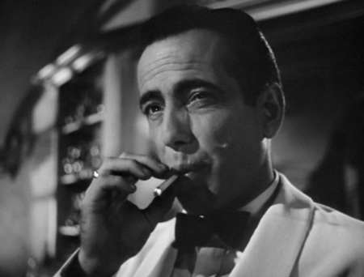
Recent declines in smoking
2000 U.S. National Cancer Institute study reported that media campaigns produce reductions in smoking only when other social and structural factors actively change the environment of the smoker
Les Robinson, The Problem with Social Marketing, www.enablingchange.com.au
Notes:
Bogart, etc.: Hollywood representations reflect change in social value of smoking. From sophisticated and symbol of masculine strength to socially undesirable
regulation has made places where smoking is permissible increasingly scarce

Slide 45
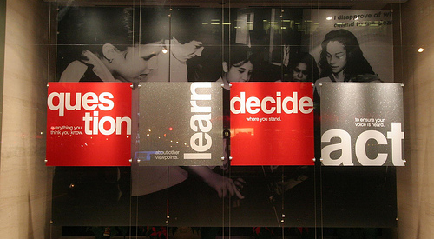
Thank you!

Slide 46
Additional social marketing campaigns
Meatless Mondays

Slide 47
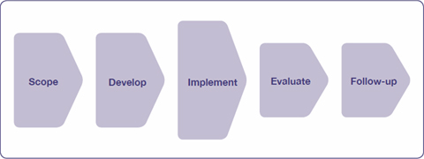
Total Process Planning
Model
image and content credit: UK Alcohol Learning Centre
Notes:
1. This is a planning model that some social marketers use instead of the 4Ps

Slide 48
SCOPE DEVELOP
Identify and consult with stakeholders
Conduct preliminary research
Learn about your audience using qualitative methods
Segment your audience
Decide on research methods
Develop evaluation procedures
Look at current services
Involve stakeholders
Look at similar or competing programs – how will they reinforce or undermine your project?
Use theory appropriate to problem and audience
Develop barrier and exchange model
Test your project
Notes:
stakeholders: community advisory committee
audience: where do they live, how do they think about their health, what are their social networks and values, what are the social, environ, econ determinants of behavior?
- current services: can they be incorporated into your program?

Slide 49
IMPLEMENT EVALUATE
Use a range of strategies and tailor campaign to audience segments
Conduct process evaluation to determine if program is being implemented as planned and how people are responding
Continue working with stakeholders
PROCESS and OUTCOME equally important.
  Process evaluation: insight into deviations from plan; understand what produced observed outcomes
  Outcome evaluation: did you reach target audience; did desired outcome occur?
Notes:
range of strategies to avoid one size fits all: , e.g. education, support, re-design environment, regulation/control

Slide 50
FOLLOW-UP
Share/disseminate best practices
Continue to track outcomes and assess sustainability of target behavior
Notes:
range of strategies to avoid one size fits all: , e.g. education, support, re-design environment, regulation/control

Slide 51

Case Study 4:
Copenhagen cycling campaign
Goal: promote commuting by bicycle in order
to reduce pollution and congestion,
improve public health
Strategy:
- foster and spread “bicycle culture”
- change infrastructure to reduce barriers to cycling and equalize different modes of transport

Slide 52
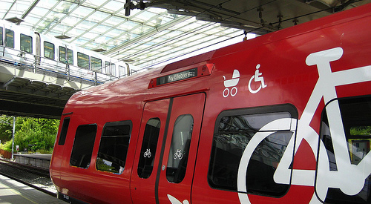
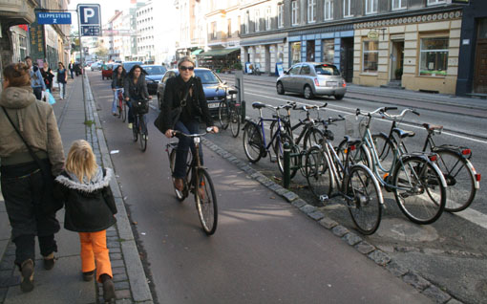
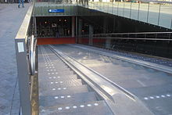
infrastructure
Notes:
train cars dedicated to bike, wheelchair and stroller transport; stairways with bike ramps, bike lanes physically separated from traffic (average width 7 ft, enabling conversation and overtaking), green bicycle routes (fast, safe, pleasant), abundant and convenient bike parking, re-designed intersections to reduce potential for bike-car collisions, readily available public bicycles

Slide 53


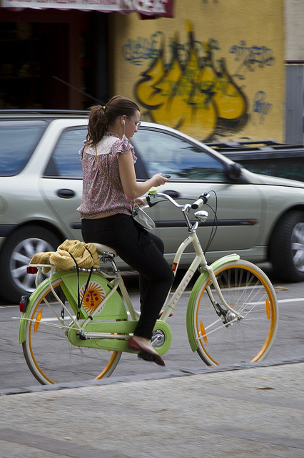
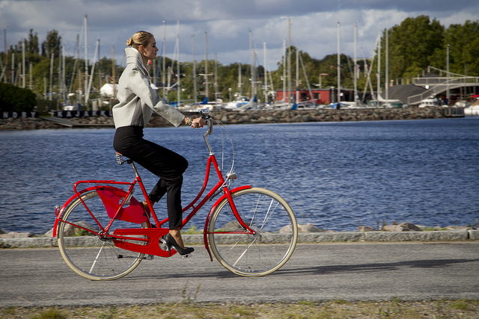
bicycle culture
Notes:
public events promoting cycling, media campaign, “cycle chic”

Slide 54
outcomes:
37% of people in greater Copenhagen commute by bike
planners’ goal: 50% by 2015
public satisfaction with cycling
1995: 17% 2004: 83%
survey: why do you cycle?
  62% easy, fast, convenient
  22% exercise
Notes:
30-40% of Danes are physically inactive
cycling campaigns have increased cycling across the country, which has had a positive impact on public health. however, when people are asked why they cycle, health is not the top reason. nor is reducing carbon footprint. therefore, the campaign has very successfully blended the goals of the planners (reduced pollution and improved public health) with directly addressing the priorities of target population (commuters) – convenient, fast, safe, low-cost means of commuting

