Slide 1
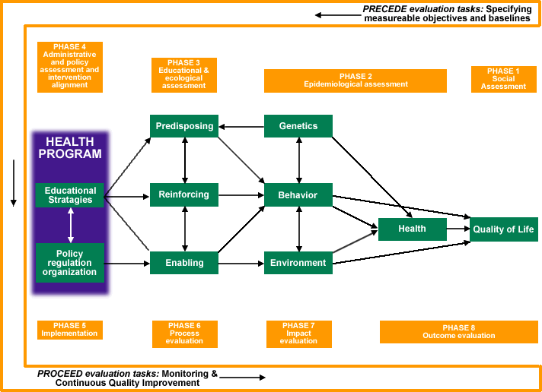
EVIDENCE & THEORY-BASED INTERVENTION DESIGN
-PRECEDE-PROCEED Model
Green L, Kreuter M. Health Program Planning: An Educational and Ecological Approach, McGraw-Hill, Inc. 2004. http://lgreen.net/precede.htm

Slide 2
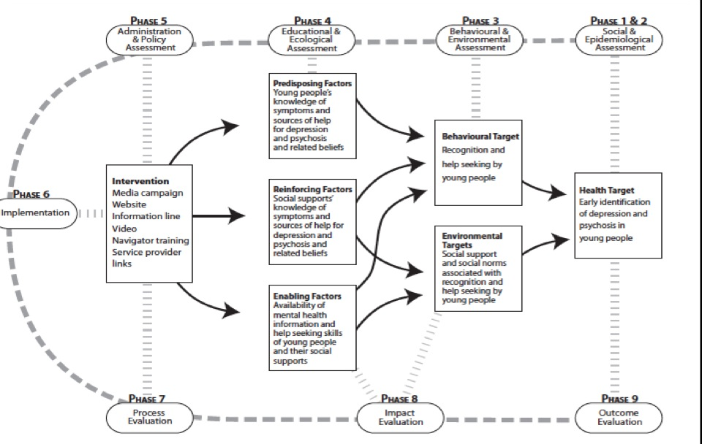
EXAMPLE: Applying PRECEDE to Improving Mental Health Literacy in Youth
Wright A et al, BMC Public Health 2006, 6:215

Slide 5
Phase 5: Administrative and
Policy Diagnosis
Health Programs
Predisposing
Factors
Health Education
Reinforcing
Factors
Policy
Regulation
Organization
Enabling
Factors

Slide 6
Phase 5: Administrative and
Policy Diagnosis
Identify administrative and organizational concerns which must be addressed prior to program implementation
  assessment of resources, budget development and allocation
  development of implementation timetable
Modify or create administrative and clinical organizational infrastructure to sustain your program

Slide 7
Phase 5: Administrative and Policy Diagnosis
Administrative Diagnosis
Analysis of policies, resources, circumstances, and prevailing organizational situations that could hinder or facilitate the development of the health program
Policy Diagnosis
Assesses the compatibility of your program goals/objectives with those of the organization and its administration

Slide 8
Phase 5: Administrative and
Policy Diagnosis
Work in this phase is specific to the context of the program and the sponsoring organization(s) and requires political savvy as much as theoretical or empirical knowledge
Informed by theories, particularly community-level theories

Slide 9
