Slide 1
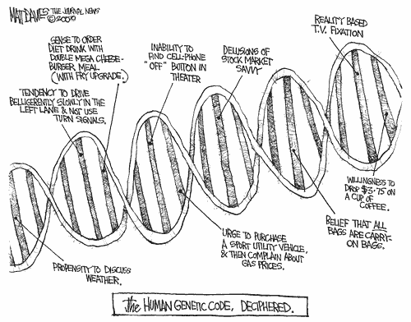
Epidemiology 217
Molecular and Genetic Epidemiology I
Notes:
1

Slide 2
Outline
Course structure
Overview of genetics
Overview of genetic epidemiology and the rest of the course

Slide 3
Course Goals
Develop a framework for interpreting and incorporating genetic information in your research
Learn:
  Common genetic measures.
  Some population genetics.
  Approaches to search for disease-causing genes:
    Association (key aspect of course)
    Linkage
    Admixture
Notes:
3

Slide 4
Course Details
11 Tuesdays from 01/06/2013 – 03/17/2013, 1:10-3:00 pm, Mission Hall 1406
Course Directors:
John Witte, jwitte@ucsf.edu
Thomas Hoffmann, HoffmannT@humgen.ucsf.edu
Lecturers:
Joe Wiemels, joe.wiemels@ucsf.edu
Eric Jorgenson, eric.jorgenson@kp.org
Neil Risch, rischn@humgen.ucsf.edu
Teaching Assistant:
Eleanor Dunican, Eleanor.Dunican@ucsf.edu
website:
https://courses.ucsf.edu/course/view.php?id=1862
(Lectures, homework assignments, and answers)
Notes:
4

Slide 5
Assignments
Problem sets (50%)
Due at noon on Mondays to Eleanor Dunican, Eleanor.Dunican@ucsf.edu
Reading / class participation (20%):
Genetic Epidemiology: Methods and Applications, by Melissa A. Austin. CABI, 2013. ISBN: 978-1780641812.
Books may be purchased either through the publisher or a variety of commercial venues (e.g., Amazon.com), where you can also read the beginning of the first chapter.
Students may be called upon during class to answer questions about the assigned chapters.
Final project (design study)
  30% of grade (due Friday, 3/13 at Noon)
  Present to class
Notes:
5

Slide 6
Syllabus - https://courses.ucsf.edu/course/view.php?id=1862
Date | Topic / Content | Lecturer | Required Reading (pre-lecture) | Assignment Due (Monday @ noon)
01/06/2015 | Introduction: The Big Picture The process of genetic epidemiology; general approaches to assess the genetic basis of disease. | J Witte | Austin Chapter 1
01/13/2015 | Population Genetics, Modeling Genetic Inheritance Basics of population genetics; Hardy-Weinberg Equilibrium; aggregation; heritability. | J Witte | Austin Chapter 2 | Assignment 1 (Due 1/12 at Noon)
01/20/2015 | Mendel’s Laws and Molecular Genetics Mendel’s laws (segregation, assortment); molecular measures; genotyping; arrays; sequencing. | J Wiemels | Austin Chapter 3 | Assignment 2 (Due 1/19 at Noon)
01/27/2015 | Family-based Studies Linkage analysis, Family-based association studies, TDT, FBAT | T Hoffmann | Austin Chapter 4 | Assignment 3 (Due 1/26 at Noon)
02/03/2015 | Genetic Association Studies General principles; candidate gene studies. | T Hoffmann | Austin Chapter 5 | Assignment 4 (Due 2/02 at Noon)
02/10/2015 | Genome-wide Association Studies (GWAS) Agnostic searches across genome for associated SNPs; multiple testing; Imputation; Consortia. | T Hoffmann | Austin Chapter 6 | Assignment 5 (Due 2/09 at Noon)
02/17/2015 | Admixture Analysis Population substructure, admixture mapping. | N Risch | Winkler et al., Admixture mapping comes of age, Ann Rev Genom Human Genet 2010 11:65-89, read through the “Admixed populations” section.
02/24/2015 | Gene-Environment Interactions and Epistasis Interactions; pharmocogenetics; less common & rare variants | J Witte | Austin Chapter 7 | Assignment 6 (Due 2/23 at Noon)
03/03/2015 | Non-mendelian genetics Mitochondrial (MT), De novo, Parent-of-origin, Methylation | E Jorgenson | Austin Chapter 8 | Assignment 7 (Due 3/02 at Noon)
03/10/2015 | Next Generation Sequencing Full genome and exome sequencing studies. Software for genetic analysis. | E Jorgenson | Austin Chapter 9 | Assignment 8 (Due 3/09 at Noon)
03/17/2015 | Putting it all Together: Incorporating Molecular and Genetic Measures into Your Research Final Project presentations | J Witte, T Hoffmann | Austin chapters 10 and 11 | Final Project Due Friday 3/13 @ noon

Slide 7
Molecular & Genetic Epidemiology
Distinction
Molecular: molecular, cellular, and other biologic measurements, on disease [e.g., biomarkers - selenium in toe nails, proteins, hormones]
Genetic: role of inherited factors in disease (encompassed within molecular)

Slide 8
Genetic Epidemiology
Focus of course
Genetic epidemiology
  Initially studied single gene disorders
  Now more complex genetic disorders and environment
Many designs same as epidemiology (e.g., case-control)
Some specialized analysis methods.
Population genetics increasingly important
Aims
Detect genetic causes of disease
Understand biological process
Prevention strategies, lifestyle intervention
Improved therapeutic strategies, personalized medicine
 | Genetics | Epidemiology
Origins | Biological science of inheritance Eperimental/breeding | Methodological sciences / public health Oservational/analytic studies
Focus | Mechanisms of inheritance, often on rare diseases | Etiologic factors, primarily on common diseases
Tools | Family studies Laboratory methods Statistical models Population models | Observational studies Case-control studies Cohort designs Clinical trials
Goals | Understand mechanisms of inheritance | Understand distribution etiology, and progression of diseases
Overlap | Diseases of interest Population studies Ultimate goal of disease prevention
Austin, Ch 1, Table 1.1. Comparison of genetics and epidemiology.

Slide 9
Outline
Course structure
Overview of genetics
Overview of genetic epidemiology and the rest of the course

Slide 10
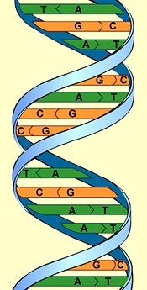
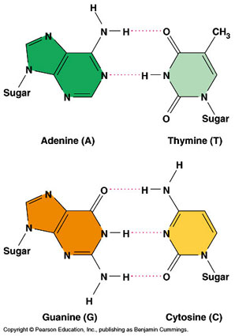
DNA
Notes:
10

Slide 11
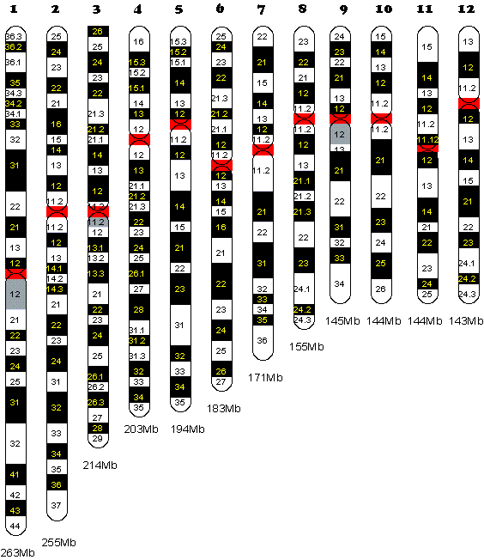
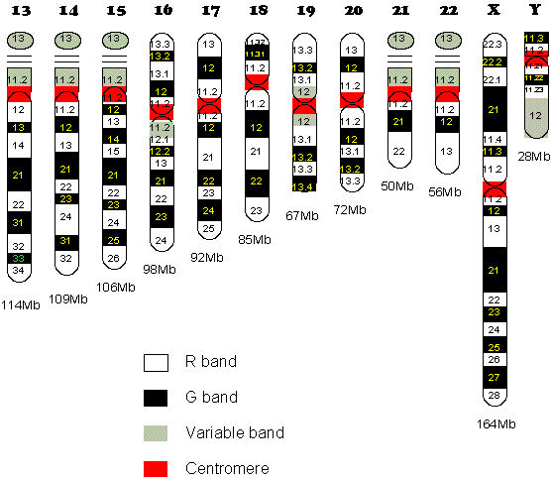
Human Chromosomes
G bands – AT rich / gene poor; R bands the reverse
Look for broad structural abnormalities from these stains
Notes:
23 pairs of chromosomes
11

Slide 12
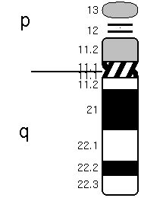
Human Chromosome 21
Telomeres
Centromere
p: petit arm
q: queue (tail) or long arm
21q22.1 is pronounced twenty-one q two two point one
Notes:
12
E. Blackburn won 2009 nobel prize for discovery of telomeres.

Slide 13
Chromosome Bands
Stain chromosomes so they can be seen by microscope
  e.g., Giesma stain (G-banding).
Appear as alternating bands
  e.g., dark/G-band and light band.
  Specific to phosphate groups of DNA.
  Attaches to DNA regions with high adenine-thymine (A-T) bonding.
With low resolution, few bands seen:
  … p2, p1 centromere q1, q2, … (count out from centromere).
With higher resolution sub bands seen:
  … p12, p11 centromere q11, q12 …

Slide 14
Variation in Genome
Mutation
  When event first occurs in an individual:
    genetic change due to internal events (e.g., copy errors during cell division) or external agents (e.g., radiation, mutagens).
  Can end with one generation, or be passed on (germline mutations)
Polymorphism
  Means “many forms”
  Minor allele frequency (MAF) > 1%
  Generated by old mutations (random, or fitness benefit).

Slide 15
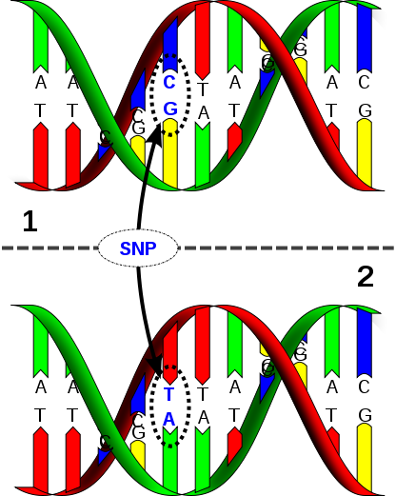
Single Nucleotide Polymorphism (SNPs)
Change a single DNA letter
Most frequent genetic variant
1 per 300 base pairs
  Common (MAF>5%)
  Less common (1-5%)
  Rare ‘variants’ (<1%)
    “SNV”
David Hall
Notes:
15

Slide 16
Genotypes
Locus 4
A
A
A
G
G
G
Alleles at locus 4
G
A
Locus: chromosomal location
that’s polymorphic.
Alleles: different variants @ locus
- Each somatic cell is diploid (two copies of each autosome)
- Thus 3 genotypes at locus 4 (use only one strand, often forward): AA, AG, GG

Slide 17
Types of Variants in Genes
Noncoding
Coding
- Synonymous = no change in amino acid
- Nonsynonymous/nonsense = change to stop codon
- Nonsynonymous/missense = change amino acid
e.g., MTHFR C677T SNP
  Normal (‘wild-type’) allele
Gene sequence …..GCG GGA GCC GAT………………
Protein Sequence ……Ala Gly Ala Asp………………
Variant allele
Gene Sequence …..GCG GGA GTC GAT……………….
Protein Sequence ……Ala Gly Val Asp ..……………
Notes:
17

Slide 18
Human Genome Statistics
3,283,984,159 basepairs
20,442 known protein coding genes
649,964 exons
Short variants (SNPs, indels, somatic mutations): 41,113,446
Mutation rate ≈ 10⁻⁸ per bp per generation
In each person:
  65 new mutations expected
  1 variant per 1,331 basepairs
  2,444,055 variants
Most variants are old
http://www.ensembl.org/Homo_sapiens
Notes:
18

Slide 19
Course Goals – Please Complete
Name: John Witte
Department/Program: Epidemiology & Biostatistics, Urology, Cancer Center, and Institute for Human Genetics
Background in Genetics: Post-doc training in genetic epidemiology; Many statistical genetics courses.
Background in Statistics: PhD in Epidemiologic Methods.
Research Interests: Methods for and analysis of the underlying genetic architecture of many diseases, esp. prostate cancer, birth defects, and pharmacogenomics.
What do you want to get out of this course?
Be able to use genetic information in my research.

Slide 20
Outline
Course structure
Overview of genetics
Overview of genetic epidemiology and the rest of the course

Slide 21
Process of Genetic Epidemiology
Defining the Phenotype
Migrant Studies
Familial Aggregation
Segregation
Linkage Analysis
Association Studies
Fine Mapping
Cloning
Characterization
Notes:
Hand out cards for them to complete
21

Slide 22
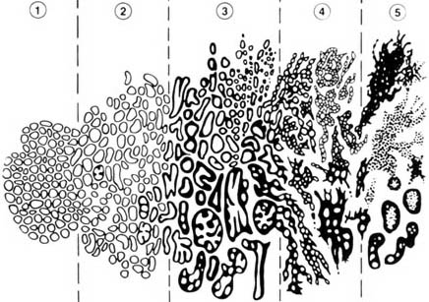
First: Define the Phenotype!
Gleason DF. In Urologic Pathology: The Prostate. 1977; 171-198.

Slide 23
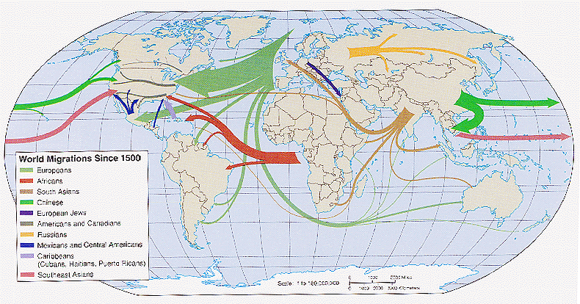
Migrant Studies
Weeks, Population. 1999
Studies based on the assumption that migrants carry a risk that reflects their country of origin, rather than the host country.
"Migrant Studies". Encycolpedia of Biostatistics, John Wiley and Sons 2005.
Notes:
23
As an initial step in the process of genetic epidemiology, one could use information on populations who migrate to countries with different genetic and environmental backgrounds⎯as well as rates of the disease of interest⎯than the country they came from.
Here, one compares people who migrate from one country to another with people in the two countries.
If the migrants’ disease frequency does not change –i.e., remains similar to that of their original country, not their new country—then the disease might have genetic components.
If the migrants’ disease frequency does change—i.e., is no longer similar to that of their original country, but now is similar to their new country—then the disease might have environmental components

Slide 24
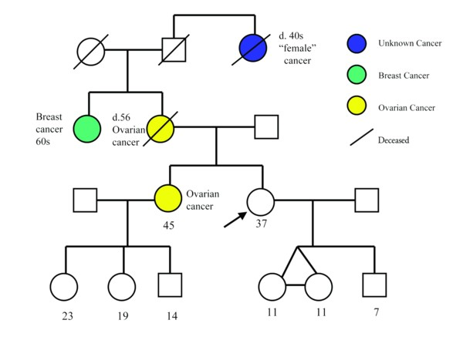
Familial Aggregation
Does the phenotype tend to run in families?
Covered more in Austin Ch 2 & Lecture 2: Population Genetics, Modeling Genetic Inheritance
Notes:
24
For a common disease or one that manifests as a continuous trait, one might simply enroll a random series of families and look at the pattern of correlations in the disease between different types of relatives (e.g., sibling-sibling, parent-offspring, etc.).
For a rare dichotomous disease, one would generally begin with the identification of probands, preferably in some population-based fashion, together with a comparable control series from the same population.
For each subject, one can then obtain a structured family history (i.e., to generate a pedigree), collecting disease and other (e.g., age, time at risk, etc.) information.
One could then consider two approaches to the analysis of such data.

Slide 25
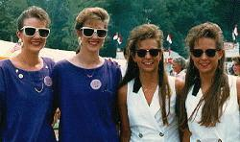
Analysis of Twin Studies
Compare the disease concordance rates of MZ (identical) and DZ (fraternal) twins.
Twin 1
Disease | Yes | No
Yes | A | B
No | C | D
Concordance =
2A/(2A+B+C)
Twin 2
Then one can estimate heritability of a phenotype.

Slide 26
Models of Genetic Susceptibility
Study families.
Estimate ‘mode of inheritance’ & what type of genetic variant might be causal.
Determine whether the disease appears to follow particular patterns across generations.
Estimate whether variants are rare or common, etc.

Slide 27
Segregation
Notes:
27

Slide 28
Segregation: Harry Potter’s Pedigree
Muggle
Wizard /
Witch
Vernon Dursley
Petunia Dursley
Lily Evans
James Potter
Dudley Dursley
Harry Potter
Notes:
28
Study families.
Estimate ‘mode of inheritance’ & what type of genetic variant might be causal.
I.e., determine whether the disease appears to follow particular patterns (recessive, dominant, co-dominant, log-additive).
Estimate whether variants are rare or common, etc.

Slide 29
Filch?
Squib
Argus Filch
Notes:
29
May need to focus on parents
Ex: Poor phenotype may be caused by inadequate environment during development
Maternal / fetal incompatibility
Maternal infection
Maternal gene*diet interaction
“Trait” is “provision of poor fetal environment”

Slide 30
Segregation Analysis
What is the best model of inheritance for observed families?
    Dominant
    Recessive
    Additive
  Disease allele frequency?
  Magnitude of risk?
Fit formal genetic models to data on disease phenotypes of family members.
The parameters of the model are generally fitted finding the values that maximize the probability (likelihood) of the observed data.
This information is useful in parametric linkage analysis, which assumes a defined model of inheritance.

Slide 31
Process of Genetic Epidemiology
Defining the Phenotype
Migrant Studies
Familial Aggregation
Segregation
Linkage Analysis
Association Studies
Fine Mapping
Cloning
Characterization
Notes:
Pass out cards for process and have them put together.
31

Slide 32
Linkage: Harry Potter’s Pedigree
Measure co-segregation in pedigree
Based on detection of recombination events (meiosis)
Muggle
Wizard /
Witch
Vernon Dursley
Petunia Dursley
Lily Evans
James Potter
or
Dudley Dursley
Harry Potter
or
Covered more in Austin Ch 4 & Lecture 4: Family-based studies
Notes:
32
Like shuffling a deck of cards.

Slide 33
Affected sib-pair Linkage
D
M₁
M₂
D
D
M₁
M₁
M₂
Notes:
33

Slide 34

Linkage Disequilibrium (LD)
important fundamental concept will come up repeatedly and be explained further in course
LD: non-random association of alleles at two or more loci that descend from a single, ancestral chromosomes.
Hirschhorn & Daly, Nat Rev Genet 2005
Notes:
34
Fortunately we don’t need to measure all of the millions of SNPs in the human genome for GWA
Phenomenon of LD among SNPs allows us to measure a subset of SNPs.
GWA indirectly measure SNPs by using those that “tag” other SNPs.
This is the idea behind the International HapMap project.
Card Trick: Phenomenon of recombination.
genotype variants in LD with the variant of interest

Slide 35
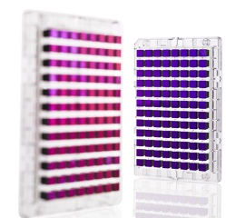
Genotyping technologies
Covered more in Austin Ch 3 & Lecture 3: Mendel's laws and Molecular Genetics
Notes:
35
Fortunately we don’t need to measure all of the millions of SNPs in the human genome for GWA
Phenomenon of LD among SNPs allows us to measure a subset of SNPs.
GWA indirectly measure SNPs by using those that “tag” other SNPs.
This is the idea behind the International HapMap project.
Card Trick: Phenomenon of recombination.
genotype variants in LD with the variant of interest

Slide 36
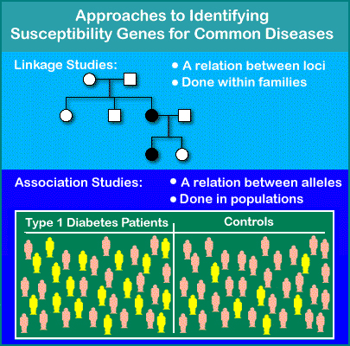
Association Studies
Covered more in Austin Ch 5 & Lecture 5: Genetic Association Studies
ROCHE Genetic Education (www)
Notes:
36
Compare alleles between individuals with extreme levels of a phenotype (i.e., cases and controls).
Association exists when cases are more (or less) likely than the controls to carry particular alleles (E.g., G).

Slide 37
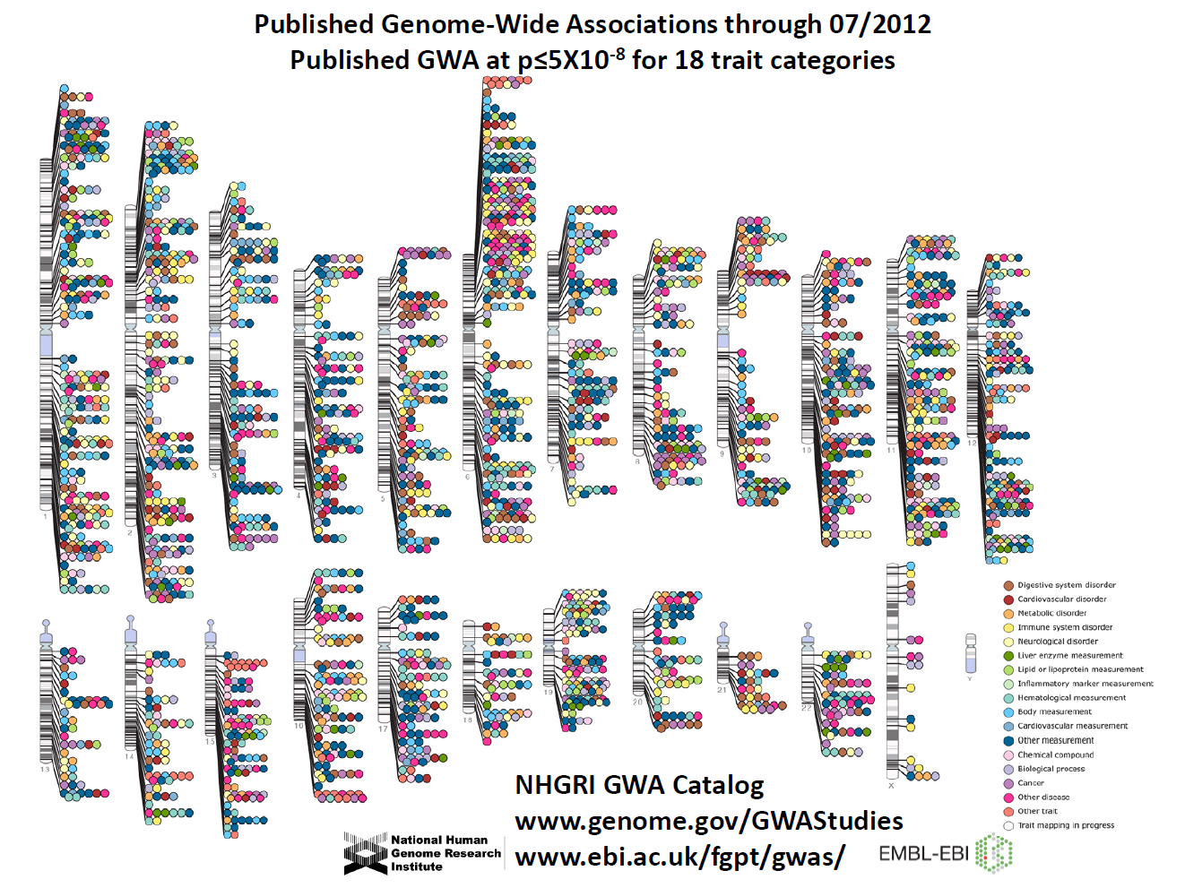
Manolio et al., Clin Invest 2008
Notes:
37
P < 9.9 × 10–7 (P<=10-6)

Slide 38
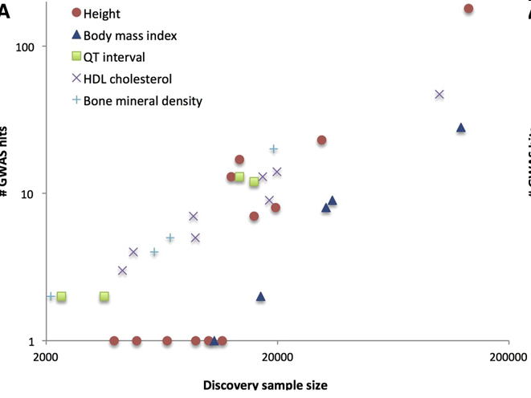
Size matters
Why?
Consortiums
Visscher, AJHG 2012

Slide 39
Admixture Mapping
Potentially powerful approach to searching for disease-causing genes
Requires:
  Two populations with naturally occurring phenotypic and genetic differences.
  Recent gene flow between the populations (e.g., within 10 generations).
Markers in the vicinity of the trait locus will also show excess ancestry from the population with the higher allele frequency
Covered more in Lecture 7: Admixture Analysis

Slide 40
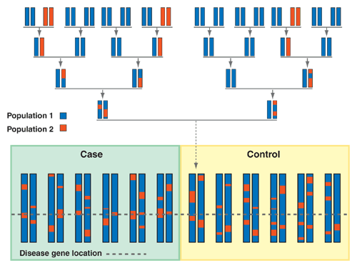
Admixture Mapping
Figure 1 Schematic of one chromosome pair from each of several individuals in an admixed population. A group of cases (for a given disease) and a group of controls are separately presented at the bottom left and the bottom right, respectively. For one of the control individuals (arrow), a schematic presentation of all its ancestors in the last four generations is shown in the upper part of the figure. Admixture mapping can be ideally applied if population 1 (blue) and population 2 (red) carry a different allele at the disease locus (dashed line). Whole-genome scanning under the admixture mapping strategy consists of scanning the genome and identifying the regions with an excess of ‘red’ ancestry in the cases versus the controls, assuming that the ‘red’ population carries the predisposition allele. The size of the blocks from different ancestors will depend on the number of generations since the populations were mixed.
Nature Genetics 37, 118 - 119 (2005)
Notes:
40
Figure 1. Schematic of one chromosome pair from each of several individuals in an admixed population.
A group of cases (for a given disease) and a group of controls are separately presented at the bottom left and the bottom right, respectively. For one of the control individuals (arrow), a schematic presentation of all its ancestors in the last four generations is shown in the upper part of the figure. Admixture mapping can be ideally applied if population 1 (blue) and population 2 (red) carry a different allele at the disease locus (dashed line). Whole-genome scanning under the admixture mapping strategy consists of scanning the genome and identifying the regions with an excess of 'red' ancestry in the cases versus the controls, assuming that the 'red' population carries the predisposition allele. The size of the blocks from different ancestors will depend on the number of generations since the populations were mixed.

Slide 41
Summary of Main Mapping Approaches
 |  | Linkage Analysis | Admixture |  | Association Study
Power* | Low |  |  | Moderate/High | High
# SNPs required for scan | Low |  |  | Low | High
Sensitivity to genetic heterogeneity | Low |  |  | Moderate | High
Mapping resolution | Poor |  |  | Intermediate | Good
Nature Genetics 37, 118 - 119 (2005)
Notes:
*Note that GWAS will have more power than admixture if there is a single causative variant at a locus. Admixture more powerful if there is a large difference in the causative allele frequency between the ancestral populations (e.g., 0.6-0.7) or if the allele is ‘private’ to one population. Also admixture can be more powerful if there are multiple causal variants at the same locus (e.g., 8q24 in prostate cancer).
41

Slide 42
Cloning a Gene
Showing that it is clearly causal for disease.
Generally requires experiments beyond those undertaken by a genetic epidemiologist.

Slide 43
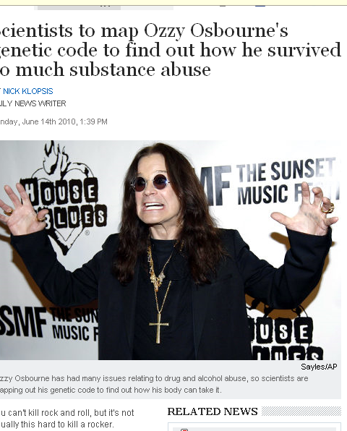
Re-Sequencing Genomes
(Ozzy Osbourne?)
"Sequencing and analysing individuals with extreme medical histories provides the greatest potential scientific value.“
Nathan Pearson, Director of Research Knome
Covered more in Lecture 9: Next-generation sequencing
Notes:
Incorporate priors into analyses of these data!!
43

Slide 44
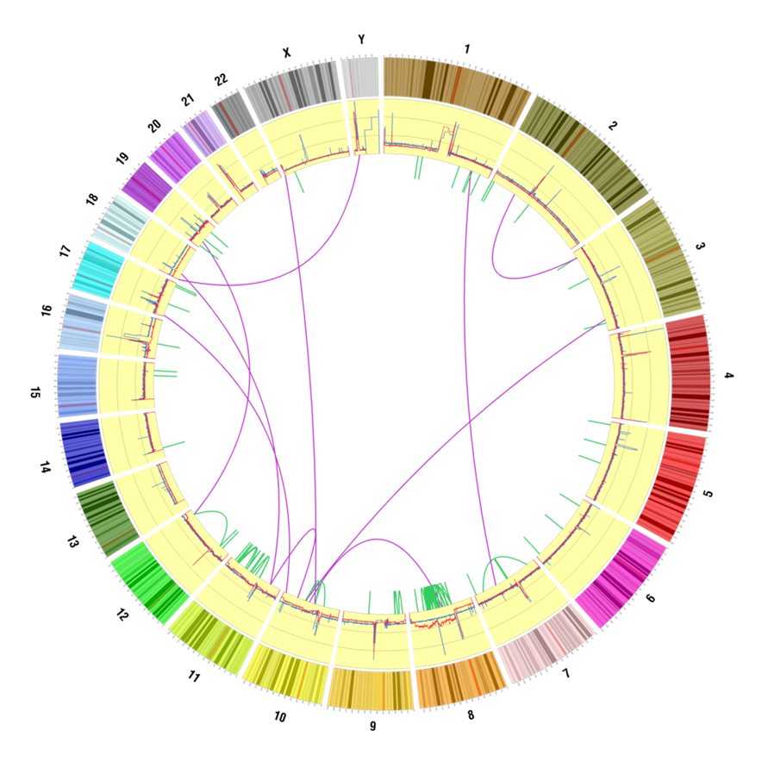
Circos Plot: Tumor – Normal
Remi Kazma
Notes:
See a large deletion at 8p, and a series of rearrangements giving an increase in copy number at 8q.
1- Connecting lines within the plot (aka links) represent junctions = reads that map simultaneously to two positions on the reference genome. Interchromosomal translocations, intrachromosomal rearrangements.
Green = intrachromosomal / Purple = interchromosomal
Thick links = high confidence, thin/transparent links = low confidence
In case you want plots without the low confidence links, I could do it but you need to ask for it today.
2- Blue histogram represent "the segmentation of the complete reference genome into regions of distinct ploidy levels" using the NORMAL sample
3- Red histogram represent "the segmentation of the complete reference genome into regions of discrete coverage levels" using the TUMOR sample
I forgot about the histograms, the scale goes from 0 to 4 by 0.25, same scale for both.For reference, the normal histogram in blue is on average at about 2.
44

Slide 45
Characterization
Once genes are identified, molecular methods are used to determine the structure of the gene, identification of regulatory elements, etc.
Use epidemiologic studies to distinguish public health implications:
  Determine frequencies of causal alleles; and
  Characterize their effects—and interacting environmental factors—on disease rates.

Slide 46

Genetic Testing?

Slide 47
Large RR ≠ Good Prediction
Witte, Nat Rev Genet, 2009

Slide 48


Genetic Testing Based on GWAS?
Multiple companies marketing direct to consumer genetic ‘test’ kits.
Send in spit.
Array technology (Illumina / Affymetrix).
Many results based on GWAS.
Companies:
    23andMe
    deCODEme
    Navigenics

Slide 49
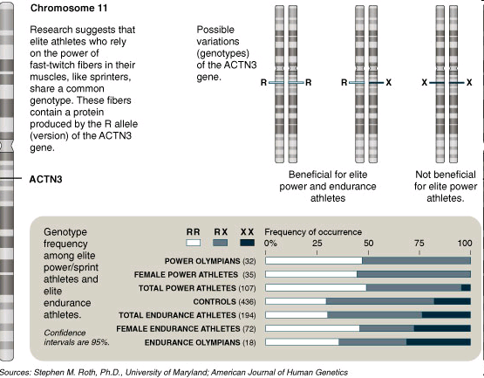
‘Test to Play’
NY Times, 11/30/08

Slide 50


Slide 51
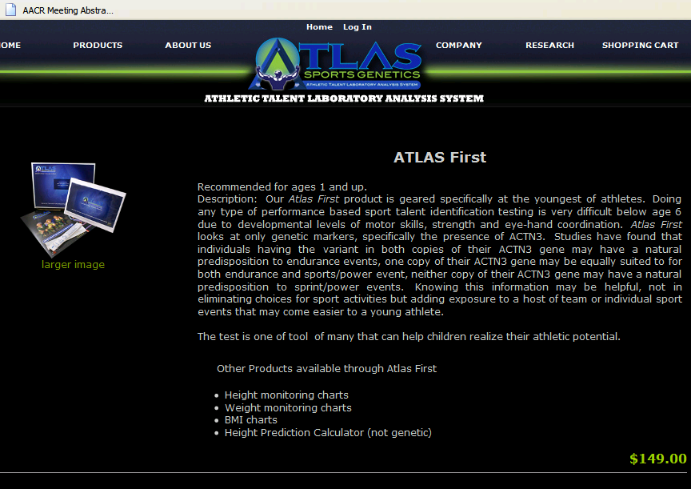

Slide 52
Genetic Taste Testing & Earwax Project
Taste testing
  Strips coated with Phenylthiocarbamide (PTC, or phenylthiourea).
  Bitter or tasteless, depending on variants in the taste receptor TAS2R.
Earwax
  Wet or dry?
What do you think your phenotype is?

