Slide 1
Non-Mendelian Genetics
Eric Jorgenson
Epidemiology 217
3/3/15

Slide 2
Outline
Mitochondrial DNA
De Novo Variation
Parent-of-origin Effects
Epigenetics: DNA Methylation and Histone Modification

Slide 3
Outline
Mitochondrial DNA
De Novo Variation
Parent-of-origin Effects
Epigenetics: DNA Methylation and Histone Modification

Slide 4
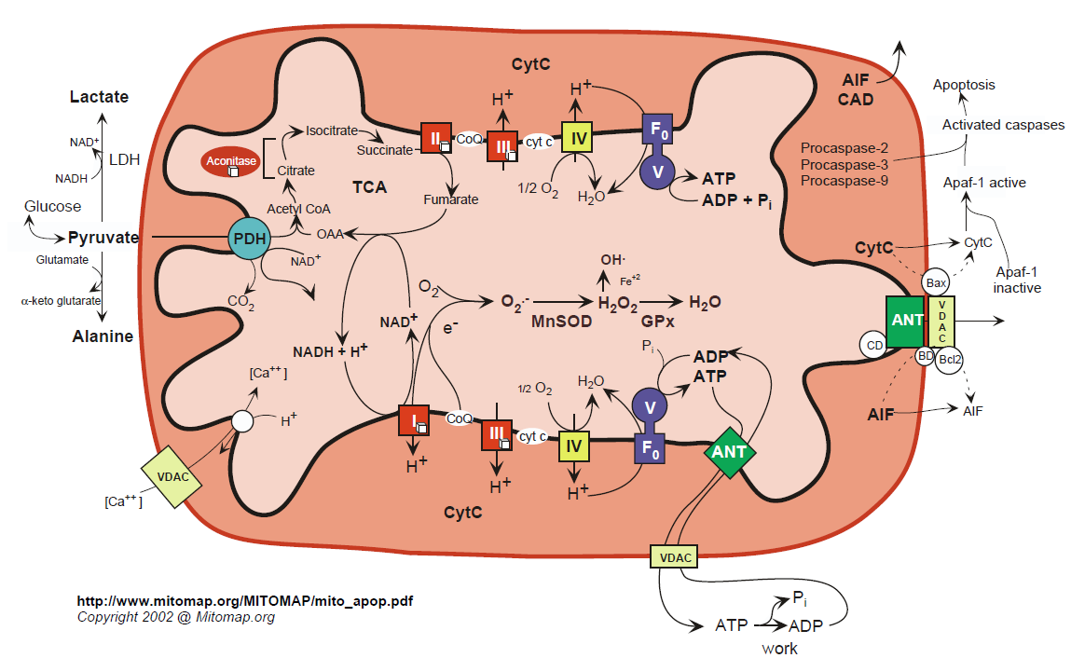
Mitochondrial Energetics
Notes:
Single mitochondrion in one celled organisms
1-2,000 in human liver cells

Slide 5
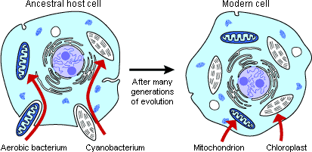
Origin of Mitochondria
Notes:
Mitochondria appear to have entered the eukaryote lineage as a singular event .

Slide 6
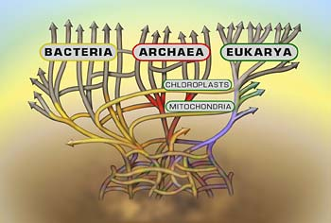
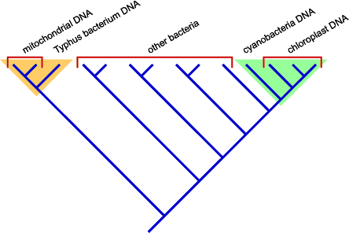
Origin of Mitochondria
Notes:
DNA sequence analysis suggests that the proto-mitochondrion was related to a aerobic alpha-proteobacterium like Typhus.

Slide 7
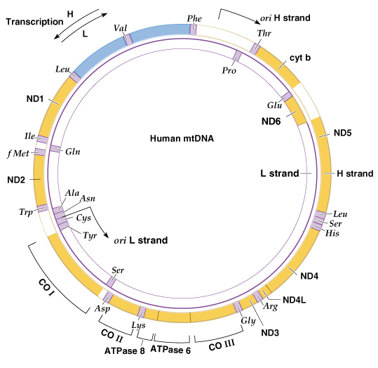
Human mtDNA (16,569 bp)
Notes:
Mitochondrial genomes are generally circular, double stranded, supercoiled, and small (less than 20 Kb in length in animals)
linear mitochondrial genomes are also found in some protozoa and fungi
In most animals the two strands of mtDNA have different densities, so they are called the H (heavy) and L (light) strands

Slide 8
Mitochondrial Genes
  tRNAs
  rRNAs
  Protein subunits:
    cytochrome oxidase
    NADH dehydrogenase
    ATPase

Slide 9
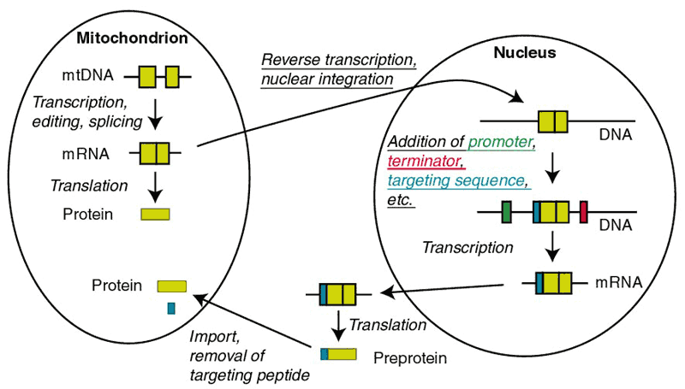
mtDNA Products Act Inside and Outside the Mitochondrion

Slide 10
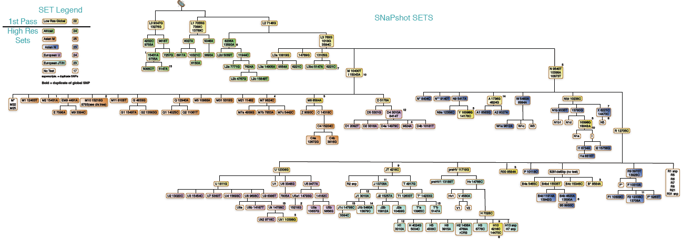
Human mtDNA Lineages

Slide 11
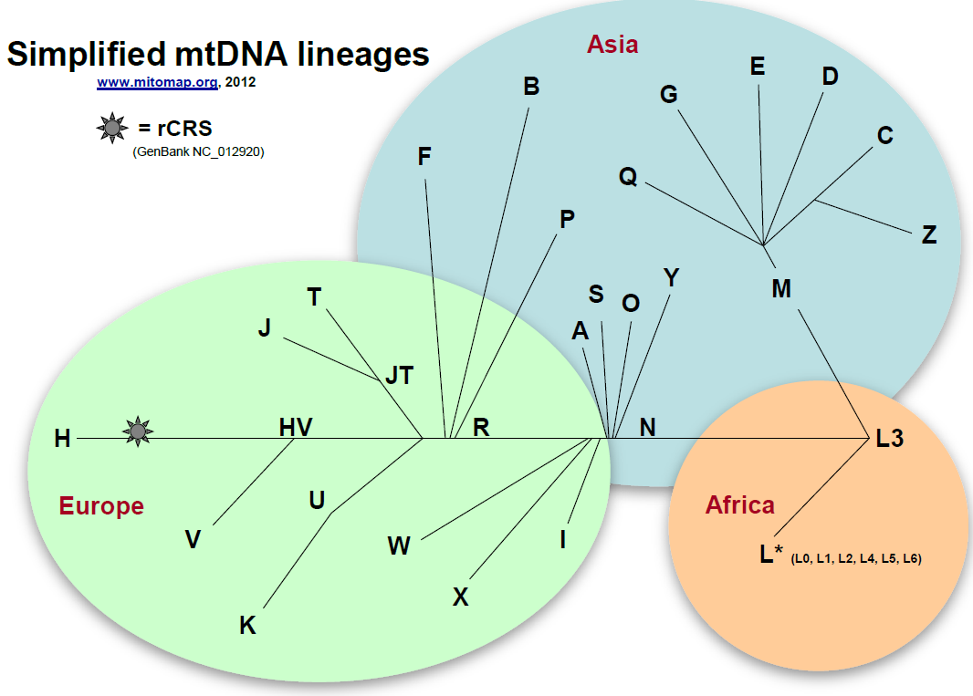
mtDNA Lineages (Simplified)

Slide 12
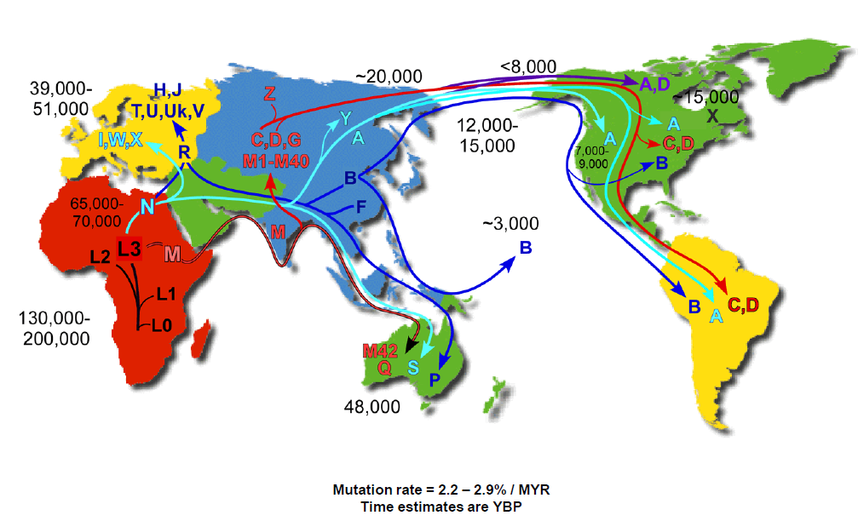
Human mtDNA Migrations

Slide 13
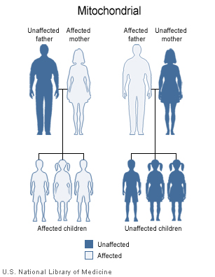
Mitochondrial Inheritance

Slide 14
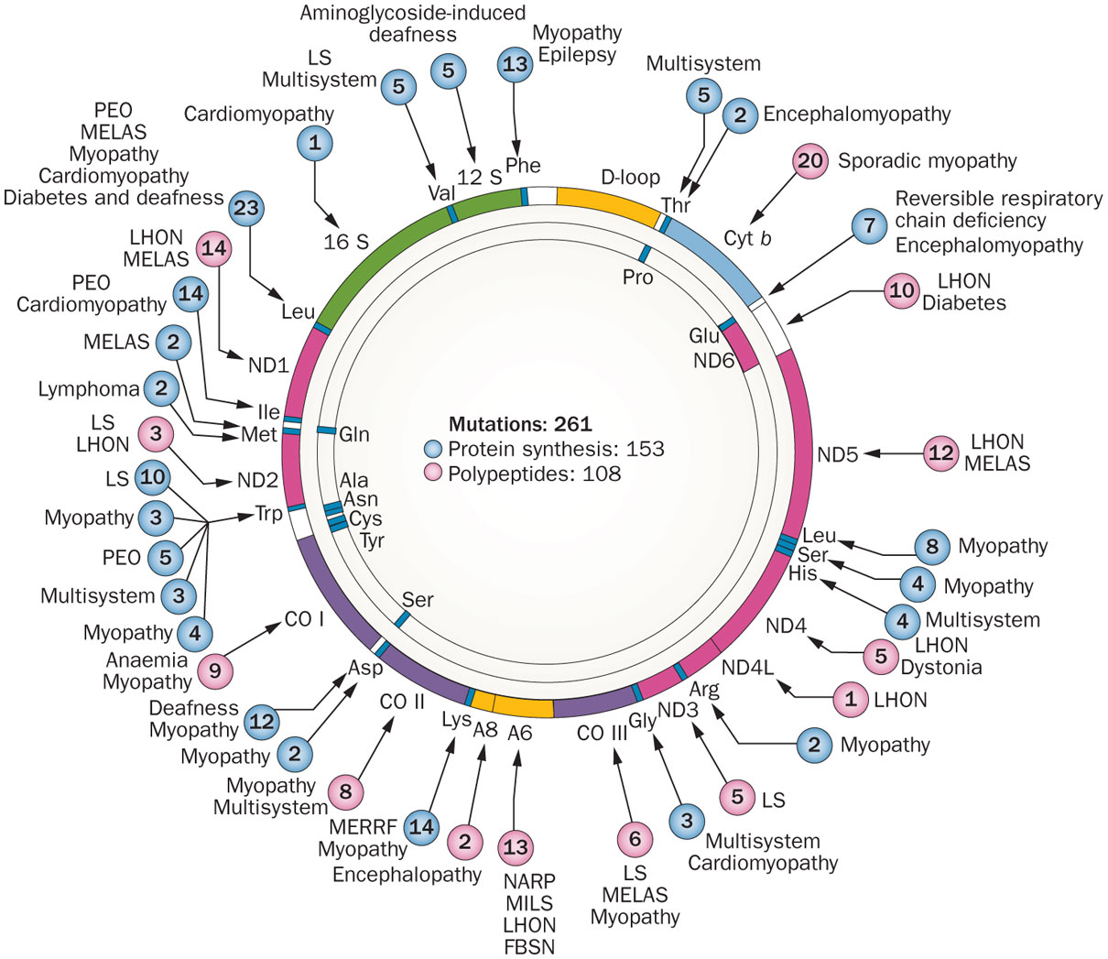
Morbidity Map of mtDNA
DiMauro, S. et al. (2013) The clinical maze of mitochondrial neurology
Nat. Rev. Neurol. doi:10.1038/nrneurol.2013.126
Notes:
Affects mid-life adults resulting in complete or partial blindness from optic nerve degeneration
Several mutations in mitochondrial electron transport chain enzyme complexes have been identified
LHON results from defects in the enzymes of oxidative phosphorylation: without ATP production, the optic nerve dies

Slide 15
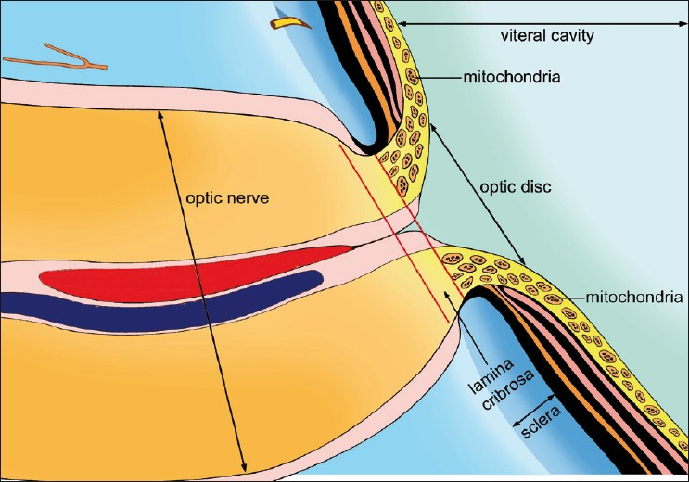
High Concentration of Mitochondria at Optic Disc
Notes:
Leber’s Hereditary Optic Neuropathy

Slide 16
Genetic Epidemiology Research in Adult Health
and Aging (GERA) Cohort Characteristics
Characteristics of the GERA Cohort
 | Number of Subjects | %
Gender
Females | 63,883 | 57.9%
Males | 46,383 | 42.1%
Age at Specimen Donation
18-39 | 7,025 | 6.3%
40-59 | 33,344 | 30.2%
60-79 | 57,856 | 52.4%
80+ | 12,041 | 10.9%
Race – Ethnicity
African American | 3,765 | 3.4%
Asian | 8,512 | 7.7%
Hispanic | 7,917 | 7.2%
Non-Hispanic White | 89,259 | 81.0%
Total | 110,266 | 100.0%
Notes:
Baseline characteristics
More women than men
Broad age range: average 62
Diverse

Slide 17
Primary Open Angle Glaucoma Case and Control Definitions
Cases
  35 or older
  KPNC members from 2008-2014
  One or more diagnoses of primary open angle glaucoma (POAG)
    ICD-9 Codes: 365.01, 365.05, 365.1, 365.10, 365.11, and 365.15
  No diagnosis of any other type of glaucoma
Controls
  35 or older
  KPNC members from 2008-2014
  No glaucoma diagnosis of any kind
  No documented IOP measures above 22 mmHg in either eye
  No documented Cup-to-Disc ratio difference of more than 0.2 between eyes

Slide 18
Primary Open Angle Glaucoma
in GERA
 | Cases |  | Controls
 | n=4,580 |  | n=75,766
Age (years) | n | % | n | %
35-44 | 30 | 0.66 | 6,283 | 8.29
45-54 | 164 | 3.58 | 13,288 | 17.54
55-64 | 743 | 16.22 | 23,075 | 30.46
65-74 | 1,450 | 31.66 | 20,022 | 26.23
75-84 | 1,676 | 36.59 | 10,837 | 14.30
85+ | 517 | 11.29 | 2,261 | 2.98
Mean (SD) | 72.89 | (9.94) | 62.45 | (12.13)
Sex
Women | 2,324 | 50.74 | 43,537 | 57.48
Men | 2,256 | 49.26 | 32,219 | 42.52
Race
Non-Hispanic white | 3,607 | 78.76 | 62,393 | 82.35
Latino | 371 | 8.10 | 6,154 | 8.12
East Asian | 313 | 6.83 | 5,167 | 6.82
African American | 289 | 6.31 | 2,052 | 2.71

Slide 19
Mitochondrial Association Study in GERA non-Hispanic whites
-log₁₀(P-value)
Position on mitochondrial genome

Slide 20
mtSNPs Associated with POAG
in non-Hispanics whites
SNP | Position in mtDNA (bp) | Minor Allele Frequency |  | OR | P-value | Haplogroups
 |  | Control | Case
rs28357981 | T4977C | 0.0014 | 0.0046 | 4.04 | 6.39*10⁻⁷ | B2, L4, N10
rs1029294 | C6473T | 0.0020 | 0.0055 | 3.05 | 8.32*10⁻⁶ | B2, M1
rs3928312 | A2833G | 0.0001 | 0.0012 | 12.36 | 1.50*10⁻⁴ | R5, M38, M67
rs3134801 | T9950C | 0.0026 | 0.0055 | 2.45 | 3.26*10⁻⁴ | B2, B5, HV4, L0, L3, M11, W1

Slide 21
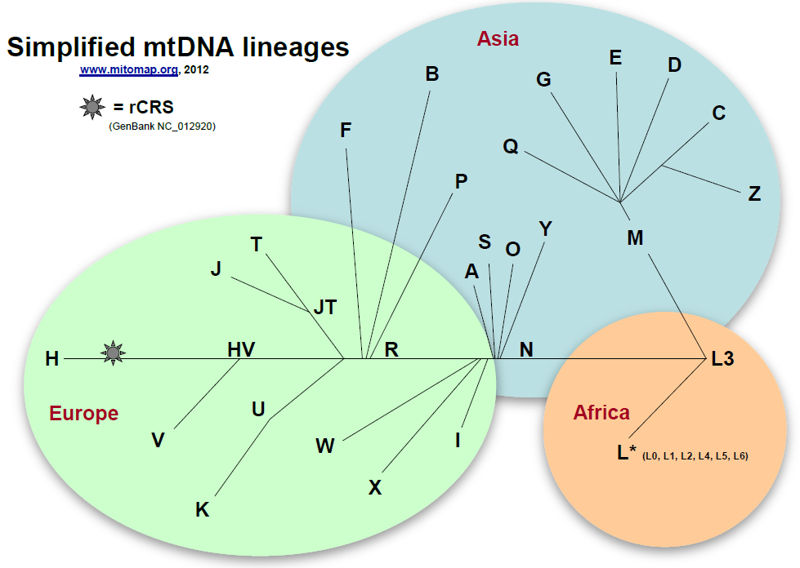
Mitochondrial Lineages Cluster by Continent
B2

Slide 22
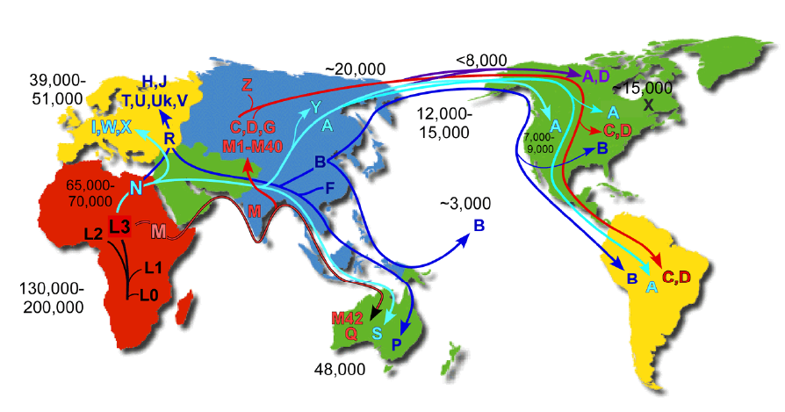
Mitochondrial Migrations
B2

Slide 23
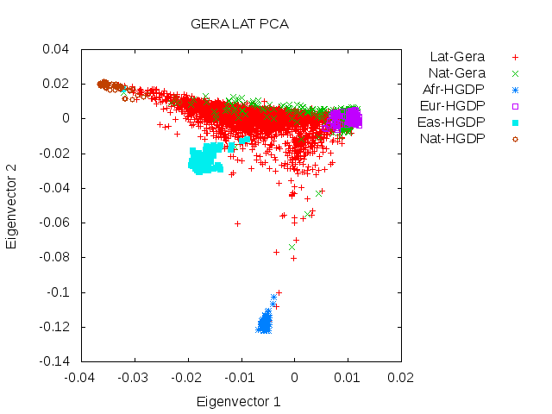
Ancestry of Latinos in GERA
Native
American
European
African

Slide 24
The Effect of Ancestry on B2
and mtSNP Associations
Haplogroup/SNP | Unadjusted |  | Adjusted
 | OR | P-value | OR | P-value
non-Hispanic white
B2 | 2.95 | 3.88*10⁻⁵ | 3.34 | 1.54*10⁻⁵
rs28358586 | 1.71 | 1.93*10⁻² | 2.08 | 2.40*10⁻³
rs28357981 | 3.59 | 8.37*10⁻⁷ | 4.35 | 1.05*10⁻⁷
rs1029294 | 2.96 | 4.49*10⁻⁶ | 3.15 | 5.04*10⁻⁶
rs3134801 | 2.20 | 7.04*10⁻⁴ | 2.50 | 2.00*10⁻⁴
Latino
B2 | 1.34 | 0.031 | 1.19 | 0.220
rs28358586 | 1.33 | 0.038 | 1.20 | 0.206
rs28357981 | 1.38 | 0.016 | 1.24 | 0.133
rs1029294 | 1.34 | 0.031 | 1.19 | 0.229
rs3134801 | 1.32 | 0.039 | 1.19 | 0.235

Slide 25
Outline
Mitochondrial DNA
De Novo Variation
Parent-of-origin Effects
Epigenetics: DNA Methylation and Histone Modification

Slide 26
Your De Novo Mutations
74 new SNPs
2 new Indels
Rarely a CNV

Slide 27
De Novo Mutation Methods
Family Design
  Trios
Exome Sequencing
  Coding Variants
Array CGH
  CNVs
Bioinformatics
  Filter artifacts
Sanger Sequencing
  Confirmatory

Slide 28
Sporadic Autism Exome Study and De Novo Mutations
209 Families, 677 Individuals
  Trios
  Unaffected Siblings
Exome Sequencing
248 De Novo Events
  225 SNVs (single nucleotide variants)
  17 Indels
  6 CNVs
181 nonsynonymous changes
  120 severe

Slide 29
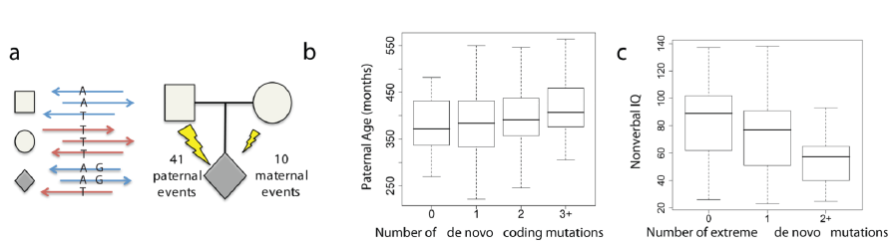
De Novo Mutations and Autism Spectrum Disorder
Notes:
a Haplotype phasing using informative markers shows a strong parent-of-origin bias with
41/51 de novo events occurring on the paternally inherited haplotype.
b and c, Box and whisker plots for 189 SSC probands.
b, The paternal estimated age at conception versus the
number of observed de novo point mutations (0, n = 53; 1, n = 65; 2, n = 44; 3+, n = 27).
c, Decreased nonverbal IQ is significantly associated with an increasing number of “extreme”
mutation events (0, n = 138; 1, n = 41; 2+, n = 10), both with and without CNVs

Slide 30
Outline
Mitochondrial DNA
De Novo Variation
Parent-of-origin Effects
Epigenetics: DNA Methylation and Histone Modification

Slide 31
Parent-of-origin Effects
In utero effects
  Mother’s genotype can affect environment
Imprinting
  Genes expressed only from one parent
  DNA Methylation
  <1% of genes

Slide 32
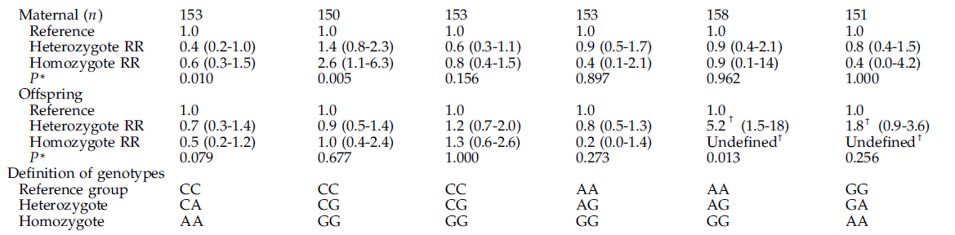
Testicular Germ Cell Tumors and Maternal Genotype

Slide 33
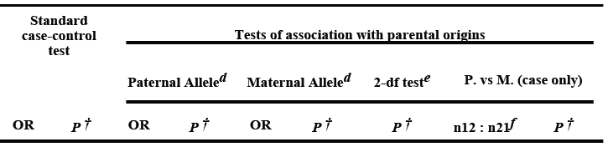


Parent-of-origin Effects in GWAS Findings

Slide 34
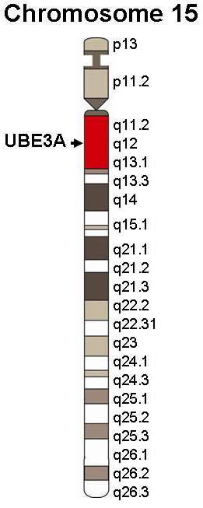
Diseases of Imprinting: Prader-Willi and Angelman
Paternal loss = Prader-Willi (gene SNRPN, Necdin gene, clusters of snoRNAs)
PWS/AS region
Maternal loss = Angelman (gene UBE3A)
Paternal allele silenced in hippocampus and cerebellum
Notes:
Prader-Willi: hypotonia, short stature, hyperphagia, obesity, behavioral issues (specifically OCD-like behaviors), small hands and feet, hypogonadism, and mild mental retardation
Mother’s copy is imprinted (off)
Angelman: Developmental delay, speech impairment, ataxia, behavioral uniqueness (happy demeanor, frequent laughter/smiling)
Father’s copy is imprinted (off)

Slide 35
Outline
Mitochondrial DNA
De Novo Variation
Parent-of-origin Effects
Epigenetics: DNA Methylation and Histone Modification

Slide 36
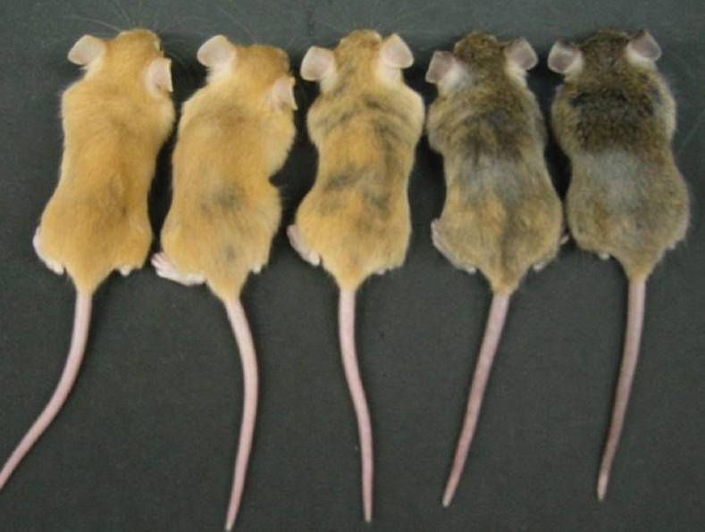
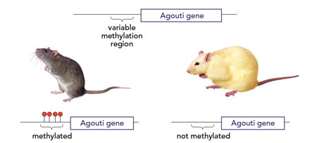
‘Over’
Epi-genetics
Epigenetic gene regulation comprises the
heritable changes in gene expression that occur in the absence of changes to the DNA sequence itself
Genetically identical adult yellow agouti (A^{vy}) mice displaying five different coat color phenotypes

Slide 37
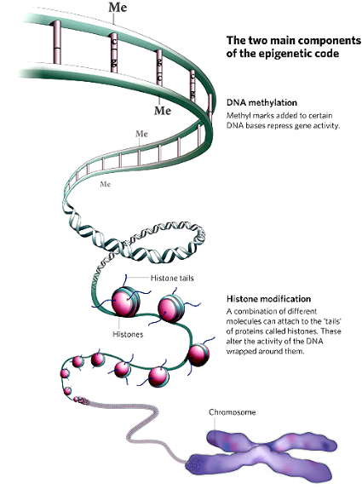
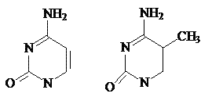
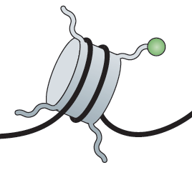
The two main components of the epigenetic code
DNA methylation
DNA Methylation occurs predominantly at CpG dinucleotides in mammals
Histone modification
Different molecules can attach to the tails of proteins called “histones”

Slide 38
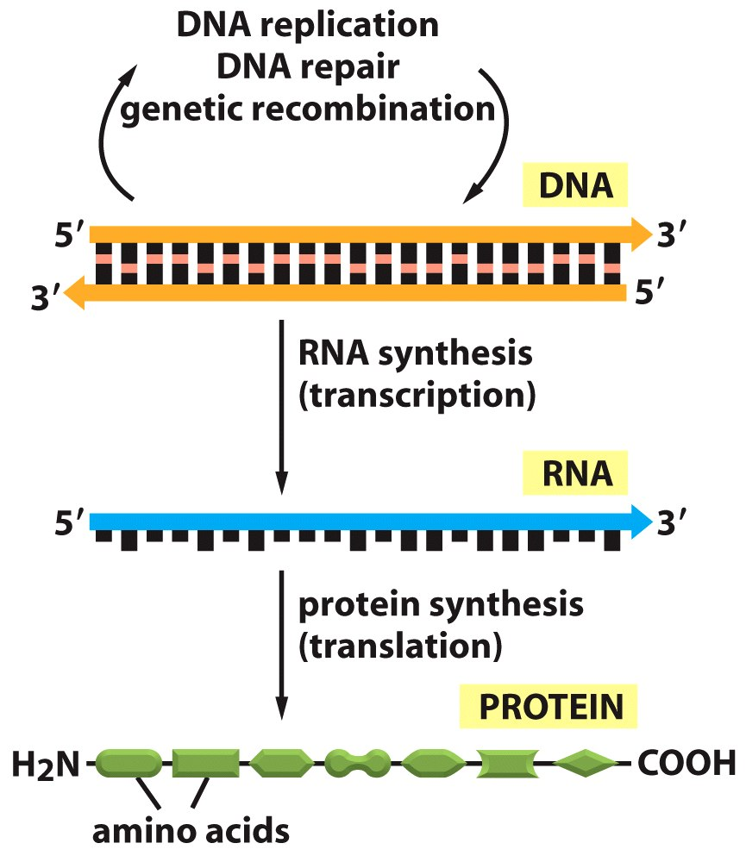
Central Dogma: DNA→RNA→Protein

Slide 39
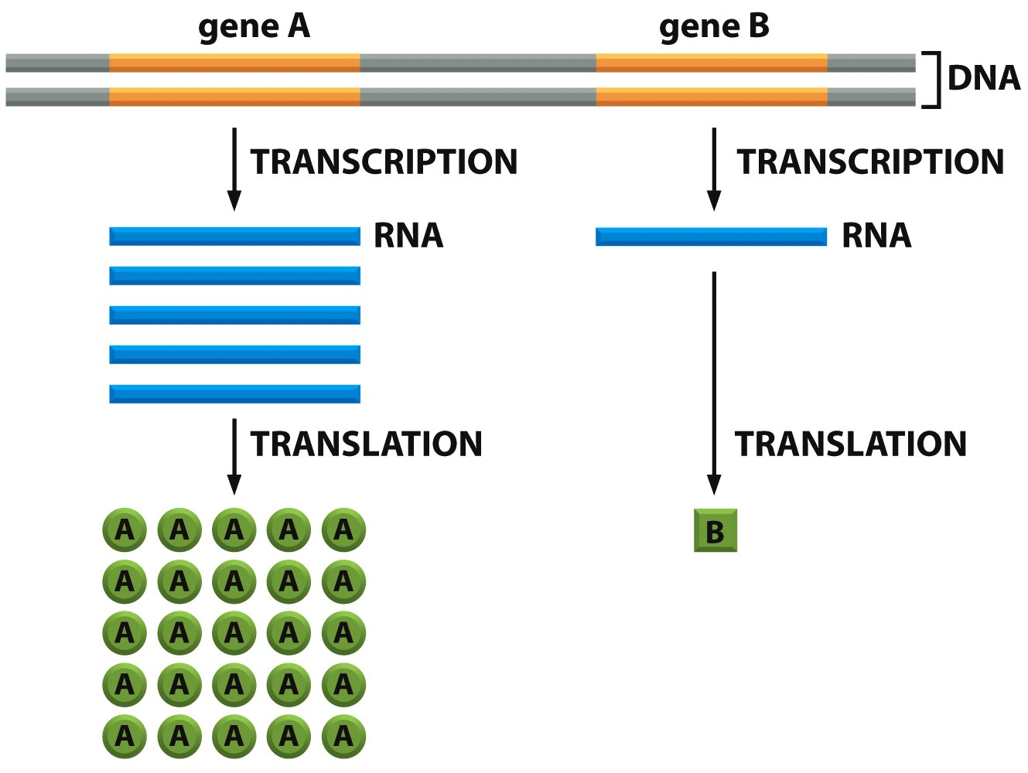
Does Not Address Amount of Genetic Information

Slide 40
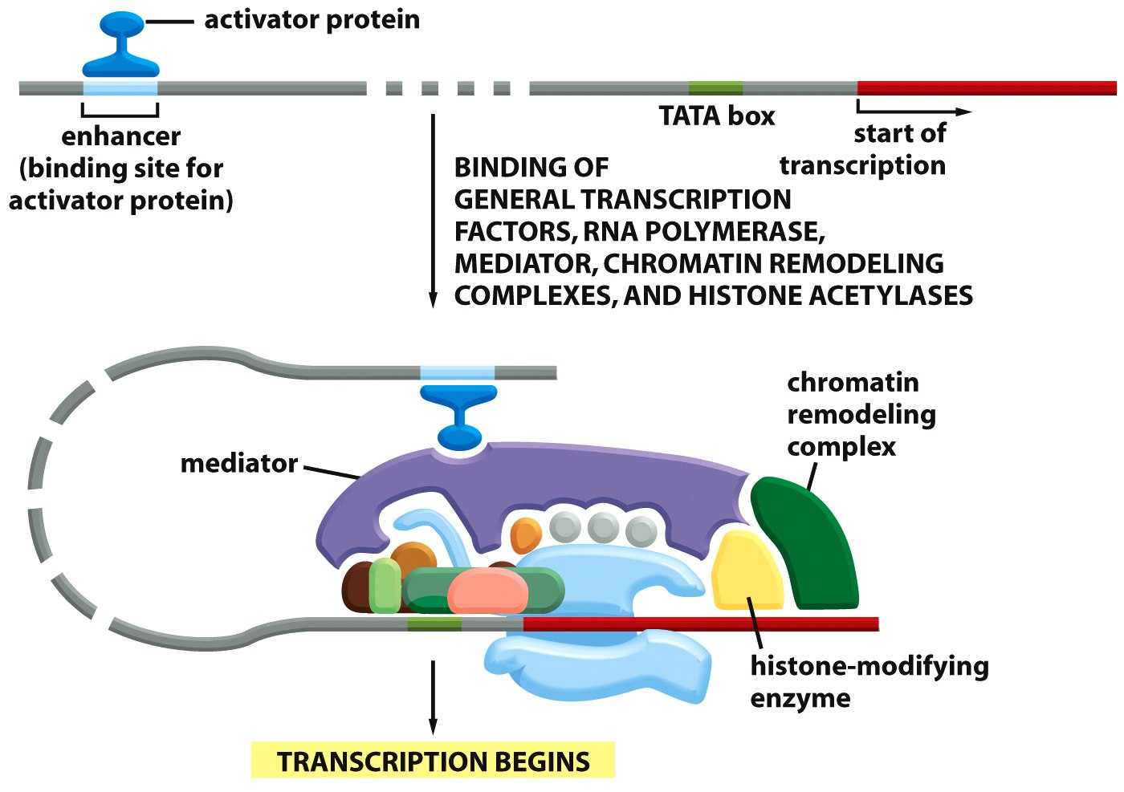
Activator Protein is Required to Turn on Genes
Notes:
The binding of activator proteins depends on chromatin structure

Slide 41
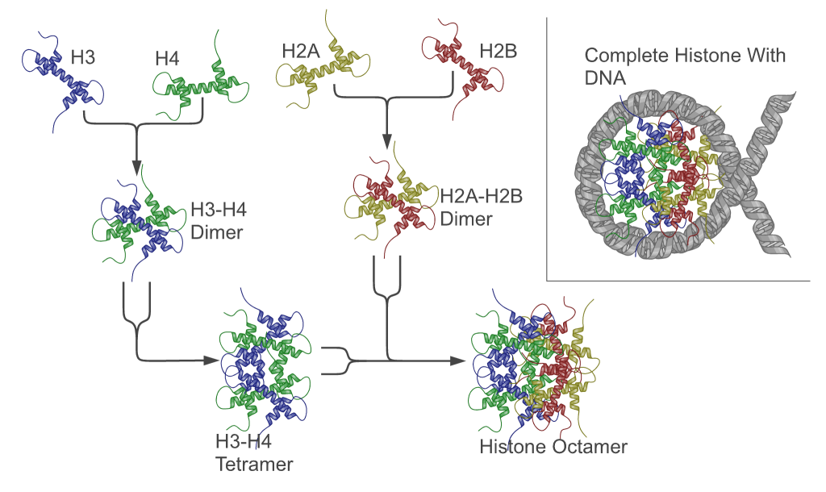
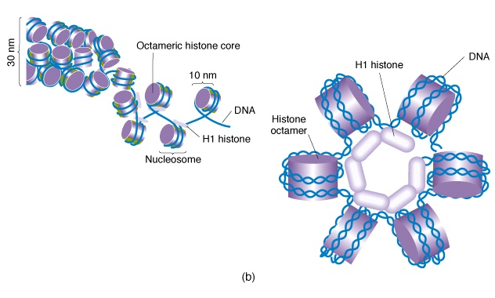
Chromatin: Histones Provide Structure to DNA
Chromatin
Notes:
Histones are proteins; they combine to form an octamer (8 subunits)
DNA wraps around the histone octamer twice to form a nucleosome
The resulting structured DNA and protein complex is called chromatin
Changes in chromatin lead to changes in gene regulation
in eukaryotes
80bp DNA = 1 turn
DNA wraps two times and 145bp DNA associates with each core
Linker DNA = 55bp
Human nucleus = 15-30 x 10⁶ nucleosomes

Slide 42
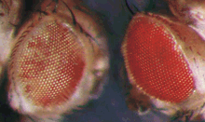
Euchromatin and Heterochromatin
Euchromatin
  Active, less condensed, gene rich
Heterochromatin
  Inactive, highly condensed, gene poor
Position effect variegation
White⁺
Euchromatin
Heterochromatin
White⁺
Heterochromatin spreads

Slide 43
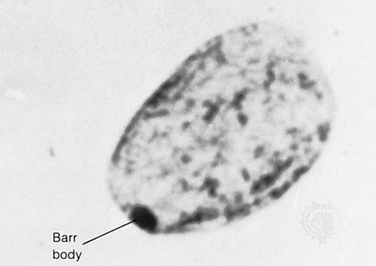
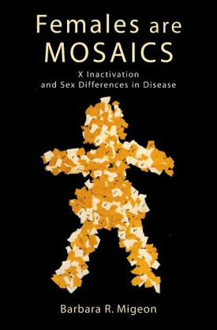
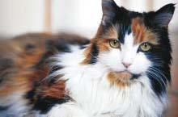
X Chromosome Inactivation
Dosage Compensation
  Males XY, Females XX
Barr Body
  One copy effectively off
  heterochromatin
Random inactivation

Slide 44
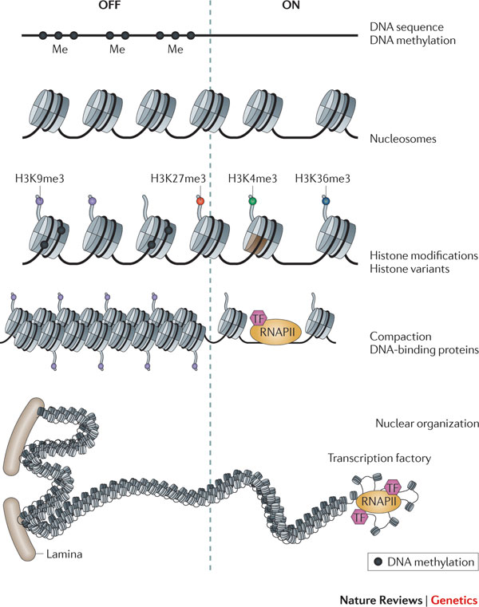
Chromatin Structure is determined by
DNA Methylation and Histone Modifications

Slide 45
Histone Modifications Influence Gene Expression
Chromatin structure altered directly
Inhibit binding of repressive factors
Recruit activating factors

Slide 46
Histone Modifications
Nucleosome
Histone tails
Chemical modification
DNA (147 bp)
Modification | Role in transcription | Histone-modified sites
Acetylation | Activation | H3 (K9,K14,K18,K56)
 |  | H4 (K5,K8,K12,K16)
 |  | H2B (K6,K7,K16,K17)
Phosphorylation | Activation | H3 (S10)
Methylation | Activation | H3 (K4,K36,K79)
 | Repression | H3 (K9,K27)
 |  | H4 (K20)
Notes:
Residues of histone tails can be covalently modified. There are at least 150 different modifications that define the histone code

Slide 47
Histone Acetylation and Deacetylation
AC
ON
HAT
activator
Upstream activator sequence
HAT= Histone acetyltransferase
AC
HDAC
OFF
repressor
Upstream repressive sequence
HDAC= Histone deacetylase

Slide 48
Acetylation Reduces Histone Binding to DNA
AC
Transcription factor
Transcription ON
Closed
Open
Notes:
Neutralization of positively charged lysines by acetylation reduces the strength of binding of the histones to the negatively charged DNA and thus opens DNA binding sites.

Slide 49
Histone Methylation
Occur at either lysines or arginines
Activate or repress gene transcription depending on the position within the histone tail
Multiple possible methylation states on each residue (-mono, -di or –tri methylated).

Slide 50
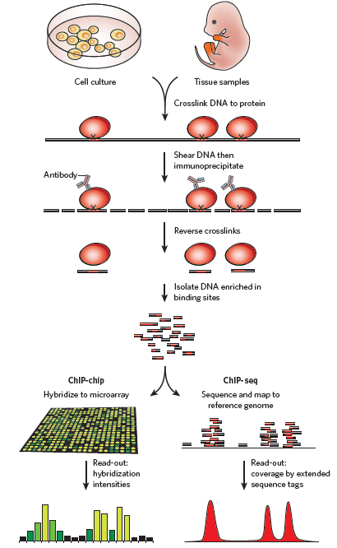
How Can We Measure Chromatin Structure?
Proteins are cross-linked to the DNA
Chromatin is isolated and fragmented
Antibodies against activating proteins are used to precipitate DNA : protein complexes
Binding between DNA and protein is released
DNA is sequenced
Sequences are mapped back on the genome to identify the binding sites.

Slide 51
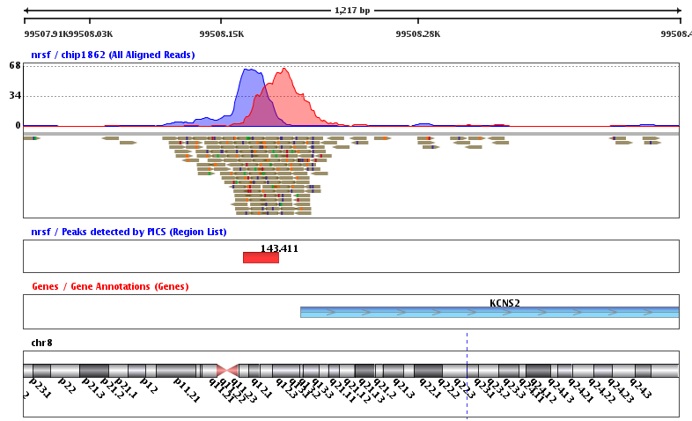
Chromatin Immunoprecipitation
Notes:
Sequences are mapped on the human genome in order to look at the position with respect to genes and other functional sequences.

Slide 52
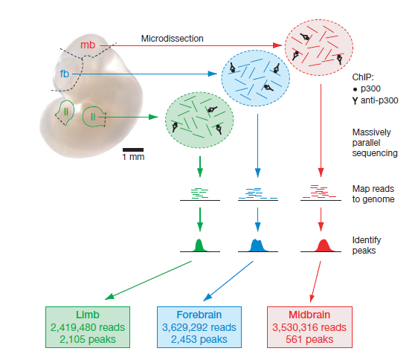
Identification of Enhancers using ChIP
HAT
activator
P300
Enhancer
Prediction of enhancer position using ChIP against activator protein p300
Chromatin isolated from midbrain, forebrain, and limb
Immunoprecipitation performed with antibodies against p300
DNA binding p300 sequenced and mapped on the human genome

Slide 53
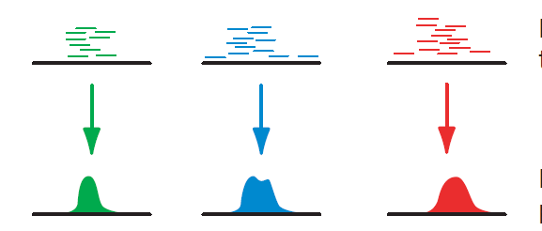
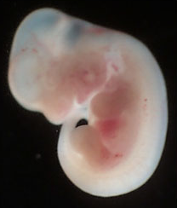
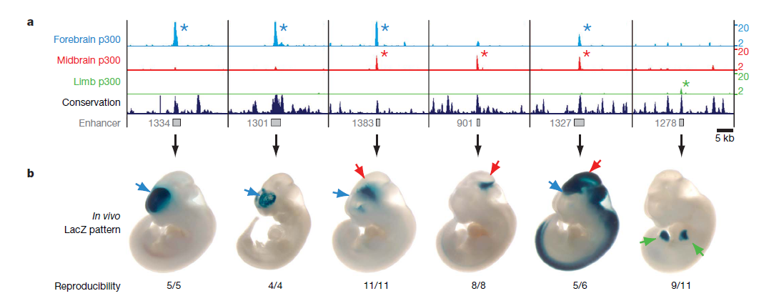
Validation of Enhancers
Midbrain
LacZ
weak
promoter
Enhancer
Notes:
The putative enhancer is cloned in a vector and its ability to drive expression of LacZ is tested in transgenic mice.

Slide 54
DNA Methylation
Unmethylated
de novo
methylation
Dnmt3a
Dnmt3b
Methyl CpG
Methylated
DNA
replication
maintenance
methylation
Dnmt1
Hemimethylated
Notes:
Cytosine methylation occurs predominantly in CpG dinucleotides in mammalian cells.
DNA methylation is established and maintained by DNA methyltransferases.
So far Dnmt1 and Dnmt3a and Dnmt3b have been shown to have methylase activity on CpG DNA.

Slide 55
DNA Methylation affects Gene Expression in Two Ways
Model 1
The presence of the methyl groups interferes with the binding of transcription factors that activate transcription from a specific gene.
Transcription factor
Model 2
Repressing proteins are attracted by methylated DNA.
Repressive factor

Slide 56
How Can We Study DNA Methylation?
Bisulfite sequencing
Treatment with sodium bisufite converts all cytosines (C) in uracils (U)
unless they are methylated (C^{m}).
m
CTGTCGAGTCGT
GACAGCTCAGCA
m
m
UTGTCGAGTUGT
GAUAGCTUAGUA
m
m
TTGTCGAGTTGTAT
AACAGCTCAACATA
Bisulfite
treatment
PCR
Sequencing
Notes:
After PCR the uracils are substitute with thymines (T). Sequencing allows to determine is a sequence is mainly methylated (>CG) or hypomethylated (>TG).

Slide 57
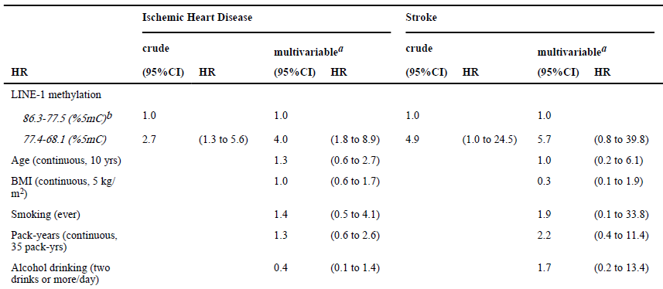
DNA Methylation and Heart Disease and Stroke
Notes:
Long Interspersed Nucleotide Elements
Repetitive, highly methylated sequences
Demethylation of LINE-1 increases their activity as transposable elements
That leads to genomic alteration and deregulates gene transcription

Slide 58
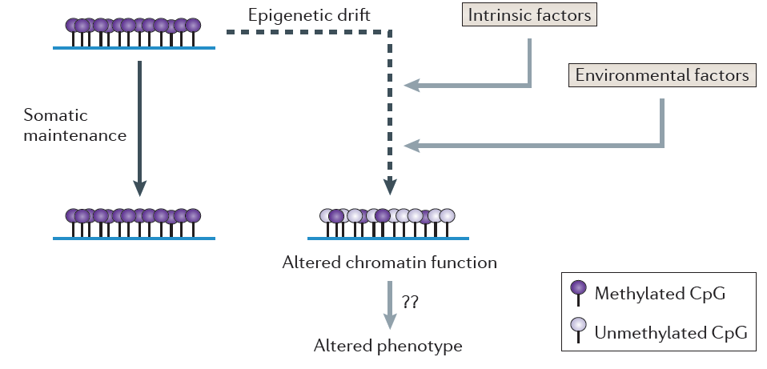
Environment and Epigenetics
Epigenetic marks can change over time
Epigenetic modifications biologically stabilized at a particular stage of development
Feil and Fraga, 2012 Nature Reviews Genetics

Slide 59
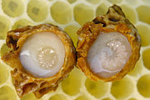
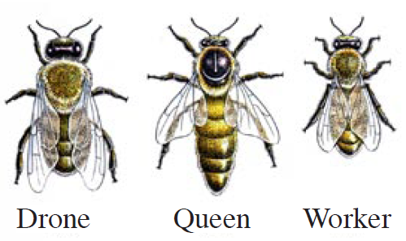
Environment and Epigenetics
Royal Jelly
Unmethylated
DNMT3 silencing
Methylated
Kucharski, R., Maleszka, J., Foret, S. & Maleszka, R. Nutritional control of reproductive status in honeybees via DNA methylation. Science 319, 1827–1830 (2008).
Lyko, F. et al. The honey bee epigenomes: differential methylation of brain DNA in queens and workers. PLoS Biol. 8, e1000506 (2010).
Notes:
Only larvae that are fed royal jelly develop into queens.
Silencing DNMT3 prevents methylation and produces queens.
Fertile queens and sterile workers are alternative forms of the adult female honeybee that develop from genetically identical larvae following differential feeding with royal jelly. We show that silencing the expression of DNA methyltransferase Dnmt3, a key driver of epigenetic global reprogramming, in newly hatched larvae led to a royal jelly-like effect on the larval developmental trajectory; the majority of Dnmt3 small interfering RNA-treated individuals emerged as queens with fully developed ovaries. Our results suggest that DNA methylation in Apis is used for storing epigenetic information, that the use of that information can be differentially altered by nutritional input, and that the flexibility of epigenetic modifications underpins, profound shifts in developmental fates, with massive implications for reproductive and behavioral status.

Slide 60
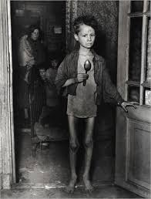
Development and Epigenetics
The Dutch famine of 1944 took place in the German-occupied part of the Netherlands near the end of World War II. About 4.5 million were affected.
Famine exposure in the periconceptional period led to an increased risk of metabolic and psychiatric disorders.
Notes:
Epigenetic alterations that arise around the time of conception, or during early embryogenesis, are amplified during development by cell division and somatic maintenance, and thus affect a high proportion of cells in the fully grown organism.
Fetal metabolic adjustments to nutritionally unfavorable conditions can affect growth and development, and may substantially alter the risk of chronic disorders later in life.

Slide 61
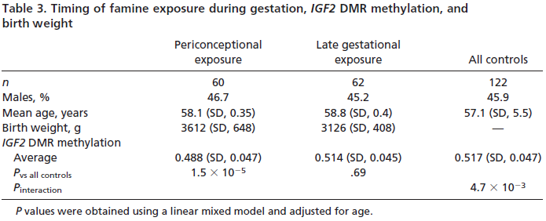
Development and Epigenetics
Heijmans et al., PNAS 2008
Notes:
Differences in DNA methylation were detected by different studies and affected genes involved in growth and metabolic disease.
Famine exposure later during gestation had no significant effects on DNA methylation

Slide 62
Next Week
Next generation sequencing

Slide 63
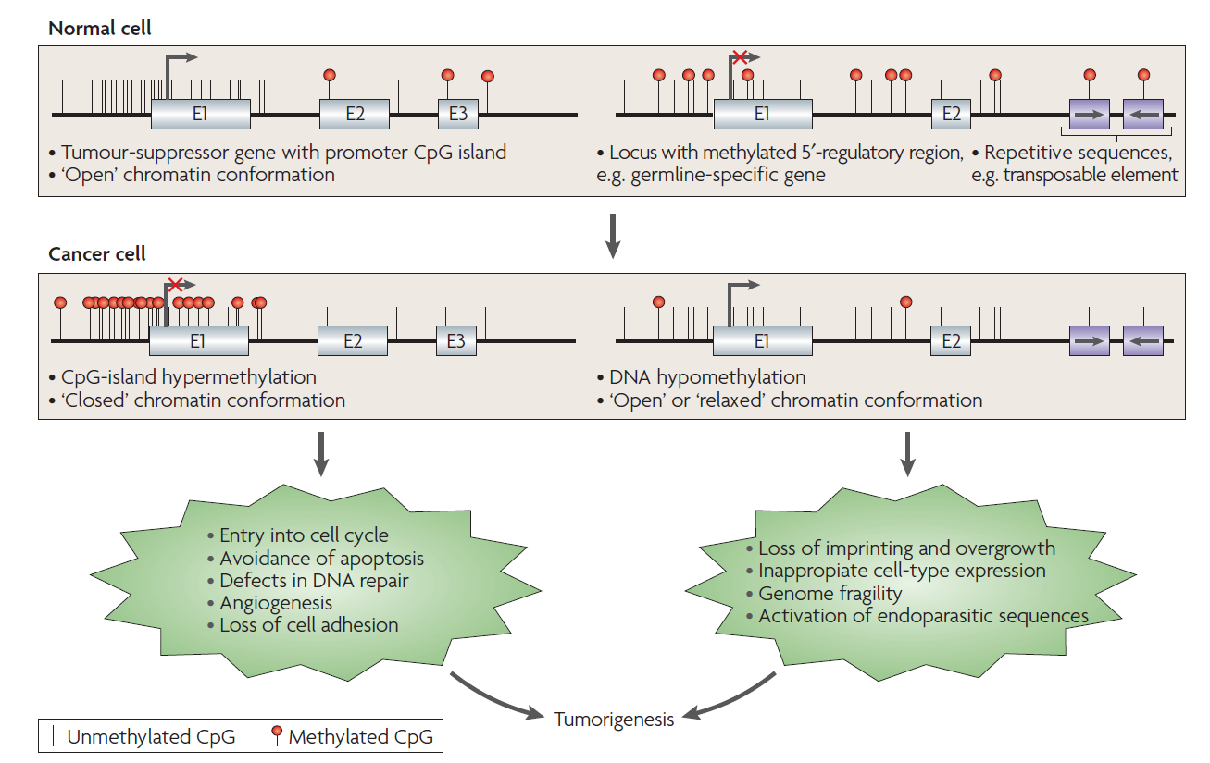
Cancer and Epigenetics
MLH1, BRCA1, p16^{INK4a}
From Esteller 2007, Nature Reviews Genetics
Notes:
Human tumors undergo a massive overall loss of DNA methylation, but also acquire specific patterns of hypermethylation at certain promoters

