Slide 1
Epi 246
Applying Concepts from Behavior Change Theories and Frameworks into
Grant Proposals-
Margaret Handley, PhD MPH

Slide 2
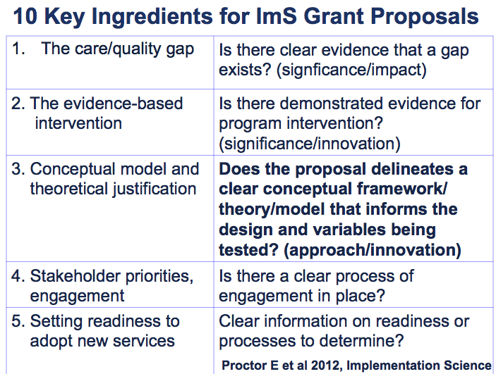

Slide 9
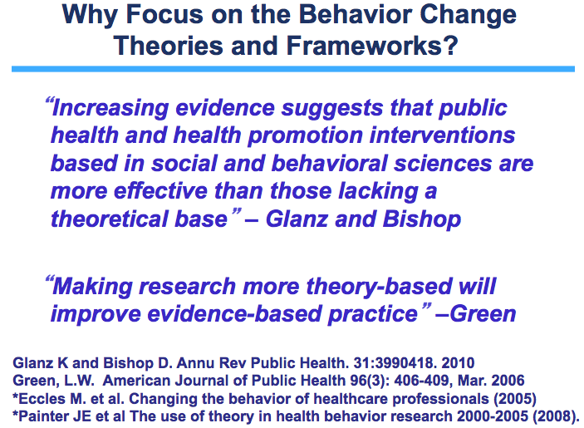

Slide 10
Examples- ImS funded grants- Handley
NIH-NIMHD P60 sub-project:
The STAR-Moms intervention is based on Socio-Ecological and Chronic Care Models for prevention of disease and behavior change (CCM). A socio-ecological framework for behavior change recognizes that in addition to behavior change messages targeted to individuals, it is essential to include enabling and reinforcing factors that are related the social and family contexts in which diabetes-related behaviors are developed and maintained. The CCM has been associated with improved chronic disease outcomes and has been promoted to be equally applicable as a chronic disease prevention model. CCM areas of focus in this project include: collaborative goal-setting, identification of personal barriers and supports, development of individual problem-solving, linkages to community resources, social support, and tailored follow-up.

Slide 11
Examples- ImS funded grants- Handley
This gives more detail on what I mean when I say socio-ecological
NIH-NIMHD P60 sub-project:
The STAR-Moms intervention is based on Socio-Ecological and Chronic Care Models for prevention of disease and behavior change (CCM). A socio-ecological framework for behavior change recognizes that in addition to behavior change messages targeted to individuals, it is essential to include enabling and reinforcing factors that are related the social and family contexts in which diabetes-related behaviors are developed and maintained. The CCM has been associated with improved chronic disease outcomes and has been promoted to be equally applicable as a chronic disease prevention model. CCM areas of focus in this project include: collaborative goal-setting, identification of personal barriers and supports, development of individual problem-solving, linkages to community resources, social support, and tailored follow-up.
This too gives details for this model and focuses the reader on what aspects of the CCM are being included

Slide 12
The STAR-Moms intervention builds on theoretical constructs found in Social Cognitive Theory, Theory of Planned Behavior, and Theories of Social Support found to be effective in weight loss, physical activity and dietary change, based on a recent meta-analysis and other studies. Our proposed development of STARMoms will incorporate specific behavior change techniques associated with these theories, including: "self-regulatory“ intervention techniques (specific goal setting, prompting self-monitoring, providing feedback on performance, goal review), self-efficacy building intervention techniques (motivational interviewing, using decisional balance and relapse prevention), individual tailoring techniques (information on content and resources), and culturally tailored social support, and which incorporates family needs.
Specific techniques are listed
2. Bilingual Health Coach-
Provision of Social Support, Action Planning Counseling, and Connections to Community Resources
3. Community Resources/ Primary Care Clinician
1.Automated Calls-
weekly phone queries and narratives
Postpartum pGDM Participants
Figure 1. STAR-Moms/STAR Mamá Enrolled participants select call times to receive proactive calls or call in toll-free. 1. Each week participants receive a rotating set of prevention-focused queries (e.g., diet, exercise, breastfeeding, smoking). 2.If a participant generates a value rated "out of range," participants also hear recorded narratives related to their "out-of-range" reply encouraging behavior change. 3. A health coach receives daily electronic downloads of STAR-Mom responses and, depending on the problem, calls back to engage participant in goal setting/action and provides information about community resources. 4. The health coach may send a notification to a patient’s clinic and/or clinician if deemed urgent.

Slide 13
Finally, STAR-MOMS builds on health literacy frameworks focused on improving an individual’s ability to specify planned health actions and to identify environmental cues to actions, as through "action planning.” Recent studies have identified that incorporating culture-specific values can significantly improve interventions targeted at health behavior change among Latinos. We will examine the importance of culture-specific constructs for Latina pGDM women.
Examples of these values for Latinas relate to: familismo
(family orientation), personalismo (preference for relationships with individuals, not institutions), fatalismo (fatalism), respeto (respect), confianza (relationship trust), and aguantarse (the ability to withstand stressful situations). Motivational interviewing highlights ambivalence and discrepancies between current behaviors and personal goals thereby promoting optimism and intention to change.

Slide 14
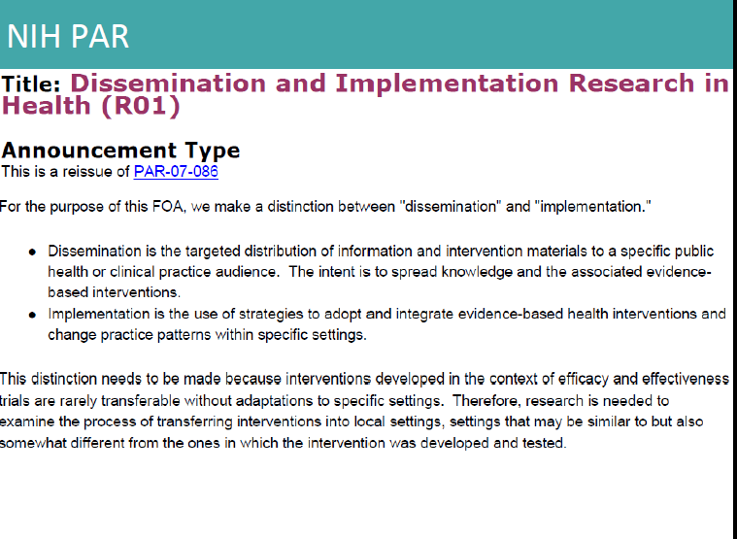
Mobile Health for Implementation of Home-Based TB Contact Tracing Investigation in Uganda - Davis

Slide 15
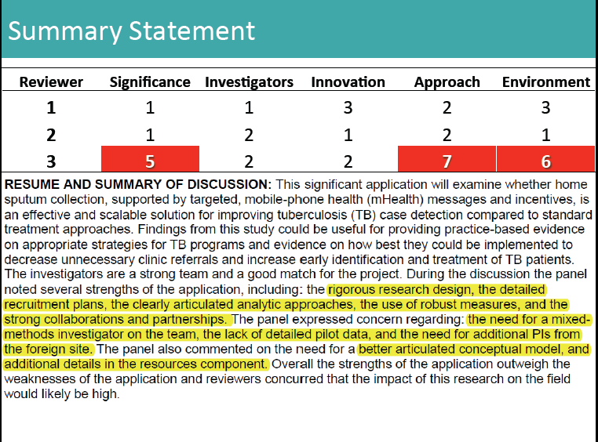
Davis - UCSF funded grants- round 1

Slide 16
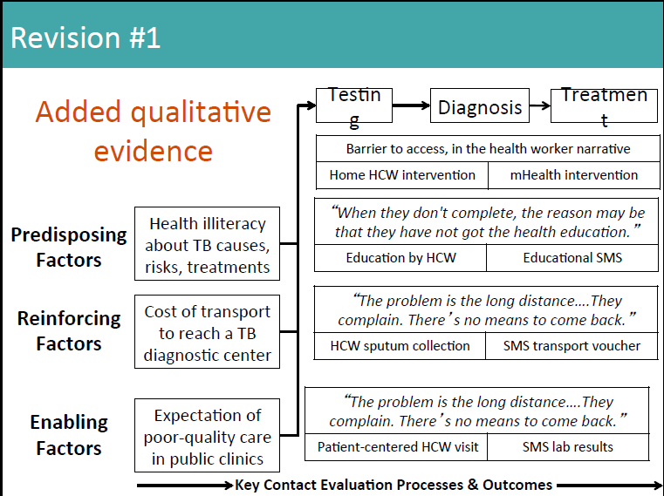
Davis - round 2 – Understanding barriers using PRECEED/PER

Slide 17
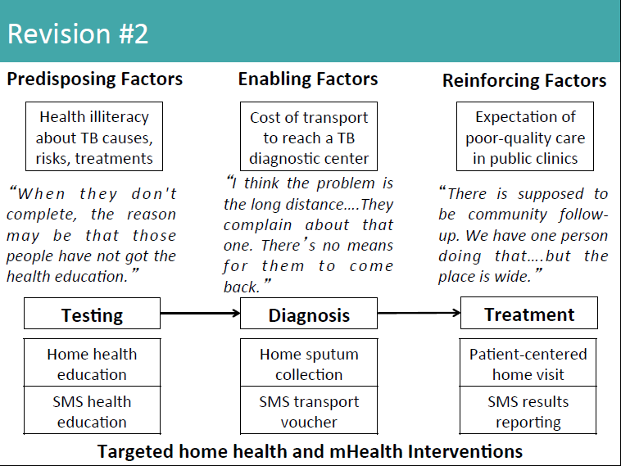
Davis - round 2 –Intervention targeting based on PRECEED/PER

Slide 18
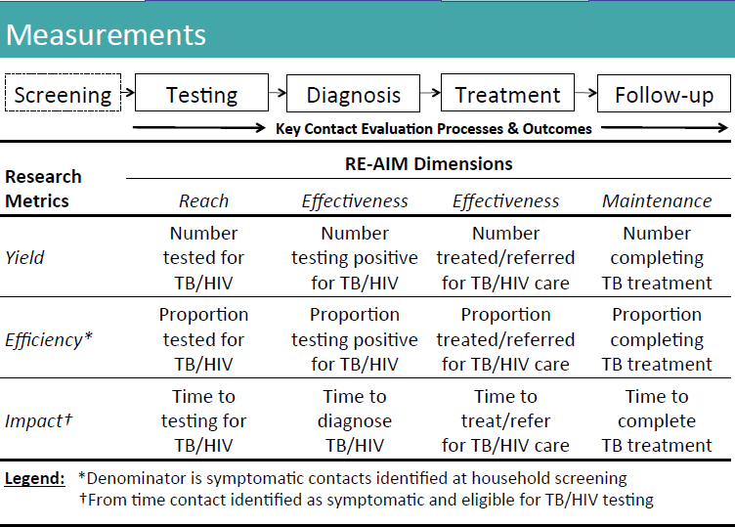
Davis - round 2 – RE-AIM Framework for measures

