Slide 1
What is Health Policy
Andy Bindman, MD
Epi 249
January 8, 2015

Slide 2



Andy Bindman
Primary care physician
Health services researcher
RWJ Health Policy Fellow in Congress during ACA
Part-time senior advisor at HHS/CMS since 2011

Slide 3
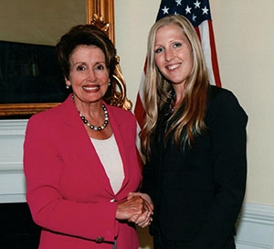
Brooke Hollister, PhD
Assistant Professor in School of Nursing
Policy research on long-term care
Fellow in Congress working with Minority Leader, Representative Nancy Pelosi

Slide 4
Format of the Class
Flipped classroom
Done at Home
  Watch video documentaries
  Do readings for upcoming class
  Prepare homework
Done in the Classroom
  Discussion of video and reading
  Workshop homework assignments in small group
  Present revised homework exercise before entire class

Slide 5

Video Instruction

Slide 6


Slide 7
Grading and Class Credit
Based on homework assignments and class participation
Revised assignments with track changes due to Brooke Hollister at the end of each class
Homework is designed to relate to your area of research
Cannot miss more than 1 class and receive credit
No final exam

Slide 8

Health Policy

Slide 9
What is Health Policy
Government decisions that are discretionary, unstructured, and consequential
Reflected in things policymakers choose to do
Reflected in things they choose not to do

Slide 10
Major Health Policy Content Areas
Financing health care:
  Coverage, benefits, provider payment
Public health:
  Infectious disease control, drug safety
Research:
  Basic science, clinical and health system
Workforce/Health professions education:
  Physicians, nurses, dentists, allied health

Slide 11
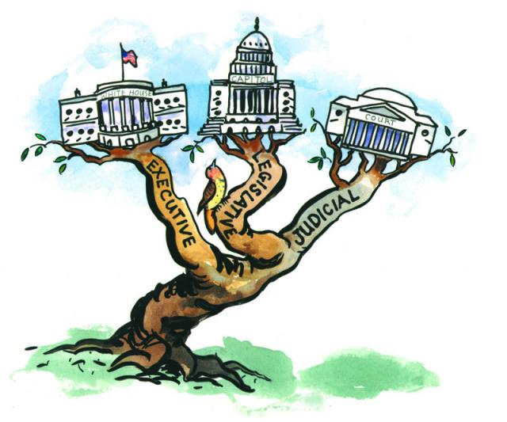
Who Makes Health Policy
Legislative branch passes laws
Executive branch writes regulations to implement laws
Courts render decisions on legality of laws

Slide 12

Federal Health Care Reform
Congress passed law 2010
Executive branch wrote regulations covering the more than 700 cases where ACA said “Secretary shall…”
Supreme Court upheld law but made Medicaid expansion optional

Slide 13
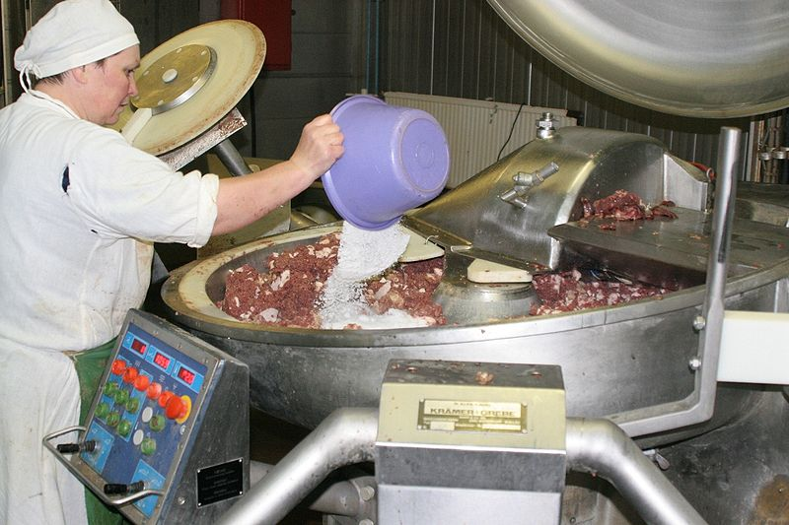
Making a Law
Notes:
13

Slide 14
Legislative Process
Typically legislation evolves through subcommittees and full committees of jurisdiction before full chamber level votes
“Hearings” and “Mark-ups”
If multiple committees of jurisdiction then bills must be merged before chamber votes
House and Senate must pass the same version of bill and President must sign to become law

Slide 15
ACA’s Long and Winding Road
ACA is a package of health reform laws
3 House Committees (E&C/W&M/Labor)
2 Senate Committees (Finance/HELP)
Full chambers passed similar but different bills with no Republican votes
“Conference” to create a single bill aborted when Democrats lost 60th vote
House agreed to Senate version and modified using “Reconciliation” which only required majority of Senate

Slide 16
Behind the Scenes of the ACA
Iron Triangle: Congress, WH, Stakeholders
Small team of leaders in WH, Senate and House set budget targets and high level policy
Staff develops legislative language
CBO estimates federal budget impact
Provisions added, dropped, and adjusted to meet budget targets or to acquire necessary votes
Stakeholders remain active throughout process – lobbying, communicating and brokering

Slide 17
Discussion of the ACA Policy Process
PROGRAM: Steven Brill
  America’s Bitter Pill: Money, Politics, Back-Room Deals, and the Fight to Fix Our Broken Healthcare System;
6:00pm – 7:00 PM Tuesday, Jan 13 2015
Location: 595 Market St @ 2nd Street, 2nd floor, San Francisco
Limited number of free tickets under my name

Slide 18
Inertia in the Policy Process
Stakeholders tend to focus on preserving status quo and promoting their narrow interest
They express this through words and financial contributions
Consensus for votes typically results in incremental change rather than ideal solution
Laws can be rendered ineffectual by authorizing but not appropriating funding
Downstream actions by executive branch, state or local governments can slow effects of a law

Slide 19

Role of Research in the Policy Process
To identify problems in need of a solution
To provide evidence regarding policy options
To monitor/evaluate the anticipated and unanticipated impacts of a policy

Slide 20
Who Defines Health Policy Agenda
Policymakers own special interest
Constituents/Personal Stories
Journalists
Stakeholder/Interest Groups
Researchers

Slide 21
Policymakers Decision to Act
Is it a policy issue
  Health professionals given a great deal of autonomy
Will issue resolve itself with time
  Marketplace versus regulatory solution
Is there a viable policy solution
  Benefits and harms of a possible solution

Slide 22

How Do Policymakers Weigh Evidence
Little primary assessment of research
Information filtered via media, stakeholders, think tanks, and experts
Selective rather than systematic use of evidence

Slide 23
What Limits Research Impact on Policy
Findings often related but not exactly aligned with policy question
Data are often old by the time research is published
Policymakers often don’t know about it

Slide 24
Translating Research into Policy
Requires a good understanding of policymakers questions
  Need to move from general to the specific
Requires capacity to act quickly
  Need up to date information and rapid analytic capacity
Requires ability to get findings in hands of policymakers
  Akin to effective clinical referrals

Slide 25
Effective Clinical Referrals
Select appropriate consultant
Begun the work up
Provide a summary of the case
Make clear what asking consultant to do

Slide 26
Health Policy Counterparts of Referral
Clinical
Type of consultant
Have begun work up
Summarize the case
Explain what asking consultant to do
Health Policy
• Who in the government
• Homework on policy context
• Summarize research and its
relevance for policy
•The Ask

Slide 27
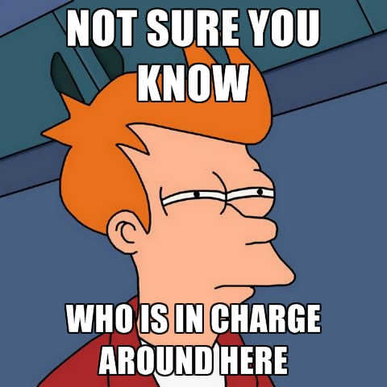
Figure Out Who to Talk To
Level of government: local v state v federal
Branch of government: legislative v executive
Agency or Committee of jurisdiction

Slide 28

Doing Your Policy Homework
Identify political context for action –e.g. election cycle
Learn about current law and pending legislation
Know policymakers voting and personal history with the issue

Slide 29

Communicate Effectively
Organize a simple message
A story can be helpful
Make it relevant to policymaker’s constituents

Slide 30

State What You Are Asking For
Be specific
  A letter of support
  Participation in a meeting
  A hearing or an investigation
  Support for pending legislation
  Drafting of new legislation

Slide 31
Your Relationship with Policy
For most:
  Aligning research to inform policy
  Want to know how to effectively translate research into policy
For some:
  On-going advisory role with policy decision-makers
  Requires some understanding of the policy process
For few:
  Direct role as a policy decision-maker
  Requires a detailed knowledge of the policy process
Relationship may evolve over time

Slide 32
Your Research and Policy Goals
State in 90 seconds or less
  What is your area of research
  What is an important policy questions in your area of research
  Who is the policy target- level/branch of government

Slide 33
For Example
I am interested in evaluating Medicaid patients’ access to care
I do this through physician surveys of whether they are accepting Medi-Cal patients in California
One important policy question related to this issue is whether the Medicaid payment rate is adequate to support access to primary care physicians
My work is targeted primarily toward the state government in California which is responsible for setting Medi-Cal payment rates.

