Slide 1
Epi 240
Qualitative Approaches in Clinical and Translational Research
Session 1
What is Qualitative Research?
Jan 7, 2015
Daniel Dohan, PhD
Philip R. Lee Institute for Health Policy Studies, UCSF
Wendy Anderson, MD
Hospital Medicine, UCSF

Slide 2
What’s up today
Who we are
Course overview
Comparing qualitative and quantitative research
What can qualitative research address?

Slide 3
Who are we?
People
Who are you, professionally (personally?)? What’s your training and background? What is your prior exposure/experience with qualitative research methods?
Projects
What are you working on and how does it relate to qualitative research methods?
Products
What would you like to get out of the course?

Slide 4
Course Overview

Slide 5
Course Syllabus
Objectives
Requirements
Paper & presentation
Session by session

Slide 6
TICR Professional Conduct Statement
Clarifications for this class
I will maintain the highest standards of academic honesty
I will neither give nor receive aid in examinations or assignments unless such cooperation is expressly permitted by the instructor
I will conduct research in an unbiased manner, reports results truthfully, and credit ideas developed and work done by others
I will not use answer keys from prior years
I will write answers in my own words, and, when collaboration is permitted, acknowledge collaborators when answers are jointly formulated

Slide 7
Comparing Qualitative and Quantitative Research

Slide 8
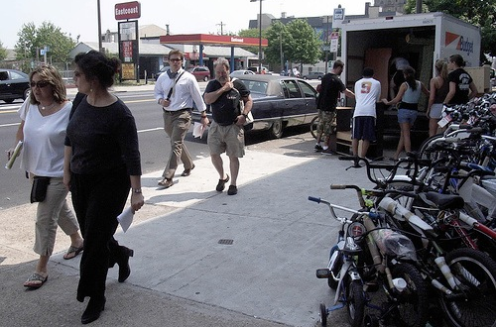
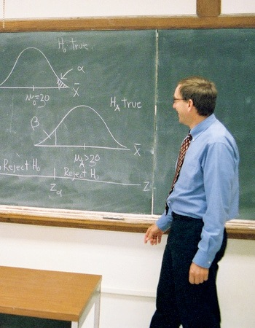

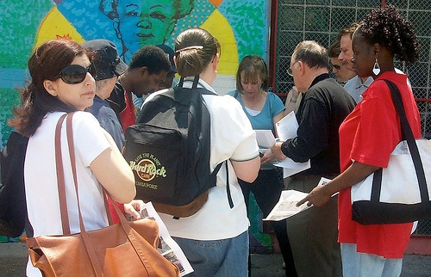
Learning
Quantitative
Qualitative

Slide 9
All researchers face 4 fundamental tasks
Select subjects to study
Interact with subjects to gather data
Avoid arbitrary findings
Convince others of what you found
Quant & qual approach these tasks differently
  Quantitative: four R’s
  Qualitative: four P’s

Slide 10
Tasks by Research Activity
Research Activity | Research Task
Data Collection | How do I select research subjects?
 | How do I work with subjects to get data?
Data Analysis | How do I avoid arbitrary findings?
 | How do I convince others of my findings?

Slide 11
Quant & Qual Research Activities
Research Activity |  | Quantitative Approaches | Qualitative Approaches
Data Collection | Select research subjects | - Representativeness: Random samples of pre-determined groups -Reactivity: Fixed data collection instruments | -Purposefulness: Sites and subjects selected according to theoretical need -Participation: Flexible data collection strategies
 | Work with subjects to get data
Data Analysis | Avoid arbitrary findings | -Reliability: Hypothesis testing via statistical inference -Replicability: Standard reporting formats (i.e. tables) | -Process: Iterative coding and memoing to refine results -Particularity: Narrative reports of findings in context
 | Convince others of findings

Slide 12
Different Approaches to Research:
4 “R’s” versus 4 “P’s”
Research Task | 4 R’s (Quantitative) | 4 P’s (Qualitative)
How do I select research subjects? | Representativeness | Purposefulness
How do I work with subjects to get data? | (non-)Reactivity | Participation
How do I avoid arbitrary findings? | Reliability | Process
How do I convince others of my findings? | Replicability | Particularity

Slide 13
What can qualitative research address?

Slide 14
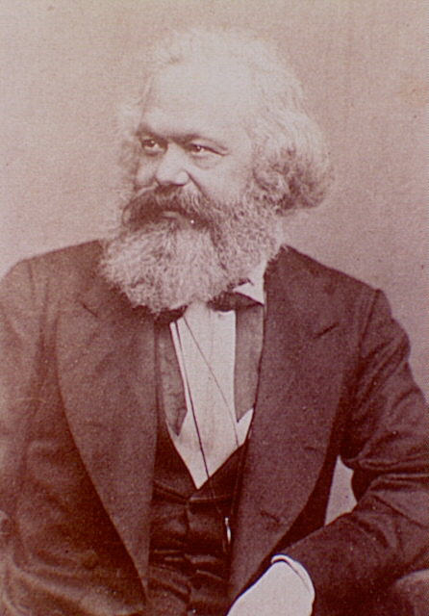
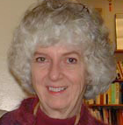
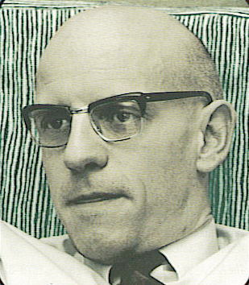
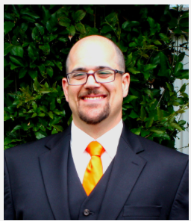
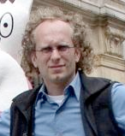
Epistemology
Phenomenology
Grounded Theory
Critical
Post-modern
Pragmatist
Positivist-Behavioral
Notes:
Creswell, Sanchez-Jankowski, Strauss, Charmaz, Timmermans, Marx, Foucault

Slide 15
Qualitative methods in research
Generative: produce taxonomy or hypotheses to inform hypothesis-focused studies
Emergent: explore social situations to extend understanding and stimulate theory
Critical: reveal social mechanisms to critique status quo or inspire action

Slide 16
Takeaways & Discussion
Qualitative research is a craft; experience is more central than technique
There are many different styles and approaches, including distinct epistemologies
While not fundamentally different than quantitative research, qualitative researchers must typically “translate” their results
Discussion: Thoughts on “Journalist and the Murderer”: How is qualitative research similar to/distinct from journalism?

