Slide 1
Cost-effectiveness Analysis:
Overview & Developing an analysis
Training in Clinical Research
UCSF Department of Epidemiology
and Biostatistics
DCEA Epi 213
James G. Kahn
29 January 2015

Slide 2
Outline
Overview
Components of cost-effectiveness analysis
Steps in cost-effectiveness analysis
Implications of CEA

Slide 3


Why do cost-effectiveness analysis?

Slide 4
Why do cost-effectiveness analysis?
Choice of Volkswagen Jetta vs. Porsche Panamera
Points:
  Why not get a Panamera? It costs a lot. Could probably get extra money – loans from parents, friends, banks – but that money would then be taken out of other priorities in our budget.
  So the question is about the value of a new car -- compared with a different car, in turn compared with a bicycle or other means of transportation.

Slide 5
Why do cost-effectiveness analysis?
  Resource allocation is a reality:
  among social goods, within health care
  $ for one intervention decreases $ for another – via budgets
  We don’t like to spend huge $ on health care that hardly works
  Use health care $ to do most good: CEA is a measure of efficiency
  efficient allocation saves lives, improves health

Slide 6
How can CEAs make a positive difference?
  Huge concerns with rising health care costs in U.S.
  ~18% of GDP, > $2.7 trillion, 45+ million uninsured

Slide 7
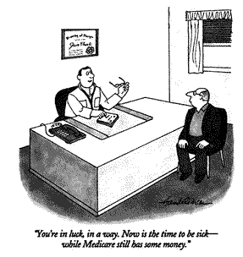

Slide 8
How can CEAs make a positive difference?
  Huge concerns with rising health care costs in U.S.
  18% of GDP, > $2 trillion, 49+ million uninsured
  Renewed attention to global health – AIDS and more

Slide 9
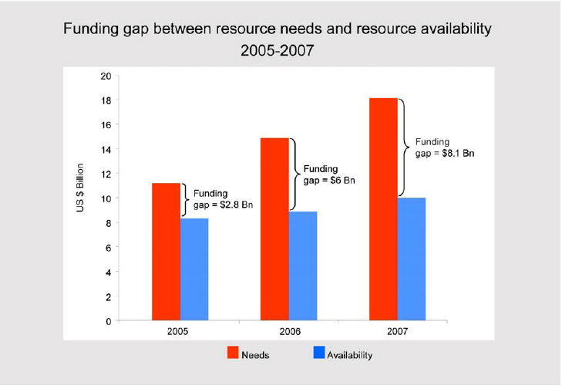
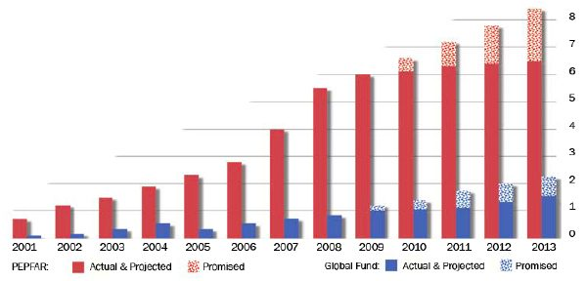

Financing HIV and other care in developing countries
Lancet Commission on Investing in Health – Global Health 2035 (Jamison et al, Dec 2013). The “Grand Convergence” (infectious disease, maternal and child health) needs billions.

Slide 10
How can CEAs make a positive difference?
  Huge concerns with rising health care costs in U.S.
  18% of GDP, > $2 trillion, 49+ million uninsured
  Renewed attention to global health – AIDS and more
  Funding decisions: which programs should get funded?
  Cost-effectiveness = one consideration

Slide 11
The Basic Question
What health benefits do we get
for money we spend on health care?

Slide 12
Goldman et al, Health Affairs 2005, doi: 10.1377/hlthaff.w5.r5

Slide 13
Cost-effectiveness analysis in context
    Prior lectures on clinical decision analysis & utilities
    Now add costs

Slide 14
Choices and CEA
  Assessing a choice:
  comparing 2 or more courses of action with different effects and/or costs.
Clinical management: medication vs. surgery, medication A vs. B (e.g., streptokinase vs. t-PA).
Prevention: program vs. no program, or universal vs. targeted to high risk individuals, or vs. treatment
Health service delivery: incentive payments vs none, innovative programs such as home care vs none.

Slide 15
CE Question Formulation
  What added health benefits are realized for each added dollar spent on health care?

Slide 16
CEA Framework
Costs
CE ratio relevant
CE ratio irrelevant and not interesting
Effectiveness
CE ratio irrelevant and interesting

Slide 17
COX-2 Inhibitors vs NSAIDS
$12k
Comparator: Naproxen
$100k per QALY
$6k
$50k per QALY
Change in costs
$10k per QALY
$0
0
0.05
0.10
Gain in health benefit (QALYs)
Source: Spiegel et al., The Cost-Effectiveness of Cyclooxygenase-2 Selective Inhibitors in the Management of Chronic Arthritis, Ann Intern Med. 2003;138:795-806.
Notes:
Explain that the slope of the dashed line reflects a CER of $100k. How to pick the threshold is a value judgement.

Slide 18
COX-2 Inhibitors vs NSAIDS
$12k
Comparator: Naproxen
Basecase
$100k per QALY
Assumption: Excludes effects on heart
$6k
$50k per QALY
Change in costs
Change in cost: $11,600
Change in benefit: 0.04 QALYs
Incremental CER: $290,000/QALY
$10k per QALY
$0
0
0.05
0.10
Gain in health benefit (QALYs)
Source: Spiegel et al., The Cost-Effectiveness of Cyclooxygenase-2 Selective Inhibitors in the Management of Chronic Arthritis, Ann Intern Med. 2003;138:795-806.
Notes:
Explain that the slope of the dashed line reflects a CER of $100k. How to pick the threshold is a value judgement.

Slide 19
COX-2 Inhibitors vs NSAIDS
$12k
Comparator: Naproxen
Basecase
$100k per QALY
Assumption: High-risk patients
$6k
$50k per QALY
Change in costs
High risk
Change in cost: $4,720
Change in benefit: 0.08 QALYs
Incremental CER: $56,000/QALY
$10k per QALY
$0
0
0.05
0.10
Gain in health benefit (QALYs)
Source: Spiegel et al., The Cost-Effectiveness of Cyclooxygenase-2 Selective Inhibitors in the Management of Chronic Arthritis, Ann Intern Med. 2003;138:795-806.
Notes:
Explain that the slope of the dashed line reflects a CER of $100k. How to pick the threshold is a value judgement.

Slide 20
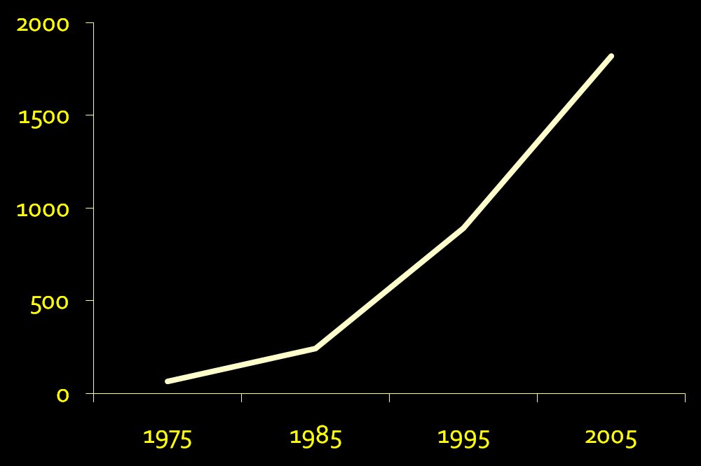
Cost-effectiveness literature: pubmed artices

Slide 21
Outline
Overview
Components of cost-effectiveness analysis
Steps in cost-effectiveness analysis
Implications of CEA

Slide 22
    Two major components of CEA:
    Outcome measures – health, cost
    Input data

Slide 23
1. Outcomes
  Cost-effectiveness analysis in health care assesses the incremental gain in health status achievable with incremental increase in health care resources

Slide 24
Gain in Health Status
  Measured in "health outcomes” (as in decision analysis)
  Mortality
  Morbidity: e.g., episodes of illness, infections, duration of disability (e.g., years of sight)
  Life years: expected duration of life
  Quality-adjusted life years (QALYs): health
  life years x utility scores
  Disability-adjusted life years (DALYs): burden
  life years lost + life years * disability weight

Slide 25
Increase in health care resources
  Difference in resources between less and more expensive course of action.
  Unit = dollars (or any currency), to allow resources of all types to be summed and compared

Slide 26
The Incremental CE Ratio (ICER):
  increment in costs between two courses of action
  divided by
  the increment in health outcomes
E.g., cost of universal HIV prevention minus cost of targeted HIV prevention
divided by
HIV infections with targeted prevention minus infections with universal prevention.
Thus, dollars per HIV infection prevented.
Cost of universal / HIV infections universal doesn’t make sense – cost per infection occurring. CEA is always comparative.

Slide 27
Other CE outcomes
Cost-utility analysis (CUA): dollars per QALY gained. Often used interchangeably with “CEA”.
Cost per DALY averted – adopted in global health. Approx. the negative version of cost per QALY gained.
Cost-benefit analysis (CBA): Health outcomes translated into financial values (e.g., willingness to pay). Difference: dollars spent on the intervention minus dollars saved in benefits. Ratio also often used, but less robust.

Slide 28
2. Input data
  Broad set of input data on health outcomes and costs.
  Data collected using various techniques.
  How does it all fit together?

Slide 29
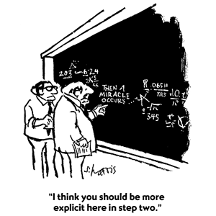

Slide 31
Outline
Overview
Components of cost-effectiveness analysis
Steps in cost-effectiveness analysis
Implications of CEA

Slide 32
Steps in a cost-effectiveness analysis: overview
  (1) Define analysis.
  DA: Clinical or policy situation, alternative strategies.
  CEA: Economic perspective, CE outcomes.
  (2) Specify technical approach.
  Structure (eg tree) and formulas
  (3) Determine input values.
  DA: health values (chance nodes, utilities)
  CEA: costs for programs and medical care.
  (4) Conduct analyses.
  (5) Dissemination.

Slide 33
CEA is iterative
  Steps usually in order, more or less.
  Often desirable to refine or redefine the analysis as it progresses
  Good news: Until published, can revise. Feedback and reflection makes better analysis.
  Bad news: Until published, can revise.
  When will this end?
  Perfection vs. good enough: experience → balance

Slide 34
(1) Define the analysis
  Aneurysm: clinical situation = woman, aged 50, with unruptured cerebral aneurysm found incidentally.
  Options = no treatment or surgery (clipping).
  Perspective = societal. i.e., economic effects on patients, providers, insurers, etc not separated.
  Costs counted regardless of who pays.
  Outcome measure is cost per QALY gained.
    “This CEA compares surgical clipping to no treatment
    for the management of an asymptomatic small cerebral
    aneurysm, for a 50 year old woman, estimating the societal
    cost per QALY gained.”

Slide 35
(2) Specify technical approach
Spreadsheet / decision tree analysis
Markov model
Simulation
Dynamic models

Slide 36
The technical approach

Slide 37
The cost per QALY gained is defined as:
  Cost with surgery - cost with no surgery
  QALYs with surgery - QALYs with no surgery
I.e.,
Δ Cost
Δ QALYs

Slide 38
(3) Determine input values
Here are key cost inputs:
Cost input Value (range) Source
Clipping $25,150 (18,000-35,000) Cohort study – cost accounting system
Moderate/severe
disability $20,000/yr (13,000-30,000) Published estimate
SAH hospitalization $47,000 ($33,000-$67,000) Cohort study – cost accounting system
Discount rate 3% (0-5) CEA guidelines

Slide 39
(3) Determine input values (cont’d)
Both effectiveness and cost must be discounted
e.g., $47,000 for SAH hospitalization, average 17 years into the future, NPV = $35,912.

Slide 41
(4) Conduct analyses
How are calculations done?
By hand - Instructive once, inefficient and error-prone.
Spreadsheets - Flexible –any structure, input, calculation, outcome, or format E.g., infectious disease epidemic modeling, or interacting Markov models.
Must program some standard CEA tasks.
For Monte Carlo and other sensitivity analyses, Crystal Ball.
Decision analysis packages - TreeAge, etc
Designed to do CEA tasks, eg trees, inputs, outputs, simple Markov, SA. Learning curve?

Slide 42
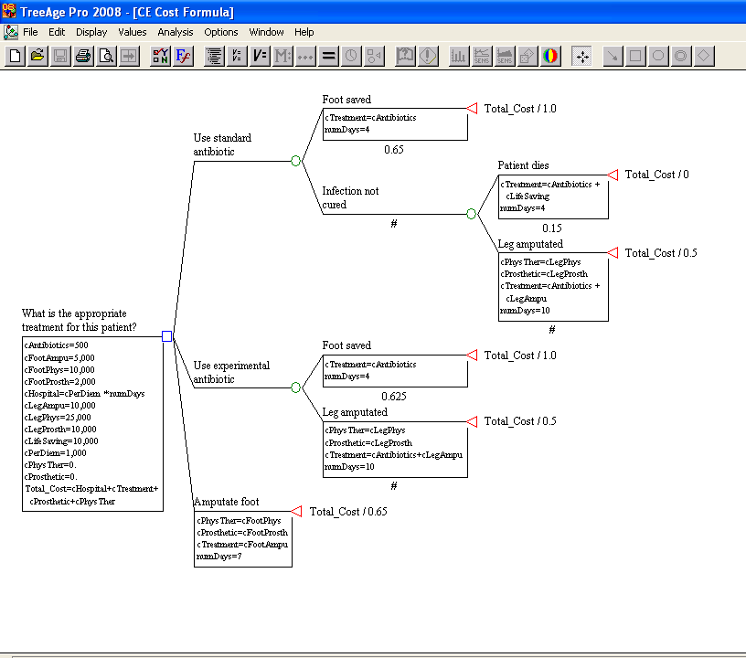

Slide 43
“Base case” for aneurysm analysis

Slide 44
Base case graphically, referent case at origin
$
$39,666
$534
QALYs
19.74
21.37

Slide 45
In manuscript, the results might be presented as follows.
QALYs Costs
Scenario Total Incremental Total Incremental $ / QALY
No symptoms, <10 mm, no past SAH
No treatment 21.37 -- $534 -- --
Clipping 19.74 -1.63 $39,666 $39,132 Dominated

Slide 46
ICERs and Dominance
$10k
ICERs:
Comparator vs A: Dominated (strictly)
Strategy C
B vs A: ($2,800-$1,000) / (5-2)
=$600/QALY
Strategy D
$5k
C vs B: ($9,000-$2,800) / (7-5)
=$3,100/QALY
Costs
Strategy B
D vs B: ($6,200-$2,800) / (5.5-5)
=$4,800/QALY
Extended dominance, if a mix of B & C is possible
Comparator
Strategy A
$0
0
5
10
Gain in health benefit (QALYs)

Slide 47
Incremental analysis: Targeting
HIV Prevention, group of 1000 individuals
QALYs Program Costs
Scenario Total Added Total Added $ / QALY
No prevention 20,000 -- $0 -- --
Targeted (100) 20,025 25 $20,000 $20,000 $800
Universal 20,027 2 $200,000 $180,000 $90,000

Slide 48
Incremental analysis:
Multiple medication options

Slide 49
Incremental analysis:
Medical vs. surgical management

Slide 50
Incremental analysis:
Sequential vs Immediate costly drug

Slide 51
Sensitivity analysis: How high does rupture risk need to be to recommend clipping?

Slide 52
Outline
Overview
Components of cost-effectiveness analysis
Steps in cost-effectiveness analysis
Implications of CEA

Slide 53
Cost-effective medicine vs evidence-based medicine
EBM only tells you whether something works, not whether we should pay for it.
  LVAD example
  Many other similar examples
Evidence of effectiveness ≠ Evidence of value

Slide 54
What does CEA say about value of life?
A cost-effectiveness threshold is one way to use CEA to determine which interventions represent good value.
In the US and OECD countries, that threshold is probably around $150,000 per QALY gained.
What is the threshold in other countries?
  Related to per-capita GDP as a proxy for income
  < GDP/capita: very CE, < 3 x GDP/cap: CE
  Limitations of this approach … vs. league table

Slide 55
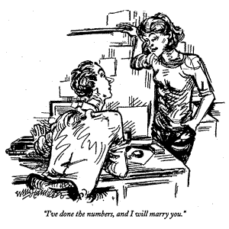
CEA can seem an odd input …

Slide 56
CEA abuse …
  Defend policies deemed unacceptable for other reasons (depriving of rights, unfair, cruel, etc)
  Methods correct but interpretation skewed
  Methods incorrect or strategies not considered

Slide 57
What’s next?
CEA section (and special lecture on HIV CEA)
Markov
Data inputs
Sensitivity analyses

