Slide 1
EPI 262:
Introduction to Pharmacoepidemiology
Course Director: Michael A. Kelsh, MPH, PhD
Center for Observational Research, Amgen, Inc.
Department of Epidemiology and Biostatistics, UCSF
Guest Lecturers:
Victoria Chia PhD
Michael Sprafka, PhD
Fei Xue, PhD
Michael Woolley, PhD
Alex Liede, PhD

Slide 2
Outline
Introductions
Course overview & logistics
  Texts and readings
  Course requirements
  Seminar Review
Pharmacoepidemiology: Definition and selected history, role in drug safety
The expanding role of pharmacoepidemiology

Slide 3
Introduction – Kelsh
Current Position: Director, Center for Observational Research – Therapeutic Oncology at Amgen
Former Adjunct Professor: UCLA Department of Epidemiology:
  Environment Exposure Assessment
  Occupational Health
Previous Position: Consultant – Occupational, Environmental Health, Pharmacoepidemiology
Disclosure: Opinions/statements in this course reflect my personal opinions, not policy or opinions of Amgen, Inc.

Slide 4
Kelsh – Contact Information
Email: mkelsh@amgen.com
michaelakelsh@gmail.com
Phone: Office - (805) 447-7891
Mobile – (805) 625-4529
Office Hours: Immediately after class or by
appointment

Slide 5
Acknowledgements
Mary Haan, Vice Chair, UCSF Department of Epidemiology and Biostatistics
Robert Hiatt, Chair, UCSF Department of Epidemiology and Biostatistics
Brain Bradbury, Adjunct Professor UCLA Department of Epidemiology, Director Amgen
Cathy Critchlow, Executive Director, Amgen
Guest lecturers
Administrative support from UCSF Department of Epidemiology and Biostatistics
Disclosure: Opinions/statements in this course reflect my personal opinions, not policy or opinions of Amgen, Inc.

Slide 6
Student Introductions
Department
Academic goals, degree objectives
Previous experience, coursework
What you hope to get out of this course

Slide 7
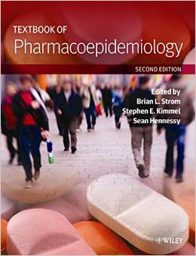
Recommended Text and Readings
Recommended Text:

Slide 8

Recommended Text and Readings
Another useful Textbook:

Slide 9
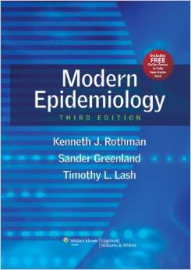

Recommended Text and Readings
Useful General Epidemiology Textbooks:

Slide 10

The field of pharmacoepidemiology continues to mature
ISPE’s Education Committee recently sought to define the core content of the field and identified the following competencies as essential:
  Pharmacovigilance
  Analysis of exposure data
  Epidemiologic methods
  Communication skills
The discipline will continue to respond to rapidly evolving challenges and opportunities
Jones JK, et al. Pharmacoepidemiol Drug Saf 2012;21:677-689.
Notes:
Pharmacovigilance
Example: definition of adverse events vs adverse drug reactions
Analysis of exposure data
Example: knowledge of types of data on drug use
Epidemiologic methods
Example: basic study designs and their usual hierarchy
Communication skills
Example: conveying results to non-epidemiology scientists

Slide 11
Course Grading and Class Project
Each lecture has pre-read materials
Classes are intended to be interactive
  Students should feel free to ask questions and engage in class discussion
Student assessments will be made based on:
  Class participation (33%)
    Students should be able to discuss reading materials
  Project Presentations (33%)
    Short presentation on selected pharmacoepidemiology topic
  Final Assessment (33%)
    3-5 page paper on pharmacoepi topic

Slide 12
Course Objectives
To provide students with an introduction to:
  The field of pharmacoepidemiology
  Basic study design principles and analysis in pharmacoepidemiology research
  Awareness of available data sources, strengths/ limitations for pharmacoepidemiologic research
  Post-marketing pharmacovigilance/drug safety research
  Health economics and pharmacoepidemiology
  Issues of bias and conflict of interest
  Discuss the role of epidemiology in the drug development lifecycle

Slide 13
Course Schedule
Date | Instructor | Topic
01/08 | M. Kelsh | Class logistics, Intro to Pharmacoepidemiology
01/15 | M. Kelsh | Study Design in Pharmacoepidemiology
01/22 | V. Chia | Pharmacoepidemiology: data sources
01/29 | M. Sprafka | Pharmacoepidemiology and Drug Safety
02/05 | F. Xue | Advanced Methods/Analytical Approaches
02/12 | M. Kelsh | Evidence-based medicine, systematic review, meta-analysis
02/19 | TBA | Regulatory Environment, FDA Sentinel
02/26 | M. Woolley | Health Economics
03/05 | A. Liede | Ethics in Pharmacoepidemiologic Research
03/12 | M. Kelsh | Student Presentations, Class Summary

Slide 14
Study Design and Analysis Seminar
Basic epidemiologic study designs used in pharmacoepidemiology
  Comparative advantages/disadvantages
Epidemiology measures of effect
Study Bias and methods to address bias
Case Studies

Slide 15
Data Sources for Pharmacoepidemiology
Data needs in pharmacoepidemiology
“Real World Data” – what is the hype?
Data sources:
  Administrative claims data
  EMRs
  Other (e.g. registries, existing cohorts, surveys)
Practical aspects in working with databases
Limitations/strengths of each type of database
Examples

Slide 16
Pharmacology and Drug Safety
Drug safety monitoring (pharamacovigilance) – review of regulatory data systems:
  FAERS/Spontaneous Reports
  FDA Sentinel
  Clinical trial safety data
Safety signals – evaluation across pre-clincial to post-market settings
Definitions
International Perspective (EMA – PASS studies)
Case Study – Vioxx and cardiovascular disease

Slide 17
Advanced Methods in Pharmacoepi
Goal - to provide “exposure” and familiarity with more complex analytical tools
Review of confounding by indication
Methods to address confounding by indication:
  Propensity Score analyses
  Instrumental variables
  Marginal Structural models
Changing exposure over time
Validity studies

Slide 18
Meta-Analysis and Systematic Review
Review of evidence-based medicine: Mission and methods
Meta-Analysis
  How to conduct, when is it appropriate to combine results across studies?
  Analytical approaches – e.g. “fixed effects”, “random effects”
  Strengths and limitations
Case Studies

Slide 19
Health Economics, Health Outcomes
Economic evaluation in Health Care: overview of basic definitions and concepts
Uniqueness of health care in the context of economic evaluation
Cost Benefits/Cost Effectiveness Analyses
Health Technology Assessment

Slide 20
Ethics in Pharmacoepi Research
Ethical Issues:
  Equipoise
  Authorship
  Conflicts of Interest
Conflicts of interest
  Is financial/funding the only source? – discussion of financial, social political/idealogical, and professional conflicts
  Approaches on how to deal with conflicts of interest

Slide 21
Historical Perspective
Thanks to Sean Hennessy, University of Pennsylvania, for Select History graphics

Slide 22
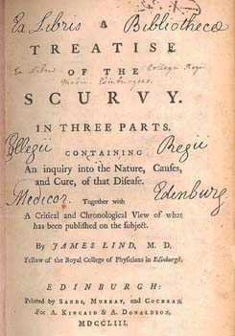
Early Examples of Interventional Studies
1742: James Lind conducted a controlled trial examining different interventions for treating scurvy
Observed that those given oranges and lemons experienced remarkable recovery
Notes:
In 1747, while serving as surgeon on HMS Salisbury, he carried out experiments to discover the cause of scurvy, the symptoms of which included loose teeth, bleeding gums and haemorrhages.
Lind selected 12 men from the ship, all suffering from scurvy, and divided them into six pairs, giving each group different additions to their basic diet. Some were given cider, others seawater, others a mixture of garlic, mustard and horseradish. Another group of two were given spoonfuls of vinegar, and the last two oranges and lemons. Those fed citrus fruits experienced a remarkable recovery. While there was nothing new about his discovery - the benefits of lime juice had been known for centuries - Lind had definitively established the superiority of citrus fruits above all other 'remedies'.

Slide 23
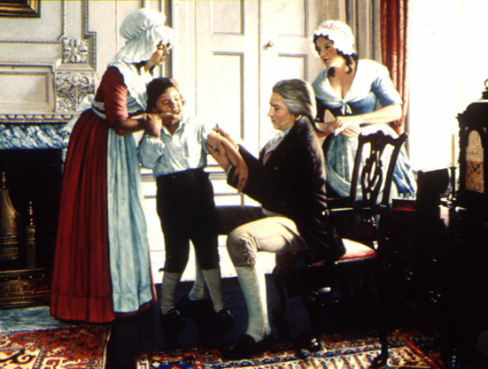
Early Examples of Interventional Studies (2)
1796: Edward Jenner investigated the usefulness of vaccinations
Inoculated a child with cowpox material and challenged him with smallpox
This paved the way for successful eradication of smallpox in 1980
Willis NJ. Edward Jenner and the eradication of smallpox. Scott Med J 1997;42:118-211.
Notes:
Edward Jenner's careful investigations into the usefulness of cowpox vaccination for the prevention of smallpox during the late 1790s, and his enthusiastic and continued advocation of vaccination despite the scepticism of critics, laid the foundations for the growth of understanding about the nature of infectious disease and the development of immunity during the 19th century. He began the long process which resulted in the successful eradication of the smallpox virus in 1980. His life story remains an inspiration to physicians facing an uncertain future as viruses and bacteria not yet eradicated adapt to the antibiotic age.

Slide 24
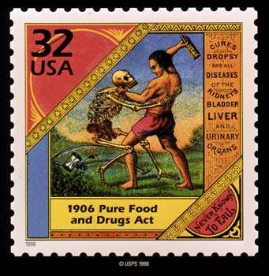
US Pure Food and Drug Act was passed in 1906
In response to adulterated and misbranded products
Government given power to remove products that were adulterated or misbranded
No requirements for efficacy or safety
FDA created

Slide 25
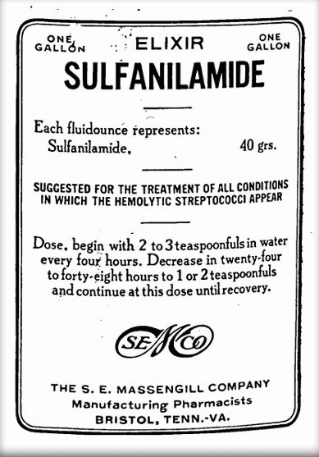
Food, Drug and Cosmetic Act was passed in 1938
1937: over 100 people died from renal failure after taking elixer of sulfanilimide dissolved in diethylene glycol
Preclinical toxicity testing was required for the first time
Manufacturers required to gather drug safety data and submit to FDA before drug marketing
No requirement for efficacy data
Notes:
Sulfonamide drugs were the first antimicrobial drugs, and paved the way for the antibiotic revolution in medicine. The first sulfonamide was trade named Prontosil and was the first medicine ever discovered that could effectively treat a range of bacterial infections inside the body. It had a strong protective action against infections caused by streptococci, including blood infections, childbed fever, and erysipelas, and a lesser effect on infections caused by other cocci. However, it had no effect at all in the test tube, exerting its antibacterial action only in live animals. Later it was discovered by a French research team, led by Ernest Fourneau (French), at the Pasteur Institute that the drug was metabolized into two pieces inside the body, releasing from the inactive dye portion a smaller, colorless, active compound called sulfanilamide. The discovery helped establish the concept of "bioactivation" and dashed the German corporation's dreams of enormous profit; the active molecule sulfanilamide (or sulfa) had first been synthesized in 1906 and was widely used in the dye-making industry; its patent had since expired and the drug was available to anyone.^{[3]}
The result was a sulfa craze.^{[4]} For several years in the late 1930s, hundreds of manufacturers produced tens of thousands of tons of myriad forms of sulfa. This and nonexistent testing requirements led to the Elixir Sulfanilamide disaster in the fall of 1937, during which at least 100 people were poisoned with diethylene glycol. This led to the passage of the Federal Food, Drug, and Cosmetic Act in 1938. As the first and only effective antibiotic available in the years before penicillin, sulfa drugs continued to thrive through the early years of World War II.^{[5]} They are credited with saving the lives of tens of thousands of patients.

Slide 26
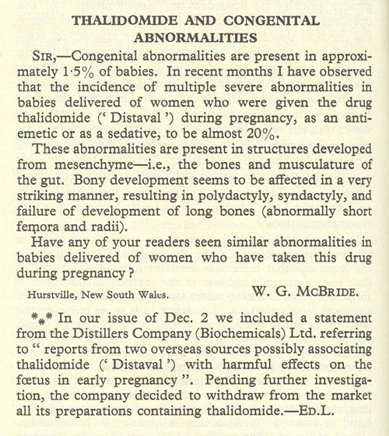
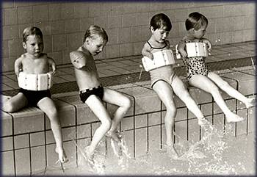
Thalidomide Disaster
McBride WG. Lancet 1961;2:1358
Notes:
Over the counter medicine used to treat morning sickness in pregnant women.

Slide 27
Kefauver-Harris Amendments Passed in 1962
Required extensive preclinical pharmacological and toxicological testing
Submission of Investigational New Drug Application (IND) prior to use in humans
Defined three phases of clinical trials
Required evidence of efficacy

Slide 28
Drug Development is Now Highly Regulated
Drug regulation has evolved as governments have become more involved in the drug development process
Successful drug development now requires substantial evidence demonstrating:
  Safety
  Efficacy
  Quality (manufacturing)
There is also greater attention focused on appropriate marketing practices
  Fair balance when discussing benefits and risks
    Direct-to-consumer advertising

Slide 29
The Regulatory Process for Drug Development
Pre-marketing phase (Required)
  Preclinical studies
    Dose ranging
    Pharmacokinetics (PK) / pharmacodynamics (PD))
  Phase I-III
    Identifying optimal doses
    Identifying potential toxicities
    Establishing efficacy; ensuring safety
Post-marketing phase (Required?)
  Adverse event reporting
  Post-marketing studies, Phase IV
This is referred to as “drug development lifecyle”
Notes:
Medication Guide
Medication Guides are paper handouts that come with many prescription medicines. The guides address issues that are specific to particular drugs and drug classes, and they contain FDA-approved information that can help patients avoid serious adverse events.
FDA requires that Medication Guides be issued with certain prescribed drugs and biological products when the Agency determines that:
certain information is necessary to prevent serious adverse effects
patient decision-making should be informed by information about a known serious side effect with a product, or
patient adherence to directions for the use of a product are essential to its effectiveness
Phase 4 studies
The intent of Phase 4, or post-marketing studies, is to learn more about the drug after it has been approved by government authorities. In Phase 4 studies, researchers gather information about an approved drug's risks, benefits, and best uses in ‘real-life’ conditions. These studies can also include trials of different doses or schedules of administration, other stages of disease or other disease and age groups, cost studies, quality-of-life studies, or use of the drug over a longer period of time.

Slide 30
Food & Drug Administration
Amendment Act (FDAAA)
In 2007, President Bush signed into law H.R. 3580, the Food and Drug Administration Amendments Act of 2007. This new law represents a very significant addition to FDA authority.
  Prescription Drug User Fee Act (PDUFA) , Medical Device User Fee and Modernization Act (MDUFMA)
  Best Pharmaceuticals for Children Act (BPCA) , Pediatric Research Equity Act (PREA)
The FDA was granted enhanced authority regarding post-marketing safety of drugs
  FDA can mandate a drug manufacturer conduct a study
  Granted authority to require a Risk Evaluation and Mitigation Strategy (REMS)
  Mandated to develop an active surveillance system for monitoring drugs, using electronic data from healthcare information holders
Notes:
PDUFA/MDUFMA have been reauthorized and expanded.
These programs will ensure that FDA staff have the additional resources needed to conduct the complex and comprehensive reviews necessary to new drugs and devices.
BPCA / PREA
Both of these are designed to encourage more research into, and more development of, treatments for children.

Slide 31
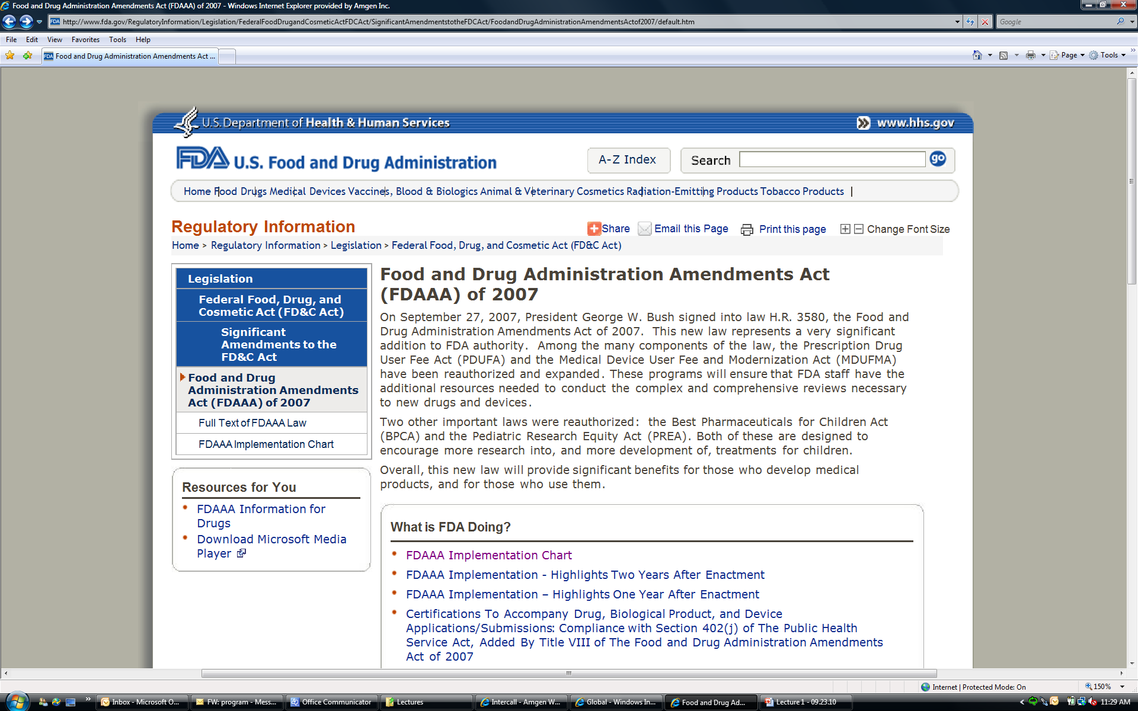
FDAAA

Slide 32
Post-marketing Pharmacovigilance is Intensifying
Companies are being required to establish REMS for their products
  Medication guide: contain FDA-approved information that can help avoid serious adverse events
  Ensure that the benefits of the drug outweigh the risks
Companies may be required to establish a registry for all patients receiving a new drug
  Minimize off-label use
  Help to monitor the clinical outcomes, side-effects, etc.
Notes:
Medication Guide
Medication Guides are paper handouts that come with many prescription medicines. The guides address issues that are specific to particular drugs and drug classes, and they contain FDA-approved information that can help patients avoid serious adverse events.
FDA requires that Medication Guides be issued with certain prescribed drugs and biological products when the Agency determines that:
certain information is necessary to prevent serious adverse effects
patient decision-making should be informed by information about a known serious side effect with a product, or
patient adherence to directions for the use of a product are essential to its effectiveness

Slide 33
FDA Sentinel System
A new active surveillance system that will eventually be used to monitor all FDA-regulated products
  Linked, automated and sustainable system
  Leverages existing electronic data records (e.g., automated healthcare data from multiple sources)
    Claims database (e.g., Blue Cross, Medicare)
    Electronic medical records (e.g., Kaiser, Veteran’s Administration)
  Designed to enable rapid signal detection and verification across multiple data sources
It will change the field of post-marketing drug surveillance significantly
  Reliance on core pharmacoepidemiologic methods
  Development of new surveillance methods for signal detection and validation
  Increase the demand for well-trained pharmacoepidemiologists

Slide 34
The Field of Pharmacoepidemiology
Continues to Evolve
Increased need to understand the safety profile of drugs prior to their approval
Increased need to understand the safety of drugs once they have been approved (post-marketing drug surveillance research)
Desire to identify sub-populations in whom therapies should be targeted
Identification of potential beneficial effects beyond labeled indication

Slide 35
Understanding the Safety Profile of Drugs Prior to their Approval
Ideally, safety information is obtained prior to drug approval (Phase I-III)
Pre-marketing studies have limitations:
    Sample size
      Study size often limits the ability to detect rare events (e.g., an event has a background rate of 1 in 5,000 - this is not generally detectable in study of 2,000 patients)
      Study size also limits ability to make inference about less frequent events (e.g., 3 in one arm and 5 in another)
    Strict inclusion/exclusion criteria
      Select healthier patients to maximize efficacy
    Study duration
      Studies are often not long enough to observe events

Slide 36
Definition and Need for Pharmacepidemiology

Slide 37
What is Pharmacoepidemiology?
“Pharmacoepidemiology is the study of the use of and the effects of drugs in large numbers of people.”
The application of epidemiologic methods to clinical pharmacology
A branch of general epidemiology
Strom BL. Pharmacoepidemiology 3rd edition. 2000

Slide 38
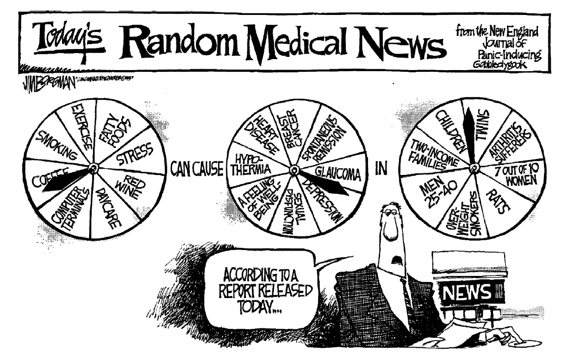
Vandenbroucke JP. Lancet 2004;363:1728-1731.

Slide 39
The Field of Pharmacoepidemiology
Continues to Evolve
Increased need to understand the safety profile of drugs prior to their approval
Increased need to understand the safety of drugs once they have been approved (post-marketing drug surveillance research)
Desire to identify sub-populations in whom therapies should be targeted
Identification of potential beneficial effects beyond labeled indication

Slide 40

Epidemiology is essential across all stages of drug development
Article by Guess et al (1988)
  Utility extends beyond just studying drug effects
Harry A. Guess, MD, PhD
1940-2006
Natural history and burden of target disease
Current therapies, treatment patterns
Occurrence of comorbidities, events of interest
Pharmacovigilance
Real-world & comparative effectiveness and safety
Guess HA, et al. J Clin Epidemiol 1988;41:995-996.

Slide 41
Understanding the Safety Profile of Drugs Prior to their Approval
Ideally, safety information is obtained prior to drug approval (Phase I-III)
Pre-marketing studies have limitations:
    Sample size
      Study size often limits the ability to detect rare events (e.g., an event has a background rate of 1 in 5,000 - this is not generally detectable in study of 2,000 patients)
      Study size also limits ability to make inference about less frequent events (e.g., 3 in one arm and 5 in another)
    Strict inclusion/exclusion criteria
      Select healthier patients to maximize efficacy
    Study duration
      Studies are often not long enough to observe events

Slide 42
Understanding the Safety Profile of Drugs Prior to their Approval (2)
Understanding the safety profile of drugs also requires in-depth understanding of the disease
  Clinical profile of patients with the disease
  Natural history of the disease
  Common/uncommon clinical outcomes in patients with the disease (i.e., background rates)
  Understanding the risks associated with other, similar therapies used to treat the same condition
  Helps to define the right population for study and treatment

Slide 43
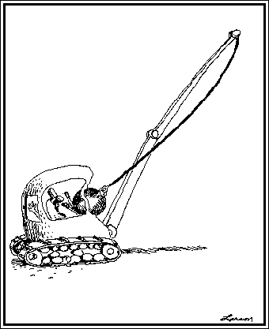
Weight of the available evidence suggests…
So what went wrong???
Elevated MI risk associated with rofecoxib
  RR from RCTs: 2.24 (95% CI: 1.24-4.02)
The small cardioprotective effect of naproxen in observational studies (RR: 0.86 (95% CI: 0.75-0.99) does not explain the VIGOR findings
Jüni et al, the Lancet 2004

Slide 44
Why do we need post-marketing safety assessment?
Study Population in RCT
Smaller sample size
Strict selection criteria
Patient Population in Clinical Practice
Variety of patients
High medication adherence
Close monitoring of patients
Highly experienced practitioners
Limited outcomes, shorter duration
Often used after a series of treatment failures, or in combination with other treatments
Sub-optimal adherence
Patients seen infrequently

Slide 45
Post-marketing Drug Surveillance Research
There is a critical need to understand the safety of drugs once they have been approved
  Identification of safety signals
    Phase IV studies or non-experimental research
  Characterization of treatment patterns
    Who is receiving the therapy?
    Are there regional differences in practices?
    Are sicker patients being referred to newer therapies (confounding)?
  Identification of uncommon side effects of therapy
  Evaluation of potential drug-drug interactions
    Typically, RCTs enroll healthier patients so interactions with other medications may not have been studied previously

Slide 46
Identification of Sub-populations in Whom Therapies should be Targeted
Identify patients for whom there is substantial efficacy
  Not all patients will respond to a given therapy
    Some may have minimal or blunted response, others none at all
  For those who do respond, the benefit may be even greater
In those patients in whom the drug is not efficacious, does treatment increase the risk of adverse events
  May provide valuable information about disease pathways
  Off-target drug effects
Notes:
Panitumumab - fully human antibody against epidermal growth factor receptor

Slide 47
Identification of Sub-populations in Whom Therapies should be Targeted (2)
One path to identifying these sub-populations is genetics (pharmacogenetics research)
Do different genotypes modify the effects of drugs?
  The wild-type KRAS gene (on tumors) is required for panitumumab efficacy in patients with metastatic colorectal cancer.
  Differential effects on progression free survival
    Wild type: HR=0.45, 95% CI:0.34-0.59
    Mutant: HR=0.99, 95% CI:0.73-1.36
Amado et al., J Clin Oncol 2008:26:1626-34.
Notes:
Panitumumab - fully human antibody against epidermal growth factor receptor

Slide 48
Identification of Potential Off-Label Uses
Identification of potential beneficial effects beyond labeled indication
  Statins (HMG-CoA reductase inhibitors) are labeled to lower cholesterol levels
  Statins are used to treat or prevent atherosclerosis and subsequent clinical sequelae (e.g. heart attacks)
  Can statins reduce the risk of incident diabetes mellitus?
    Statins do not appear to lower the risk of incident Diabetes Mellitus (results from meta-analyses)^{1,2}
¹Sattar et al., Lancet 2010; ²Rajpathak et al., Diabetes Care 2009

Slide 49
Other Focus Areas in Pharmacoepidemiology
Randomized controlled trials
  Design and conduct
  Identifying/describing target population
Comparative effectiveness research
  Which drug is the better (best) alternative? Effectiveness? Safety? Cost?
Cost-effectiveness research
  How much are we willing to spend to gain benefit?

Slide 50
Many different entities are now conducting pharmacoepidemiologic research
Government (FDA)
  The Office of Surveillance and Epidemiology (OSE) in the Center for Drug Evaluation and Research (CDER)
    http://www.fda.gov/AboutFDA/CentersOffices/CDER/ucm106491.htm
Academia
  Boston Collaborative Drug Surveillance Program (BCDSP)
    http://www.bcdsp.net/index.html
  Department of Pharmacoepidemiology & Pharmacoeconomics, Brigham & Women’s Hospital
    http://www.drugepi.org/about/index.php
  Department of Pharmacoepidemiology, University of North Carolina, Chapel Hill

Slide 51
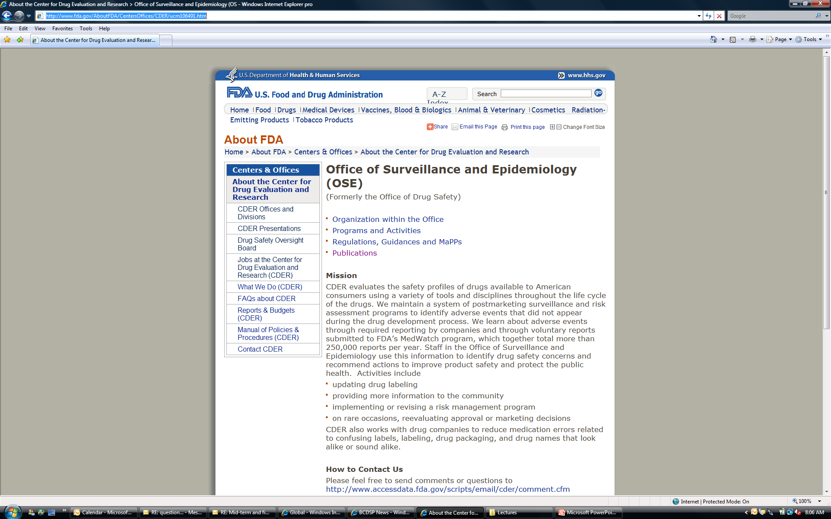
Drug Safety at the FDA
Notes:
CDER evaluates the safety profiles of drugs available to consusmers throughout the lifecycle of drugs.

Slide 52
Major Universities are Developing Expertise in Pharmacoepidemiologic Research
BCDSP publication in JAMA on antidepressants and suicide
A BCDSP study with data from the GPRD on the risk of suicide and antidepressants has recently been published in JAMA (JAMA 2004;292(3):338-43). The risk of suicidal behavior after starting antidepressant treatment was found to be similar among users of amitriptyline, fluoxetine, and paroxetine compared with the risk among users of dothiepin. The risk of suicidal behavior was increased in the first month after starting antidepressants, especially during the first 1 to 9 days. A possible small increase in risk (bordering statistical significance) among those starting the newest antidepressant, paroxetine, was of a magnitude that could readily be due to uncontrolled confounding by severity of depression. Based on limited information, we also conclude that there is no substantial difference in effect of the 4 drugs on people aged 10 to 19 years.
BCDSP studies show no association between MMR vaccination and autism
Speculations on an association between MMR vaccination and autism has recently caused considerable uncertainty about the safety of MMR vaccination and even parents refusing to have their chlldren vaccinated. The BCDSP has conducted several well-designed studies on the epidemiology and possible causes of autism (Pharmacotherapy 2003;23()12):1524-30).
The BCDSP studies concluded that there is no current evidence for an association between MMR vaccination and autism. In contrast a major cause of the recent large increase in the number of boys diagnosed with autism probably is due to changing diagnostic practices

Slide 53
Major Universities are Developing Expertise in Pharmacoepidemiologic Research (2)
Mission
The appropriate use of medications is a central aspect of health care. Each year, basic science research and biotechnology produce new treatments which hold the promise of major clinical benefit. However, these interventions also carry risks which must be rigorously measured and evaluated against the treatment’s efficacy. Drugs are also a growing component of health care expenditures, and more attention is being drawn to the relation between the costs of medication and their benefits.
Research goals
Using very large populations of patients, study the use of specific medications and clinical outcomes to identify and quantify adverse events and desired clinical outcomes;
Develop advanced methods in epidemiology, biostatistics, and informatics to detect and evaluate important signals of potential drug safety problems, as well as to compare the therapeutic results of alternative treatment strategies;
Define patterns of medication prescribing and use;
Analyze the influence of health system factors (policies, coverage and reimbursement differences) on the quality of medication use;
Design, implement, and test innovative programs to improve the appropriateness of prescribing by physicians, and medication use by patients.
Division of Pharmacoepidemiology & Pharmacoeconomics, Brigham & Women’s
http://www.drugepi.org/about/about.php

Slide 54
Many different entities are now conducting pharmacoepidemiologic research
Industry (Major biotechnology & pharmaceutical companies)
  Departments of Pharmacoepidemiology or Epidemiology
Contract Research Organizations (CRO’s)

Slide 55
In What Areas Do Epidemiologists Work in the Pharmaceutical Industry?
Drug development
  From pre-clinical through approval
Safety during drug development
  Understand background rates of adverse events
Health economics – understand the “value” of a new medication
Pharmacovigilence – post-approval

Slide 56
Pharmacoepidemiology Key Activities
Phase 1
Phase 2
Phase 3
Discovery to Pre-clinical
Filing
Launch
Post-Launch
Contribute to disease target selection
Incidence and prevalence of disease
Natural history of disease
Background rates of safety events of interest
Treatment patterns for diseases
Characterize unmet needs with current therapies
Studies to understand potential confounding (including CBI)
Benefit/risk in patients
Academia or Industry led
Benefit/risk in subpopulations
Industry led
Comparative effectiveness studies

Slide 57
Epidemiologic Contributions to Early Stage Drug Development (Pre-clinical, Phase I, IIa):
Descriptive Epidemiology Studies
Inform disease target selection
  Incidence/prevalence
  Disease natural history
Inform clinical trial development
  Characteristics of target population
  Clinical and surrogate measures
Contribute to decision of further development
  Side effects associated with disease or concomitant treatments
  Unmet needs of current therapies

Slide 58
Contributions to Trial Design
Case definitions and ascertainment methods
Identify, develop, and/or validate outcome measures
Inclusion/exclusion criteria
Covariate data to collect
Key safety endpoints

Slide 59
Summary
Pharmacoepidemiology is a rapidly growing field
Greater attention to drug safety and costs
There are many different dimensions to practicing epidemiology in this setting
Many different sectors are looking for well-trained pharmacoepidemiologists
  Academia, consulting, government, industry

Slide 60
