Slide 1
Novel Combination Therapies for
the Treatment of Patients
with Genotype 1 Hepatitis C
Public Meeting
January 22, 2015

Slide 2
CTAF Overview
Core program of the Institute for Clinical and Economic Review (ICER), an independent non-profit research organization that evaluates scientific evidence on the clinical effectiveness and cost implications of medical interventions
Goal: Help patients, clinicians, insurers, and policymakers apply evidence to improve the quality and value of health care
Deliberation and voting by CTAF Panel – independent clinicians, methodologists, and leaders in patient engagement and advocacy
Supported by a grant from the Blue Shield of California Foundation
Notes:
CTAF does not determine health plan benefit coverage

Slide 3
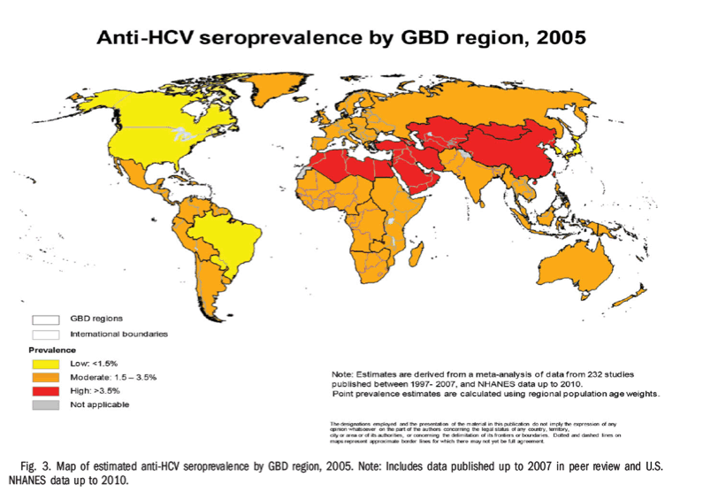
Background – Hepatitis C
Clinical:
Progresses slowly
Causes liver damage, cancer, death
World epi:
  170 million living with CHC
  350,000 deaths per year
  6 genotypes
United States epi:
  2.3 million living with CHC
  16,500 new cases per year
  16,600 deaths per year
  Genotype 1 accounts for 70%
HCV is curable!

Slide 4
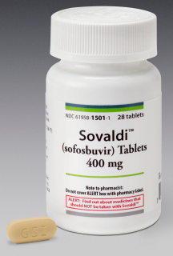
Background – Therapy
New drugs & new regimens including interferon-sparing
  Ledipasvir/sofosbuvir (October 2014)
  Simeprevir/sofosbuvir (November 2014)
Advantages
  Less toxic
  Shorter duration
    12 weeks vs 48 weeks
  Easy to dose/lower pill burden
  Highly effective: 50% SVR for old vs > 90% SVR for new therapies
Disadvantage
  Very expensive

Slide 5
Evidence Review
Jeffrey A. Tice, MD
Division of General Internal Medicine
Department of Medicine
University of California San Francisco
December 18, 2014

Slide 6
I have no conflicts of interest.

Slide 7
Treatment of Chronic HCV Infection
Rapid evolution of treatment for genotype 1
  Pegylated interferon + ribavirin (PR) 2001
  Boceprevir or telaprevir + PR 2011
  Simeprevir or sofosbuvir + PR 2013
  Interferon-free DAA combinations 2014
Intermediate outcome
  Sustained virologic response (SVR)
Key patient oriented outcomes
  Cirrhosis, hepatocellular carcinoma (HCC), liver transplantation, death
Notes:
The new interferon-free DAA combinations have primarily been studied in GT1 and only have an FDA indication for GT1 – thus the updated clinical review focuses exclusively on GT1, which represents 70%-75% of chronic Hep C infections in the US.
Surrogate outcomes: smaller, faster, cheaper and less informative studies.

Slide 8
FDA: Treatment of GT1 with Single DAA Therapy
Simeprevir + PR daily x 12 weeks
  + 12 more weeks of PR for most
  + 36 more weeks of PR for prior partial or non-responders
Sofosbuvir + PR daily x 12 weeks
Sofosbuvir + R daily x 24 weeks if interferon-ineligible

Slide 9
Single DAA Treatment for GT 1
Good SVR12: 55% to 92%
Many contraindications due to interferon
  Psychiatric illness, autoimmune disease, advanced liver disease
Many side effects due to interferon
  Fatigue, fever, anemia, depression, anxiety
Notes:
RCT participants are more likely to comply and complete treatment, hence have higher SVR than real-world patients.

Slide 10
New Direct acting anti-viral therapy

Slide 11
FDA: Treatment of GT1 with
Dual DAA Therapy
Harvoni (single pill combination of ledipasvir 90 mg and sofosbuvir 400 mg)
  12 weeks if treatment-naïve
    8 weeks if HCV RNA < 6 million IU/ml
  24 weeks if treatment-experienced
Simeprevir 150 mg + sofosbuvir 400 mg daily
  12 weeks if no cirrhosis (naïve and experienced)
  24 weeks if cirrhosis (naïve and experienced)
Notes:
Important to highlight the % eligible for 8 weeks of therapy. Note that about 2/3 of patients appear to be eligible for 8 week therapy, but real world data are limited in the published literature.

Slide 12
Additional Multiple DAA Therapies Considered for the Treatment of GT1
Daclatasvir 60 mg + sofosbuvir 400 mg daily x 12 - 24 weeks
  FDA requested additional data
3D ± R: paritaprevir / ritonavir 150/100 mg with ombitasvir 25 mg in a single pill and dasabuvir 250 mg twice daily with or without weight-based ribavirin
  FDA decision expected soon
Notes:
Steve comment: Should Daclatasvir be included?

Slide 13
Evidence review

Slide 14
Four Subgroups within GT1
Treatment-naïve / non-cirrhotic 69% | Treatment-naïve / cirrhotic 9%
Treatment-experienced / non-cirrhotic 19% | Treatment-experienced / cirrhotic 3%
Notes:
Influences both treatment duration and SVR

Slide 15
Methods
Systematic review
  Professional librarian; published reviews; manufacturers; experts
  Phase 2 & 3 trial data on FDA-approved dose and duration
    Exception to standard CTAF requirement for only published data to allow consideration of all data relevant to the topic
Meta-analysis within 4 subgroups
  No shared comparison group: precluded network meta-analysis (NMA)
  Discontinuation rates included lost to follow-up, withdrew consent, never treated, and discontinuations due to adverse events (AEs)

Slide 16
Genotype 1
SVR in each subgroup

Slide 17
Treatment-naïve, Non-cirrhotic: SVR
Notes:
Let me orient you to this figure as there will be 3 more that are similar The height of each bar represents the SVR, the vertical black line is the 95% CI. The first 3 bars are single DAA regimens and the last 4 are the dual or triple DAA regimens. Single DAA SVR ranges from 75% for SOF+R to 92% for SOF + PR. Multiple DAA therapy 98-100%. Note wide CI for SMV/SOF: only 4 patients like this in COSMOS who received SMV/SOF for 12 weeks without ribavirin.

Slide 18
Treatment-naïve, Cirrhotic:
SVR
Notes:
Again, the SVRs for the multiple DAA regimens are higher than single DAA and the CI’s overlap. It is difficult to distinguish between them. Much wider CI’s because many fewer patients for each treatment group. Lower SVRs with cirrhosis. The benefits of the new regimens are more pronounced. Single DAA SVR ranges from 54% for SOF+R to 82% for SOF + PR. Multiple DAA therapy 89-100%.

Slide 19
Treatment-experienced, Non-cirrhotic: SVR
Notes:
No clinical trial data for SOF + PR or SOF + R in this subgroup. Simeprevir: 78%; multiple DAA therapy 97% to 100%.

Slide 20
Treatment-experienced, Cirrhotic:
SVR
Notes:
Much wider CI’s because many fewer patients for each treatment group. Lower SVRs with cirrhosis. Single DAA 73% for simeprevir. Multiple DAA therapy 97-100%: better than treatment naïve as longer therapy.

Slide 21
Genotype 1
Harms of treatment

Slide 22
Adverse Events (AEs)
 | SMV12 PR24 | SOF12 PR12 | SOF24 R24 | SMV12 SOF12 | LDV12 SOF12 | DCV12 SOF 12 | 3D12 R12
N | 781 | 327 | 566 | 28 | 539 | 41 | 1379
Flu | 26% | 16% | 3% | NR | <5% | 0% | NR
Anemia | 12% | 23% | 9% | 0% | 0% | 0% | 3%
Rash | 28% | 18% | 8% | 11% | 4% | 5% | 11%
Flu-like symptoms with P
Anemia with PR or 24 weeks R therapy
Photosensitivity rashes with simeprevir
Notes:
In general: 12 weeks of therapy to permit comparisons. SOF-R requires 24 weeks. Other 24 week regimens will have higher AE rates.
Note low n for SMV+SOF and DCV+SOF
SAE: significant adverse event. Stop AE: discontinued therapy due to AE. Anemia: <10 g/dL).
These were low: SAE 1-4% versus 0-2%
Discontinue due to AE 1-3% versus 0-1%

Slide 23
Genotype 1 summary

Slide 24
Limitations
No direct comparisons, randomized or observational
  Possible selection bias
Intermediate outcome: SVR12
  Imperfect measure of cure
  Residual risk for HCC
Small numbers studied
  Great uncertainty around the estimates of SVR and harms
Real world results likely not as impressive
Notes:
Breakthrough status: – not the usual evidence standard for drug therapy: ie usually have two RCTs comparing new therapy to old standard.
Selection bias somewhat limited because we focused on the 4 key subgroups within GT1 only. Still age, race, 1a versus 1b, VL, etc differed across studies

Slide 25
Additional Studies Needed
RCTs comparing therapies
Large, well done observational studies
  Real-world SVR
  Comparing therapies
  Uncommon AEs
  Precise measures of AEs
Special and under-represented populations
  Co-infection: HIV, Hepatitis B
  Decompensated liver disease, peri-transplant
  African Americans, older adults, injection drug users
Notes:
OK to drop this slide if needed for time.

Slide 26
Key Comments Received
Bristol-Myers Squibb
  Recommend including daclatasvir regimens with ribavirin
  Asunaprevir, but not daclatasvir, withdrawn from FDA
Project Inform
  Quality of life outcomes not included in evidence review
Janssen
  Simeprevir + PR data should be limited to those without the Q80K polymorphism
  Phase 3 SMV + SOF OPTIMIST trials with results in 2015

Slide 27
Key Comments Received #2
Gilead
  ERADICATE trial (HIV/HCV co-infection): new results
  Patients with decompensated cirrhosis in the ELECTRON-2 trial should be excluded from SVR estimates
  Data on LDV/SOF + R for 12 weeks in treatment-experienced patients with cirrhosis at AASLD
AbbVie
  HCV-TARGET and TRIO real world data at AASLD
  CORAL trial (HIV) now published in NEJM

Slide 28
Summary
Multiple DAA therapy better than single DAA therapy
  Moderate certainty
    Greater SVR12 (>90%) with fewer side effects
    Fewer pills, no injections
    No direct comparisons
    Small sample sizes in many subgroups
Comparing the 4 multiple DAA therapies
  Insufficient evidence to distinguish
    No direct comparisons
    Small sample sizes in many subgroups
Notes:
Moderate certainty of small to substantial net benefit
Insufficient evidence: no comparative studies, wide confidence intervals, grossly similar benefits and harms.
Among the FDA approved studies, ledipasvir/sofosbuvir has much more data than simeprevir + sofosbuvir
Difference between the two judgments: the size of the net benefit is moderate to large, even though there is considerable uncertainty.

Slide 29
Care Value Analysis
James G Kahn, MD, MPH
Philip R. Lee Institute for Health Policy Studies
Department of Epidemiology and Biostatistics
University of California San Francisco
Co-authors: Harinder Chahal, PharmD, MSc
and Elliot Marseille, DrPH, MPP
December 18, 2014
Notes:
Be sure to acknowledge Rena Fox for providing her insight into clinical aspects of HCV.

Slide 30
I have no conflicts of interest.
Notes:
FYI only: Conflict = >$10,000 invested in any one relevant company.

Slide 31
Research Questions
What are the outcomes and costs of newer treatment regimens:
  When compared with previous interferon + ribavirin therapy?
  When compared with each other?
What are the relative costs and health gains of waiting until patients reach more advanced disease (fibrosis stages F3, F4) versus treating a “prevalent cohort” of all fibrosis stages (F0–F4)?

Slide 32
Methods – Inputs
  Population: US, 60 years old, prevalent mix of fibrosis stages
“All payer” perspective: direct medical care and drug costs
Lifetime time horizon
HCV natural course (Markov disease state model)
  Without treatment or treatment failure
  After successful treatment
Costs: Drugs, ongoing HCV care, HCV complications
Quality of life: Utilities (measures quality of life)
Efficacy data: ICER systematic review

Slide 33
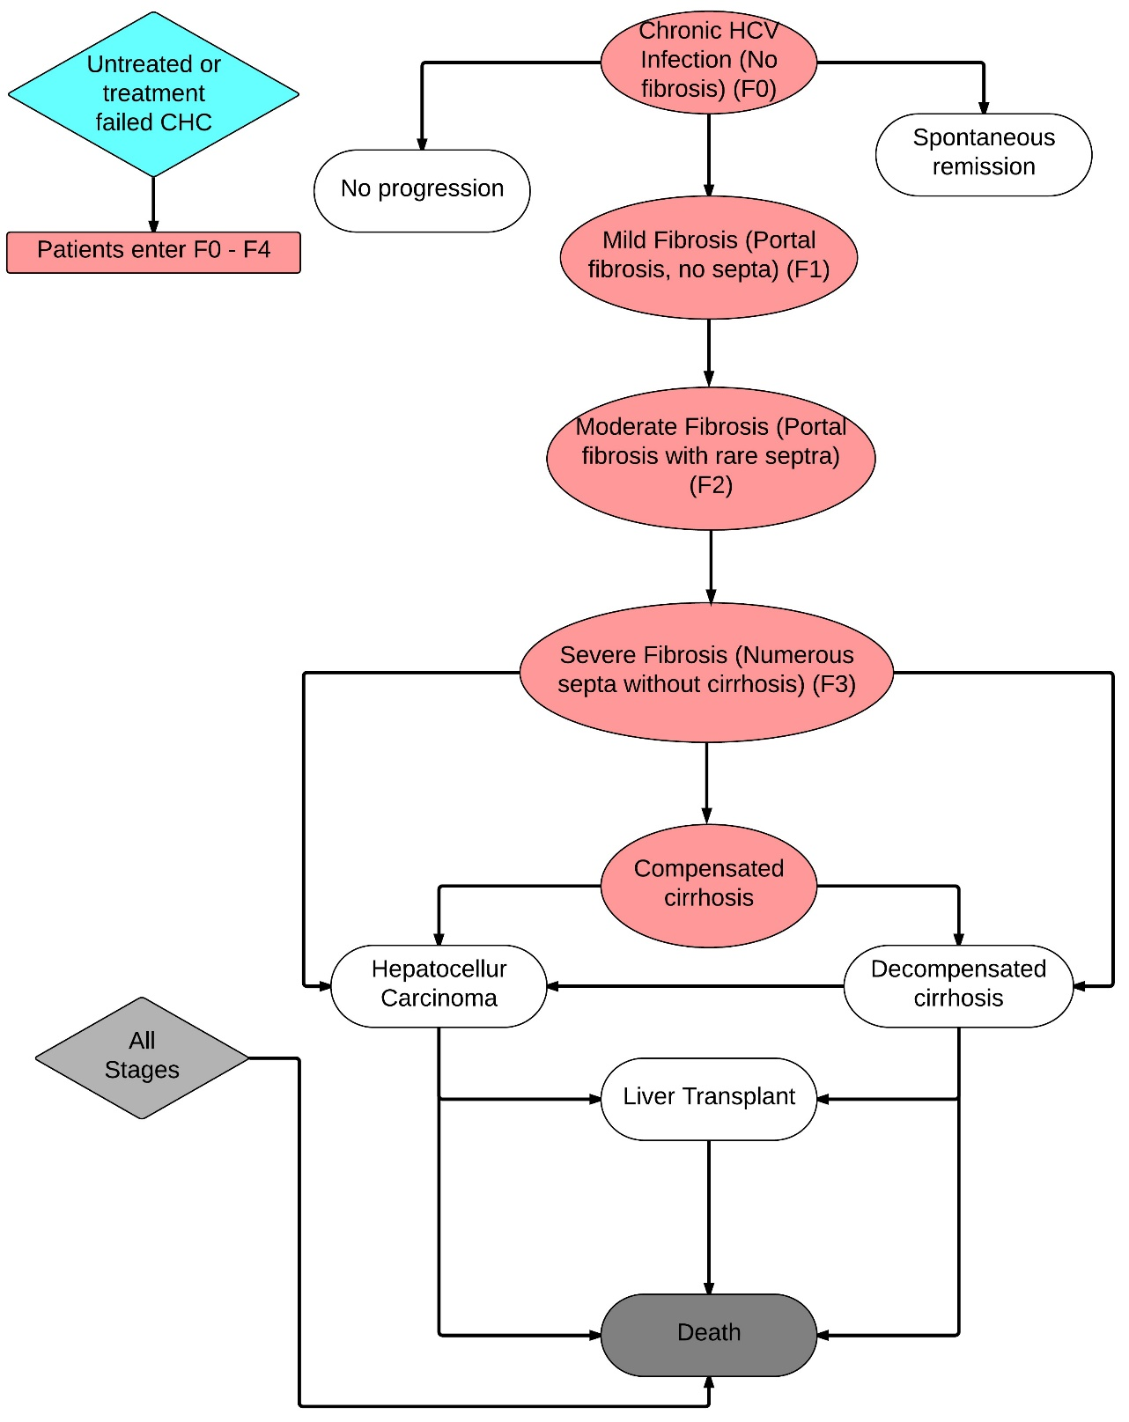
HCV Markov States

Slide 34
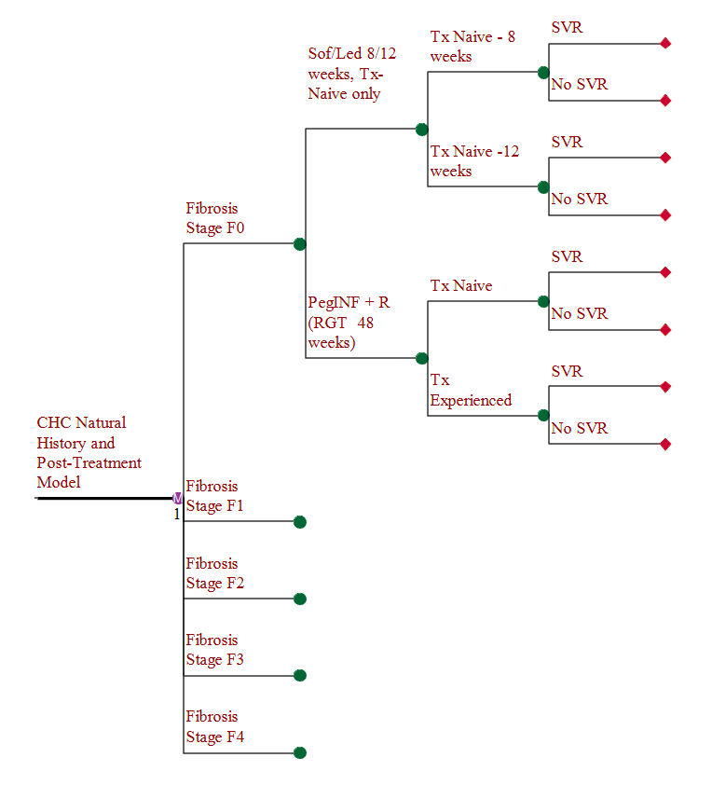
Simplified Model Structure
Notes:
Known CHC patients. Prevalent cohort of pts starting treatment at various F-stages
But model allows us to control when people start treatment and compares regimens.

Slide 35
Outcomes
Costs
  Drug treatment
  Costs from complications and sequelae (e.g., hepatocellular carcinoma)
  Other ongoing HCV-related care (e.g., monitoring, treatment of extra-hepatic manifestations)
Quality-adjusted life-years (QALYs) gained
Incremental Cost-Effectiveness Ratio (ICER)
  Difference in costs divided by difference in QALYs
Notes:
Explain what QALYS are – a useful metric that combines changes in both Quality of Life and Quantity of life (i.e., Life-Years).
Explain what ICERs are: Something like, “CEA assumes comparison of one or more interventions. The ICER is a ratio that reflects the difference in cost between any two interventions and the difference in QALYS. It can be thought of as the ‘price’ of gaining an extra QALY as you go from a less costly to a more costly option.”

Slide 36
Results: Treatment-naïve
New treatments vs. PR
Tx naïve, treat all
Effect
Net cost
ICER
(QALYs)
LDV/SOF(8/12 weeks)
$ 28,451
1.413
$ 20,132
SOF + PR (12 weeks)
$ 45,402
1.183
$ 38,386
Common criteria for evaluating incremental cost-effectiveness:
$50,000 - $150,000 per QALY gained
LDV/SOF (12 weeks)
$ 46,079
1.475
$ 31,234
SMV + SOF (12 weeks)
$ 116,942
1.474
$ 79,341
SOF + R (24 weeks)
$ 123,972
0.655
$ 189,160
Tx Naive, treat F3/F4
Effect
Net cost
ICER
(QALYs)
LDV/SOF (8/12 weeks)
$ 16,853
1.057
$ 15,940
SOF + PR (12 weeks)
$ 22,266
0.886
$ 25,134
LDV/SOF (12 weeks)
$ 32,218
1.101
$ 29,257
SMV + SOF (12 weeks)
$ 66,566
1.069
$ 62,261
SOF + R (24 weeks)
$ 66,635
0.455
$ 146,472
Notes:
Note that while the differences in ICERs are substantial, the differences in QALYs are limited. It is difficult to distinguish differences in benefits among the new treatments. Differences in ICERS mainly driven by cost.
Be sure to mention: We didn’t,t model either daclatasvir (DAC) or 3D+R - similar benefits for both but no published price yet

Slide 37
Results: Treatment-experienced
New treatments vs. PR
Tx exp, treat all
Effect
Net cost
ICER
(QALYs)
PR (48 weeks)
SOF + PR (12 weeks)
$ 39,922
1.983
$ 20,130
LDV/SOF (12/24 weeks)
$ 47,298
2.706
$ 17,477
SMV + SOF (12 weeks)
$ 110,894
2.563
$ 43,267
Tx exp, treat at F3/F4
Effect
Net cost
ICER
(QALYs)
SOF + PR (12 weeks)
$ 15,248
1.566
$ 9,734
LDV/SOF (12/24 weeks)
$ 20,509
2.179
$ 9,411
SMV + SOF (12 weeks)
$ 58,484
2.074
$ 28,202
Notes:
QALYs gained are higher than in Tx-naïve b/c PR not very effective in treating experienced patients.

Slide 38
One-way Sensitivity Analysis: Treatment-naïve, Treat All
Cost of LDV/SOF
Cost of PR
% eligible for 8 weeks of LDV/SOF
PR discontinuation rate
Notes:
Mention that almost all inputs varied from 50 / 150%.
Not surprisingly cost of drugs is the big driver of ICERS.
Important: Although the top bars look long, notice that the horizontal bar ends at $50,000 per QALY indicating even with unfavorable value, the intervention is CE by accepted standards.

Slide 39
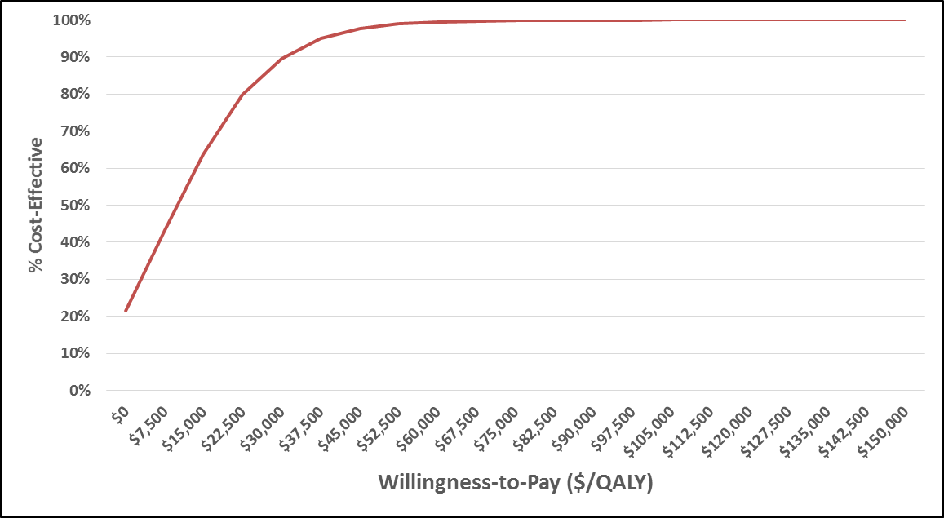
Probabilistic Sensitivity Analysis: LDV/SOF vs. PR, Treatment-naïve, Treat all
$50,000
QALY
threshold
$150,000
QALY
threshold

Slide 40
Results: Comparing “Treat all” with “Treat at F3, F4 only”
Treat All vs. Treat at F3, F4
Effect
Treatment naïve
Net cost
ICER
(QALYs)
PR (48 weeks)
$14,106
0.368
$38,282
LDV/SOF (8/12 weeks)
$25,703
0.724
$35,484
SOF + PR (12 weeks)
$37,241
0.665
$55,975
LDV/SOF (12 weeks)
$27,966
0.743
$37,663
SMV + SOF (12 weeks)
$64,482
0.773
$83,391
SOF + R (24 weeks)
$71,443
0.569
$125,577
Effect
Treatment experienced
Net cost
ICER
(QALYs)
PR (48 weeks)
$12,432
0.228
$54,421
SOF + PR (12 weeks)
$37,105
0.645
$57,510
LDV/SOF (12/24 weeks)
$39,221
0.756
$51,911
SMV + SOF (12 weeks)
$64,842
0.718
$90,348

Slide 41
Why More QALYs in the “Treat all” Approach vs. Waiting Until F3, F4?
SVR improves quality of life for patients with F0-F2 fibrosis scores, especially due to regression to earlier stages.
SVR reduces mortality by reducing the number of patients progressing to F3 and beyond (eg HCC).
NB – SVR does not fully stop progression. Thus want to slow the train (disease progression) early.
Depending on regimen, 55-74% of benefit of early treatment is from health status effect;
26-45% is from lower mortality.
Notes:
Important assumption: SVR is not a “cure” for all patients. A significant minority continue to progress post-SVR, F3. Thus, you reduce that risk by preventing patients from reaching F3.

Slide 42
Key Model Limitations
Clinical trial data used; may not represent real-world results
Not considered:
  Reduction in transmission from successful therapy
  Risk of reinfection with HCV or SVR relapse
  Retreatment of patients who fail to achieve SVR – modeled only one course of treatment
  Co-infection with hepatitis B or HIV

Slide 43
Conclusions
Under a wide range of values for price and effectiveness, LDV/SOF and SMV/SOF show cost-effectiveness ratios (ICERs) below commonly accepted thresholds
Model appears to show that treating everyone rather than waiting until F3/F4 meets commonly accepted cost-effectiveness thresholds ($50,000 to $150,000 per QALY gained)

Slide 44
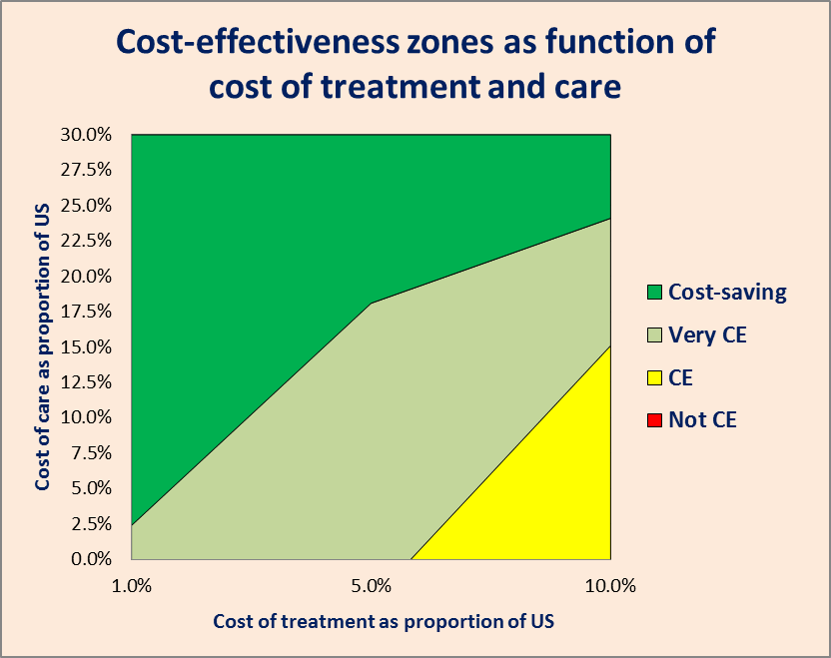
Can the new HCV treatments be cost-effective in low and middle-income countries?
Illustrative example assuming $1,000 per capita GDP

Slide 45
Health-System Value Analysis
Daniel A. Ollendorf, PhD
Chief Review Officer
Institute for Clinical and Economic Review
December 18, 2014

Slide 46
I have no conflicts of interest.

Slide 47
Health-System Value Analysis:
3 Components
Clinical outcomes/total costs at 1, 5, 20 years after treatment initiation in hypothetical cohort
  Based on outputs from cost-effectiveness analysis
Budgetary impact of new therapy for GT1, 2, and 3
  Extrapolated to size of California Medi-Cal/Dept of Corrections population
  Budget impact compared to costs for common Medi-Cal service provided
Threshold policy analysis
  Based on a 0.5%-1.0% “affordable” PMPM budget impact
  Implicitly considered by some payers as the threshold at which short-term budget impact of a single intervention often requires some policy effort to avoid negative effects of high costs on patients across the health system
Notes:
Extrapolated based on ExpressScripts analysis: (1) very conservative estimate of CHC pop’n size; (2) likely overestimate of costs (because we got no data on true costs in each system)
Explain these issues as rationale for conducting “thought experiment” on policy thresholds
Describe 0.5-1.0% PMPM threshold here

Slide 48
Cohort Analysis: LDV/SOF vs. PR, Treatment-naïve, Treat all
Hypothetical cohort of 1,000 HCV patients at a prevalent distribution of fibrosis stages
Followed for 20 years
Compared to historical PR, LDV/SOF would prevent:
  150 cases of cirrhosis (55 decompensated)
  20 cases of hepatocellular carcinoma
  3 liver transplants
Notes:
Substantial clinical benefits over 20 years of follow-up
But make the point that clinical differences overstated, UCSF model was based on single course of treatment. In reality, PR failures would get something else, and ultimate “cure” rates would be higher

Slide 49
Cohort Analysis: LDV/SOF vs. PR, Treatment-naïve, Treat all
$36,146
$45,954
$48,435
Notes:
LDV/SOF as the most cost-effective regimen from model, PR as the historical standard
As with previous assessment, while some of the difference in upfront treatment costs is offset after 20 years, from a budget impact perspective, we’re not looking at cost neutrality at any time point

Slide 50
Budgetary Impact to
Medi-Cal and Dept of Corrections
Key Assumptions:
  Candidate population: 93,000 with chronic HCV*
  50% of infected individuals aware of infection and treated
  Most effective new therapies for GT1 (LDV/SOF) as well as GT2/GT3 (SOF + R)
  Presented as increased treatment costs over one year as well as with potential offsets after 5 and 20 years
    Compared to cost of PR, weighted by % eligible for interferon-based therapy (60%)
* Express Scripts 2014. http://lab.express-scripts.com/insights/specialty-medications/state-governments-may-spend-$55-billion-on-hepatitis-c-medications
Notes:
# with CHC in Medi-Cal/corrections EXTREMELY conservative
Offset analysis the same as we did before

Slide 51
Budgetary Impact to Medi-Cal/
Dept of Corrections: All Patients
Notes:
Note that offset is much greater for GT2 than GT3 because SOF+R regimen is twice as long. But findings still driven in large part by GT1, the most prevalent.

Slide 52
Budgetary Impact to Medi-Cal/ Dept of Corrections: All Patients
First-year budgetary impact across the three common genotypes:
  ~$3 billion ($33 PMPM)
  5% increase over current Medi-Cal base PMPM ($611)*
Approximate Medi-Cal payment for well-child visits in established patients: $44
Increased expenditure = ~70 million well-child visits
  ~18 visits for each of the 3.9 million children currently enrolled in Medi-Cal
* DHCS, 2014: http://www.dhcs.ca.gov/dataandstats/reports/Documents/MMCD_Fin_Rpts/Medicaid_ACA_Expansion_Rates.pdf
Notes:
An example of opportunity cost associated with investment this large

Slide 53
Budgetary Impact to Medi-Cal/ Dept of Corrections: F3/F4 Only
Notes:
$800 million vs. $3 billion ($9 PMPM vs. $33, little more than 1% increase in PMPM vs. 5%)
But no cost-neutrality here; previous analysis used more assumptions that favored cost offsets (i.e., doubling of benefit for treating at F3/F4)

Slide 54
Policy Threshold Discussion
Assumptions:
  Current Medi-Cal PMPM: $611
  # of individuals with HCV GT1 in Medi-Cal/Dept of Corrections = ~65,000
  50% of infected individuals aware of infection and treated
Cost of new therapy that would meet 0.5%-1% PMPM threshold: $34,000 – $42,000
Notes:
Treated #=33,000

Slide 55
Policy Threshold Discussion (2)
At current LDV/SOF prices, number of patients that could be treated with 8/12 regimen if expenditure increases held to:
  ≤1% PMPM: ~16,500 (64%)
  ≤0.5% PMPM: ~12,600 (49%)
If treatment restricted to F3/F4, all patients could be treated at current prices and remain under 1% threshold (at 0.5% threshold, 91% could be treated)

Slide 56
Public Comments Received: Model
Estimate of % with known infection (50%) too high… or too low
Drug prices do not take mandated/supplemental rebates into account
Complication/HCV care costs underestimated
Models do not consider benefits of “treatment as prevention”
More clarity needed around:
  Medi-Cal PMPM calculation
  Rationale for 0.5%-1.0% PMPM thresholds
Incremental costs/budget impact should be compared to “new” standard of care (e.g., SOF + PR, SMV + SOF)

Slide 57
Summary
LDV/SOF and other potential interferon-free regimens provide substantial clinical benefits over historical treatment
Short-term budgetary impact to Medi-Cal/Dept of Corrections would be 5% PMPM under policy analysis of all eligible patients with known infection treated at current prices
Limiting treatment to patients with F3/F4 fibrosis would allow all or almost all patients to be treated at current prices while remaining below 0.5%-1.0% PMPM budget impact
Price of new drugs for HCV that would allow treatment of all infected individuals with known infection without exceeding 0.5%-1.0% PMPM increase: $34,000 – $42,000

