Slide 1
Lecture 4 –
Clinical Development Informatics
Meir Pinco, Ph.D

Slide 2
Agenda
Overview of clinical development informatics
  Drug Safety
  Electronic Data Capture
  Clinical Trial Management Systems
  CDISC
  Signal Detection
  Medical Coding
Computer System Validation
Systems Integration
OMOP

Slide 3
Data is critical for the clinical development process and clinical data is one of the most valuable assets to a pharmaceutical company. Clinical data is utilized as a basis for submission, approval, labeling and marketing of a drug.
The value of a new drug crucially depends on the quality of the data that should be well organized, easily accessible, thoroughly documented data out of well-designed clinical trials.

Slide 4
Clinical Development Systems
Safety Systems
Signal Detection
Clinical Trial Management System
Clinical Electronic Data Capture
Coding Tools
Reports Generators
Statistical & Analytical Tools

Slide 5
PV Operational Overview
Starts with safety information coming from a variety of sources, such as clinical trials data, safety call centers, spontaneous reports, and literature searches.
Within the pv department each case is processed, causality is assessed to the product.
Cases are reported either as an expedited report or as part of an aggregate report, based upon pv policies, regulations, and guidance documents, to the regulatory authorities and other stakeholders.

Slide 6
PV Operational Overview
Aggregate data are systematically analyzed for safety issues and assessed for benefit versus risk, and periodic safety update reports (PSURs) are submitted to the regulatory authorities as additional safety information is collected. This continues throughout the product’s life cycle.
Safety issues are addressed in order to mitigate risk. This may include changes in proposed labeling, change to a clinical trial design, implementation of a risk mitigation plan or discontinuation of development or use of a marketed product.

Slide 7
Drug Safety System
To effectively manage the complexity of safety and risk management, companies large and small are investing heavily in robust and compliant pv-software.
Enterprise system for Clinical and Post-Marketing Safety
Software enables a highly scalable end-to-end safety process providing automated global case processing, periodic reporting, E2B intake and submission, comprehensive reporting, and analytics within a single system

Slide 8
AE Case Processing Workflow
Case Source
Case
Intake
Case Processing
Case
Output
Aggregate
Output
Output
Analysis
Safety Call Center
Reported Cases
Case Intake
Medical input/Review/Final Triage
Individual Case Reporting
Aggregate Data Review
Periodic
Reports
Clinical Trials SAEs
Safety Data
Processing
Safety Systems
Support
Signal
Analysis
Spontaneous Reports
Triage
Data
Entry
Query
Process
QC
Case
Close
Risk Benefit
Assessment
and Mitigation
Literature Search
Cases

Slide 9
Clinical Electronic Data Capture (EDC)
EDC system is a computerized system designed for the collection of clinical data in electronic.
EDC enables sponsors and CROs to streamline study setup and efficiently manage the execution of complex clinical trials, improving staff and site productivity, operational effectiveness, and IT efficiency.
Notes:
Clinical Data and Submission Requirements
All Phase 2 and 3 CSRs must include a clinical database unless specifically exempted by FDA
The data must be presented in a method that the FDA can incorporate and analyze easily
You are required to use SAS Transport Files

Slide 10
Clinical Data Interchange Standards
Consortium (CDISC)
In the late 1990’s a consortium of industry companies collaborated and defined global standards aimed to streamline clinical research.
CDISC has spent the past decade developing and establishing standards that facilitate the collection, exchange, reporting and submission of clinical data along with the underlying standard terminology
CDISC standards have become accepted as the global standard for the development and implementation of of EDC from trial planning to regulatory submission.

Slide 11
CDISC Components
SDTM - Study Data Tagging Model
ADaM - Analysis Data Model
SEND ‐ Standard for Exchange of Nonclinical Data
CDASH ‐ Clinical Data Acquisition Standards Harmonization
LAB ‐ Laboratory Data Model
ODM - Operational Data Model
Notes:
SDTM - Defines a standard structure for study data tabulations (datasets) that are to be submitted to a regulatory authority such as the FDA. Allows reviewers to develop a repository of all submitted studies and create stand alone tools to access, manipulate and view the study data.
Adam - Provides a framework that enables analysis of the data. ADaM enables reviewers and other recipients of the data to have a clear understanding of the data’s lineage from collection to analysis to results. he design of analysis data sets is generally driven by the scientific and medical objectives of the clinical trial.

Slide 12
  Clinical Trial Management System (CTMS)
Used to manage clinical trials in clinical research. The system maintains and manages planning, performing and reporting functions, along with participant contact information, tracking deadlines and milestones.
Functionalities includes budgeting, patient management, compliance with government regulations project management, financials, patient management and recruitment, investigator management, regulatory compliance and compatibility with other systems such as EDC and safety systems.

Slide 13
Medical Coding
Medical coding is the process of assigning codes to clinical and safety.
Storing clinical data in a controlled, consistent and reproducible manner for data retrieval and analysis is a essential to protect the patient’s safety, for success of the clinical study and for regulatory compliance.
Coding adverse events, serious adverse event, medical history and concomitant medications is mandate in any given clinical trial.

Slide 14
Dictionaries
Two widely used medical coding dictionaries used for coding medical terms generated in clinical trials and drug-safety are-
Medical Dictionary for Regulatory Activities (MedDRA) is a medical coding dictionary developed by Maintenance and Support Services Organisation (MSSO). Is supported by International Conference on Harmonization (ICH) on for registration of Pharmaceuticals for human use
World Health Organization Drug Dictionary (WHODRUG). This dictionary is maintained and updated by Uppsala Monitoring Centre (UMC).

Slide 15
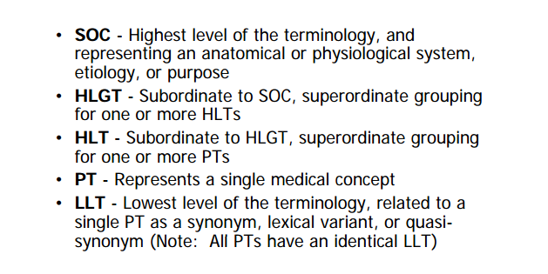
MedDRA Term Level Definitions
SMQ - Standardized MedDRA Queries are groupings of terms that relate to a defined medical condition or area of interest.
Notes:
Standardised MedDRA Queries (SMQs) are tools developed to facilitate retrieval of MedDRA-coded data as a first step in investigating drug safety issues in pharmacovigilance and clinical development. SMQs are validated, pre-determined sets of MedDRA terms grouped together after extensive review, testing, analysis, and expert discussion. SMQs are a unique feature of MedDRA and provide a strong tool to support safety analysis and reporting. The SMQ topics are intended to address the important pharmacovigilance topics needed by regulatory and industry users. SMQs have been developed with the CIOMS Working Group on Standardised MedDRA Queries that provides pharmacovigilance expertise and validation of SMQs. The SMQs are maintained with each release of MedDRA by the MSSO.
Currently, almost 100 SMQs have been created. Additional SMQs are created as the need arises. The following are a small sampling of SMQs that are available to users today:
Anaphylactic reaction
Cerebrovascular disorders
Convulsions
Depression and suicide/self-injury
Drug abuse, dependence and withdrawal

Slide 16
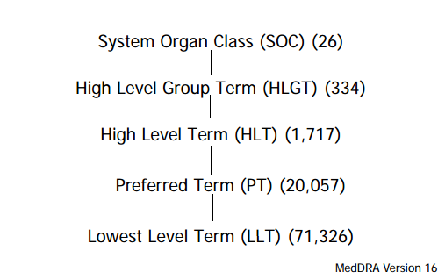
MedDRA Structure

Slide 17
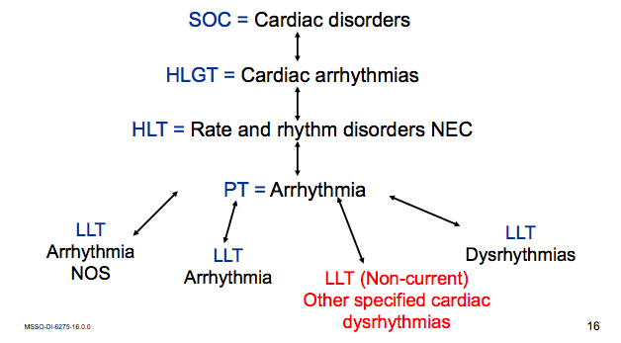
Examples of LLTs

Slide 18
Dictionary Browsers
Browsers are tools used for accessing terms in a specified dictionary is called a browser. Browsers are designed for quickly find terms of interest and should be flexible, intuitive, and quick to use.

Slide 19
Medical Coding Methods
Autoencoders- A programmatically assisted process for matching a reported term to a dictionary term.
Manual Coding- A person selects an appropriate dictionary entry
Hybrid Approaches-
  Autoencoder are first automatically code reported terms that match a dictionary term or that match a term that has previously been coded (synonym list).
  The terms that are not auto-encoded are then manually coded.

Slide 20
Dictionaries Change Control
MSSO releases updated MedDRA versions twice a year - in March and September. The March release is the main annual release and contains changes at the HLT level and above along with LLT and PT changes. The September release typically contains changes only at the LLT and PT level. The September 2014 Version 17.1 release is the current version.
Dictionary version control is critical since dictionaries updated versions occasionally change pathways to body systems or organ classes.
Dictionary updates can have a substantial effect on conclusions regarding a product’s effects and may have an impact the labeling of the product.

Slide 21
Clinical Systems and Data Integration
EDC
CDMS
Medical
Coding
CTMS
Safety
Database
Medical
Coding
Pharmaceutical companies often have multiple critical systems to handle the core data and trial activities associated with clinical development. Patient’s, study’s and drug’s data is distributed and may be redundant across multiple systems.

Slide 22
SAE Reconciliation
SAEs reconciliation is the comparison of key safety data elements between clinical and safety database.
Occurs several times during the study period and it depends on the frequency of data receipt and the management of the safety data from pv to the regulatory agencies.

Slide 23
What Is a Safety Signal?
A safety signal is an information that arises from one or multiple sources which suggests a new, potentially causal association, or a new aspect of a known association between an intervention and an event or set of related events, either adverse or beneficial, that is judged to be of sufficient likelihood to justify verificatory action.
From the Council for International Organizations of Medical Sciences (CIOMS)

Slide 24
Safety Signal Databases
Pharmaceutical companies safety database- contained spontaneous AEs are collected from patients, health care providers, lawyers, health authorities, the medical literature, and other sources.
FDA Adverse Event Reporting System (AERS) database- support the FDA’s post-approval safety surveillance program. AERS contains data for all approved medicines and therapeutic biologic products.
VigiBase WHO global database which contains Individual Safety Case Reports submitted from 80 member countries in the WHO Programme for International Drug Monitoring from the start 1968 until today. VigiBase is maintained and developed on behalf of WHO by the Uppsala Monitoring Centre (UMC), situated in Uppsala, Sweden.

Slide 25
  Oracle Empirica Signal
System mines drug safety data for signals of adverse events that may be occurring more often than expected in corporate and public databases like FDA AERS or WHO VigiBase.
Once identified, signal strength is quantified on a numerical scale and depicted graphically
Changes in signals can be monitored as they develop over time
Allows create records of signals and other safety related topics of interest.
Designed for use in a 21 CFR Part 11-compliant environment.

Slide 26
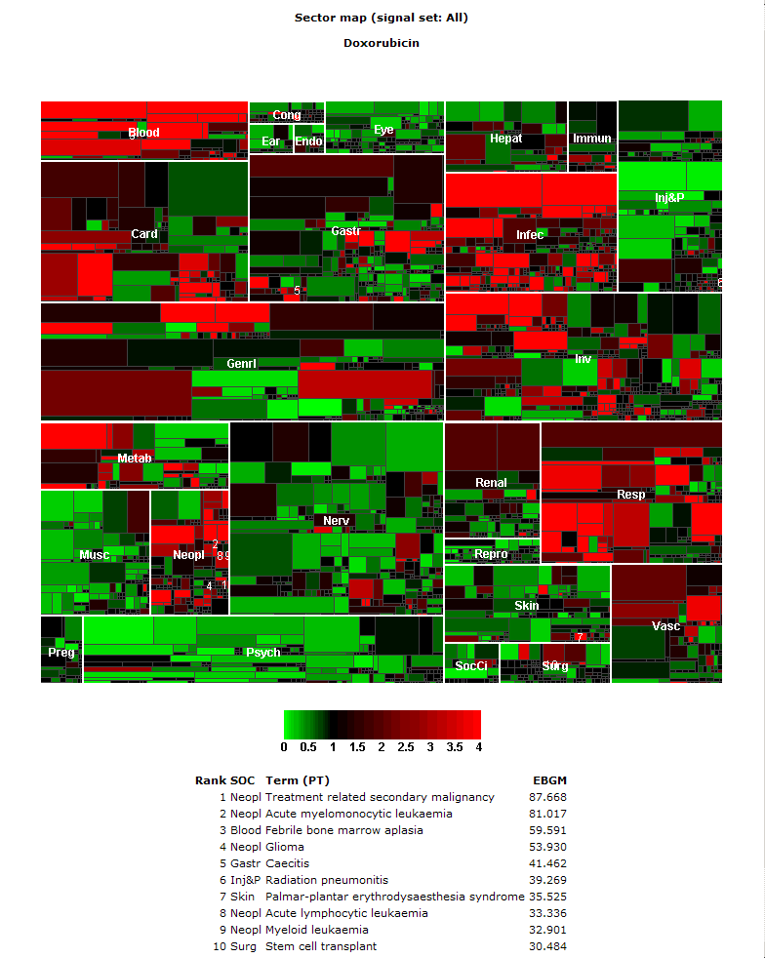
Empirica Signal - Sector Maps
Display disproportionality analysis in a sector map which allows visual assessment of signal strength
Large tiles are the MedDRA System Organ Class (SOC)
Smaller tiles are the Preferred Terms (PT)
Colors represent the strength of the signal – bright red indicates the AE’s occurring significantly higher than expected with the drug – bright green indicates significantly less occurrences than expected, or potential indications.

Slide 27
Validation Process
Establishing documented evidence which provides a high degree of assurance that a specific process will consistently produce a product meeting its predetermined specifications and quality attributes.
FDA Guidelines on General Principles of Process Validation 1987
Notes:
Computer system validation (CSV) is the process of establishing documented evidence that a computerized system will consistently perform as intended in its operational environment.

Slide 28
Why is Validation Needed
Reduces risk and legal liability
Having the objective evidence that computer systems are operating to their intended use.
Software is constantly evolving to keep up with the increasingly complex needs of the people that use it and the regulatory requirements.

Slide 29
The Validation Process
Consists of specific processes
  Validation Plan
  Project Plan
  Installation Qualification (IQ)
  Operational Qualification (OQ)
  Performance Qualification (PQ)
  Validation Summary Report (VSR)

Slide 30
Specification and Qualification Relationships
User Requirement Specification
PQ
Verifies
Functional Specification
OQ
Verifies
Design Specification
IQ
Verifies
System Build

Slide 31
Observational Medical Outcomes Partnership (OMOP)
In partnership with PhRMA (Pharmaceutical Research and Manufacturers of America) and the FDA, the Foundation for the National Institutes of Health (FNIH) launched in 2008 the OMOP to identifying the most reliable methods for analyzing huge volumes of data drawn from heterogeneous sources.

Slide 32
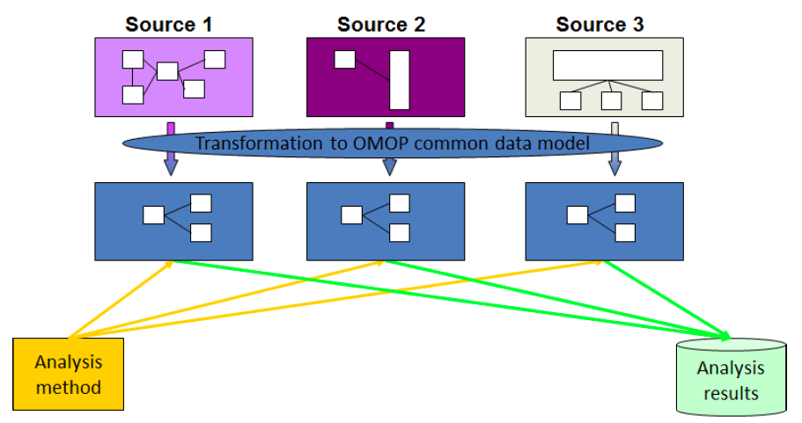
OMOP Common Data Model (CDM)
CDM allows for the systematic analysis of disparate observational databases.
The transform data contained within disparate databases into a common format, and then perform systematic analyses using a library of standard analytic methods applied on the common format.

Slide 33
OMOP Challenge
OMOP worked to design experiments testing a variety of analytical methodologies in a range of data types to look for drug impacts that are already well known.
OMOP research yielded some confidence that particular methods used with particular data types could potentially identify reliable correlations between individual medical interventions and specific health outcomes.

Slide 34
OMOP Work
Built a research lab (RL) that include a common data model (CDM),
Medical dictionary to enable the mapping of the source data to standard terminology and classification schemes
88 million patient records from clinical and administrative sources in a centralized database,
Access to additional patient records through its distributed data partners
Multiple analytical tools
Shared methods library and a scalable infrastructure.
OMOP Web RL available in the public domain.

Slide 35

Questions?

