Slide 1
Epi 240
Qualitative Approaches in Clinical and Translational Research
Session 5
Memoing and Coding
Feb 4, 2015
Daniel Dohan, PhD
Philip R. Lee Institute for Health Policy Studies, UCSF
Wendy Anderson, MD, MAS
Division of Hospital Medicine, UCSF

Slide 2
What’s up today
Announcements: Assignments, recording (5 min)
3 projects in 30 minutes
  1 sentence: what is your research question?
  1 sentence: what do you want feedback on?
  Discussion
Lecture: Memo’ing and Coding (25 min)
In-class work on coding with focus group transcript (30 min)

Slide 3
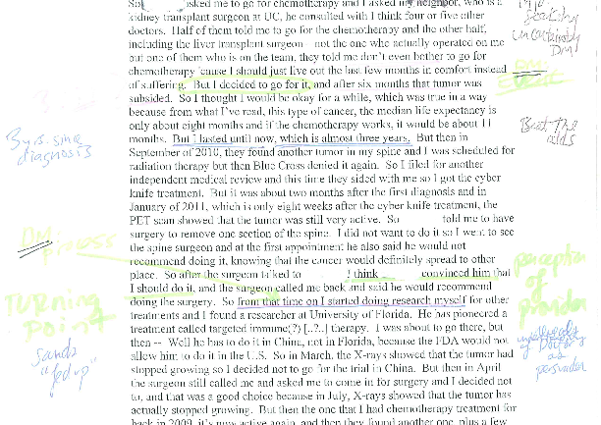

Slide 4
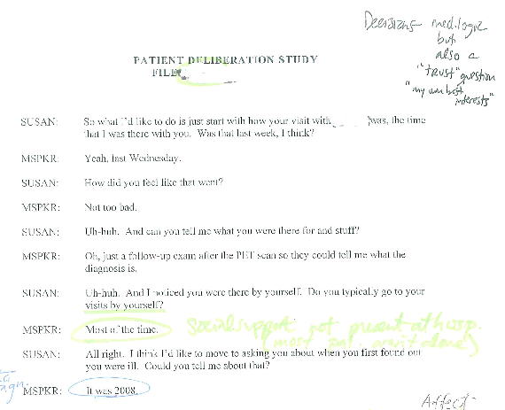
Epi 240, Qualitative Research Methods, Dohan

Slide 5
Memo writing
Different Types of Memos
  Documentation -- usually, to explain a code or the logic behind a fieldwork decision
  Reflections -- integrate into fieldnotes or annotate interview transcripts
  Analytic -- thoughts and insights as they occur; a key part of the analysis process; the building blocks of reported analysis
How to Write Them
  productivity = (low stakes)*(small audience)*(manageable goal)
  free writing, mind-mapping

Slide 6
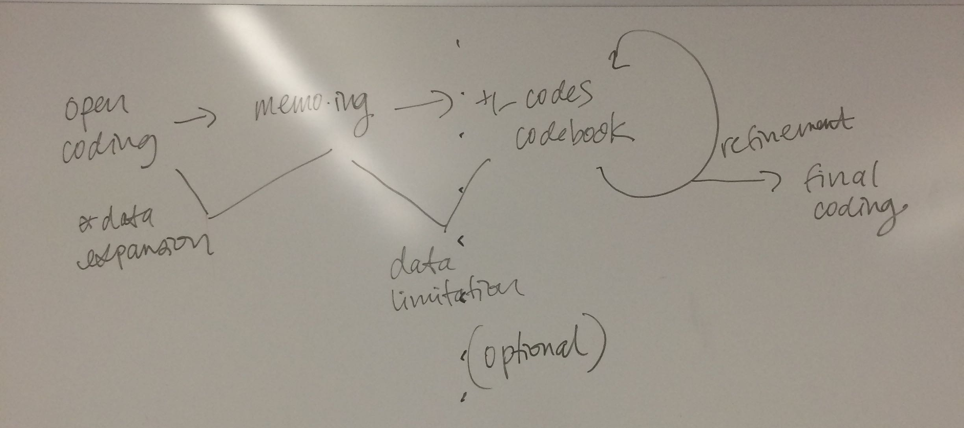
The Coding Process

Slide 7
Documentation
CODEBOOK [Updated Quarterly—for most current code list see code map and hierarchy above]
Domain: Analytical
Super family: Communication (CXN)
Family: About disease (CXN_Disease)
This code family and the group of codes that make it up discuss various facets of cancer as a disease, the process of the disease, and its progression throughout and during therapy.
Code: Diagnosis (CXN_Disease_Diagnosis)
Use this code any time there is mention of a diagnosis. The code CXN-DIS-Diagnosis designates units in which a participant, whether provider, caregiver, or patient, use a diagnosis, diagnostic term, or allude to a diagnosis.
INCLUSION: Any explicit recounting of the communication of a diagnosis, even just a reference to what diagnosis the patient has.
EXCLUSION: Any text not related to a diagnosis.
Example:
iv7034_20110704, unit 039
It was a change in my bowl movements and my urine that caused me to make an appointment to see my primary care physician, who happens to be a gastroenterologist. And when I went to him, originally we started down the path of possibly there was a parasite or bacteria and so forth and one test led to another, which ultimately led to a diagnosis of cholangiocarcinoma.

Slide 8
Case Overview
This colon cancer patient has (for our cohort) an unusual background, with 10 years of serious substance abuse, having lost contact with all friends and family, and now "rediscovering" a sense of purpose and connection since his diagnosis.
Key Event History & Timeline:
Sept 2010: Gets “clean” from substance abuse
Oct 2010: Lab results from primary care physician indicate
need for further investigation
Nov 2010: Tests indicate mestastic colon cancer.
Jan 2011: Surgery
April 2011: Chemo began
Notable Observations
Major turning points:
1.After procrastinating about conducting a fecal occult blood test at home, finally does it and takes it to be analysed. All subsequent medical investigations stemmed from this. MID p. 4
2. A **** doctor insisted that the patient get a colonoscopy without delay by literally taking the patient over to radiology and not leaving until appointment booked. TOP p. 6.
3. Switched from *** insurance program to Medi-Cal (requires disability status), which opened up options like **** and chemotherapy. LOW p. 1.
4. Major mental turning point: when patient understands "oncology-think", i.e. that "success" means 1-2 years of post-surgery survival. MID-LOW p. 10.
5. Month of travel reminds patient of "why you need to live". MID-TOP p. 9
6. Decision to move to **** and leave his lonely life in ****. (in case he does only live 1-2 years more, wants to be with friends) MID p. 12
Notable:
His best friend (whom he has moved in with in ****) is pediatric oncology nurse, MID-TOP p. 12
Comment: It seems a large majority of our patient cohort find "insiders" who are personal friends, whether it be a provider or someone who knows someone who is an "insider" as a way of navigating through the system, or a source for confirming whether the system is functioning as it should.
He wrote a mission statement for his cancer treatment, MID p. 11
Comment: This is the first time I see this in any patient interview. Shows determination, but also need for social support.
Discusses openly that he "probably is going to die from this" MID-TOP p. 9
Comment: I have not seen many patients articulate this so directly, i.e. use the word "die"
Reflections

Slide 9
Serious Illness Memo 4.8.10
Topic: Mention of the actuality or possibility that illness is life-limiting as a key interaction in discussions of serious illness.
Conceptual Definition: Text will be coded where either the doctor or patient mention of the actuality or possibility that illness is life-limiting as a key interaction in discussions of serious illness. This will include vague references (see examples below), along with more over statements.
* Mentioning the actuality or possibility that illness is life-limiting is related to but not necessarily the same as prognosis. Prognosis to me indicates that that the specific time a patient has to live is discussed, or what their functional status will be. Statements of prognosis, e.g. how long someone will live, whether they will recover in functional status would count as acknowledgement that the patient will die from the disease, but it is possible to acknowledge or mention this possibility without talking about numbers, chances, etc.
Data Illustrations:
Example A: Patient 097
Context: Patient has cancer and was admitted to the hospital because he could no longer care for himself.
The conversation starts with the discussion of why patient can’t care for himself – because of weakness or his leg not working (because of cancer met).
MD: So, uh, I hear that you’re coming in because you’re having trouble at home?
PT: Uh, it’s … well, //if be more blunt 0556// about it, it’s uhm, there’s no way that, you know, friends and family can take care of me at home.
MD: Ok.
Analytic

Slide 10
Table D6. Preliminary Coding Scheme
Code | Description
A | Patient engagement with EP trial decision-making
A1 | expressing knowledge of EP trials or research
A2 | discussing considerations related to participation in EP research
A3 | making decisions about whether or how to engage with EP research
A4 | expressing views of hopes/fears for cancer treatment
A5 | interacting with others (caregivers or providers) about EP trials
B | Caregiver engagement with EP trial decision-making
B1 | expressing responsibilities for patient with respect to cancer care
B2 | noting patient orientations or beliefs about medical research or EP trials
B3 | expressing personal perspectives on medical research or EP trials
C | Provider engagement with EP trial decision-making
C1 | discussing interest or role of research or EP trials in professional identity or activities
C2 | expressing responsibility for care and treatment of advanced cancer patients
C3 | noting challenges in patient-provider communication related to EP research
C4 | discussing strategies or approach for discussing research with patients or caregivers
C5 | reflecting on kinds of patients that are appropriate for clinical research
D | Contextual factors
D1 | existing routines or assumptions about EP research decision-making
D2 | identifying gaps in communication about EP research
D3 | changing perspectives on EP decision-making as patients progress

Slide 11
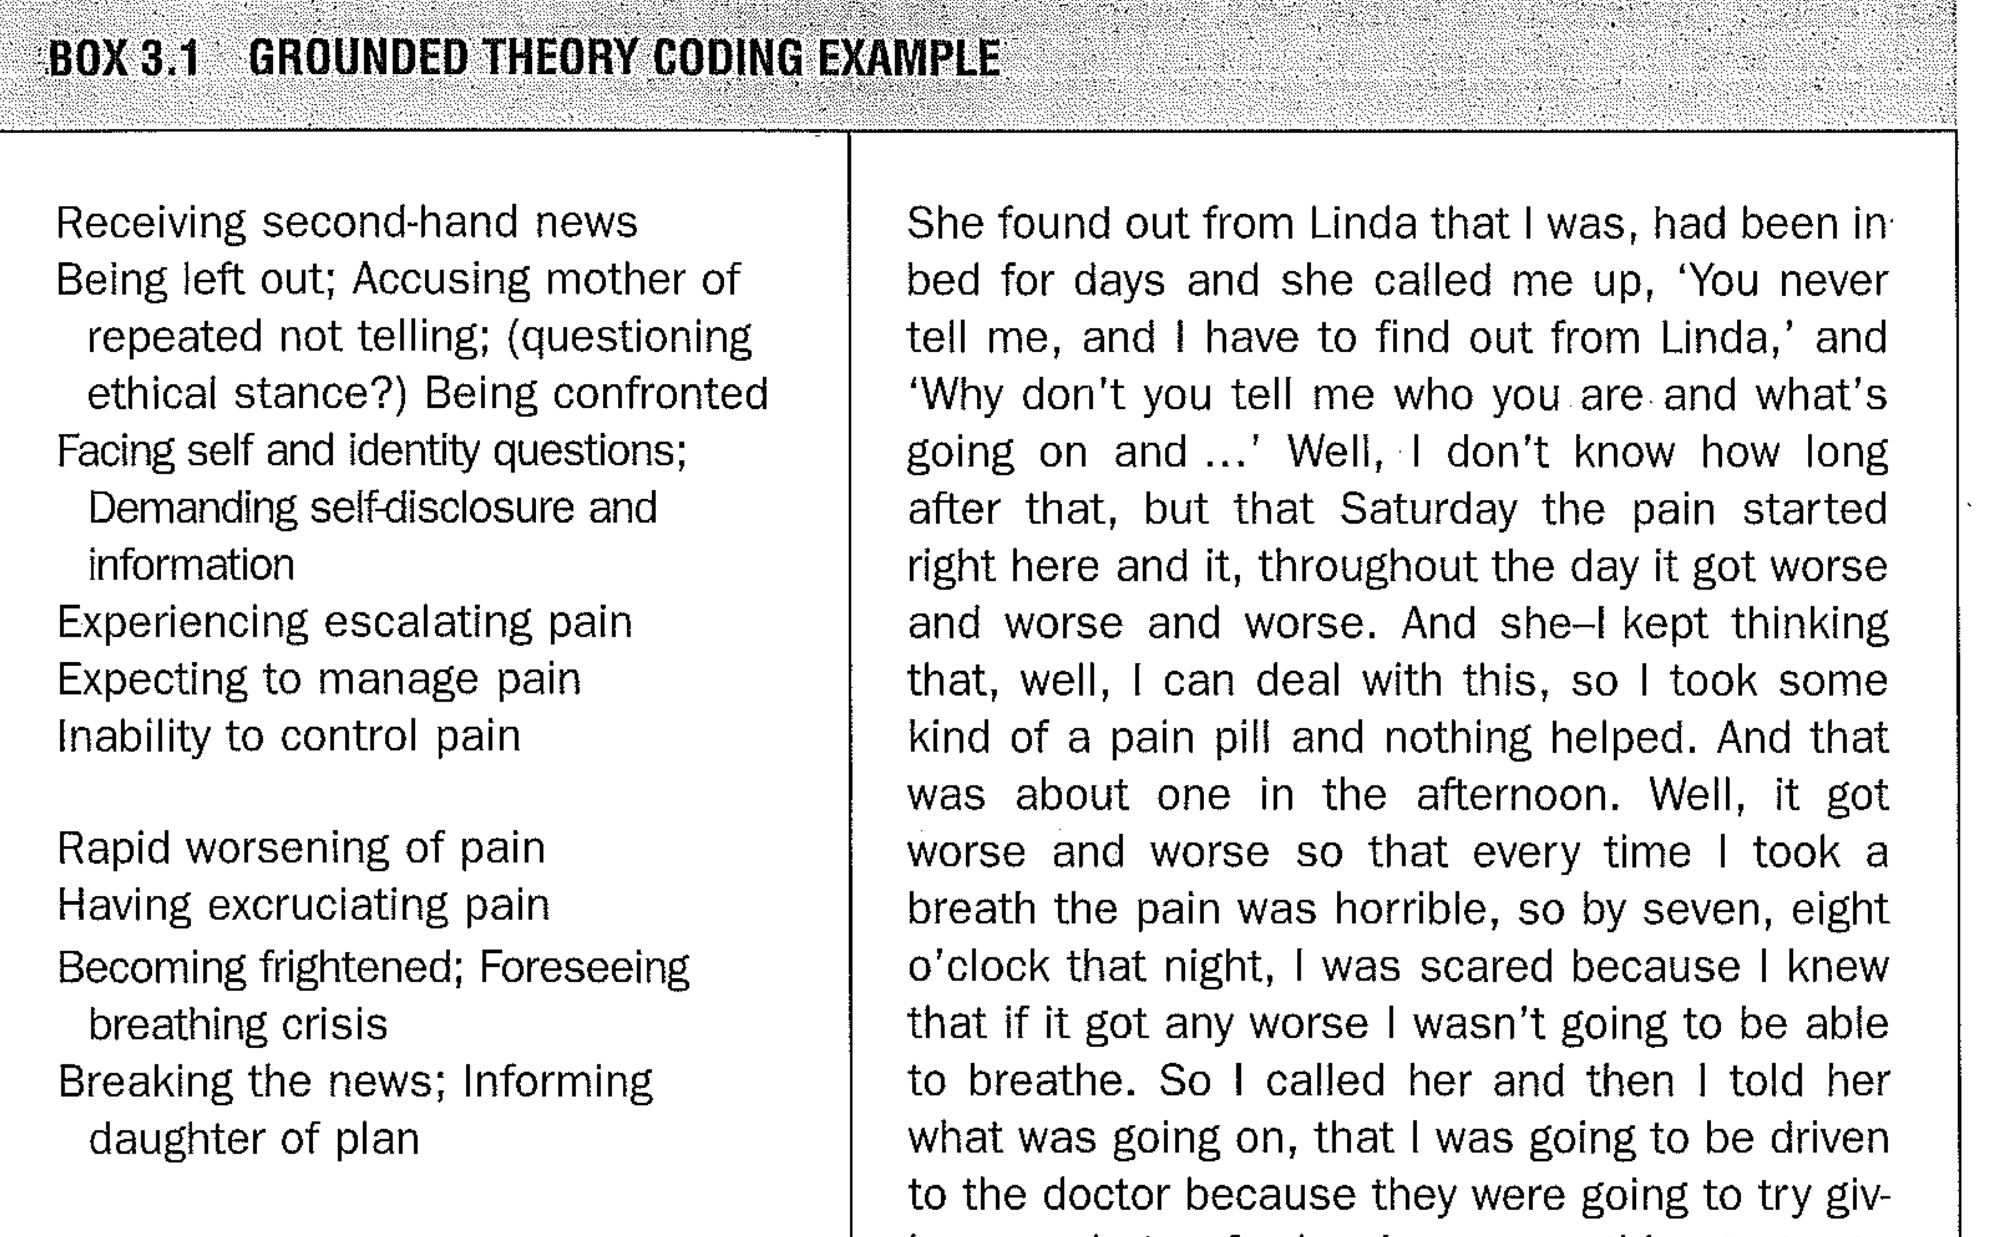
Charmaz, Kathy. 2006. Constructing Grounded Theory: A Practical Guide Through Qualitative Analysis. Los Angeles: Sage. p. 44

Slide 12
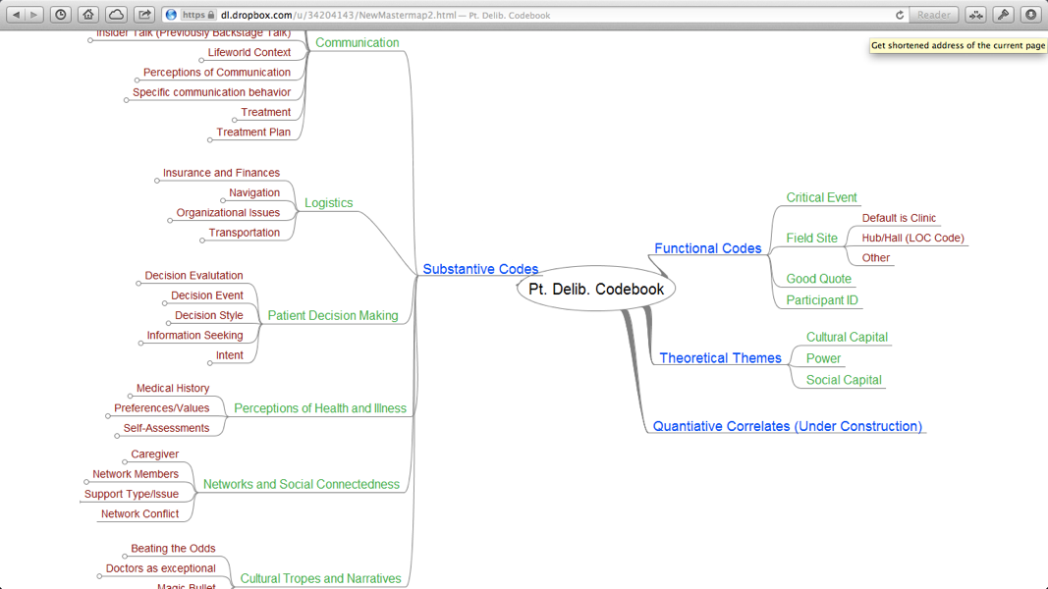

Slide 13
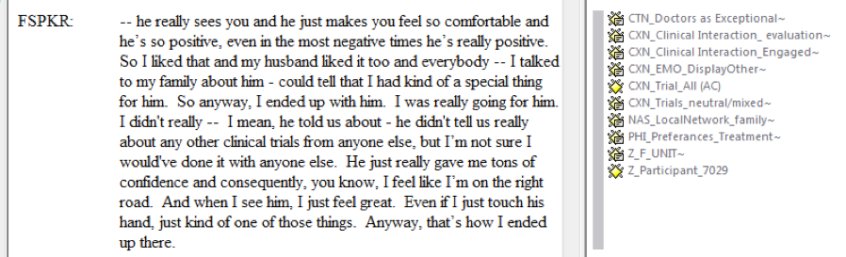

Slide 14
Deductive coding
“Define” codes early in the project conceptualization process
  Via participation, you are a research instrument
Reflect on your clinical, personal, political experience
  Why is this interesting to you?
  Explore big themes and small cases and exceptions to the rule
Review the literature and pull out themes, issues, variables, and theories that others have used
Do key-informant interviews with experts in the field
  “Elevator pitch” your project
  Ask them what they would want to find out from your data
Throughout: Document, review, consolidate, expand

Slide 15
Emergent coding
Begin as soon as you begin to collect data
  Via process, analysis and collection inform each other
Leave time for contemplation, especially during beginning fieldwork or first interviews
Write-up and document coding ideas or themes as they occur
Member-check these ideas
  Weave them into fieldwork; use ideas to select interviewees and fieldsites as well as to fine-tune your interview guides
  Explore them in informal conversations with subjects, colleagues, friends, and loved ones
Bear in mind the “tricks” for emergent coding (next slide)

Slide 16

Coding exercise
Discuss deductive themes from readings and clinical & life experiences
Develop 1-3 deductive codes for whole group
Practice coding the FG transcript
Try line coding and paragraph coding
Discuss and report out
Embrace ambiguity
Move quickly
OK to mix deductive/inductive

Slide 17
Coding exercise: Deductive and Emergent Themes

