Slide 1
Development and Approval of
Drugs and Devices
EPI260
Lecture :
Use of Biomarkers in Drug Development
May 31, 2012
June H. Lee, MD
Director, Early Translational Research
Clinical and Translational Science Institute (CTSI)
UCSF
Associate Professor, Pulmonary and Critical Care
Notes:
Lecture today is on the use of biomarkers in drug development.
Introduction

Slide 2
Outline
Biomarker definitions
Case studies of Biomarker use in drug development
  Diagnostic
    Predictive
    Prognostic
  Surrogate biomarkers
    Cardiology (LDL)
Notes:
The outline for the presentation today is to first, present the definitions for the general categories of biomarkers fairly briefly and then spend the rest of the time presenting to you 5 case studies of how biomarkers were used in drug development or thereafter in understanding the disease and patient better, or utilizing the drug more effectively.

Slide 3
Definition of Biomarker
A characteristic that is objectively measured and evaluated as an indicator of biological processes, pathogenic processes, or pharmacologic responses to a therapeutic intervention
Notes:
Biomarker is substance which is used as an indicator of a biological state.
Serum marker
Blood pressure
Imaging
It needs to be an objectively measured character

Slide 4
PK/PD Biomarkers
Pharmacokinetics
  Measured post-treatment to ensure that active drug concentrations are generated
  “What the body does to the drug”
Pharmacodynamics
  Measured post treatment
  Confirms active drug-target interaction has occurred
  “What the drug does to the body”
Both are used extensively in early drug development
  In vitro studies
  Animal experiments
  Phase I trials
Notes:
PK/PD markers are defined here. Will not discuss further here.

Slide 5
Categories of clinical biomarkers
Diagnostic
  Predictive
    identify subpopulations of patients who are most/least likely to respond to a given therapy
  Prognostic
    a biomarker that provides information on the likely course of the disease in an untreated individual
Surrogate
  A biomarker intended to substitute for a clinical endpoint
  Ideally, predictive of clinical endpoint
  Frequently used for early decision making but few are also considered approvable regulatory endpoints
Notes:
Clinical endpoint
A characteristic or variable that reflects how a patient feels or functions, or how long a patients survives.
Predictive diagnostic BM is defined as a biomarker which help to identify a subpopulation of patients most/least likely to respond to a given therapy
. Tremendous evolution in the use of predictive biomarker both in drug development and beyond
Prognostic biomarker is a biomarker that provides information on the likely course of a disease in an untreated individual
There have been fewer progress made in this area but the list of conditions for which a good prognostic marker is considered crucial is growing.
Surrogate biomarker is a biomarker which is intedted to substitute for a clinical endpoint.

Slide 6
Why use a predictive biomarker?
Predictive biomarkers can enable:
  In clinical development process
    Patient selection to include/exclude the most appropriate patients
    Increase the probability of showing benefit of a therapy
    Smaller studies and reduction in the cost of development
    Limit exposure (and side effects) of patients not likely to benefit
  Post-marketing
    Reduce/eliminate treatment of patients not likely to benefit
      Minimize potential for side effects/adverse effects
      More effective use of limited healthcare resources

Slide 7
Why use a prognostic biomarker?
Indicator of the progression of disease with or without treatment
In diseases with heterogeneous disease course, identifying a cohort with more predictable disease progression can be very helpful
  In designing the study
  Identifying subset of patients where benefit/risk is most appropriate

Slide 8
What is a surrogate biomarker?
Surrogate endpoint (or marker) is a measure of effect of a certain treatment that may correlate with a real clinical endpoint but doesn’t necessarily guarantee a relationship
Used when the primary endpoint is undesired (e.g., death), or when the number of events is very small, or readout takes a long time thus making it impractical to conduct a clinical trial to gather a statistically significant number of events
Many reasons why it might fall short

Slide 9
Why use a surrogate biomarker?
It can substantially aid in early decision making in clinical development programs
  MRI findings in multiple sclerosis
  Amyloid PET imaging for Alzheimers
  LDL for coronary disease
  Tumor imaging for cancer
Less frequently, biomarkers can be regulatory approvable endpoints for some disease indications
  C-peptide in T1DM
  Hemoglobin A1c in T2DM
  LDL for hyperlipidemia

Slide 10
Case Study #1: Targeted treatment of Cystic Fibrosis

Slide 11
Cystic Fibrosis
Cystic fibrosis is a common systemic disease caused by defective CFTR gene
CF is most common among Caucasians: 1/25 people of European descent carry at least one allele for CF
Approximately 30,000 Americans have CF, making it one of the most common life-shortening inherited diseases in the United States
CFTR gene is required for ion transport and regulation of sweat, mucus, etc.
Over 1500 other mutations have been identified and can
  Cause replacements, duplications, deletions, or shortenings in the CFTR genes
  Result in CFTR proteins that may not function, work less effectively, are more quickly degraded, or are present in inadequate numbers.
Notes:
It is a gene with high prevalence
Mutations consist of replacements, duplications, deletions or shortenings in the CFTR gene and result in proteins that may not function, work less effectively, are more quickly degraded, or are present in inadequate numbers

Slide 12
Current treatment targets secondary effects of CFTR dysfunction
Antibiotics to prevent and treat lung and sinus infections.
Inhaled medicines to help open the airways
DNAse enzyme replacement therapy to thin mucus and make it easier to cough up
Oxygen therapy and lung transplant appropriate
A special diet high in protein and calories for older children and adults
Pancreatic enzymes to help absorb fats and protein
Vitamin supplements, especially vitamins A, D, E, and K
* None of the currently available treatments target enhancing CFTR function
Notes:
The protein created by this gene is anchored to the outer membrane of cells in the sweat glands, lungs, pancreas, and other affected organs. The protein spans this membrane and acts as a channel connecting the inner part of the cell (cytoplasm) to the surrounding fluid. This channel is primarily responsible for controlling the movement of halogens from inside to outside of the cell; however, in the sweat ducts it facilitates the movement of chloride from the sweat into the cytoplasm. When the CFTR protein does not work, chloride and thiocyanate[42] are trapped inside the cells in the airway and outside in the skin. Then hypothiocyanite, OSCN, cannot be produced by immune defense system.[43][44] Because chloride is negatively charged, this creates a difference in the electrical potential inside and outside the cell causing cations to cross into the cell. Sodium is the most common cation in the extracellular space and the combination of sodium and chloride creates the salt, which is lost in high amounts in the sweat of individuals with CF. This lost salt forms the basis for the sweat test

Slide 13
G551D-CFTR Mutation
CFTR is an anion channel located in the apical membrane of epithelial cells, including in the airways, was discovered (1989)
G551D-CFTR channels reach the cell membrane but rarely open (1993)
  G551D-CFTR mutation occurs in 4-5% and is the most prevalent
With financial support and scientific advice from the Cystic Fibrosis Foundations, Vertex initiated high throughput screening and chemical engineering to develop orally bioavailable drug targeting CFTR
  Goal: An agent that would facilitate the opening of G551D-CFTR channels
VX-770 is a CFTR potentiator which increase ion-channel function of actived cell surface CFTR
  Increases the fraction of time phosphorylated G551D-CFTR channels are open
Notes:
Since the discovery of CFTR mutation as the culprit for CF in 1989, it has been recognized that improving CFTR function may greatly benefit patients with CF.
This was attempted in a variety of ways including gene therapy by a many different delivery platform. None successful to date in restoring CFTR function
In 1993, it was discovered that there are CFTR mutations which allow channels to reach the cell membrane but with diminished function.
G551D mutation was identified to be one such mutation and one that accounts for 4-5% of all CFTR mutations causing disease.

Slide 14
VX-770 Phase II overview
Objective | Assess the effect of VX-770 in Persons with Cystic Fibrosis and the G551D-CFTR Mutation
Design | Randomized, double blinded, placebo controlled
Population | 39 adults with CF and at least one G551D-CFTR allele
Treatment | VX770 q 12 hrs at 25, 75, 150 mg or plcebo for 14 day VX770 q 12 hrs at 150, 250 mg or pcb for 28 days
Endpoints | Primary: Safety and tolerability Secondary: CFTR mediated ion transport, lung function
Notes:
Study enrollment took 15-16 months across 13 sites

Slide 15
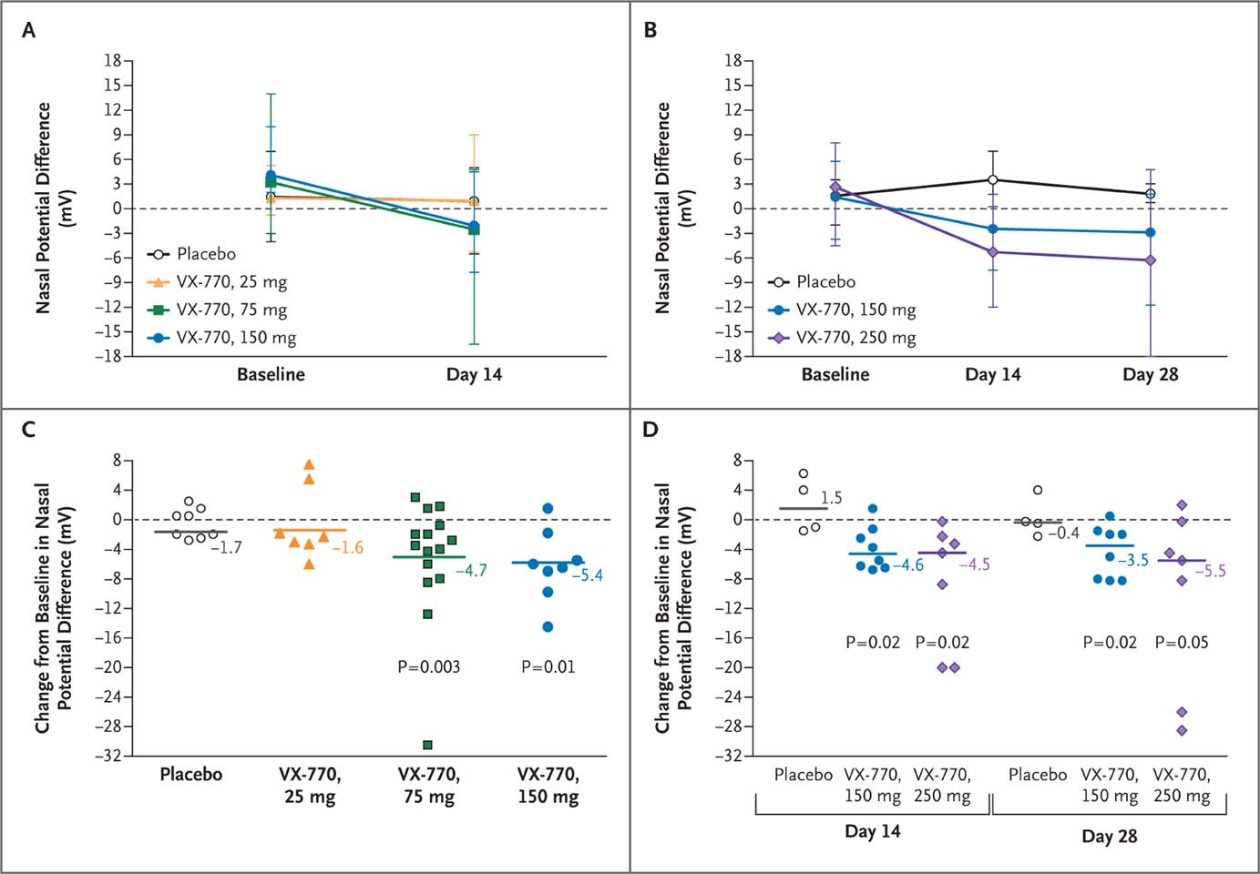
Measurements of the Nasal Potential Difference
Accurso FJ et al. N Engl J Med 2010;363:1991-2003
Notes:
Used as a surrogate to assess CFTR chloride transport function in the airway epithelium. Nasal potential difference is a test that measures the salt (sodium and chloride) transport in and out of the cells in the nose in response to different salt solutions. The way that cells respond to the changing salt solutions can be used to make a diagnosis of CF. G551D is a mutation which has CFTR with impaired ion transport so what we’re looking for is enhanced potential difference with active treatment.
Part I…increased nasal potential with increasing doses. Up to 8mL change from baseline.
Part II…higher doses are used. Continued increase in nasal potential with higher dose of 250 mg.
Phase II surrogate endpoints here would be
Figure 1 Measurements of the Nasal Potential Difference. Panel A shows the mean nasal potential difference (in response to the administration of a chloride-free isoproterenol solution) at baseline and day 14 during part 1 of the study in each of the four study groups. The I bars indicate the ranges, and the dashed line indicates no response. Panel B shows the mean nasal potential difference at baseline, day 14, and day 28 during part 2 of the study in each study group. The I bars indicate the ranges, and the dashed line indicates no response. Panel C shows the change in the nasal potential difference from baseline to day 14 in individual subjects (indicated by symbols) in each study group and the least-squares means (indicated by solid lines) from the mixed model in part 1 of the study. The dashed line indicates no change. Panel D shows the change in the nasal potential difference from baseline to day 14 or day 28 in individual subjects (indicated by symbols) in each study group and the medians (indicated by solid lines) in part 2 of the study. The dashed line indicates no change. P values are for within-subject comparisons.

Slide 16
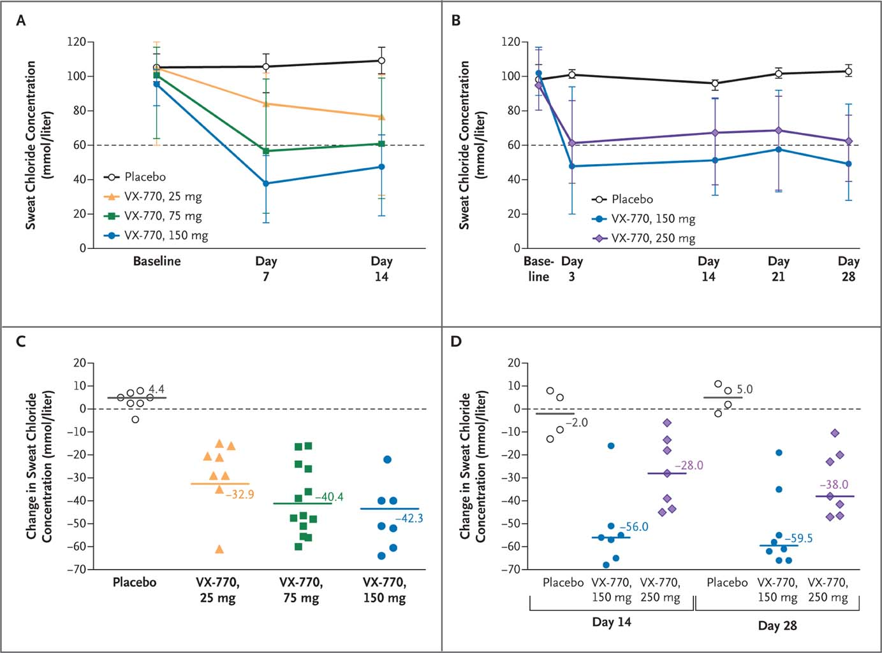
Measurements of Sweat Chloride Concentration
Accurso FJ et al. N Engl J Med 2010;363:1991-2003
Notes:
Sweat chloride test Used as a surrogate to assess CFTR chloride transport function outside of the respiratory epithelium.
Figure 2 Measurements of Sweat Chloride Concentration. Panel A shows the mean sweat chloride concentration at baseline and days 7 and 14 during part 1 of the study for each study group. The I bars indicate the ranges. Panel B shows the mean sweat chloride concentration at baseline and days 3, 14, 21, and 28 during part 2 of the study for each study group. The I bars indicate the ranges. The dashed lines in Panels A and B indicate the lower limit of abnormal sweat chloride concentrations. Panel C shows the change in the sweat chloride concentration from baseline to day 14 in individual subjects (denoted by symbols) in each study group and the least-squares means (indicated by solid lines) from the mixed model in part 1 of the study. P<0.001 for all comparisons (within-subject and vs. placebo). The dashed line indicates no change. Panel D shows the change in the sweat chloride concentration from baseline to day 14 or day 28 in individual subjects (symbols) in each study group and the medians (indicated by solid lines) in part 2 of the study. At day 14, in the VX-770 150-mg group, P=0.02 for within-subject comparisons and P=0.03 versus placebo. In the VX-770 250-mg group, P=0.02 for within-subject comparisons and P=0.05 versus placebo. At day 28, in the VX-770 150-mg group, P=0.008 for within-subject comparisons and P=0.02 versus placebo. In the VX-770 250-mg group, P=0.02 for within-subject comparisons and P=0.03 versus placebo. The dashed line indicates no change.

Slide 17
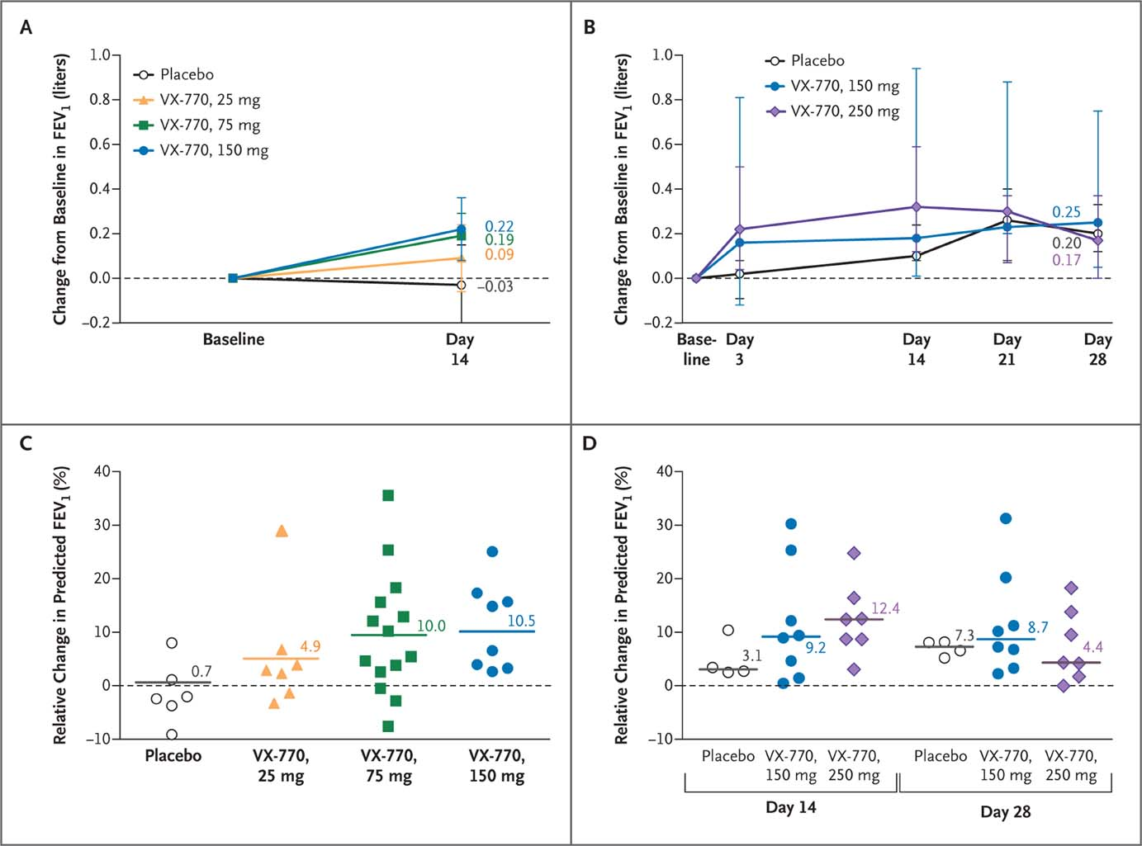
Measurements of Pulmonary Function
Accurso FJ et al. N Engl J Med 2010;363:1991-2003
Notes:
Figure 3 Measurements of Pulmonary Function. Panel A shows the mean change from baseline to day 14 in the forced expiratory volume in 1 second (FEV₁) during part 1 of the study in each study group. In the VX-770 150-mg group, P=0.006 for within-subject comparisons and P=0.04 versus placebo. In the VX-770 75-mg group, P=0.003 for within-subject comparisons and P=0.05 versus placebo. The I bars indicate the ranges. Panel B shows the median FEV₁ change from baseline during part 2 of the study in each study group. In the VX-770 250-mg group, P=0.02 for within-subject comparisons for all time points shown except for day 28, when P=0.03 for within-subject comparisons. In the VX-770 150-mg group, P=0.05 for within-subject comparisons at day 3 and P=0.008 for within-subject comparisons at days 14, 21, and 28. The I bars indicate the ranges. Panel C shows the relative change from baseline in the percentage of predicted FEV₁ from baseline to day 14 in individual subjects (indicated by symbols) in each study group and the least-squares means (indicated by solid lines) from the mixed model in part 1 of the study. In the VX-770 75-mg group, P=0.002 for within-subject comparisons, and in the VX-770 150-mg group, P=0.008 for within-subject comparisons. Panel D shows the relative change in the percentage of predicted FEV₁ from baseline to day 14 and day 28 in individual subjects (indicated by symbols) in each study group and the medians (indicated by solid lines) in part 2 of the study. At day 14, in the VX-770 150-mg group, P=0.008 for within-subject comparisons. In the VX-770 250-mg group, P=0.02 for within-subject comparisons. At day 28, in the VX-770 150-mg group, P=0.008 for within-subject comparisons. In the VX-770 250-mg group, P=0.03 for within-subject comparisons. In all four panels, the dashed lines indicate no change from baseline.

Slide 18
Conclusions
This study to evaluate the safety and adverse-event profile of VX-770 showed that VX-770 was associated with within-subject improvements in CFTR and lung function.
These findings provide support for further studies of pharmacologic potentiation of CFTR as a means to treat cystic fibrosis.

Slide 19
VX-770 update
Phase 3 Study of VX-770 Showed Profound and Sustained Improvements in Lung Function (FEV1) and Other Measures of Disease Among People With a Specific Type of Cystic Fibrosis
  Relative mean improvement in lung function of approximately 17% from baseline compared to placebo achieved by people treated with VX-770; mean absolute improvement from baseline of approximately 10.5% compared to placebo; both measures through 24 and 48 weeks
  Significant improvements in all key secondary endpoints for VX-770; patients were 55% less likely to experience a pulmonary exacerbation, had significant reductions in sweat chloride and, on average, gained nearly 7 pounds
  Discontinuations due to adverse events were less frequent among people treated with VX-770
VX-770 approved in January 2012

Slide 20
Questions
Predictive marker?
Prognostic marker?
Surrogate marker?

Slide 21
Key takeaways/ Remaining issues
Surrogate markers are often used for decision making in early phase studies
  CFTR conductance
More meaningful clinical endpoints are often included to ascertain correlation with the surrogate markers
  Lung function measurements
Mechanistically appropriate predictive diagnostic enabled the development of a novel class of CF therapeutic
Still unmet remaining need for the other 95% of the CF patients with CFTR mutation other than G551D-CFTR allele
  VX-809 is being developed as a combination with VX-770
  VX-809 is designed to move defective CFTR to surface

Slide 22
Case Study # 2: BRAF-ing Metastatic Melanoma

Slide 23
Melanoma
Malignant tumor of melanocytes
Predominantly occur in skin but occasionally in other parts of the body
Less common than other skin cancers but with much worse prognosis. Causes 75% of deaths related to skin cancer
Metastatic melanoma
  Aggressive disease with few effective therapies
  Only 3 drugs approved with overall response rates in 10-20% range
    High-dose IL-2
    Dacarbazine
    Ipilimumab (Anti-CTLA-4)
  Median survival ~8 months

Slide 24
Identification of BRAF expression on melanoma
BRAF is an upstream component of growth promoting mitogen-activated protein (MAP) kinase pathway
Melanoma cells containing mutant BRAF are dependent on MAP kinase signaling for their growth and survival
Discovery that 50% of human melanomas harbor an activating mutation in BRAF
Extensive preclinical data validated the V600E mutation as an important therapeutic target in melanoma

Slide 25
PLX4032: Phase I/II study in metastatic melanoma
Objective | Assess safety and tolerability of PLX4032 in solid tumor and the efficacy of inhibition of mutated, activated BRAF in Metastatic Melanoma
Design | Multicenter, dose escalation Phase I/II study with extension phase
Patients | Dose escalation: Patients with refractory solid tumor Extension: Patients with melanoma with V699 BRAF mutation as ascertained by PCR
Treatment | Dose escalation: 160 mg po bid and higher until unacceptable side effects or disease progression Extension: Treated at MTD identified during the dose escalation phase
Endpoints | Primary: Safety and tolerability Secondary: Tumor response
Flaherty KT et al. N Engl J Med 2010;363:809-819
Notes:
Plexikon initiated a Phase I/II study
Assess the safety and tolerability of PLX4032 by doing the usual dose escalation study. For that part of the study, they enrolled patients with refractory solid tumor and conducted the usual dose escalation study until Maximal Tolerated Dose was reached.
This dose was then used in the extension part of the study where they enrolled patients with metastatic melanoma with V699 BRAF mutation as ascertained by PCR
The primary endpoint was safety and tolerability and the Secondary was tumor response.

Slide 26
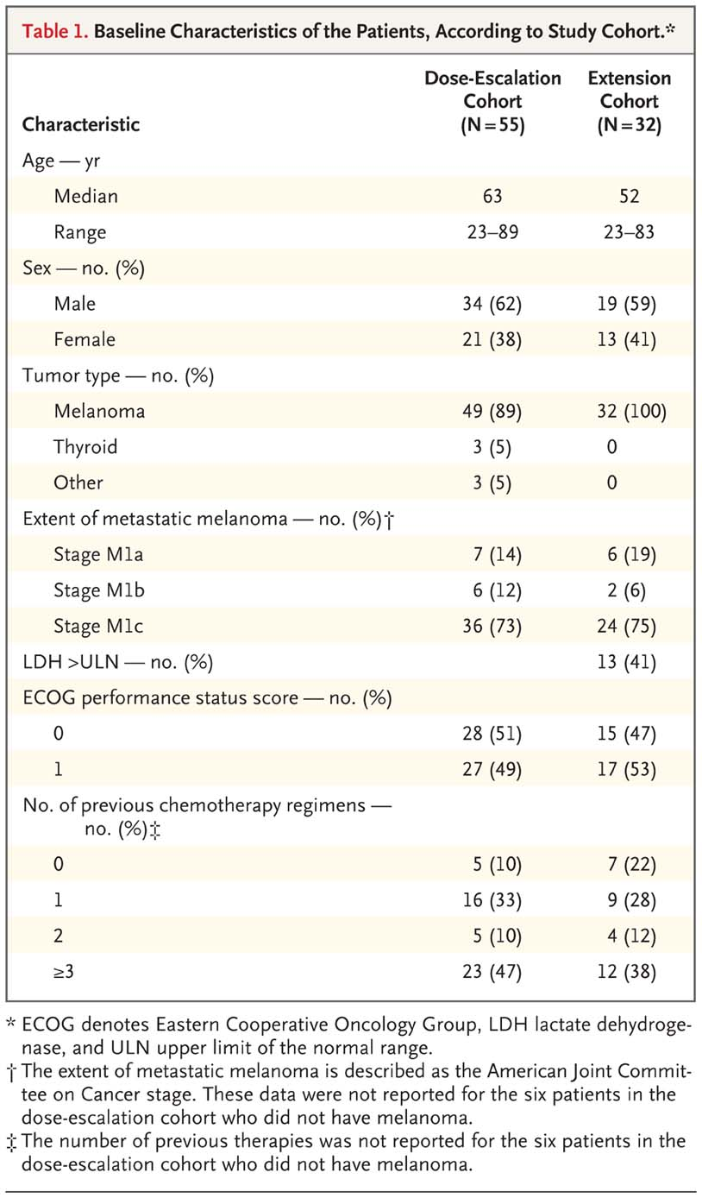
Baseline Characteristics of the Patients, According to Study Cohort
Flaherty KT et al. N Engl J Med 2010;363:809-819
Notes:
Table 1 Baseline Characteristics of the Patients, According to Study Cohort.
A couple of thins worth noting…
You’ll note that despite entry criteria in the dose escalation cohort including all refractory solid tumors, a great majority of the patients were patients with melanoma. This reflects the lack of treatment out there for melanoma but also reflects the excitement about this pathway generated by the preclinical data.

Slide 27
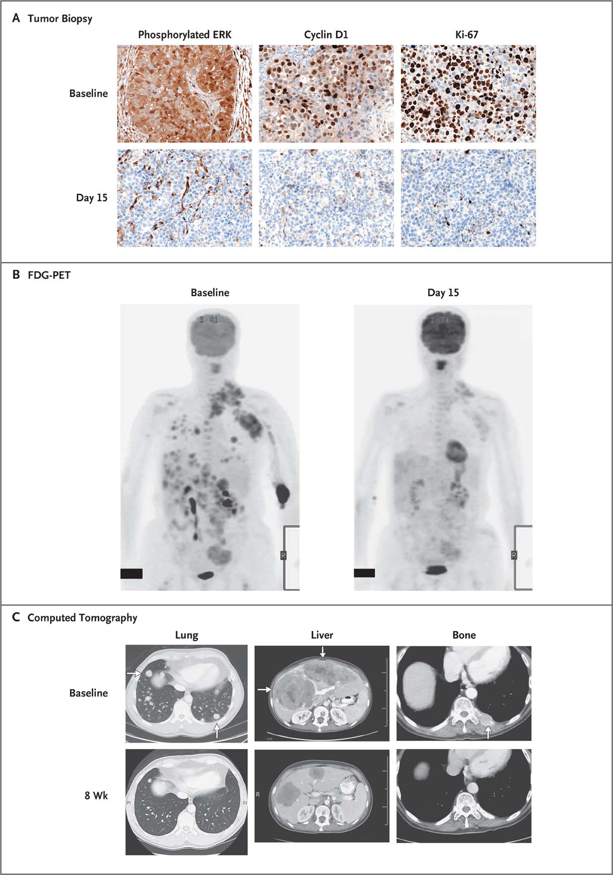
Representative Findings of the Effect of PLX4032 at the Recommended Phase 2 Dose in Study Patients with Melanoma That Carried the V600E Mutation
Flaherty KT et al. N Engl J Med 2010;363:809-819
Notes:
Figure 2 Representative Findings of the Effect of PLX4032 at the Recommended Phase 2 Dose in Study Patients with Melanoma That Carried the V600E Mutation. The recommended phase 2 dose was 960 mg twice daily.
Panel A (hematoxylin and eosin) shows immunohistochemical analyses of the expression of phosphorylated extracellular signal-regulated kinase (ERK), cyclin D1 (regulatory unit of an enzyme with many functions among which cell cycle/prolifetion is implicated), and Ki-67 in tumor-biopsy specimens obtained at baseline and on day 15 of treatment….suggests that PLX4032 inhibited the MAP kinase pathway resulting in decreased cyclin D1 levels and decreased proliferation. Antigen KI-67 is a nuclear protein that is associated with and may be necessary for cellular proliferation
Panel B shows the uptake of ¹⁸F-fluorodeoxyglucose (FDG) at baseline and on day 15 of treatment, as assessed by means of positron-emission tomography (PET). On the baseline panel, you can see the many tumors lighting up and on the Day 15, substantially less.
Panel C shows computed tomographic images of lesions (arrows) in lung, liver, and bone (with each pair of images shown for a different patient) at baseline and at 8 weeks.

Slide 28
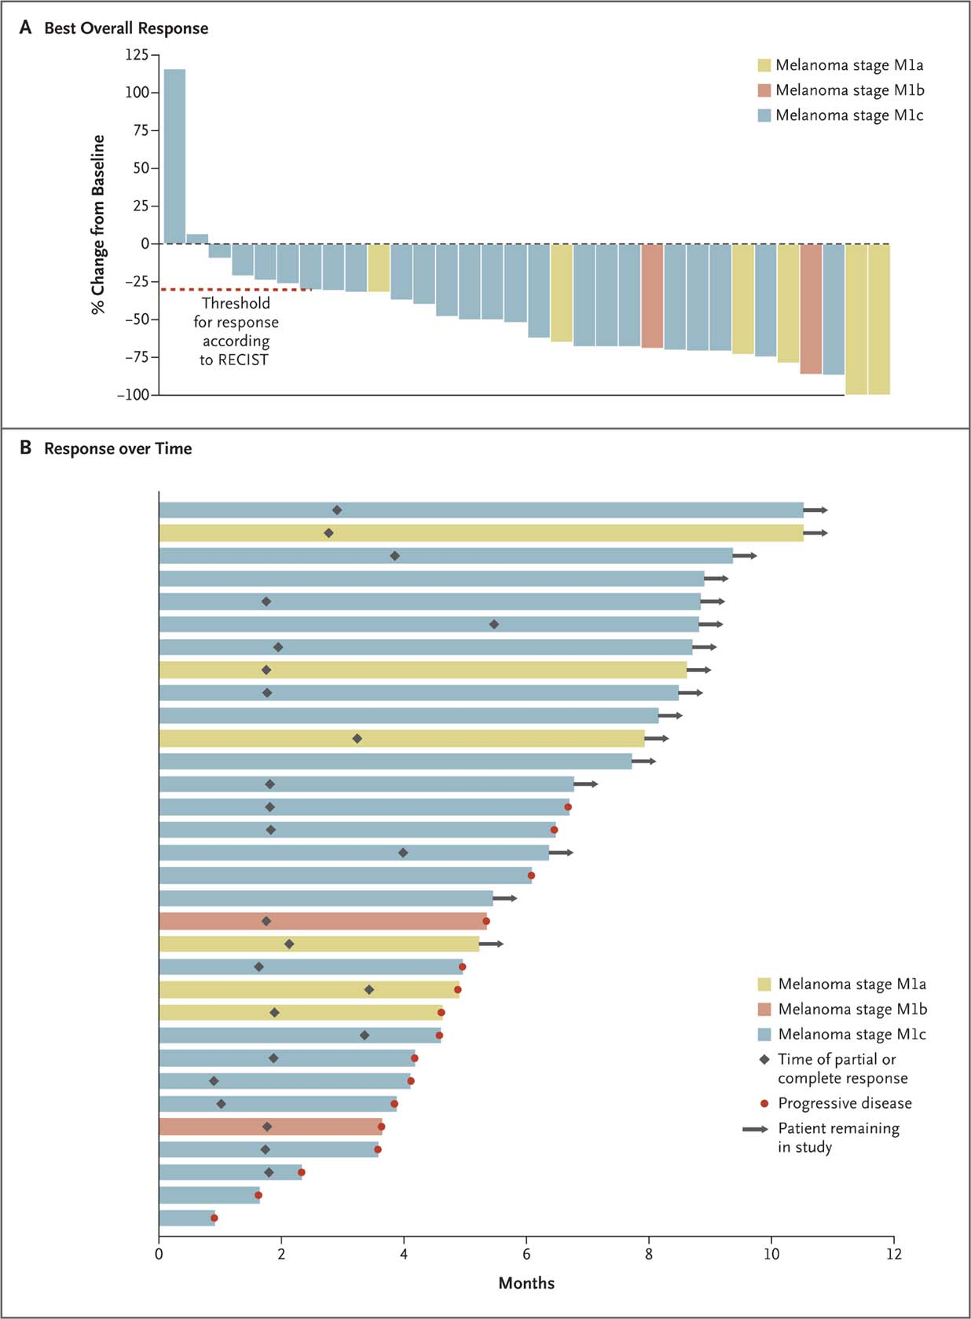
Antitumor Response in Each of the 32 Patients in the Extension Cohort
Flaherty KT et al. N Engl J Med 2010;363:809-819
Notes:
This shows the Antitumor Response in Each of the 32 Patients in the Extension Cohort.
All 32 patients had melanoma tumors that carried the V600E mutation of the v-raf murine sarcoma viral oncogene homologue B1 (BRAF).
All were treated at the recommended phase 2 dose of 960 mg twice daily.
Panel A shows the best overall response for each of the 32 patients, measured as the change from baseline in the sum of the largest diameter of each target lesion. Negative values indicate tumor shrinkage, and the dashed line indicates the threshold for a partial response according to Response Evaluation Criteria in Solid Tumors (RECIST) (i.e., shrinkage by 30%). Two patients had a complete response.
Panel B shows the duration and characteristics of the responses in each patient.
Side effects included rash, arthralgia, fatigue, and keratoacanthoma

Slide 29
Update on PLX4032
In Phase I study in metastatic melanoma, treatment with PLX4032 resulted in 81% response rate and extended overall survival by 7 months (range 2-18 months)
  Responses observed within 1-2 weeks of initiating therapy
  Tumor shrinkage at all metastatic sites like bone, liver, and small bowel
Preliminary results from Phase II trials showed a RR of 52%, with PFS of 6.2 months
PLX 4032 is one of the rare drug to go directly in Phase III trials without completion of Phase II BRIM 2 trial
Approved in August 2011 for increasing OS and PFS in treated patients
The product does not work in patients without BRAF gene mutation and failed to show activity in colon cancer patients with BRAF gene mutation
Notes:
In Phase I, Treatment with Vemurafenib (PLX 4032, RG7204) at 960 mg BID produced 2 complete responses and 24 partial responses out of 32 patients. Responses were observed within a week 1-2 of initiating therapy. tumor shrinkage was observed at all metastatic sites like bone, liver and small bowel.
Vemurafenib (PLX 4032) is a BRAF gene mutaton inhibitor which may herald the era of personalized therapy for melanoma patients. It seems to work in patients who test positive for the gene mutation. In BRAF V600E gene mutation +ve patients it resulted in tumor regression and increased survival varying by few months and had complete and partial responses.
However all the patients had relapse and progressive disease after a period of PFS.

Slide 30
Questions
Predictive biomarker?
Prognostic biomarker
Surrogate biomarker?

Slide 31
Key takeaways
Biomarkers can be used for patient selection
Predictive biomarkers can reduce the size of the study by enriching for responders
Surrogate biomarkers can be used for decision making but may be considered insufficient for regulatory approval
Outstanding questions
Worked in BRAF positive melanoma, not in colon carcinoma…why?
With predictive biomarker, is it important to ensure that it does not work in the diagnostic negative patient group---Phase III include patients who are BRAF negative?
All patients relapse…why?
Notes:
How do you define BRAF positive?
Why the recurrence? Escape mutants?
Phase III population include BRAF negative patients?

Slide 32
Prognostic biomarkers
Forecasts the likely course of disease in a defined population due the underlying pathology irrespective of treatment
  Biomarker at baseline
  Change in biomarker over time
  Examples from clinical practice
    Triple negative breast cancer, heart rate variability post-MI, etc
Use of prognostic biomarker has been limited in drug development
Prognostic biomarkers have the potential to add huge value in
  Development of disease modifying therapies
  Development of therapies for diseases with an overall slow progression rate (but a subgroup may progress faster)
  Development of drugs in diseases where only a fraction of the patients progress
Notes:
Disease modifying….T1DM (once disease onset, Beta cells are gone)
Alzheimers
NASH

Slide 33
Examples of diseases where prognostic factor would facilitate drug development
  Alzheimer’s
    MCI to Alzheimer’s disease conversion rate is 12%
    Clinical trials assessing treatment response rate (conversion for MCI to mild Alzheimer’s disease) will require very large studies.
    Enrichment of trials with patients of similar prognosis could speed up proof of concept and dose-ranging studies
    Understanding which patients progress would help direct treatment to the most appropriate patients
  Non-alcoholic steatohepatitis
    Fatty liver to liver cirrhosis occurs in approximately 15%
    Progression from fatty liver to cirrhosis can take 5 to 20 or more years
    Enrichment of study with patients likely to progress (faster) would enable clinical development
Understanding which patients progress would help direct treatment to the most appropriate patients

Slide 34
Use of surrogate endpoints in cardiology

Slide 35
Surrogate biomarkers
Must be relevant to MOA
Must be relevant to pathophysiology of disease
Can be used for early phase decision making if appropriate
Greater evidence of correlation with clinical endpoint of interest is required to be considered an approvable endpoint from regulatory perspective
  Should be correlated with outcome in clinical trials of more than one drug with the same mechanism of action targeted at the same indication
  Longterm follow up may be required to ensure predictability
  Extrapolation of a validated surrogate marker to drugs with different mechanisms for the same clinical indication or to drugs with same mechanisms for different indications needs careful consideration

Slide 36
Surrogates as approvable endpoints in cardiology
Blood pressure
LDL
Only became approvable with substantial evidence that lowering of blood pressure and cholesterol are clearly linked to reduction in mortality due to h=MI and stroke (4S Scandinavian Simvastatin Survival Study and Heart Protection Study)
Notes:
These surrogate endpoints have stimulated drug development in this space significantly over the past couple of decades.

Slide 37
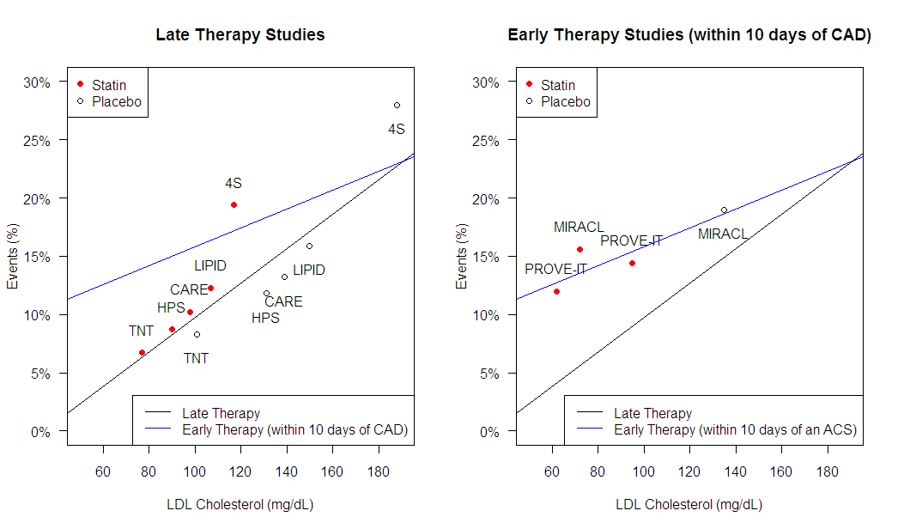
Regression line in late therapy studies*:
Events (%) = 0.148* LDL (mg/dL) - 5.1
MACE events versus LDL cholesterol levels
Slide 37
Regression line in early therapy studies
(4 data points from MIRACL and PROVE-IT):
Events (%) = 0.08* LDL (mg/dL) + 7.7
*LaRosa et al., N Engl J Med 2005;352:1425-35
Notes:
Progessive lowerig of of LDL through intensification of statin therapy has led to reduction in cardiovascular events and death from cardiovascular causes

Slide 38
Ezetimibe
Cholesterol lowering through reduction of cholesterol absorption in the intestine
FDA approved for use in 2002 based on ability to lower LDL
  Pivotal studies for approval comprised of 6 week studies demonstrating 31% reduction of LDL cholesterol on patients treated with ezetimibe
Vytorin (ezetimibe plus simvastatin) was approved by FDA in 2004 as an LDL lowering agent
  Pivotal studies for approval comprised of 6 week studies to demonstrating substantial (40-60%) reduction of LDL cholesterol in patients treated with Vytorin

Slide 39
Controversies regarding Ezetimibe approval
Primarily LDL lowering
Not a statin
Some of the benefits of reduction in mortality by statin treatment is attributed the anti-inflammatory effects of statins and not to LDL lowering

Slide 40
Intravascular Ultrasound (IVUS)
Medical imaging study used for visualizing the endothelium of blood vessels in living individuals
Most often used in the coronary arteries to quantify atheromatous plaque built up and the degree of stenosis of the arterial lumen
IVUS is widely available in coronary catheterization labs worldwide
Increasingly being used to evaluate newer and evolving strategies for the treatment of coronary artery disease as a precursor to a clinical outcomes study
Notes:
Non-invasive imaging and biochemical biomarkers for identification of “vulnerable plaque” for primary prevention studies
IVUS
FDG-PET
MRI
Multislice CT
Using imaging for proof of concept studies prior to initiation of outcome studies
Potential for imaging to become approvable endpoint?

Slide 41
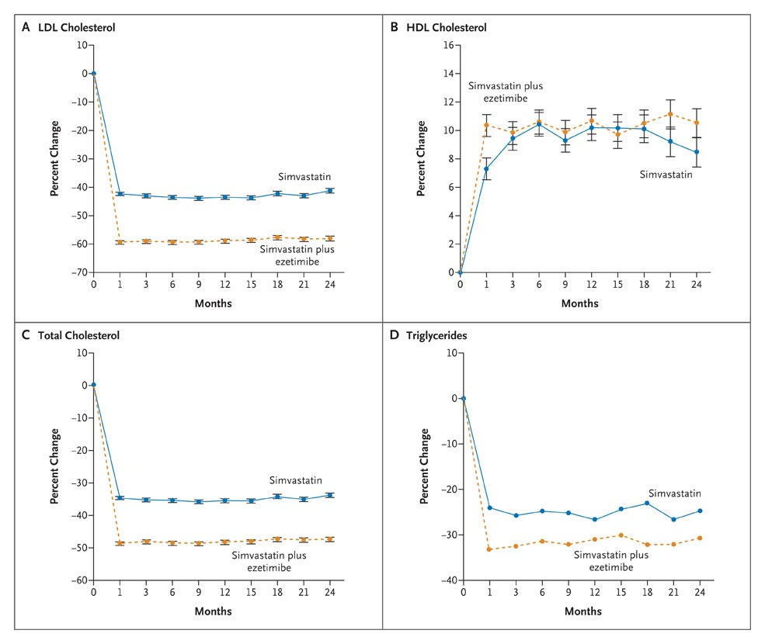
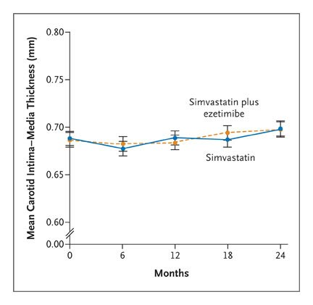
ENHANCE Trial Results
In a 2-year clinical trial, the addition of ezetimibe to simvastatin had no effect on the progression of atherosclerosis, as measured by carotid-artery intima-media thickness, despite the additional lowering of levels of low-density lipoprotein cholesterol and C-reactive protein by ezetimibe when added to simvastatin
.
Kastelein JJP et al. N Engl J Med 2008;358:1431-1443
Notes:
The ENHANCE trial was not a clinical-outcome trial, but an imaging study of the thickness of plaque in arteries. The American College of Cardiology (ACC) maintains that ezetimibe may be a reasonable option for patients who cannot tolerate a statin or cannot be controlled on a high dose statin.[13] The primary outcome in the treatment of hypercholesterolemia is prevention of cardiovascular events such as death from cardiovascular disease. While the ENHANCE trial did not have the power to detect significant differences in death, it measured the difference in artery thickness (in the carotid and femoral intima-media) to detect reductions in atherosclerotic plaque. At the end of two years, there was no significant difference in artery thickness between patients taking simvastatin and ezetimibe versus patients taking simvastatin alone.[14]
Since in the ENHANCE trial ezetimibe didn't reduce cardiovascular events, atherosclerosis or death, despite the reduction in LDL, doctors have been trying to figure out whether it has any use. Doctors have also concluded that reducing LDL doesn't always reduce atherosclerosis. Reviewers of the ENHANCE trial have raised the possibility that it did not last long enough for ezetimibe to work. Also, many patients had already been treated on statins for a long time, so their artery thickness was already lower. Perhaps if they had not used statins, ezetimibe might have had a greater effect.[15]
Results from the trial have provoked three large clinical-outcome trials.
The ARBITER 6–HALTS trial[2] enrolled patients with coronary artery disease, or an equivalent risk condition such as diabetes, who were already taking statins. They were randomized to additionally take either extended-release niacin or ezetimibe, and the primary end point was change in artery wall thickness. Both drugs reduced LDL cholesterol levels. Niacin reduced artery wall thickness, but ezetimibe paradoxically increased artery wall thickness. Patients on ezetimibe also had more major cardiovascular events. The trial was terminated early after 208 volunteers had completed the study.
The results from the other trials will be presented in the next 3 years. However even before completion of ARBITER 6–HALTS, a March 30, 2008 meeting of the ACC resulted in negative press for drugs like Zetia as Yale University Cardiologist Harlan Krumholz and concurring colleagues called into question the efficacy of such drugs.[16] Krumholz' statements maintained that such pharmaceuticals should not be the first or even second option for prescribing doctors. Definitive conclusions of the efficacy and safety of Zetia can be made such a time when the results of more substantial and comprehensive trials are released, such as the upcoming SHARP Trial which has an enrollment of 9000 patients and will report in 2010 and IMPROVE-IT Trial which has an enrollment of 18,000 patients and will report in 2012.
Results of the Simvastatin and Ezetimibe in Aortic Stenosis (SEAS) trial (ClinicalTrials.gov number, NCT00092677 [ClinicalTrials.gov] ) showed a potential increase in cancer in association with the use of these drugs together. (www.nejm.org September 2, 2008 (10.1056/NEJMe0807200). The actual significance has yet to be determined.
Trials of ezetimibe in combination with simvastatin have proven more favourable than those for ezetimibe alone, however. A 2010 study found that this combination was more effective at lowering lipid levels than alternative agents rosuvastatin and atorvastatin.[3] In the SHARP study, cardiovascular events were lowered by combining ezetimibe and simvastatin

Slide 42
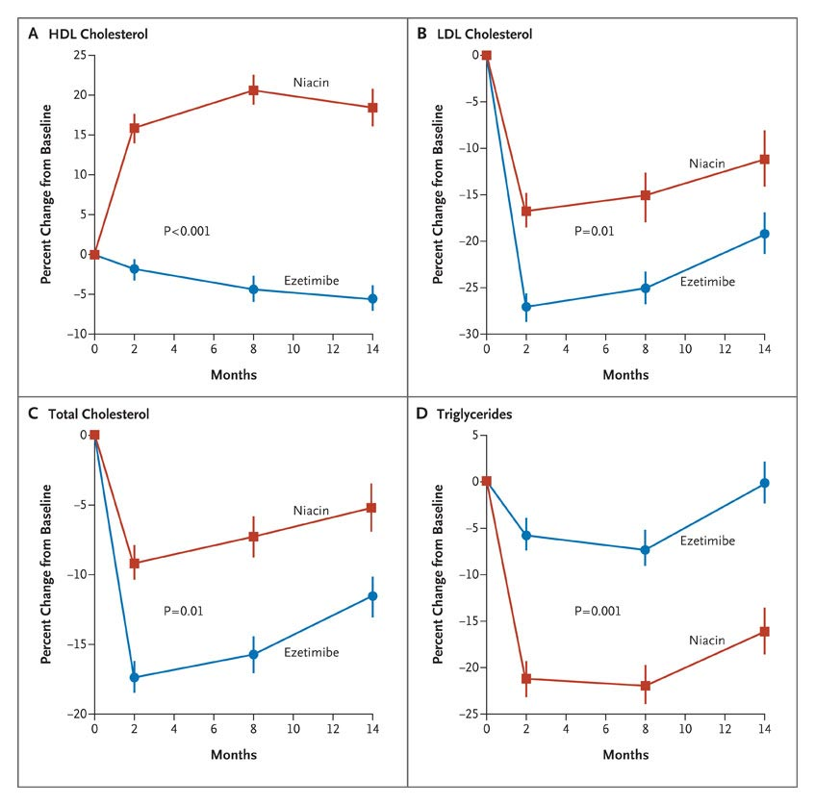
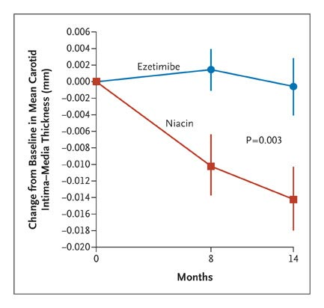
ARBITER 6-HALTS Study: Extended –release Niacin or Ezetimibe and carotid intima-media thickening
In patients who have, or are at risk for, coronary artery disease, extended-release niacin added to statin therapy resulted in regression of the carotid intima-media thickness
In contrast, ezetimibe added to statin therapy paradoxically resulted in progression of the carotid intima-media thickness in relation to the extent of reduction of low-density lipoprotein (LDL) cholesterol levels
Taylor AJ et al. N Engl J Med 2009;361:2113-2122

Slide 43
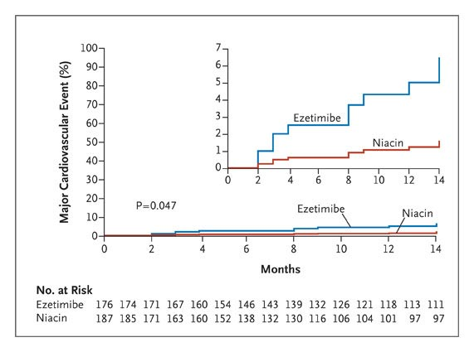
Kaplan-Meier Estimates of the Incidence of a Major Cardiovascular Event among the 363 Study Patients, According to Treatment Group
Patients on ezetimibe also had trend for more major cardiovascular events.
The trial was terminated early after 208 volunteers had completed the study
Taylor AJ et al. N Engl J Med 2009;361:2113-2122
Notes:
Figure 3. Kaplan-Meier Estimates of the Incidence of a Major Cardiovascular Event among the 363 Study Patients, According to Treatment Group. The P value, calculated with the use of the log-rank test, is given for the comparison between the two treatment groups at 14 months. The inset shows the same data on a magnified scale.

Slide 44
Implications for Ezetimibe and LDL surrogate endpoint
Results from the trial have provoked large clinical-outcome trials
  SHARP Trial
    The objectiveof this study is to evaluate the effect of treatment with simvastatin/ezetimibe vs simvastatin alone on:
      Major adverse cardiovascular events ( MACE) in patients with kidney disease.
      Blood cholesterol levels
      Progression to dialysis
    Total enrollment: 9000
    Last patient in: Sept 2010
  IMPROVE-IT Trial
    The primary objective is to evaluate the clinical benefit of Ezetimibe/Simvastatin Combination compared to Simvastatin on
      MACE
    Total enrollment: 18000 patients
    Last Patient in: 2013

Slide 45
Takeaways
Must be relevant to MOA
Must be relevant to pathophysiology of disease
Surrogate biomarkers should be correlated with outcome in clinical trials of more than one drug with the same mechanism of action targeted at the same indication
Longterm follow up may be required to ensure predictability
Extrapolation of a validated surrogate maker to drugs with different mechanisms for the same clinical indication or to drugs with same mechanisms for different indications needs careful consideration

Slide 46
Review
Biomarker definitions
  Pharmacokinetics
  Pharmacodynamics
  Predictive
  Prognostic
  Surrogate
Case studies of Biomarker use in drug development
  Cystic fibrosis drug development
  New targeted therapy in melanoma
  Use or surrogate marker in cardiology development

Slide 47
Take home message
Many different types of biomarkers are used in drug development
The more mechanistic understanding there is for the disease, the easier it will be to select an appropriate biomarker
The most mechanistic understanding there is for the drug target, the easier it will be to select an appropriate target
There are risks associated with use of biomarkers in decision making in drug development
Appropriate use of biomarkers are essential in efficient drug development process

Slide 48
APPENDIX

