Slide 1
Overview of the Following Sections:
Section II: Sponsor and Co-Sponsor,
Goals for Fellowship/Training,
Activities Planned Under this Award,
Doctoral Dissertation and Research Experience
Sarah Woolf-King, PhD, MPH
Epi 258
February 8th, 2015

Slide 2
Overview of Section II
Limited to 6 pages (I-98)
Must include following section with header (see title of slide)
  Research Support Available
  Recent & previous mentees
  Training plan
  Environment & Research facilities
  Current number of fellows/trainees
  Applicant’s qualifications and potential for a research career

Slide 3
Choosing a Sponsor/Mentoring Team
From Siegle et al
  Sponsor should be expert in research area of proposal
  Published a bunch
  Mentored other NRSA or K-awardees
  Have funding in proposed research area
  Be local (i.e., at UCSF)
  Have a team of consultants

Slide 4
Research Support Available
In a table, list all current and pending research and research training support specifically available to the applicant for this particular training experience.
Include funding source, complete identifying number, title of the research or training program, and name of the principal investigator, dates, and amount of the award. Include this information for any co-sponsor as well.
List for all co-sponsors as well
Example: Santos

Slide 5
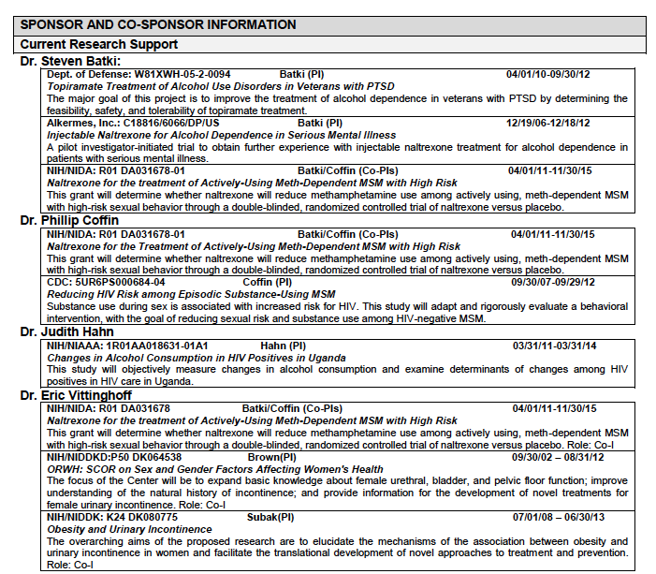
Example: Research Support (Santos)

Slide 6
Sponsor/Co-Sponsor’s Previous Fellows/Trainees
  Give the total number of predoctoral and postdoctoral individuals previously sponsored.
  Select up to five that are representative and, for those five, provide their present employing organizations and position titles or occupations.
  Include this information for any co-sponsor as well.

Slide 7
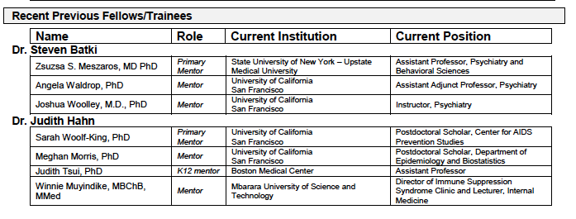
Example: Fellows/Trainees

Slide 8
Training plan
Describe the research training plan that has been developed specifically for you.
Include items such as classes, seminars, and opportunities for interaction with other groups and scientists.
Career development plan should be described in detail and reiterated in the “Goals for Fellowship and Training”
Written in the voice of your Sponsor

Slide 9
Training Plan Cont’d
From Siegle et al:
  Training should be “above and beyond what you would receive in grad school”
  Specific skills to further your career
  If proposing coursework, should be more than you would already be gaining from grad program
  Training should differentiate you from sponsor
  May want to include skills-building in grant & manuscript writing.

Slide 10
Training Plan Cont’d
WIDE variability is how this section is written.
The “training” component is at least .5 page, but up to 2.
Emphasize how proposed training is above/beyond training would otherwise receive in grad school (i.e., how is it individually tailored and specialized?)
  You will be able to describe the basic program requirements of your PhD in “Additional Education Information”
Examples:
  Santos/Moseson: “Logic Model”, heavily focused on mentoring, no specifics on coursework.
  Bryant-too much space devoted to environment?
  Redacted really good example of how to organize this section according to training needs. Also good example of how Training Plan can be complimentary with Goals for Fellowship Training and Career. Also liked the “manuscript writing and grantsmanship” training goal.
  Sheffield also good example.
  What do you guys think?

Slide 11
Environment & Research Facilities
Most of the F31s do this in ½ page or so
  Although WIDE variability—from no text (Wagman) to 1.5 pages (Bryant)
  Prob best to put something, but make it complimentary with F & OR.
    May want to get the text form your dept for F&OR and then add a paragraph or so that is not redundant for this section.
    F&OR is more physical resources, while this section maybe focused more on seminars, courses, faculty have access to.
  No need to waste a lot of space on this if it’s redundant with F & OR
Let’s look at a couple of the examples…

Slide 12
Applicant's Qualifications and Potential for a Research Career
Describe how the Fellowship applicant is suited for the research training opportunity based on his/her academic record and research experience level
How does the research training plan, and the sponsor’s own expertise, assist in producing an independent researcher.
Read and Discuss Sheffield & Wagman

Slide 13
Discussion:
Sheffield & Wagman
What did you like/dislike about each?
Which one came across as more personal/specific to the Applicant?
If you were a reviewer, what impression would you have of the Applicant based on these statements?

Slide 14
Qualifications Cont’d
Sheffield
  Tone is informal, but personal
  To me, looks like Sponsor actually wrote it
  Nicely differentiates Sponsor’s research from the Applicant’s
  Strengths listed are very specific to the Applicant (i.e., not generic).

Slide 15
Qualifications Cont’d
Wagman
  Short in length, and not super enthusiastic
    E.g., “highly appropriate” vs “outstanding!
  Lists of strengths are less specific/individualized
    E.g., “competent” and “committed”

Slide 16
Goals for Fellowship and Training
1 page
Probably helpful to write this in tandem with “Training” component of Section II.
Describe overall career goals; explain how the proposed research training will enable the attainment of these goals.
Identify the skills, theories, conceptual approaches, etc. to be learned or enhanced during the award.

Slide 17
Activities Planned Under Award
1 page
Describe by year the activities (research, coursework, etc.) you will be involved in under the proposed award and
Estimate the percentage of time to be devoted to each activity, based on a normal working day for a full-time fellow as defined by the sponsoring institution. The percentage should total 100 for each year.
Also, briefly explain activities other than research and relate them to the proposed research training

Slide 18
Examples:
Activities Planned Under Award
Again, variability (and creativity!) allowed in how you present this section.
Santos
Wagman

Slide 19
Doctoral Dissertation &
Research Experience
Limited to 2 pages (I-97)
Summarize research experience in chronological order
Advanced graduate students, who have (or will have) completed their comprehensive examinations by the time of award must also include a narrative of their doctoral dissertation (may be preliminary).
If you have no research experience, list other scientific experience. Do not list academic courses.

Slide 20
Doctoral Dissertation and Research Experience
Redacted vs. Santos-Thoughts?
List all of your experiences, however don’t make too dry.
Insert some of yourself! Why are you so passionate about what you’re doing?

Slide 21
Assignments
Assignment 5a: Turn in 1st draft of these 2 sections (Due 2/16):
  Goals for Fellowship Training and Award (1 page)
  “Training” Section of Section II (.5 to 1.5 pages)
Assignment 5b: Turn in mentor feedback (summarize if feedback given verbally) and revised specific aims page. Due 2/23.
Assignment 5c: Request information needed from sponsor and co-sponsor for Section II: Parts A, B, and D. Due 2/23.
Watch NIH peer review video (for class 2/23)http://public.csr.nih.gov/aboutcsr/contactcsr/pages/contactorvisitcsrpages/nih-grant-review-process-youtube-videos.aspx
Read http://grants.nih.gov/grants/peer/critiques/f.htm (for class 2/23)

