Slide 1
EPI 262:
Meta-Analysis Case Studies
Course Director: Michael A. Kelsh, MPH, PhD
Center for Observational Research, Amgen, Inc.
Department of Epidemiology and Biostatistics, UCSF
* Acknowledgement – Charles Poole, UNC

Slide 2
Meta-Analysis – Promise and Concern
"Meta-analysis is the wave of the future...It’s going to revolutionize how sciences, especially medicine, handle data. And it’s going to be the way many arguments are ended.”
Thomas Chalmers (1990)
"Meta-analysis is a boon for policy-makers who find themselves faced with a mountain of studies... That’s what everybody likes about it, and that’s also what everyone is so worried about.”
Kay Dickersin (1990)

Slide 3
Meta-analysis attitude scale
| 0 | 1 | 2 | 3 | 4 | 5 | 6 | 7 | 8 | 9 | 10 |
Always
aggregate
“We understand meta-analysis as being the use of statistical techniques to combine the results of studies addressing the same question into a summary measure.”
Villar et al. (2001)
“Meta-analysis is a quantitative method of aggregation.”
Olkin (1994)

Slide 4
Meta-analysis attitude scale
| 0 | 1 | 2 | 3 | 4 | 5 | 6 | 7 | 8 | 9 | 10 |
Never
aggregate
"There are still too many epidemiologists who are willing to equate aggregation with truth.“
Shapiro (1994)
“I would like to reinforce that meta-analysis is not solely a synonym for the statistical procedures that produce a combined effect size.”
Olkin (1995)

Slide 5
Measure of Risk: Poole’s letter on Coffee and MI
Before 1st cup of coffee – reads case-control study about MI and coffee consumption OR=1.5
Hummm – what is the Risk Difference
Need to obtain baseline risk data for MI
Found information in Framingham Study ~ 10% risk across 10 year time period
Translates to 1/million risk in next hour, so 50% increase (from 1 to 2/million) or extra heart attack per 2,000,000 cups of coffee
Always consider the absolute risk

Slide 6
Indirect Comparison of Meta-Analysis Findings on Adverse Treatment Outcomes: Impact of Trial Heterogeneity and Effect Measure Selection
Case Study

Slide 7
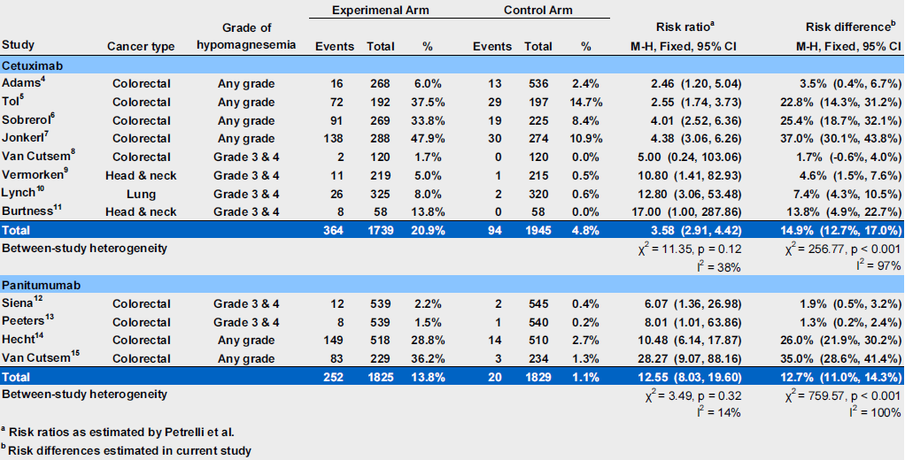
Table 1. Risk of hypomagnesemia associated with cetuximab and panitumumab as reported in Petrelli et al. with corresponding risk differences estimated in the present study

Slide 8
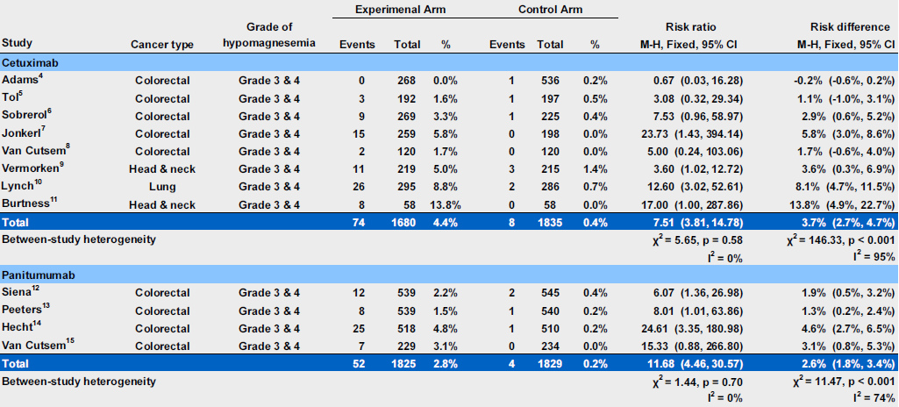
Table 2. Risk of hypomagnesemia associated with cetuximab and panitumumab: a subgroup analysis restricting to grade 3 & 4 events

Slide 9
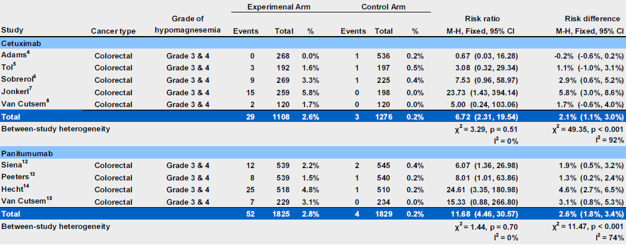
Table 3. Risk of hypomagnesemia associated with cetuximab and panitumumab: a subgroup analysis restricting to grade 3 & 4 events in colorectal cancer trials

Slide 10
MetaAnalysis – A Transparent Quantitative Summary of Epidemiologic Data? – Think Again: A Case Study of Hair Dye Use and Bladder Cancer

Slide 11
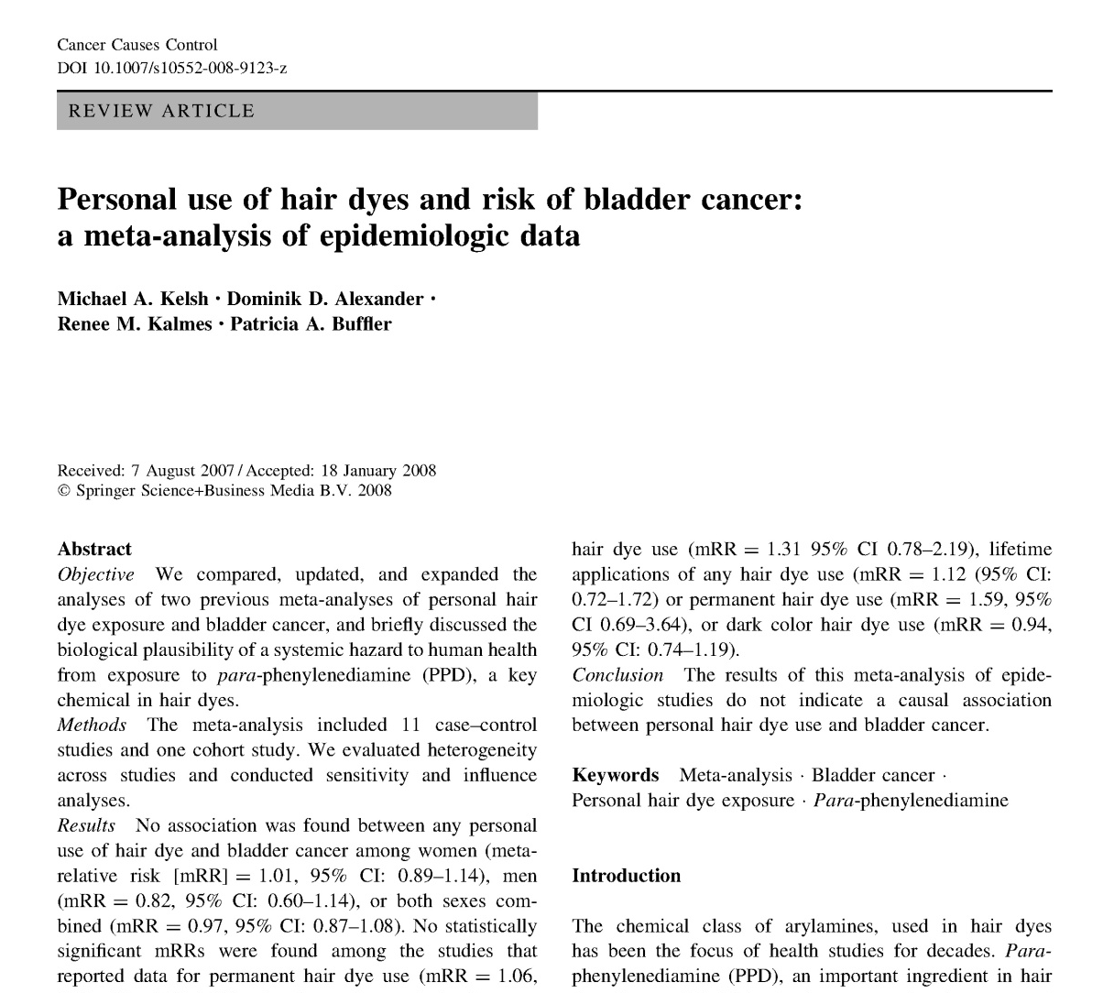
Kelsh et al., 2008
Publication – Meta-Analyses of Hair Dyes and Bladder Cancer

Slide 12
Research Funding
This research was funded by L’Oreal USA, a manufacturer of hair dyes and other beauty care products
L’Oreal staff had no role in the design, interpretation of these data, or writing of the scientific manuscript
Manuscript was not subject to approval by any staff or representative of L’Oreal

Slide 13
Personal Hair Dyes and Bladder Cancer
Bladder cancer – significant public health issue ~ 50,000 new cases diagnosed per year
Widespread hair dye use
  > 33% usage among women > 40 yrs old
  ~10% usage among men > 40 yrs old
Aromatic amine in hair dyes – potential to be absorbed percutaneously
Potential occupational risk among hair dressers

Slide 14
Conflicting Meta-Analysis Conclusions
Huncharek and Kupelnick 2005 (Public Health Reports):
  “The available epidemiological data suggest an association between personal hair dye use products and increased risk of bladder cancer”
Takkouch et al 2005 (JAMA):
  “..pooled relative risk for ever users of hair dyes was 1.01 (95% CI 0.89-1.14) for bladder cancer (10 studies). No effect was observed for use of permanent dyes or for extensive use..”

Slide 15
Conflicting Meta-Analysis Conclusions
Huncharek and Kupelnick 2005 (Pub Health Reports):
  “Initially combining homogeneous data from six case-control and one cohort study yielded a non-significant RR of 1.01 (95% CI 0.92-1.11), suggesting no association between hair dye use and bladder cancer”
  “Sensitivity Analysis examining the influence of hair dye type, color, and study design… showed that uncontrolled confounding and design limitations contributed to a spurious non-significant summary of RR.” Sensitivity summary RRs ranged from 1.22 (1.11-.51) to 1.50 (1.30-1.98).

Slide 16
Meta-Analysis Study Objectives
Compare, update and expand previous meta-analysis on hair dye use
Updated meta-analysis would include:
  Heterogeneity, sensitivity & influence analyses
  Two recently published studies
  Analyses of regular and permanent hair dye use
  Analyze aspects of exposure – duration, frequency, dark hair dyes
Assess potential methodological differences of previous meta-analyses

Slide 17
Personal Hair Dye Use and Bladder Cancer – Individual Study Results

Slide 18
Comparison of Meta-Analysis of Personal Hair Dye Use
Study Factor | Huncharek & Kupelnick 2005 | Takkouche et al., 2005 | Kelsh et al., 2008
Number of studies | 7 6 case-control 1 cohort | 10 9 case-control 1 cohort | 12 11 case-control 1 cohort
Number of studies permanent hair dye | Did not report | 3 | 5
Years of publication of studies | 1980-2001 | 1977-2004 | 1977-2006
Gender | No | No | Yes
Other exposure metrics | No | Intensive exposure | -Duration -Lifetime frequency -Dark color
Findings | 1.01 (0.92-1.11) | 1.01 (0.89-1.14) | 0.97 (0.87–1.08) M+F 1.01 (0.89-1.14) W 0.82 (0.60-1.14) M

Slide 19
Meta-Analysis of Personal Hair Dye Use and Bladder Cancer – Sex Differences?
Study | # Exposed Cases | Women | Men | Women and Men
Gago-Dominguez et al. 2001ª | 82 (women) 13 (men) | 1.8 (1.01-3.3) | 0.8 (0.4-2.0) | 1.4 (0.9-2.2)
Henley & Thun 2001 | 92 (women) | 1.08 (0.84-1.38) | Not reported | Not reported
Andrew et al. 2004 | 32 (women) 7 (men) | 1.5 (0.8-2.7) | 0.6 (0.2-1.5) | 1.15 (0.7-1.88)^{b}
Lin et al. 2006 | 77 (women) 23 (men) | 0.90 (0.41-1.96) | 0.68 (0.36-1.29) | 0.81 (0.50-1.30)
Kogevinas et al. 2006 | 60 (women) | 0.8 (0.5-1.5) | Not reported | Not reported
Meta Relative Risk |  | 1.15 (0.91-1.46) | 0.69 (0.44-1.08) | 1.06 (0.89-1.27)*
P-value for Heterogeneity |  | 0.311 | 0.909 | 0.464

Slide 20
Meta-Analysis – By Usage Characteristics
Summary RR Factor | Duration | Lifetime Frequency | Dark Hair Dye Use
Any Hair Dye Use | 1.00 (0.85 – 1.19) 0.397* | 1.12 (0.72 – 1.72) 0.093* | 0.93 (0.74 – 1.19) 0.893*
Permanent Hair Dye Use | 1.31 (0.78 – 2.19) 0.130* | 1.59 (0.69 – 3.64) 0.118* | NA
20+ Years Hair Dye Use | 1.06 (0.79 – 1.40) 0.203* | NA | NA
Comments | Categories of duration: 6 - 33 years. 5 of 7 studies 20+ years | # of applications 5 studies | *p-value for heterogeneity Black, Brown, Red hair dyes

Slide 21
Why Different Conclusions?
Huncharek sensitivity analysis – appeared to be ad-hoc and subjective
  Small studies excluded, mortality studies excluded – re-combined studies in inconsistent ways
Three new studies (all reporting no association) – not included in first meta-analysis
Data not fully explored in earlier meta-analyses

Slide 22
Limitations of Individual Studies
Reliance on self report of hair dye use – likely exposure misclassification
Small numbers of exposed cases
Different types of bladder cancer not evaluated, may have different risk factors
Limited characterization of exposure information

Slide 23
Other Observations Across the different
Meta-Analysis
Inclusion criteria varied slightly (e.g. letters to editor not included in one meta-analysis)
Data abstracted not always the same set
Sensitivity analysis, subset analyses varied across the different studies
Limitations of underlying studies – interpreted differently
  Lead to bias towards null – so association exists
  Do not allow for conclusion of association

Slide 24
What Can Meta-Analyses Tell Us?
Reduces statistical error/uncertainty
Cannot eliminate systematic error in underlying individual studies
Identify characterize heterogeneity across studies, influential groups of studies
Depending on how data are reported – can provide insight on exposure response
Don’t necessarily address other criteria for evaluating causality
  Biological plausibility

Slide 25
Adult R/R ALL historical comparator study:
A Case Study of Pooled Analysis Used in Drug Filing

Slide 26
Background/Setting
ALL – rare disease
Fast developing cancer – need to treat quickly
Poor prognosis in adults – especially among patients who relapse after induction therapy – basically no treatment options
Ethical and practical limitations impact ability to conduct Phase III clinical trial
Unmet need – desire to get drug to patients as soon as possible

Slide 27
Regulatory guidance on the use of historical controls
Comparisons to historical controls can be “notoriously unreliable” due to selection bias
Untreated historical control groups tend to have worse outcomes than an apparently similarly chosen control group in a randomized study due to selection bias
Need careful consideration of the design of the control selection and potential biases

Slide 28
Issue to consider: Selection bias
Controls may have different patient, tumor, or clinical characteristics
There may be immortal time bias: a period of follow-up when death or the study outcome cannot occur
    E.g. Trial patients who lived to a certain date to be eligible for the trial are compared to control patients who may possible not live long enough to enroll in the trial
    Necessarily biases the results in favor of the treatment under study by conferring a false survival advantage to the treated group

Slide 29
Requirements for a valid historical comparator
A precisely defined standard treatment
Part of a recent clinical study which contained same patient eligibility criteria
Methods of treatment evaluation are the same
Distribution of important patient characteristics should be the same as in the trial
Historical controls come from the same investigators or clinical sites as for the trial
No other reason to expect different results between the trial participants and historical controls
Reference: Pocock SJ. J Chronic Dis 1976; 29:175–188

Slide 30
Possible statistical methods
Standard models adjusting for covariates
Propensity score analysis (propensity to be enrolled in the trial)
Match (on important covariates) a group of controls to each case and adjust index date for controls to match trial participants
Weighted analysis procedures

Slide 31
Adult R/R ALL Historical Comparator Study:
Key Study Design and Analytical Characteristics
Characteristic | Description
Design | Pooled analysis of historical clinical data
Study Collaborators | 11 study groups across US (MD Anderson, Cleveland Clinic, Dana Farber) and EU (Germany, France, Spain, Italy (2), UK, Poland, Czech Republic)
Patient population | Adult R/R ALL Ph- patients diagnosed ≥ 1990 with no CNS involvement Experienced early relapse*, were refractory to prior treatments, or were in 2nd or greater salvage
Study Endpoints | Complete Remission (CR) Overall Survival (OS) Relapse-free survival (RFS) Allogeneic hematopoietic stem cell transplant (alloHSCT)
Analytical Approach | Weighted analysis – weight historical comparator data by age, line of treatment to reflect MT103-211 trial population Subgroup analysis – un-weighted analysis by line of treatment, clinical and demographic factors

Slide 32
Adult R/R ALL Historical Comparator Study:
Study Schema
Investigator Databases
Analysis Sets/
Planned analysis
Study Endpoints
Primary/Secondary Analyses
EU
N=8
Pooled Historical Comparator
Database
Primary:
- CR
Secondary:
- OS
- Duration of CR
- Rate of HSCT
Ph- Early Relapse Analysis Set
Subgroup Analysis
Stratum-Adjusted Analysis
Review Data
Harmonize Data
Create Variables
Exploratory Analyses
US
N=3
Ph- Late Relapse Analysis Set
Subgroup Analysis
Ph + Analysis Set
Subgroup Analysis

Slide 33
Definitions for analysis sets
Primary analysis set: includes patients with ALL who meet one of the following criteria:
  In first relapse or salvage treatment after a first remission duration of ≤12 months, or
  Refractory to initial treatment, or
  Relapsed/refractory after first or later salvage, or
  Relapsed/refractory within 12 months of alloHSCT
Late relapse set: in first relapse after a first remission duration of >12 months

Slide 34
Definitions for endpoints
Complete remission as defined by the study groups/sites (CRsg)
  ≤5% blasts in the bone marrow, no evidence of disease, full recovery of peripheral blood counts, and absence of extramedullary disease including CNS disease. In study group data representing the standard of care, CR may include patients where full peripheral blood count recovery was not documented, and may include only a bone marrow response without peripheral blood recovery.
Overall survival (OS)
  Survival time was calculated from the start of the last salvage treatment or the last relapse if salvage date was unavailable

Slide 35
Type of analyses for endpoints
Unweighted
  Uses original data provided by country
Stratum-specific
  Uses original data provided by country within specific strata
Combined and weighted
  Applies stratum-specific weights to create a combined estimate that is weighted to the MT103-211 study population

Slide 36
