Slide 1
Ethics and Conflict of Interest in the Pharmaceutical Industry
Alexander Liede, PhD
Amgen, Center for Observational Research
Epidemiology 262
UCSF Department of Epidemiology and Biostatistics
March 5, 2015

Slide 2
Opening Questions
What is ethics?
What does it mean to be ethical?

Slide 3
Ethics and Conflict of Interest in the Pharmaceutical Industry
Equipoise
Authorship (esp. ghostwriting, author shifting)
Conflict of interest
Show me the money!
Thomas Kuhn on objectivity
Why focus on financial interests?
Does the focus on financial interests detract from scientific evaluation?
How best to deal with conflicts

Slide 4
Equipoise
The state of being balanced or in equilibrium
Randomized clinical trials should only be considered when there is genuine uncertainty about which treatment would benefit patients’ most
Many gray areas
    Definition of genuine uncertainty
    Research involving “standard of care”
    Research in lesser developed countries

Slide 5
Ghostwriting
How I was asked to “author”
a ghostwritten research paper
By Adriane Fugh-Berman
Thursday April 21, 2005
The Guardian Newspaper
Recently, the House of Commons health select committee looked at the submission of ghostwritten articles to medical journals. Witnesses from two pharmaceutical groups, GlaxoSmithKline and AstraZeneca, "strongly denied that ghostwriting was practised in their respective companies". But such work can be hired out. Last summer, I was asked by RxComms, a British medical communication company, to author a review of interactions between herbs and warfarin (a generic anticoagulant prescribed to prevent strokes or blood clots). Well, not "author", exactly. The usual practice is for a complete article to be supplied; all I would have to do was review it and sign it off.

Slide 6
Author Shifting
Shifting is more problematic than ghostwriting
Solutions:
  Develop an explicit publication process that includes following ICMJE uniform guidelines
  Gain agreement on order of authorship early in project
  Work only with trusted academic colleagues who have a publication clause in their contracts

Slide 7
International Committee of Medical Journal Editors (ICJME) Guidelines
Authorship credit should be based on
  Substantial contributions to conception and design, acquisition of data, or analysis and interpretation of data;
  Drafting the article or revising it critically for important intellectual content; and
  Final approval of the version to be published
  Agreement to be accountable for all aspects of the work in ensuring that questions related to the accuracy or integrity of any part of the work are appropriately investigated and resolved
Acquisition of funding, collection of data, or general supervision of the research group alone does not constitute authorship
Ref: Defining the Role of Authors and Contributors – ICJME

Slide 8
Conflict of Interest
Show me the money!
Thomas Kuhn on objectivity
Why focus on financial interests?
Does the focus on financial interests detract from scientific evaluation?
How best to deal with conflicts

Slide 9
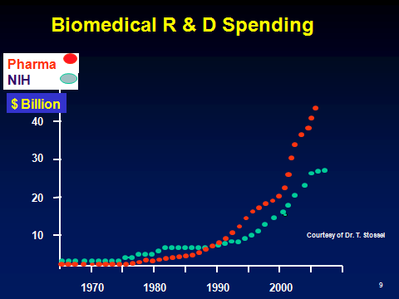
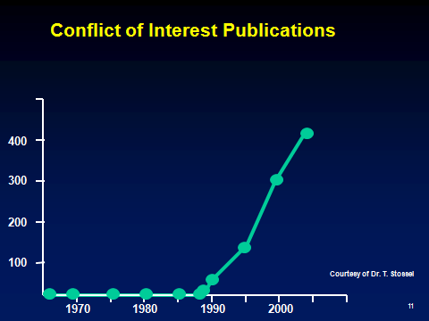
Show Me the Money!

Slide 10
Thomas Kuhn: The Challenge of Scientific Objectivity
A scientist’s worldview influences what he or she researches and how results are interpreted
Our comprehension of science can never rely wholly upon "objectivity" alone. Science must account for subjective perspectives as well, since all objective conclusions are ultimately founded upon the subjective conditioning/worldview of its researchers and participants.

Slide 11
Interests
Financial (e.g., personal reward & research funding)
Sociopolitical & ideological
Professional (e.g., status)
Ref: Horton R. Conflicts of interest in clinical research: opprobrium or
obsession. Lancet 1997; 349:1112-1113.

Slide 12
The Three Fallacies
Scientific writing can be free from biases
Financial conflicts cause the most concern
Disclosure heals the wound inflicted by a financial conflict
Ref: Horton R. Conflicts of interest in clinical research: opprobrium or
obsession. Lancet 1997; 349:1112-1113.

Slide 13
Why focus on financial conflicts of interest?
“Conflict-of-interest rules usually focus on financial gain, not because it is more pernicious than other secondary interests, but because it is more objective and more fungible.… Just because we cannot do much about other secondary interests, it does not follow that we should do little about financial gain”
Thompson DF. NEJM 1993;329:573-576
Environmental and social activism are popular special interests; financial interests are not.
Questions: Since epidemiology is a science, shouldn’t all interests be treated as critically as possible? Is it true that we can’t do much about other secondary interests?

Slide 14

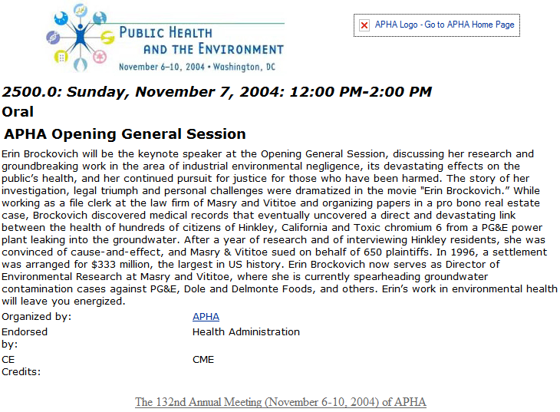

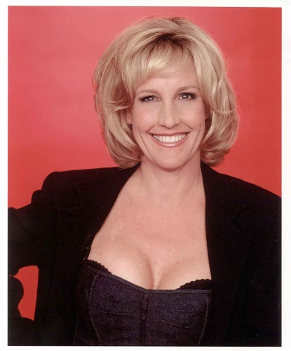
Concern expressed about American Public Health Association Keynote

Slide 15
Headline: “Sex, Not Science, Featured at Public Health Meeting”
“I was just appalled to learn that Erin Brockowich has been named the keynote speaker for the upcoming convention. This is like making the guy who advertises for malpractice business the keynote for the AMA convention. … This lady is an anti-public health uneducated "researcher" who does nothing but work for a tort lawyer. Whether the case goes for the plaintiff or the defense (including the one that the movie is based on), there is no scientific merit to the claim.… She routinely puts down and tries to prevent pertinent epidemiologic investigation. If she speaks, it means that APHA espouses anti-epidemiology.”
Tom Mack
Department of Preventive Medicine
University of Southern California

Slide 16
Preference
The state of being preferred
The act, fact, or principle of giving advantages to some over others
Ref: Merriam-Webster Online Dictionary. www.m-w.com

Slide 17
Does the focus on financial conflicts hinder scientific evaluation?
“We, like many others, give most credence to papers
published in reputable journals by academics working in
institutes of excellence. The credibility rating goes down
when a project is funded by a drug company that
has an interest in its outcome.”
Raveendran R, Gitanjali B.
Letter to the Editor. Lancet 1997:349:1173-1174.

Slide 18
Are we developing a caste system in clinical epidemiology research?
“Under the new Policy, ASCO will not accept an abstract or paper describing company-funded original research if the first, last, or corresponding author has been the Company’s employee, investor, or paid speaker during the previous 2 years.”
ASCO 2013. American Society of Clinical Oncology Policy for Relationships with Companies: Background and Rationale. J Clin Oncol Published Ahead of Print on April 22, 2013 as 10.1200/JCO.2013.49.4997

Slide 19
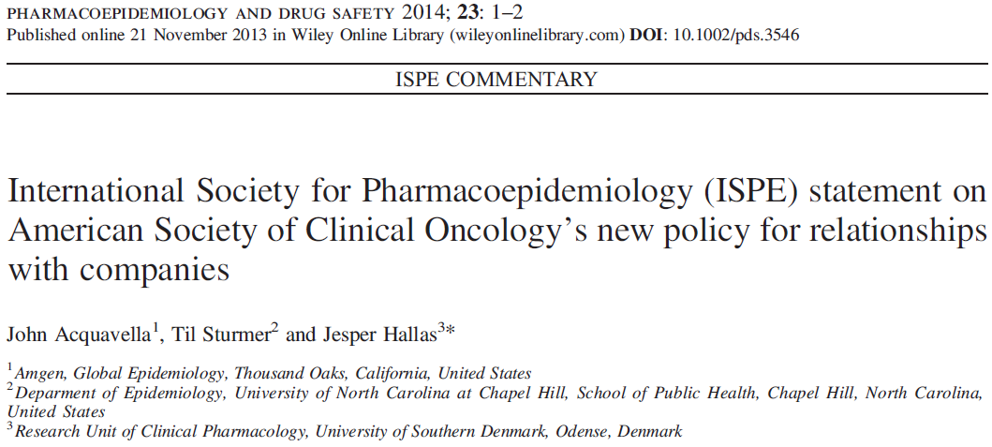
ASCO Reconsiders its Policy
“ASCO leadership has carefully considered the concerns expressed by the biomedical community regarding the author restrictions in the 2013 COI policy and has decided to suspend enforcement of these restrictions for a period of at least 3 years.”
ASCO 2014. The Changing Landscape of Conflict of Interest Supports Further Study of American Society of Clinical Oncology Authorship Restrictions for Research Studies J Clin Oncol: Published Ahead of Print on February 10, 2014 as 10.1200/JCO.2014.55.4006

Slide 20
“Conflict of interest. The New McCarthyism in Science”
“The objectivity of the [scientific] process depends on each contribution receiving its due regard, whatever the motivations for bringing it. It depends on judging a work on its merits, rather than on the inferred state of mind of the author.”
Ken J. Rothman
JAMA 1993; 269:2782-2784, p 2783.

Slide 21
When You Are Looking for Jobs… Ask the Right Questions
How do you limit commercial influence on epidemiologic research? Specifically, does research get published regardless of outcome?
Do you have any examples of early career epidemiologists as first authors on published papers?

Slide 22
Beware of your own biases, Lead by example
Judge on merit, not on presumed conflict of interest
Advocate a more balanced perspective on conflict of interest
Engage financial and other interests to live up to highest standards of our profession
Help clean up irregularities that exist (e.g., ghostwriting, author shifting)

Slide 23
Beware of Scientific vs Sponsor Interests
All sponsors have an interest in the outcome
Beware that you can be influenced
Only get involved in projects where the scientific issue is clear and can be pre-specified in a protocol. Consider sponsor input at protocol stage.
Be clear with the sponsor on the strengths and limitations of the proposed research
Insist on appropriate publication language in contracts
Consider sponsor suggestions and accept only those that make scientific sense

Slide 24
Case Study: Ethical Debate
A PhD student presents a paper at an epidemiology society meeting describing an association between pesticide X and fetal death. The paper is part of his/her dissertation that is scheduled for defense in one month.
In this study, each subject was classified as exposed if a pesticide application was recorded in a state database during her first trimester within a square mile of the women’s residence.
At the meeting, an Industry scientist tells the student that his/her exposure assessment approach is likely to misclassify most if not all subjects, based on exposure biomonitoring studies on farms during pesticide applications that show no detectable exposure for those not directly involved in the application. He suggests that before completing the dissertation and publishing this work, that the student collect some biomonitoring data to determine whether anyone characterized as exposed is really exposed.
The PhD student ignores the advice, completes his/her dissertation, and publishes a paper on the results.
Did the student behave ethically? What is his/her responsibility to consider criticism/advice offered at a scientific meeting? What would you have advised as a dissertation committee member?
Did the industry scientist behave ethically? Would the industry scientist have been justified to pursue the matter with the student’s university?

Slide 25
Perspectives in Bioethics

Slide 26
Perspectives in Bioethics
Historical Context: Protection of human subjects
Ethics at Amgen
From the Headlines: Case studies
Ethical Dilemmas in the Digital Age: New technologies posing new challenges

Slide 27
Laws to Protect Human Subjects: The Nuremberg Code
A Turning Point in Bioethics
1947 – Nuremberg Code established as part of the Nuremberg trials after World War II, specifically related to the violation of rights of human subjects as part of medical experiments during Nazi Germany
First document to specify ethical principles that should guide medical staff engaged in human research
Set the standard for the protection of human subjects in medical research
Did not have the strength of law, it was created post hoc, and it applied to only non-therapeutic human subjects research
Notes:
To condem the Nazi atrocities and to convict the Nazi doctors

Slide 28
The Declaration of Helsinki (1964)
A set of ethical principles regarding human experimentation developed for the medical community by the World Medical Association (WMA).
  The Declaration more specifically addressed clinical research. A notable change from the Nuremberg Code was a relaxation of the conditions of consent, which was 'absolutely essential' under Nuremberg. Now researchers are to obtain consent 'if at all possible' and research was allowed without consent where a proxy consent, such as a legal guardian, was available.
  Document set the stage for the implementation of the Institutional Review Board (IRB) process.
“Biomedical research cannot be legitimately carried out unless the importance and objective is in proportion to the inherent risk to the subject.”
  Widely regarded as the cornerstone document of human research ethics, and continually revised, 6th revision cycle 2007-2008

Slide 29
Different Codes and Guidelines
  Each country may also have local regulations – e.g., Tri-Council Policy Statement in Canada, or international guidelines such as CIOMS, Nuffield Council (UK) and UNESCO.
  1991: Common Rule in the U.S. – In addition to the requirements of the FDA and Office for Human Research Protections (OHRP):
  “…No investigator may involve a human being as a subject in research… unless the investigator has obtained the legally effective informed consent of the subject.”
There are a number of available tools which compare these
  e.g., "Comparison of Common Rule with the Declaration of Helsinki and Good Clinical Practice". 2012.

Slide 30
Good Clinical Practice, an international standard
  2008 – FDA issued a final decision on April 28, 2008 to replace the Declaration of Helsinki with Good Clinical Practice (GCP) effective October 2008
  GCP is an international quality standard that is provided by International Conference on Harmonisation (ICH), an international body that defines standards, which governments can transpose into regulations for clinical trials involving human subjects
  Today, the GCP are used in clinical trials throughout the globe with the main aim of protecting and preserving human rights

Slide 31
ISPE-Professional Certification Commission (PCC) Code of Ethics
Our professional society, the International Society for Pharmacoepidemiology, has a certification that defines a set of principles for the professional conduct expects from its certificants and candidates.
The Code of Ethics works together with the Standards of Professional Conduct which provides guidance for certificants and candidates regarding ethical and fair professional practices. The Certificants and candidates shall:
Hold paramount the health, welfare and safety of the public, customers, colleagues and employers and protect the environment and property in the performance of the certificants professional duties.
Act with objectivity, competence, and in an ethical manner with colleagues in the pharmaceutical and related industries, the public, employers, clients and prospective clients worldwide.
Maintain all relationships with the highest standards of integrity and honesty.
Take reasonable steps to ensure the privacy and safekeeping of confidential and proprietary information concerning the business affairs and technical processes of any former or present employer or client or public body for which they serve.
Refrain from receiving or offering gratuities or inducements that may compromise professional standards or independent judgment.
http://www.ispe.org/certified-pharmaceutical-industry-professional/code-of-ethics

Slide 32
What is Bioethics?
The study of ethics or ethical implications of biological research and its applications, especially in medicine.
It is a shared, reflective examination of ethical issues in healthcare, health science, and health policy.
Ethics is the systematic study of moral choices.
Ethical debate ensues with technological advances.
Ethical decision-making requires respect for individual rights, neutrality, and concern for the consequences of intended actions.
The moral basis for choices in biomedical research relies on the four guiding principles of bioethics: autonomy, justice, beneficence, and nonmaleficence.

Slide 33
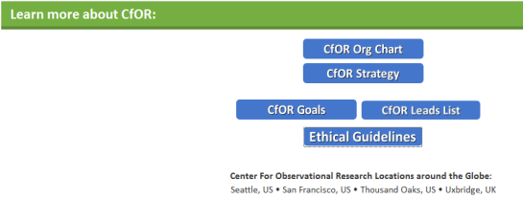
Ethical Guidelines at Amgen
At Amgen, we learn about the importance of ethical conduct in clinical research
  History
  GCP standard
  “Do the right thing” training
Specific ethical guidelines for observational researchers can be derived from the 4 guiding principles of bioethics:
  Autonomy: Requires that the patient have autonomy of thought, intention, and action when making decisions regarding health care procedures
  Justice: The idea that the burdens and benefits of new or experimental treatments must be distributed equally among all groups in society
  Beneficence: Requires that the procedure be provided with the intent of doing good for the patient involved
  Non-malificence: Requires that a procedure does not harm the patient involved or others in society
Center for Observational Research

Slide 34
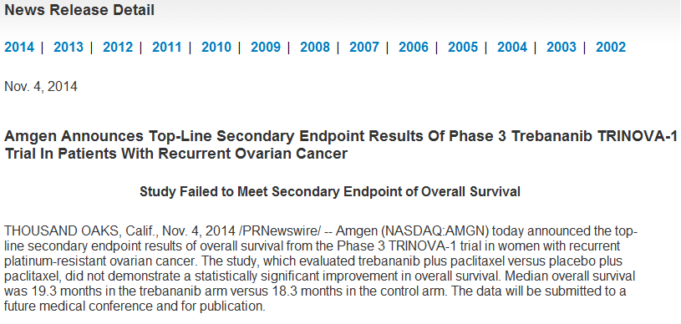
Case Study: Sometimes Priorities Change
Ongoing epidemiology studies in ovarian cancer
Ethical commitment to complete work, often represent academic collaborations

Slide 35
From the Headlines
Supreme Court rules against Myriad gene patents
American College of Medical Genetics and Genomics (ACMG) recommendation sparks controversy in genetics community
FDA orders 23andMe to stop selling genome analysis service
Case Study: Hereditary Breast and Ovarian Cancer

Slide 36

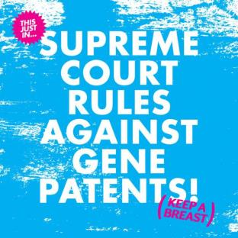
In 2013, Two Key Events Re-Ignited Interest in Genetic Testing and BRCA1/2

Slide 37
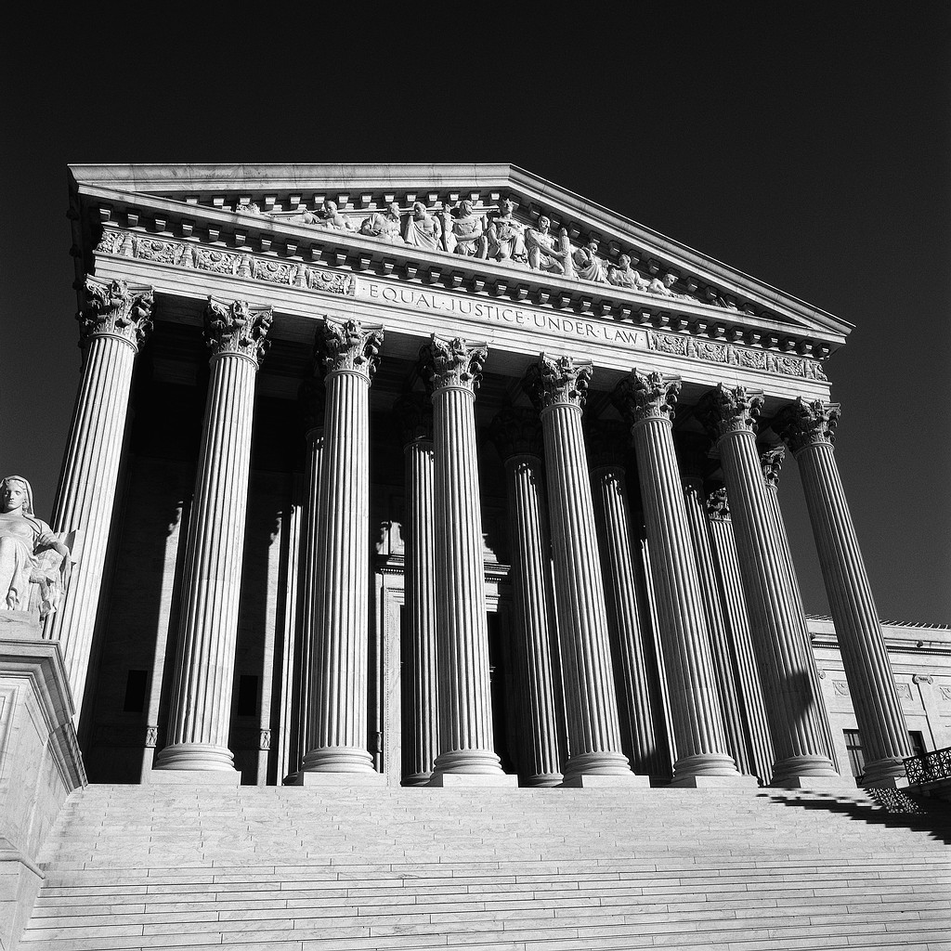
Supreme Court Ruling on Gene Patents
June 13, 2013 - Association for Molecular Pathology v. Myriad Genetics (No. 12-398)
U.S. Supreme Court unanimously ruled that, "A naturally occurring DNA segment is a product of nature and not patent eligible merely because it has been isolated," invalidating Myriad's patents on the BRCA1 and BRCA2 genes
More competition, low cost, more access to genetic testing

Slide 38

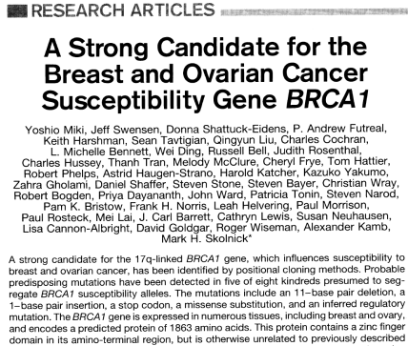
Myriad Genetics: 10+ Years Since Discovery of BRCA1
1994 - BRCA1 cloned by Myriad Genetics and published by 40 collaborators in Science
BRCA1 patent filed; Myriad develops process and laboratory to perform high throughput sequencing
1995 - BRCA2 patent filed
2010 – Myriad’s patents on the BRCA1 and BRCA2 genes ruled invalid on March 29, 2010 in the U.S. District Court for the Southern District of New York
Approximate costs before Supreme Court ruling:
  $3000 for full BRCA1/2 testing
  $415 for 3 Jewish founder mutations
  $350 for single site analysis
Science 7 October 1994

Slide 39

  Genetic Information: DNA sequencing is cheaper and easier than ever
Are the proper standards in place?

Slide 40
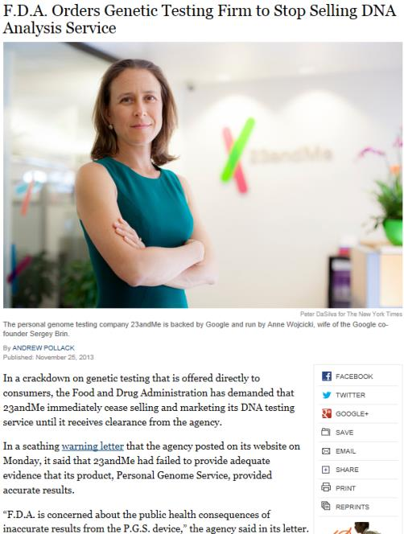

FDA vs 23andMe
November 25, 2013
FDA issued a warning letter about the accuracy and standards of test results from the Personal Genome Service
Of greatest concern was testing for mutations that indicate a woman would have a very high risk of getting breast cancer, stating that a false positive could lead to an unnecessary preventive mastectomy
  Genetic testing for breast cancer risk is one example where guidance from doctors and genetic counselors is warranted, and offering these results directly to consumers is of concern
Class-action suit followed, claimants allege 23andMe misled them by continuing to promote health promises — about helping people diagnose diseases or make better decisions about their medications — without regulatory approval and good science behind them.

Slide 41
Although CLIA approved “1 step forward, 23 steps back”
Controversy related to informed consent and privacy from Close Relatives check box after a patient discovered that his parents were not his biological parents by selecting to learn more about his ancestry by linking to others in family who were tested.
  Debate ensues around 23andMe balancing the right to know vs. the right not to know for families tested.
  Company announed they will hire a chief privacy officer to help ensure that customers are equipped to make informed, conscious decisions about whether and how to receive potentially overwhelming information.
Headline: Expansion to UK sparks privacy concerns
  Will my data be sold to Google?
Ethical problem: patient autonomy, right not to know

Slide 42
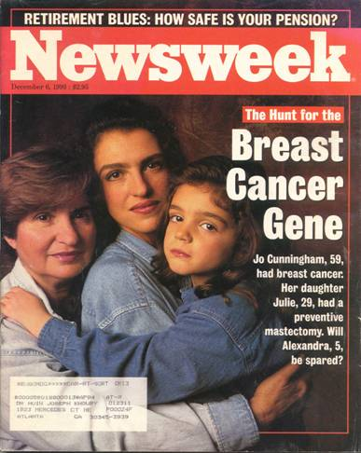
Case Study: Hereditary Breast-Ovarian Cancer (HBOC)
1866 - Hereditary breast cancer syndrome first described by Paul Broca, in the form of a large pedigree with 10 breast cancer cases
Late 1960s - Henry Lynch (Lynch syndromes I and II) started to describe families showing autosomal dominant inheritance patterns for breast cancer
1990 - Mary-Claire King provided first convincing linkage data in early-onset breast cancer families which mapped the susceptibility gene, thereafter named BRCA1 for Breast Cancer 1, to the long arm of chromosome 17
Notes:
Relative to last year, the SRE market growth is flat or -1%. Another milestone was over 100,000 patients treated with XGEVA by 2013. However, the brand team plan anticipated about a 30% growth in SRE market and now CfOR and GHE are working to help provide a better understanding of the proportion of bone mets patients that remain untreated. To better understand the drivers and barriers of prescribing bone modifying agents to prevent skeletal complications.

Slide 43
BRCA1 is A Highly Penetrant Gene And The Single Greatest Risk Factor for Breast or Ovarian Cancer
Breast Cancer Risk to Age 70
Up To 10-Fold Higher Risk¹⁻³
Breast Cancer Age of Onset per Registry of 13,000+ BRCA1/2 Carriers⁴
Risks to Age 70
mean age of breast ca 42.6 yrs (n=3,985 with BC among 10,017 BRCA1 mutation carriers)
Up to
87%
Up to
60%
Incidence of breast cancer (%)
Cumulative risk (%)
BRCA1
BRCA1
8%
<2%
Age
Easton et al. Am J Hum Genet. 1995;56:265-71.
Ford et al. Lancet. 1994;343:692-695
Struewing et al. N Engl J Med. 1997;336:1401-8
Hereditary Breast Cancer Study Group (BRCA1/2 Registry n=13,584– Steven Narod), n=3,985 BC among 10,017 (not published)

Slide 44
Prospective Data Breast Cancer Incidence: 2-4% Per Year¹⁻⁵
Prospective Studies of Unaffected BRCA1 Mutation Carriers Confirm High Risk
Prospective 10-Year Study of
Women of Jewish Descent in L.A.⁴
Breast cancer risk (prospective):
60% U.K.¹
61% Norway²
55% Poland³
69% North America (shown)³
mean age of breast ca 45 yrs
(42 to 56 yrs)
BRCA1
BRCA1
Cumulative incidence of breast cancer
Cumulative incidence of breast cancer (%)
Non-carriers: <1%
General population⁶
Years of Follow up
Mavaddat et al. JNCI 2013 105(11):812-22. av. 1.8% (1.3-2.6%) per year; range 1.7% to 3.6% (30 to 59 yrs).
Moller et al. Clin Genet. 2013 Jan;83(1):88-91. av. 2.0% (95% CI 1.7–2.5%) per year.
Lubinski et al. Int J Cancer 2012 131(1):229-34
Liede et al. JCO 2002 20(6):1570-7. n=213, mean 7.2 yrs f/u among BRCA; 2.1% per year BC
update to Lubinski (not published)
American Cancer Society. Cancer Facts & Figures 2013.
Notes:
13,000+ BRCA

Slide 45
How Are Individuals Heterozygous for a BRCA1 Mutation Normally Identified?
Begins with genetic testing of affected family member who comes forward or is referred for familial cancer risk evaluation/genetic counseling
Exception: individuals from ethnic groups with higher prevalence, e.g., Ashkenazi Jewish
“female cancers”
Br 43
Major Phenotypic Features
Autosomal dominant inheritance pattern
Number of cancers, multiple generations
  3+ relatives w/ breast ca at any age
  2+ relatives w/ breast ca, one <50 yrs
Age of onset
  Breast cancer <50 yrs
Type of cancer
  Ovarian cancer at any age
  Male breast cancer
  Triple –ve breast cancer
  Pancreatic cancer w/ breast or ovarian ca
Bilateral or multiple primaries
  2 Primary breast cancers
  Breast and ovarian ca in one individual
Ethnicity, founder effects
Br 49
Ov 56
Ov 60
Br 42
Br 39
BRCA1 family of Ashkenazi Jewish descent, modified from:
Liede et al. J Clin Oncol 2002 20(6):1570-1577

Slide 46
Genetic Counseling for BRCA1/2
2-3 appointments minimum
First visit
  Details of family history
  Confirmation (pathology reports)
First or next visit
  Risk assessment
  Genetic testing offered
Results disclosure
Follow-up
Genetic Counseling Themes
Risk Assessment
Emotional issues
Cancer fear
Risk perception
Family issues
Genetic counseling process as described in more detail in:
Metcalfe, Liede et al. J Med Genet 2000 37:866-874

Slide 47
Case Study: Genetic Counseling Issues (Family)
Ethical concern: patient autonomy, right not to know
Family involvement
  For accurate risk assessment or testing
  Communicating results
Confirmation of a “cancer gene” in family
Expectations of family members
  Family members may or may not wish to have testing or share results
  Strategy to inform relatives
What about the right not to know?
Genetic guilt
BRCA2 family from the Philippines, as described in:
De Leon Matsuda et al. Intl J Cancer 2002 98:596-603

Slide 48
Motivations for genetic testing...
Doctor’s recommendation ranks low
Liede et al., Am J. Human Genetics 2000 67:1494-1504
Metcalfe, Liede et al. J Med Genet 2000 37:866-874

Slide 49
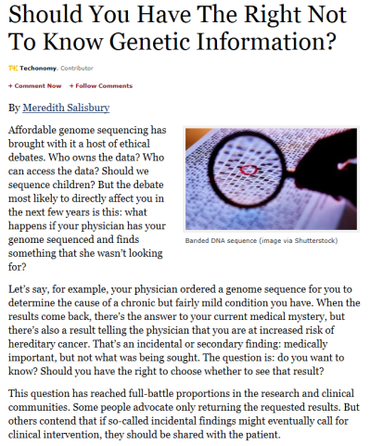
Patient Autonomy and the Right Not to Know
Forbes.com 11/05/2013
November 5, 2013
American College of Medical Genetics and Genomics (ACMG) recommendation that 57 genes should be evaluated any time a physician orders a genetic test
  Genes related to diseases such as Alzheimer’s or Huntington’s, with no known medical treatment, are not on the list
  Genes linked to hereditary breast and ovarian cancer are among the selected 57
This “duty to hunt” was surprising—caused heated debate at a recent American Society of Human Genetics (ASHG) meeting because part of the recommendation said these findings should be shared even with patients who expressly do not want to know the results
Ethical problem: patient autonomy, right not to know

Slide 50
Genetic Testing Reveals BRCA in Family: Pros and Cons
Removes uncertainty of risk level
More vigilant screening, surgery, prevention strategies
Predictive testing possible for family members
  Can identify family members at risk
  Family members not at high risk can be spared anxiety and the need for increased surveillance
Predictive testing (Also can be a Con)
  How to disclose information to family members?
  How to manage the right not to know?
More screening, surgery, chemoprevention
New uncertainty about risk
More anxiety, cancer fear, emotional distress
Confidentiality (medical record, insurance concerns)
Efficacy of interventions still unproven
  More research involvement
Individuals in families who decline genetic testing may have higher anxiety levels and depression compared with siblings who undergo testing
Notes:
Founder effect seen easily in homogeneous groups, i.e. Iceland, and
in groups with high incidence of either breast or ovarian cancer.
Knowing the incidence of various mutations in different populations is important. Many genes that cause serious human disease occur with different frequency in different racial or ethnic groups.
“Founder effects” in such groups have led, for example, to unusually high frequencies of otherwise very rare genetic diseases. Traits found among French Canadian, the Ashkenazi Jewish, and the Finnish populations provide examples.
Usually dominantly inherited disorders, even those with apparent decrease in fitness, are characterized by many mutations and by a measurable rate of new germ-line mutations, such as Huntington’s disease.

Slide 51
Risk Management Strategies
Early detection/screening
Prophylactic surgery
Chemoprevention

Slide 52
Gilda Radner Ovarian Cancer Detection Program
Women at risk of ovarian cancer in Los Angeles (n>1,600); family history
Followed at Cedars-Sinai for 10 years (1991-2001); 8 incident ovarian cancers
  Free surveillance with CA125, TVS, color Doppler
Study cohort: Ashkenazi Jewish women (n=290)
  Informed consent obtained and genetic counseling; 213 (73.4%) tested in 1998
Results: 16% BRCA-positive (31 BRCA1, 2 BRCA2 mutation carriers)
BRCA1 carriers
Cumulative risk at 10 years:
28% ovarian cancer
21% (adjusted)
P < 10⁻⁶
Non-carriers
Time since entry to program (years)
Liede et al. J Clin Oncol 2002 20(6):1570-1577
Notes:
From the follow-up of ten years available on this cohort of women, I was able to calculated the cumulative risk of cancer for BRCA1 mutation carriers versus non-carriers. You may recall that all these women were “healthy” at the start of the program. Women were censored if they were diagnosed with cancer, died, or at the date of their last appointment or date of oophorectomy for Kaplan-Meier survival analysis.
43 women had prophylactic oophorectomy.
Because we tested 100% of women who developed cancer and only 72% of women who did not develop cancer. We reduced or adjusted our estimates by 24%.

Slide 53
8 Incident Ovarian Cancers
Cancer Type - stage BRCA Elevated TVS Indication Months since
Age Mutation† CA 125 Abnormal for Sx last screen
Ovarian - Ic 48 - - + TVS 1.4
Ovarian - IIc 55 + - - Pain (1.5)*
Peritoneal - IIIc 55 + +++ - CA 125 1.2
Peritoneal - IIIc 55 + - - Pain 5.9
Peritoneal - IIIc 45 + ++ - Ascites 15.6
Peritoneal - IIIc 38 + - - Ascites § 17.2
Peritoneal - IIIc 42 + - - Pain (1) *
FT/Peritoneal - IIIc 39 + + + TVS 3.4
† “+” indicates germline BRCA1 185delAG
* left program (screened elsewhere)
§ omental cake on obstetric sonogram
Liede et al. J Clin Oncol 2002 20(6):1570-1577
Notes:
What is most interesting is to examine the characteristics of the women who developed ovarian cancer, during the course of their involvement in this ovarian cancer detection program. All but one of these women were BRCA1 185delAG mutation carriers. Two women had stopped attending the program.
1. The first case is the ovarian cancer at stage Ic diagnosed following the detection of a complex mass on the ovary by ultrasound
2. The second woman shown here developed ovarian cancer, stage IIC, age 55. Her CA125 and ultrasound screens were normal 1.5 months before her surgery. She presented with pelvic pain
3. Of the 5 peritonal cancer cases, two had elevated CA125, two presented abdominal pain, two with bloating - one of these had her peritoneal cancer diagnosed during her pregnancy
Last case had synchronous cancers of the fallopian tube and peritoneum. She had a moderately elevated CA125 level and tumours were evident on ultrasound. Ultrasound findings were the indication for surgery.
Peritoneal cancer was diagnosed in these women using the
Gynecologic Oncology Group criteria:
1. The ovaries are normal in size or enlarged by a benign process
2. The extraovarian sites of carcinoma are of significantly greater volume than the tumor present on either ovary
3. The ovarian tumor component is either non-existent, confined to the ovarian surface with or without stromal invasion measuring less than 5 x 5 mm
4. The histologic characteristics indicate serous papillary carcinoma of any grade

Slide 54

Ethical Decision to Discontinue Gilda Radner Cancer Detection Program
Bottom Line: Screening failed to detect early-stage ovarian cancers
All women who developed ovarian cancers were stage IIIc, and were BRCA1 185delAG mutation carriers
  One stage Ic ovarian cancer identified, in a non-carrier
  Risk of cancer in non-carriers <3% in ten years
Program redesigned to focus on BRCA1/2 mutation carriers
Notes:
The Gilda Radner Program allowed us to conduct the first prospective study on BRCA1 or BRCA2 mutation carriers.
We observed that….
Implications for surgical prevention of ovarian cancer - how do we reduce the risk of peritoneal cancer in carriers.

Slide 55
Risk Management Strategies
Early detection/screening
Prophylactic surgery
Chemoprevention

Slide 56

What Options do Women With a BRCA1 Mutation Choose?
Angelina Jolie, 37, underwent prophylactic bilateral mastectomy
Mother, Marcheline Bertrand, died of ovarian cancer age 56 (French Canadian with a strong family history of HBOC)
Angelina announced she will undergo prophylactic bilateral salpingo oophorectomy next to reduce her risk of ovarian cancer
Women with a sister or mother with breast or ovarian cancer are significantly more likely to have prophylactic surgical procedures¹
Only 11% of Jewish women who underwent population genetic testing in Canada had bilateral mastectomy within 2 years, and 90% had oophorectomy³
Risk reducing options chosen by 2,677 BRCA1/2 mutation carriers (2,051 BRCA1)²
Option | Israel | Norway | Poland | Italy | Austria | Canada | France | Netherlands | US
Mastectomy* | 4% | 4% | 3% | 10% | 20% | 22% | 25% | 33% | 36%
Oophorectomy | 67% | 74% | 35% | 50% | 52% | 57% | 71% | 64% | 71%
Tamoxifen or raloxifene* | 11% | 0% | 6% | 0% | 5% | 10% | 0% | 0% | 12%
Any risk-reducing measure (above)* | 57% | 68% | 26% | 40% | 40% | 59% | 75% | 56% | 72%
Mammography | 96% | 93% | 66% | 100% | 100% | 97% | 100% | 100% | 98%
MRI | 2% | 14% | 7% | 72% | 65% | 48% | 67% | 95% | 24%
*among women without breast cancer
Metcalfe et al. Clin Genet. 2008;73(5):474-9.
Metcalfe et al. Int J Cancer. 2008; 122(9):2017–22.
Metcalfe et al. Breast Cancer Res Treat. 2012;133(2):735-40. n=19, mean age 46 yrs (28–67 yrs).
Notes:
Relative to last year, the SRE market growth is flat or -1%. Another milestone was over 100,000 patients treated with XGEVA by 2013. However, the brand team plan anticipated about a 30% growth in SRE market and now CfOR and GHE are working to help provide a better understanding of the proportion of bone mets patients that remain untreated. To better understand the drivers and barriers of prescribing bone modifying agents to prevent skeletal complications.

Slide 57
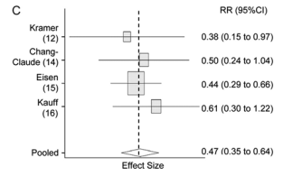
Breast Cancer Risk Management Strategies for BRCA1 Overview
Mastectomy
Oophorectomy
Tamoxifen
> 90%
Roughly 1 in 4 women choose this option (higher among women with higher education)¹
> 50%²
Consistent data, greatest protection <40 yrs
≤ 50% ?
Few women choose this option; Limited data
(2 studies on contralateral BC risk, prevention of ER+ BC)
Metcalfe et al. J Med Genet. 2000;37(11):866-74. 2. Rebbeck et al. JNCI 2009;101:80-7
Notes:
Forest plots of relative risk (RR) estimates for risk reduction associated with risk-reducing salpingo-oophorectomy (RRSO). A) Ovarian cancer risk reduction in BRCA1/2 mutation carriers. B) Breast cancer risk reduction in BRCA1/2 mutation carriers. C) Breast cancer risk reduction in BRCA1 mutation carriers. D) Breast cancer risk reduction in BRCA2 mutation carriers. The box sizes reflect the relative sample sizes of the individual studies; horizontal lines represent 95% confidence intervals (CIs). Diamonds represent the pooled point estimate and 95% confidence intervals. Vertical dashed lines represent the pooled relative risk estimate. Estimates less than a value of 1.0 suggest a favorable reduction in cancer risk associated with RRSO.

Slide 58
Health Insurance Portability and Accountability Act (HIPAA) of 1996
Protects health insurance coverage for workers and their families when they change or lose their jobs.
Administrative Simplification (AS) provision requires the establishment of national standards for electronic health care transactions and national identifiers for providers, health insurance plans, and employers.
Right to privacy to individuals from age 12-18.
  The provider must have a signed disclosure from the affected before giving out any information on provided health care to anyone, including parents.
  Research can be exempt from HIPAA’s Privacy Rule; HIPAA’s Privacy Rule only applies to PHI gathered by or from covered entities

Slide 59

HIPAA and Privacy Challenge: Much of the EMR Data Remains Untapped
EMR research to date
Structured data
(e.g., demographics, stage, diagnosis)
There’s more to EMR
Unstructured data
(e.g., pathology, stage, biomarkers, physician notes)

Slide 60
HIPAA Example: Electronic Health Records (EHR) in Research
HIPAA-compliant de-identification process → Linkable Patient ID
Clearing House Medical Claims (1 out of 2)
Pharmacy Prescriptions
(3 out of 4)
500,000+ Unique Cancer Patients
in OSCER
>90% Linkable
Tumor Registry
Hospital charge master
(400 hospitals)
Death Records (Experian)
PharMetrics Plus Claims
The Health Insurance Portability and Accountability Act (HIPAA)-compliant de-identification process allows for data linkage to external data sources (e.g., claims data) for detailed information on patient care.
Quach et al (2013) presented at 29th international conference on Pharmacoepidemiology and Therapeutic Risk Management, Montreal, Canada, August 25-28, 2013.

Slide 61
In Scandinavia, Patient SSN Can Be Used to Link Across National Databases
specimens
Linking gastric cancer specimens,
MET analysis, and mortality outcomes

Slide 62
Each Country may have its own regulation
In Denmark, access to patient-level data is governed by the Danish Data Protection Agency: http://www.datatilsynet.dk/english/
  Getting approval from this agency is the first step for each study.
  To access patient medical records (as opposed to registry records), one needs informed consent of patients.
  The procedure is more or less similar in other Nordic countries.
In Germany, data access governed by laws: http://www.gesetze-im-internet.de/sgb_10/BJNR114690980.html
EU Data Protection Directive 95/46/EC is relevant: http://eur-lex.europa.eu/LexUriServ/LexUriServ.do?uri=CELEX:31995L0046:en:HTML

Slide 63
  Physician As Research Participants
  Ensuring the rights of participants while encouraging research enrollment
  Law and regulations in place to prevent:
Coercion
  Incentives to participate
Undue Influences
  Payment
Pressures
  Manipulation and Persuasion
Exploitation
Conflict of interest
  Increases the likelihood of the other ethical concerns
Physician surveys as part of mandated PV to measure prescribers’ understanding of risks associated with drug
  Ethical concern: How to protect confidentiality with “test results” provided to regulatory agency
ICC/ESOMAR Code on Market and Social Research: http://www.esomar.org/knowledge-and-standards/codes-and-guidelines.php

Slide 64
PV and Signal Detection Not Always Evolving With the Digital Age
“Pharmacovigilance suffers from bureaucratic sclerosis. Instead of the system being a lively, engaging, dynamic, collaborative, humane enterprise, sharply focused on improved therapy and the welfare and safety of patients, it is a sluggish routine that fails to excite and motivate...”
- B ruce Hugman, WHO Uppsala Monitoring Center

Slide 65
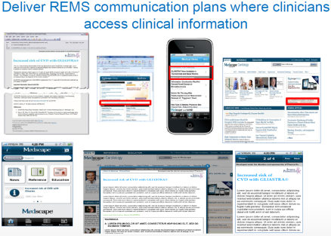
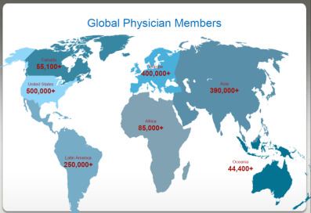
Physician Communities Online: >75% of US physicians own an Apple mobile device
Case Example: MedScape
Reputable partner for FDA REMS
2.6 million U.S. physician visits per month
33 distinct specialty sites
539,000 12-month active U.S. physicians
312,000 U.S. physicians using Medscape via Mobile

Slide 66
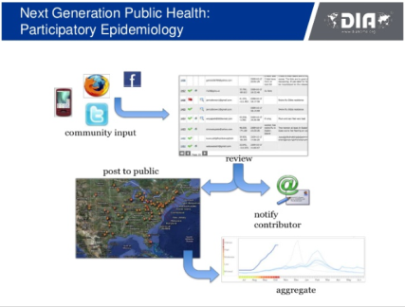
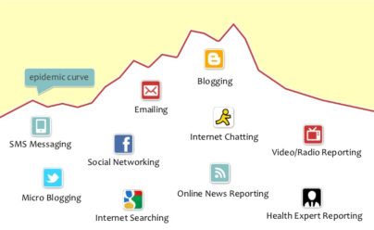
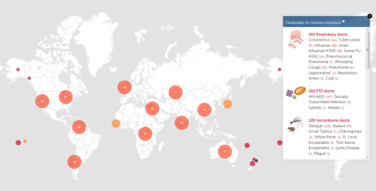
  Participatory Epidemiology
Signal detection methods evolving leveraging online methods and communities of researchers
HealthMap.org
  Report AEs
  Track outbreaks
Days from outbreak start to discovery 167 days (1996), to 20 days (2010)

Slide 67
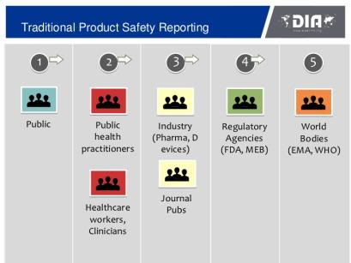
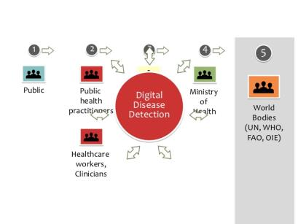
Where Social Media Holds Promise…
169M US adults (72% of all adults) went online to research a health question in 2010, compared with 63M in 2002
80% of serious AEs are reported by pharmaceutical companies

Slide 68

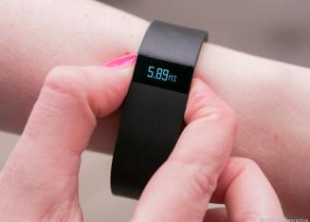
Mobile Technology, Social Networks and the Future of Medicine
ICPE 2013 Plenary Session: How the FDA Uses Mobile Apps and Social Media Monitoring to Identify AEs (Nabarun Dasgupta)
  Technological advances to help FDA monitor safety signals in social media
MedWatcher.org
  MedWatcher App, launched 2010
  Supported by FDA since 2012
  Report adverse events
Tracking our health behaviors with new technologies

Slide 69
Thank you

