Slide 1
Epi 240
Qualitative Approaches in Clinical and Translational Research
Session 8-9
Qualitative Project and Product
Feb 25 & March 4, 2015
Daniel Dohan, PhD
Philip R. Lee Institute for Health Policy Studies, UCSF
Wendy Anderson, MD, MAS
Division of Hospital Medicine, UCSF

Slide 2
What’s up today
Reminder: quant (Rs) v. qual (Ps)
Qualitative research in a “quantitative” world, Part 1
  Funding
  Human subjects
Qualitative research in a “quantitative” world, Part 2
  Writing it up
  Career considerations

Slide 3
Comparing Qualitative and Quantitative Research
Research Activity |  | Quantitative Approaches | Qualitative Approaches
Data Collection | Select research subjects | - Representativeness: Random samples of pre-determined groups -Reactivity: Fixed data collection instruments | -Purposefulness: Sites and subjects selected according to theoretical need -Participation: Flexible data collection strategies
 | Work with subjects to get data
Data Analysis | Avoid arbitrary findings | -Reliability: Hypothesis testing via statistical inference -Replicability: Standard reporting formats (i.e. tables) | -Process: Iterative coding and memoing to refine results -Particularity: Narrative reports of findings in context
 | Convince others of findings

Slide 4
Qualitative research in a Quantitative World:
Part 1
Funding: show don’t tell to make the case for your project
  Make your case using a conceptual model
  Illustrate your procedures
Human subjects: interacting to collect data
  Educate your IRB
  Leverage “protocable” activities
I skate to where the puck is going to be, not where it has been.
- Wayne Gretzky

Slide 5
Making the funding case for qualitative research
Innovation: skate to where the puck is going to be
    Qualitative research attacks tough cultural or conceptual problems that can’t be quantified
    Disparities & inequalities, implementation & dissemination, patient-engagement, implications of the ACA, etc.
Significance: Underscore necessity of qualitative understanding to achieve impact, translation, implementation
Approach: Orient the reader to your contribution via a well-designed conceptual model
  Illustrate how you will operationalize your conceptual model to produce findings of relevance to a broad audience
  Point out how qualitative data can inform policy translation (which equals impact)

Slide 6
Using a conceptual model to orient your reviewers to your project
What are the core 2-4 elements of your project
  What is the most important thing in the project?
  What other things are in your project?
  What are the constituent pieces of these things?
Describe how these elements fit together
  How do they align?
    Physically, temporally, historically, politically, etc.
  Does anything cause anything else? You sure?
    What would make you more sure?

Slide 7
What it could look like...

Slide 8
What causes what?
Z
X
Y
W
Antecedent
Predictor
Intervening
Outcome

Slide 9
What shapes what?
Social Structures
Health Sciences Research
Public Agencies
Individuals
Community-Based Organizations

Slide 10
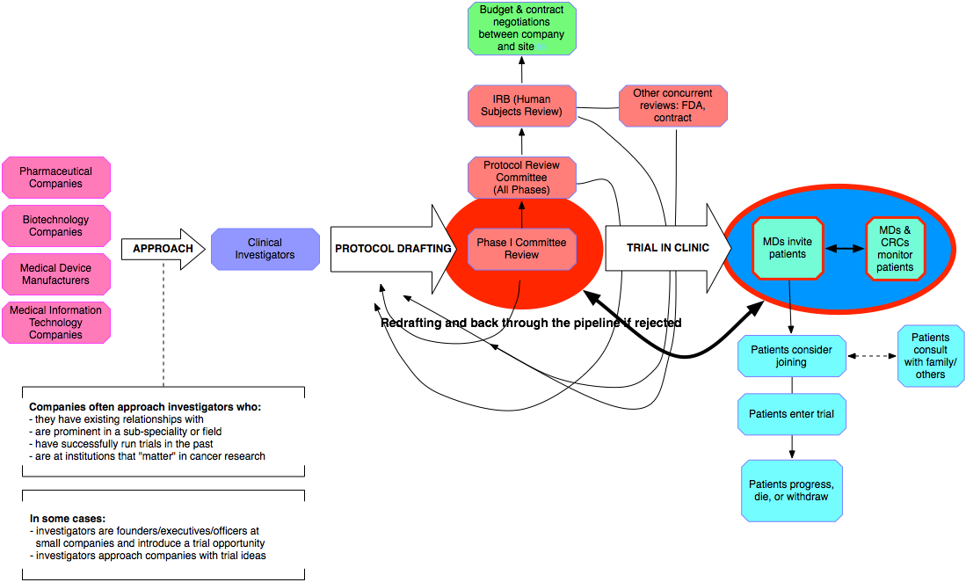
Show Contextual Complexity

Slide 11
Show how your team/activities fit your model

Slide 12
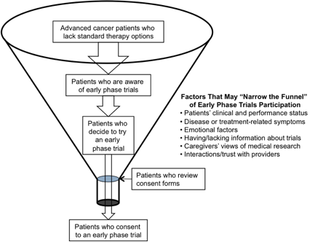
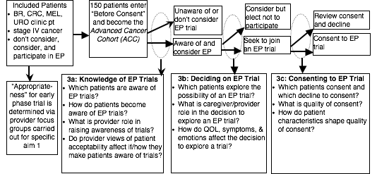
Show how your analyses fit your model

Slide 13
Show how you will accomplish your aims

Slide 14
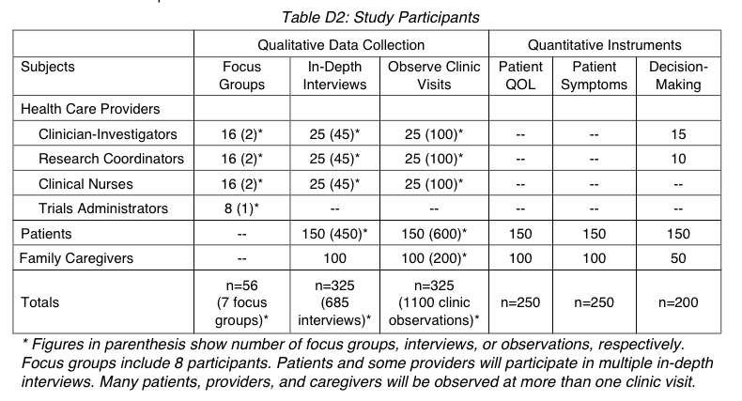
Show your purposeful sampling

Slide 15
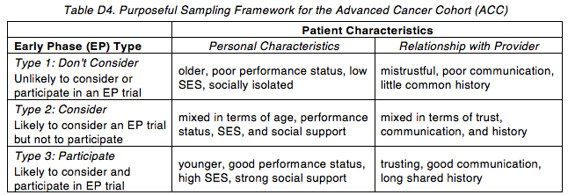
Show off your purposeful sampling

Slide 16
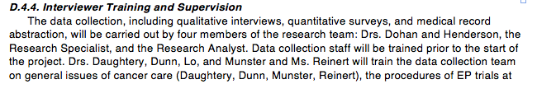
Show how you will participate:
Field techniques and training

Slide 17
Show how you will participate:
Interview guides

Slide 18
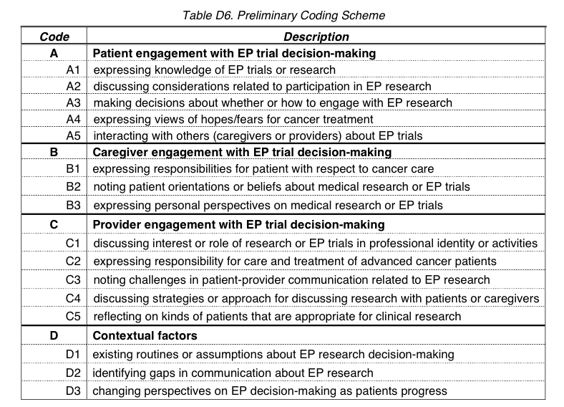
Show your process: Coding scheme

Slide 19
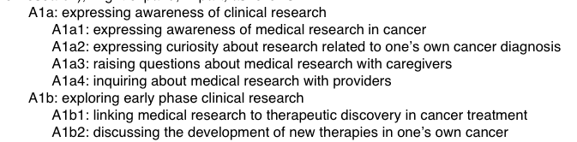
Show your process:
Iterative development of the coding scheme

Slide 20
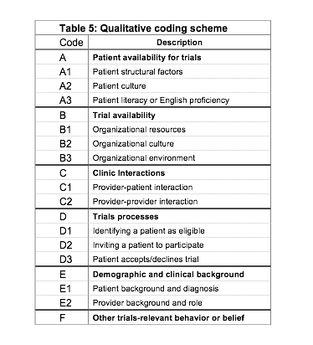
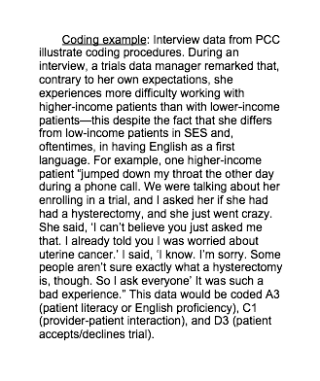
Show your process: Applying the coding scheme

Slide 21
Reassure them you know the particulars
Dr. Dohan met Ms. Santos (a pseudonym), a breast cancer patient two months after she was diagnosed with metastatic disease, and he subsequently followed her progress for the next 26 months until her death. He met Ms. Santos at the clinic where she received care and observed 6 of her visits. He conducted an in-depth interview with her in her home approximately 10 months before she died and met her mother, who was her main caregiver. In addition to observing her clinic visits, he also interviewed her oncologist. At the time of her diagnosis with advanced cancer, Ms. Santos expressed no awareness of early phase trials although her oncologist spoke to her about enrolling in a phase 3 study. During her in-depth interview, she expressed confidence that God would take care of her although by that point she had failed at least 2 chemotherapy regimens and had severe symptoms including two hospitalizations for pleural effusions. In the next few months, she became even weaker and failed other therapies. She started to come to her clinic appointments in a wheelchair equipped with an oxygen bottle. During her last two visits, she had to lie in a bed. During these visits, she mentioned EP trials for the first time – having heard from an uncle that a “new drug” might help her. Her mother was clearly distressed by Ms. Santos’ condition, but she did not seem enthusiastic about finding a “new drug” and focused on keeping her daughter comfortable with her breathing and trying to get her to eat. Her oncologist never explained that these “new drugs” were only available in a research study, but the doctor did tell Ms. Santos that no new drugs were available right now. Later, out of earshot of Ms. Santos, the physician said that Ms. Santos had become too weak to contemplate enrolling in an EP trial.
As in aim 3a, we will first extract information from the Atlas database on ACC patients’ decisions about EP trials and link this to the baseline Stata data. To operationalize the concept of “pursuing a trial,” we will focus on whether patients discuss EP trials in general (as did Ms. Santos in the example above) versus whether they identify a particular EP trial in which they would like to enroll (something Ms. Santos did not do). We will then use descriptive data and statistics to compare the characteristics of patients who explore EP trials generally versus those who identify a specific trial. Sample size permitting, we will also conduct multivariate analyses to better understand which patient factors predict EP trial consideration. Our analyses will examine quality of life, symptoms, and emotions (especially depression) as predictors of the decision to explore an EP trial.
In Atlas, we will continue to examine data under Code A (in particular, “A2 – discussing considerations related to participation in EP research” and “A3 – making decisions about whether or how to engage with EP research”). We will also examine data in Codes B (Caregiver engagement with EP trial decision-making) and C (Provider engagement with EP trial decision-making).

Slide 22
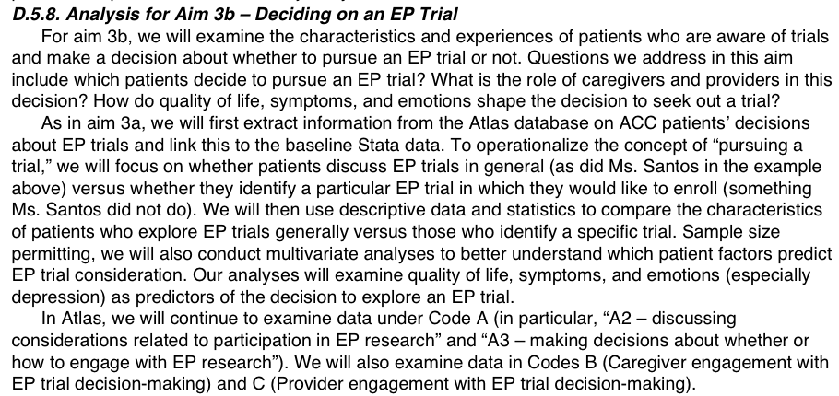
Show how you will use your particular knowledge to address each research aim

Slide 23
Human Subjects: Ethics and the IRB
Notes:
Obtaining and maintaining CHR approval can sometimes resemble a story-telling exercise. The anthropologic maxim that there are multiple truths that all tend to be quite local could not be truer than here. I usually find myself “translating” what I know will happen in the field into language that appears consistent with the IRB requirements. And, at least at UCSF, this process has become much better and much more consistent with ethnographic procedures in the last few years.

Slide 24
Contemporary biomedical research ethics
origins: involuntary medical “experiments” (Nazi, Tuskegee) and deceptive social science experiments (Milgram, Zimbardo)
principles: respect, beneficence, justice, informed consent
procedures
  prospective review of protocol by independent board;
  retrospective reporting of adverse events;
  ongoing tracking of in-progress results (via DSMB)

Slide 25
Qualitative research: naturalistic, informal, everyday
origins: fieldwork in the context of positive science and imperialism
principles: relationships, power, and representation
procedures: protocols as frameworks not recipes
  obtain IRB approval
  enter and re-enter the field
Notes:
Obtaining and maintaining CHR approval can sometimes resemble a story-telling exercise. The anthropologic maxim that there are multiple truths that all tend to be quite local could not be truer than here. I usually find myself “translating” what I know will happen in the field into language that appears consistent with the IRB requirements. And, at least at UCSF, this process has become much better and much more consistent with ethnographic procedures in the last few years.

Slide 26
Relationships, power & representation
Researchers inevitably negotiate relationships with their subjects
Power
  Power distorts beneficence, justice, informed consent, pay...
  Power is never equal
    Studying “down” -- examples?
    Studying “up” -- examples?
Researcher controls how subjects are represented
  Subjects’ voices
  Multiple truths

Slide 27
IRB: The qualitative “protocol”
“Protocolable” activities
  Be clear in your mind: What is “protocolable” and what is not
    Interviews Observation
Tips & tricks for IRB approval
  Educate your IRB (show don’t tell)
  Expedited review (risks are usually slight)
  Focus on confidentiality: individuals, field sites, the “powerful” and the “vulnerable”
Guide
Questions
Recording
Where/When
What you’ll do
Oral Consent

Slide 28
Materials & process for a qualitative manuscript?
Equivalent of tables in quant paper (variables, sequences argument)
Manageable amount of raw data and memos (20-200 pps.)
  You must be able to “keep it in your head”
  Equivalent of the numbers in the tables
Abstract: Remind yourself of the research question
Outline of the paper
  Abstract and outline should evolve from all those memos you’ve been writing
Process: Writing = re-writing, especially in qualitative research
    Deductive: Write abstract→ Develop Outline→ Fill in data
    Inductive: Write up data→ Discover Outline→ Draft Abstract

Slide 29
Career considerations
Institutional factors
  Who is reviewing your file?
  What is your timeline for production and advancement?
Funding mechanisms: R v. K; NIH v. private sources
Collaboration and other safe havens
  Pitfalls of the “5%” qualitative component
  Teaching, practice, and other strategies for support
Relationship to clinical research and biomedical science
  answering their questions
  critiquing their approaches
  redefining the terms of debate and interaction

