Slide 1
Overview for Today
Student Presentations (2)
Summary/Overview – “Take Home” Themes
Pharmacoepidemiology at UCSF – Thoughts moving forward
Course Evaluations

Slide 2
EPI 262:
Introduction to Pharmacoepidemiology
Course Director: Michael A. Kelsh, MPH, PhD
Center for Observational Research, Amgen, Inc.
Department of Epidemiology and Biostatistics, UCSF
Guest Lecturers:
Victoria Chia PhD
Michael Sprafka, PhD
Fei Xue, PhD
Fiona Callaghan
Michael Woolley, PhD
Alex Liede, PhD

Slide 3
Course Objectives
To provide students with an introduction to:
  The field of pharmacoepidemiology
  Basic study design principles and analysis in pharmacoepidemiology research
  Awareness of available data sources, strengths/ limitations for pharmacoepidemiologic research
  Post-marketing pharmacovigilance/drug safety research
  Health economics and pharmacoepidemiology
  Issues of bias and conflict of interest
  Discuss the role of epidemiology in the drug development lifecycle

Slide 4
Why do we need post-marketing safety assessment?
Study Population in RCT
Smaller sample size
Strict selection criteria
Patient Population in Clinical Practice
Variety of patients
High medication adherence
Close monitoring of patients
Highly experienced practitioners
Limited outcomes, shorter duration
Often used after a series of treatment failures, or in combination with other treatments
Sub-optimal adherence
Patients seen infrequently

Slide 5
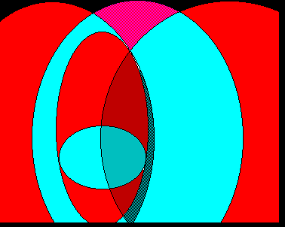
Health services
research
Economics
Epidemiology
Health
economics
Outcomes
research
Clinical epidemiology
Pharmaco-
Epidemiology
Conceptualization by Harry Guess

Slide 6
Study Design and Analysis
Pharmacoepidemiology relies on basic epidemiologic study designs:
  Cohort Studies
  Cross-sectional Surveys
  Descriptive Analyses
  “Ecologic” Studies
  Case-Control Studies
    Nested Case-control
    Case-Crossover
Not to forget – clinical trial design

Slide 7
Multiple sources of systematic error (bias) in pharmacoepidemiologic studies
Selection Bias
  Referral Bias
  Self-Selection Bias
  Prevalence Bias
  Protopathic Bias
Misclassification
  Recall bias
  Detection bias
  Immortal time bias
Confounding
  By indication
  By co-medication

Slide 8
Large databases are essential for conducting pharmacoepidemiologic studies
Phase 1
Phase 2
Phase 3
Launch
Post-Approval
Pharmacoepidemiology
Evaluating:
Utilization of existing therapeutics
  Clinical practice patterns
  Treatment guidelines
  Coverage policies
Patient outcomes with current therapies
Evaluating:
Real world utilization
Post-marketing effectiveness
Pharmacovigilance
Predictors of patient outcomes
Informs public health and decision-making:
Identify patients with unmet medical need
Size patient populations
Inform clinical trial design
Pricing & reimbursement/patient access
Informs public health and decision-making:
Are therapies used appropriately?
What is the population-level impact?
What is the benefit/risk profile?
Patient stratification
Treatment guidelines
Health policy

Slide 9
Types of databases
Administrative claims
  US: Medicare, Medicaid, United HealthCare, MarketScan
Pharmacy databases
  US: IMS LRx, Retail pharmacy chain data
Surveillance – surveys, registries
  National Health and Nutrition Examination Survey (NHANES)
  Surveillance Epidemiology and End Results (SEER)
  Nordic national databases and registries
Electronic medical/health records databases
  US: Kaiser Permanente, Group Health Cooperative, Geisinger, OSCER
  UK: Clinical Practice Research Datalink (CPRD, formerly GPRD)
Cohort studies
Notes:
Spontaneous reporting of ADR (adverse drug reaction) may generate hypotheses

Slide 10

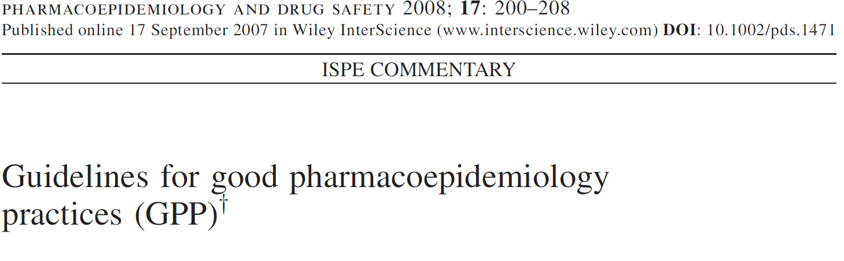
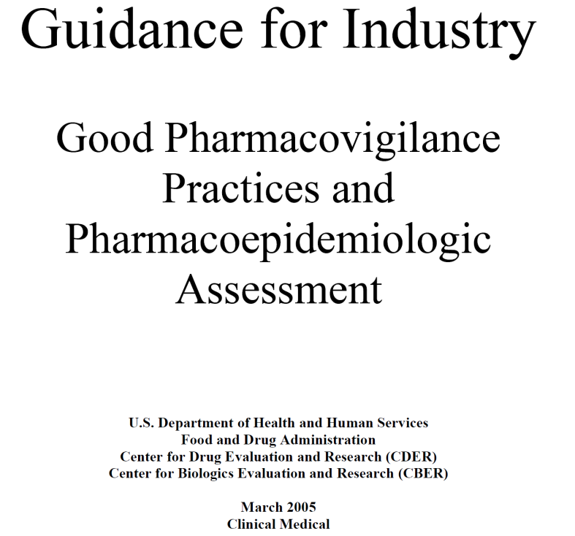
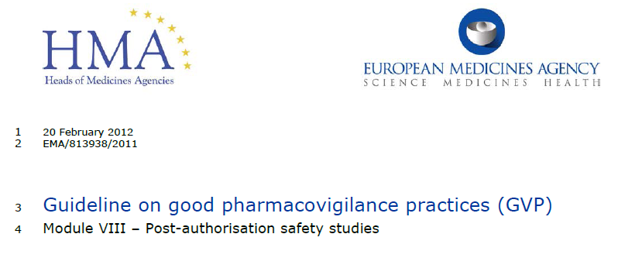
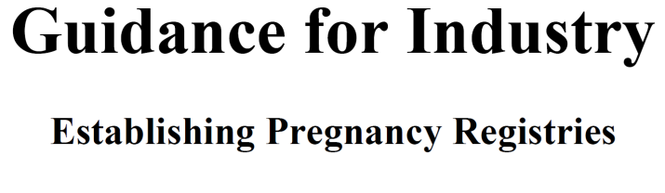
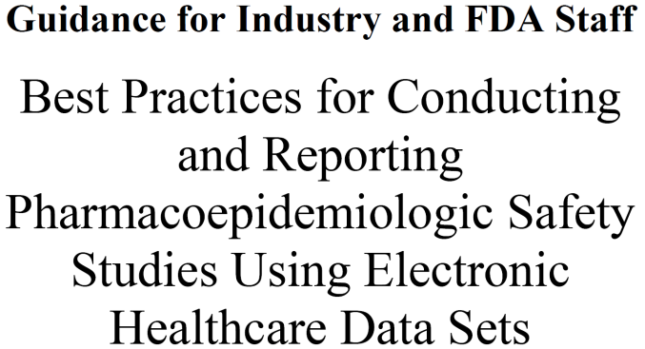


To Keep Up with the Consistently Evolving Environment
Registries for Evaluating Patient Outcomes: A User’s Guide
AHRQ Publication No. 07-EHC001-1 April 2007

Slide 11
Data Mining and Signal Detection in
Spontaneous Reporting Systems
J. Michael Sprafka MPH, PhD
Center for Observational Research
AMGEN

Slide 12
Limitations – Signal Detection Reporting and Evaluation
Chronic under-reporting
Episodic over-reporting (e.g., publicity, litigation)
Misreporting
Incomplete information
Changes over time in reporting and naming/coding practices
Data quality (e.g., dosage, duration of exposure)

Slide 13

Observational Research by the FDA's Sentinel Initiative
Transforming how we monitor the safety
of FDA-regulated products
Types of Assessments
Assessments make use of the Mini-Sentinel Distributed Database to describe
  exposures to medical products*
  occurrences of particular diagnoses and medical procedures
  health outcomes** among individuals exposed to medical products
  impact of FDA's regulatory actions and interventions

Slide 14
The Vioxx Example
FDA approves Vioxx May, 1999
VIOXX was evaluated for the treatment of the signs and symptoms of OA of the knee and hip in placebo- and active-controlled clinical trials of 6 to 86 weeks duration that enrolled approximately 3900 patients.
Registered trademark of MERCK & CO., Inc., Whitehouse Station, New Jersey, USA
COPYRIGHT Ó MERCK & CO., Inc., 1998
All rights reserved.

Slide 15
Clinical Development Systems
Safety Systems
Signal Detection
Clinical Trial Management System
Clinical Electronic Data Capture
Coding Tools
Reports Generators
Analytics Tools

Slide 16
AE Case Processing Workflow
Case Source
Case
Intake
Case Processing
Case
Output
Aggregate
Output
Output
Analysis
Safety Call Center
Reported Cases
Case Intake
Medical input/Review/Final Triage
Individual Case Reporting
Aggregate Data Review
Periodic
Reports
Clinical Trials SAEs
Safety Data
Processing
Safety Systems
Support
Signal
Analysis
Spontaneous Reports
Triage
Data
Entry
Query
Process
QC
Case
Close
Risk Benefit
Assessment
and Mitigation
Literature Search
Cases

Slide 17
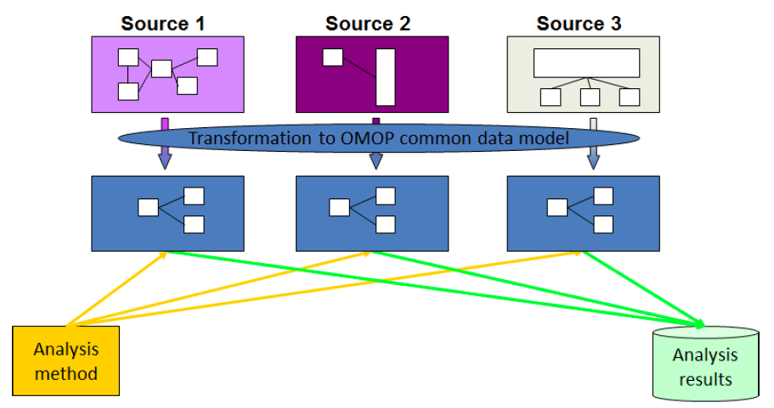
OMOP Common Data Model (CDM)
CDM allows for the systematic analysis of disparate observational databases.
The transform data contained within disparate databases into a common format, and then perform systematic analyses using a library of standard analytic methods applied on the common format.

Slide 18
Advanced Methods In Pharmacoepidemiology - Topics
Assess bias and confounding in observational studies
  Causal diagram
Methods to address confounding by indication:
  Propensity score analyses
  Marginal structural models
  Instrumental variables
  External covariate adjustment
Handling changing exposure over time
Validity studies

Slide 19
Strategies to Reduce Confounding When Confounders are Measured
Measured Confounders
Design
- Restriction
- Matching
Analysis
- Standardization
- Stratification
- Regression
- Marginal
Structural Models
Propensity Scores
Figure adapted from a presentation made by Sebastian Schneeweiss, ICPE, Chicago 2011

Slide 20
Strategies to Reduce Confounding When Confounders are Unmeasured
Unmeasured Confounders
Measurable in sub-study
- 2-stage sample
- External adjustment
- Imputation
Unmeasurable
- Cross-over analysis
- Instrumental variables
- Etc
Figure adapted from a presentation made by Sebastian Schneeweiss, ICPE, Chicago 2011

Slide 21
Incident User Cohort Design – Overview
Alternatively called “new user design”, “initiator cohort design”, “intent-to-treat analysis”, etc
Identify all patients in a defined population who start a course of treatment with the study drugs.
  Restricted to patients with a minimum period of nonuse (washout) prior to the start of treatment (index date)
Covariates evaluated during the washout period
Follow up for endpoints starting from the initiation of the treatment until censoring by disenrollment, death or occurrence of the endpoint (if incident case is of interest)
Analysis of data is similar to the way for clinical trials
  The index date is randomization

Slide 22
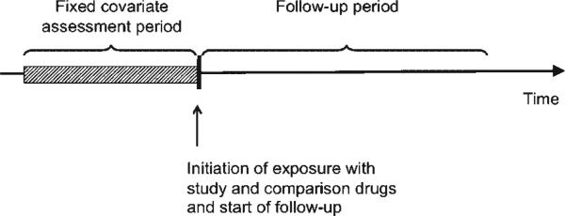
Incident User Cohort Design – Overview

Slide 23
Meta-Analysis and Systematic Review
Meta-Analysis
  How to conduct, when is it appropriate to combine results across studies?
  Analytical approaches – e.g. “fixed effects”, “random effects”
  Strengths and limitations
Case Studies

Slide 24
Health Economics, Health Outcomes
Economic evaluation in Health Care: overview of basic definitions and concepts

Slide 25
Ethics and Conflict of Interest in the Pharmaceutical Industry
Equipoise
Authorship (esp. ghostwriting, author shifting)
Conflict of interest
Show me the money!
Thomas Kuhn on objectivity
Why focus on financial interests?
Does the focus on financial interests detract from scientific evaluation?
How best to deal with conflicts

Slide 26
Pharmacoepidemiology at UCSF
Courses Currently Available:
This course – Intro Pharmacoepidemiology (Epi 262)
Clinical Trials (Epi 205)
Development and Approval of Drugs & Devices(Epi 260)
Systematic Review (Epi 214)
Clinical (Epi 204)
Cancer Epi (Epi 252)
Molecular & Genetic Epi (Epi 217)
Other Potential courses:
  Special topics in Pharmacoepidemiology
  Advanced methods
  Database course

