Slide 1
Multi-Level and Longitudinal Conceptual Approaches for Health Disparities Research
Christine Dehlendorf, MD MAS
Associate Professor

Slide 2
How Pervasive are Health Disparities?

Slide 3
Infant Mortality
Rates per 1,000 Live Births by Detailed Race & Hispanic Origin of Mother: U.S.,
2005
Source: CDC, NCHS, Health, United States, 2008, Table 18 http://www.cdc.gov/nchs/data/hus/hus08.pdf
Notes:
Updated 3/24/09 CDC, NCHS, HUS 2008, Table 18, http://www.cdc.gov/nchs/data/hus/hus08.pdf
Infant mortality is much higher for African Americans and American Indians when compared with other groups. This slide demonstrates that infant mortality can vary widely within racial/ethnic groups. For example, Cuban Americans have the lowest rate of infant mortality for any subgroup, but Puerto Ricans have one of the highest rates.
Some of the disparities in infant mortality are caused by disparities in Sudden Infant Death Syndrome (SIDS).

Slide 4
Infant Death Under 1 Year
Rates per 1,000 Live Births by Race & Hispanic Origin: U.S.,
2005
Source: National Vital Statistics Report, 56(16), 6/11/08: Deaths: Preliminary Data for 2006, Table 4, p22 http://www.cdc.gov/nchs/data/nvsr/nvsr56/nvsr56_16.pdf
Notes:
Updated 3/24/09 CDC, National Vital Statistics Report, 56(16), 6/11/08: Deaths: Preliminary Data for 2006, Table 4, p22 http://www.cdc.gov/nchs/data/nvsr/nvsr56/nvsr56_16.pdf

Slide 5
Maternal Mortality for Complications of Pregnancy, Childbirth, & the Puerperium
Age-Adjusted Death Rates per 100,000 Persons by Race & Hispanic Origin: U.S.,
2005
Source: CDC, NCHS, Health, United States, 2008, Table 42.
http://www.cdc.gov/nchs/data/hus/hus08.pdf
Notes:
Updated 3/24/09 CDC, NCHS, HUS 2008, Table 42, http://www.cdc.gov/nchs/data/hus/hus08.pdf

Slide 6
Diabetes
Age-Adjusted Death Rates per 100,000 Persons by Race & Hispanic Origin: U.S.,
2005
Source: CDC, NCHS, Health, United States, 2008,
Notes:
Updated 6/2/08 by SB.

Slide 7
Human Immunodeficiency Virus (HIV) Disease
Age-Adjusted Death Rates per 100,000 Persons by Race & Hispanic Origin: U.S.,
2005
Source: CDC, NCHS, Health, United States, 2008
Notes:
Updated 6/2/08 by SB.
Age-Adjusted Death Rates per 100,000 Persons by Race, and Hispanic Origin for Human Immunodeficiency Virus (HIV) Disease: U.S., 2002
The HIV/AIDS epidemic is a health crisis for African Americans. In 2001, HIV/AIDS was among the top three causes of death for African American men aged 25–54 years and among the top 4 causes of death for African American women aged 20–54 years. It was the number one cause of death for African American women aged 25–34 years. (18)
According to the 2000 Census, African Americans make up 12.3% of the U.S. population. However, they have accounted for 368,169 (40%) of the 929,985 estimated AIDS cases diagnosed since the epidemic began. During 2000–2003, HIV/AIDS rates for African American females were 19 times the rates for white females and 5 times the rates for Hispanic females. Rates for African American males were 7 times those for non-Hispanic white males and 3 times those for Hispanic males. (18)
Causes for the Disparity:
--According to a recent study of HIV infected and noninfected African American men who have sex with men (MSM), approximately 20% of the study participants reported having had a female sex partner during the preceding 12 months. In another study of HIV-infected persons, 34% of African American MSM reported having had sex with women, even though only 6% of African American women reported having had sex with a bisexual man.
--Injection drug use is the 2nd leading cause of HIV infection for African American women and the 3rd leading cause of HIV infection for African American men.
-- The highest rates of sexually transmitted diseases (STDs) are those for African Americans. In 2003, African Americans were 20 times as likely as whites to have gonorrhea and 5.2 times as likely to have syphilis. Partly because of physical changes caused by STDs, including genital lesions that can serve as an entry point for HIV, the presence of certain STDs can increase one’s chances of contracting HIV by 3- to 5-fold. Similarly, a person who is coinfected has a greater chance of spreading HIV to others
-- Studies show that a significant number of African American MSM identify themselves as heterosexual. As a result, they may not relate to prevention messages crafted for men who identify themselves as homosexual.
-- Nearly 1 in 4 African Americans lives in poverty. Studies have found an association between higher AIDS incidence and lower income. The socioeconomic problems associated with poverty, including limited access to high-quality health care and HIV prevention education, directly or indirectly increase HIV risk. A recent study of HIV transmission among African American women in North Carolina found that women with HIV infection were more likely than noninfected women to be unemployed, receive public assistance, have had 20 or more lifetime sexual partners, have a lifetime history of genital herpes infection, have used crack or cocaine, or have traded sex for drugs, money, or shelter. (18)
Slide source (9)

Slide 8
Tuberculosis (TB) Case Rates
Age-Adjusted Case Rates Per 100,000 Persons by Race & Ethnicity: U.S.,
2007
Source: CDC, MMWR, March 21, 2008 / 57(11);281-285, Trends in TB, US, 2007, Table: http://www.cdc.gov/mmwr/preview/mmwrhtml/mm5711a2.htm
Notes:
Updated 6/2/08 by SB.
Age-Adjusted Case Rates Per 100,000 Persons by Race/Ethnicity for Tuberculosis (TB): U.S., 2001
Asian Americans and Pacific Islanders (AAPIs) are 2.4 times as likely to have Tuberculosis (TB) as African Americans, and 5.8 times as likely as all races. (JW)
Several important factors likely contribute to the disproportionate burden of TB in minorities. In foreign-born persons from countries where TB is common, TB disease may result from infection acquired in the country of origin. In racial and ethnic minorities, unequal distribution of TB risk factors, such as HIV infection, may also contribute to increased exposure to TB or to an increased risk of developing TB once infected with M. tuberculosis. However, much of the increased risk of TB in minorities has been linked to lower socioeconomic status and the effects of crowding, particularly among U.S.-born persons. (14)
Slide source (15)
Source: CDC, MMWR, March 21, 2008 / 57(11);281-285, Trends in TB, US, 2007, Table: http://www.cdc.gov/mmwr/preview/mmwrhtml/mm5711a2.htm

Slide 9
Breast Cancer
Age-Adjusted Death Rates per 100,000 Persons by Race & Hispanic Origin: U.S.,
2005
Notes:
Updated 6/2/08 by SB.

Slide 10
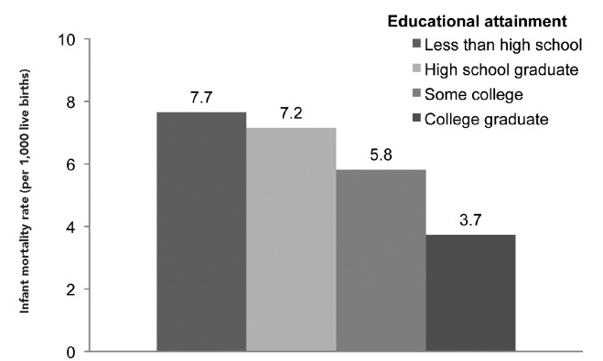
Infant Mortality by Education
Braveman, Public Health Reports, 2014

Slide 11
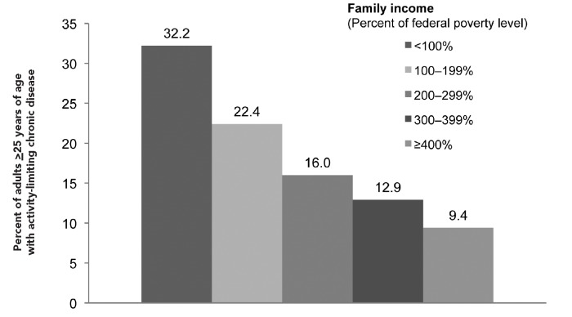
Chronic Diseases by Income
Braveman, Public Health Reports, 2014

Slide 12
Self-Reported Health
Braveman et al. analyses of NHIS 2001-2005.
Age-Adjusted.
Braveman et al. analyses of NHIS 2001-2005.
Age-Adjusted.
Notes:
Will talk a bit more in a second about why less common

Slide 13
Diabetes-related mortality by Federal Poverty Level (FPL)
Age adjusted to the 2000 U.S. standard population
Rates per 100,000 person years
National Health Interview SUrvey
Notes:
NHIS 1990-200

Slide 14
What is Health Disparities Research?
Research designed to describe, understand, and ameliorate differences in health outcomes negatively impacting disadvantaged groups
It is possible to do Health Disparities Research and not know it
It is important to pay attention to disparities, even if not doing “Health Disparities Research”
Krieger, J Epi Comm Health, 2001
Notes:
Don’t have to do just health disparities research to contribute to the idea of health disparities research
Note this course is also designed to help people who just want to do nuanced research – don’t want to do HDR but also don’t want to do bad research that doesn’t take issues of difference and disadvantage into account
3
Important to know about social epi as a health disparities research – a lot of health disparities research falls in this category – while health care and interventions have been less a focus, it is a growing area – not always known about by clinical folks doing HDR

Slide 15
A Little Bit of History…
Increasing attention to health disparities in 1970s in the UK
  Black Report
  Focused on class inequities

Slide 16
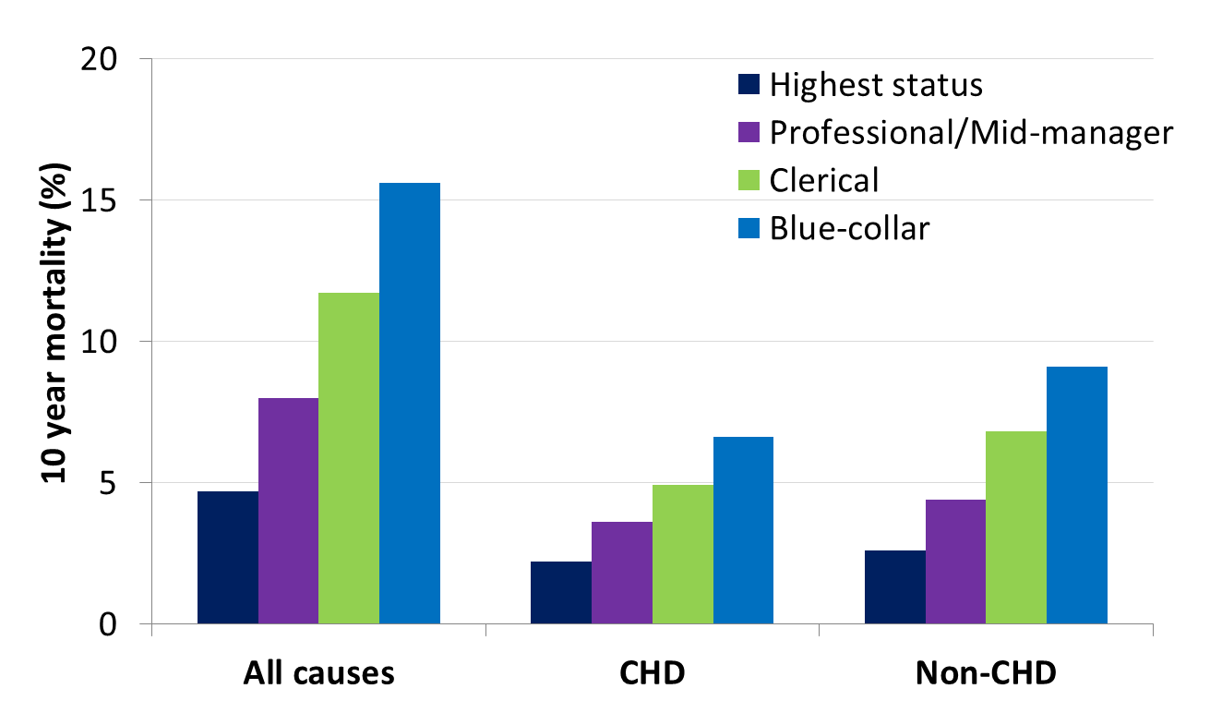
Higher-status job, longer life:
UK Whitehall Study
Marmot, M. G., et al (1984).
Lancet 1(8384): 1003-1006.
Notes:
KA updated numbers to more accurately reflect data table in article (numbers were estimates before).

Slide 17
History of Health Disparities Research in US
In 1980s, Heckler Report from Department of Health and Human Services documented extent of racial/ethnic health disparities
  Led to initiatives, including establishing Office of Minority Health
In 1990s, attention to class increased
Increasing attention to importance of considering both factors
Notes:
OMH eventually became NIMHD
The U.S. government is one of the few developed Western nations that does not routinely report health statistics by class

Slide 18
Course Objectives
Identify the meaning and measurement of race/ethnicity, SES and other core concepts
Understand a multi-level and longitudinal framework for the etiologies of differences in health by race/ethnicity and SES
Describe the essential role of community engagement
Incorporate a rigorous approach to measurement in research in diverse populations
Understand the application of different study designs to health disparities research
Notes:
Identify leading debates and areas of uncertainty, as well as priority areas of research, in health disparities research

Slide 19
Overview of Next 6 Weeks
Week 1: Overview of conceptual models
Week 2: Social determinants
Week 3: Biological determinants
Week 4: Behavioral determinants
Week 5: Health systems and health care determinants
Week 6: Social and health policy determinants

Slide 20
Objectives
Review conceptual approaches to understanding health disparities
Understand rationale for ecological framework for research on health disparities
Apply ecological thinking to specific areas of health disparities research

Slide 21
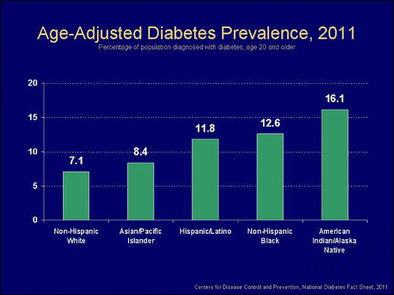
Notes:
Also have more complications – blacks ahve 2-4 times the rate of renal disease, blindness, amputation, and amputation related mortalitt, latinos higher rates of renal disease and retinopathy
http://link.springer.com/article/10.1007/s11892-012-0324-1/fulltext.html

Slide 22
What causes these disparities?
Behavioral factors?
  Diet
  Sedentary lifestyle
  Obesity
Genetics?
Sharma, Ethn Dis, 2004
Notes:
Usually weight and cholesteral less assocaited
They don’t break down the specific risk factors for SES – may want to look into that
“dominant theories” per krieger of lifestyle and genetics

Slide 23
Black Box Epidemiology
Diabetes
Behavioral Factors
Genetic Factors
Kurian, Ethn Dis, 2007
Notes:
Straightforward descriptions of disease origins and sweeps for risk ratios – not interested in interconnections, intervening factors or causation
Coincides with the use of individually based psychology models – designed to focus on motivation etc without underlying understanding of causes
Not genetics = http://www.sciencedirect.com/science/article/pii/S1047279714003196
Importance of poverty/place interconnections - http://www.ncbi.nlm.nih.gov/pubmed/24228660

Slide 24
Black Box Epidemiology
Diabetes
Behavioral Factors
Environmental Factors
Genetic Factors
Kurian, Ethn Dis, 2007
Notes:
Straightforward descriptions of disease origins and sweeps for risk ratios – not interested in interconnections, intervening factors or causation
Often focus has been on lifestyle and genetics, although environment can be incldued her as relevant exposures
Not genetics = http://www.sciencedirect.com/science/article/pii/S1047279714003196
Importance of poverty/place interconnections - http://www.ncbi.nlm.nih.gov/pubmed/24228660

Slide 25
Paradigms of Epidemiology
Miasma: Sanitary statistics
Germ theory: Infectious disease epidemiology
Black box: Chronic disease epidemiology
  Emphasis on individual behavior change theories
Now what?
Susser and Susser, AJPH, 1996
Notes:
Other possible ways to present these frameworks – the point is that the frameworks in play are in response to the needs of the time and are responsive to what we know at any one time. Not knowing about bacteria, we couldn’t do infectious disease epidemiology. ID epi is what lead to the exposure-outcome framework. Now with chronic diseases, we are beginnign to understand more that the strictly individual perspective is not adequate and we need to think bigger

Slide 26
Black Box Epidemiology
Diabetes
Behavioral Factors
Environmental Factors
Genetic Factors
Kurian, Ethn Dis, 2007
Notes:
What’s wrong with this approach?
- proximate risk factors
Individual focus
Limited in time
No interconnections

Slide 27
Determinants of Health:
Premature Mortality
Genetic
30%
Social
15%
Environment
5%
Health care
10%
Behavior
40%
Source: McGinnis JM, Russo PG, Knickman, JR. Health Affairs, April 2002.
Notes:
To be fair, state this:
Ultimately, the health fate of each of us is determined by factors acting not mostly in isolation but by our experience where domains interconnect. Whether a gene is expressed can be determined by environmental exposures or behavioral patterns. The nature and consequences of behavioral choices are affected by our social circumstances. Our genetic predispositions affect the health care we need, and our social circumstances affect the health care we receive.
But don’t really focus on it

Slide 28
Avoiding the Prison of the Proximate
1960s - Social epidemiology defined as a discipline
  Investigation of social factors as etiologies for disease
Development of theories to explain relationships
Notes:
Avoiding the prison of the proximate

Slide 29
Theory of Fundamental Causes
1995 Link and Phelan addressed persistence of SES disparities in health despite changes in context and conditions
  19th century: Infectious disease
  20th and 21rst centuries: Cancer, cardiovascular disease

Slide 30
Theory of Fundamental Causes
SES is a fundamental cause of poor health:
  Regardless of disease or context, high SES individuals and groups can flexibly deploy resources to avoid risks and mitigate effects of poor health
Resources include:
  Money
  Knowledge
  Power/Prestige
  Social connections
Notes:
Flexibly is key here
Also operate on both group and individual level – i.e. neighborhood effects and having individual resources
Whitehall shows the importance of power
Power is both interpersonal and meta (i.e. policies)

Slide 31
Theory of Fundamental Causes
Infectious diseases:
  Avoid areas that carry risk of contamination
  Limit entry of potential infectious individuals
Cardiovascular diseases:
  Access healthy food
  Live in communities that facilitate healthy choices
All contexts:
  Access quality medical care
Notes:
Flexibly is key here
Also operate on both group and individual level – i.e. neighborhood effects and having individual resources

Slide 32
Evidence to Support Theory of Fundamental Causes
SES gradients in mortality are more pronounced with preventable conditions
Advances in treatment increase disparities in outcomes
Specific example:
  Smoking: No SES gradient until evidence of cancer risk released in 1950s
Notes:
No SES gradient with smoking prior

Slide 33
Race as a Fundamental Cause
Initially, theory of fundamental causes focused only on SES
Racial/ethnic disparities considered as collinear with SES
Paper by Link and Phelan to come out this year considering race/ethnicity to be both:
  Predictive of SES
  An independent fundamental cause
Notes:
Preasages debate about effect of race
According to Link and Phelan, a fundamental social cause of health inequalities has four key components:
The cause influences multiple disease outcomes
The cause affects disease outcomes through multiple risk factors.
The cause involves access to resources that can assist in avoiding health risks or to minimize the sequelae of disease once it occurs.
“The association between a fundamental cause and health is reproduced over time via the replacement of intervening mechanisms” ^{[1]}

Slide 34
Social Production of Disease
Focus on economic and political institutions that create and perpetuate inequality
  Both within and between countries
Rooted in critique of capitalist model and emphasis on human rights and social equity

Slide 35
Upstream Theories:
Not the Whole Story
Important in encouraging a broader perspective
  Encourage structural approaches to disparities
BUT - Neglect the “downstream” mechanisms by which social conditions are mediated
  Both perspectives are needed
Example of decline in infectious mortality:
  Economic growth -> improved nutrition
  Public health efforts such as sanitation, antibiotics

Slide 36
Thinking Ecologically
Move toward ecological approach rooted in work in social science disciplines in 20th century
The ecological model is "a model of health that emphasizes the linkages and relationships among multiple factors (or determinants) affecting health.” – Institute of Medicine
  Allows for intervention at multiple levels
Notes:
Ecological language and thinking was introduced to urban studies by sociologists associated with the Chicago School after the first world war. But the popularity of these ideas declined. There was an overall souring of interest in using ecology to understand human social worlds, because various ideas from biology such as “competition” and “survival of the fittest” became unpalatable when they were used in association with morally unacceptable actions and policies.
Idea that ecology “integrates macro, meso and micro levels and allows for complex relationshiups”
Behavior is affected by and affects multiple layers
http://jech.bmj.com/content/59/1/6.full
The ecological model of health has its origins in the fields of psychology
and human development, in the mid-20th century work of Lewin, Barker,
and Bronfenbrenner, and others who began to understand behavior in a
context of the interplay of the individual and the environment.

Slide 37
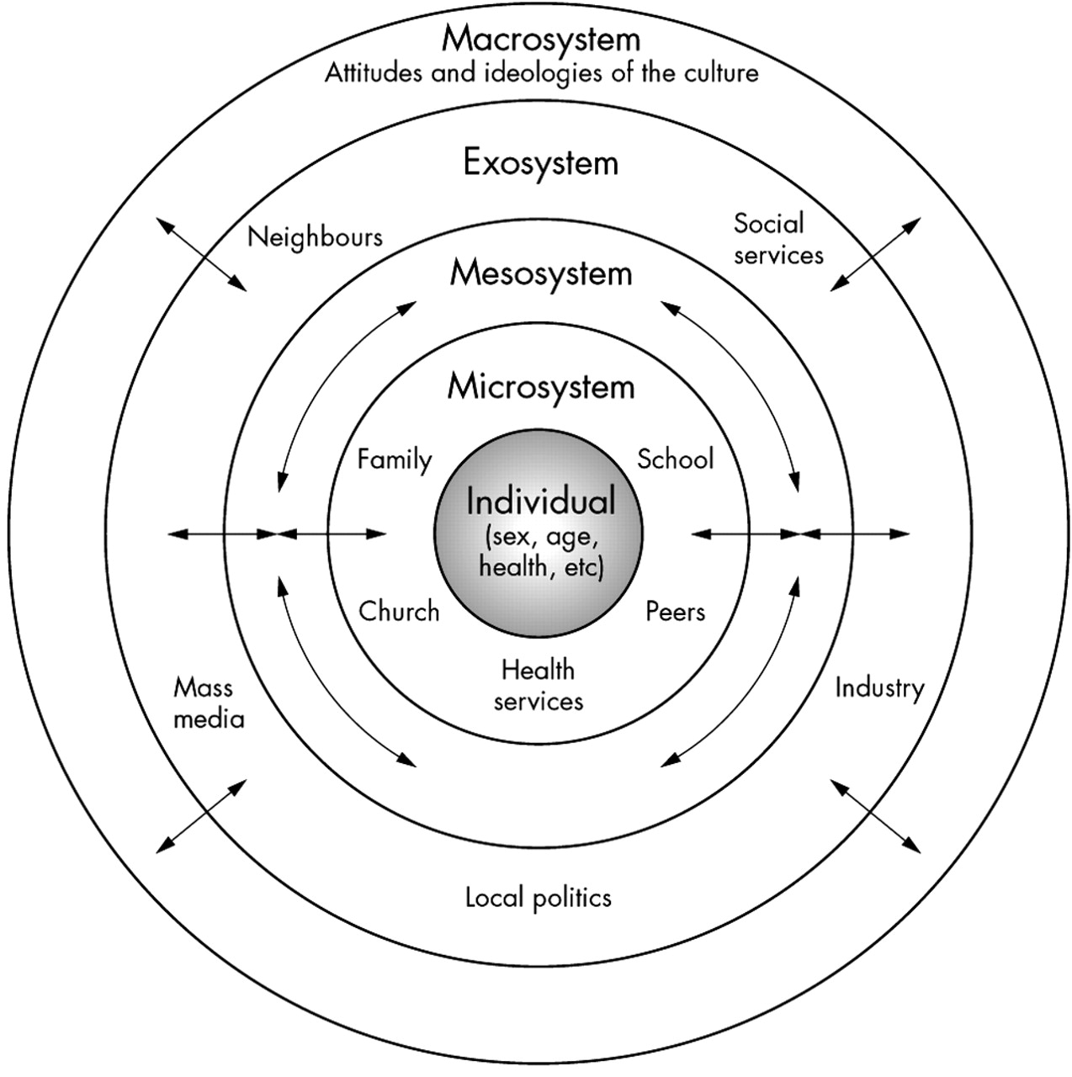

Brofenbrenner’s ecological theory of development
McLaren L , and Hawe P
J Epidemiol Community Health 2005;59:6-14
Notes:
Brofenbrenner’s ecological theory of development (adapted from Santrock et al45).
Urie Bronfenbrenner (29 April 1917 – 25 September 2005)^{[1]} was a Russian-born^{[1]} American developmental psychologist who is most known for his ecological systems theory of child development.^{[2]} His scientific work and his assistance to the United States government helped in the formation of the Head Start Program in 1965
Bronfenbrenner's research and his theory was key in changing the perspective of developmental psychology by calling attention to the large number of environmental and societal influences on child development.^{[3]}
The ecological model that we’re focusing on in this tutorial “emphasizes
the importance of the social and physical environments that strongly
shape patterns of disease and injury as well as our responses to them
over the entire life cycle”
(Fielding JE, Teutsch S, Breslow L. A framework for public health in the United
States. Public Health Reviews 2010;32:174-189).

Slide 38
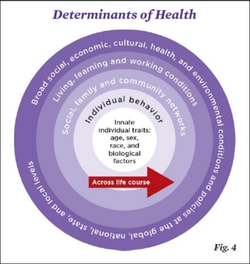
IOM Ecological Model
Notes:
Adding across the life course is important
Arrow indicates that they influence each other

Slide 39
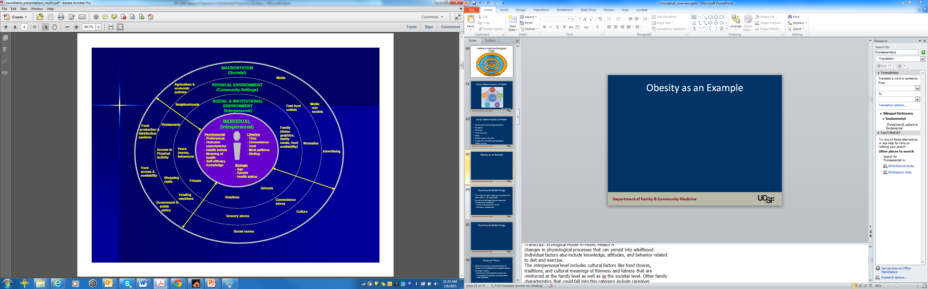
Obesity as an Example
Mullis, An ecological approach to childhood obesity. USDA, 2009
Notes:
Does not talk about epigenetics
http://www.nifa.usda.gov/nea/food/in_focus/obesity_if_roundtable_pres.html
Let's turn to an example of an ecological model for obesity.
Obesity is often used in examples of applying an ecological framework, so
you’re probably familiar with some variation on this theme. I would argue
that these models often are not fully elaborated, with just selected
components highlighted. In designing interventions, of course you have
to select targets; but understanding the big picture is a critical first step
before narrowing your focus. The examples I’ve filled in here aren’t
necessarily comprehensive, but I’ve tried to include a representative
range of factors. There’s also a lot of interaction among factors and
overlap across levels that my limited graphic design skills couldn’t
capture, so we could reasonably differ in how we’d choose to identify or
group many of these elements. This is just a quick look at how we might
begin to examine obesity from within an ecological model.
Individual factors could include both genetics and epigenetics (changes
in gene expression without a modification to the DNA sequence). For
example, there is evidence of epigenetic changes associated with obesity
that are related to environmental exposures to endocrine disrupting
chemicals, and to maternal obesity—exposures early in life that trigger
Transcript: Ecological Model in Public Health 4
changes in physiological processes that can persist into adulthood.
Individual factors also include knowledge, attitudes, and behavior related
to diet and exercise.
The interpersonal level includes cultural factors like food choices,
traditions, and cultural meanings of thinness and fatness that are
reinforced at the family level as well as as the societal level. Other family
characteristics that could fall into this category include caregiver
behavior, time pressures affecting the ability to cook and eat together,
and the role of food in the context of family relationships.
Institutional factors might include school and workplace food options and
opportunities for physical activity, and access to health promoting
services like wellness programs, clinics, or gyms. In the workplace,
providing time and space for lactating mothers to pump breast milk could
even be a factor. The degree to which breastfeeding reduces the risk of
later obesity is still in question, but I’m mentioning it just as an example
of the array of factors that could be considered in a full picture of the
influences.
Community factors include access to, and affordability of, healthy food,
recreation facilities, health care services; walkability and the layout of
streets; the safety of outdoor spaces; having neighbors who exercise; and
community norms related to food choices and accepted weight ranges.
And again, as an example of the full range of factors that could be at
play, how about school hours? Insufficient sleep has been linked to
obesity, so might school system policies that start the high school day
very early in the morning, at odds with teenagers’ natural or preferred
sleep patterns, contribute to sleep deficits that prime the body to store
more fat?
I put community level social norms in here, but social norms may act on a
larger societal level, too, so they could reasonably be placed in the
broadest level of the model. Other factors in the broad social and policy
level could include things like regulations pertaining to school food
programs, agricultural subsidies, zoning laws, exposure to obesogenic
chemicals in foods, food packaging, and other products, all of which are
affected by the regulatory environment. And the balance between
individual rights and regulations—which we recently saw come into play
when Mayor Bloomberg tried to ban the sale of very large cups of soda in
New York City restaurants.
Add in ecoscoial model text around structural causes etc.

Slide 40
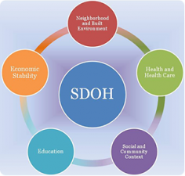
Social Determinants of Health
Healthy People 2020
Notes:
One end result of focus on the ecological model is attention to SDH
“Health starts where we live, learn,
work, and play.” – RWJ

Slide 41
Social Determinants of Health
The social determinants of health are those determinants of health that lie outside of the individual; they are beyond genetic endowment and beyond individual behaviors. They are, in fact, the context in which individual behaviors arise and in which individual behaviors convey risk. The social determinants of health include individual resources, neighborhood (place-based) or community (group-based) resources, hazards and toxic exposures, and opportunity structures.
-Jones et al 2009

Slide 42
Social Determinants of Health
Employment and working conditions
Education
Housing
Food insecurity
Stress
Social support networks
Availability of healthy transportation
+/-Health services
Notes:
Social stratification can be in there
Need to be careful to not think of these in two granular a context – i.e. the cuases of the causes

Slide 43
IOM Ecological Model
Notes:
Adding across the life course is important
Arrow indicates that they influence each other

Slide 44
A Different Approach to the Ecological Model
Economic & Social
Opportunities and Resources
Living & Working Conditions
in Homes and Communities
Behaviors
Medical Care
Interaction with genetic/other biological factors
HEALTH
Adapted from Braveman et al., for RWJ Foundation
Commission to Build a Healthier America | www.commissiononhealth.org

Slide 45
Psychosocial Epidemiology
Why does the same exposure not produce the same effect in all individuals?
Environmental/social stressors may alter resistance/susceptibility
  Focus on neuroendocrine function
Concept of “allostatic load” as measure of cumulative physical wear and tear
Notes:
Other approaches that have focused more on interrelationships with Biology
Allostatic
load (or cumulative biological risk) has
been proposed as a biological link that explains
socioeconomic disparities in morbidity and
mortality6,7; empirical studies have demonstrated
that allostatic load is patterned by social
determinants (e.g., ethnicity, education,
and income)8---11 and prospectively predicts
mortality as well as cognitive and physical
decline.12---14
Now going to briefly talk about two specific theories that can be helpful to know about that are related to the big picture ecological model
First – a way in which stressful life circumstances can produce biological effects
Ignores who is thrown into the river
A psychosocial framework directs attention to both behavioural and endogenous biological responses to human interactions.1 At issue is the “health-damaging potential of psychological stress”, as “generated by despairing circumstances, insurmountable tasks, or lack of social support” (page 41)36; see also “stress” (below). Typically conceptualised in relation to individuals, its central hypothesis is that chronic and acute social stressors: (a) alter host susceptibility or become directly pathogenic by affecting neuroendocrine function, and/or (b) induce health damaging behaviours (especially in relation to use of psychoactive substances, diet, and sexual behaviours).1 4 36

Slide 46
Psychosocial Epidemiology
Telomere length associated with:
  Educational attainment
  Occupational class
  Work schedules
  Stress
Allostatic load associated with social determinants and predictive of mortality and cognitive and physical decline
Notes:
http://www.ncbi.nlm.nih.gov/pmc/articles/PMC3863696/
Important to note this is direct length of sdh with outcomes not through behavior – but psychosocial could be either one
http://ajph.aphapublications.org/doi/pdf/10.2105/AJPH.2013.301707

Slide 47
Ecosocial Theory
Combines concepts related to social production of disease with biological and ecological analysis
Concepts include:
  Embodiment of the material and social world
  Accountability of institutions and structures for social inequalities (including researchers)
Acknowledges role of material and power differentials
Notes:
Related multi level frameworks include eco-epidemiology and social-ecological systems perspective – but this is the one that most focuses on biology
http://www.ncbi.nlm.nih.gov/pmc/articles/PMC3484783/

Slide 48
Example: Disparities in Diabetes
Approach | Presumed Etiology
Black box epidemiology | Diet/exercise and genes
Fundamental cause/Social Production of disease | Inequitable SES/racism
Ecological model | Interplay between behavior/genes, family, community, neighborhood and structural influences
- Social determinants of health | Lack of equity in distribution of life-enhancing resources
- Psychosocial epidemiology | Neuroendocrine effects on glucose control from chronic stress associated with disadvantage
- Ecosocial model | Embodiment of disadvantage through multiple mechanisms, including stress from social disadvantage and discrimination, structural barriers to healthy eating and exercise, inadequate access to health care, and targeted marketing of commodities

Slide 49
Understanding Diabetes Disparities
Women’s Health Initiative:
  “ Despite large racial/ethnic differences in diabetes incidence, most variability could be attributed to lifestyle factors. Our findings show that the majority of diabetes cases are preventable, and risk reduction strategies can be effectively applied to all racial/ethnic groups.”
But what causes differences in healthy behaviors?
Notes:
Only controlled for education, was looking at individual level factors

Slide 50
Understanding Diabetes Disparities
Boston Area Community Study
  Biogeographical ancestry (measured using ancestry informative markers) not associated with diabetes
  Socioeconomic factors (income, education, occupation) explain ~ 50% of racial/ethnic disparities
Piccolo et al, Ann Epidemiology, 2014
Notes:
http://www.ncbi.nlm.nih.gov/pubmed/25088753
Others have taken a step back and done both – individual level and bigger picture

Slide 51
Diabetes Disparities
Poor quality retail food environments associated with obesity
Insulin resistance found to be associated with:
  Experiences of racism
  Internalized racism
Perceived discrimination associated with poor dietary habits
Notes:
Can go even further and talk about food policy, corn syrup etc.
http://www.ncbi.nlm.nih.gov/pubmed/24392603
http://www.ncbi.nlm.nih.gov/pubmed/15622689
http://www.ncbi.nlm.nih.gov/pubmed/18366535/
Perceived discrimination/racism has been shown to play a role in unhealthy behaviors such cigarette smoking, alcohol/substance use, improper nutrition, and refusal to seek medical services (Lee, Ayers, & Kronenfeld, 2009; Peek et al, 2011).

Slide 52
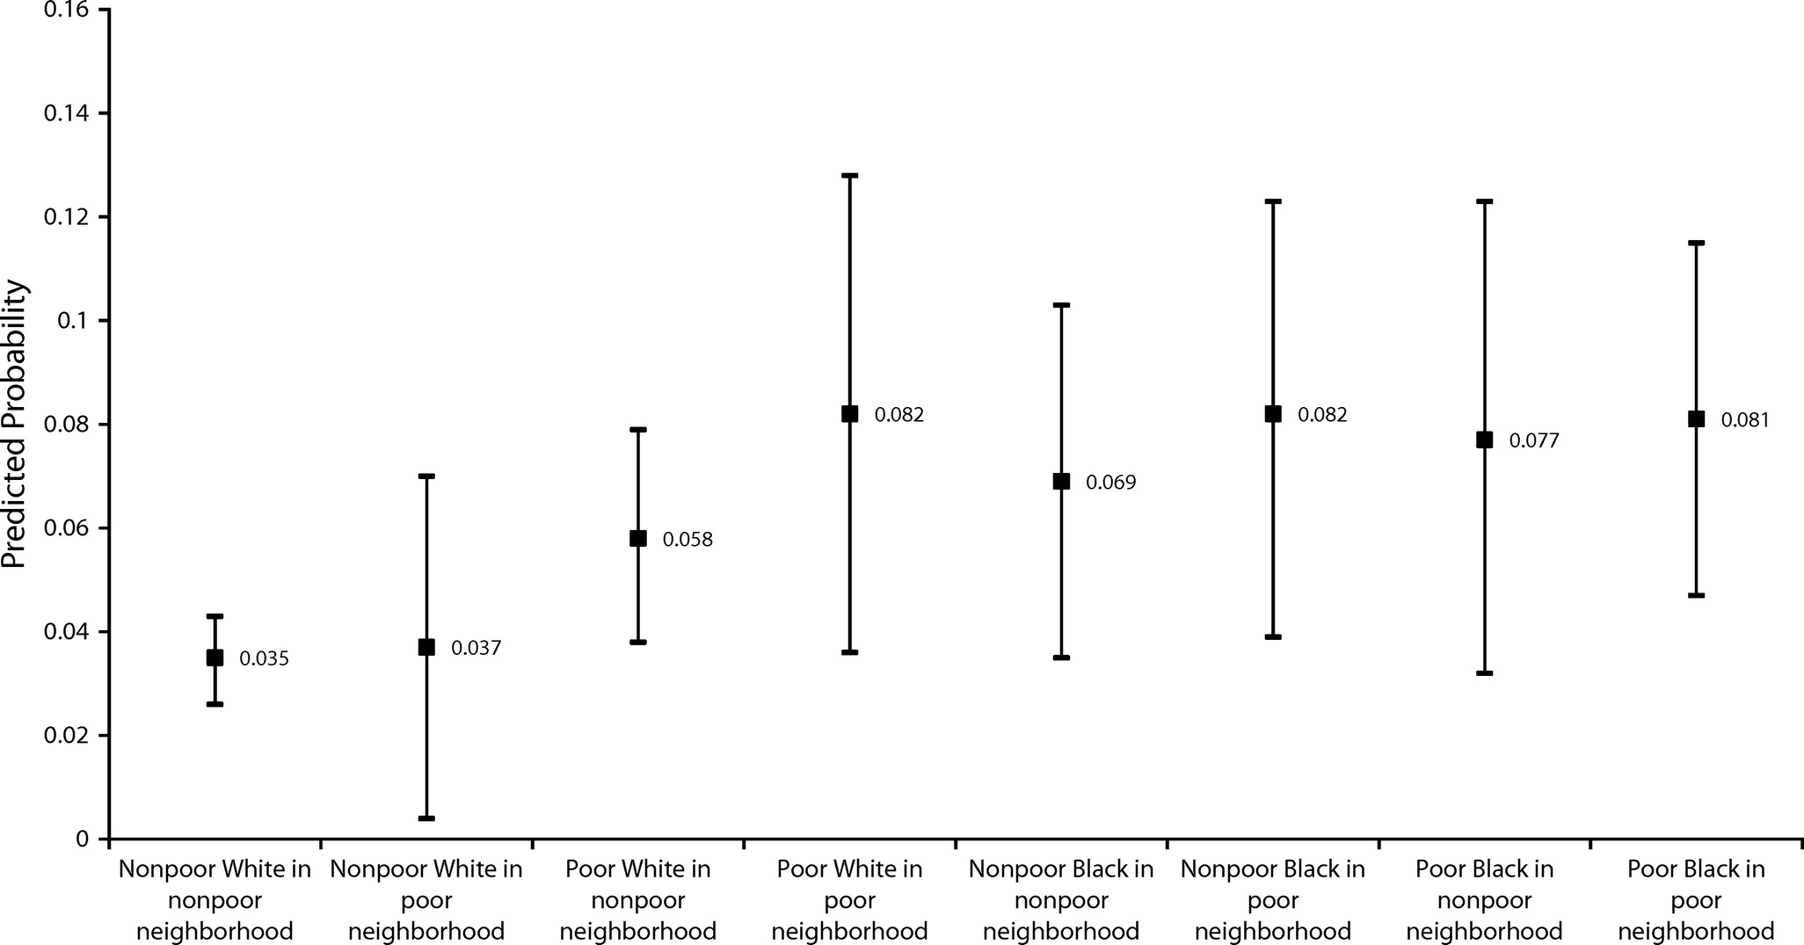
Predicted probabilities of diabetes prevalence by race, poverty, and place category: 1999–2004 National Health and Nutrition Examination Survey and 2000 US Census.
Gaskin, AJPH, 2013
Notes:
Finally, in the race–poverty–place model, we categorized adults by their individual race, individual poverty status, and neighborhood poverty concentration. Similar to the bivariate analysis, we found evidence of a race–poverty–place gradient for poor Whites and nonpoor Blacks in the logistic analysis. We found that, compared with nonpoor Whites in nonpoor neighborhoods, poor Whites in poor neighborhoods were the most disadvantaged (OR = 2.51; 95% CI = 1.31, 4.81). The size of the disadvantage was smaller for poor Whites in nonpoor neighborhoods (OR = 1.73; 95% CI = 1.16, 2.57). Compared with nonpoor Whites in nonpoor neighborhoods, poor Blacks in poor neighborhoods and nonpoor Blacks in poor neighborhoods were similarly disadvantaged (OR = 2.45; 95% CI = 1.50, 4.01; and OR = 2.49; 95% CI = 1.48, 4.19, respectively). The size of the disadvantage was slightly lower for poor Blacks in nonpoor neighborhoods (OR = 2.34; 95% CI = 1.22, 4.46), and lower for nonpoor Blacks in poor neighborhoods (OR = 2.08; 95% CI = 1.26, 3.44). Although the CIs overlap, the overall trends suggest that there is a place gradient for poor Whites and Blacks
Read More: http://ajph.aphapublications.org/doi/full/10.2105/AJPH.2013.301420

Slide 53
Life Course Considerations
Ecological thinking needs to take into account contextual factors over time
Timing and persistence of exposures may influence their impact
  Understanding disparities requires attention to different exposures at different time points
Notes:
Note that this started in norway, began to notice childhood effects

Slide 54
Framework: Socioeconomic Status Over the Life course and Health
Socioeconomic Position
Intrauterine
conditions
Education,
environment
Work conditions,
income
Income,
assets
Birth
Childhood
Adulthood
Old Age
Low birth weight
Growth retardation
Smoking,
diet, exercise
Inadequate
medical care
Job stress
Atherosclerosis
CVD
Reduced
function
Lynch J and Kaplan G, Social Epidemiology,
Oxford, 2000 (Ch 2, p. 28)
Notes:
Need to remember that poor health can also influence SES
Point here is to show that poor SES can have an effect on CVD at different points in life – need to think about what youa re measuring

Slide 55
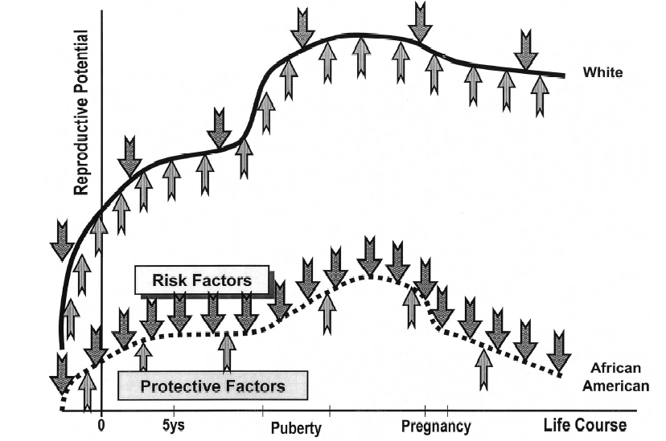
Life Course Perspective on Birth Outcomes
Lu MC, Halfon N. Racial and ethnic disparities in birth outcomes: a life-course perspective.
Matern Child Health J. 2003;7:13-30.
Notes:
http://www.ncbi.nlm.nih.gov/pubmed/12710797 – good life course paper
Bring up the epigenetic component here
This may be particularly important for all of us in MCH, where one developmental stage often gets disconnected from another. In perinatal health, we focus so much on events occurring in the 9 months of pregnancy we forget that there are a great deal of life course influences on perinatal outcomes, and a great deal of perinatal influences on life course outcomes.
For example, in explaining the Black-White gap in infant mortality, for decades we searched for maternal risk factors during pregnancy rather than looking at the mothers’ cumulative life course experiences. The danger of focusing solely on risk factors during pregnancy is not only that it doesn’t adequately explain the disparities, but more importantly it can misguide public health programs and policies. For two decades we thought if we could get women universal access to good quality prenatal care, then we can do something about reducing infant mortality and racial disparities in this country.
Many of us recognize now that to expect prenatal care, in less than nine months, to reverse all the cumulative disadvantages and inequities over the life course of the woman, may be expecting too much of prenatal care. If we as are serious as a nation about improving birth outcomes and reducing disparities, we have to start taking care of women and families not only during pregnancy, but before and between pregnancies and indeed, across their entire life course.

Slide 56
SES Across The Lifecourse:
Adult income
Latency/critical period model:
Exposure during sensitive window puts one at risk for development of disease much later in life. Exposures encountered after the critical window closes do not influence risk. Focus on early life experiences that do not have a cumulative effect.
Childhood SES
Old Age Health
Adult occupation
Notes:
Can be a biological (i..e in utero programming) or a social critical period
Big concerns about validity of instruments, especially since IV effect estimates were systematically larger than the OLS estimates.
The weak relationship between the instrument and the predictor: Inflates standard errors
May lead to a biased estimate
Makes it difficult to see any effect on the outcome
*Shy kids born in 2nd quarter
SES or geographic differences in birth distribution
This may be helped by using two instruments: idea is that if both give the same estimate, you are golden.

Slide 57
SES Across The Lifecourse:
Adult income
Social trajectory model:
Social disadvantage increases risk of future disadvantage later in life. The initial insult does not necessarily have a harmful effect on the outcome – but the first exposure leads to subsequent exposures that then directly cause the outcome.
Old Age Health
Education
Adult occupation
Notes:
Big concerns about validity of instruments, especially since IV effect estimates were systematically larger than the OLS estimates.
The weak relationship between the instrument and the predictor: Inflates standard errors
May lead to a biased estimate
Makes it difficult to see any effect on the outcome
*Shy kids born in 2nd quarter
SES or geographic differences in birth distribution
This may be helped by using two instruments: idea is that if both give the same estimate, you are golden.

Slide 58
SES Across The Lifecourse:
Adult income
Cumulative biological model:
Each period of exposure to a risk factor wreaks physiological harm that increases risk of later developing illness, even if the individual is subsequently removed from exposure.
Old Age Health
Education
Adult occupation
Notes:
Big concerns about validity of instruments, especially since IV effect estimates were systematically larger than the OLS estimates.
The weak relationship between the instrument and the predictor: Inflates standard errors
May lead to a biased estimate
Makes it difficult to see any effect on the outcome
*Shy kids born in 2nd quarter
SES or geographic differences in birth distribution
This may be helped by using two instruments: idea is that if both give the same estimate, you are golden.
Also need to think about intergenerational effects

Slide 59
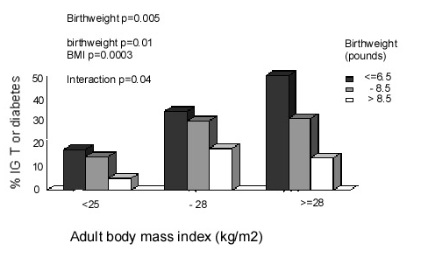
Risk of Glucose Intolerance by Birthweight and Adult BMI
Hales CN, et al. Fetal and infant growth and impaired glucose tolerance at age 64. BMJ 1991; 303: 1019-1022

Slide 60
Overwhelmed?
What if you just want to do clinical research?
Do conceptual models really need to take into account all these different levels?
It is really possible to influence structural determinants of disease anyway?
Notes:
Going to punt a bit on the last one – until the last lecture, but will address a bit later on

Slide 61
Why Thinking Ecologically Matters
Ensure research is grounded in contextual understanding
  Collect necessary data
  Use appropriate analytic techniques
  Provide nuanced interpretation of results
Notes:
Example of – race being a proxy for SES – missing the point
Regardless of wehther primary question is disparities or not

Slide 62
Perils of Ignoring Ecology, Part 1
Not collecting/analyzing adequate data on relevant social determinants
  “When income was used to “adjust for SES,” Mexican Americans appeared to be at significantly increased risk of fair or poor health compared with non-Hispanic whites; however, risks appeared significantly lower when both poverty and educational levels were included.” Braveman, JAMA, 2005
  Important whether goal is measurement of disparities or unconfounded estimate of association between other predictor and outcome
Notes:
True for all research – not just health disparities research
For example – you may be just interested in controlling for confounding – but if you don’t do it well
Will take about this later – how you can
Need example where this was a problem
Need to say that also need to consider ecological measures – will mention in a second
http://www.ncbi.nlm.nih.gov/pubmed/24618999 - winkleby shows that effect of SES on breast cancer outcomes varies by race/ethnicity

Slide 63
Perils of Ignoring Ecology, Part 2
Not considering race and SES separately and in combination in analytic models
  “Both neighborhood and individual SES are associated with survival after breast cancer diagnosis, but these relationships vary by race/ethnicity.”
  Shariff-Marco S, Cancer Epidemiol Biomarkers Prev, 2014

Slide 64
Perils of Ignoring Ecology, Part 3
Risk of misinterpreting data from multivariate models
  Individualistic fallacy
  Biologic fallacy
Implications of results may depend on context

Slide 65
Biologic Fallacy
The presumption that differences that cannot be explained by identified non-biologic factors must be due to biologic differences.
“High rates of ESRD among blacks is not fully explained by racial differences in age, socioeconomic status, or access to health care…. suggest[ing] an inheritable genetic predisposition.“ – Controlled for percent of individuals with college education in zip code
Notes:
You have all learned about ecologic fallacy – but the other side is an issue as well.
Only controlled for education, was looking at individual level factors – intepreted this as “independent of SES”. Studies that have controlled for multiple factors have found a much bigger effect of controlling.
So did not collect right data, and provided overly broad interpretation – even if was not SES controlled, then needs to say why lifestyle factors might be diferrent.
http://www.ncbi.nlm.nih.gov/books/NBK25517/#a2000af96rrr00690
Kaufman, cooper and mcgee
May even be a factor in genetic studies
1996
Such a conclusion is unwarranted
because of our limited knowledge of non-biologic factors,
combined with our inability to measure and
adjust for known non-biologic factors.

Slide 66
Individualistic Fallacy
The fallacy of assuming that individual-level outcomes can be explained exclusively in terms of individual-level characteristics
  “Living in a low SES neighborhood confers additional mortality risk beyond individual SES.”
  “The odds of violence for African Americans was 2.7 times greater than the odds of violence for Whites… when neighborhood disadvantage was added to the logistic regression equation, the significant effect of race was eliminated.”
Winkleby, J Epi Comm Health, 2003
Silver, Law Hum Behav, 2000
Notes:
Good example of this is with respect to infectious disease – vaccines and stis
http://www.ncbi.nlm.nih.gov/pubmed/10974802
With respect to discharged psychiatric patients
http://aje.oxfordjournals.org/content/151/4/409.full.pdf+html
Examples – air pollution etc
Some variables are not measurable on the individual level
http://www.ncbi.nlm.nih.gov/pmc/articles/PMC1615039/pdf/amjph00456-0117.pdf
Individualistic fallacy is the erroneous presumption
that differences in population outcomes can be entirely
explained by differences in individual-level characteristics.
In the present study, the census-based variables
are intended to capture neighborhood or "contextual"
effects of SES, and not to stand as proxies for personlevel
SES variables.
The use of the ecological fallacy in
epidemiology also fosters a dismissal of
social variables as causal factors in disease.
First, as seen above, it leads to a
consignment of sociological and anthropological
studies to examining impacts on
whole societies,2 and it denies that ecological
variables can affect individual processes.
28 Second, it reinforces an assumption
that aggregated variables are
substitutes for individual-level variables.
Under such an assumption, the potential
etiological influence of aggregate-level
variables, distinct from the effects of the
same measures on an individual level,
would not be considered.
http://www.ete-online.com/content/11/1/18
ecological study design may also be utilised when the underlying question regards individuals, such as when one is interested in the effects of air quality on health. In this context, ecological studies are potentially susceptible to the “ecological fallacy”; biases that may occur when an observed relationship between aggregated variables differs from the true, i.e. causal, association at an individual level [2]. Indeed, since Robinson in 1950 showed that correlations on an individual level can differ markedly from those on an aggregate, ecological level, epidemiological textbooks, papers and courses have warned us about the dangers of this ecological fallacy [3,4].

Slide 67
Need to Understand Context
Example of my fellowship research in reproductive health

Slide 68
Unintended Pregnancy Rates by Income and Race/Ethnicity, 2006-2008
Finer et al. Contraception, 2011

Slide 69
Disparities in Unintended Pregnancy
IUDs are most effective method of contraception
Are used less often by women of color
Are women of color counseled differently about IUDs?
Performed RCT using videos of standardized patients presenting for contraceptive advice
  Shown to participants at national meetings of ACOG and AAFP
Dehlendorf, AJOG, 2010
Notes:
Also so objective evidence…

Slide 70
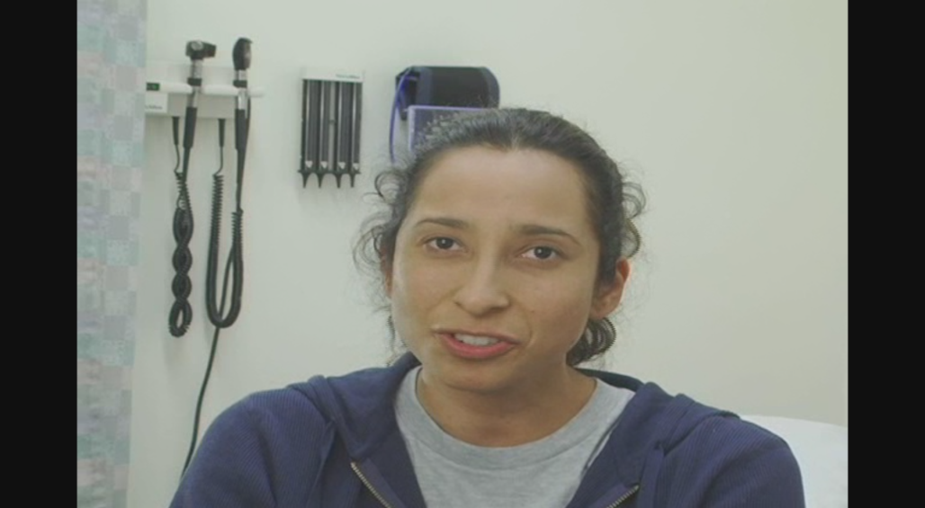
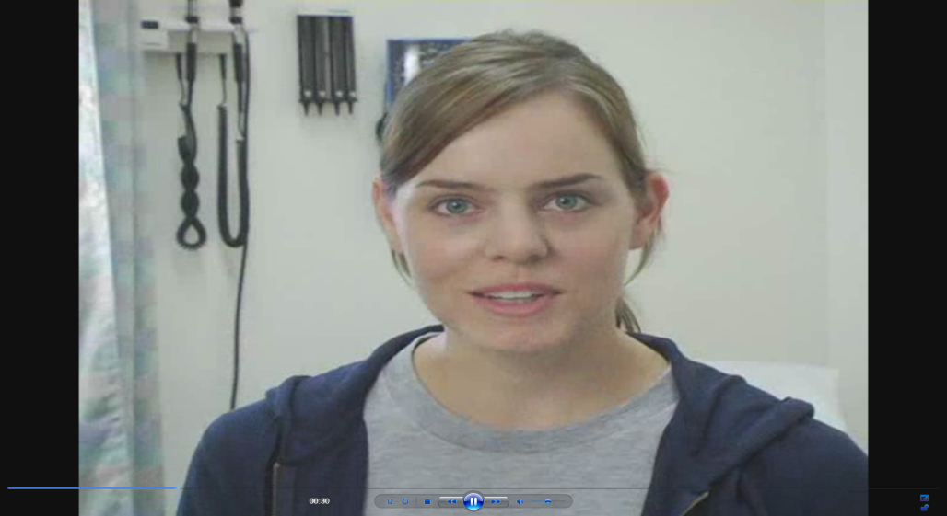
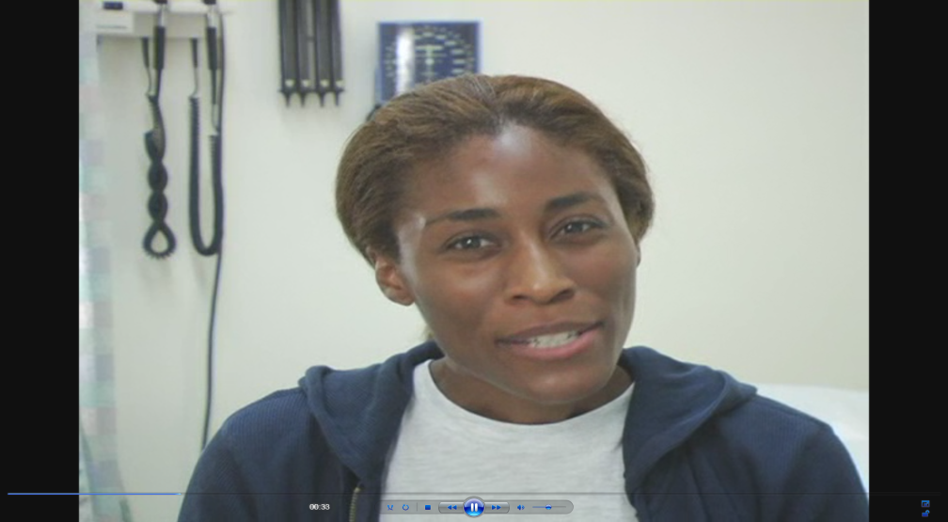
The “Patients”
Notes:
And these are the low SES patients
As you can imagine, planning and directing these videos, including the hiring of actresses as a challenge for someone with no background in this area, so it was definitely a learning experience.

Slide 71
P<0.05
Dehlendorf, et al. AJOG, 2010
Notes:
We interpreted this to indicate concern about pid in this group

Slide 72
What does this mean?
Are women of color getting better care?
Complex history of coercion
  Differential counseling towards provider controlled method potentially problematic
Context essential to understand nuance of data and its implications

Slide 73
Why Thinking Ecologically Matters, Part 2
Provide broader and more accurate insight into possible approaches to address health disparities
Women’s Health Initiative:
  “ Despite large racial/ethnic differences in diabetes incidence, most variability could be attributed to lifestyle factors. Our findings show that the majority of diabetes cases are preventable, and risk reduction strategies can be effectively applied to all racial/ethnic groups.”
Notes:
This leads into the fact that you have to understand the nuance of your results in order to be able to understand how to act on them to make a difference

Slide 74
Solutions to Health Disparities
Food availability
Social norms
  Barbershop interventions for hypertension
Housing
Health coaches
Notes:
Can be multilevel
Keep you from flogging the individual in a way that won’t m ake a difference
i.E admissions for hypoglycemia associated with running out of money
http://www.ncbi.nlm.nih.gov/pubmed/24395943

Slide 75
Application to Specific Research Questions
Interconnections and variables of interest depend on research question
Specifying relationships:
  Ensures that ecologic thinking is incorporated into research question and design
  Provides clarity into pathways being investigated and how they relate to other influences

Slide 76
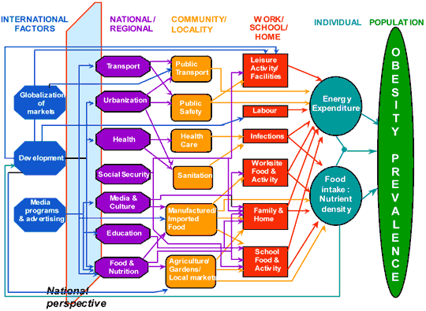
International Obesity Task Force Model

Slide 77
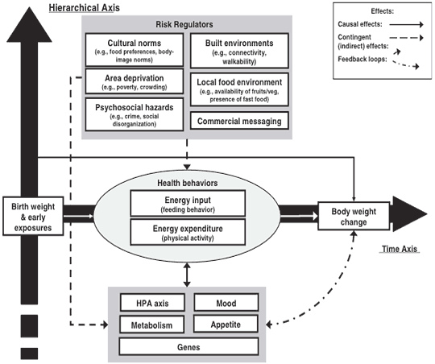
CDC Multilevel Model for Obesity
Notes:
http://www.cdc.gov/pcd/issues/2009/jul/09_0013.htm

Slide 78
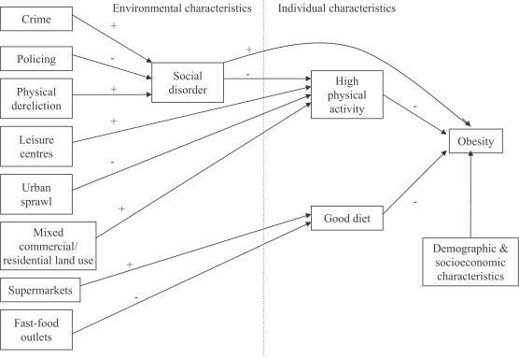
Theoretical model linking social and physical environmental characteristics to obesity
Pathways to obesity: Identifying local, modifiable determinants of physical activity and diet
Mai Stafford , Steven Cummins , Anne Ellaway , Amanda Sacker , Richard D. Wiggins , Sally Macintyre
Social Science &amp; Medicine, Volume 65, Issue 9, 2007, 1882 - 1897

Slide 79

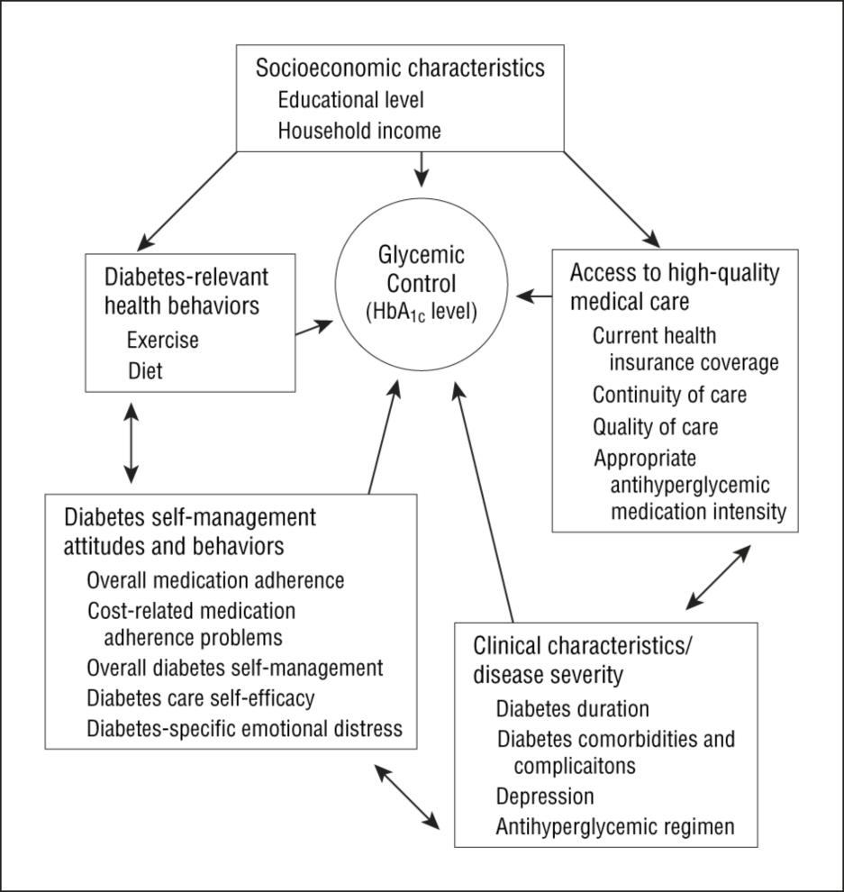
From: Mechanisms for Racial and Ethnic Disparities in Glycemic Control in Middle-aged and Older Americans in the Health and Retirement Study
Arch Intern Med. 2007;167(17):1853-1860. doi:10.1001/archinte.167.17.1853
Figure Legend:
Hypothesized mechanisms for racial/ethnic disparities in glycemic control. HbA_{1c} indicates hemoglobin A_{1c}.
Date of download: 2/9/2015
Copyright © 2015 American Medical Association. All rights reserved.

Slide 80
Models for Research in Context of Health Systems
Relationship of health care to disparities is complex
  Equity in health care is necessary but not sufficient to address disparities
  Health care influenced by other social determinants
  Health care has potential to address social determinants
Notes:
Influeneced by patient ses, racism etc.
As a step in the direction of more complete understanding of how specific social determinants affect specific disease risks, the Institute of Medicine in April released a report on what information might be gathered in electronic health records to measure social determinants and the proposed process of measurement in order to connect clinical information with social determinant information.
The IOM workgroup identified 17 domains based on available evidence of the association to health, usefulness (how a measure might inform a decision), ability to develop a standard score, sensitivity (how likely patient would be to share) and whether or not the data would be available from another source. They include socio-demographic indicators (gender, race/ethnicity, place of birth, financial/job/home security), psychological indicators (stress, depression, anxiety), behavioral indicators (nutrition patterns, lifestyle, smoking) and individual-level social connections (being part of a "group," such as church, community groups).

Slide 81
A Different Approach to the Ecological Model
Economic & Social
Opportunities and Resources
Living & Working Conditions
in Homes and Communities
Behaviors
Medical Care
Interaction with genetic/other biological factors
HEALTH
Adapted from Braveman et al., for RWJ Foundation
Commission to Build a Healthier America | www.commissiononhealth.org

Slide 82
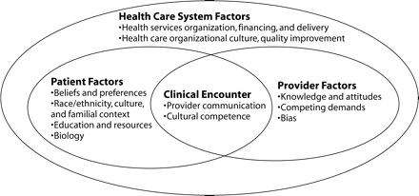
Models for Research in Context of Health Systems
Origins of health and health care disparities from a health services research perspective – Kilbourne, AJPH, 2006
Notes:
I would argue that contextual factors are not adequately considered here, but as long as aware of the broader ecological perspective this can be useful
Note that there is increasing emphasis on the fact that health care systems can engage with issues of social determinants
Address this in the intervention lecture - http://archinte.jamanetwork.com/article.aspx?articleid=1682357
Introduce the idea of health care disparities here

Slide 83
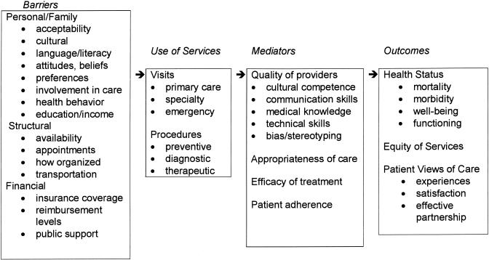
Barrier and Mediators of Equitable Health Care - Cooper, JGIM, 2002
Models for Research in Context of Health Systems

Slide 84
Where Does Race/Ethnicity Fit In?
Employment/ Occupation
Toxic/Dangerous Environments (Housing, work, infections, lead)
Education
Income
Wealth
Behaviors (diet, exercise, medical care, sex, violence)
Disease
Onset, Progression, and Consequences
Social Networks
Knowledge
Cognitive Skills (literacy, numeracy)
Psychological Experiences
(stress, shame)
Race/
Ethnicity
Self efficacy

Slide 85
Overview of Next 6 Weeks
Week 1: Overview of conceptual models
Week 2: Social determinants
Week 3: Biological determinants
Week 4: Behavioral determinants
Week 5: Health systems and health care determinants
Week 6: Social and health policy determinants

Slide 86
Questions?

Slide 87
Discussion
Think about health outcome of interest to you
Take 5 minutes and sketch conceptual model for this outcome (as you currently understand it)
Identify where your area of research or area of interest connects to the model
Identify:
  Greatest areas of uncertainty in model, and/or
  Areas with greatest potential for intervention

