Slide 2
Research Misconduct;
Lies, Damned Lies, and Medical Science
Ethics and the Responsible Conduct of Research, BMS 214
Bruce Conklin MD
Gladstone Institutes
UCSF Division of Human Genetics
Departments of Medicine and Pharmacology
April, 2015

Slide 3
Research Misconduct: the NIH definition
Fabrication: making up results
Falsification: manipulation of research materials, equipment, or processes or changing or omitting results such that the result in not accurately represented
Plagiarism: the appropriation of another’s ideas, processes, results, or words without giving credit

Slide 4
Research Misconduct Excludes
Unintentional “honest” error
Sloppiness, incompetence, laziness
Differences of opinion or interpretation
Notes:
Failure to share instruments, duplicate publication, sexual harassment.

Slide 5
Research Misconduct Excludes
Other Bad Actions
Financial mismanagement
Discrimination
Poor mentoring

Slide 6
Two Cases and Discussion
STAP Stem Cell Scandal
Hypothetical case discussion
Duke Fraudulent Array Data
Leading to Cancer Trial

Slide 7
STAP Stem Cell Scandal
Background
2005 Korean stem cell scandal
2006, induced Pluripotent Stem (iPS) Cells
2014, Jan 30: STAP cell discovery in Nature “faster, cheaper, better” method of making pluripotent stem cells

Slide 8
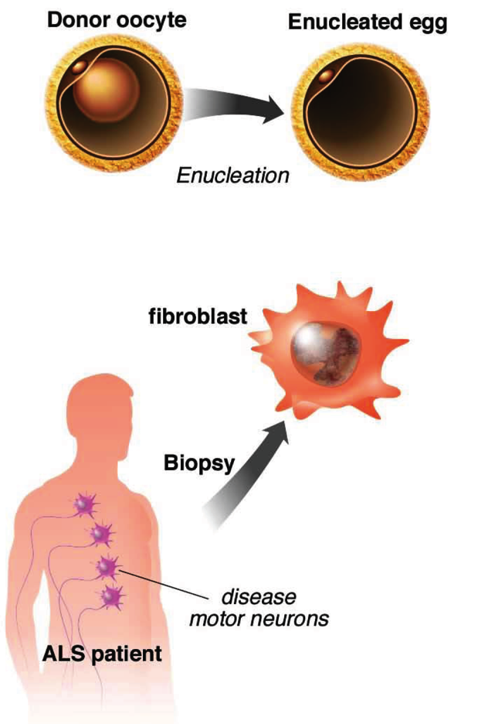
Background 2005:
Generation of Embryonic Stem Cells via
Somatic Cell Nuclear Transfer (SCNT)

Slide 9
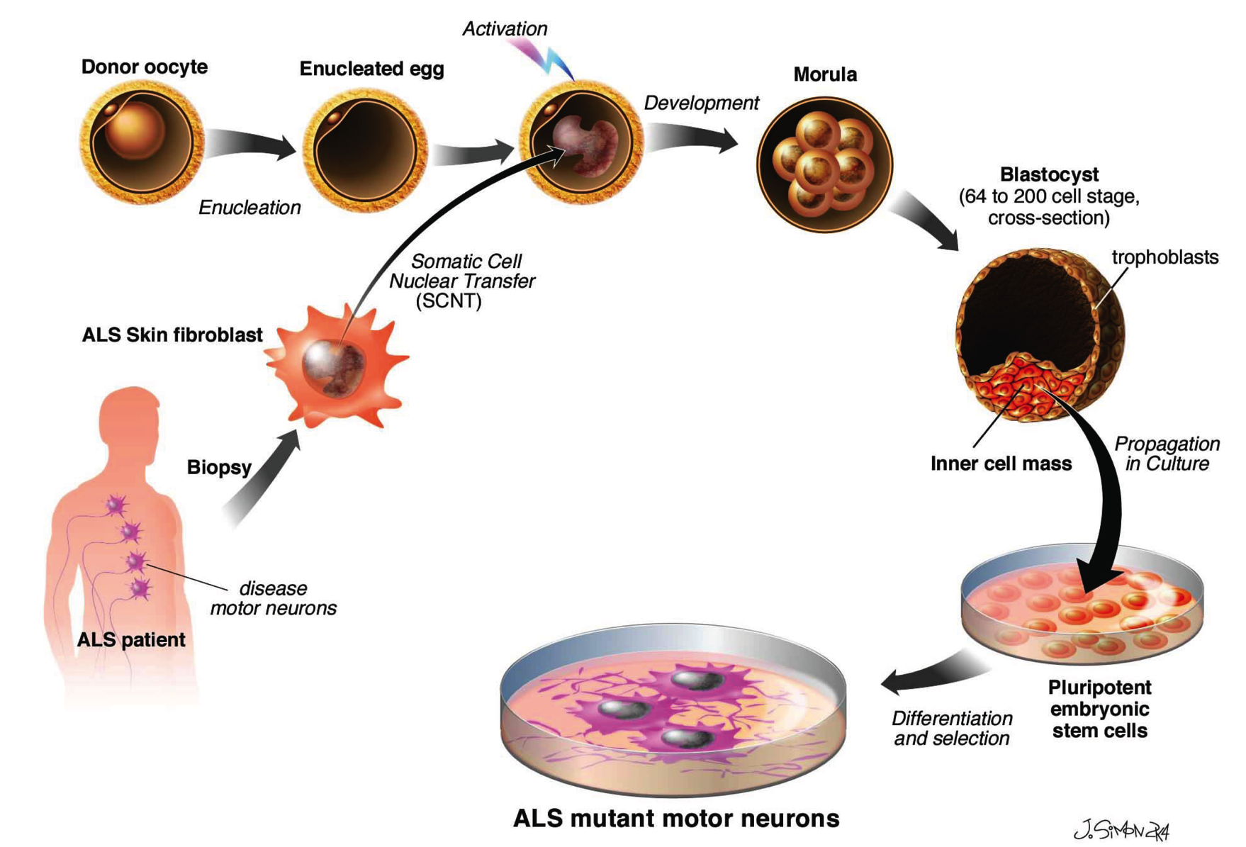
How Scientists Hoped to Clone
Human Stem Cells with Nuclear Transfer
Skin fibroblast
Person with
genetic variant
Pluripotent
Stem cells
Tissue with genetic variant
Notes:
In fact you may remember that a Korean group claimed that it worked

Slide 10

Major Problem, Nuclear Transfer
Doesn’t Work Well in Humans!...
(Korean Stem Cell Scandal)
Skin fibroblast
Person with
genetic variant
Pluripotent
Stem cells
Tissue with genetic variant
Notes:
In fact you may remember that a Korean group claimed that it worked

Slide 11
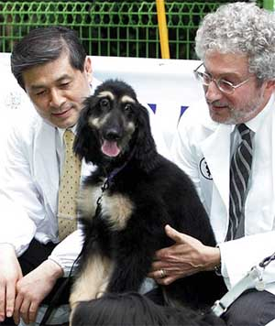
Woo-Suk Hwang
Seoul National University,
South Korea, Stem cell research funded extensively by Korean government with success in cattle, mice and dogs
June 2005, Science: Nuclear transfer into 11 human eggs
Notes:
Fall 2005: increasing accusations
Questionable egg donations
Falsified and Fabricated data
Set-back for stem cell research
International scrutiny

Slide 12
S. Korean Investigation
All SCNT lines are identical to one human embryonic stem cell line
2261 oocytes from 119 donors
  Papers reported only 427 oocytes
  66 compensated, contrary to publication
  Technicians, grad student donated, contrary to previous statements
  Failed to fully explain risks
  15/79 treated for ovarian hyperstimulation syndrome

Slide 13
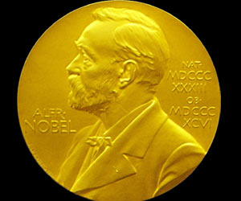
2006 Shinya Yamanaka Induced Skin Cells to Become Pluripotent Stem Cells (iPS)
Skin fibroblast
iPS
4 Factors
Person with
genetic variant
Pluripotent
Stem cells
Tissue with genetic variant
No Eggs Needed!
Nobel 2012
Notes:
In fact you may remember that a Korean group claimed that it worked

Slide 14

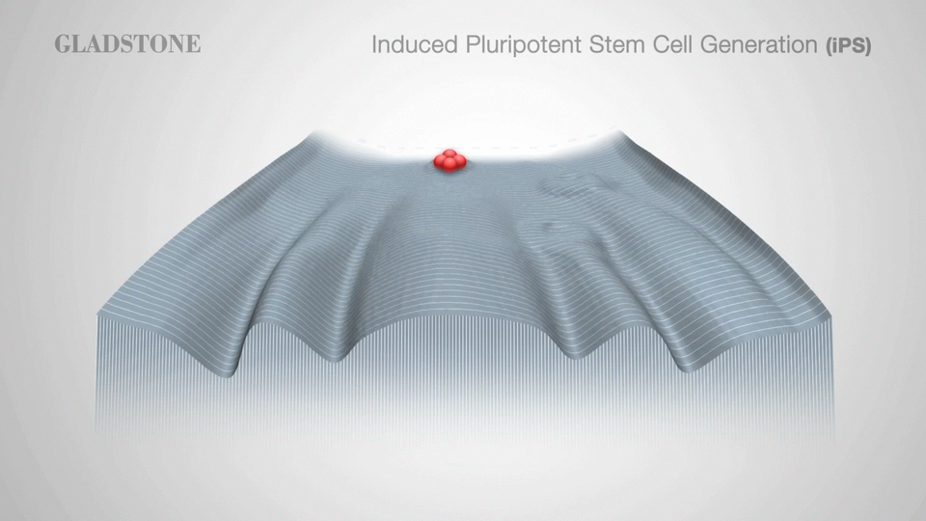
The Landscape of Development and iPS Cells
Notes:
e hypothesized that the factors that play important roles in the maintenance of ES cell identity also play pivotal roles in the induction of pluripotency in somatic cells. Based on this hypothesis, we have selected 24 factors as candidates of reprogramming factors.

Slide 15
2014 Haruko Obokata of RIKEN Reports Pluripotent Stem Cells 30 min Acid Treatment!
Skin fibroblast
30 min
Acid
Person with
genetic variant
Pluripotent
Stem cells
Tissue with genetic variant
STAP cells,
Stimulus-triggered Acquisition of Pluripotency
Notes:
In fact you may remember that a Korean group claimed that it worked

Slide 16
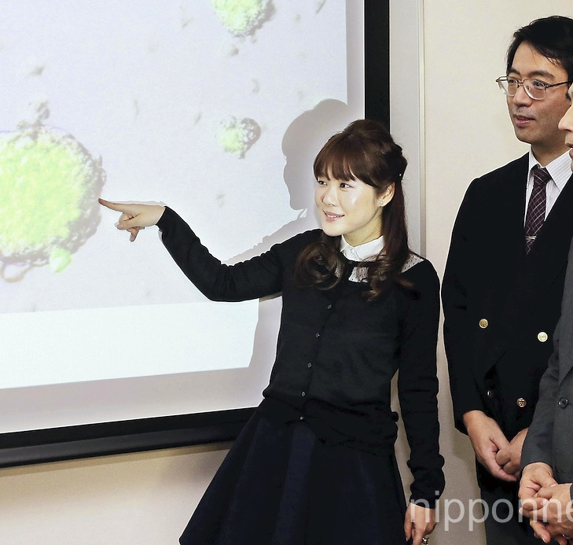
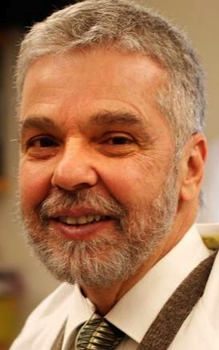
Stimulus-triggered fate conversion of somatic cells into pluripotency
J A N U A RY 2 0 1 4 , N AT U R E
Hitoshi Niwa, Masayuki Yamato & Charles A. Vacanti
Haruko Obokata, Teruhiko Wakayama, Yoshiki Sasai, Koji Kojima, Martin P. Vacanti,
Yoshiki Sasai
Haruko Obokata
Charles A. Vacanti
Brigham and Women
Harvard
Notes:
Fall 2005: increasing accusations
Questionable egg donations
Falsified and Fabricated data
Set-back for stem cell research
International scrutiny

Slide 17
Haruko Obokata 2014. STAP cells
Paul Knoepfler: IPS.com Blog
Rapid public response
One week after publication…
February 7, 2014

Slide 18
Ken Lee live-blogged his lab’s attempt to reproduce STAP

Slide 19
Conclusions of Investigation
“STAP Cells” where actually mouse embryonic stem cells (RIKEN investigation)
Haruko Obokata dismissed by RIKEN
Yoshiki Sasai commits suicide
Charles A. Vacanti resigns from Brigham-Harvard, but no investigation announced
RIKEN Kobe undergoes major reorganization

Slide 20
Differences in Korean and STAP cases
STAP Cells are complete fabricated
SCNT is routinely used for cloning dogs cows, pigs (revolutionizing livestock production)
Haruko Obokata unlikely to ever return to science
Woo-Suk Hwang has thriving private institute

Slide 21
What do these events have in common?
High profile journal article (Science, Nature)
Excessive publicity of hero / heroine
Potential for monetary rewards, national pride
Young researchers investigating (tip to media; crowd source)

Slide 22
You Will Contact Fraud
Manuscript or grant looks familiar
Cannot validate/replicate data
Inconsistencies in data
Data are too good to be true
Cash bonuses for Nature, Science or Cell papers

Slide 23
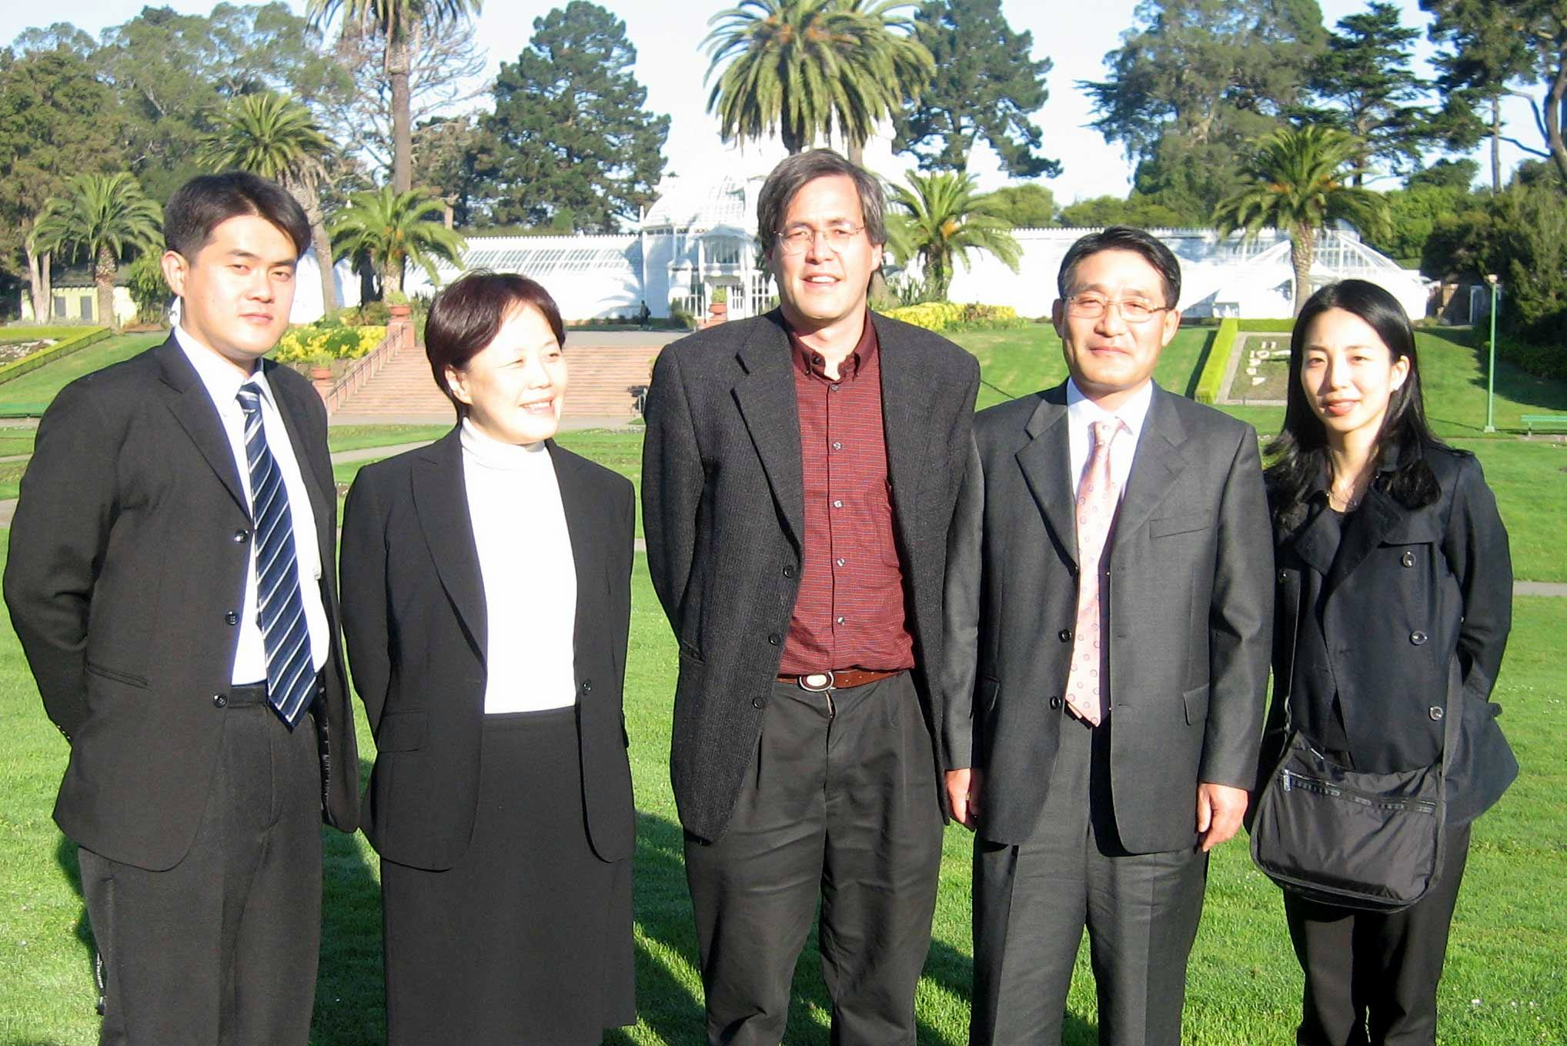
Hosting Korean Delegation Fall 2005
(Just before meltdown)

Slide 24
What Should You Do?
Hypothetical example:
You a a new graduate student, in Dr X’s lab. Jim is a senior researcher in the lab who always gets good results. You are happy to be assigned to work with Jim. In 8 months you have strong evidence that Jim has fabricated ELISA and qPCR data for a grants and a submitted paper…..What do you do?
Break up into groups 3-4 to discuss

Slide 25
What Should You Do?
Hypothetical example:
You a a new graduate student, in Dr X’s lab. Jim is a senior researcher in the lab who always gets good results. You are happy to be assigned to work with Jim. In 8 months you have strong evidence that Jim has fabricated ELISA and qPCR data for a grants and a submitted paper…..What do you do?
My answer: Report UCSF Research Integrity Officer, Dr. Elizabeth A. Boyd, Associate Vice Chancellor, Ethics and Compliance (elizabetha.boyd@ucsf.edu) or (415) 476-1825.

Slide 26
What Should the Penalty Be?
Hypothetical example for “Jim”
3 year supervision plan for reviewing papers and grants.
Grants continue, research can continue
2 papers retracted
Publically listed on
Office of Research Integrity http://ori.hhs.gov/
Retraction Watch http://retractionwatch.com/

Slide 27
Examples of Consequences of Research Misconduct
1. Fabrication of “preliminary results” on a federal grant…..Supervised review for grants for 2 years (and very bad for scientific reputation)
2. Fabrication of data on multiple papers that were NIH supported…….Barred for 2 years from Federal Funding
3. Fabrication of clinical data with financial conflicts of interest….Suspension of federal grants (5 years)

Slide 28
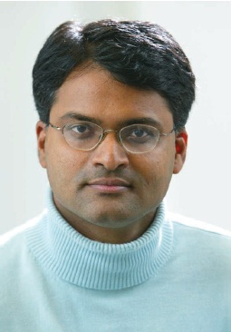
Case #2
Duke Fraudulent Array Data
Leading to Cancer Trial
Anil Potti MD
Oncology fellow at Duke
Race to find gene expression signature for cancer treatments
2006-2010 >10 publications Nature Medicine, PNAS, New England Journal

Slide 29
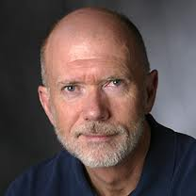
Duke Fraudulent Array Data
Leading to Cancer Trial
Joseph R. Nevins, PhD
Duke Professor and
HHMI Investigator
Great track record, highly respected scientist
Postdoctoral Mentor to Potti, and co-author of over 10 papers with Potti

Slide 30
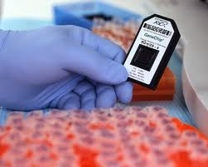
Genomic Signatures to Guide the Use of Chemotherapeutics
Cancer of Breast, Colon, immune cells
Dr. Potti apparently “cracked the code”
to use gene expression to guide cancer
Therapy.
Patents applied for, company is started
“CancerGuide Diagnostics”
Almost too good to be true

Slide 31
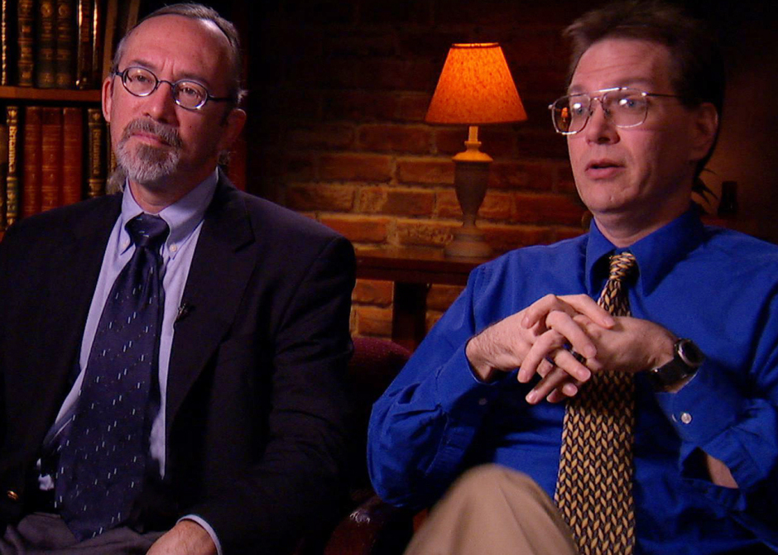
Texas, MD Anderson Scientists
Want do a Trial based on Potti’s findings
Keith Baggerly PhD
Kevin Coombes PhD
2007 could not replicate data
Wrote Duke investigators, who
denied problems
2009 published article about problems
Duke ordered to stop clinical trials
Duke review, clears Potti in
early 2010, clinical trails restarted
>100 patients enrolled

Slide 32
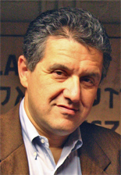
Faked Resume Leads to Exposure of Fraud
Paul Goldberg,
Investigative journalist at The Cancer Letter
July 2010, reveal multiple parts of Potti CV are faked, including
Rhodes Scholar, Merit Awards etc
Faud becomes clear, 10 papers retracted
Clinical trials stopped
By February 2012, scandal covered in Nature,
New York Times and 60 Minutes

Slide 33

Update 2014
Anil Potti MD,
Multiple malpractice suits
Reprimanded in several states
Practicing Oncology in Grand Forks North Dakota
Joseph Nevins PhD
Full Professor at Duke, with lab
9 total papers retracted
Institute of Medicine Report:
Evolution of Translational Omics

Slide 34
Questions Raised
Appropriate authorship
  Co-authors took credit for work
  Did not meet criteria for authorship
  Not willing to take responsibility for work

Slide 35
The View from Congress
“The foundation of public support for science… is trust that scientists and research institutions are engaged in the dispassionate search for truth.”

Slide 36
The View from Congress
“I have a duty to see that taxpayer dollars appropriated for scientific research are actually used for research.”

Slide 37
Take Home Points
Misconduct a serious offense, with serious consequences
Allegations of misconduct need to be taken seriously
Technology is changing bringing new challenges
Thank You!

