Slide 1
Multi-level Etiologies of Health Disparities:
Pt 1. social determinants
Irene Yen, PhD, MPH
Associate Professor

Slide 2
Objectives
Review multi-level conceptual approach
Social determinants – multiple examples
  Socioeconomic status, socioeconomic position
  Race / ethnicity

Slide 3
Improving health & reducing disparities by addressing the role of social factors
Economic & Social
Opportunities and Resources
Living & Working Conditions
in Homes and Communities
Behaviors
Medical Care
Interaction with genetic/other biological factors
HEALTH
Adapted from Braveman et al., for Robert Wood Johnson Foundation Commission to Build a Healthier America | www.commissiononhealth.org

Slide 4
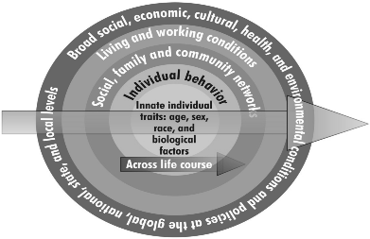
Institute of Medicine Ecological Model

Slide 5
Fundamental Cause
Influences multiple disease outcomes;
Affects disease thru multiple risk factors;
Involves access to resources that can assist in minimizing risk once the disease occurs;
Reproduced over time
Notes:
Usually weight and cholesteral less assocaited
They don’t break down the specific risk factors for SES – may want to look into that
“dominant theories” per krieger of lifestyle and genetics

Slide 6
Theory of Fundamental Causes
SES is a fundamental cause of poor health:
Resources include:
  Money
  Power
  Knowledge
  Prestige
  Social connections
Notes:
Flexibly is key here
Also operate on both group and individual level – i.e. neighborhood effects and having individual resources

Slide 7
Social Determinants of Health I
Socioeconomic status
  Income
  Employment and working conditions
  Education
Socioeconomic position
Race / ethnicity – unfair treatment
Housing
Food (partial)
Notes:
Social stratification can be in there

Slide 8
Social Determinants of Health II
Stressors / Stress
Transportation
Incarceration

Slide 9
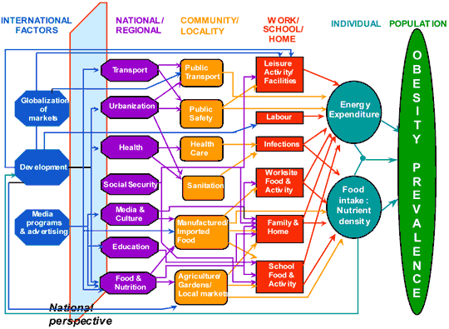
International Obesity Task Force Model

Slide 10



Socioeconomic status
From the American Psychological Association:
Socioeconomic status is commonly conceptualized as the social standing or class of an individual or group. It is often measured as a combination of education, income and occupation.

Slide 11
Social status
the relative rank that an individual holds, with attendant rights, duties, and lifestyle, in a social hierarchy based upon honor or prestige.

Slide 12


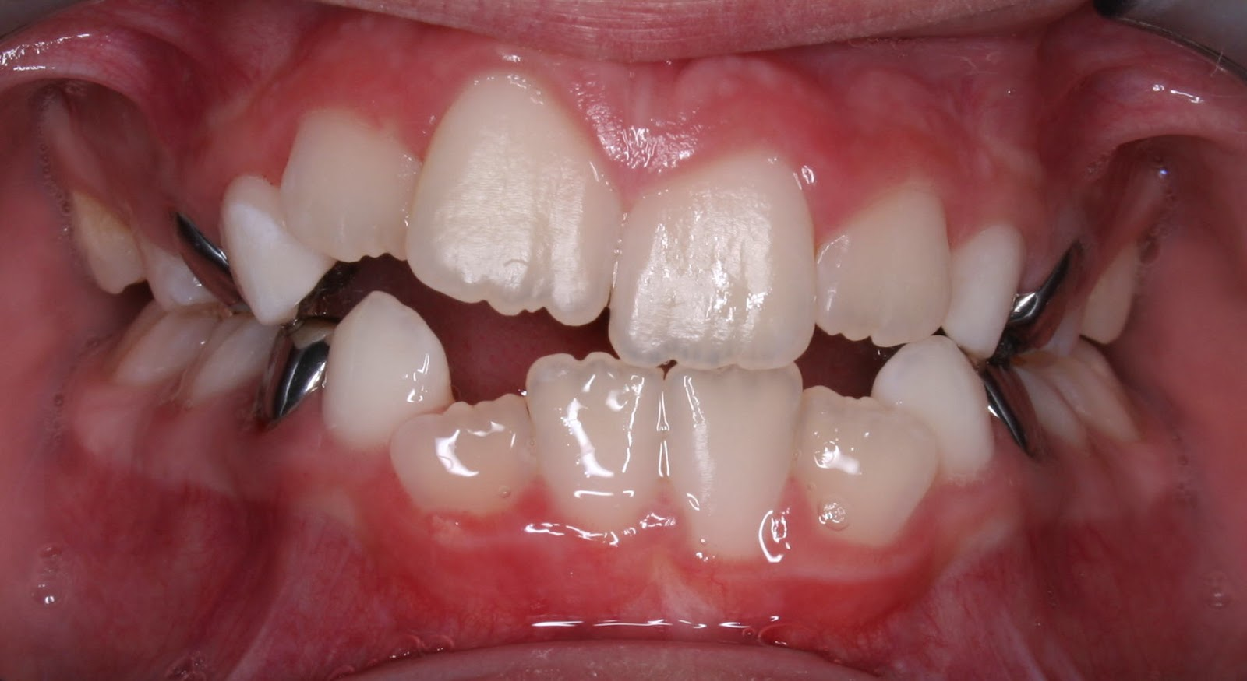
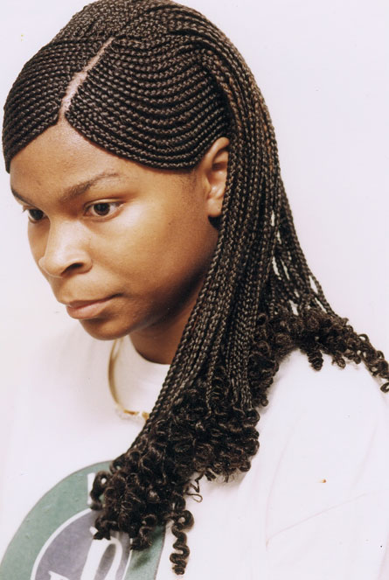
Notes:
Slide pictures give an opportunity to speak to the point that these a social measures – how people fit into a social group – how they are recognized to be in the group based on exteriors

Slide 13
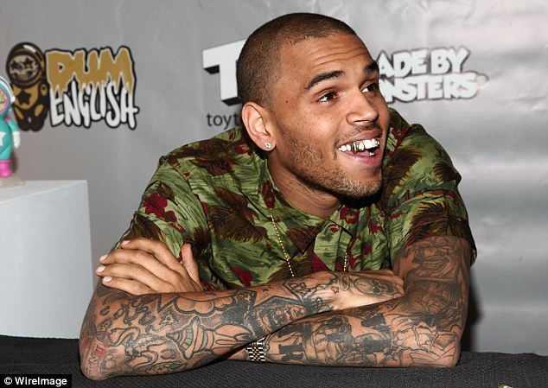
Net worth?
Notes:
$20-25 million

Slide 14
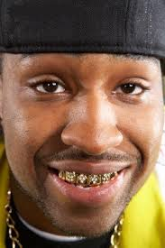
Net worth?
Notes:
Median net worth of black households $6000

Slide 15
Childhood SES is associated with adult health
Nurses Health Study:
Parental education is associated with the self-rated health of their adult children, after taking into consideration current SES (highest year of schooling, total household income, total net worth)
[Moody-Ayers, et al. 2007]
Health and Retirement Survey:
Parental occupation is associated with cardiovascular disease in middle age, after taking into consideration current SES (highest year of schooling)
[Gliksman et al. 1995]

Slide 16
Childhood SES is associated with adult health
Regression models – physical functioning
Beta coefficients
Model 1 | + father’s SES | + adult SES | + father’s SES, adult SES
Two parents 6.48*
Age started working -4.89* | * | *** | *
Perception importance educ 6.48*** | ** | ** | **
Extracurr Activities HS
Adult discourage -1.06* | * | * | *
* P <0.05; ** p < 0.01; *** p <0.0001

Slide 17
Results - summary
Raised by two parents, perception of importance of education are positively associated with perceived health and physical functioning
Age began working is negatively associated with perceived health and physical functioning
Discouragement by adults is negatively associated with physical functioning
Associations remain after adjustment for parental and adult SES (except for two parents)

Slide 18
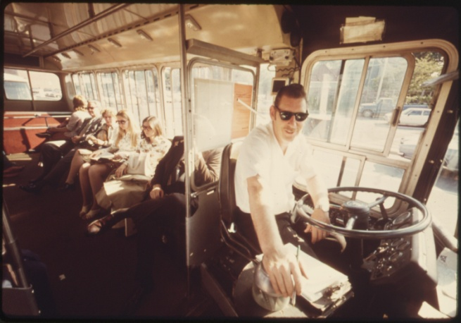
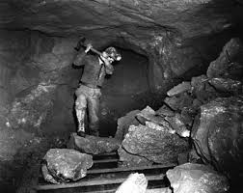
Employment and working conditions
Occupational classification
  Current
  Longest lasting
Employed vs. not

Slide 19
Higher-status job, longer life.
Male civil servants, UK Whitehall Study I
Age-adjusted, age 40-64
Source: Marmot, M. G., et al (1984). "Inequalities in death--specific explanations of a general pattern?" Lancet 1(8384): 1003-1006.

Slide 20
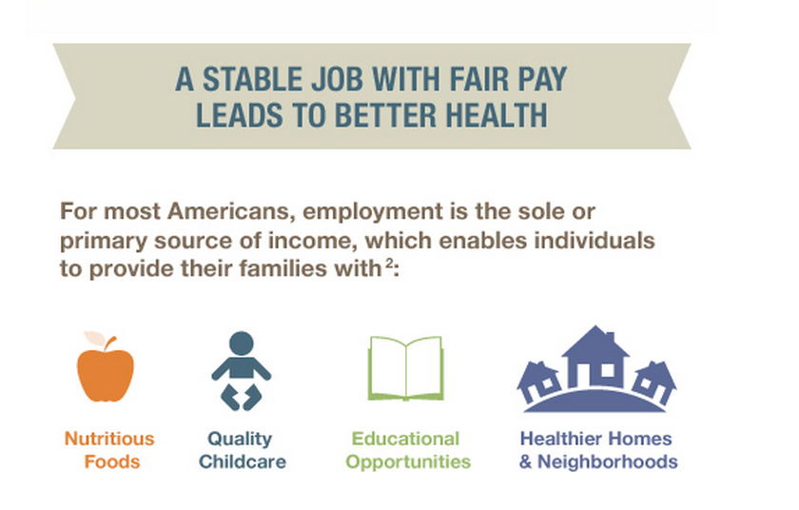

Slide 21
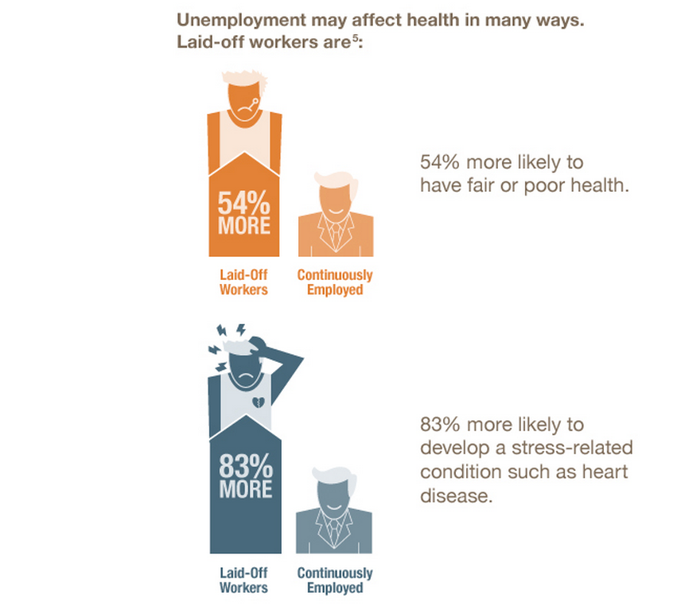

Slide 22
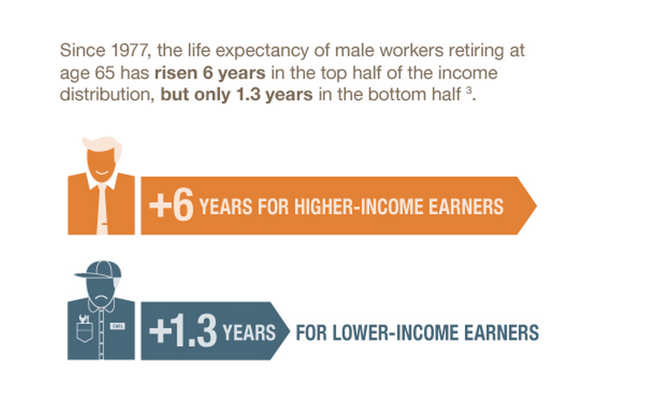

Slide 23

Education
# of years of schooling
Credentials

Slide 24
Higher income (or education), longer life:
Life expectancy at age 25
Source: National Longitudinal Mortality Study, 1988-98.

Slide 25
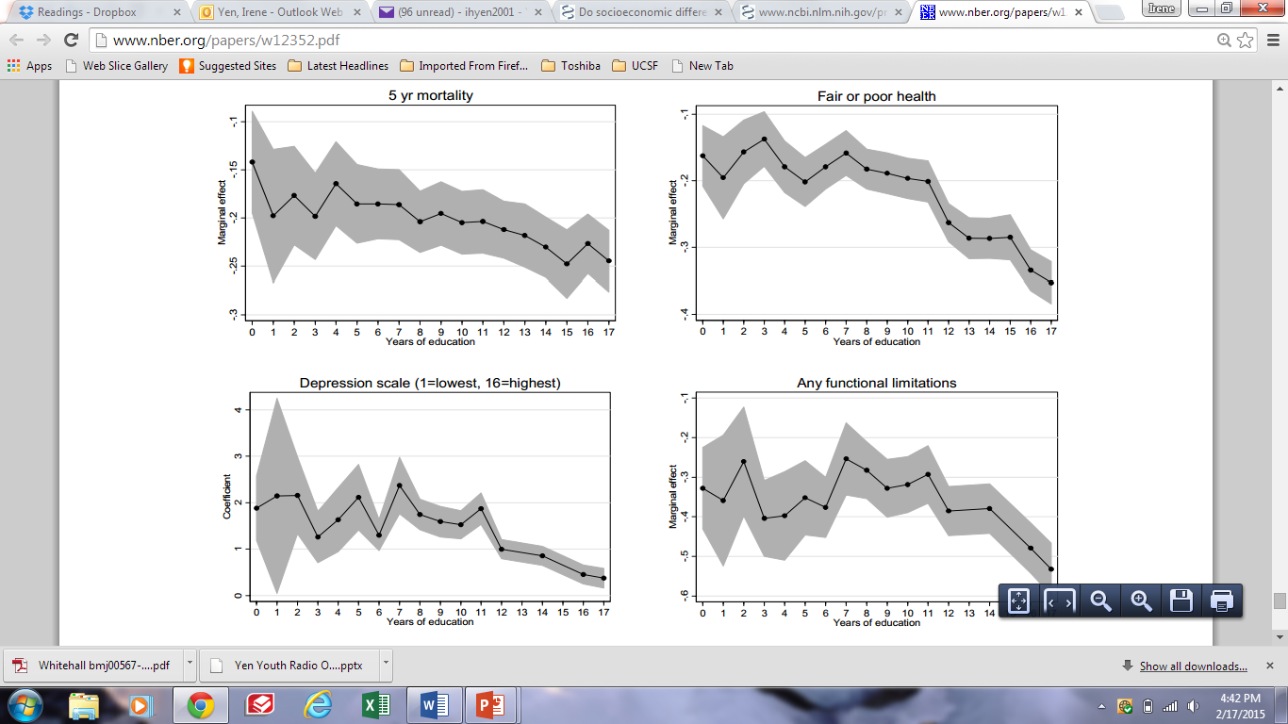

Slide 26
Stressors
Food insecurity
Job insecurity
High demands / Low control
Notes:
Can go even further and talk about food policy, corn syrup etc.
http://www.ncbi.nlm.nih.gov/pubmed/24392603
http://www.ncbi.nlm.nih.gov/pubmed/15622689
http://www.ncbi.nlm.nih.gov/pubmed/18366535/
Perceived discrimination/racism has been shown to play a role in unhealthy behaviors such cigarette smoking, alcohol/substance use, improper nutrition, and refusal to seek medical services (Lee, Ayers, & Kronenfeld, 2009; Peek et al, 2011).

Slide 27
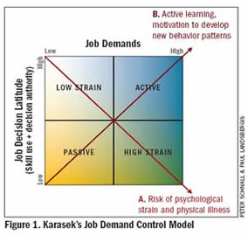
High Demands / Low control = job strain
Notes:
Note that this started in norway, began to notice childhood effects

Slide 28
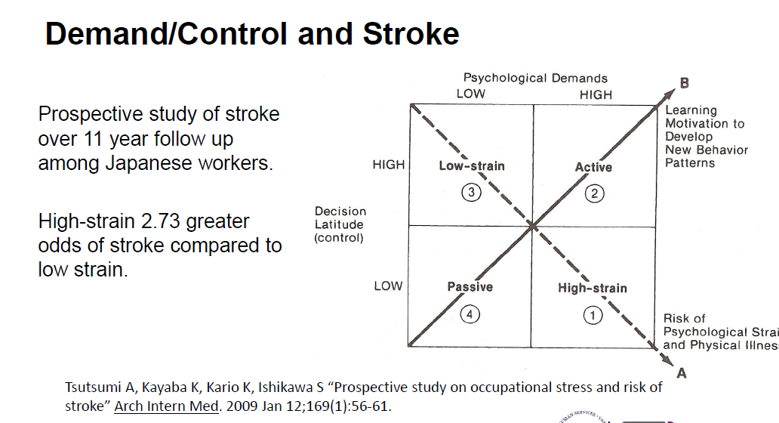

Slide 29
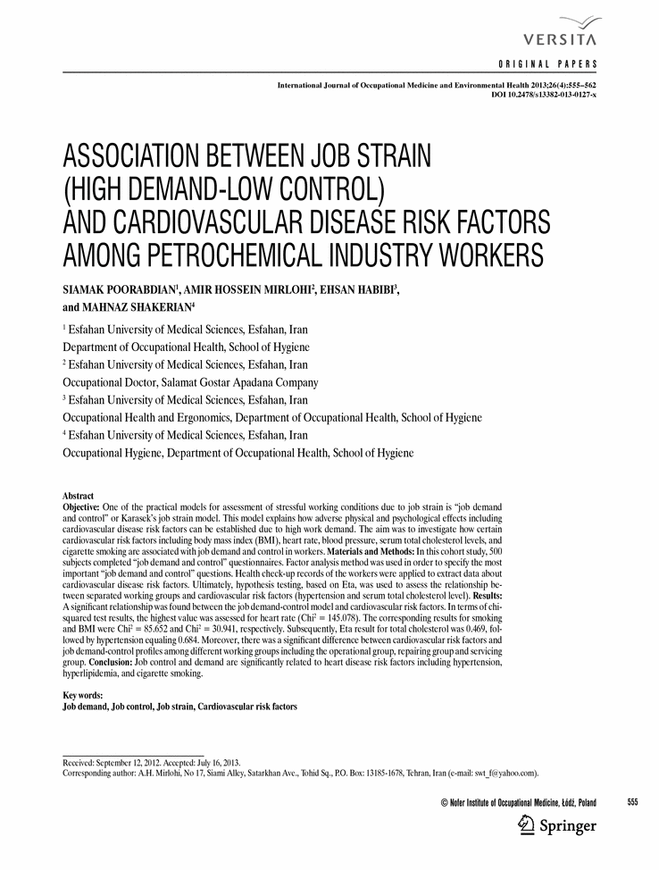

Slide 30
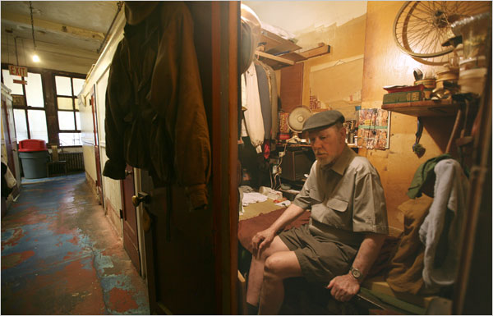
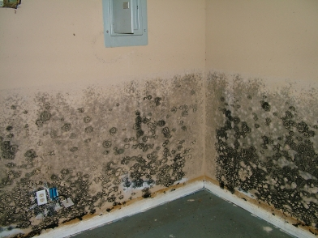
Housing
Own vs. rent
Cost / income proportion

Slide 31
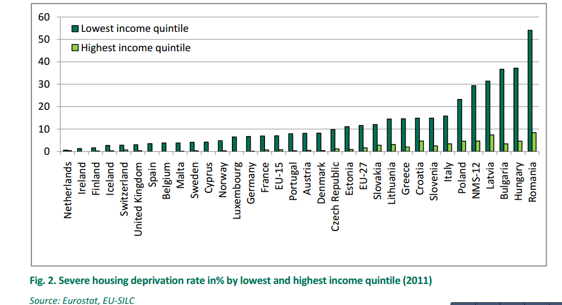
Housing Deprivation
Notes:
In 2011, 5.5% of the EU population suffered from severe housing deprivation, defined as an overcrowded dwelling in combination with one or more of the above‐mentioned housing deprivation measures. In five EU Member States, more than a tenth of the population faced severe housing deprivation, with the share rising to 17.9% in Latvia, and 25.9% in Romania. Across all EU countries, low income is associated with increased exposure levels to housing deprivation

Slide 32
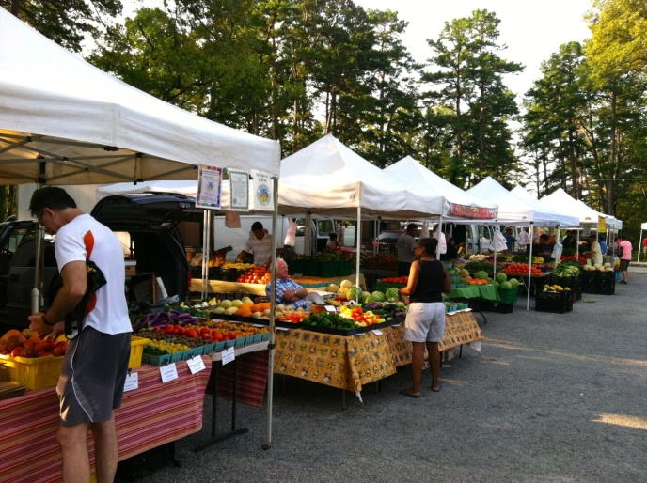
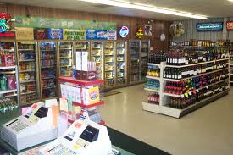
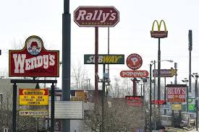
Food
Healthy People 2020

Slide 33

Food
America’s poor :
higher food prices than the national average,
use cost saving techniques, such as buying lower quality foods, generic brands, and larger package sizes,
spend less per unit of weight or volume for many foods, such as beef,
spend a higher proportion of their income on food than wealthier households
Trader Joe’s - $3.39
TJ’s organic - $3.89
Notes:
More in the behavioral lecture

Slide 34
Race / Ethnicity
  Social?
  Biological?
Notes:
http://www.ncbi.nlm.nih.gov/pmc/articles/PMC3863696/
Important to note this is direct length of sdh with outcomes not through behavior – but psychosocial could be either one
http://ajph.aphapublications.org/doi/pdf/10.2105/AJPH.2013.301707

Slide 35
Racial/ethnic differences do not explain
differences in adult health by income
Analyses by Braveman et al., UCSF.
Data source: NHIS 2001-2005. Age-adjusted.

Slide 36
Racial/ethnic differences do not explain adult health differences by education
Braveman, Egerter et al., 2009.
Data source: BRFSS. Age-adjusted.

Slide 37
Race / Ethnicity
Unfair treatment
Discrimination
In your day-to-day life, how often do any of the following things happen to you?
1. You are treated with less courtesy than other people are.
You are treated with less respect than other people are.
You receive poorer service than other people at restaurants or stores.
People act as if they think you are not smart.
People act as if they are afraid of you.
Have you ever been unfairly treated in the following six domains (Yes/No):
fired or denied a promotion
not hired for a job
treated unfairly by the police
discouraged by a teacher from continuing education
prevented from moving into a neighborhood
neighbors have made their life difficult.

Slide 38
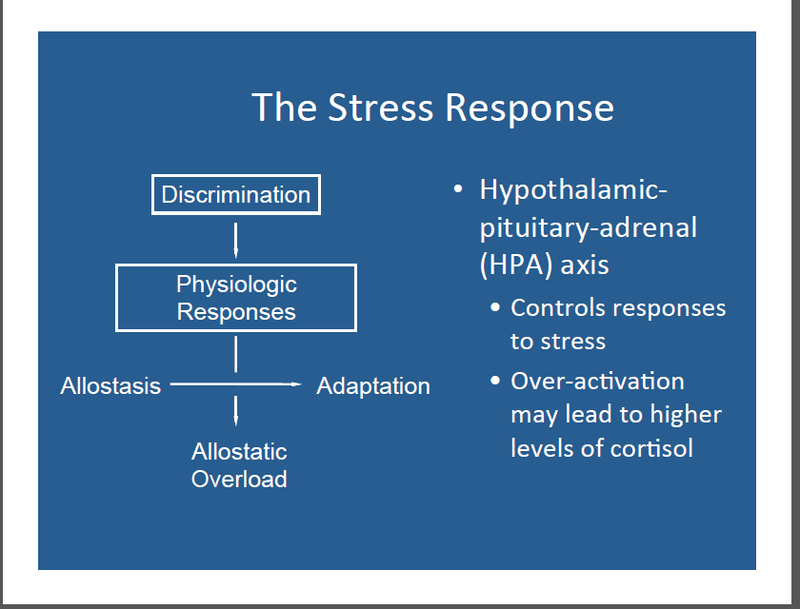

Slide 39
Hypersegregation
Segregation highest for African Americans
Characterized by not only by racial segregation
But also socioeconomic segregation
Socioeconomic segregation does not account for racial/ethnic segregation
Related to discrimination in housing/ mortgage markets

Slide 40
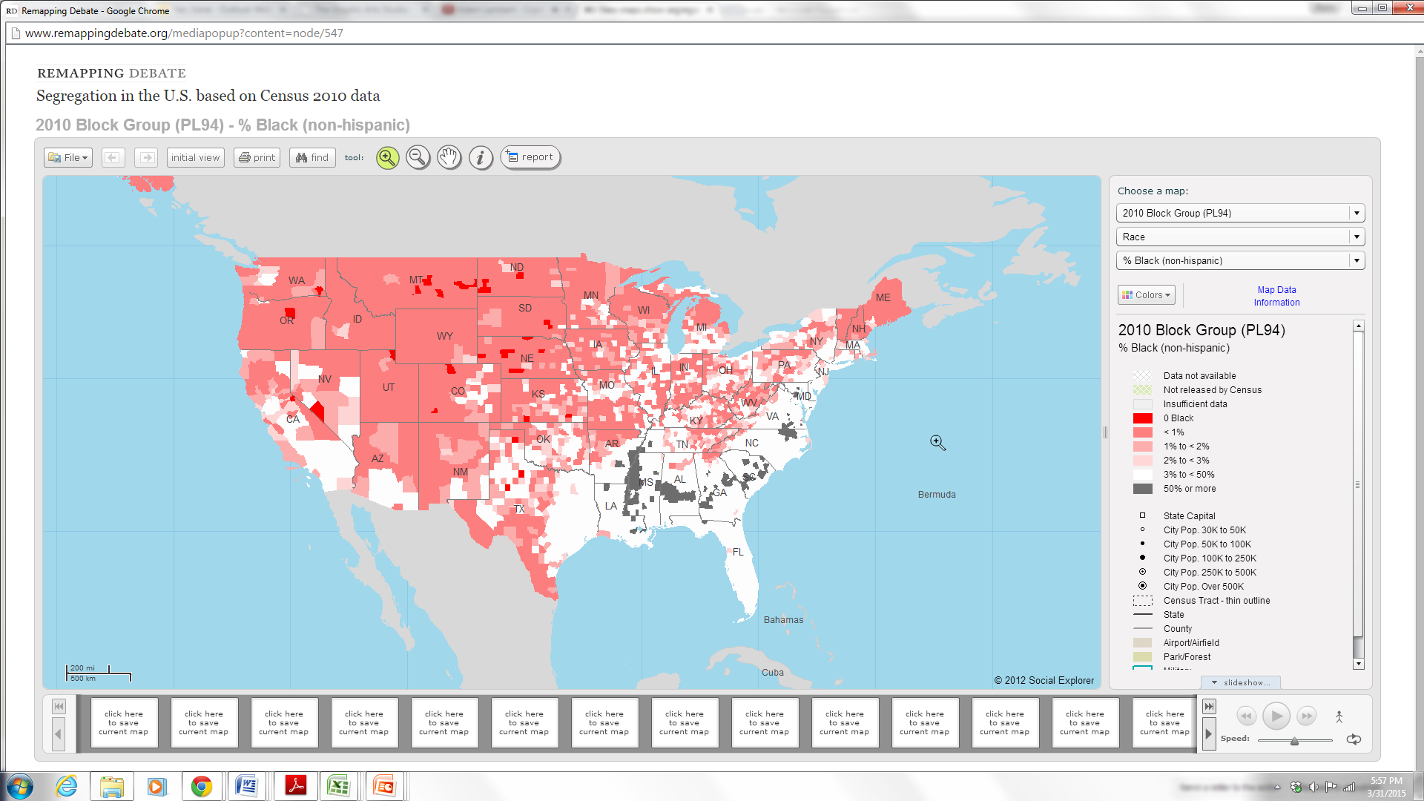

Slide 41
National City rewarded loan officers for charging fees that boosted the cost of a home loan above what the bank stated on its term sheets. The bank gave loan officers broad discretion to offer loans at higher or lower costs, though National City's compensation policies discouraged discounts. The bank didn't have clear guidelines for these pricing decisions and did not require loan officers or mortgage brokers to justify their actions.
Notes:
Got higher rates with same credit rating – Mark French

Slide 42
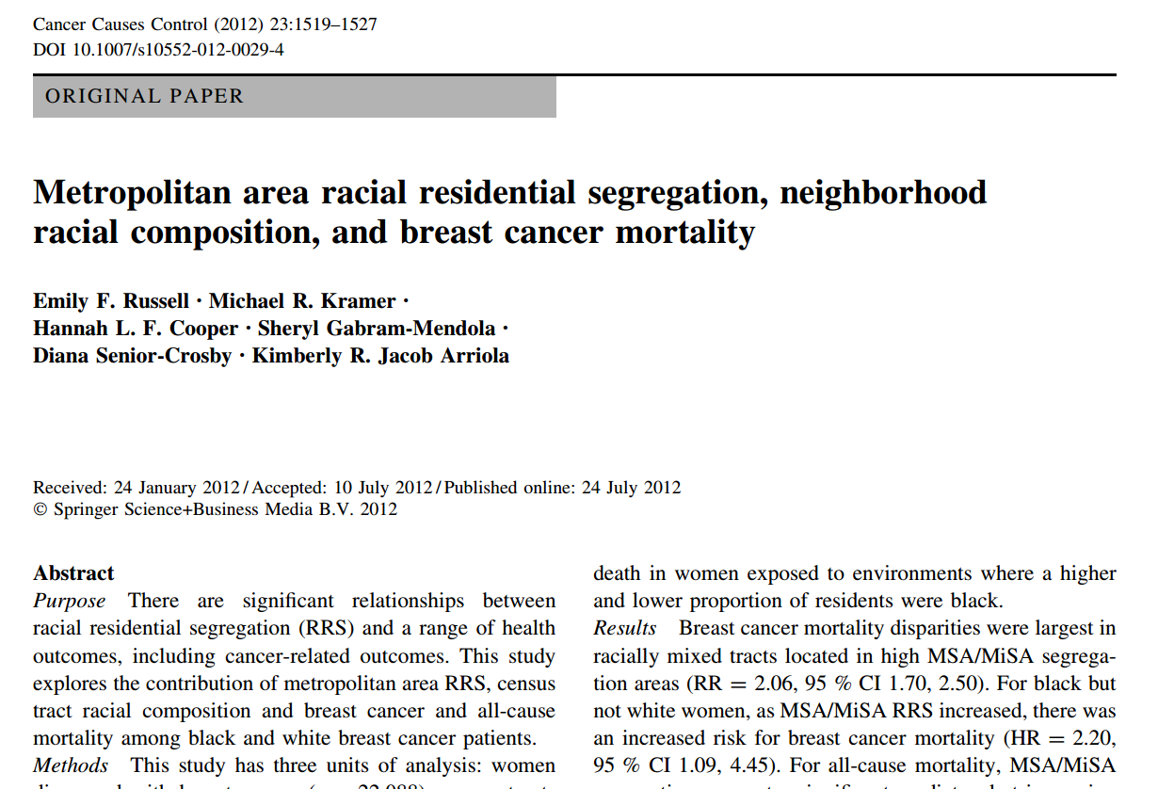

Slide 43
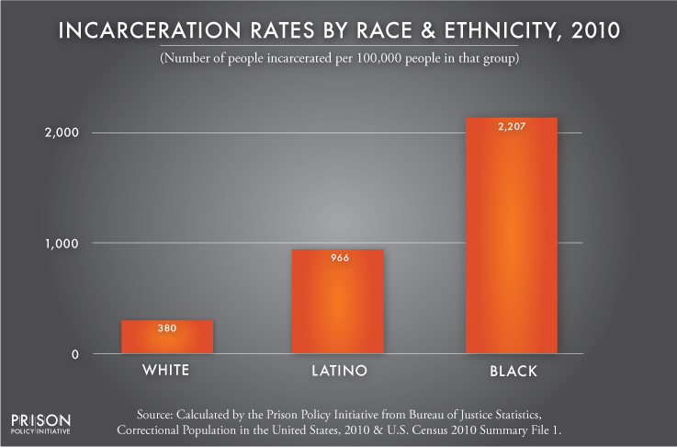
Incarceration

Slide 44
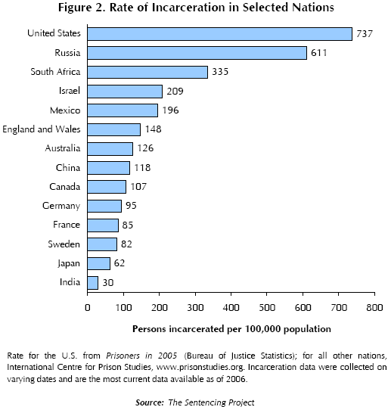
Incarceration

Slide 45
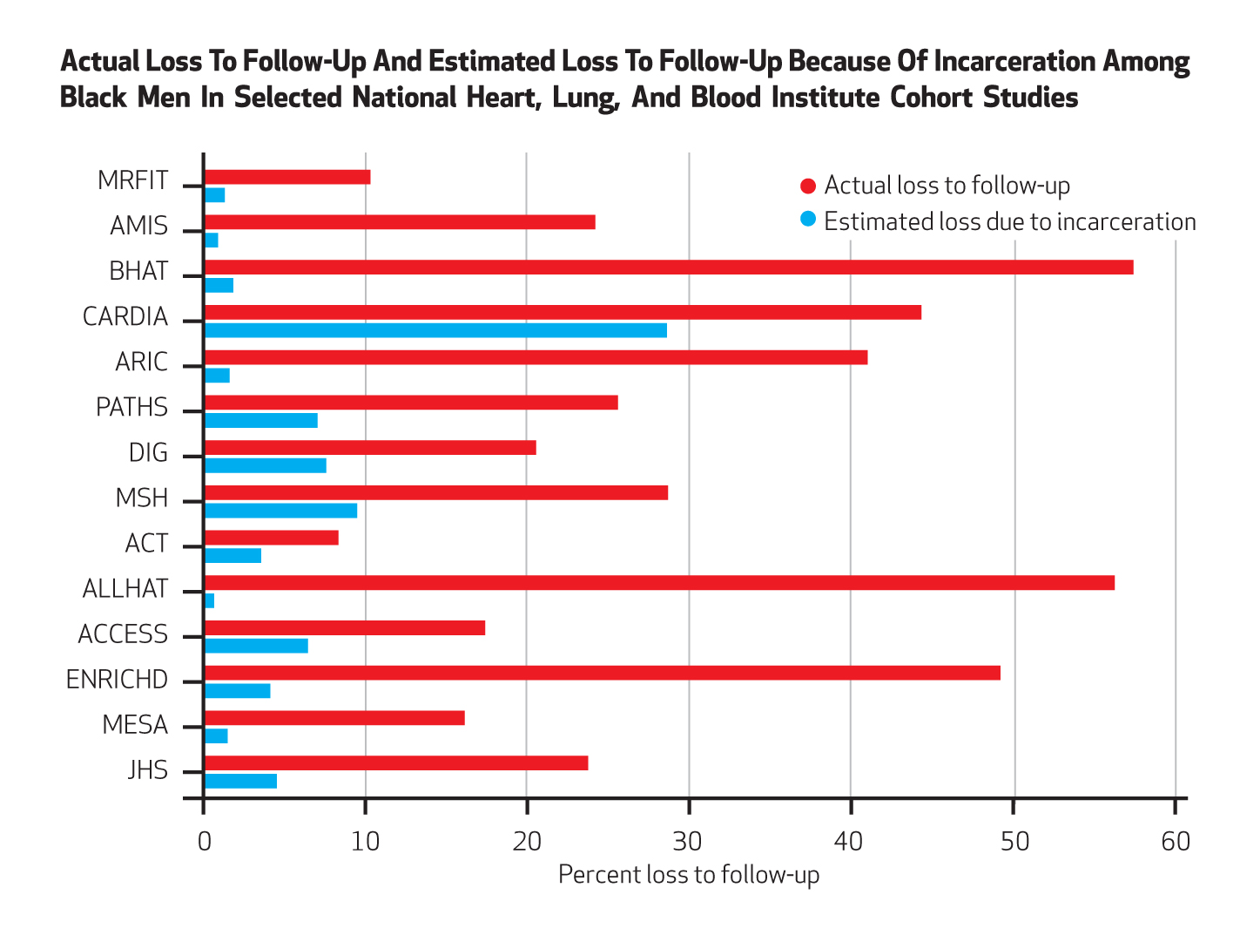
Incarceration
Notes:
Health Affairs 2014

Slide 46
Incarceration
As of 2004, there were approximately six times more inmates and ex-inmates than in the mid-1970s.
Presently, there are more than 16 million felons and ex-felons in the United States (Uggen et al. 2006)

Slide 47
Incarceration
The lifetime cumulative risk (measured to age 34) of imprisonment for all African American males is > 20 % (Pettit & Western 2004).
African American males without a high school diploma, the lifetime risk of incarceration is 59 % (Pettit & Western 2004). (5x the rates of comparable whites.))
correctional policies have caused the emergence of a new ‘‘felon class’’ in society.
  8 % of the adult population,
  22% of the black adult population
  33% percent of the black adult male population.

Slide 48
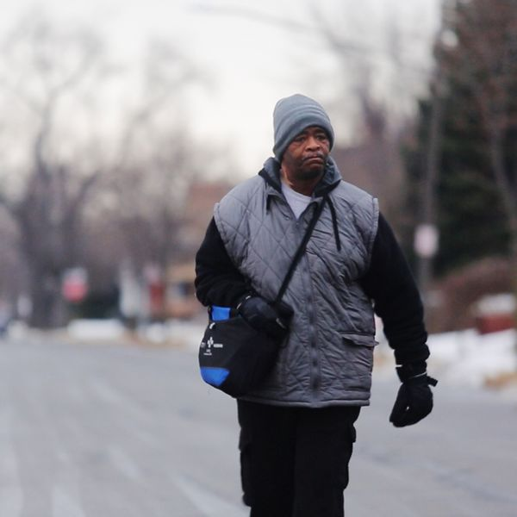
Transportation
Notes:
walks 21 miles each day round trip just to get to his job. No matter what the weather, Robertson has been hiking it to work ever since his car broke down 10 years ago
His job at a factory pays $10.55 so he says he can't afford a car and the bus only takes him so far to work. The rest he has to walk, consuming large amounts of Coca-Cola and Mountain Dew just to stay awake
Low-income, inner-city residents suffer from a “modal” mismatch, a drastic divergence in the relative advantage between those who have access to automobiles and those who do not (Blumenberg and Hess 2003; Blumenberg and Ong 2001; Grengs 2010; Kawabata 2003; Ong and Miller 2005; Shen 1998; Taylor and Ong 1995; Wyly 1998). In almost all metropolitan areas, individuals without reliable access to automobiles can reach far fewer opportunities within a reasonable travel time compared with those who travel by automobile (Benenson et al. 2010; Blumenberg and Ong 2001; Grengs 2010; Kawabata 2009; Kawabata and Shen 2006, 2007; Ong and Miller 2005; Shen 2001, 1998).

Slide 49
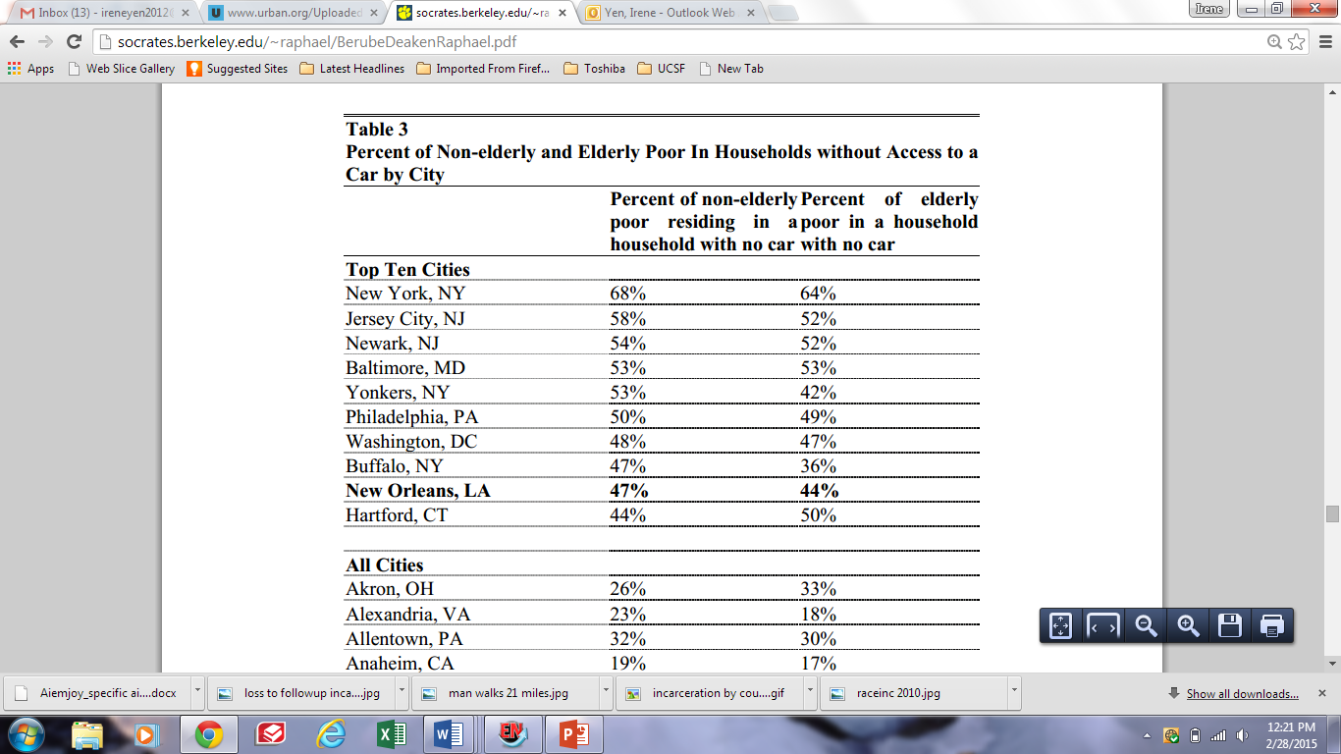

Slide 50
What produces health disparities across the life course and across generations?
SOCIETY
Reducing social
inequality
INDIVIDUAL
Social position, e.g. by race & class
Social
Context
1. Social inequality
2. Differential exposure
Reducing harmful exposures
Specific exposure
3. Differential vulnerability
Reducing vulnerability
Disease
4. Differential consequences
Preventing unequal
consequences
Policy
Context
5. More social inequality
Social consequences
of ill health
Adapted from Diderichsen, U. Copenhagen

Slide 51
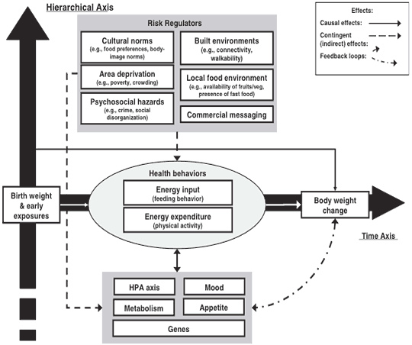
CDC Multilevel Model for Obesity
Notes:
http://www.cdc.gov/pcd/issues/2009/jul/09_0013.htm

Slide 52
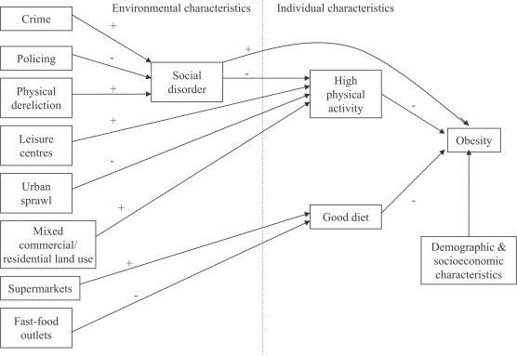
Theoretical model linking social and physical environmental characteristics to obesity
Pathways to obesity: Identifying local, modifiable determinants of physical activity and diet
Mai Stafford , Steven Cummins , Anne Ellaway , Amanda Sacker , Richard D. Wiggins , Sally Macintyre
Social Science &amp; Medicine, Volume 65, Issue 9, 2007, 1882 - 1897

Slide 53
Questions?

Slide 54
Discussion
Think about health outcome of interest to you
What is known about various social determinants and your health outcome of interest?

