Slide 1
Publishing and Presenting
Clinical Research
2015
Lecture 2: Figures & Tables
April 21, 2015
Vivek Jain, M.D., M.A.S.
Assistant Professor of Medicine
HIV/AIDS Division
San Francisco General Hospital, UCSF

Slide 2
Goals
Highlight points from Warren Browner: Publishing and Presenting Clinical Research, 3rd Edition
Explore the best use of tables and figures to graphically display quantitative data
Conveying maximum information in easiest format to understand
Design considerations for different displays
Making design itself invisible
Illustrations

Slide 3


Books

Slide 4
Tables
When to use:
  display comparison
  enumerate a list that cannot be in text form
When not to use
  when dimensionality >2 and can’t be easily handled
  when longitudinal data is better shown as a line, graph, etc. rather than numbers

Slide 5
Tables: design considerations
Title: describe succinctly but with detail—not too little, not too much
Table title | Comment
Table 1. Baseline Characteristics of the Participants | Standard Table 1 title; Could include n=X sample size
Table 2. Clinical Characteristics of the Patients at Baseline | Could include sample size
Table 2. Adverse Events up to Day 91. | Adverse clinical events up to Day 91 in aerosolized vs. subcutaneous vaccine groups
Table 3. Description of the air pollutants at the 39 schools | Great
Table 5. Population and school characteristics by school traffic | Great
Table 6. Difference in cognitive development, at baseline and 12-mo change, by school air pollution exposure (high/low group or interquartile range increase) in 2,715 children and 10,112 tests from 39 schools. | Changes in cognitive development by air pollution exposure at 39 schools (n=2,715)
Low et al. NEJM, 2015; Robinson et al., NEJM, 2015; Sunyer et al. PLOS Medicine, 2015

Slide 6
Tables: design considerations
The eye reads across → set up comparisons horizontally
  often, table can make sense both ways: decide what is the primary item to be compared
Use horizontal lines to ease/guide interpretation
No vertical lines; only horizontal
Labeling
  Label columns and rows in good size font
  Give units
  Be clear on groups, no acronyms
  Avoid “Arm A/Arm B”, or “Intervention/Control”, “Group 1/2” etc
  Eliminate footnotes, asterisks, p-values in the footer
  Think about centering (+/-)
  Merge cells and group labels
In manuscripts, don’t double space.. print all on one page
Make one or two nice tables formatted the way you like, then re-use these every time you write a paper

Slide 7
Example: not easy to look at
Improve the title
Comparison of Selected Characteristics of the Two Groups of Subjects.
Say what intervention was; include N
Label as control &
include N
Give effect size & CI, then p-value
Female row
duplicates info
Characteristic | Group I | Group II | P
Male | 265/401= 66% | 197/402= 49% | *
Female | 136/401= 34% | 205/402= 51% | *
CHD | 43/401= 11% | 48/402= 12% | NS
Income in dollars | $59,323 ± $13,358 | $61,482 ± 16,552 | NS
Age (years) | 48 ± 16 | 49 ± 17 | NS
<30 years | 80/401 (20%) | 84/402 (21%) | NS
31-65 years | 45% | 45% | NS
>65 years | 35% | 34% | NS
*p < 0 .05. NS = nonsignificant.
Give p-value
right here not in footnote
Acronym
($)
Use a sans serif font
Eliminate vertical lines

Slide 8
Improvements
Table 1. Baseline clinical and socioeconomic characteristics of exercise intervention (n=401) and no-exercise control (n=402) participants.
Characteristic | Exercise Intervention (N = 401) | No-exercise Control (N=402) | P-value
Male, n (%) | 265 (66) | 197 (49) | <0.01
Coronary heart disease, n (%) | 43 (11) | 48 (12%) | 0.6
Median age (years ± IQR) | 48 ± 16 | 49 ± 17 | 0.4
<30 years, n (%) | 80 (20) | 84 (21) | <0.001
31-65 years, n (%) | 180 (45) | 181 (45) | 0.5
>65 years, n (%) | 140 (35) | 137 (34) | 0.5
Median 2014 Income ($ ± IQR) | $59,323 ± $13,358 | $61,482 ± 16,552 | 0.7

Slide 9
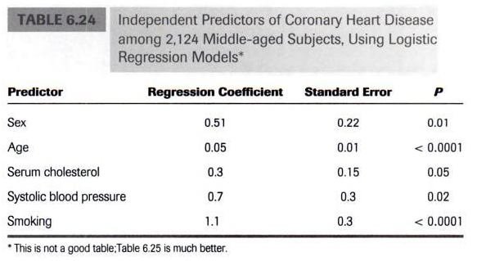
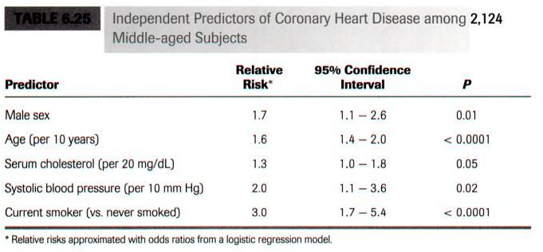
Table of Regression Output
Predictors: describe, and display as: “age (per 10 years)”, e.g.
No regression coefficients
Favor 95% CI over p-values
Browner, Publishing and Presenting Clinical Research, 2nd Ed.

Slide 10
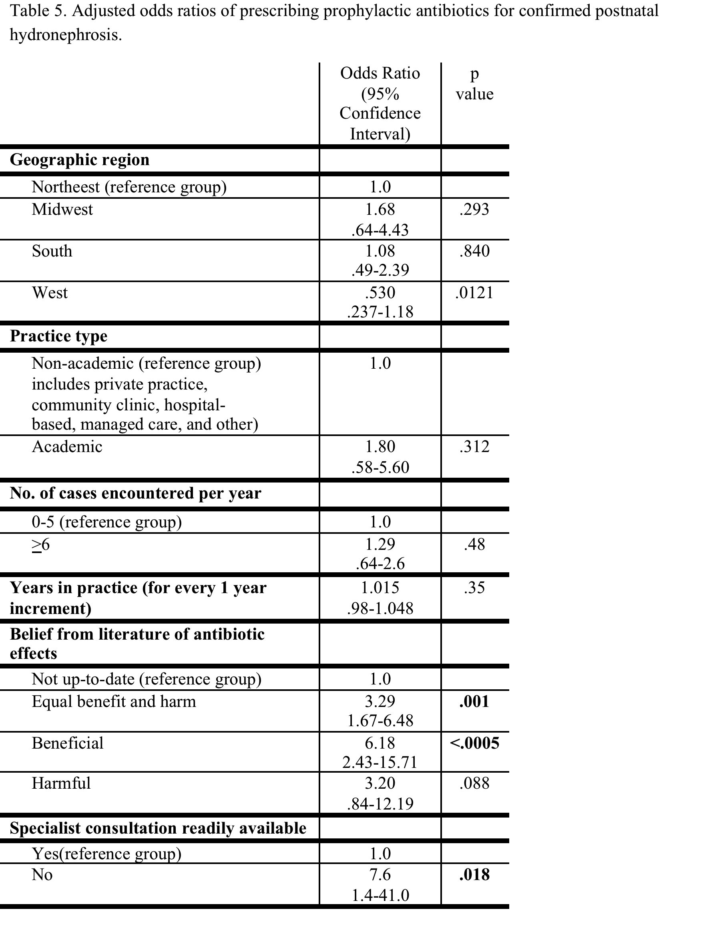
For discussion
Good title
Overall organization good
Categorical variables clear
Referent is very clear
OR=1.0 included (or can say ---)
Vertical lines
Needs top and bottom lines
Too many thick lines
Could separate OR from 95% CI
P-values could go one decimal, especially
the ones <0.05
“Non-academic” description → footnote
No need to bold the significant p-values

Slide 11
Figures: General Principles
When to use
  demonstrating overall effects, comparisons
  showing trends, longitudinal variation
When not to use
  can data be displayed in text? as a table?
Design features
  dimensionality of data
  data to ink ratio
  simple design, large easy to read labels, all axes labeled, sans serif fonts
  sketch out by hand before making the graphic

Slide 12
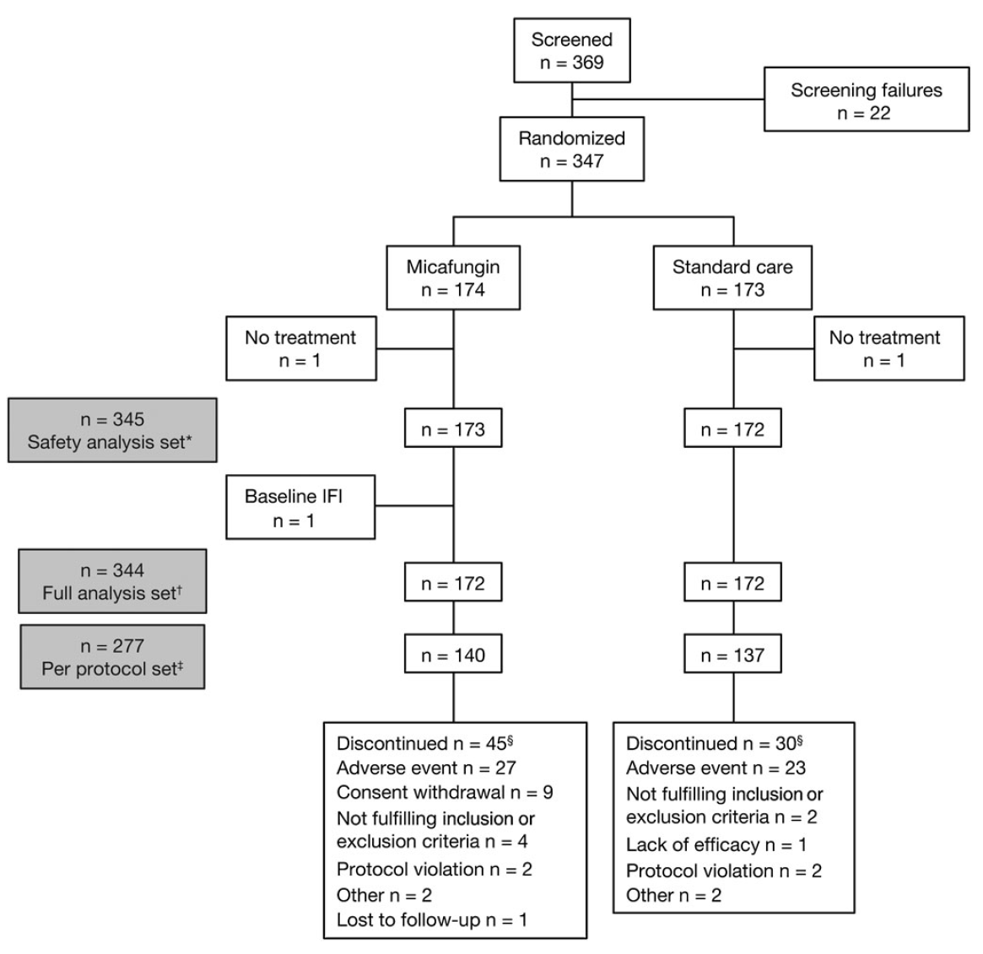
Diagrams
Study subject flow, CONSORT diagrams
PowerPoint versatile; Word can make these but not as well
Note vertical vs horizontal flow
Generally want to avoid unnecessary “boxing” of words, but here it is helpful…
Saliba et al. Clin Infect Dis, 2015

Slide 13
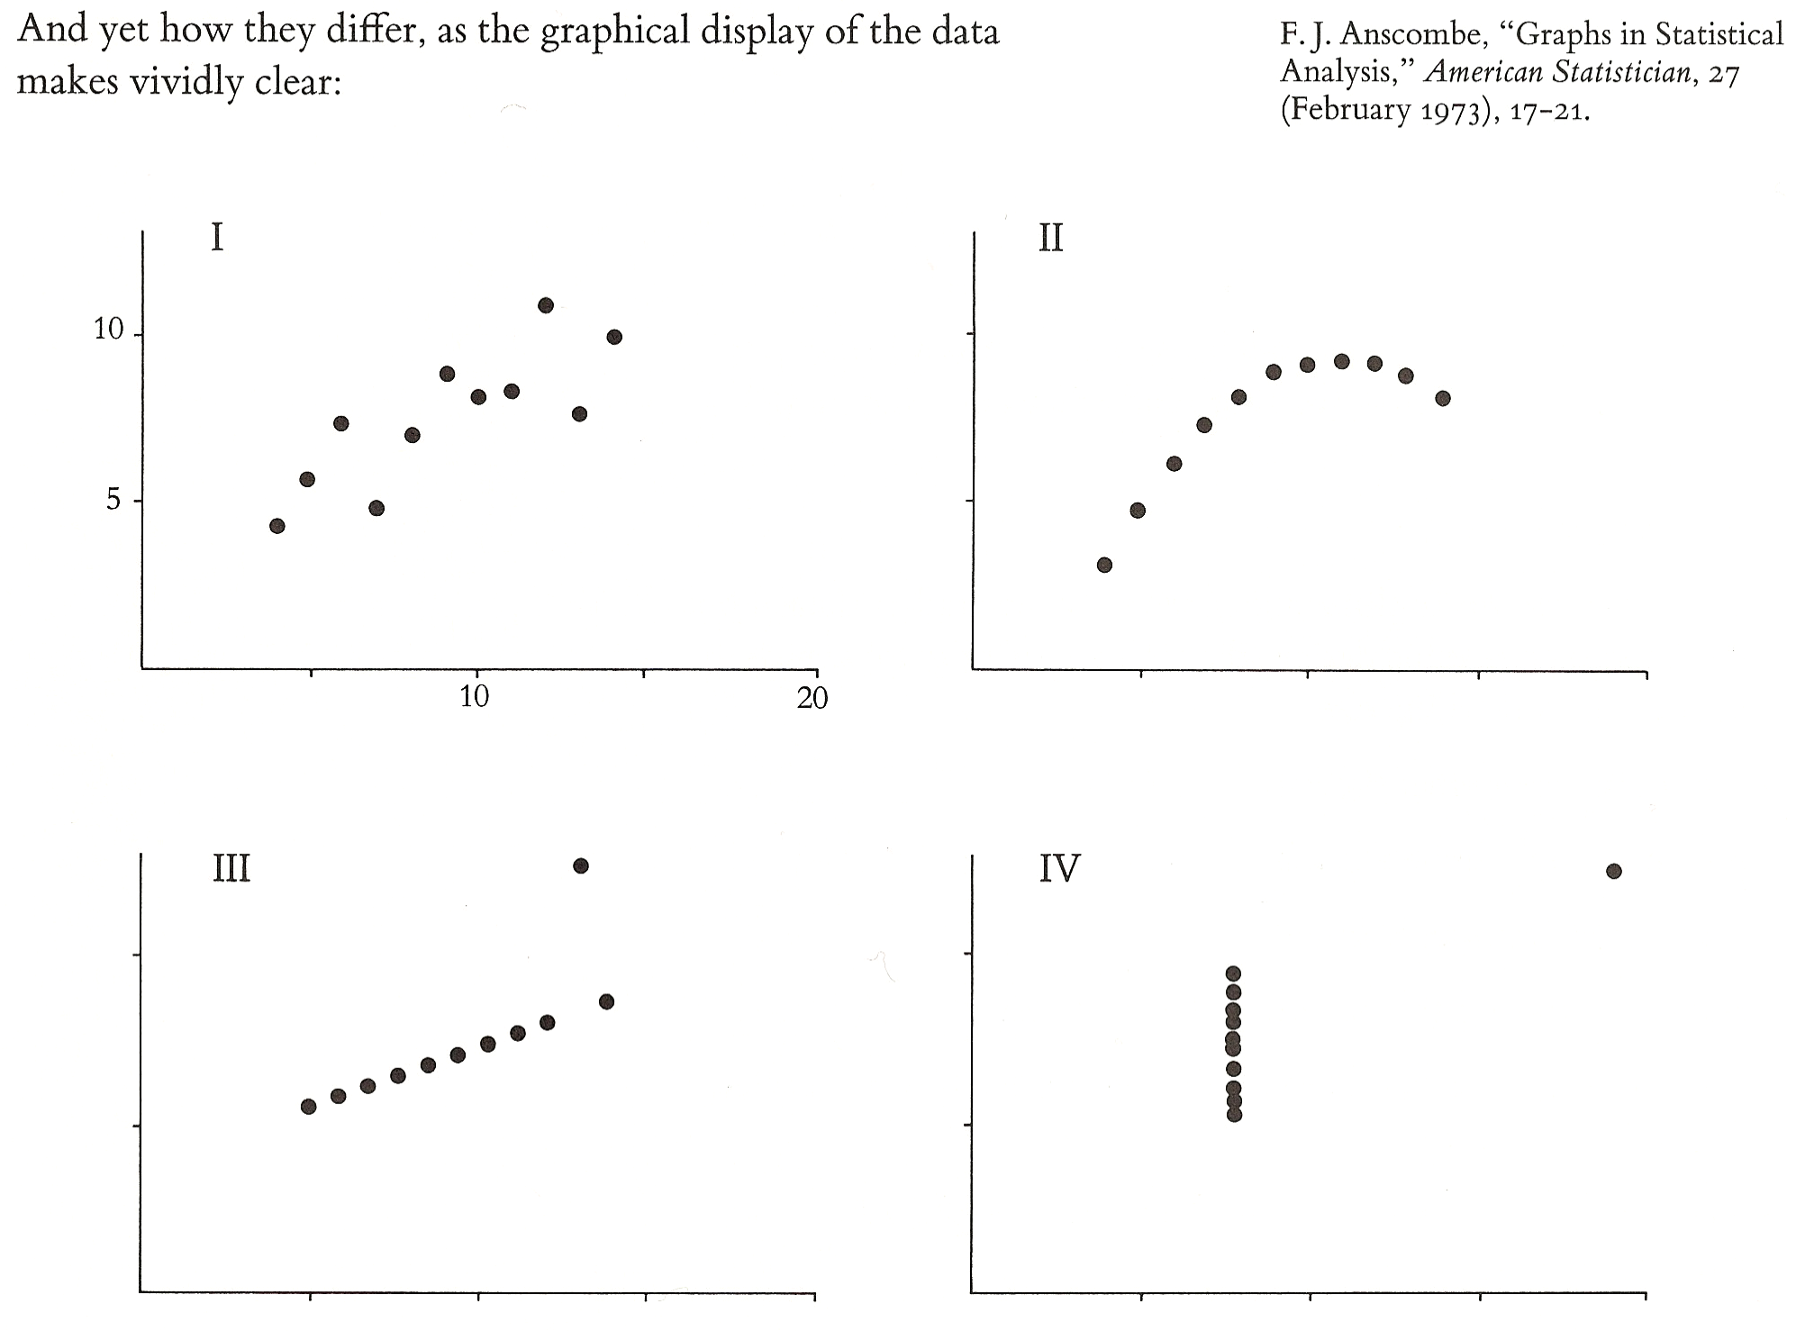
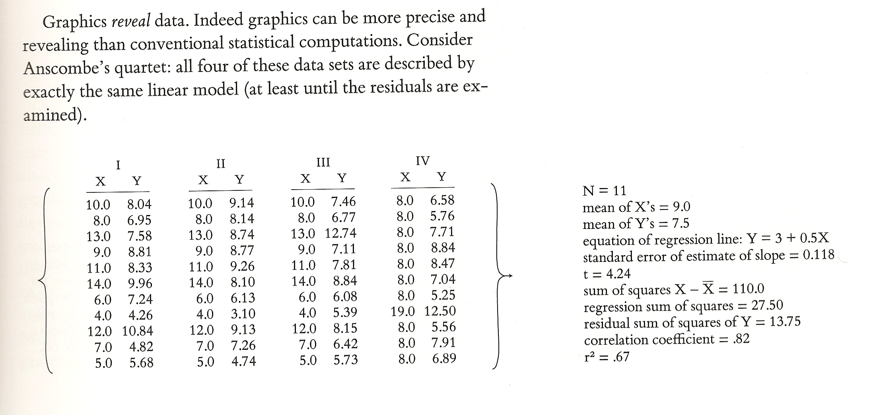
Scatterplots
Often very useful
  shows all discrete data points, including interesting outliers
  essential first step in examining data
Tufte, ER, VDQI, 2nd Ed., p.14-15

Slide 14
Bar Graphs
Ubiquitous, often very useful
Stacked bar: useful for showing proportions, trends, be careful with y-axis
Avoid color unless needed; avoid moire effects-use grayscales
Median
Household income ($)
Quartile

Slide 15
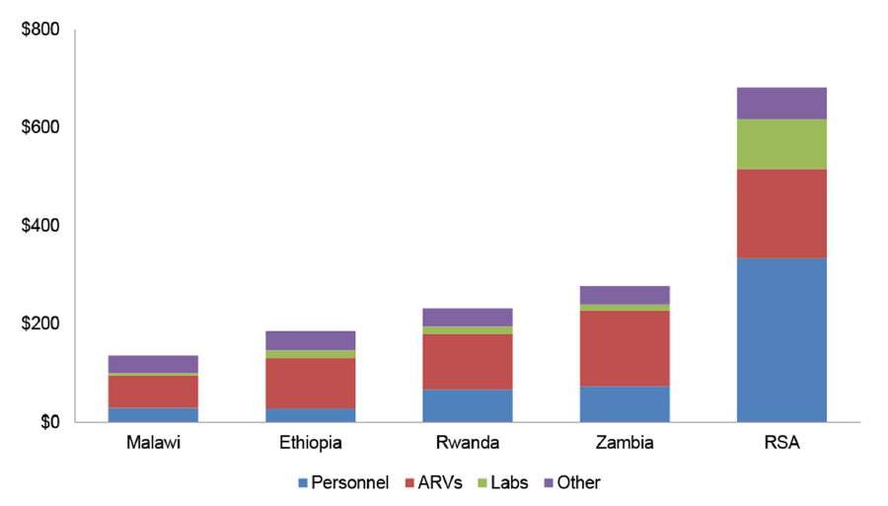
Stacked Bar 1: components
Tagar et al. PLOS ONE, 2014

Slide 16
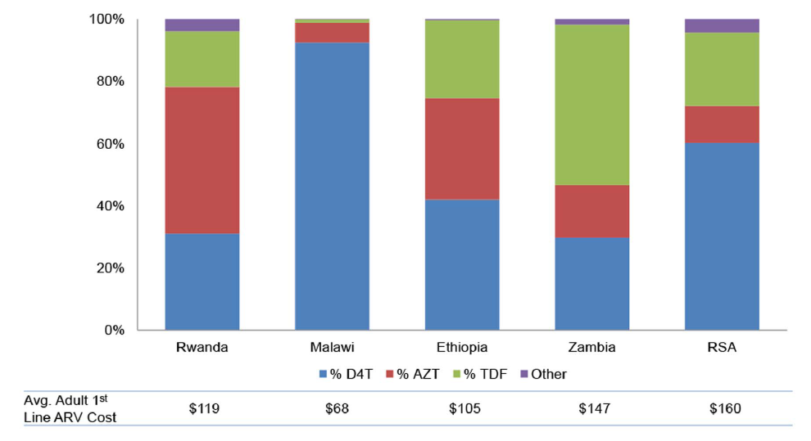
Stacked Bar 2: adds to 100%
Tagar et al. PLOS ONE, 2014

Slide 17
Table vs. Stacked Bar Graph
CD4+ Group (cells/uL) | Clinic (n) | Community (n)
>500 | 200 | 350
350-500 | 200 | 300
200-350 | 200 | 200
<200 | 400 | 150
Simulated data

Slide 18
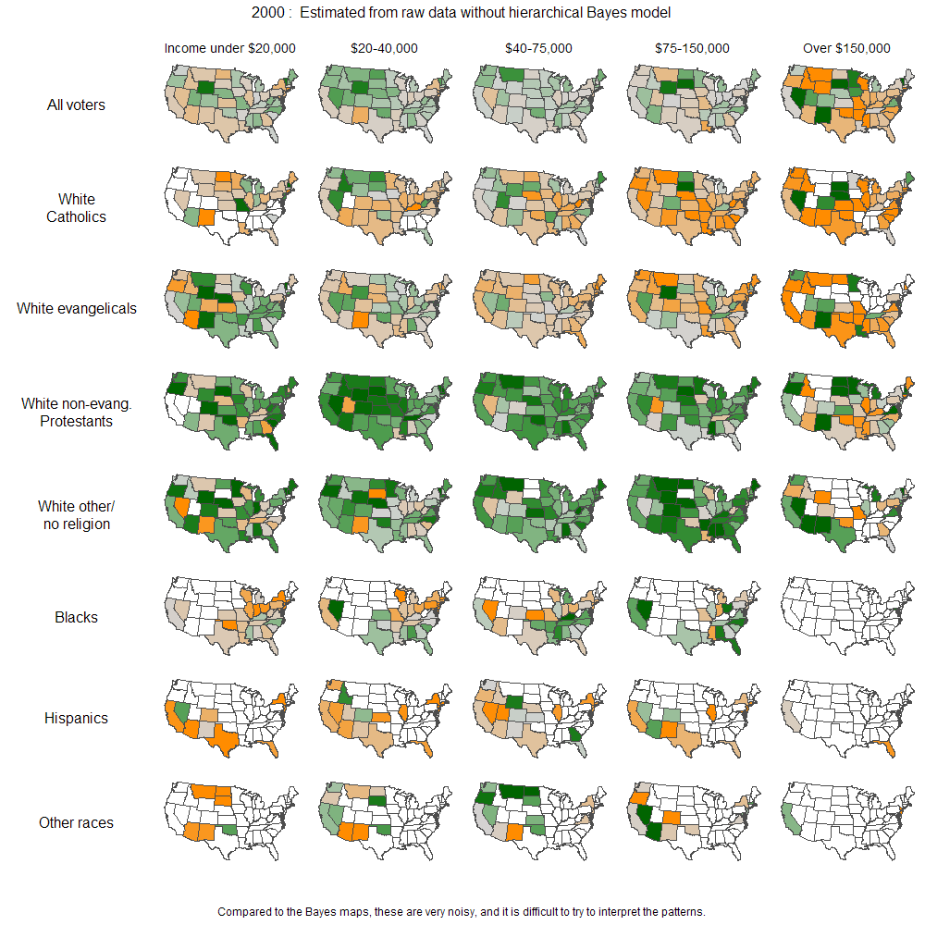
Small Multiples
The eye trains on the first complex image; rest of content is then rapidly absorbed.
http://andrewgelman.com/2009/07/15/hard_sell_for_b/

Slide 19
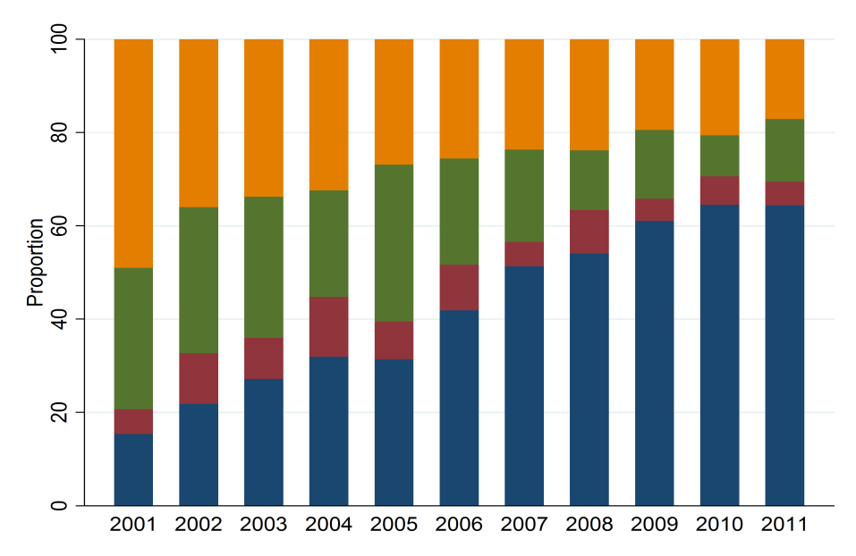
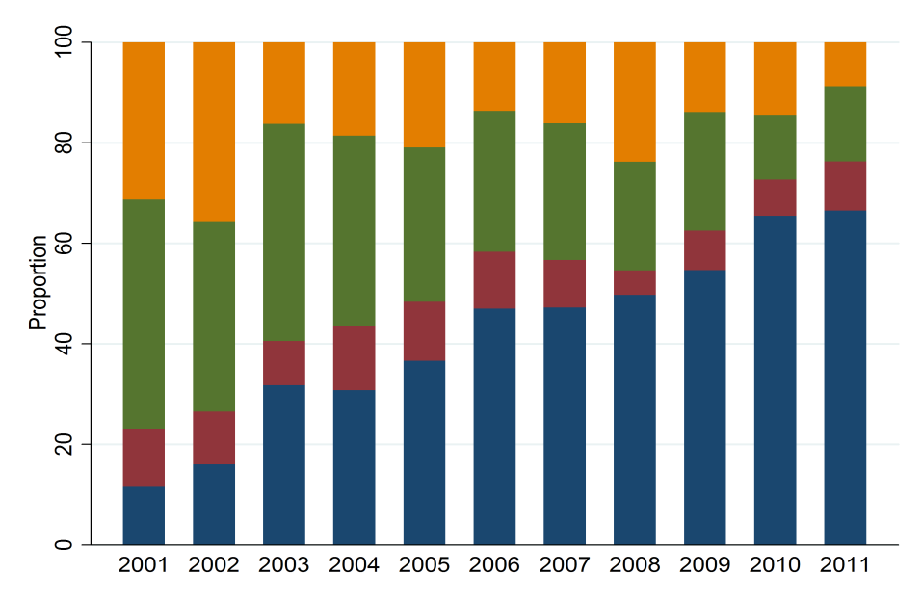
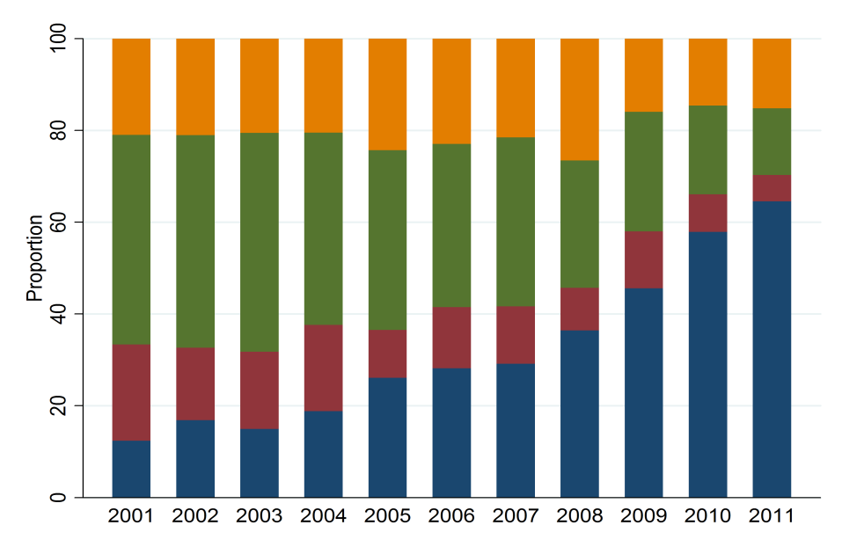
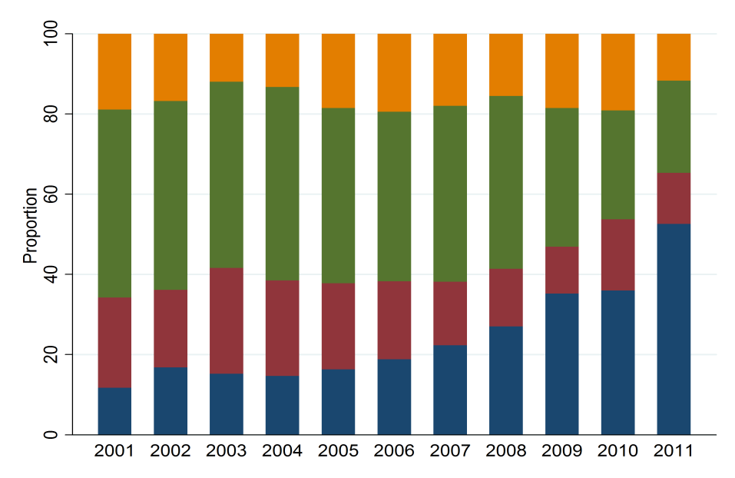
Stacked Bar Graph with Small Multiples: Dense Information
CD4 Level <200/µl at Clinic Entry
CD4 Level 200-350/µl at Clinic Entry
Viral Load Strata
<500 c/ml
501-5,000 c/ml
5,001-50,000 c/ml
>50,000 c/ml
01 02 03 04 05 06 07 08 09 10 11
01 02 03 04 05 06 07 08 09 10 11
Graph shows:
1) rising viral suppression of HIV over a decade (blue)
2) this occurs in 4 different patient groups (CD4 counts)
3) in high CD4+ patients, this occurs later, when guidelines changed favoring treatment in this group.
CD4 Level 351-500/µl at Clinic Entry
CD4 Level >500/µl at Clinic Entry
01 02 03 04 05 06 07 08 09 10 11
01 02 03 04 05 06 07 08 09 10 11
Geng et al. Clin Infect Dis. 2012.
Notes:
Comments on this graphic. Scientifically, it shows how antiretroviral therapy (whose goal is to suppress the HIV RNA plasma level in patients) has been given with increasing success over the last decade, judging by the percent of patients with an undetectable viral load (blue). It also shows historical trends about how treatment expanded in patients of different CD4+ count ranges, depending on what the prevailing guidelines were in different years. Lastly, in the >500 CD4 group, it shows how the SF General HIV clinic’s new policy of offering antiretroviral therapy to all patients regardless of CD4 count resulted in a more recent improvement in virologic suppression among patients in this CD4 range (lower right panel, blue color).
In terms of design features: this is a type of graph called the stacked bar graph- shows proportions of a variable, adding up to 100%. Here the graphic utilizes multiple techniques. First, it is a stacked bar: within any given year, it shows the proportion with 4 different strata of viral load (the 4 colors). Second, it shows how these proportions change over 11 years (displaying trends over time). Third, it shows these changing proportions over 11 years within 4 types of patients (using idea of “multiples” – where you digest the first panel, and several other panels are identically constructed. This graphic conveys very dense numeric information that would be very difficult to convey in tabular format.

Slide 20
3D Bar Graphs
Fig. 1. Proportion of men and women who reported voting
F
Female | Male
36% | 22%
M
“Overall, 36% of women and 22% of men reported voting.”

Slide 21
3D Bar Graphs: Better Example

Slide 22
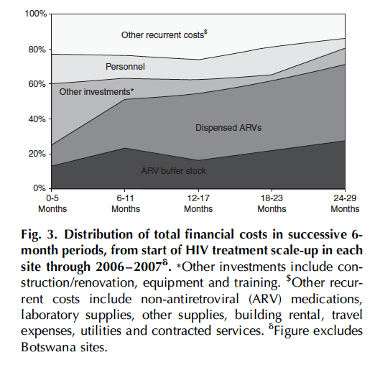
Stacked Line Graph
Menzies et al. AIDS, 2011

Slide 23
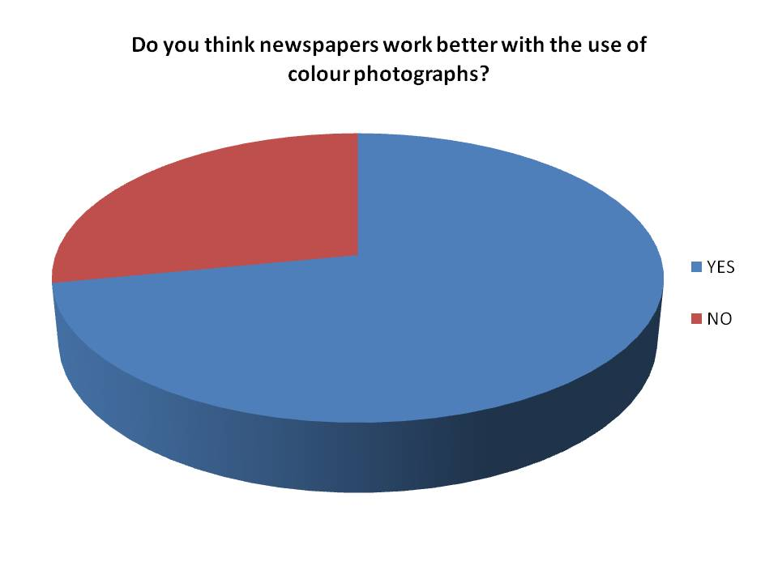
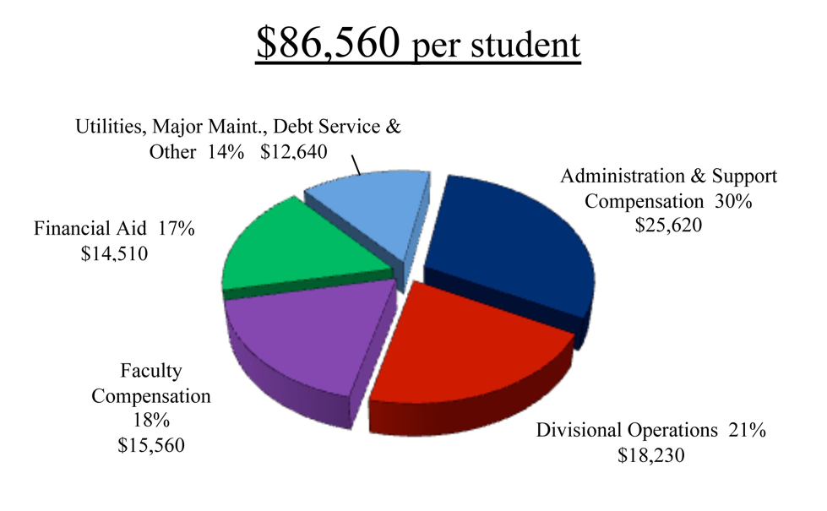
Pie Charts: rarely indicated
http://www.bowdoindailysun.com/wp-content/uploads/2010/07/PieChart-e1279277617776.jpg
http://pollysnella2newspaper.blogspot.com/2012/08/audience-research-pie-charts.html
Component | Cost
Financial Aid | $15,560
Division operations | $18,230
Administrative compensation | $25,620
Debt service | $12,640
Financial aid | $14,150
“74% of respondents said they preferred newspapers with color photos.”

Slide 24
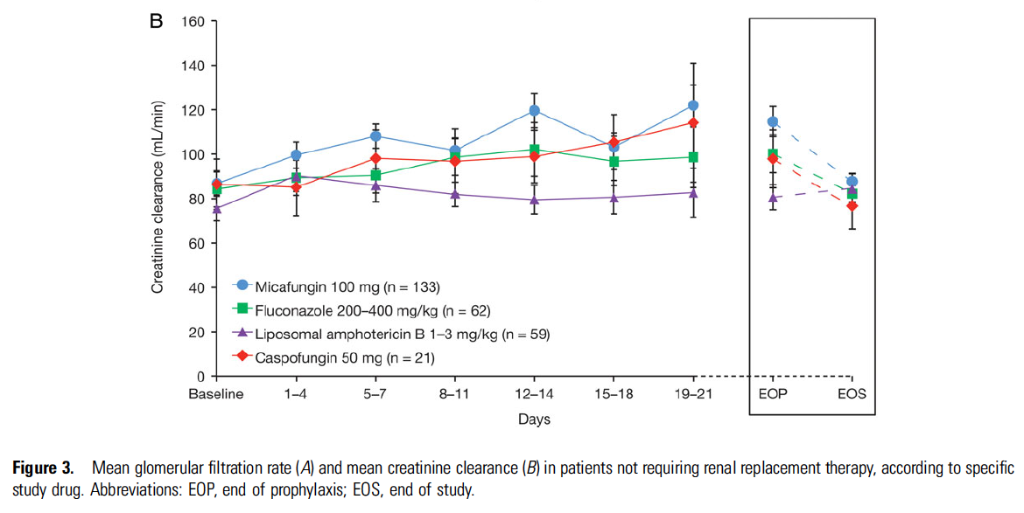
Line Graphs
Very useful for showing longitudinal data: within-subject or within-group data over multiple timepoints
Saliba et al. Clin Infect Dis, 2015

Slide 25
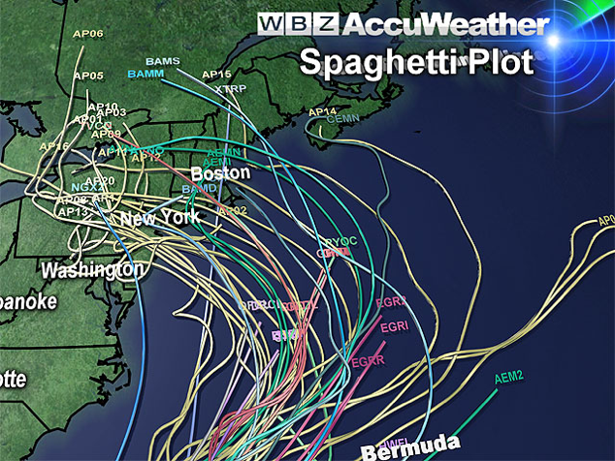
Spaghetti Plots
80
80
60
60
40
% (CD38+/HLA-DR+)
% (CD38+/HLA-DR+)
40
20
20
0
0
Acute HIV
1Y
ART
Max
ART
Acute HIV
Pre-
ART
1Y
ART
Max
ART
Jain et al., JID, 2013
https://cbsboston.files.wordpress.com/2012/10/spaghetti.jpg
Hunt et al., AIDS, 2011

Slide 26
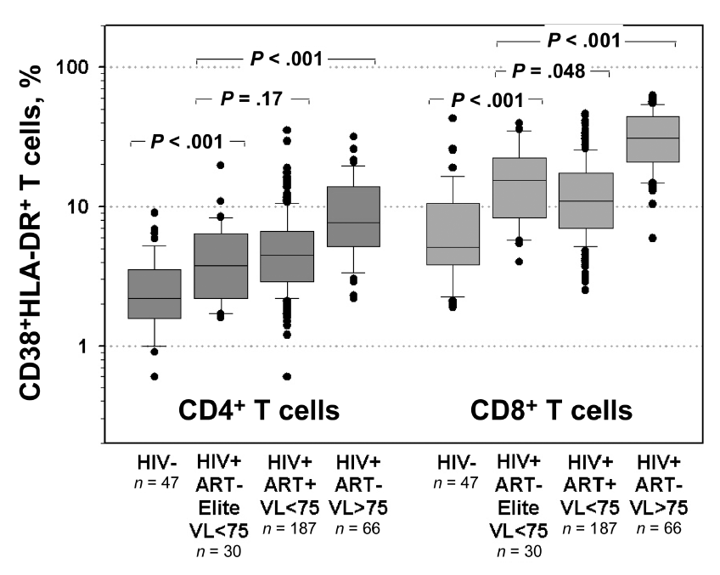
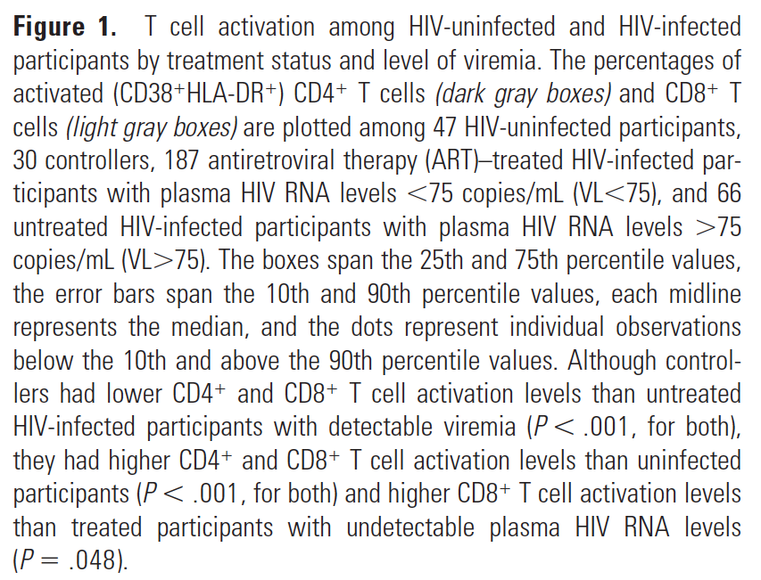
Box Plots & Christmas Tree Plots
Hunt et al., PLOS ONE, 2011
Hunt et al., JID, 2008

Slide 27

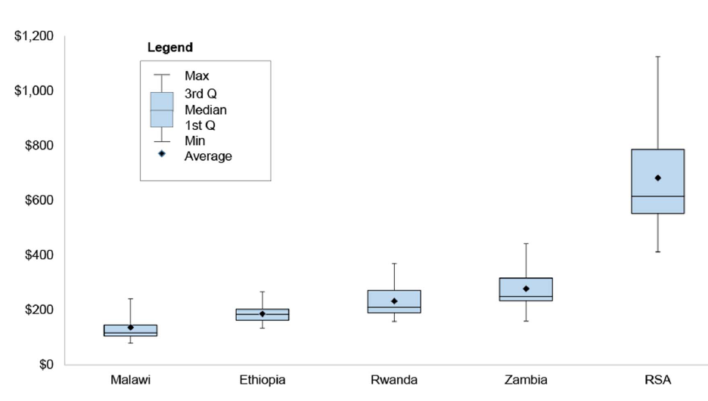
Box Plot
Tagar et al. PLOS ONE, 2014

Slide 28
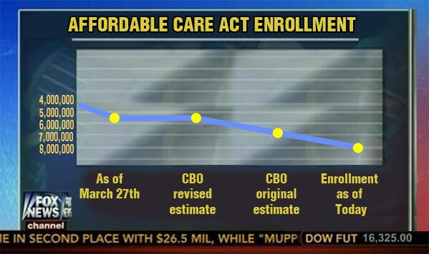
Graphics: Responsibility
Graphics are powerful – with great power comes great responsibility
Courtesy: Fox News, 5/3/2014

Slide 29
Summary
Examine data and the hoped for message it will convey
Choose graphical display based on this
Graphical excellence
Data-to-ink ratio
Eliminate unnecessary embellishments, lines, boxes, etc.
Don’t be afraid to label in order to explain:
  “To clarify, add detail”
Develop preferred formats and use them repeatedly

Slide 30
Thanks!
Happy to take any questions!

