Slide 1


REDCap
DemoNstration
Lecture
Jennifer Creasman, MSPH
Director, UCSF CTSI CS Data Management Unit
Associate Director, UCSF Women’s Health Clinical Research Center

Slide 2
Outline
How to deliver data to your statistician
REDCap Background/Advantages/Disadvantages
REDCap Overview
Creating a New Project
Adding Forms
Customizations with HTML coding
REDCap Events/Arms
Importing/Exporting Data Dictionary
Exporting raw data/Uploading existing data
Survey Feature
User Rights/Defining Groups

Slide 3
Outline
How to deliver data to your statistician
REDCap Background/Advantages/Disadvantages
REDCap Overview
Creating a New Project
Adding Forms
Customizations with HTML coding
REDCap Events/Arms
Importing/Exporting Data Dictionary
Exporting raw data/Uploading existing data
Survey Feature
User Rights/Defining Groups

Slide 4
How to Deliver Data to Your Statistician
Purpose: Avoid common pitfalls and sources of delay in the transition from data collection to data analysis!
Data delivery check list
The raw data
A tidy data set
A code book describing each variable and its values
An explicit and exact recipe on how to get from A to Z
From the Leek Group Guide to Sharing (https://github.com/jtleek/datasharing)

Slide 5
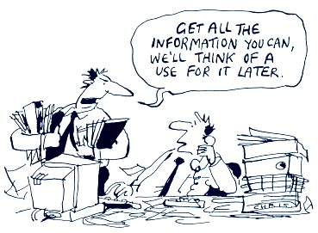
How to Deliver Data to Your Statistician: Tidy Dataset
Tidy dataset will dramatically decrease the workload of the statistician!
General Principles of a Tidy Dataset
Each variable should be in one column
Each observation should be in a different row
If you have multiple tables, each table should include a column that allows the tables to be linked
First row contains column names (not necessary, but helpful)
From the Leek Group Guide to Sharing (https://github.com/jtleek/datasharing)

Slide 6
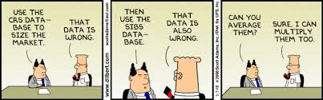
How to Deliver Data to Your Statistician: Instructions
Provide an explicit and exact recipe to get from A to Z
Instructions describing how to calculate a comprehensive score
Clear instructions on how to define calculated variables
  Primary outcome: percent change at week 12 from baseline([baseline].[leak] - [week_12].[leak])/ [baseline].[leak]
Describe how data should be summarized (i.e., take first lab chronologically before the visit)
Describe how
missing values
should be treated
Mock tables/Empty
tables shells
From the Leek Group Guide to Sharing (https://github.com/jtleek/datasharing)

Slide 7
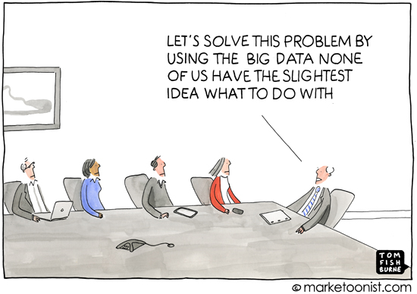
How to Deliver Data to Your Statistician: Code Book
What to include in your code book
Description of how the data was collected.
Information about the variables not included in the tidy dataset (variable label, units, response definitions, data type)
Relationships between tables
If from a questionnaire, provide
the corresponding question
From the Leek Group Guide to Sharing (https://github.com/jtleek/datasharing)

Slide 8
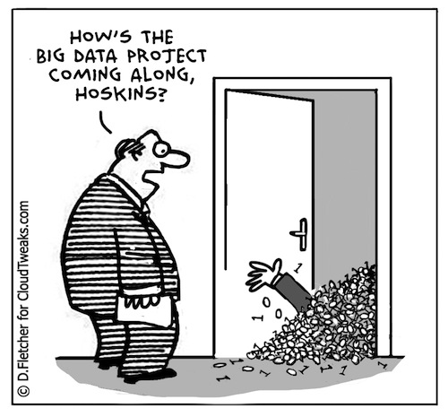
What to Expect from the Analyst
Careful inspection
  Your statistician should check your recipe, ask questions and try to confirm that they are obtaining the same answer that you are intending to get.
  Careful statisticians will perform spot checks to ensure the data are “tidy”.
Description of statistical methods
The computer code used to run the analysis
Output and figures
From the Leek Group Guide to Sharing (https://github.com/jtleek/datasharing)

Slide 9
Outline
How to deliver data to your statistician
REDCap Background/Advantages/Disadvantages
REDCap Software Overview
Creating a New Project
Adding Forms
Customizations with HTML coding
REDCap Events/Arms
Importing/Exporting Data Dictionary
Exporting raw data/Uploading existing data
Survey Feature
User Rights/Defining Groups

Slide 10
Background of REDCap
Research Electronic Data Capture
Developed by an informatics core at Vanderbilt University in 2004 to address common problems for academic biomedical research
Available free to UCSF reserachs through UCSF Academic Research Systems – https://it.ucsf.edu/services/redcap
Reference: Paul A. Harris et al. (2009). "Research electronic data capture (REDCap) – A metadata-driven methodology and workflow process for providing translational research informatics support". Journal of Biomedical Informatics 42 (2): 377–381. doi:10.1016/j.jbi.2008.08.010

Slide 11
Features of REDCap
Hosted on a secure server, maintained with nightly backups and security updates
Web-based (secure connection via internet) with several levels of permissions for users
Longitudinal Study capability
Survey capability (including automated email invitations)
Exports to common stat package formats
Audit trail for tracking data manipulation and export
Classroom and online training resources
Active user community (164,000 users)
Code book (data dictionary)
http://project-redcap.org/

Slide 12
Limitations of REDCap
Limited ways to set up relational data, flat file
Limited data management features
  - Very simple data viewing, querying capabilities
  - No data manipulation or analysis tools
Limited advanced programming features
Rigid navigation

Slide 13
Outline
How to deliver data to your statistician
REDCap Background/Advantages/Disadvantages
REDCap Software Overview
Creating a New Project
Adding Forms
Customizations with HTML coding
REDCap Events/Arms
Importing/Exporting Data Dictionary
Exporting raw data/Uploading existing data
Survey Feature
User Rights/Defining Groups

Slide 14
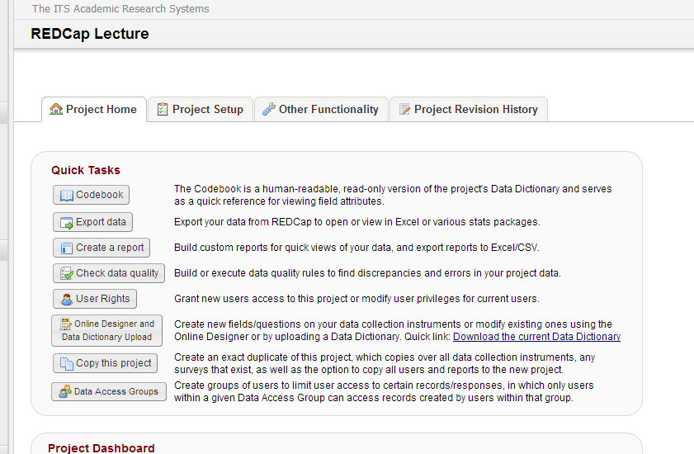
->Project Home
Quick Link Tabs
Notes:
View Codebook
Export data into .csv, .sas7bdat, .dta or .sps
Create a “simple” report
Common Data Quality/Validation Checks
Assign User Rights – Read, Write,
Design your database
Create a copy of your project
Define Data Access Groups

Slide 15
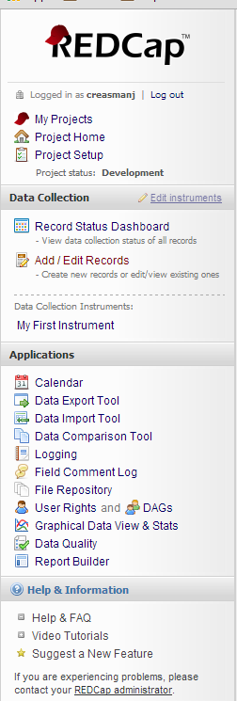
->Project Home
Quick Link Side Bar
My Projects Tab
Project Home Tab
Project Setup
~Manage Survey Participants
~Record Status Dashboard
~Add/Edit Records
~Data Collection Instruments
~Applications

Slide 16
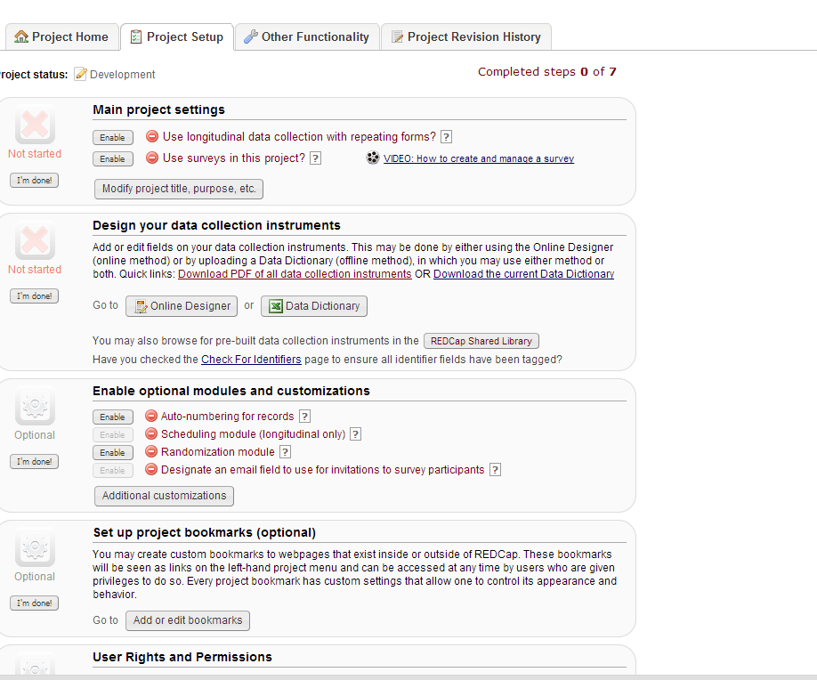
->Project Setup
Quick links
Notes:
New~ Main Project Settings
Design your database
Assign User Rights
Define Data Access Groups
~ Set up project bookmarks
~ Test your project
~ Move to projection status

Slide 17
Outline
How to deliver data to your statistician
REDCap Background/Advantages/Disadvantages
REDCap Overview
Creating a New Project
Adding Forms
Customizations with HTML coding
REDCap Events/Arms
Importing/Exporting Data Dictionary
Exporting raw data/Uploading existing data
Survey Feature
User Rights/Defining Groups

Slide 18
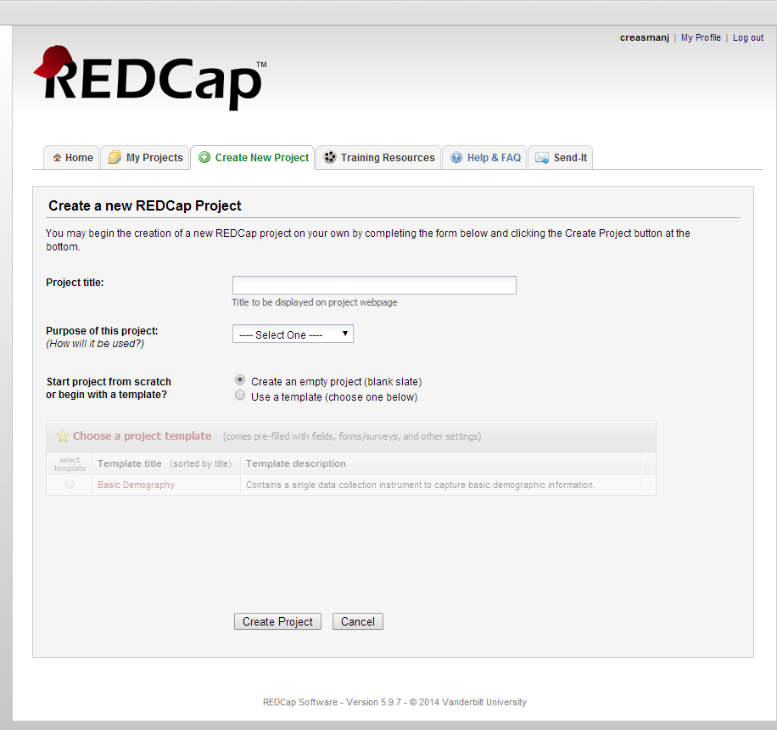
Create New Project
-> Login at https://redcap.ucsfopenresearch.org/index.php
-> Create New Project

Slide 19
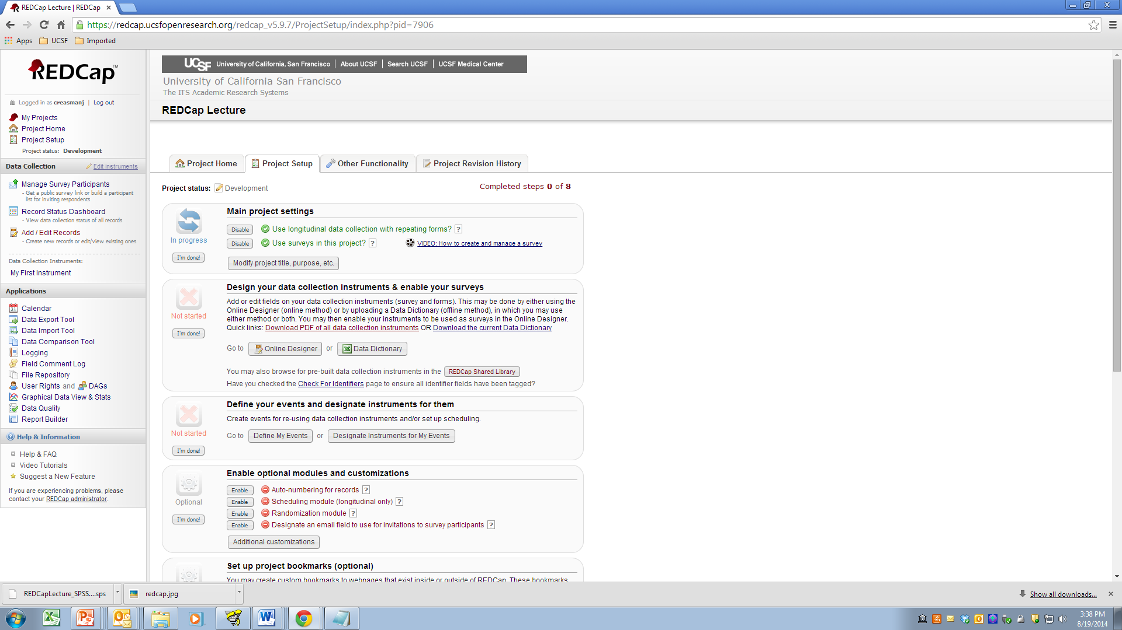
->Project Setup -> Main project Settings
REDCap has two “relational” features – Events and Arms
REDCap’s Surveys
Allows you to email participants the data collection form, similar to SurveyMonkey
Track who has viewed and completed your surveys
Send multiple emails.

Slide 20
->Project Setup -> Design your data collection instruments & enable your surveys
‘Online Designer’ to create/modify forms
‘Data Dictionary” to download or upload your data dictionary
REDCap Shared Library takes a repository of REDCap forms
‘Define My Events’ is the longitudinal/relational feature
‘Designate Instruments for My Events’ is where you choose the forms to be completed at each “event” or, in some cases, visit

Slide 21
Outline
How to deliver data to your statistician
REDCap Background/Advantages/Disadvantages
REDCap Software Overview
Creating a New Project
Adding Forms
Customizations with HTML coding
REDCap Events/Arms
Importing/Exporting Data Dictionary
Exporting raw data/Uploading existing data
Survey Feature
User Rights/Defining Groups

Slide 22
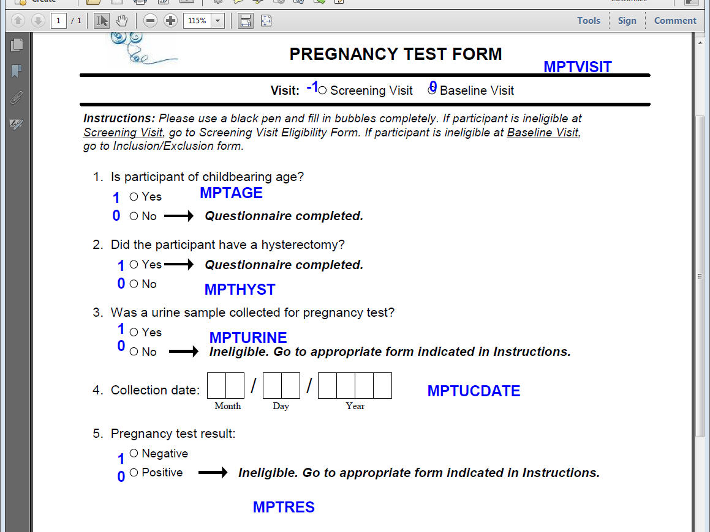
Create a Form
->Project Setup -> Online Designer
A well designed database starts with clearly marked annotated forms
Clearly label numeric values for each response
Print the variable name next to each question
Prefix your variable names to identify the form.
Include skip patterns or ‘warnings’

Slide 23
Outline
How to deliver data to your statistician
REDCap Background/Advantages/Disadvantages
REDCap Software Overview
Creating a New Project
Adding Forms
Customizations with HTML coding
REDCap Events/Arms
Importing/Exporting Data Dictionary
Exporting raw data/Uploading existing data
Survey Feature
User Rights/Defining Groups

Slide 24
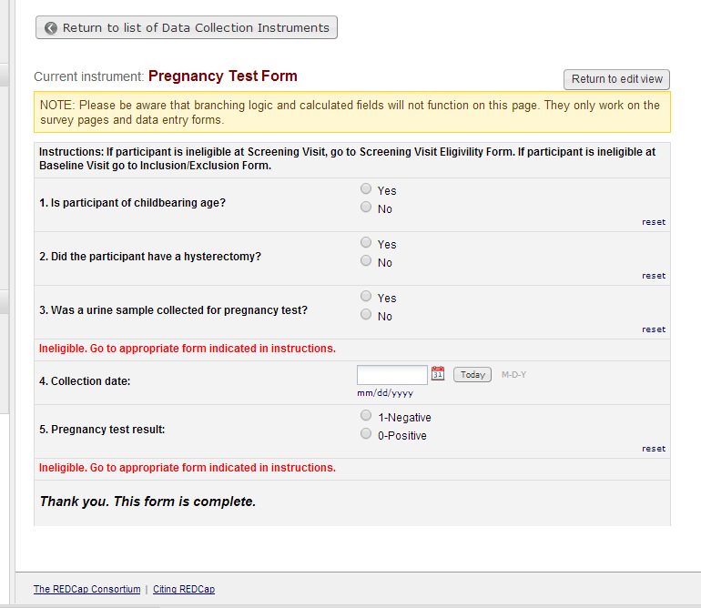
Customization with HTML coding
HTML coding examples
<FONT COLOR='#FF0000'>Ineligible. Go to appropriate form indicated in instructions.</FONT>
<p style="font-size: 125%;"><i>Thank you. This form is complete.</i></p>

Slide 25
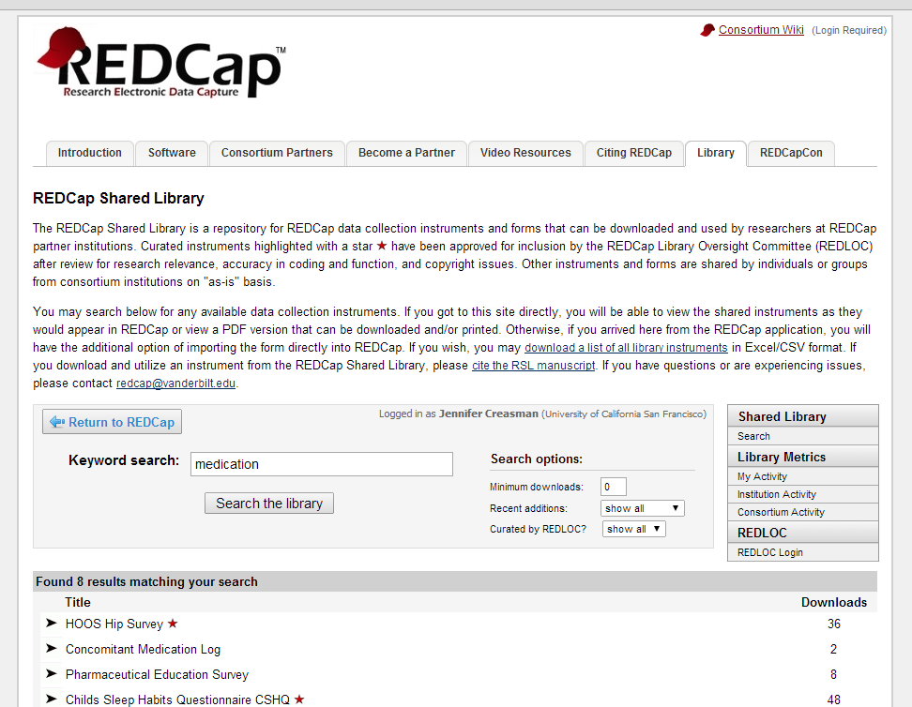
REDCap Shared Library
Demonstration: Adding forms from the REDCap Shared Library
Concomitant Medications
Adverse Events with Branching Logic

Slide 26
Outline
How to deliver data to your statistician
REDCap Background/Advantages/Disadvantages
REDCap Software Overview
Creating a New Project
Adding Forms
Customizations with HTML coding
REDCap Events/Arms
Importing/Exporting Data Dictionary
Exporting raw data/Uploading existing data
Survey Feature
User Rights/Defining Groups

Slide 27
Setting up ‘Visits’ or ‘Events’ and Multiple Arms
Create a “Visit” arm – Baseline, Week 4 and Week 12
Create a “Floating AE” arm with up to 5 AEs

Slide 28
Outline
How to deliver data to your statistician
REDCap Background/Advantages/Disadvantages
REDCap Software Overview
Creating a New Project
Adding Forms
Customizations with HTML coding
REDCap Events/Arms
Importing/Exporting Data Dictionary
Exporting raw data/Uploading existing data
Survey Feature
User Rights/Defining Groups

Slide 29
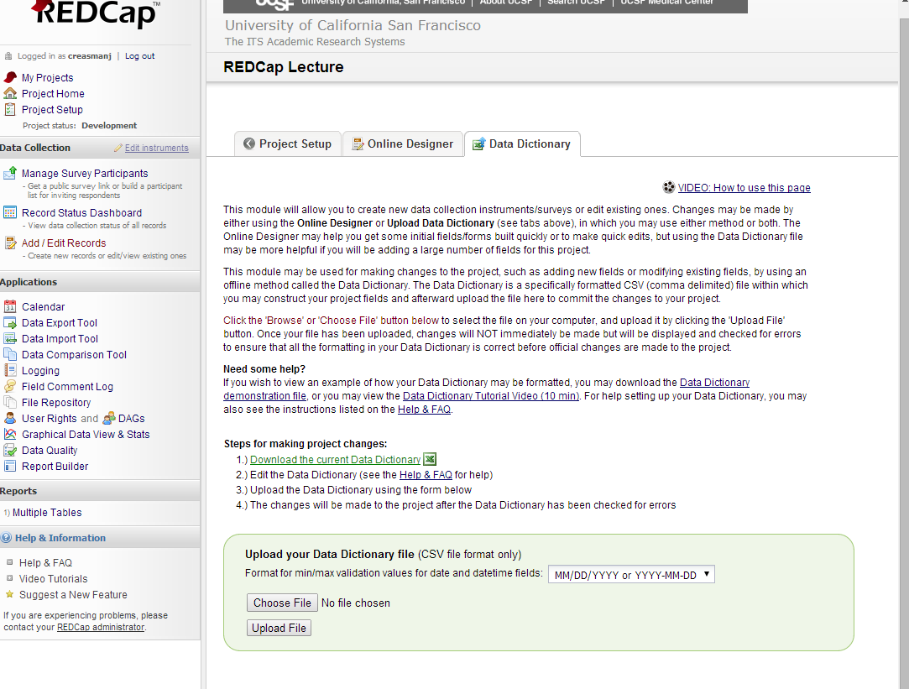
Export/Upload your Data Dictionary
Add Enrollment form from HCV study

Slide 30
Outline
How to deliver data to your statistician
REDCap Background/Advantages/Disadvantages
REDCap Software Overview
Creating a New Project
Adding Forms
Customizations with HTML coding
REDCap Events/Arms
Importing/Exporting Data Dictionary
Exporting raw data/Uploading existing data
Survey Feature
User Rights/Defining Groups

Slide 31
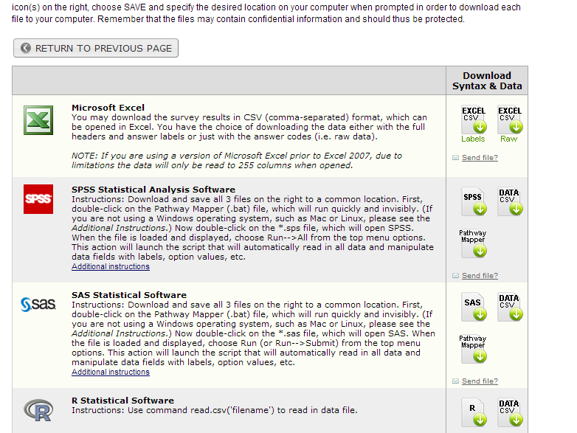
Export data/Upload data from another source
Export
*.csv Raw vs Labels
SAS files include data labels and formats
Import
Recordid must be the first variable
All data must have the same format as indicated in the data forms (variable name and values)
REDCap will provide errors if variables names or values do not match
Include “arm”, “visit” and group information

Slide 32
Outline
How to deliver data to your statistician
REDCap Background/Advantages/Disadvantages
REDCap Software Overview
Creating a New Project
Adding Forms
Customizations with HTML coding
REDCap Events/Arms
Importing/Exporting Data Dictionary
Exporting raw data/Uploading existing data
Survey Feature
User Rights/Defining Groups

Slide 33
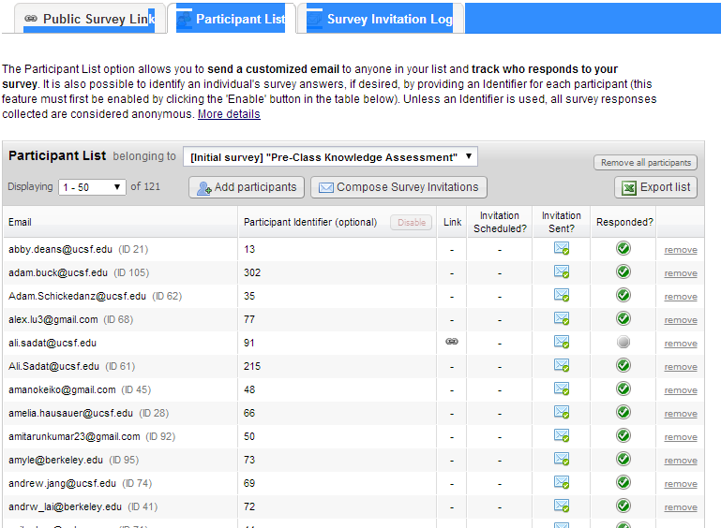
Survey feature:
Managing Participant Surveys
On-line Learning example
Invite participants
Track with a ID number (not the same as the Recordid)
Unique link for each participant
Track response (opened, started, completed)
Automated survey invitations (based on some criteria) send surveys

Slide 34
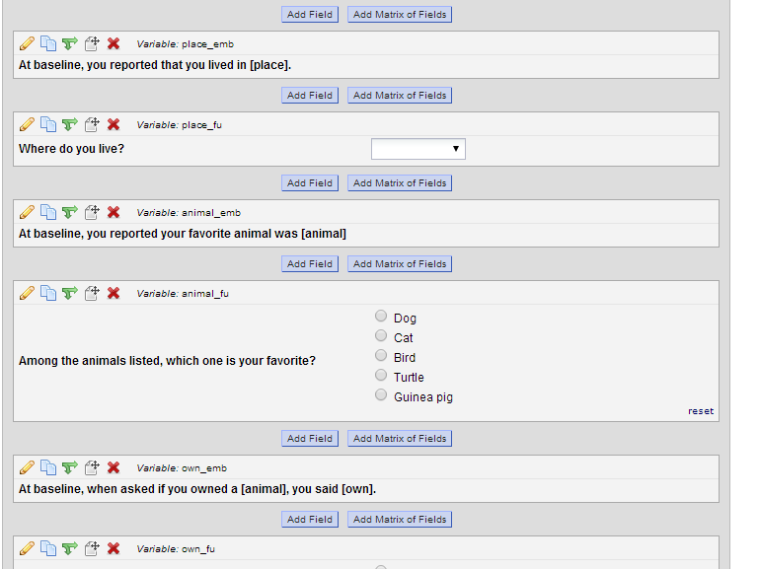
Piping Example
For database with multiple events you can specify the event [baseline][place].

Slide 35
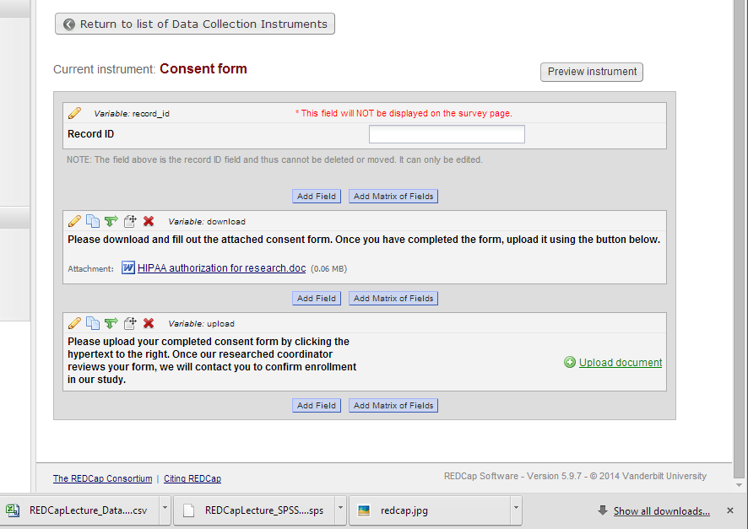
Uploading forms
Consent
Participants can upload a file to survey

Slide 36
Outline
How to deliver data to your statistician
REDCap Background/Advantages/Disadvantages
REDCap Software Overview
Creating a New Project
Adding Forms
Customizations with HTML coding
REDCap Events/Arms
Importing/Exporting Data Dictionary
Exporting raw data/Uploading existing data
Survey Feature
User Rights/Defining Groups

Slide 37
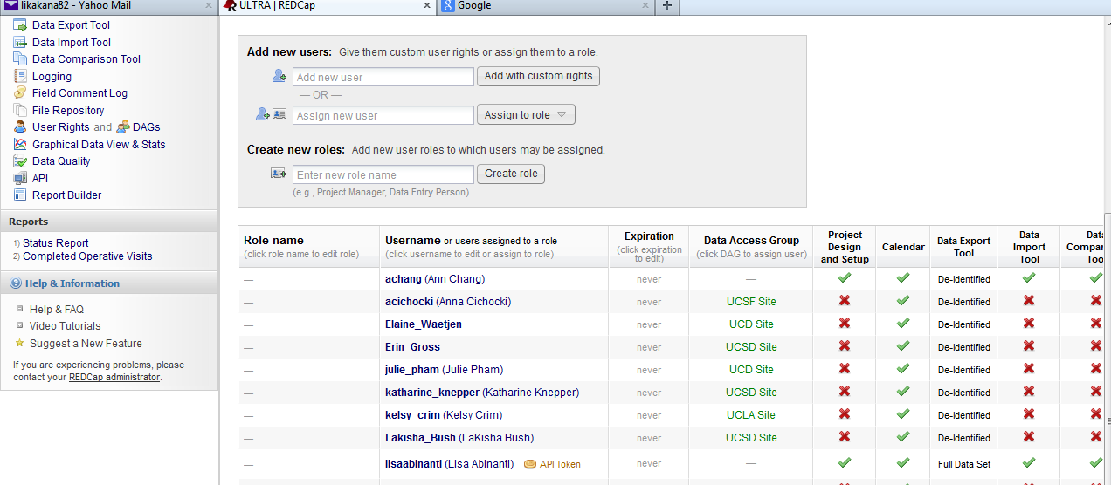
User Rights/Defining Groups

Slide 38
Additional REDCap Training Opportunities
Advance registration is required
Please login to the UCSF Learning Management System to register for a webinar or instructor-led training: https://learningcenter.ucsfmedicalcenter.org/
Class | Date | Time | Type
REDCap 101 | August 20, 2014 | 10:00 to 11:30 | Instructor led
REDCap 202 | August 20, 2014 | 1:00 to 2:30 | Instructor led
MyResearch | August 13, 2014 | 9:30 to 11:00 | Webinar
MyResearch | August 27, 2014 | 1:00 to 2:30 | Instructor led
Class | Date | Time | Type
REDCap 101 | September 3, 2014 | 8:30 to 10:00 | Webinar
REDCap 202 | September 3, 2014 | 10:30 to 12:00 | Webinar
REDCap 101 | September 23, 2014 | 10:00 to 11:30 | Instructor led
REDCap 202 | September 23, 2014 | 1:00 to 2:30 | Instructor led
MyResearch | September 4, 2014 | 9:30 to 11:00 | Webinar
MyResearch | September 24, 2014 | 1:00 to 2:30 | Instructor led

