Slide 1
Overview of a K-award
Sarah Woolf-King, Ph.D., M.P.H.
TAPS Seminar May 8th, 2012

Slide 2
Helpful K info
K-Kiosk: Which K award is right for you?
  http://grants.nih.gov/training/careerdevelopmentawards.htm
http://accelerate.ucsf.edu/training/K-grant-writing
Salary and budget:
  http://grants1.nih.gov/grants/guide/contacts/parent_K23.html
Example Program Announcement (PA-14-049) for K23
  http://grants.nih.gov/grants/guide/pa-files/PA-14-049.html
Use the SF424 (R&R) application guide including the Supplemental Instructions to the SF424 (R&R) for Preparing an Individual Research Career Development Award (CDA) Application ("K" Series)
  Begin on p. I-157

Slide 3
K award types
K01: Mentored Research Scientist Development Award
  For supervised career development experience in the biomedical, behavioral, or clinical sciences leading to research independence
K23: Mentored Patient-Oriented Research Award
  To support the career development of individuals with a clinical doctoral degree who have made a commitment to focus their research endeavors on patient-oriented research
K99/R00: Pathway to Independence Award
  Must currently be in a mentored, postdoc training position with no more than 4 years of postdoc experience
  5 years of support in 2 phases
    At least 1 year (up to 2) at “K” phase
    Up to 3 years of “independent research support” in R phase
      R phase contingent on “satisfactory progress in K phase & approved, independent, tenure-track (or equiv) faculty position.
    Budget during R phase is 249,000/year
  There is no citizenship requirement for K99 applicants.

Slide 4
K award types cont’d
K25: Mentored Quantitative Research Development Award
  Provides support and “protected time” for a period of supervised study and research for productive professionals with quantitative (e.g., mathematics, statistics, economics, computer science, imaging science, informatics, physics, chemistry) and engineering backgrounds to integrate their expertise with NIH-relevant research.
K08: Mentored Clinical Scientist Research Career Development Award
  This program represents the continuation of a long-standing NIH program that provides support and “protected time” to individuals with a clinical doctoral degree for an intensive, supervised research career development experience in the fields of biomedical and behavioral research, including translational research. If doing patient-oriented research, refer to K23.

Slide 5
Sections of a K-app

Slide 6
Sections of a K-app
Cover Letter (1 page)
Project Summary/Abstract (1 page)
Facilities and Other Resources
Other Attachments
Biosketches
Budget & Budget Justification (no limit)
Letters of References (3-cannot be from sponsors)
PHS 398 Forms
Section 2: Candidate Background (1 page)
Section 3: Career goals and Objectives (.5 page)
Section 4: Career Development Activities During Award Period (1.5 pages)
Section 5: Training in Responsible Conduct of Research (1 page)
Section 7: Plans & Statements of Mentor and Co-mentor (6 pages)
Section 8: Letters of support from collaborators, contributors, and consultants (6 pages)
Section 9: Description of Institutional Environment (1 page)
Section 10: Institutional Commitment (1 page)
Section 11: Specific Aims (1 page)
Section 12: Research Strategy (9 pages)
Section 14: Protection of Human Subjects (no limit)
Section 15: Inclusion of women and minorities (1 paragraph)
Section 16: Inclusion of Children (1 paragraph)
Sections 17-21: Other sections (Vertebrate animals, Select agent research, Contractual agreements, Resource sharing plan, Appendix)

Slide 7
Cover Letter-Same as F31
List referees (name, dept affiliation, & institution) that is included in the Other Project Information Form.
Can also include info in section I.4.2., e.g.,
  Applicant information
  Name of Federal Agency
  Title of project
  FoA
  Institute/center you want grant assigned to
  Scientific Review Group (SRG) want assigned to

Slide 8
“Other Project Information Form”
Project Summary/Abstract (1 page; I-162)
  Abstract of entire application (candidate, environment, & research).
  Candidate immediate & long-term career goals, key elements of career development plan, and description of research project.
Facilities and Other Resources
  Detailed description of the institutional facilities and resources available to the candidate. Of “major importance” in establishing feasibility of activities.
Other attachments
  List of references (also include in cover letter).

Slide 9
Biosketches
For K applicant (directions from SF424, I-163):
  Personal Statement:
    Briefly describe why your experience and qualifications make you particularly well-suited to receive the K award for which you are applying.
    The relevant factors may include aspects of your training; your previous experimental work on this specific topic or related topics; your technical expertise; your collaborators or scientific environment; and your past performance in this or related fields (you may mention specific contributions to science that are not included in Section C).
    Also, you may identify up to four peer reviewed publications that specifically highlight your experience and qualifications for this project.
    If you wish to explain impediments to your past productivity, you may include a description of factors such as family care responsibilities, illness, disability, and active duty military service.
  Contributions to science
    Up to 5; half page for each. Provide URL to full list of published work.
Must also include biosketches for all Key Personnel (e.g., mentors, scientific advisors).

Slide 10
Letters of reference
At least 3, but no more than 5
From individuals not directly involved in the application (cannot be from mentor)
Include name and contact info for references in “Other Attachments” in “Other Project Information Form” (see section 7.4.3 of Supplemental instructions) as well as in Cover Letter
Should address candidates “competence” & “potential” to become independent investigator
Due on application deadline
Submitted directly through ERA commons

Slide 11
Budget and Budget Justification
Budget
Budget Justification
Instructions on p.174 (I-166)
Only R&R budget form applicable, and only few categories used (RSC will help with this)
Senior/Key person: Candidate only
Other Direct costs
  Only part you have say over
  The 25-50K in research devel & othe costs (see IC for specific amt)
Indirect costs: set at 8%
Provide a detailed description and justification for specific items within the Research Development Support costs;
e.g., all equipment, supplies, and other personnel that will be used to help achieve the career development and research objectives of this award.

Slide 12
PHS 398 Forms (p. 177, I-169)
PHS 398 Cover Page Supplement (I.5.3): this supplements the data requirements in the SF 424 R&R Form. Follow the instructions found in Part I.5.3 and in the K specific instructions below.
{PHS 398} Planned Enrollment Report and Cumulative Inclusion Enrollment Report Follow the instructions found in Part I. 5.8.
PHS 398 Career Development Award Supplemental Form (I.7.5)

Slide 13
Candidate Information: Sections 2-4
Combined with Research Strategy is 12 pages and includes the following:
  Candidate’s Background
  Career Goals and Objectives
  Candidate’s Plan for Career Development/Training Activities During Award Period

Slide 14
*Candidate Background
  Instructions: p. 181 (I-173)
  Typically 1 page
  “Provide any additional information not described in the Biographical Sketch Format Page such as research and/or clinical training experience.”
  Like an academic narrative- Highlight your research and academic experiences to-date, what inspired you.
  Also highlight your training needs.
  Example

Slide 15
*Career Goals and Objectives
Typically 1-2 paragraphs
  Describe where you want to be at end of proposal period
  “My long term goal is to become….”
  What are the “challenges” or training “deficits” you’d like to address?
“Describe your past scientific history, indicating how the award fits into past and future research career development. If there are consistent themes or issues that have guided previous work, these should be made clear; if your work has changed direction, the reasons for the change should be indicated. It is important to justify the award and how it will enable you to develop or expand your research career. You may include a timeline, including plans to apply for subsequent grant support.”

Slide 16
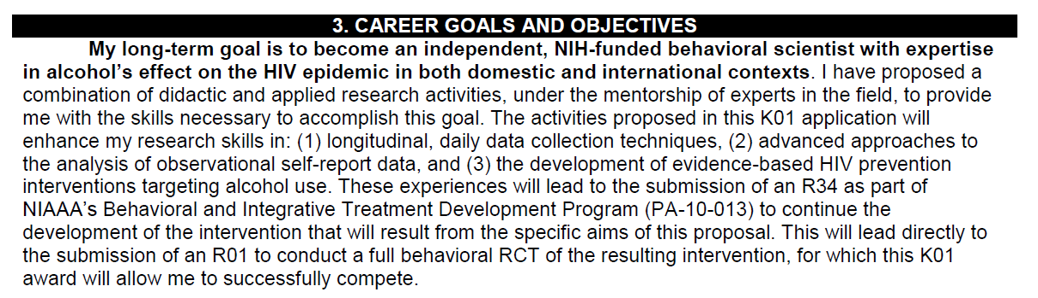
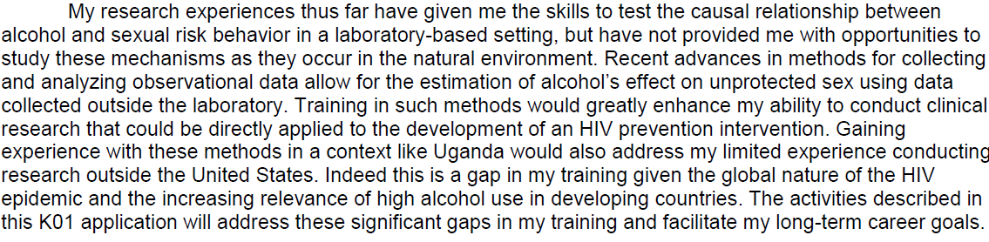
Candidate Background &
Career Goals/Objectives: Example

Slide 17
Candidate’s Plan for Career Development/Training Activities During Award Period
1-2 pages
Like a specific aims for training-should map on to your research aims
Describe in detail how you will gain this training, such as through specific courses, individualized tutorials, or practical experience gained from conducting the research.
“Stress the new enhanced research skills and knowledge you will acquire as a result of the proposed award. If you have considerable research experience in the same areas as the proposed research, reviewers may determine that the application lacks potential to enhance your research career. For mentored awards, describe structured activities, such as course work or technique workshops, which are part of the developmental plan. If course work is included, provide course numbers and descriptive titles. Briefly discuss each of the activities, except research, in which you expect to participate. Include a percentage of time involvement for each activity by year, and explain how the activity is related to the proposed research and the career development plan. “
Sample Format
  Description of the training aim
  Didactic Training (coursework, workshops, etc)
  Practical Training (mentorship, applied research activities)

Slide 18
Training in Responsible Conduct of Research: Section 5
Instructions on p. 184 (I.176)
1 page
Should document prior instruction in RCR training during current career stage (including data instruction was last completed), and propose plans to meet the once every 4 year requirement.
How you will incorporate the 5 instructional parts outlines in NIH policy on Instruction in RCR: format, subject matter, faculty participation, duration and frequency.
Can include individualized instruction or independent scholarly activities that will enhance applicant’s understanding of ethical issues related to the specific research activities and societal impact of the research.
Role of mentor in RCR must be described.

Slide 19
Plans and Statements of Mentors/Co-mentors: Section 7
P. 186 (I-178); 6 pages
Mentor must explain how he/she will contribute to candidate’s research career, which should include:
  Plan for training and research
  Source of anticipated support for research project
  Nature and extent of supervision and mentoring
  Anticipated teaching load/clinical responsibilities
  Plan for transitioning candidate from mentored to independent researcher
Must include all mentors and SAs
  Must be clear exactly how each mentor is contributing
  Primary mentor(s) statements should be longest
  Be prepared to write most of these
  These are separate from letters of recommendation!
Can Include table describing mentor contributions

Slide 20
Letters of support from contributors, collaborators, & consultants: Section 8
P. 187 (I-179); 6 pages
All mentored career development award applications should identify any and all collaborators, contributors, and consultants involved with the proposed research and career development program not already included in Item 7.
Letters should briefly describe their anticipated contributions and document their role and willingness to participate in the project

Slide 21
Description of Institutional Environment: Section 9
P. 188 (I-180)
“The sponsoring institution must document a strong, well-established research program related to the candidate's area of interest, including the names of key faculty members relevant to the candidate's proposed developmental plan.
Referring to the resources description (See section 4.4.10 Facilities and Other Resources), indicate how the necessary facilities and other resources will be made available for career enhancement as well as the research proposed in this application.
Describe opportunities for intellectual interactions with other investigators, including courses offered, journal clubs, seminars, and presentations.”

Slide 22
Institutional Commitment: Section 10
Institutional Commitment
  P. 189 (I-181); 1 page
  Letter expressing UCSF’s: “commitment to the candidate and the candidate’s career development, independent of the receipt of the CDA.”
  Carefully worded: “We expect to appoint Dr. Woolf-King full-time as an Assistant Professor …”
  Signed by Chair of Dept of Medicine and Chief of your Department (e.g., Steve Morin)

Slide 23
Sections 11 & 12
Specific Aims
Research Plan: p. 179 (I-171)
  “Major part of career development plan”; “important to relate the research to the candidate’s career goals”; how will research “provide the experience, knowledge & skills necessary to achieve the objectives of the CDP and launch an independent research career”
  Significance & Innovation (1 page)
  Approach
    Background
      1 page; present conceptual model; don’t be redundant with Sig & Inn
    Preliminary Studies
      What research have you done that is directly relevant to research proposed in K
    Methods
      May be helpful to organize by Aims
    Future Directions and Timeline
      Be specific; make argument for 5 years of funding

Slide 24
Research Plan format Example
Setting
Study Population
Specific Aim 1 (repeat for each aim)
  Rationale & Design
  Hypotheses
  Measures
  Procedures
  Data Analysis and Management
  Potential Problems and Alternative Strategies
Future Directions and Timeline

Slide 25
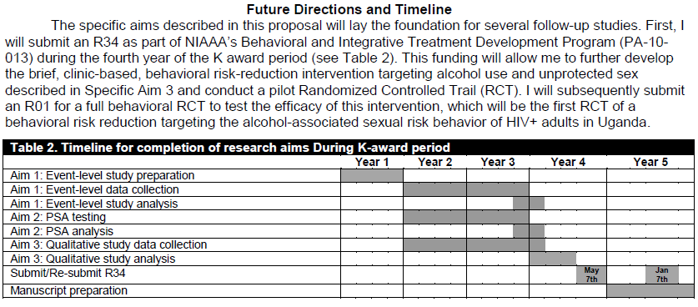
Future Directions & Timeline: Example

