Slide 1


Slide 2
Advanced Techniques for Meta-Analysis
Survival Analysis
Diagnostic Tests & ROC curves
Indirect Meta-Analysis
Network Meta-Analysis
Meta-Regression

Slide 3
Survival Analyses
Reconstruct actuarial life tables
- impute interim timepoints
Reconstruct log rank statistics
- need p-values
Deconstruct survival curves
- using a ruler, ‘graph mapping software’
Combine into meta-analysis of median survival time

Slide 4
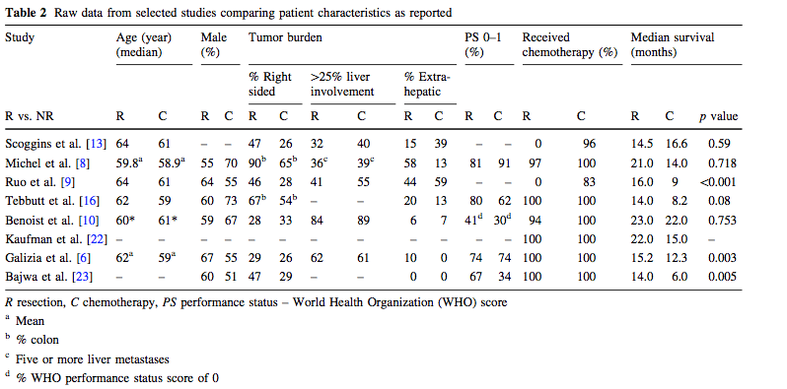
Survival Analyses
Meta-Analysis of Survival of Patients with Stage IV Colorectal Cancer Managed with Surgical Resection Versus Chemotherapy Alone P. Stillwell • P. G. Buettner • Y-H. Ho World J Surg (2010) 34:797–807

Slide 5
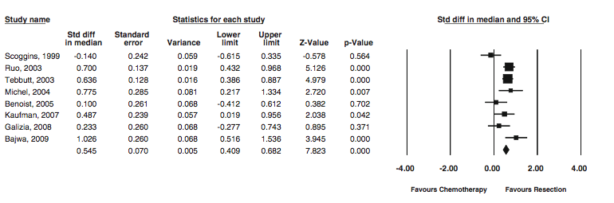
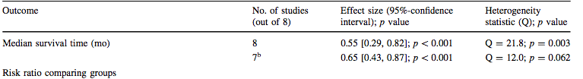
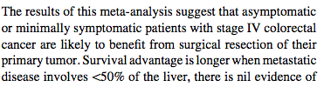
Survival Analyses
Sensitivity Analysis of Heterogeneity

Slide 6
Diagnostic Studies
Objective may be diagnosis, imaging modalities,
evaluation vs. a gold standard
Studies may use different thresholds
- compute 2 x 2 tables for each study
Compare areas under the ROC curve using logit models

Slide 7
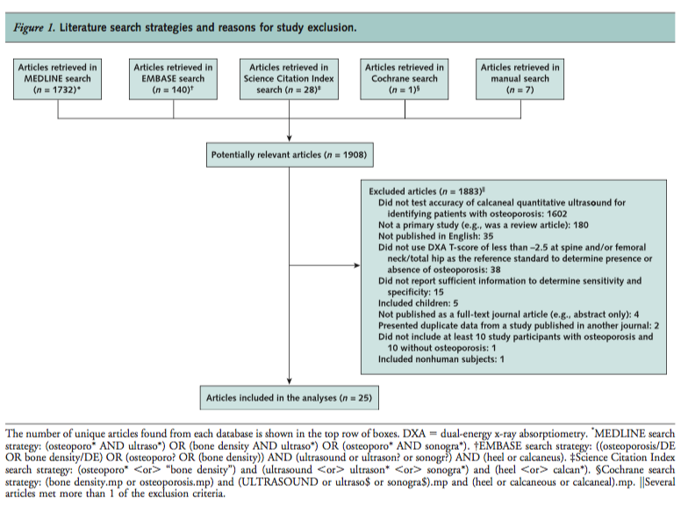
Diagnostic Studies
Meta-Analysis: Accuracy of Quantitative Ultrasound for Identifying Patients with Osteoporosis Smita Nayak, MD; Ingram Olkin, PhD; Hau Liu, MD, MPH, MBA; Michael Grabe, PhD; Michael K. Gould, MD, MS; I. Elaine Allen, PhD; Douglas K. Owens, MD, MS; and Dena M. Bravata, MD, MS
6 June 2006 Annals of Internal Medicine Volume 144 • Number 11

Slide 8

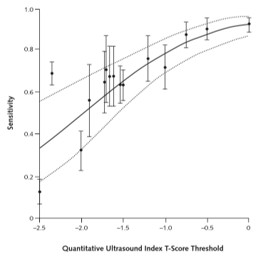
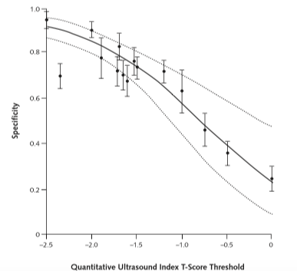
Diagnostic Studies

Slide 9
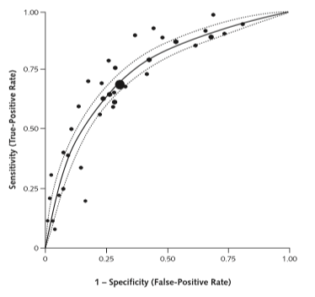
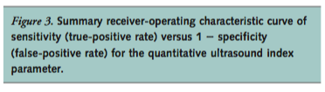
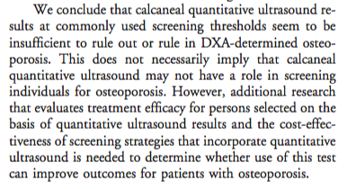
Diagnostic Studies

Slide 10
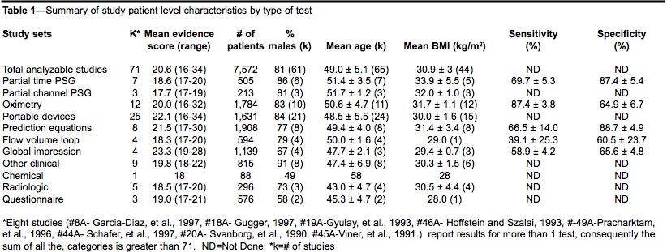
Diagnostic Studies
Systematic Review and Meta-analysis of the Literature Regarding the Diagnosis of Sleep Apnea Susan D. Ross MD, FRCPC, Iris A. Sheinhait MA, Katherine J. Harrison BA,Marion Kvasz MD, MPH, Janet E. Connelly BS, Steven A. Shea PhD, and I. Elaine Allen PhD SLEEP, Vol. 23, No. 4, 2000

Slide 11
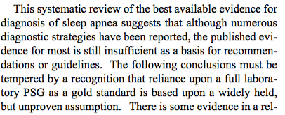
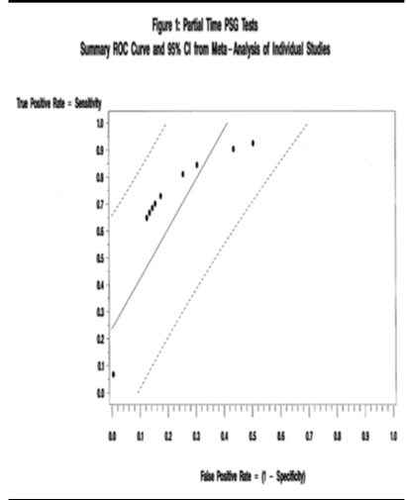
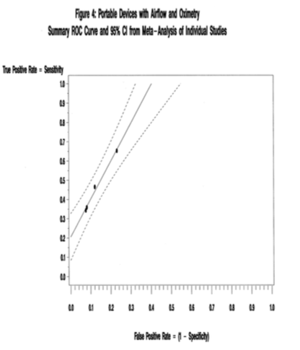
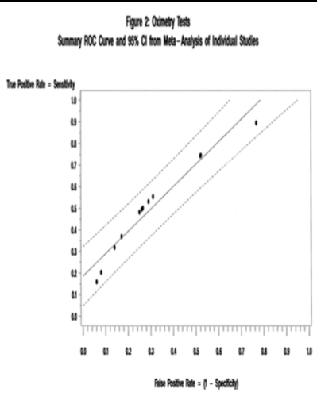
Diagnostic Studies

Slide 12
Evaluating Indirect Effects
Evidence includes studies of two treatments:
  comparing one to the other
  comparing each to a placebo
  comparing each to a third comparator
  or any combination of these

Slide 13
Evaluating Indirect Effects
Estimating Missing Effect Sizes
TYPE OF INTERVENTION
Standard Type1 Type2 Type3
Region
A X X X
E X X X
T X X

Slide 14
Testing Treatment Differences in Placebo Controlled Studies
Evaluating Indirect Effects
Outcomes at 30 Days Composite (Death or MI)
Study Drug # of Patients # Studies Odds Ratio 95% CI
Drug A 9,606 5 0.45 (0.37, 0.55)
Drug E 5,834 4 0.82 (0.69, 0.98)
Drug T 3,634 3 0.73 (0.57, 0.92)

Slide 15
Evaluating Indirect Effects
Testing Treatment Differences in Placebo Controlled Studies
One-way ANOVA comparing treatments:
Drug A vs. Drug E p < 0.001
Drug A vs. Drug T p < 0.01
Drug E vs. Drug T p > 0.05

Slide 16
Evaluating Indirect Effects
Network Meta-analyses & Hierarchical Modeling
Evidence includes studies of two treatments:
  comparing one to the other
  comparing each to a placebo
  comparing each to a third comparator

Slide 17
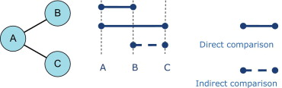
Types of Indirect Effects (1)
Similarity assumption in an indirect treatment comparison. AB trials and the AC trials are comparable on effect modifiers, and an unbiased indirect estimate for the relative effect of C versus B can be obtained from the estimates of the effect of B ...
Jeroen P. Jansen , Rachael Fleurence , et al, Value in Health, Volume 14, Issue 4, 2011, 417 - 428

Slide 18
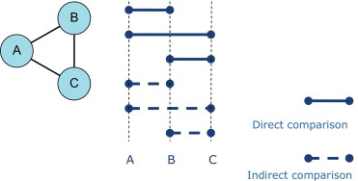
Types of Indirect Effects (2)
Consistency assumption in a mixed treatment comparison. AB trials, AC trials, and BC trials are comparable in effect modifiers, and for each pairwise comparison, the direct and indirect estimates are consistent.
Jeroen P. Jansen , Rachael Fleurence , et al, Value in Health, Volume 14, Issue 4, 2011, 417 - 428

Slide 19
Estimating Missing Effect Sizes With Complete Patient Data
Evaluating Indirect Effects, Network Meta-analyses & Hierarchical Modeling
Use Hierarchical Modeling Techniques
y_{ijk} = m_{i} + t_{i} + L_{j} + R(L)_{jk} + (tL)_{ij} + e_{ijk} ,
where y_{ijk} is the outcome for the ijk^{th} patient
m_{i} is the i^{th} intervention mean
t_{i} is the intervention effect
L_{j} is the region effect

Slide 20
Estimating Missing Effect Sizes With Complete Patient Data
Testing the Hierarchical Model.
R(L)_{jk} is the effect of subject within a region.
(τL)_{ij} is the intervention-by-region effect.
e_{ijk} is the error and the k-subscript indicates patient within region.
Intervention effects are then tested using,
F = MS(intervention) MS(region*intervention).

Slide 21
Meta-Regression
Subgroup analyses
Examining the control rate
Identification of important covariates
Control for baseline differences
Control for bias or sponsorship
Control for heterogeneity

Slide 22
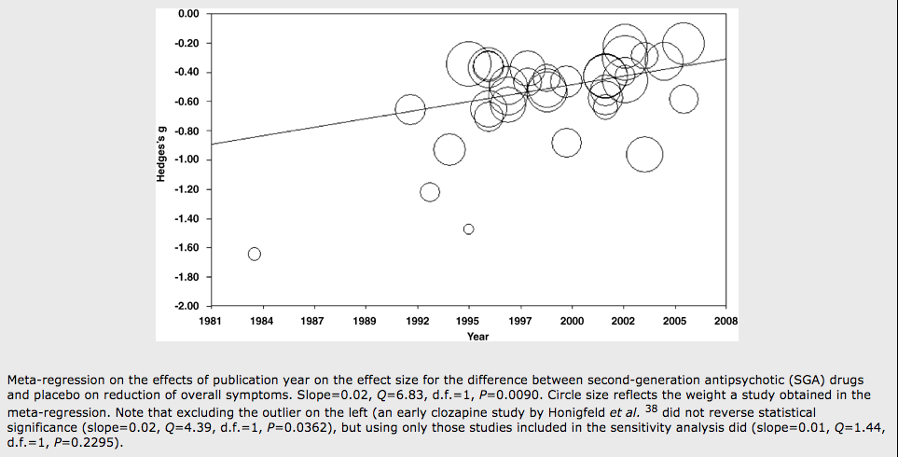
Meta-Regression
Only appropriate in meta-analyses of 10 or more studies
The outcome is the effect estimate
Predictors are characteristics of study design
How effective are second-generation antipsychotic drugs? A meta-analysis of placebo-controlled trials S Leucht, D Arbter, R R Engel, W Kissling & J M Davis, Moleular Psychiatry , 2008

Slide 23
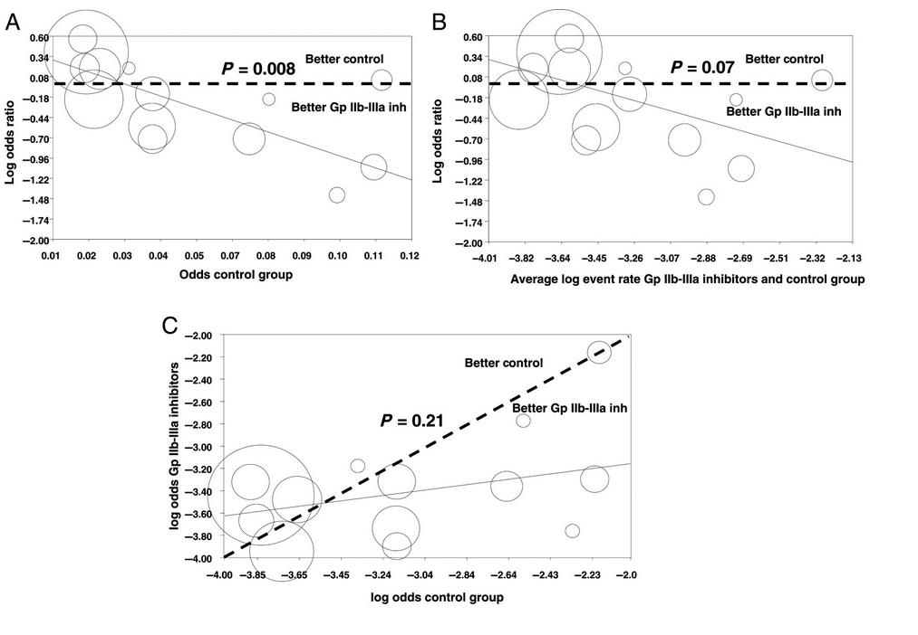

Risk profile and benefits from Gp IIb-IIIa inhibitors among patients with ST-segment elevation myocardial infarction treated with primary angioplasty: a meta-regression analysis of randomized trials Giuseppe De Luca , Eliano Navarese , Paolo Marino European Heart Journal October 2009
Meta-Regression

Slide 24


Slide 25
Special Issues in Meta-Analysis
Meta-Analysis of transition probabilities
Meta-Analysis of rates
Pharmocoeconomic Meta-Analysis
Meta-Analysis of zero events

Slide 26
Markov Chain Meta-Analyses
Where is it being applied?
Policy analyses in mental health
-modeling transition probabilities within a mental health system
-probability of transition to outpatient or readmission
Genome analyses
-modeling likelihood of gene pairings

Slide 27
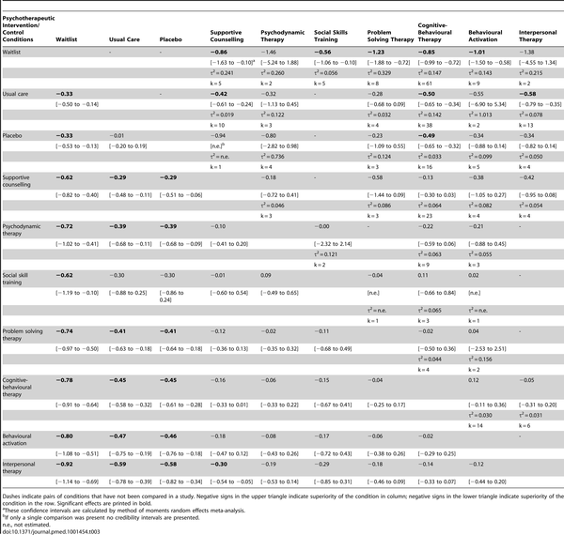
Markov Chain Meta-Analyses
Relative effect sizes (and 95% credibility intervals)
of psychotherapeutic interventions
Barth J, Munder T, Gerger H, Nüesch E, et al. (2013) Comparative Efficacy of Seven Psychotherapeutic Interventions for Patients with Depression: A Network Meta-Analysis. PLoS Med 10(5): e1001454. doi:10.1371/journal.pmed.1001454
http://www.plosmedicine.org/article/info:doi/10.1371/journal.pmed.1001454

Slide 28
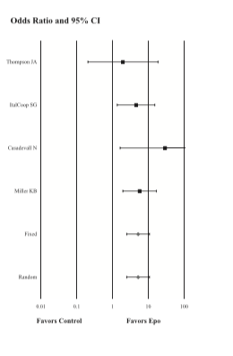
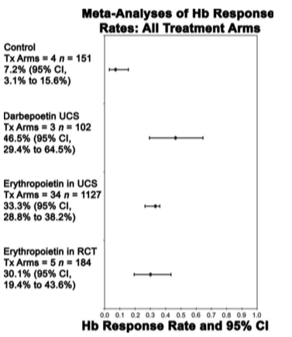
Meta Analysis of Rates
Efficacy and Safety of Erythropoiesis-Stimulating Proteins in Myelodysplastic Syndrome: A Systematic Review and Meta-Analysis Susan D. Ross, I. Elaine Allen, Corey A. Probst, Brian Sercus, Sheila M. Crean and Gayatri Ranganathan Oncologist 2007;12;1264-1273

Slide 29
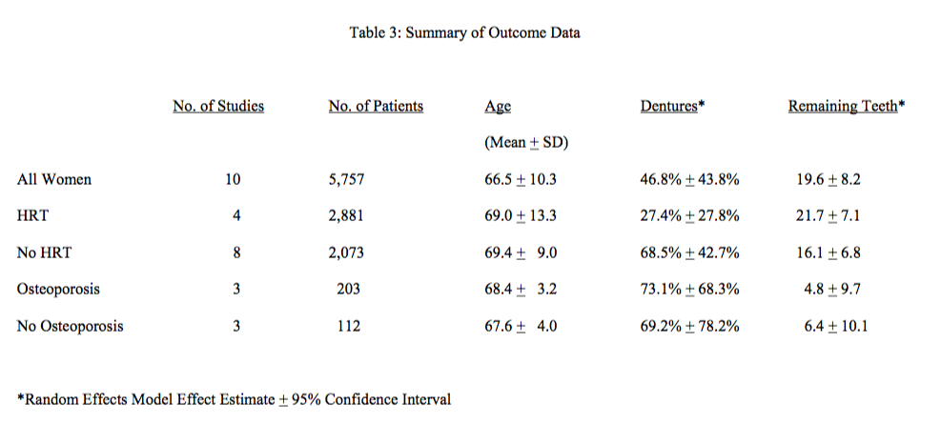
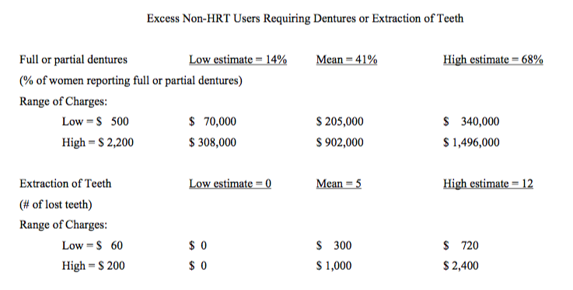
Pharmacoeconomic Meta-Analysis
Effect of postmenopausal hormone replacement therapy on dental outcomes: systematic review of the literature and pharmacoeconomic analysis.
Allen IE, Monroe M, Connelly J, Cintron R, Ross SD. Managed Care Interface, 2000
Overall, the annualized excess cost associated with these two dental outcomes in non-HRT users is estimated to be between $ 14,000 and $ 300,000 with a mean of $ 100,000 per thousand untreated postmenopausal women per year.

Slide 30
What to do with zero events?
Bracco v. Amersham (X-Ray Contrast Media)
Dueling Marketing Claims each based on a meta-analysis
Re-analysis of both meta-analyses by each company
Most fun: Teaching the judge (she was an English major) about statistics, odds ratios, meta-analyses, and Bayes

Slide 31
What to do with zero events?
Renal Safety of Iodixanol(IOCM) v. Iopamidol (LOCM) on the incidence of Contrast Induced Nephropathy
Fixed effects models
Per protocol analysis
Omits 6 studies with zero outcomes

Slide 32
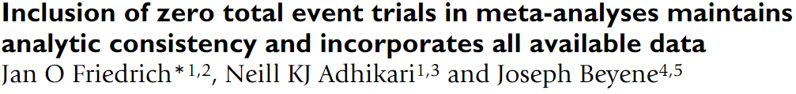
What to do with zero events?
Reanalysis using all the studies, intent-to-treat population, and random-effects models

Slide 33
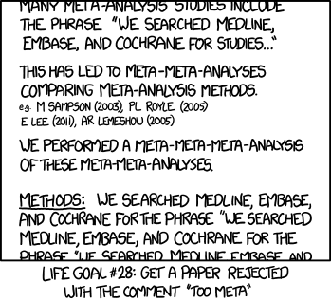
Questions? Final Thoughts?
*
*xkcd

