Slide 1
Multi-level Etiologies of Health Disparities:
Behavioral
Irene Yen, PhD, MPH
Associate Professor

Slide 2
Median household wealth – 2011 update
White household - $111,146
Black - $7,113
Latino - $8,348

Slide 3
NYT – April 20, 2015
New York, 120,000 black men between the ages of 25 and 54 are missing from everyday life
Chicago, 45,000
Philadelphia 30,000

Slide 4
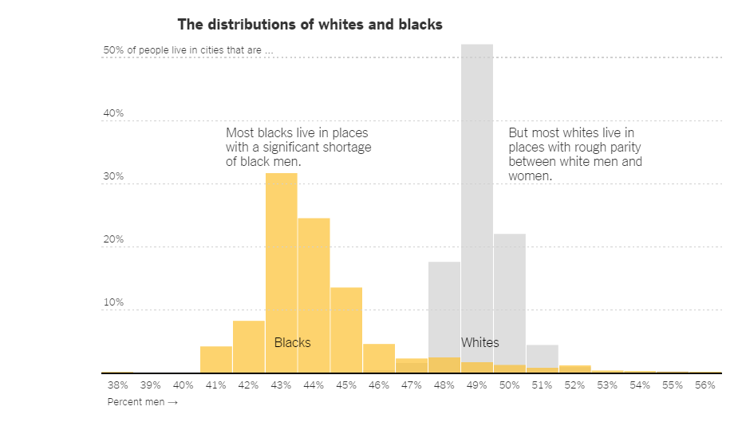

Slide 5
Improving health & reducing disparities by addressing the role of social factors
Economic & Social
Opportunities and Resources
Living & Working Conditions
in Homes and Communities
Behaviors
Medical Care
Interaction with genetic/other biological factors
HEALTH
Adapted from Braveman et al., for Robert Wood Johnson Foundation Commission to Build a Healthier America | www.commissiononhealth.org

Slide 6
Behaviors - Key messages in last week’s lecture:
  Behavioral patterns are shaped by social context
  Influence of social context on behavior can be mediated by physiologic changes that occur in response to environmental stimuli (epigenetic regulation, neurological development)
  The biological embedding implies that environmental causes may be relevant at developmentally specific ages

Slide 7
Objectives
Behavioral determinants
  Tobacco
  Diet
  Physical activity
  Alcohol / Drugs
  self control / self regulation

Slide 8
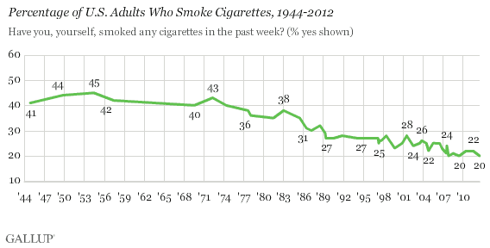
Tobacco

Slide 9
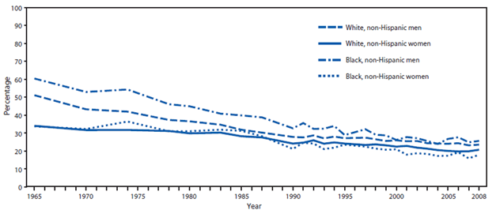
Tobacco – by race/ethnicity

Slide 10
Tobacco – by education

Slide 11
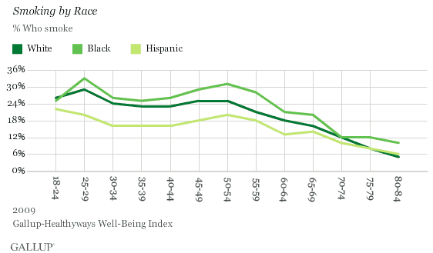
Tobacco

Slide 12
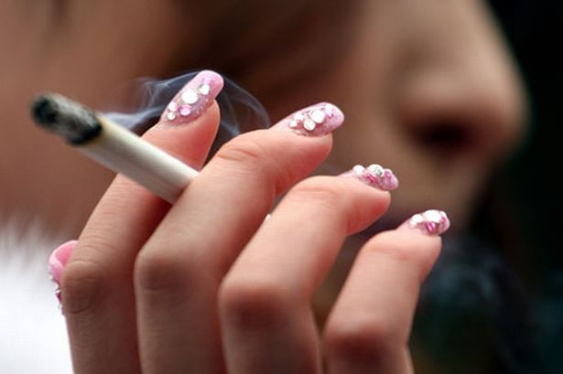
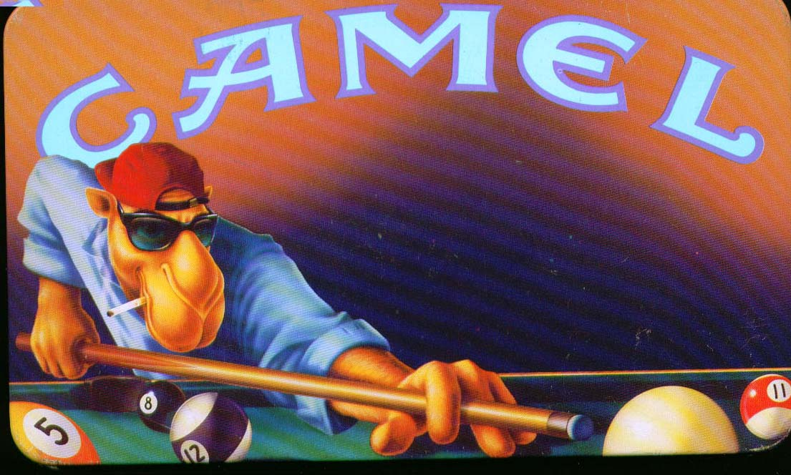
Tobacco
9 out of 10 smokers start smoking by age 18
99% of smokers start smoking by age 26

Slide 13

Notes:
Keira Kneightly (“Domino”) – example of product placement

Slide 14
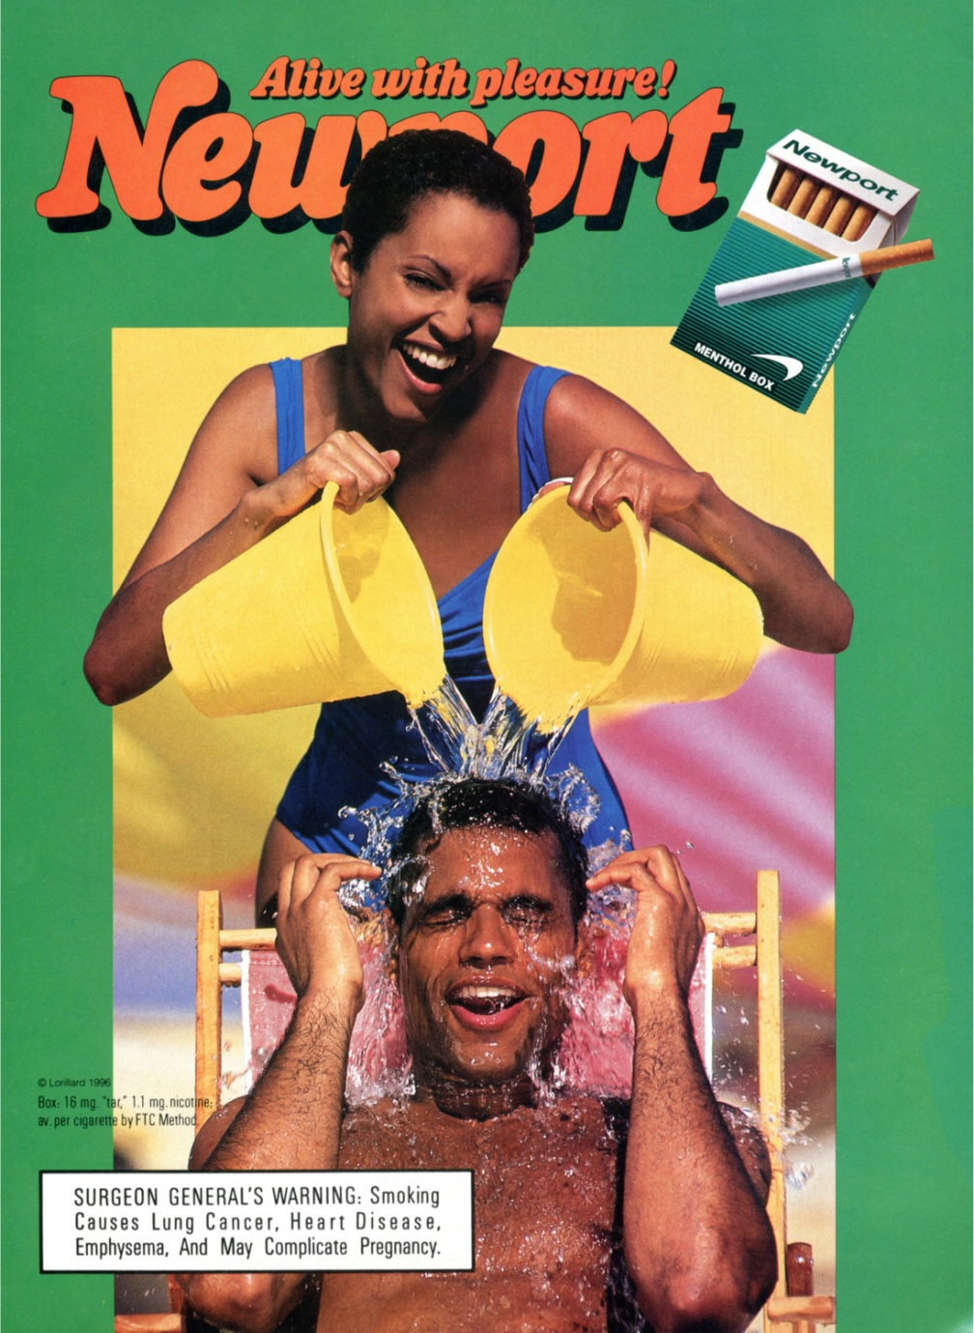
For every 10 % increase in the proportion of African-American students at a school, the per-pack price of Newport (the leading brand of menthol cigarettes) was 12 cents lower.
the prices for the leading non-menthol brand weren’t affected by school demographics.
Henriksen, et al. 2011

Slide 15
Obesity Trends* Among U.S. Adults
BRFSS, 2001
(*BMI ≥30, or ~ 30 lbs. overweight for 5’ 4” person)
<10% 10%–14% 15%–19% 20%–24% ≥25%

Slide 16
Obesity Trends* Among U.S. Adults
BRFSS, 2005
(*BMI ≥30, or ~ 30 lbs. overweight for 5’ 4” person)
<10% 10%–14% 15%–19% 20%–24% 25%–29% ≥30%

Slide 17
Obesity Trends* Among U.S. Adults
BRFSS, 2010
(*BMI ≥30, or ~ 30 lbs. overweight for 5’ 4” person)
<10% 10%–14% 15%–19% 20%–24% 25%–29% ≥30%

Slide 18
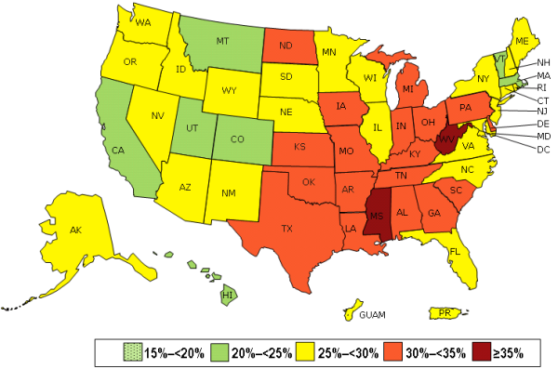
Prevalence* of Self-Reported Obesity Among U.S. Adults by State and Territory, BRFSS, 2013

Slide 19
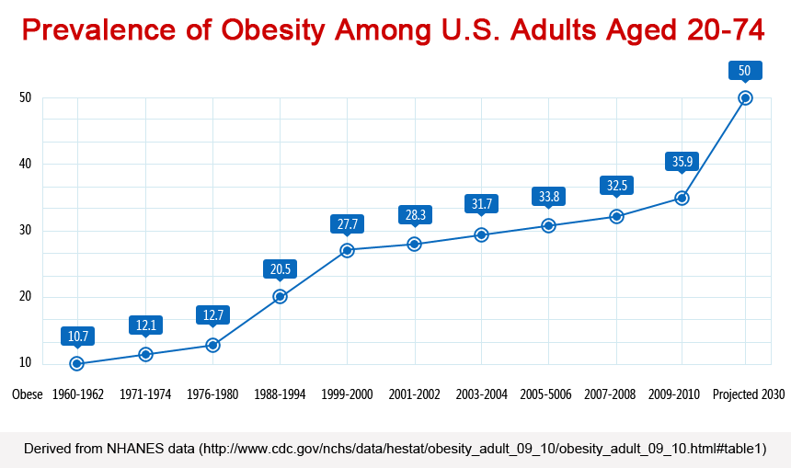
Obesity

Slide 20
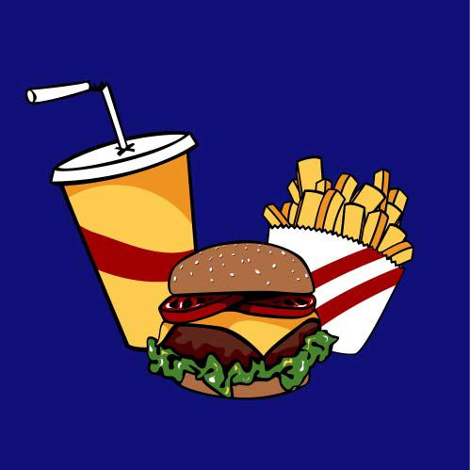
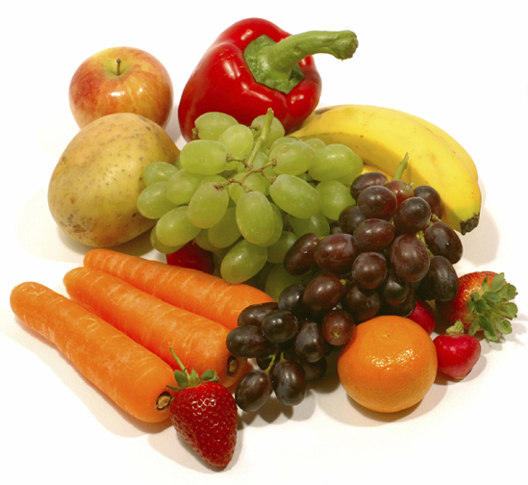
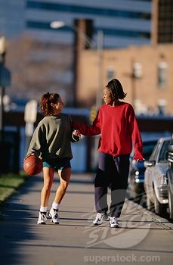
20

Slide 21
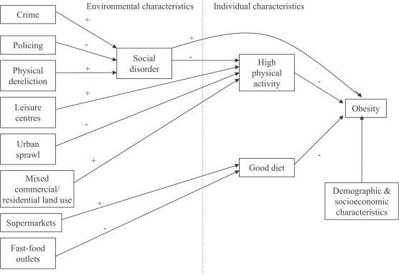
Theoretical model linking social and physical environmental characteristics to obesity
Pathways to obesity: Identifying local, modifiable determinants of physical activity and diet
Mai Stafford , Steven Cummins , Anne Ellaway , Amanda Sacker , Richard D. Wiggins , Sally Macintyre
Social Science &amp; Medicine, Volume 65, Issue 9, 2007, 1882 - 1897

Slide 22
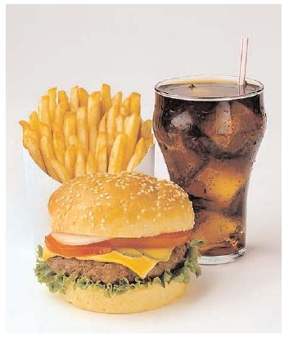
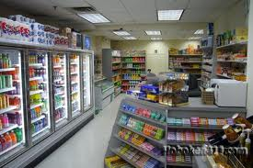
Examples – stores and obesity
Galvez et al 2009:
Children (ages 6-8) living on a block with 1 + convenience stores (range, 1–6) were more likely to have a BMI percentile in the top tertile (odds ratio 1.90, 95% confidence interval, 1.15–3.15) compared with children having no convenience stores
Oreskovic et al 2009:
distance to nearest fast-food restaurant was inversely associated with BMI

Slide 23
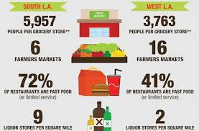
Diet / Food
“Food Desert” - low-income census tract where a large number of residents are more than a mile from a grocery store.

Slide 24
Diet
Meta-analysis of 27 studies - healthy eating costs $1.48 more per day per adult than eating a low-quality diet ($550 more annually per person).

Slide 25
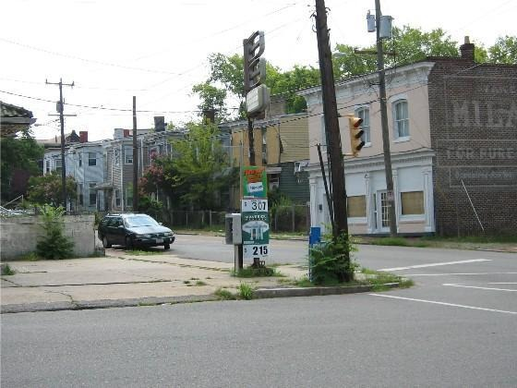
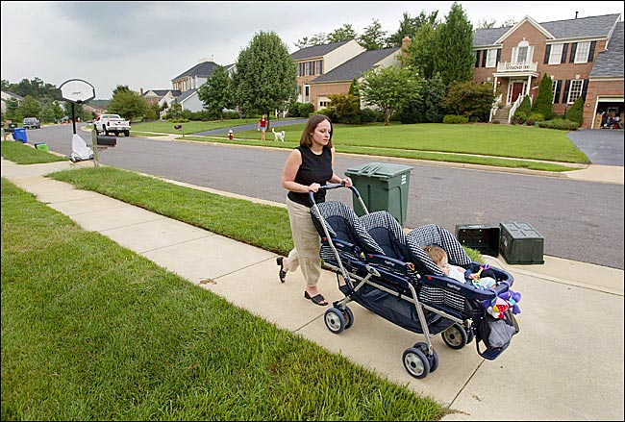

Physical Activity
Only 1 in 3 children are physically active every day.
< 5% of adults participate in 30 minutes of physical activity each day

Slide 26
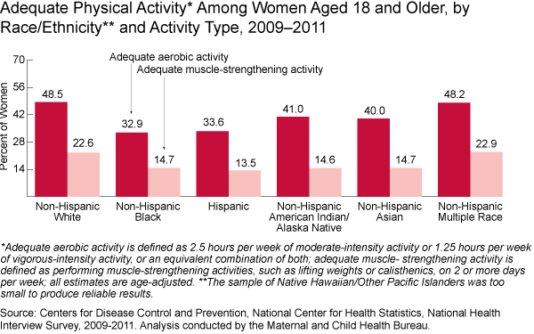
Physical Activity by race/ethnicity

Slide 27
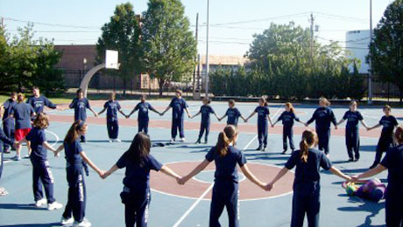
Physical Education – California example
National Association for Sports and Physical Education (NASPE) recommends 150 minutes of PE per week for elementary students and 225 minutes per week for middle and high school students.
Since early 1990s, the California Dept of Education has required:
  200 minutes of PE per 10 school days - grades 1-6 (100 minutes per week) (48%)
  400 minutes of PE per 10 school days - grades 7-12 (200 minutes per week) (24%)

Slide 28
Physical Activity - Organized sports
Adolescents from more affluent families are more likely to participate in organized activities than adolescents from low-income families
Girls in suburban communities participate in sports at a similar rate to boys. However, urban and rural girls, low-income girls and girls from immigrant families all participate in sports at significantly lower rates than their male counterparts
Asian Americans and Latinos are less likely to participate in sports than other ethnic groups
Notes:
or become directly pathogenic by affecting neuroendocrine function, and/or (b) induce health damaging behaviours (especially in relation to use of psychoactive substances, diet, and sexual behaviours).1 4 36

Slide 29

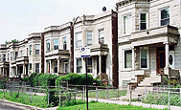
Neighborhood and Diet
Direct observation
CYGNET Study of 7-year-old girls
68-item modified St. Louis Audit Tool
  Land use environment (residential buildings, commercial destinations, public, community or government destinations, recreational facilities/ destinations)
  Transportation environment
  Facilities
  Park or playground contents
  Physical disorder
2,328 total street segments were observed
Leung IJBNPA 2010
29
29
29

Slide 30


Slide 31
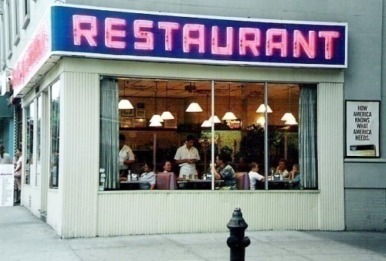
Neighborhood constructs
“mixed residential and commercial”
  Two-six-family homes (“walk-ups”)
  Apartment building/ complex or condominium
  Convenience or small grocery store
2. “food and retail”
  Chain fast food restaurant
  Supermarket
  Full-service restaurant
  Coffee shop
Leung IJBNPA 2010
31
31

Slide 32
Methods Girls’ energy intake (i.e. calories)
  Total energy intake in kilocalories (quartiles)
  Based on 24-hour recall surveys
32

Slide 33
Total Energy Intake (quartiles)
 | Odds Ratio† | 95% CI
Mixed residential and commercial | 0.94 | 0.85, 1.04
Food and retail | 0.86 | 0.75, 0.98
Recreation | 0.95 | 0.80, 1.14
Walkability | 1.00 | 0.80, 1.25
Incomplete sports equipment | 0.41 | 0.15, 1.14
Physical disorder | 0.96 | 0.72, 1.28
† Adjusted for age, race/ethnicity, BMI, age of birth mother, household size, and household income
33

Slide 34
Total energy intake (continued)
OR = 0.86, 95% CI (0.75, 0.98)
For every one-item increase in food outlets, there is a 14% decreased odds in consuming the next highest quartile of calories.
There is an inverse association between food outlets and total energy intake.
Leung IJBNPA 2010
34

Slide 35
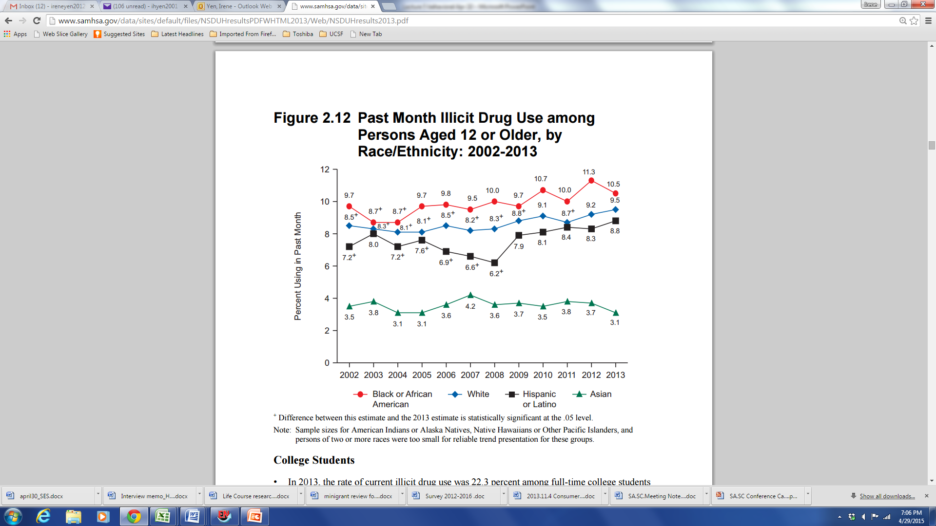
Drugs and Alcohol
2013 National Survey on Drug Use and Health

Slide 36
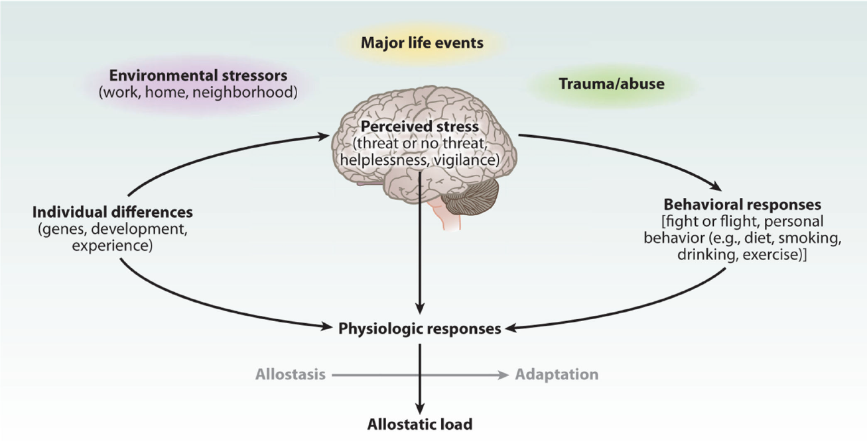
Stress triggers HPA and SNS Response to improve behavioral response
McEwen and Gianaros, annu rev med, 2011

Slide 37
Affordances Model
… behaviors African Americans engage in to cope with the stresses and strains on their lives contribute, along with the poor circumstances, to bad physical health outcomes such as early morbidity and so on, but those behaviors collectively are actually protective for their mental health

Slide 38
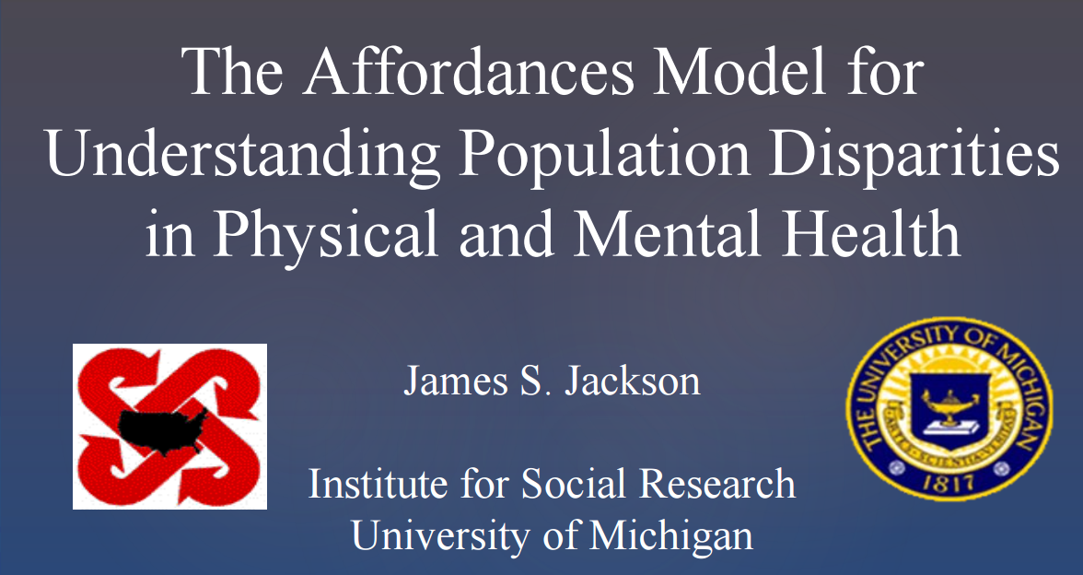
March 27th, 2013 at U of Nebraska, Lincoln

Slide 39
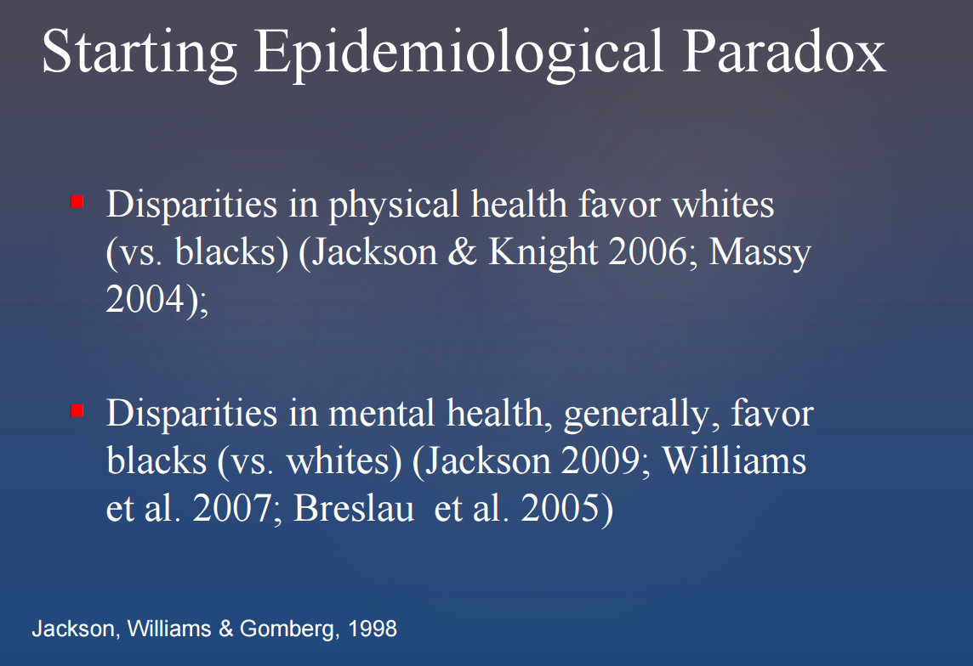

Slide 40
Lifetime prevalence of DSM IV
major depressive disorder
Notes:
National Survey of American Life (2001-2003)
percents

Slide 41
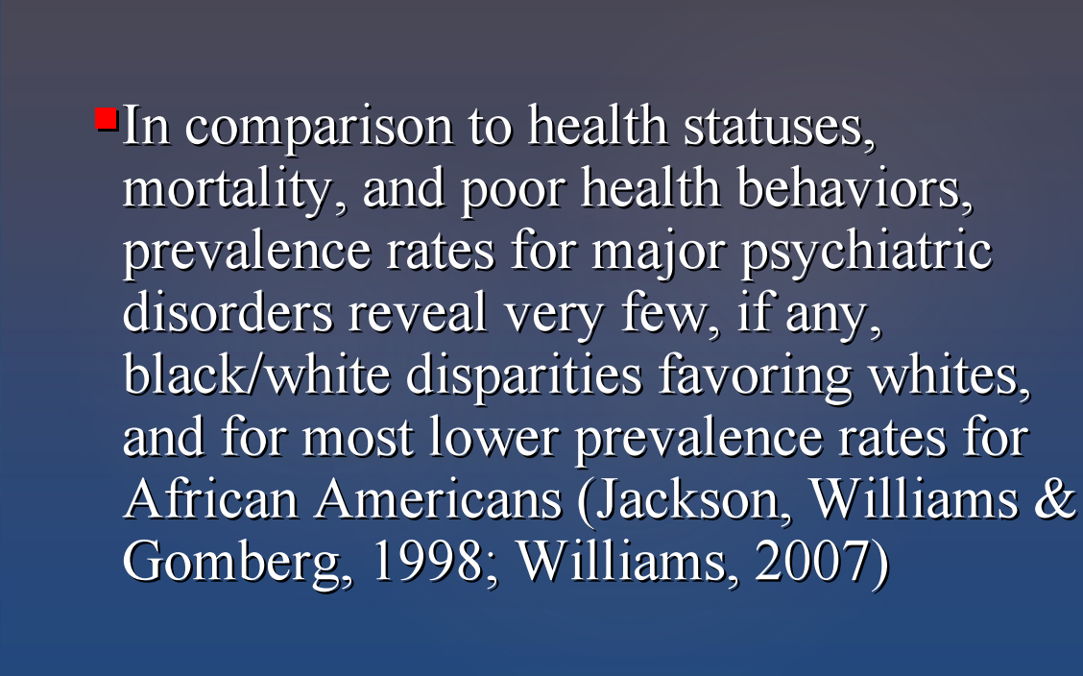

Slide 42
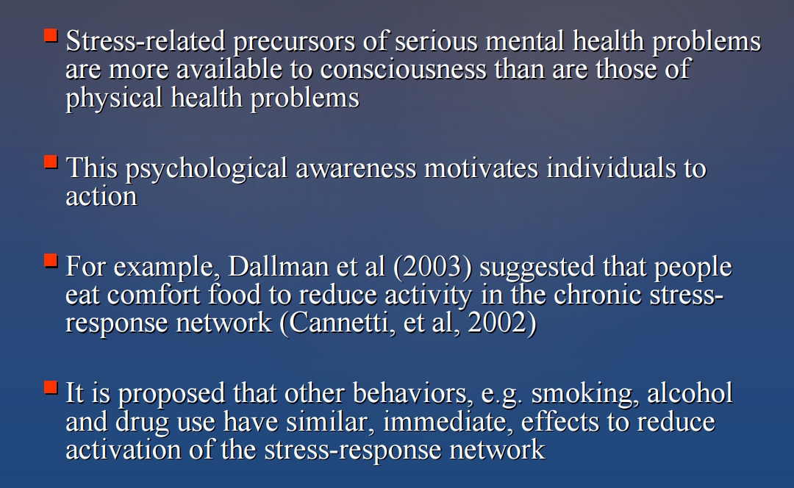

Slide 43
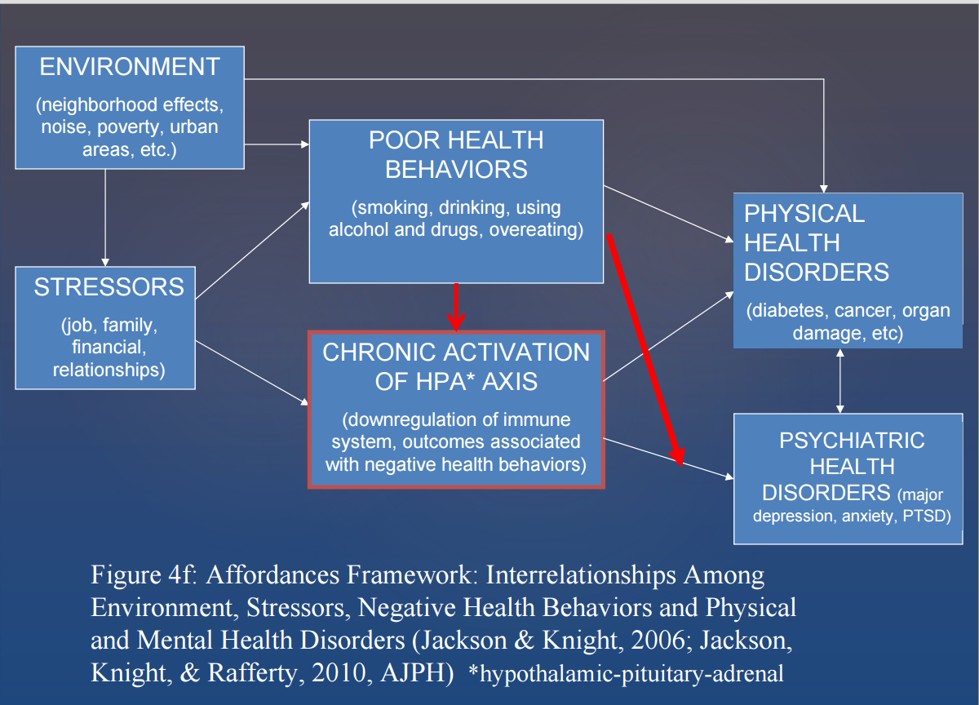

Slide 44
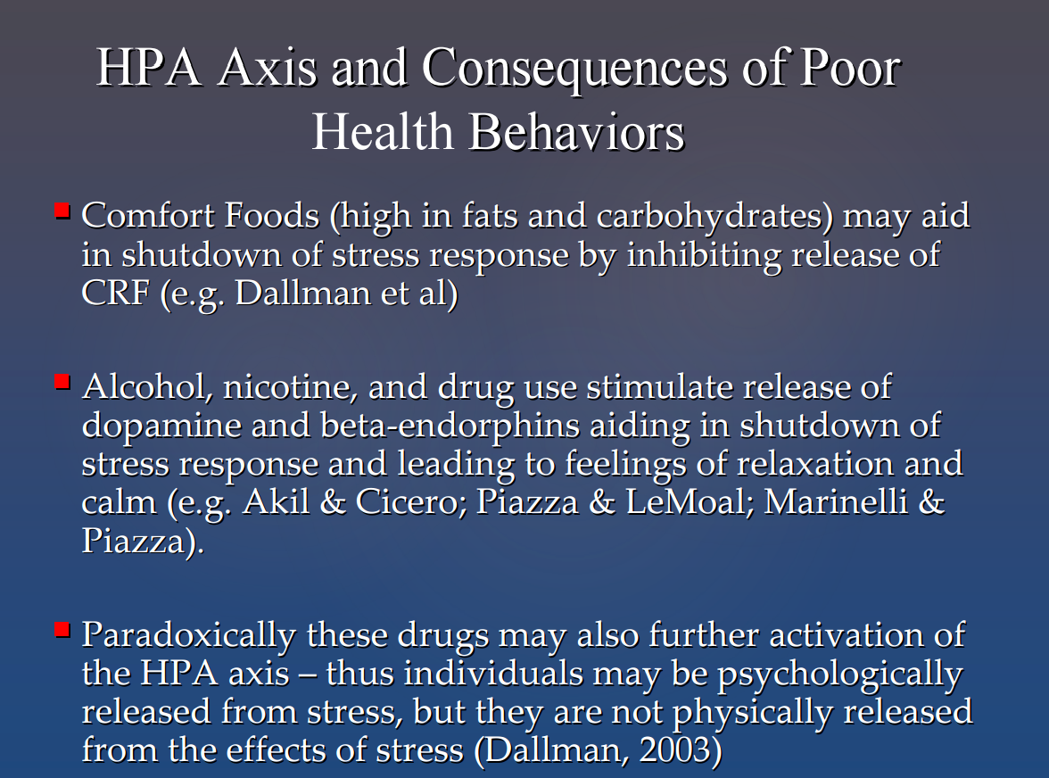

Slide 45
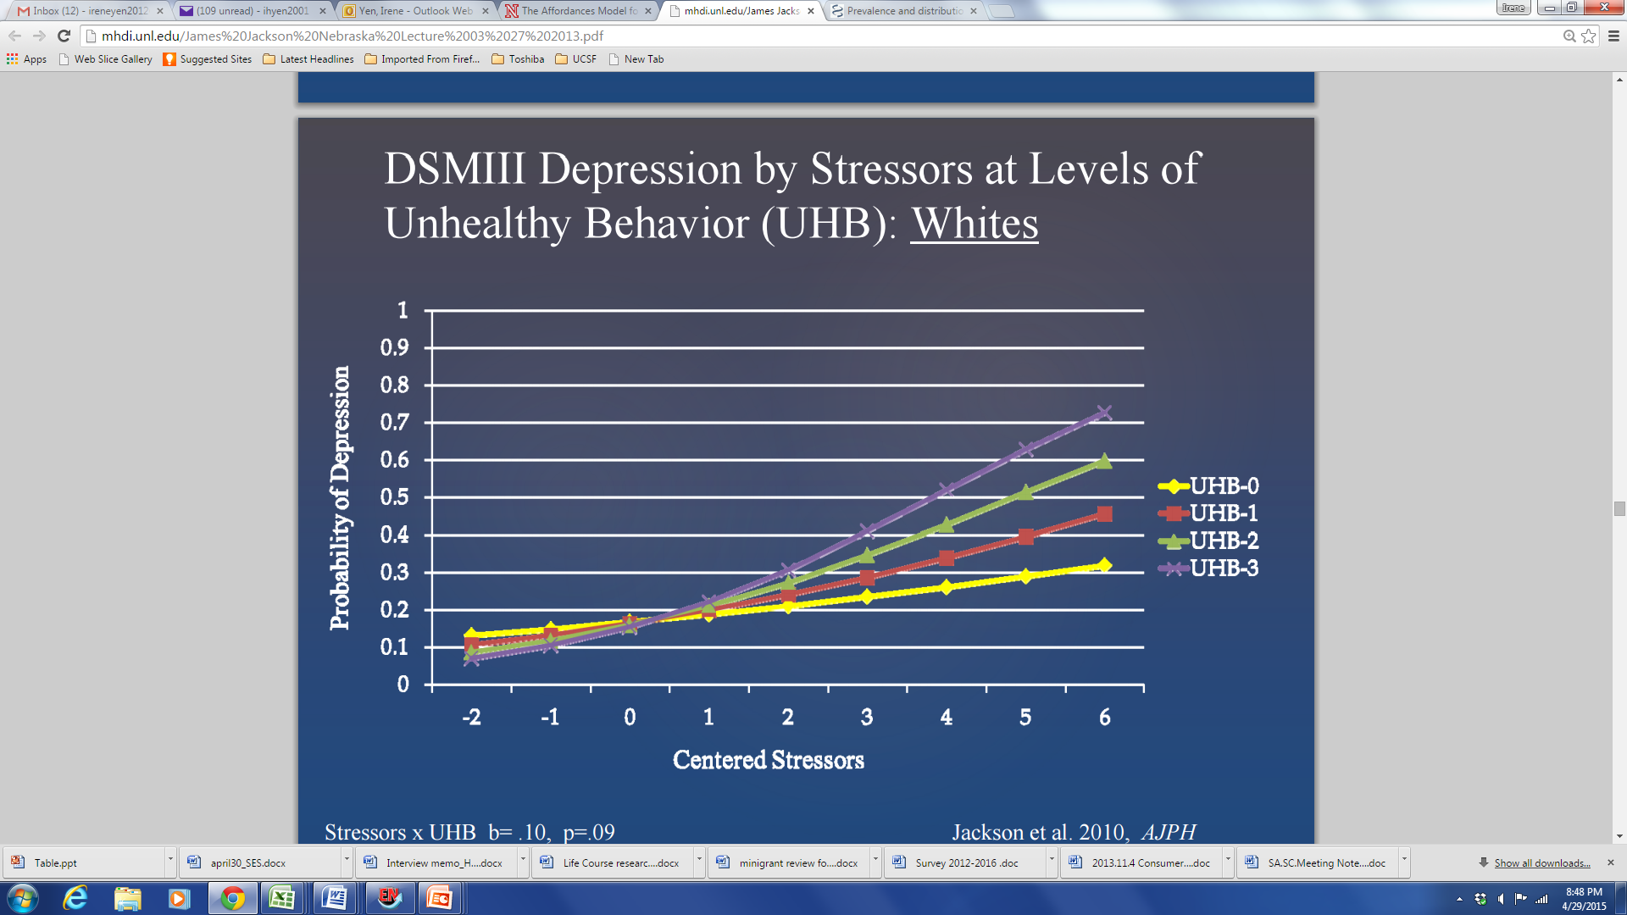
Notes:
Negative Stressful Events (count) (Wave I) Negative Stressful Events (count) (Wave I) Serious illness, moved, lost job, robbed, Serious illness, moved, lost job, robbed, anything else bad

Slide 46
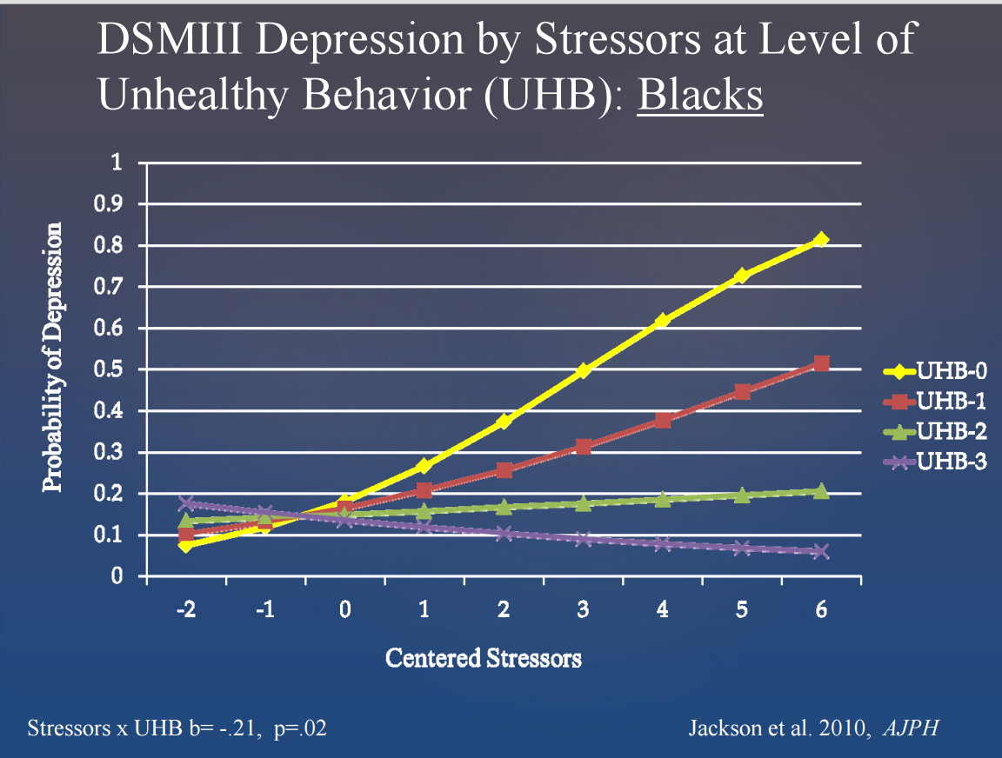

Slide 47
Self-regulatory depletion- blood glucose influences self-regulation
Self-regulation conceptualized as a “resource” depleted by making difficult decisions or resisting temptation
  Famous examples: Judges make more lenient parole decisions early in the morning and right after lunch (moral: bring your dissertation committee snacks)
  Exposing people to radishes and cookies and asking them to only eat the radishes led to reductions in amount of time spent in a subsequent problem solving task
  Giving people food (glucose) restores self-control (Gailliott)
  Meta-analysis shows persistence across task demands and subsequent displays of self-control

Slide 48
Self-control / Self-regulation
at any moment, there is a fixed amount of regulatory capacity available for self-regulation
after self-regulation in one sphere, self-regulation in another may not be as effective
Single dimension - traditional measure of self-control, e.g. delay of gratification, and endurance of physical discomfort
any self-regulatory exertion will deplete the capacity for any other

Slide 49
Questions?
Notes:
Key points: it is not the individual woman’s job to solve public health problem of unintended pregnancy on her own time
It is about informed preferences
Comparison to maternal mortality – our job is to give women the information they need and to think about how it relates to their preferences. In the visit, s not to solve public health problem.
Contraception as preference sensitive – maybe elucidate this a bit more
Challenges around “Shared” – from a feminist perspective
Importance of question “what is important to you about your method”
The public health question – some people really felt like it was okay to have the public health hat on during a visit. I think it is important to say that while affecting public health outcomes may be secondary outcome of your clinical care, it should never be what you are primarily focusing on – it should be about influencing the individual women’s outcome – and this is why the public health level outcome around IUD use goes along with getting women to use IUDs regardless of their preferences.
Really, you should never really have the public heatlh in mind – it should be the individual patient’s goals that matter – i.e. avoiding diabetes related foot amputations.

Slide 50
Discussion
Think about health outcome of interest to you
Which health behavior is particularly important?
How can you study this behavior in relation to your health outcome in a way that addresses health disparities?

