Slide 1


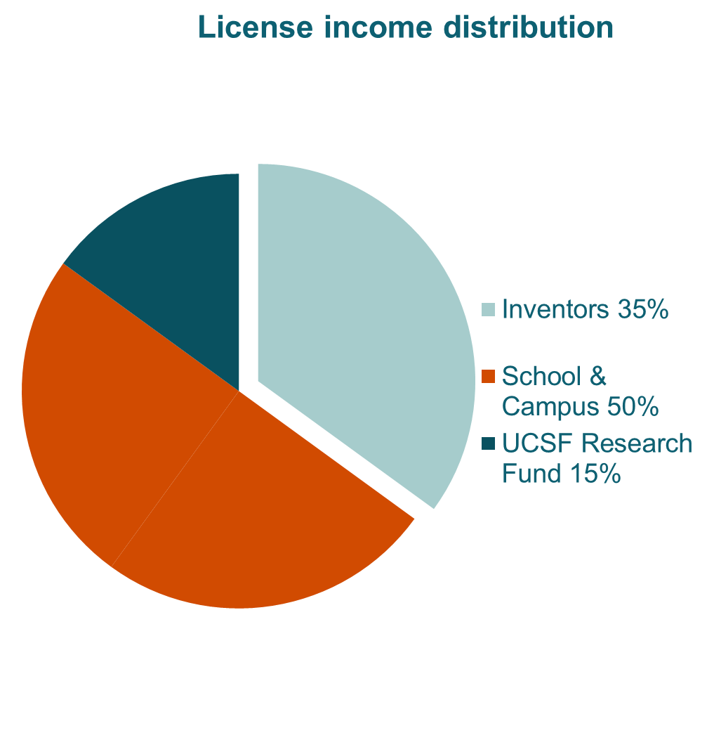

Slide 2
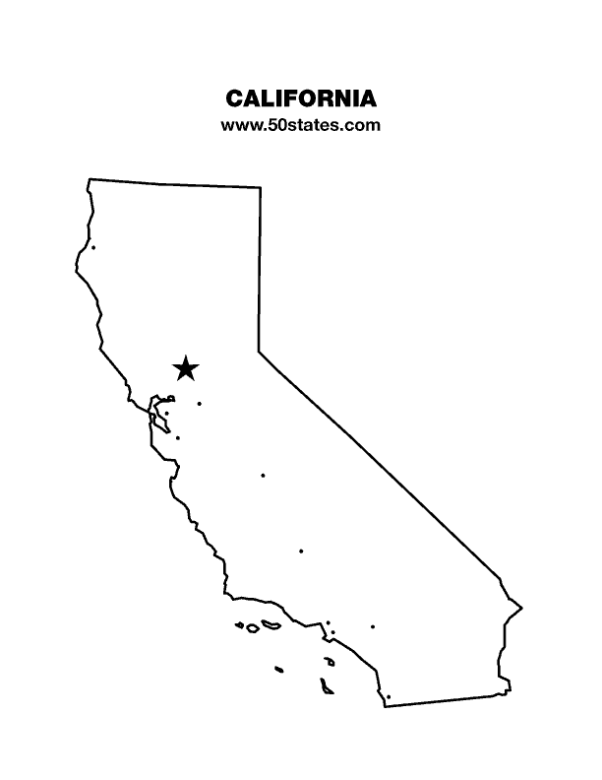


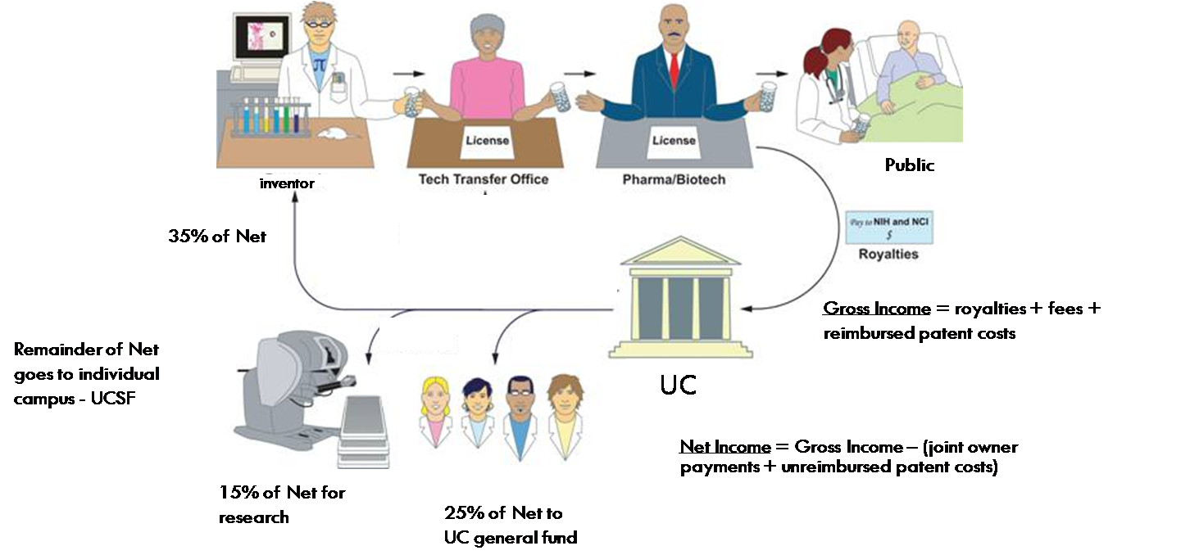
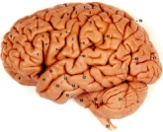
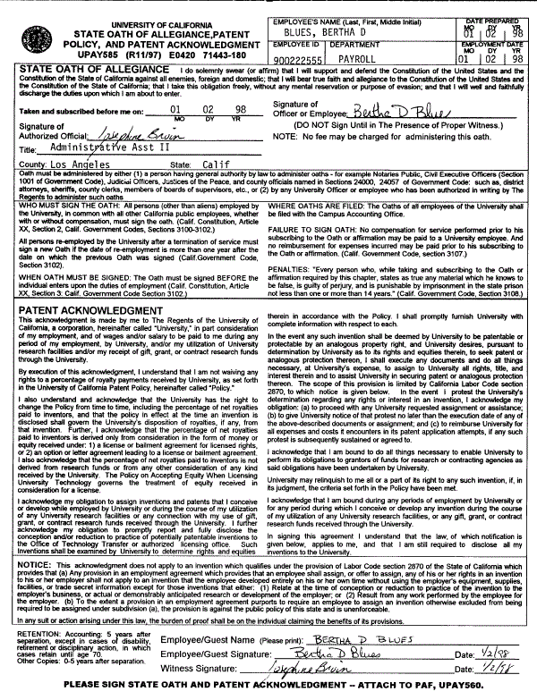
Who owns inventions made by UCSF employees?
Pa
California State Labor Code
  The Federal Bayh-Dole Act
Patent Acknowledgement Form
UNIVERSITY OF CALIFORNIA (with few exceptions) owns the intellectual property created by UC employees
Notes:
Need to know – disclose invention to OTM.
OTM manages all of these inventions.

Slide 3
Inventorship & Ownership of IP
Do I have to disclose my inventions to UCSF?
YES!
Do I have to list my PI as an inventor when I disclose an invention?
  Inventorship is a legally defined term in the U.S!
“If the university owns the data and my ideas while I'm here at UCSF, what if I just don't tell anyone I have a billion-dollar idea until I leave UCSF, and then I move to patent the product/idea?”
“Why won’t you just license to my start-up?”

Slide 4
Industry-sponsored Research
Who owns the IP?
  Generally follows inventorship and obligations to assign, but industry generally gets 1st option.
  “So, what if I just don’t disclose a new invention to the sponsor?”
Co-mingling of funding sources: AVOID!
  Unethical
  Conflicting IP obligations
  Gov’t rights attach to Gov’t funding
  Foundation funding also comes with obligations

Slide 5
The Sorry Tale of Peter Taborsky
Taborsky – 26 year old undergraduate
  University of So. Florida in Chemistry and Biology
  Worked at USF- College of Engineering in Dr. Robert Carnahan’s Lab 1987- Florida Progress sponsored research ($20k) in Dr. Carnahan’s lab looking for way to make sewage treatment less expensive and more efficient
Contract between FP and USF gave all research results to FP
Taborsky was part of the team

Slide 6
Peter Taborsky Gets Innovative
Project ended – no “useful” results
Taborsky began getting paid from other budgets
Taborsky continues to experiment on project at USF
Taborsky finds a solution to the sewage treatment problem!
Carnahan notifies Taborsky, the research results are FP’s and if he assigns his rights to FP they will hire him to a staff position (Yay!$!)
What does Taborsky do?

Slide 7

Taborsky takes his notebooks and runs….

Slide 8
The Twists & Turns of Peter Taborsky
USF files criminal charges for “theft of trade secrets”
1990- Taborsky found guilty:
  One year suspended sentence
  One year under house arrest
  15 years' probation
  Judge stated that he could not use or profit from his notes or his invention
Taborsky files for patents anyway
Nine months later USF and FP files for the same patents
1992 - USPTO issues two patents to Taborsky

Slide 9
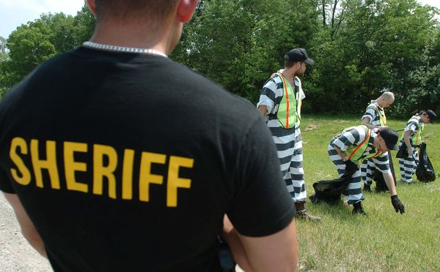
The Sad Ending for Peter Taborsky
Judge orders Taborsky to assign the rights of his patents or be sent to prison, but Taborsky refuses.
Taborsky’s new sentence:
  3 ½ years in prison
  4 months served in maximum security cell
  2 months served on chain gang

