Slide 1
Science in the Genomic Age:
Biomedical Research and Human Subjects
Ulluminair Salim, PhD(c), MPH
Kevin Shannon, MD
Zena Werb, PhD
BMS 214: Responsible Conduct of Research
May 13th and 14th, 2015

Slide 2
Poll
Would you characterize your current research as “human subjects research?”

Slide 3
What constitutes “Human Subjects Research?”
Under the definition of human subject at 45 CFR 46.102(f), obtaining identifiable private information or identifiable specimens for research purposes constitutes human subjects research. Obtaining identifiable private information or identifiable specimens includes, but is not limited to:
(1) using, studying, or analyzing for research purposes identifiable private information or identifiable specimens that have been provided to investigators from any source; and
(2) using, studying, or analyzing for research purposes identifiable private information or identifiable specimens that were already in the possession of the investigator.
In general, OHRP considers private information or specimens to be individually identifiable as defined at 45 CFR 46.102(f) when they can be linked to specific individuals by the investigator(s) either directly or indirectly through coding systems.
http://grants.nih.gov/grants/policy/hs/specimens.htm

Slide 4
Governing Treaties, Laws, and Regulations
Three sections of federal law primarily govern human subjects research and associated patient data.
The Common Rule (1991): Federal regulatory law referred to as the Common Rule requires that researchers obtain informed consent from donors prior to collecting, storing and using their tissue for research.
The FDA has a separate system designed to protect the rights of human subjects for FDA-regulated clinical investigations. Unlike the Common Rule, the FDA’s classification of whether these regulations apply is not contingent upon whether human tissues are directly identifiable and the FDA does not allow an IRB to waive its requirements.
Lastly, the Health Insurance Portability and Accountability Act (HIPAA Privacy Rule) governs research use of protected health information (PHI) such as names, social security numbers, and medical record information that is associated with specimens.
In addition to these three areas of federal law, the Genetic Information and Nondiscrimination Act is designed to protect individuals from genetic discrimination (See “GINA” topic for more information).
Notes:
Federal law governing this area remains ambiguous and potentially confusing to both researchers and specimen donors because it raises several issues related to ownership of specimens, informed consent, genetic privacy, and retention of DNA specimens and associated information. Courts have partially addressed questions related to tissue ownership, and some states have legislation clarifying uncertainties in the federal framework.

Slide 5
Informed Consent
Requirements:
Specific information to study participants containing adequate description of risks and benefits
Study participants must be informed of all intended uses for their specimens
Additional consent required for further research

Slide 6
Precedent Cases
“Although the use of human tissue is heavily regulated by the federal government, the question of who owns excised human tissue has been analyzed under state property law”
(Allen et al, 2010)

Slide 7

Moore v. Regents of University of California 1990

Slide 8

Greenberg v. Miami Children’s Research Hospital Institute 2003

Slide 9

Havasupai Tribe v. Arizona State University 2004

Slide 10

Washington University v. Catalona 2007

Slide 11
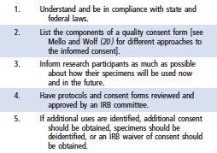
What should laboratorians and researchers do before conducting research on human tissue specimens?
Allen, et al (2010). “Human Tissue Ownership and Use in Research: What Laboratorians and Researchers Should Know.” Clinical Chemistry 56:11

Slide 12
Case Study I
Henrietta Lacks’ “Immortal Cells”
In 1951, a 31-year-old African American woman named Henrietta Lacks, went to the segregated clinic at Johns Hopkins Hospital in Baltimore, with a “knot in [her] womb”, that was diagnosed as malignant cervical carcinoma.
Prior to treatment by radium, a dime-sized biopsy was removed from the very unusual looking tumor and passed on to George and Margaret Gey, pioneers in tissue culture at Hopkins.
No permission to obtain or use those samples was required or sought.

Slide 13
HeLa cells-2
Within a week Henrietta’s cells were growing out of the biopsy with “mythological intensity”; within 8 months Henrietta was dead.
But HeLa cells lived on, distributed around the world, the first immortal human cell line.
Soon, HeLa cells were changing science forever. Indeed, HeLa cells were so robust that soon they contaminated many other cell cultures and were responsible for erroneous observations that normal cells became malignant with time in culture.
THE IMMORTAL LIFE OF HENRIETTA LACKS
By Rebecca Skloot

Slide 14
HeLa cells-3
HeLa cells grown by the ton have furthered scientific inquiry in the over 60 years since they were derived.
The cells were used in the newly developing discipline of virology to test the development of polio vaccine by Jonas Salk and eventually led to a Nobel Prize for discovering that Human Papilloma Virus caused cervical cancer.
They have earned companies a fortune.
Meanwhile Henrietta’s family was living in abject poverty. Combined with racism, this left her five children hungry, angry, poorly educated and sick.

Slide 15
There are hundreds of millions of human samples in repositories.
Most will, at best, be used as one of many samples in a research project.
Only a handful will lead to reagents or cells of any commercial value.
These do result from the intellectual pursuits by scientists and the courts concur.
Yet, seeing how something of great value such as HeLa cells gave nothing back to the poor family from which it is derived somehow seems rather heartless.

Slide 16
Sequencing the HeLa genome
In March 2013, scientists from European Molecular Biology Laboratory in Heidelberg, Germany, published the genomic sequencing of a HeLa cell line and deposited the genomic sequence dna in online open access database Landry et al. 2013). http://g3journal.org/content/3/8/1213
The family of Henrietta Lacks had not been consulted or notified prior to the publication of the HeLa cell genomic sequencehttp://www.nature.com/nature/journal/v500/n7461/full/nature12064.html
While there was no law requiring such action, the circumstances surrounding the Henrietta Lacks story lead many bioethicists to question why the family was left in the dark again.

Slide 17
Sequencing the HeLa genome-2
The initial reaction to the publication of the HeLa cell line sequence data prompted the researchers to remove the data from the online databases. While some scholars wondered how this drastic action could be warranted given the vast amounts of genomic data for HeLa cell lines already published, other scholars questioned how the peer-review process failed to consider the interests of the family of Henrietta Lacks. Skloot herself responded critically to the publication in an op-ed piece published in the New York Times as “The Immortal Life of Henrietta Lacks: the Sequel.”
There, Skloot underscored that privacy concerns by and respect for members of the Lacks family are at the heart of the controversy. And while she acknowledged that consent had not been required, Skloot condemned the “whole system” of biomedical research for failing to raise questions about consent during the peer-review process.

Slide 18
Case #1 Discussion Questions
Even though original informed consent was not required in 1951, HIPPA requirements of confidentially apply today. To what extent has the publicity around Henrietta Lacks by the book made privacy for the family impossible?
What are compelling arguments for and against publishing genomic data?
Do you believe the genomic sequencing of the HeLa cell line should have been published?

Slide 19
Case Study 2
Acute lymphoblastic leukemia (ALL) is cured in >80% of children, those with hypodiploid ALL do very poorly.
Targeted genomic analysis and biochemical profiling of leukemia samples from >100 cases of hypodiploid ALL unexpectedly revealed a high frequency with TP53 mutations, almost half of which were present in normal tissues (germline mutations). Thus, hypodiploid ALL as a new manifestation of Li-Fraumeni Syndrome, a known familial cancer syndrome.

Slide 20
Cancer Predisposition Syndromes for Which Effective Surveillance Protocols Exist
Beckwith Wiedemann syndrome
Wilms tumor associated syndromes
Familial adenomatous polyposis
Hereditary retinoblastoma
Multiple Endocrine Neoplasia, types 1 and 2
Von Hippel Lindau syndrome
PTEN Hamartoma Tumor Syndrome
Li-Fraumeni Syndrome?
S. Knapke, et al., ASCO Educational Book, 2012

Slide 21
Li-Fraumeni Syndrome: An Example of the Complexities of Testing & Surveillance
Dominant syndrome characterized by risks of multiple cancers (sarcomas, breast cancer, brain tumors, leukemia, etc).
Life time risk for cancer ~90%
20-40% of LFS pts develop cancer before 20 yrs
Children at greatest risk for multiple cancers
  0-15 years @ first cancer = 80-fold risk for more cancers
Li, Fraumeni. Ann Intern Med, 1969; Malkin et al., Science, 1990

Slide 22
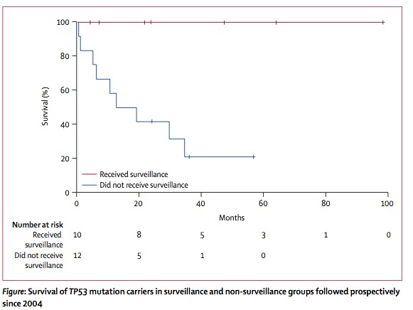
Genetic Testing for TP53 Mutations:
Does Surveillance Make a Difference?
8 LFS families
33 TP53 mut +
18 surveillance
12 no surveillance
Followed since 1/04
Surveillance
Surveillance
10 tumors, 7 pts
All pts alive
No surveillance
No Surveillance
12 tumors, 10 pts
2 alive (17%)
(http://www.sickkids.ca/pdfs/Cancer-Genetics-Program/35386-TP53TorontoProtocol.pdf)
LiFE Research Consortium-2012
A. Villani et al., Lancet Oncology, 12:559-567, 2011

Slide 23
Case #2 Discussion Questions
(1) What are the ethical implications around informing the family of the presence of a germline TP53 mutation in the index patient?
(2) What additional clinical information should be obtained and reviewed from siblings, parents and other first degree relatives?
(3) What are the implications of offering (or recommending) follow-up genetic testing for family members?

