Slide 1
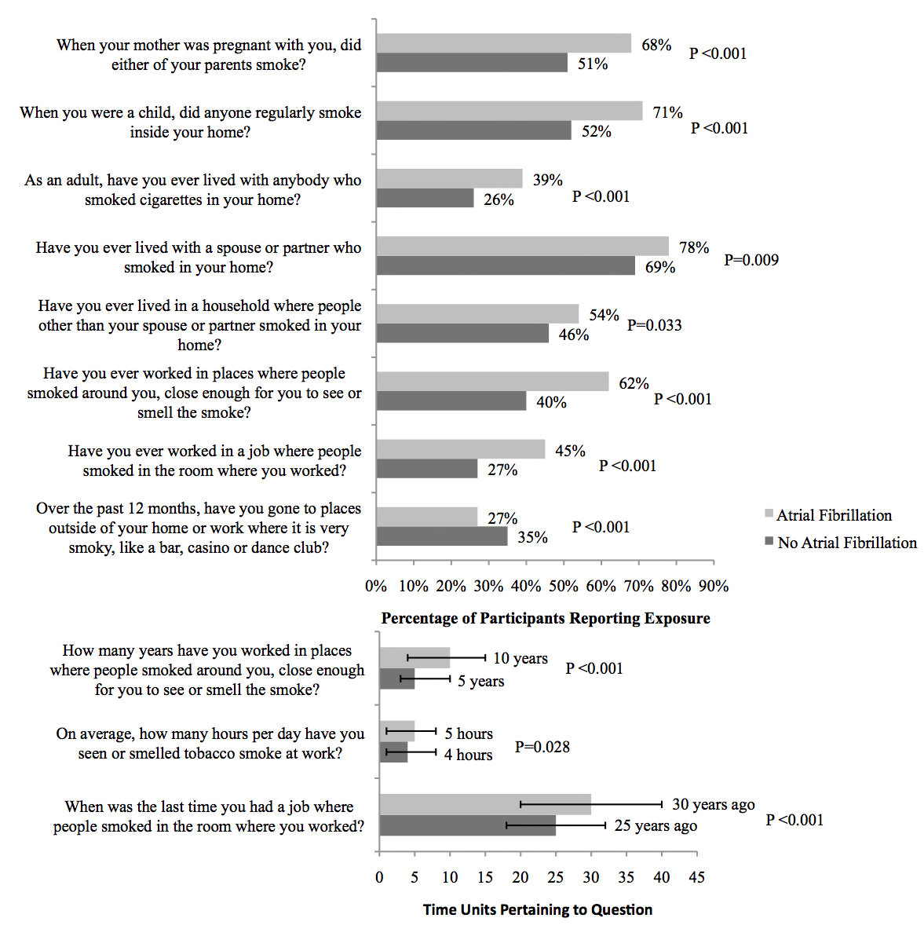
Shalini Dixit
Figure 1. Summary of secondhand smoke exposures in those with and without subsequent atrial fibrillation. Values are reported as percentages for yes/no questions and medians for numeric responses. Horizontal error bars depict interquartile ranges around median. Questions are limited to a priori selected criteria (see methods).

Slide 2
Shalini Dixit

Slide 3
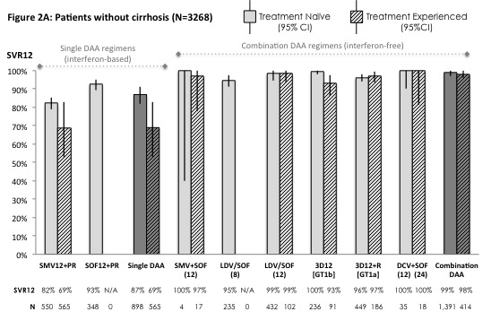
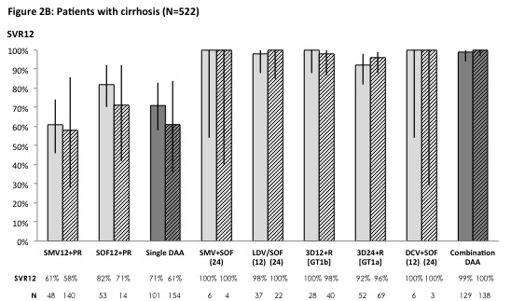
Sachin Garg
Figure 2: Summary estimates of SVR12 rates for DAA therapy for genotype 1 HCV (N=3,790)*

Slide 4
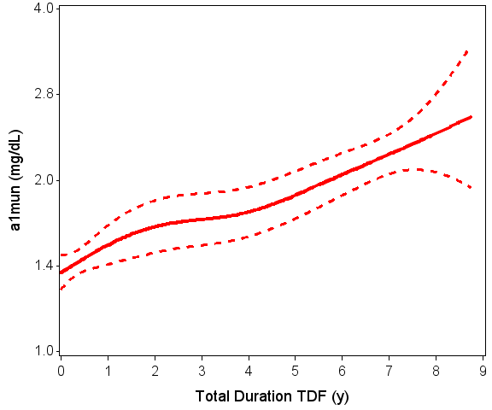
Vasantha Jotwani
Figure: Association of cumulative TDF exposure with urine α1 levels in HIV-infected MACS participants (N= 883)

Slide 5
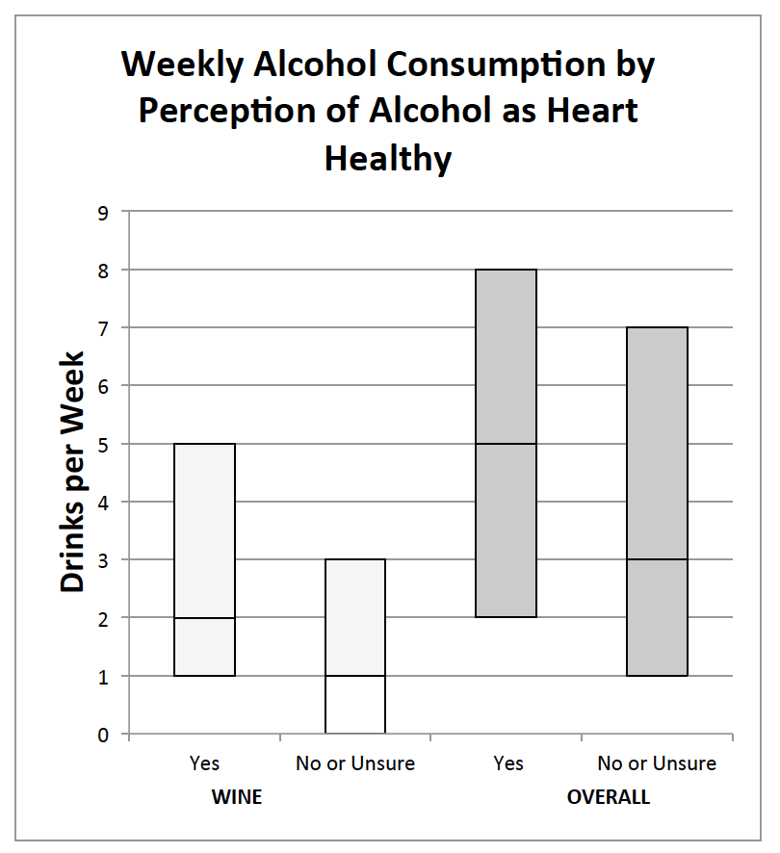
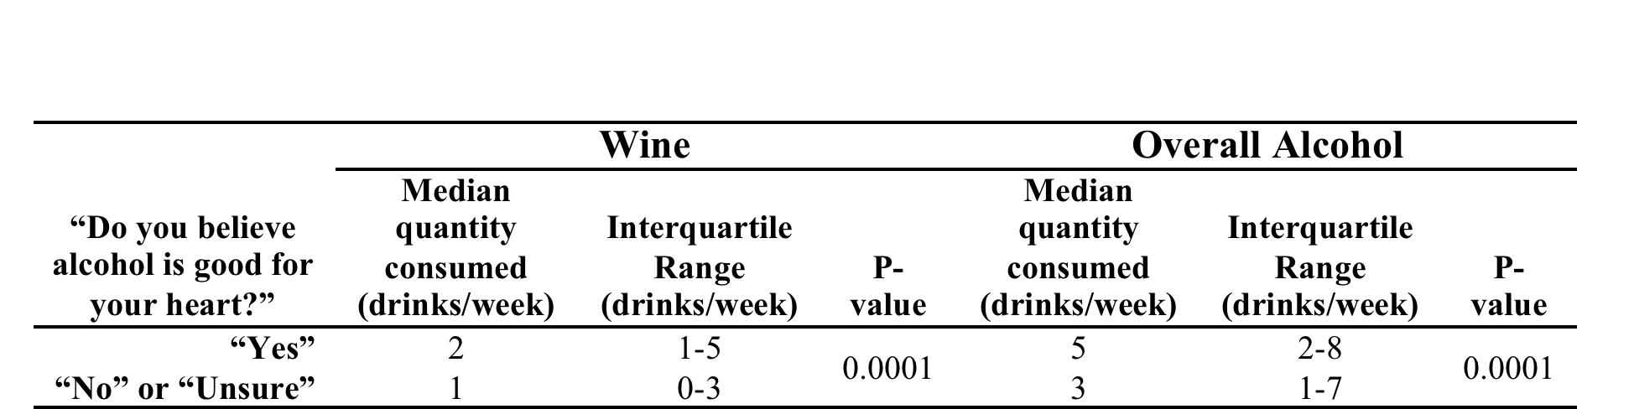
Ziggy Whitman
Table: Unadjusted Weekly Wine and Overall Alcohol Consumption by Response to the Survey Question, “Do you believe that alcohol is good for your heart?”
Figure: Unadjusted Weekly Wine and Overall Alcohol Consumption by Response to the Survey Question, “Do you believe that alcohol is good for your heart?”

Slide 6
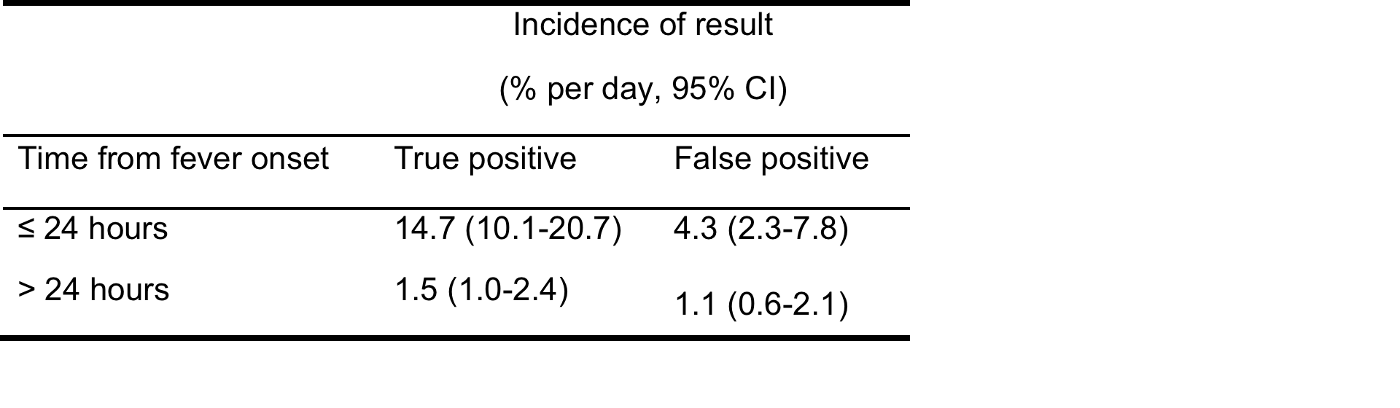
Rachel Wattier
Figure: New positive blood cultures leading to diagnosis of bloodstream infections (new BSI cultures) and positive blood cultures determined to be contaminants by day of fever. Total blood cultures obtained by day of fever are plotted on left-hand y-axis. Positive blood cultures are plotted on the right hand y-axis. Cultures collected after day 20 of fever are not shown; 25 cultures were obtained after day 20 of fever and none were positive
Table: Incidence of true positive and false positive blood culture results by time from fever onset

Slide 7
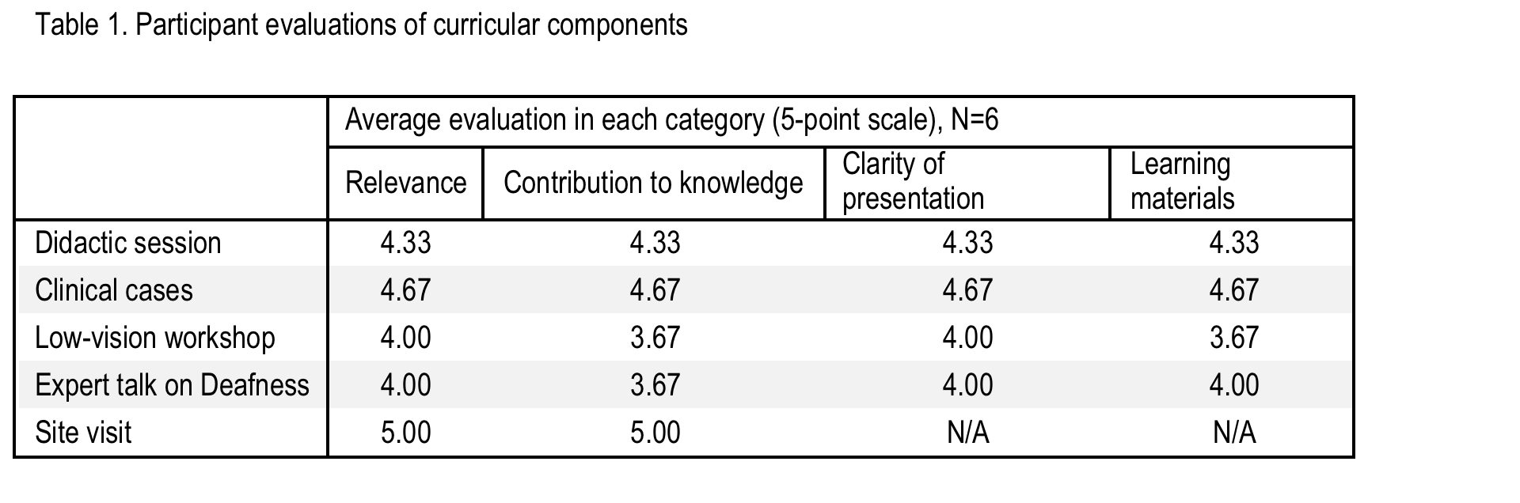
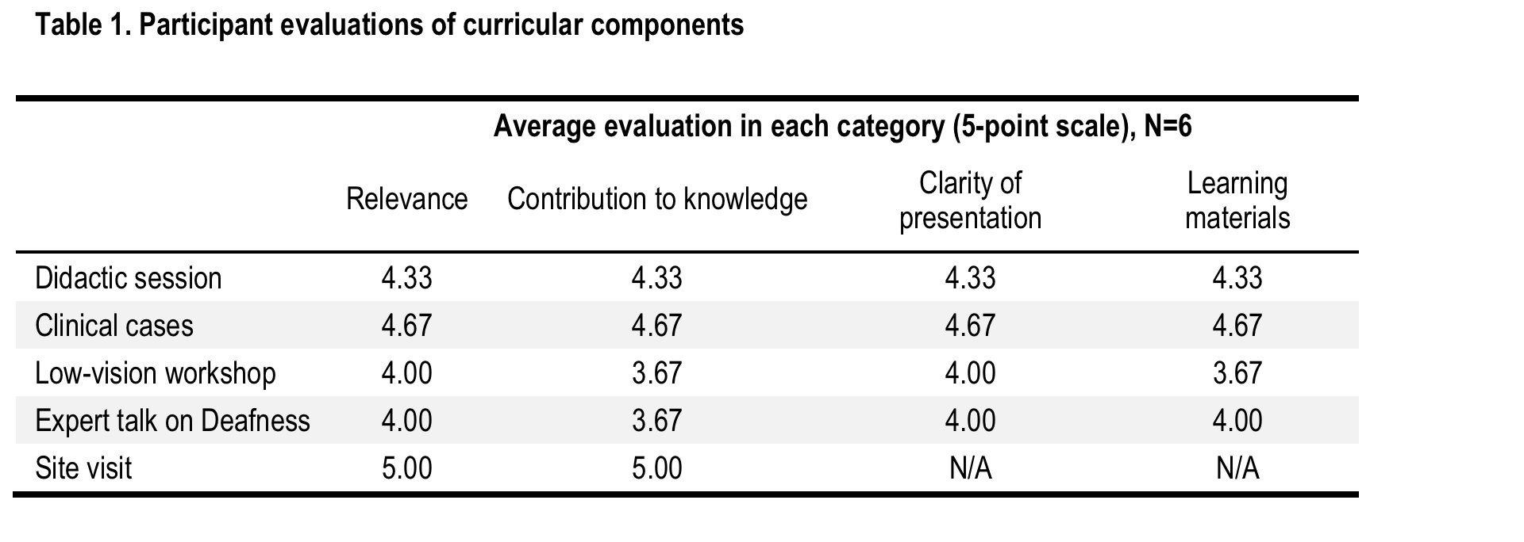
Bliss Temple

Slide 8
Bliss Temple

