Slide 1
Engaging minority populations in research
Have We Done Enough?
Anna Nápoles, PhD
Professor
EPI 222
May 21, 2015

Slide 2
Outline
lack of attention by health researchers to issues of engagement of diverse communities
Need for advancing science of R&R and community engagement methods for diverse populations
recommendations to advance R&R and community engagement in diverse populations

Slide 3
Lack of Attention to the Issues

Slide 4
NIH Mandate to Recruit Minorities
1993 NIH Revitalization Act: women and minorities must be included in clinical research supported by NIH
Sufficient numbers to allow valid evaluation of ethnic differences for major ethnic groups
Notes:
Need to describe composition of study pop, rationale and recruitment plan; targeted pop
For clinical trials need to have sufficient power to test for subgroup analyses if prior evidence exists of such differences

Slide 5
Dismal Representation
75% of public has little or no knowledge of clinical research enterprise
2% of U.S. pop participates in clinical research
3% of cancer patients participate in clinical trials
Of those, only 10% are minorities, while they make up almost 40% of U.S. population
www2.mdanderson.org/cancerwise/2010/03/minority-participation-in-clinical-trials.html;
Harris PA 2012
Notes:
Very significant room for improvement!
By 2042, whites will be the minority in the U.S., especially in Hawaii, D.C., California, New Mexico and Texas
52 million Latinos (16.4%)
15 million Asians/API (5%)
38 million African Ams (12.6%)

Slide 6
Dismal Representation
Jan 2013 review of NCI-sponsored trials
< 100/10,000 cancer trials focused on racial/ethnic minorities
Minority adult enrollment is not representative of US population with cancer
Chen M. Cancer 2014;`120(7 supple):109-6
Notes:
Very significant room for improvement!
By 2042, whites will be the minority in the U.S., especially in Hawaii, D.C., California, New Mexico and Texas
52 million Latinos (16.4%)
15 million Asians/API (5%)
38 million African Ams (12.6%)

Slide 7
Percent of Phase III Cancer Trials that Used Age, Gender or Race Targets,
1990-2000
Swanson GM. 2002 Cancer;95(5):950-9.
Notes:
In these graphs, age is represented by the dark green, gender by the light green and race by the white columns.
This review of over 260 phase III cancer trials between 1990-2000, shows that for treatment trials, while age was an explicit eligibility criteria in almost 30% of trials and gender in over 40% of trials, there were 0 trials that specified race/ethnicity targets
For prevention trials, results are better for age with about 70% of trials specifying age criteria, but pretty similar to treatment trials with almost 40% of trials specifying gender criteria and 9% race/ethnicity criteria.

Slide 8
Percent of Phase III Cancer Trials that Used Age, Gender or Race Targets,
2001-2010
Kwiatkowski K. 2013 Cancer;119(16):2956-63.
Notes:
Not much change in the 10 years after as demonstrated by this review which replicated the earlier systematic review
For treatment trials, Looking at the white columns, you can see that race/ethnicity targets were specified in 1% of Phase II treatment trials and 19% of prevention trials so we still have a ways to go

Slide 9

WHY

Slide 10


Notes:
Under-representation of minorities in research has been largely attributable to defacto exclusion.
It is a stark realty owing to years of neglect and lack of attention to these issues.

Slide 11
Failure to Attend to Barriers & Enhancers of Participation
History Distrust
Attitudes
Lack of Information
Notes:
There is also widespread lack of attention to barriers that have been well-documented in the literature with respect to enrollment of diverse populations in research, e.g., distrust, fear, lack of information, history of discrimination in the U.S.
African Americans more likely than whites to be ineligible due to perceived noncompliance (Penberthy L, 2012; review of therapeutic cancer RCTs)
African Ams more likely than whites to refuse due to family pressures, being overwhelemed (Penberthy L 2012)
Views that minority pts are risky-drop out (Joseph G 2012)
Enhancers of engagement in research are largely unknown

Slide 12
Identifying Community Priorities and Attitudes about Research
Mail survey: 117 San Francisco and Oakland CBOs serving African Americans and Latinos,
Focus groups: 36 low-income residents (aged 58-84) of Bayview Hunters Point, Western Addition and Mission District
Nápoles-Springer. Research on Aging. 2000;22(6):668-691.
Notes:
To illustrate the mismatch of priorities and some of the attitudinal factors that are recruitment issues in diverse populations, I will review a study that was conducted under CADC to assess attitudes about research and communities’ priorities
Type Percent
Social services 24
Senior centers 21
Health services 19
Recreational/cultural 11
Legal services/housing 10
Faith-based 9
Educational/employment 6

Slide 13
Unmet Needs of Older
African Americans and Latinos (%)
Percent Needing
Lots/Huge
Rank Unmet Need Amount of Help
1 Affordable housing 71
2 Enough money to meet needs 70
3 Transportation 60
4 Safer neighborhoods 60
5 Medical care 53
Nápoles-Springer. Research on Aging. 2000;22(6):668-691.
Notes:
When we asked key community informants n=117 (CBOs) how much help they felt older ethnically diverse adults needed on specific topics (none, a little, a lot or a huge amount of help) they ranked concerns over basic needs as being of highest priority. Medical was ranked 5th on the list.

Slide 14
Trust in Researchers (%)
Neither
Agree A nor D Disagree
L and AA do not take part due to distrust 65 29 6
L and AA afraid due to discrimination 43 39 18
Studies guard health of participants 41 45 14
Participants treated as guinea pigs 30 46 24
Researchers are condescending to minorities 25 62 13
Nápoles-Springer. Research on Aging. 2000;22(6):668-691.
Notes:
In a survey of San Francisco Bay Area representatives from 117 CBOs that served Latino and African American older adults, they felt that these groups did not participate in research because of negative perceptions of research and researchers
Issues of inferior treatment of Latinos and African Americans by researchers were prevalent, such as distrust, discrimination, lack of safequards, being treated as guinea pigs, and being condescending

Slide 15
Focus Groups
Barriers to Participation in Research
Distrust of doctors, researchers, institutions
Lack of information
Lack of follow-up if adversely affected
Inconvenience
Lack of transportation
Caregiver obligations
31% of African Americans and 95%
of Latinos agreed to be re-contacted

Slide 16
Focus Groups: Experimentation
“They don’t know if people are tellin’ the truth. You know, they will tell you you’re gonna get in this research. Well, what IS this research? Are you REALLY gonna do what you say you’re gonna do? Or are you gonna tell me, are you puttin’ me, and then injectin’ me with the AIDS virus, or a syphilis virus, or something else, and I’m not aware? …People are afraid. They just don’t know enough about these programs.”

Slide 17
Focus Groups: Benefits of Research
Advance scientific knowledge
To preserve one’s/community’s health
To learn more about a specific disease
To teach researchers about cultural differences
Access to new treatments

Slide 18
How Do We Address Barriers?
CBO respondent
“Researchers need to spend time in agencies and in community or clients’ homes to develop trust. Paying people and providing transportation is not enough to increase participation. The study has to have some intrinsic worth to the research participant. Communicating the results back to the agency and participants is crucial to developing trust.”

Slide 19
Focus Groups: Provide Tangible Benefits
“Me, I would have to know that the information they get is gonna benefit the community, as well as me, in some way. If I knew…the findings would benefit the community, and something would be DONE with those findings. They’ve got researchers from UC everywhere, have been out here to research the soil, the air, everything. And then after, they go, that’s the last we hear of it.”

Slide 20
How Do We Address Barriers?
Improve fit between the priorities of researchers and those of the community
Make research accessible
Provide financial incentives
Develop trust, relationships
Meet some of their information or resource needs
Nápoles-Springer. Research on Aging. 2000;22(6):668-691.
Notes:
We conducted focus groups with 34 low income African American and Latino older adults in San Francisco Bay Area
Want researchers to work with communities to address limited availability to quality health care in their communities
Want access to newest scientific advances

Slide 21
What are the Evidence-based Strategies?

Slide 22

Minorities are
less willing to participate

Slide 23
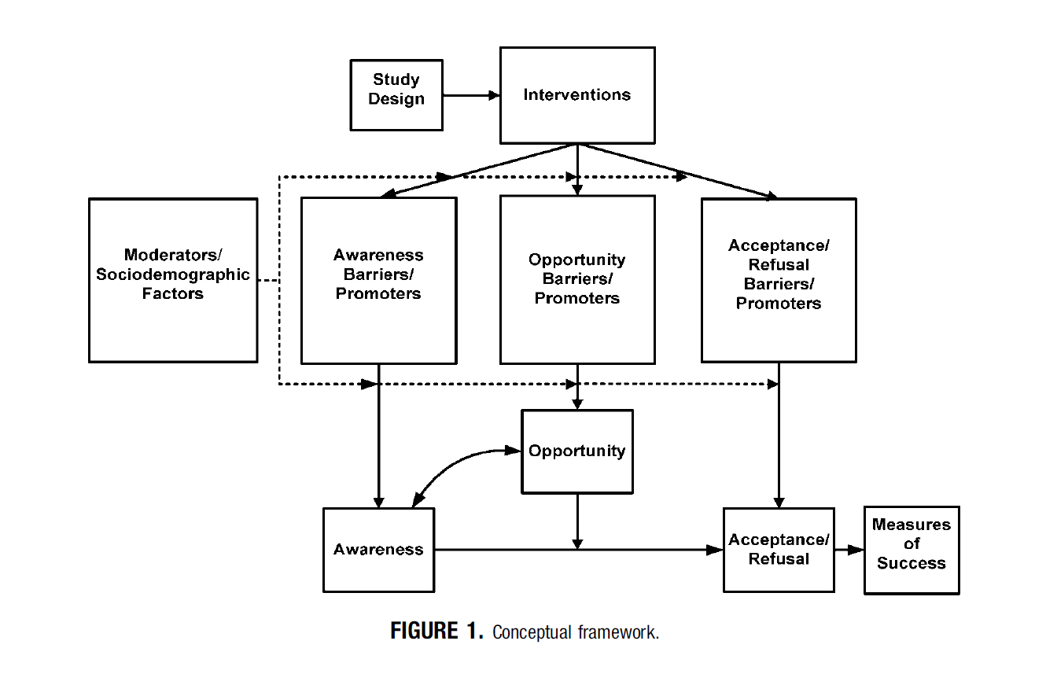
Conceptual Framework
Jean Ford et al. 2007
Notes:
This lack of attention to enrollment of minorities in clinical trials can be seen at multiple stages including the design of studies and recruitment plans, as well as, failure to report recruitment and retention results by race/ethnicity.
This limits awareness, opportunities and acceptance of clinical trials among diverse pops
Furthermore, we don’t know how race/ethnicity act to moderate participation in research. That is, does participation in trials differ by race and ethnicity for particular types of studies?
23

Slide 24
When Awareness &
Opportunity Exist (N=70,000+)
  WTP compared to Whites OR 95% CI
  3 interview studies
  AA .92 (.84 – 1.02)
  Latinos 1.37 (.94 – 1.98)
  10 clinical interventions
  AA 1.06 (.78 – 1.45)
  Latinos 1.33 (1.08 – 1.65)
  Wendler D, et al., 2006. PLoS Med;3(2):e19
Notes:
Systematic review to identify all published health research
studies that report consent rates by race or ethnicity, including NHIS and NHANES
20 health research studies that reported consent rates by race or ethnicity which involved enrollment decisions of over 70,000 individuals
Dispels myth that minorities are unwilling to participate
No race/ethnic difference in WTP for interview studies
Af Ams just as WTP as Whites, and Latinos more likely to participate than Whites in clinical interventions, possibly to increased access to state-of-the art treatments.

Slide 25
Willingness to Participate
AA & L community members value knowledge and desire to participate, especially if improves their own or communities’ health
AA & L are willing to participate if:
  we openly address their concerns
  we reduce barriers to participating
Nápoles-Springer. Research on Aging. 2000;22(6):668-691.
Notes:
We conducted focus groups with 34 low income African American and Latino older adults in San Francisco Bay Area
Want researchers to work with communities to address limited availability to quality health care in their communities
Want access to newest scientific advances

Slide 26
Current Status of R & R Science
4 Systematic reviews concluded:
Need for more systematic research
To test efficacy of specific methods
With greater methodological rigor
In specific groups
Ford JG, et al. Cancer 2007;112:228-42.
Lai G, et al. Clinical Trials 2006;3:133-141.
UyBico SJ, et al. JGIM 2007;22(6):852-63.
Yancey A, et al. Annu Rev Pub Hlth 2006;27:9.1-9.28

Slide 27
What We Know about Barriers/Enhancers
Observational Data
Extensive time, expense, effort
Community is key
Culturally sensitive methods
Multiple methods = higher yield
Notes:
It has been shown repeatedly that recruiting minorities requires more effort and expense than whites. For example, the National Lung Screening Trial, a multi-center RCT used targeted strategies/additional funding in select cities, which accounted for 78% of enrolled minorities overall.

Slide 28
What We Know about What Works
Observational Data
Mass mailing is effective in African Ams, esp. mid-higher SES; referral by friend for all r/e
Personal contact is key, but expensive
Bus ads work in metro areas
Incentives – modest increase in survey response rates; timing is not important

Slide 29

Experimental RCTs of Recruitment Methods
Special issue in Community Genetics 2008; 11

Slide 30
Asians – Cancer Genetics Networks
UCI & Fred Hutchinson
RCT of 4 methods targeting Asians:
  Traditional intro letter/packet
  Trad + $20 international phone card
  Trad + pan-Asian greeting (cover sheet)
  Combo (all 3 components)
  Wenzel L, et al. Community Genetics 2008;11:234-240.

Slide 31

Personalized Greeting in 5 Asian Languages

Slide 32
Results
Site differences:
  No incentive effect for UCI site
  Fred Hutchinson – Seattle
    Greeting 4.5 x
    Phone card 3x more likely than trad only
    Combo 3x

Slide 33
Latinos – South Texas
RCT of 3 methods targeting Latinos:
  Traditional intro letter/packet
  Trad + culturally tailored magazine
  Combo (Trad + magazine + f/u call)
  Ramirez A, et al. Community Genetics 2008;11:215-223.

Slide 34

Culturally Tailored Magazine

Slide 35
Results
Traditional only: (31%)
Traditional + mag: (30%)
Combo (trad+mag+ph call) did best (43% response rate)
28% of combo group indicated they would not have joined without the call

Slide 36
Costs?
Limited cost info by method & R/E
Oncology nurse navigator at USC enrolled 86% of eligible African American patients in RCTs at cost/enrolled of $5,677
Costs/minority enrolled for NLST from $146-$749 (mail, face-to-face outreach, media)
$ for higher incentives to participants, organizational service fees, transportation, childcare, dissemination of results
Community screening sites cost more

Slide 37

Use of Volunteer Registries
Minorities continue to be underrepresented, esp. Latinos
Will require strategic outreach
Effectiveness not yet assessed
Ex: CTSA’s ResearchMatch has enrolled > 16,000 volunteers in 50 states; 751 researchers; 540 active studies; whites=81% vs 75% of pop.
Harris PA, et al. 2012 Acad Med;87:66-73.
Notes:
Harris PA 2012
Research Match whites over represented relative to U.S. Census (81.2% vs. 75.1%);
African Americans underrepresented (9.9% vs. 12.3%)
Latinos underrepresented 4.7% vs. 12.5%
Harris PA 2005
Need to be careful of healthy volunteer bias; Vanderbilt University registry: volunteers are younger and more likely to be normal weight compared to census data

Slide 38


Slide 39
Recruitment and Retention Planning
Strategies and Resources

Slide 40
Recruitment Framework
Recruitment Factors
Sampling frame
Individual/family/ community factors
Study characteristics
Recruitment methods
Personnel
Stages of Participation
Invitation to participate
Establishing contact and eligibility
Initial response
Study retention and completion

Slide 41
Targeted Sampling Strategies
Use lists and identify surnames
  80% sensitive and specific for Latinos, higher for Vietnamese
Target high r/e-density census tracts
Budget additional $ to screen for ethnicity if not available in sampling frame
Allow for misclassification of ethnicity
Harder (more $) to recruit older adults

Slide 42
Critical Questions
Stage 1: Invitation to Participate
Is sampling frame likely to yield representative sample of targeted subgroups?
Does initial contact method account for literacy, culture, education, language, familiarity with and acceptance of research?
Are messages appealing to targeted audience?
Are there pre-recruitment strategies that might help (e.g., endorsements, outreach)?

Slide 43
Critical Questions
Stage 2: Establishing Contact and Eligibility
How accurate is the contact information?
Is ethnicity available/accurate?
When is the best time to attempt contact?
Do I have to obtain the consent of other family members?
Is no response a soft refusal?
Will poor health/high mortality affect recruitment?
Are eligibility criteria a barrier?

Slide 44
Critical Questions
Stage 3: Initial Response
Is the initial respondent burden reasonable (transportation, poor health)?
Tangible benefits to participating?
Are setting, approach, personnel welcoming?
Is research relevant and interesting?
What do I know about non-responders?
How do I deal with refusals?

Slide 45
Critical Questions
Stage 4: Study Retention and Completion
How do participants feel about continuing?
How can I maintain current contact information?
Is the ongoing respondent burden reasonable?
Ongoing tangible benefits to participating?
How can I feed back interim and final results to participants and the communities involved?

Slide 46
IPC Recruitment Results

Slide 47
IPC Recruitment Results

Slide 48
IPC Recruitment Results
Primary subject loss is prior to contact -
  from 25% (LS) to 46% (W)
Once contacted, response rates fairly high
  Higher in LS (75%) and AA (70%)
  Lower in LE (68%) and W (66%)

Slide 49
Recruitment Planning
Multiple strategies
Cultural similarity of personnel
Make participation desirable
Nurture relationships
Anticipate losses by group & stage (awareness, opportunity, participation)
Notes:
Especially for genetics /genomics study, cultural similarity and personal approaches are essential for successful minority enrollment (Johnson VA 2011-systematic review of 6 genetics studies in African Americans)

Slide 50
Practical Recruitment Steps
Budget for varied recruitment strategies
Pretest recruitment messages and strategies
  ethnically tailored flyers, contact letters, envelopes, logos
Monitor recruitment and relationships; adjust as necessary
Report results by ethnicity to build evidence base
MAKE IT PERSONAL!

Slide 51
Recommendations to Advance R & R and Community Engagement Science

Slide 52

Recommendation 1: Include Communities

Slide 53
greater resources and effort should be directed toward researching AND INVOLVING societal groups that have the greatest capacity to benefit
(Sheikh A 2006;PLoS Med 3(2): e49.)

Slide 54
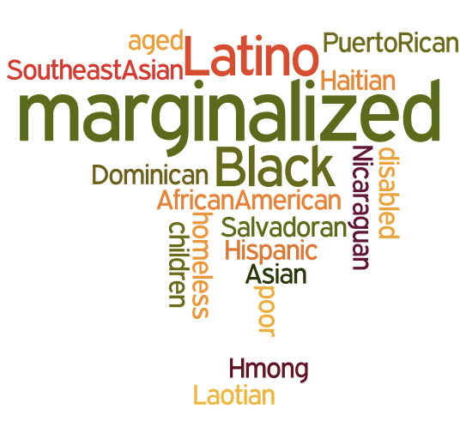
Notes:
Requires a paradigm shift from focusing on how to recruit minorities to having minority communities involved as partners in research
With shared learning and solving of health issues

Slide 55
IOM Concept of Primary Care
Integrated, accessible health care services
Attend to wide range of individual needs
Long-term partnership with clients
Attend to broader family, community, socio-economic context of health care
Use community assets to improve health
Primary Care America’s Health in a New Era, IOM, 1996.

Slide 56
Defining Community Engagement
…the process of working collaboratively with and through groups of people affiliated by geographic proximity, special interest, or similar situations to address issues affecting the wellbeing of those people. It is a powerful vehicle for bringing about environmental and behavioral changes that will improve the health of the community and its members…mobilize resources and influence systems, change relationships among partners, and serve as catalysts for changing policies, programs, and practices.
CDC, Principles of Community Engagement, 1997, p.9.
Notes:
56

Slide 57
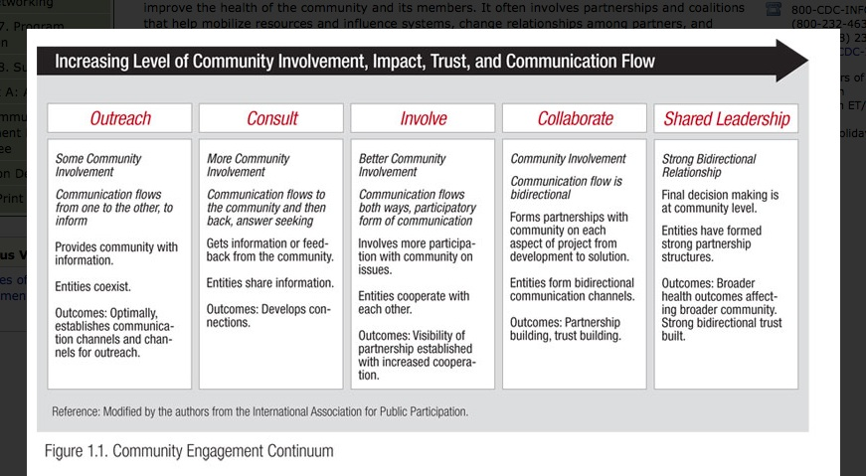
Continuum of Community Engagement

Slide 58
Working with Communities to Conduct Health Disparities Research
Expands our perspective
Shifts focus from how to recruit minority populations and how to engage/interest them in research…
  … to having minority communities involved as partners in research from the beginning

Slide 59
The Art of Recruitment
Community Engagement

Slide 60
Key Principles of CBPR
Recognizes community as an important aspect of individual and collective identity
Builds on community strengths to improve health
Facilitates collaborative partnerships through all phases of research
Integrates knowledge and action for mutual benefit of all partners
(Israel B. Annu Rev Public Hlth. 1998. 19:173-202)

Slide 61
Key Principles of CBPR (cont)
Shared learning and empowering to address social inequalities
Partnership development and maintenance to set goals, implement, interpret, disseminate, act on results
Positive and ecological perspective of health
Dissemination of findings to all partners
(Israel B. Annu Rev Public Hlth. 1998. 19:173-202)

Slide 62
Clinical Trials with CBPR Approaches
Systematic review of 19 studies; 14 since 2007; (n=18,818)
17 (90%) reported participants’ r/e
Minorities were majority in 13/17 studies
Recruited adequate # of minorities
89% of interventions were effective
De Las Nueces D. HSR.DOI: 10:.1111/j.1475-6773.2012.01386.x
Notes:
62

Slide 63
Recommendation 2: Increase Funding

Slide 64
Inadequate Funding
Searches of funding opps (1992-2010: search terms “recruitment or retention research”
  NIH Office of Extramural Research
  Federal Business Opportunities
    Yield = 1 contract award to generate representative sample for an NIA cohort study in diverse populations
FOAs can include a R & R subcomponent
Nápoles AM, Chadiha L; Gerontologist. 2011 Jun;51 Suppl 1:S142-6.

Slide 65
Recommendation 3: Increase Comparative Effectiveness Research (CER)

Slide 66
Interim Strategy-Nested Studies
Embed studies of the effectiveness of various R & R methods within larger studies, e.g., test supplemental materials or f/u
Examine moderators associated with R&R, e.g., individual, community or study characteristics
Conduct formative research prior to or after studies to examine enhancers/barriers

Slide 67
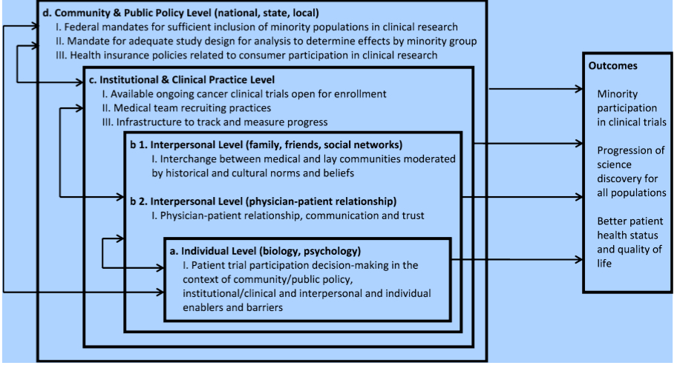
Multilevel Framework to Increase Minority Accrual
Anwuri VV. Cancer Causes Control; published online 12 July 2013
Notes:
Most R&R research and efforts have focused on individual level factors, e.g. attitudes, awareness of patients
Implemented structural changes at the institutional level , which resulted in increase from 12% minority accrual to therapeutic trials in 2005 to 14% in 2010 in a comprehensive cancer center.
Changes included:
Leadership support
Center-wide policy to require investigators define disease-specific accrual targets by race and gender based on incidence rates seen at the center
On-going monitoring and feedback policies
Baquet CR 2008 at Univ of Maryland use multi-pronged appraoches that included 1)intensive outreach, MD/Nurse education; community RCT infrastructure for 20-fold increase in CT enrollment

Slide 68
Implications
Need CER on more intensive R&R methods for underrepresented
Requires increased funding
Nesting R&R studies within studies is an interim solution for low intensity methods
What is the added value of more intensive methods, e.g., CBPR?
Notes:
68

Slide 69
Academic Institution Challenges
Build credibility of research institution through community service
Increase awareness of resources available at the research institution for the community
Increase access to research info/results

Slide 70

Conclusions
Recruitment of diverse groups is an equity issue
Working closely with minority communities in all phases of research can facilitate
  research that is relevant to their perspectives
  participation
  effectiveness
  translation/sustainability

Slide 71
APPLY RESULTS/
ID NEXT STEPS
AWARENESS
DISSEMINATE
INVITATION
FEEDBACK
RESULTS
OPPORTUNITY
PARTICIPATION
Notes:
WHAT WOULD HAPPEN IF WE INVOLVED END-USERS OF RESEARCH FINDINGS THROUGHOUT THE PROCESS?
HAVE WE DONE ENOUGH? WE HAVE BARELY SKIMMED THE SURFACE WITH RESPECT TO THE LEFT SIDE OF THE CIRCLE.
WE HAVE A LONG WAY TO GO TO ACT ON THE LEFT SIDE WHICH INCLUDES DISSEMINATING THE RESULTS AND APPLYING THEM TO ADDRESS HEALTH DISPARITIES IN PARTNERSHIP WITH THE COMMUNITIES THAT EXPERIENCE THOSE DISPARITIES AND THEIR CLINICIANS.

Slide 72
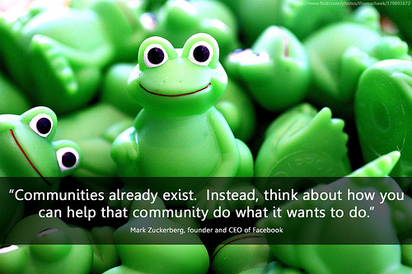
What’s in it for My Community?

Slide 73
“The preservation of the means of knowledge among the lowest ranks is of more importance to the public than all the property of the rich men in the country.”
John Adams

Slide 74
Resources
Community-Campus Partnerships for Health
http://depts.washington.edu/ccph/
National Institute of Mental Health
http://www.nimh.nih.gov/funding/grant-writing-and-application-process/recruitment-points-to-consider-6-1-05.pdf

