Slide 1
People and Measurements—The Nuts & Bolts of Research
Optimizing Subjects & Variables and Introduction to Kaiser Permanente Northern California Division of Research
Alan S. Go, M.D.
Division of Research, Kaiser Permanente Northern California
Depts. of Epidemiology, Biostatistics, and Medicine, UCSF
Dept. of Health Research and Policy, Stanford University
August 4, 2015

Slide 2
Today’s Objectives
Intro to Kaiser Permanente Northern California
  Kaiser Permanente Division of Research, population, and data sources
Selecting the People
  Develop systematic approach to optimize subject selection
Choosing the Measurements
  Understand the implications of exposure & outcome variable/measurement choices
Application to a Real Research Question: The ATRIA Study

Slide 3
Kaiser Permanente Division of Research and Population Characteristics
Regional department focused on epidemiology, health services, outcomes and clinical trial research
Kaiser Permanente Northern California population:
  >3.73 million members (>2.3 million adults); ~53% women
  Highly representative of Northern California adult pop.*
Race/Ethnicity for Age 25-79 yr | KPNC, % | Northern California (non-KP), %
Hispanic | 24.2 | 24.9
Asian/Pacific Islander | 19.7 | 15.9
Black/African American | 5.7 | 5.4
Non-Hispanic White | 49.2 | 51.8
Other | 1.1 | 2.0
*2011 Kaiser Permanente Members Health Survey

Slide 4
Kaiser Permanente Electronic Databases
Regionwide electronic health record based on EpiCare
Unique lifetime medical record number
Sociodemographics, enrollment, insurance status
Physician, clinic and medical center characteristics
Inpatient diagnoses/procedures
Ambulatory (outpatient, ED) diagnoses/procedures
Vital signs
Inpatient and outpatient drug dispensing
Inpatient and outpatient laboratory tests
Pathology findings
Selected ECG and imaging findings
Examples of Kaiser Permanente disease registries:
  CKD/ESRD/AKI, Heart Failure, CHD, Atrial Fibrillation, Diabetes, GDM, Cancer, HIV/AIDS, Viral Hepatitis

Slide 5
Transforming Massive Health Data into Usable Information
Sources: KP HealthConnect, Legacy Applications, External Data Sources
      KP HealthConnect (Clarity)
Research Database
      FRSS (Providers)
Data Span: 1960 – Current
      PARRS (KP Appointments)
      REG+ (legacy ED & Clinic encounters)
Oracle 11G
14TB
      CAMMOLOT/COPS (Legacy Chemo)
      OSCR (legacy ED & Clinic DX & PX)
Utilization
Diagnosis
Procedures
Pharmacy
Lab Results
Lab Notes
      TraceMaster (ECG’s)
      AOMS (Non-KP Plan and Referral utilization)
Enrollment
Demo-graphics
ECG
      CoPath (Pathology)
      CATS (Emergency Claims)
Providers
Rehab
Vitals
Enrollment
      Mortality
CA Death
      KP.Org
      eConsult (Referrals)
Cancer/
SEER
Cause of death
Census
      CPM (Facilities)
      Legacy ADT (legacy hospital)
      Diabetes
      Mellitus
IP Clinical Warehouse
      Kidney
      Disease
      Ad-hoc SAS Data Sets
      KITS (Immunization)
SSA Death
        Cancer Registry
      RPGEH
      Virtual Data Warehouse (VDW)
VDW Query
Teradata 14
      LURS (Labs)
Web Application
      PATDEM (Patients Demographics)
      CESR Virtual Data Warehouse
    Mini-Sentinel Common Data Model
      TRRS (Radiology)

Slide 6


Subjects and Variables: The Nuts and Bolts of the Research Question
After deciding a great research question, figuring out WHOM you want to study and WHAT you want to measure on them

Slide 7

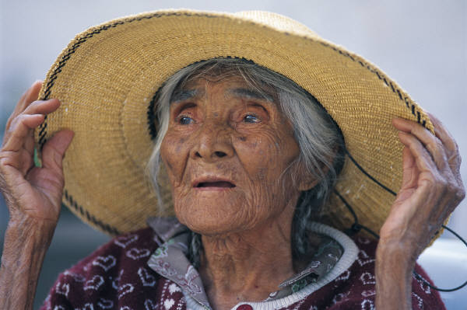



Selecting Your Subjects…

Slide 8

Optimizing Subject Selection: A Delicate Balancing Act
Feasibility
Accessibility
Cost
Time/Efficiency
Generalizability
Accuracy
Diversity
Adequate Size

Slide 9
Subject Selection: The Nitty Gritty
Explicitly Define Inclusion Criteria
  Demographic features
  Clinical/diagnostic criteria
  Geographic/administrative characteristics
  Sampling time frame
Explicitly Define Exclusion Criteria
  Minimum number needed to be feasible with acceptable generalizability to target population

Slide 10
Subject Sampling Techniques:
How to Get the “People?” (1)
Convenience Samples
  True convenience
  Consecutive
Probability Samples
  Simple random (e.g., using random number table)
  Stratified or weighted random (e.g., by gender)
  Cluster (e.g., by clinic, neighborhood, health system)

Slide 11
Subject Recruitment:
How to Get the “People?” (2)
Successful Recruitment
  ↑ response, generalizable, adequate size, on time
For hands-on studies (e.g., surveys, cohorts, trials)
  Generally harder than you think!
  Use reasonable inclusion/exclusion criteria
  Acceptable subject burden/potential benefits
  Minimize subject non-response
For database-only studies

Slide 12
Applying These Principles to Answer My Research Question:
What is the association between use of warfarin and the risk of stroke & bleeding in patients with atrial fibrillation treated in usual care?

Slide 13
Warfarin for Stroke Prevention in AF
Atrial fibrillation (AF) is most common significant arrhythmia¹ and ↑ stroke risk ~4-to5-fold^{2,3}
RCTs show warfarin ↓ stroke by 68% but ↑ bleeding³
Aspirin much less effective (RRR ~20%)
When we studied this question, warfarin was primary recommendation for many AF patients, but are RCT results generalizable to the “real world?”
¹ Go AS et al. JAMA. 2001;285:2370-75.
² Wolf PA et al. Stroke 1991;22:983-88.
³ Atrial Fibrillation Investigators. Arch Intern Med 1994;154:1449-57

Slide 14

AnTicoagulation and Risk Factors In Atrial Fibrillation
The ATRIA Study

Slide 15
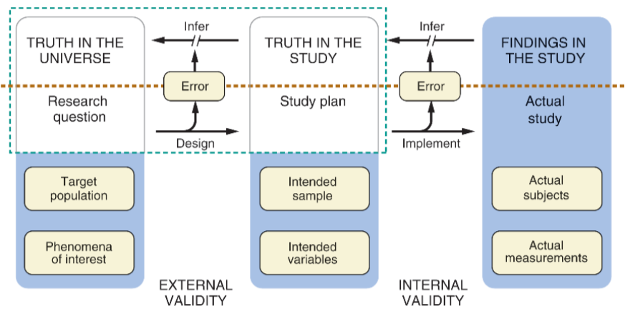
ATRIA Study
Atrial
Fibrillation
Warfarin
↓
TE/Bleeds

Slide 16
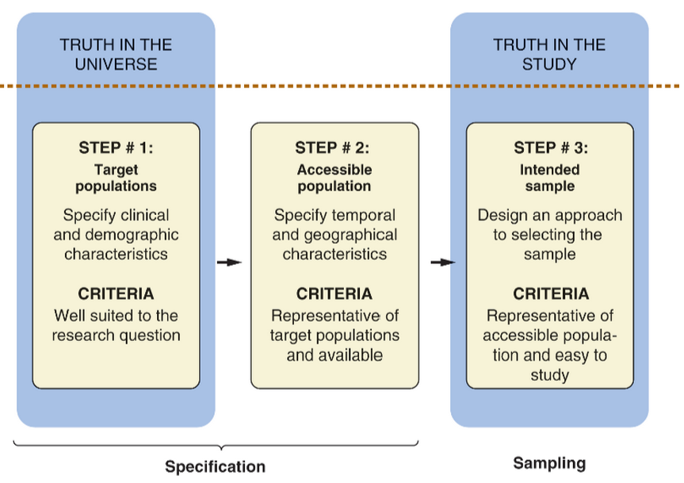
ATRIA Study: Subjects
All adults with nonvalvular AF in U.S.
Ambulatory adults with diagnosed nonvalvular AF in Kaiser Permanente
Northern
California

Slide 17
ATRIA Study: Inclusion Criteria
Sampling Frame Goal: Identify all adults with chronic nonvalvular AF
Inclusion criteria:
  Demographics: age >18 years, men/women, all races
  Clinical Criteria: Diagnosed AF from outpatient & ECG databases (≥1 outpatient AF dx + ≥1 ECG with AF or ≥2 outpatient AF dx only)
  Geography/Administrative: Kaiser Permanente No Cal
  Time Period: AF diagnosis found in 1996-1997

Slide 18
ATRIA Study: Exclusion Criteria
Exclusion criteria
  Valvular heart disease
  Transient perioperative atrial fibrillation
  Concomitant hyperthyroidism
  No health plan membership or drug benefit
  No outpatient care during 12 months after index date

Slide 19
ATRIA Cohort Assembly
≥1 Outpatient AF Dx
N=15,570
≥1 ECG with AF
N=13,052
Suspected AF
1 outpatient AF dx only
Identified by ECG only
No membership after AF dx
<18 years old
Transient AF after cardiac surgery
Concomitant hyperthyroidism
Valvular heart disease
No outpatient care after index date
or drug benefit
13,559 Ambulatory Adults with Diagnosed Chronic
Nonvalvular AF* and Known Warfarin Status
*Validation studies suggest ≥87% of cohort w/ECG-confirmed AF

Slide 20
ATRIA: Baseline Characteristics
Mean ± SD age 71 ± 12 yr
Women 43 %
Prior ischemic stroke 9 %
Chronic heart failure 29 %
Hypertension 50 %
Diabetes mellitus 18 %
Coronary disease 28 %
Older, more women, and greater comorbid burden than RCT samples→generalizable to AF patients in typical clinical practice

Slide 21

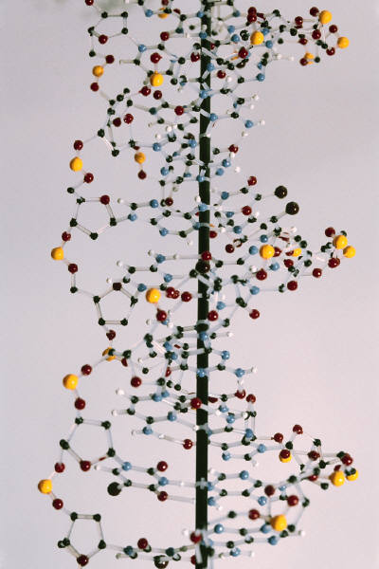


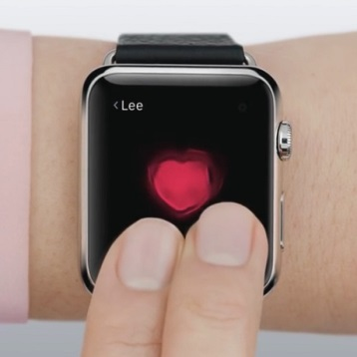

Making the Measurements:
Implications for Exposure & Outcome Variable Choices

Slide 22
Planning the Measurements
Relationship of Key Exposures
Confounding Variables
Predictor
Outcome
Effect Modifiers

Slide 23

Additional “Exposure” Considerations
Dose Issues
  Cumulative exposure
  Exposure rate
Time Issues
  Start of exposure
  When it ended
  Exposure distribution
Alcohol Use
  Total # of drinks
  # Drinks/day
  Date of first Anchor Steam
  Date of last microbrew
  Daily vs. binge drinking

Slide 24
General Variable Types
Continuous
  Quantitative intervals with typical ranking
  Examples:
    Cholesterol level
    Number of drinks
    Day supply of drug
    Waist size
Categorical
  Dichotomous (yes/no) (e.g., death, diabetes)
  Nominal (no order) (e.g., race, occupation)
  Ordinal (ordered rank) (e.g., NYHA HF Class I-IV)

Slide 25
Typical Data Sources
Goal: choose the source that gives data closest to the “gold standard” while being feasible to collect
Survey/questionnaire
Interviews
Direct observation
Environmental measurements
Databases/registries
Medical records
Physiologic measures
Biomarkers
Imaging tests
Pathology

Slide 26

Measurement Goals…
PRECISION
ACCURACY

Slide 27
Improving Precision and Accuracy of Variables & Reducing Bias
Standardized methods
Use or validate against “gold standard”
Automated measure
Multiple measurements
Less obtrusive measures
Blinding of outcome collection and adjudication
Pretest
Train & evaluate staff
Monitor quality
Timely editing, coding & correcting of forms

Slide 28
Applying These Principles to Answer My Research Question:
What is the association between use of warfarin and the risk of stroke & bleeding in patients with atrial fibrillation treated in usual care?

Slide 29
ATRIA Study: Measurements
Ambulatory adults with diagnosed NVAF in KPNC
Adults with
NVAF in U.S.
Warfarin
↓
TE/Bleeds
- Longitudinal warfarin use
- Hospitalized ischemic stroke or other systemic embolism
- Hospitalized bleeding event

Slide 30
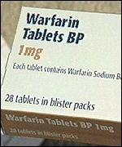
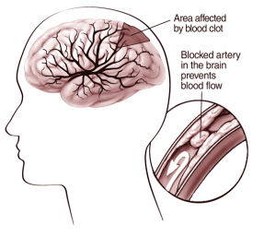

Planning ATRIA Measurements
-Demographics
-Stroke risk factors
-Warfarin contraindications
Confounding Variables
Predictor
Outcome
Effect Modifiers
(?)

Slide 31
Exposure Example: Warfarin
Warfarin use
  Baseline: Within 3 mos before index AF dx date:
    ≥1 filled warfarin prescription in pharmacy database
    “Coumadin therapy” diagnosis (ICD-9 code V58.61)
    >1 outpatient INR measurement in lab database
  Longitudinal: Time-dependent exposure based on warfarin prescriptions and INR tests
Validation study
  Chart review of random sample of “users” & “non-users”: 96% raw agreement (κ=0.92)

Slide 32
Outcome Example: Ischemic Stroke
Identification: Health plan database search
  Primary discharge ICD-9 codes for ischemic stroke (e.g., 433.x, 434.x, 436.0) found in hospitalization and billing claims databases
Validation: Medical records review
  Obtain KP and non-KP hospital records
  3-physician review (+/- Neurology consultant)
  Unable to blind warfarin status at time of event
  “Valid stroke”—acute neurological deficit lasting >24 hours not due to other etiology

Slide 33
What Did We Find?
In 13,559 adults with atrial fibrillation, longitudinal use of warfarin therapy was associated with…
  49% adjusted decrease in relative risk of ischemic stroke (crude rates: 1.11 vs. 1.88 per 100 person-years)
  1.96-fold adjusted increased relative risk of intracranial hemorrhage (crude rates: 0.51 vs. 0.33 per 100 person-years)
  Net benefit of warfarin greatest among patients at the highest risk for ischemic stroke
RCT results of the efficacy and safety of warfarin for atrial fibrillation translated well into certain settings
Go AS, Hylek EM, Chang Y, et al. Anticoagulation therapy for stroke prevention in atrial fibrillation: how well do randomized trials translate into clinical practice? JAMA 2003; 290:2685-92.

Slide 34

Interested in Collaborating with
Kaiser Permanente Northern California?
KP Research Collaboration Web Portal: www.rcwp.kaiser.org

