Slide 1
Observational
Study Designs
Kirsten Bibbins-Domingo, PhD, MD, MAS
Lee Goldman, MD Endowed Professor of Medicine
Professor of Medicine and of Epidemiology

Slide 2
Objectives
To understand the difference between descriptive and analytic observational studies
To identify the strengths and weakness of different designs and apply different study designs to the same research question

Slide 3
Descriptive vs. Analytic
Risk Factors
Heart Failure
Descriptive Questions
What proportion of patients in the DGIM have heart failure?
What is the average age of patients with heart failure in the DGIM?
Analytic Questions
Is race/ethnicity associated with heart failure among DGIM patients?
Is excessive consumption of sugar-sweetened beverages associated with heart failure among DGIM patients?

Slide 4
Analytic Studies
Attempt to establish a causal link between a predictor/risk factor and an outcome.
You are doing an analytic study if you have any of the following words in your research question:
  causes, leads to, compared with, more likely than, associated with, related to, similar to, correlated with, greater than, less than
Predictor
(risk factor)
Outcome
(disease)

Slide 5
Hierarchy of Study Types?
Descriptive
Case report
Case series
Survey
Analytic
Observational
Cross sectional
Case-control
Cohort studies
Experimental
Randomized
controlled trials
Strength of evidence for causality between a risk factor and outcome

Slide 6
Key elements of study design
Timing of the study
  Prospective
  Historical
Timing of variable occurrence & measurement
  When are predictors and outcomes measured?
How the subjects will be sample

Slide 7
Research Question
Among patients seen in General Medicine Clinic, who is at risk for heart failure?

Slide 8
Great idea, but how do you get started…
Observations in clinical practice
  Describing cases of heart failure in clinic
    Case report or Case series
  Describe characteristics of all heart failure patients (e.g. average age)
Moving from descriptive to analytic studies
  What are the risk factors associated with developing heart failure?

Slide 9
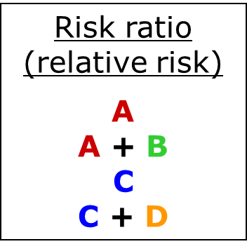
Measures of association
 |  | Disease
 |  | Yes | No
Risk Factor | Yes | A | B
 | No | C | D

Slide 10
Study Design #1
Cross-sectional study
National Health and Nutrition Exam Survey (NHANES)
Outcome: “have you been told by a doctor that you have heart failure?”
Multiple possible predictors (demographic, behavioral/lifestyle, other risk factors)
Research question: Is hypertension associated with heart failure risk?

Slide 11
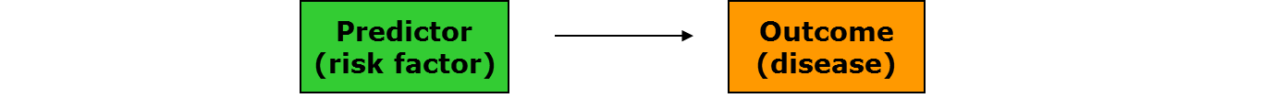
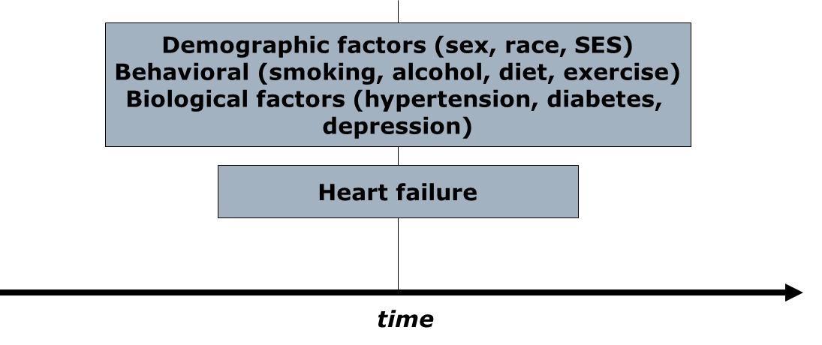
Cross-sectional study: structure

Slide 12
Cross-sectional Study: Pluses
+ Prevalence
+ Fast/Inexpensive - no waiting!
+ No loss to follow up
+ Associations can be studied
Many well-known cross-sectional studies
  NHANES
  California Health Interview Survey (NHIS, CHIS)
  Behavioral Risk Factor Surveillance Survey (BRFSS)

Slide 13
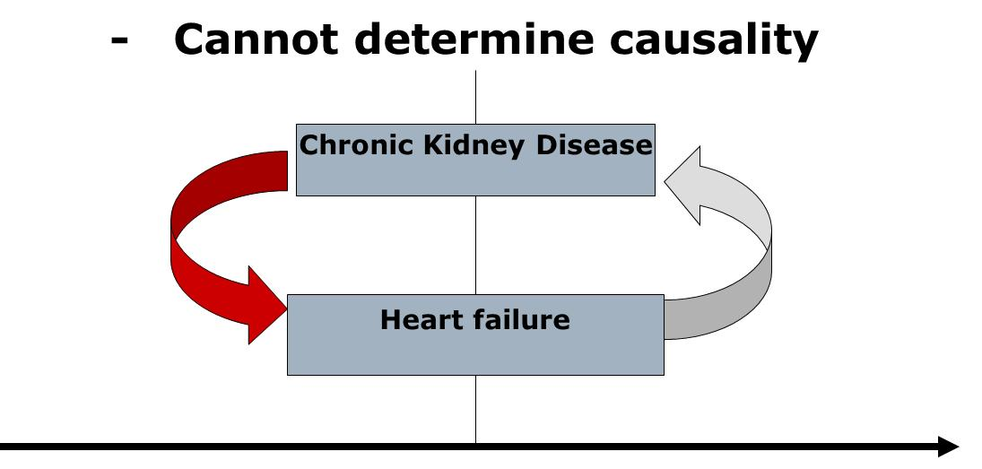
Cross-sectional study: minuses

Slide 14
Cross-sectional study: minuses
Cannot determine incidence
Cannot study rare outcomes

Slide 15
What if you are interested in the rare outcome?
Heart failure in adults before age 50
Heart failure in adults before age 30
Heart failure in children
ANSWER: A Case-Control study

Slide 16
Study Design #2
A case-control study
Cases: Adults with premature heart failure (18-50 years)
  General medicine vs. cardiology/ UCSF vs. community practice
Controls: Adults 18-50 without heart failure
  Who are the appropriate controls?
Potential predictors: Many – may be based on questionnaire
Hypothesis: Hypertension early in adulthood are more likely to have premature heart failure.

Slide 17
Case control studies
Investigator works “backward” (from outcome to predictor)
Sample chosen on the basis of outcome (cases), plus comparison group (controls)
Predictor
(risk factor)
Outcome
(disease)

Slide 18
Case-control study structure
present
CASES
Patients with heart failure before
Age 50
RISK FACTORS
Demographic
Behavioral
Biological
Genetic
CONTROLS
Patients without
Heart failure
time

Slide 19
Case control studies
Cannot yield estimates of incidence or prevalence of disease in the population (why?)
Odds Ratio is statistics

Slide 20
Measures of association
Odds ratio
A
B
C
D
Also…
A D
C B
 |  | Disease
 |  | Yes | No
Risk factor | Yes | A | B
 | No | C | D

Slide 21
Case-control Study: pluses
+ Rare outcome/Long latent period
+ Inexpensive and efficient: may be only feasible option
+ Establishes association (Odds ratio)
+ Useful for generating hypotheses (multiple risk factors can be explored)

Slide 22
Case-control study-minuses
Causality still difficult to establish
  Selection bias (appropriate controls)
    Caffeine and Pancreatic cancer in the GI clinic
  Recall bias: sampling (retrospective)
    Abortion and risk of breast cancer in Sweden

Slide 23
Case-control study--minuses
Incidence
  New cases of an outcome that occur
  Can measure in a cohort study
Prevalence
  Cases that exist at a given time
  Can measure in a cross-sectional study
Neither can be measured in a case-control study

Slide 24
Case-control - “the house red wine”
Rely tampons and toxic shock syndrome:
  High rates of toxic shock syndrome in menstruating women
  Suspected OCPs or meds for PMS
  Cases: 180 women with TSS in 6 geographic areas
  Controls: 180 female friends of these patients and 180 females in the same telephone code
  Tampon associated with TSS (OR = 29!)
  Super absorbency associated with TSS (OR 1.34 per gm increase in absorbency)
  Led to “RELY” brand tampons being taken off the market.

Slide 25
Where are we?
Cross-sectional studies and case-control studies are important for generating hypotheses about risk factors for heart failure.
What’s missing? - strengthening evidence for a causal link between risk factors and heart failure.
Use results from our previous studies to apply for funding for a prospective cohort study!

Slide 26
Study design #3
Prospective cohort study
CARDIA study:
  Prospective cohort study
  5000 (M/W, black/white, low/high SES)
  Age 18-30 at enrollment
  Followed 20 years
  Exam visits years 0, 2, 5, 7, 10, 15, 20
Outcome: Incident heart failure

Slide 27
Elements of a cohort study
Predictor
(risk factor)
Outcome
(disease)
Selection of sample from population
Measures predictor variables in sample
Follow population for period of time
Measure outcome variable
Famous cohort studies
  Framingham
  Nurses’ Health Study
  Physicians’ Health Study

Slide 28
Prospective cohort study structure
The present
The future
MI, CHF, stroke, ESRD, LEA
Everyone else
time

Slide 29
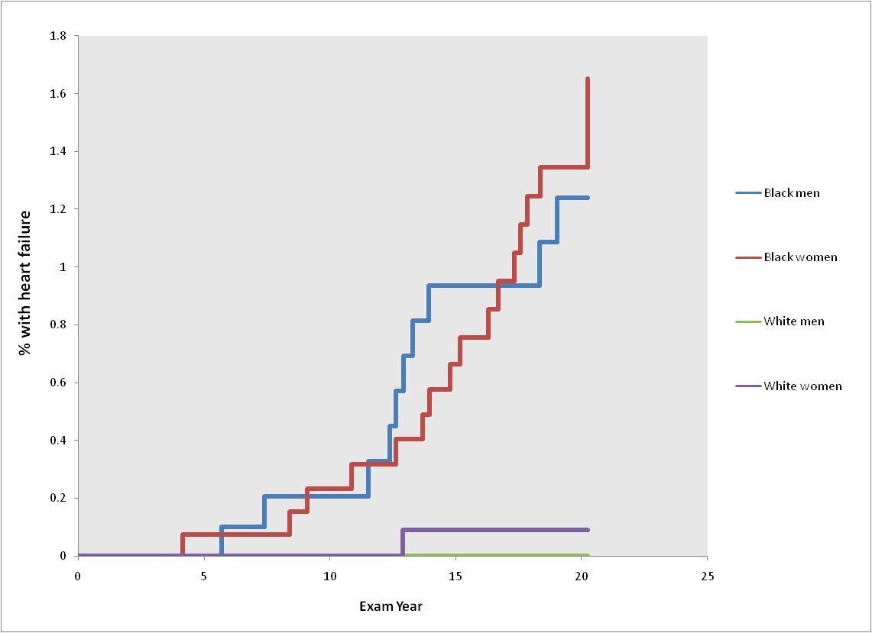
Incidence of heart failure before age 50 in black and white adults
Bibbins-Domingo et al. N Engl J Med 2009; 360:1179-1190

Slide 30
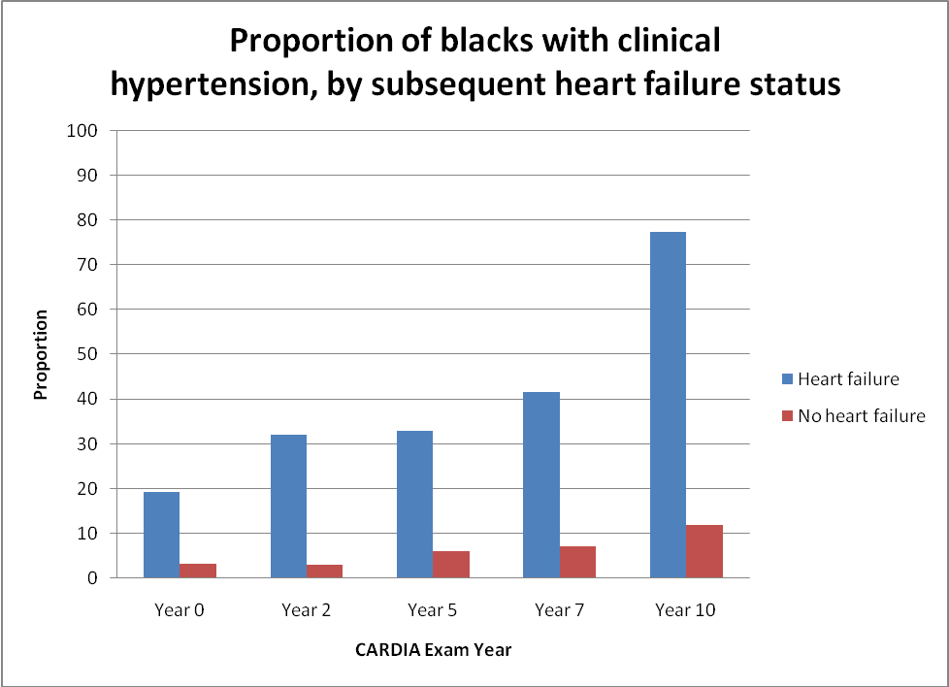
Hypertension early in life is a risk factor for heart failure before age 50 among blacks
Bibbins-Domingo et al. N Engl J Med 2009; 360:1179-1190

Slide 31
Strengths of cohort studies
Know that predictor variable was present before outcome variable occurred (some evidence of causality)
Directly measure incidence of a disease outcome
Can study multiple outcomes of a single exposure (RR is measure of association)

Slide 32
Weaknesses of cohort studies
Expensive and inefficient for studying rare outcomes
  HERS vs. WHI
Often need long follow-up period or a very large population
  CARDIA
Loss to follow-up can affect validity of findings
  Framingham

Slide 33
Other types of cohort studies
Retrospective cohort
  Identification of cohort, measurement of predictor variables, follow-up and measurement of outcomes have all occurred in the past
  Much less costly than prospective cohorts
  Investigator has minimal control over study design

Slide 34
A study type for every budget, purpose, and research question
Descriptive
Case report
Case series
Survey
Analytic
Observational
Cross sectional
Case-control
Cohort studies
Experimental
Randomized
controlled trials
A study type of every budget, purpose and research question

