Slide 1
Mostly Harmless Statistics
For Clinical Research
Michael A. Kohn, MD, MPP
Dept. of Epidemiology and Biostatistics, UCSF
DCR, 2015
Acknowledgments: Charles E. McCulloch’s 2014 presentation, Angrist and Pischke’s “Mostly Harmless Econometrics,” and the 5th book in Douglas Adams’s “Hitchhiker's Trilogy”

Slide 2
Statistics – Mostly Harmless
Review variable types and descriptive statistics
Example: smoking and carcinoma of the lung
Review study designs and measures of association
P-values
Confidence intervals
Excel demonstration
Notes:
I want to identify the role of statistics in clinical research and teach you about some of the commonly used statistical tools.

Slide 3
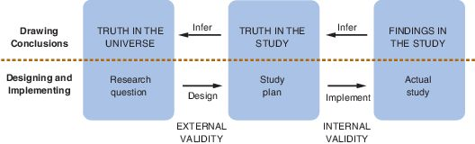
Roles of statistics in clinical research
Designing studies
  Sample size choice
Descriptive statistics
  Describe the data in the sample
Inferential statistics
  What the results in the sample tell you about the population.
Notes:
Statistics plays a role in three broad aspects of research.
Make inferences from your sample population to your target population.

Slide 4
General Variable Types*
Continuous/Numeric
  Quantitative intervals with typical ranking
  Examples:
    Cholesterol level
    Waist size
    BMD
    Number of drinks (discrete, but with quantitative intervals and typical ranking)
Categorical
  Dichotomous (yes/no) (e.g., death, fracture, DM)
  Nominal (no order) (e.g., ethnicity, occupation, blood type)
  Ordinal (ordered rank) (e.g., NYHA HF Class I-IV, Modified Rankin Scale)
*Doug Bauer’s lecture 8/5

Slide 5
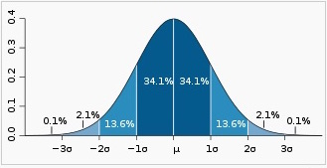
Descriptive statistics:
Continuous/numeric variables
  Mean and standard deviation (SD)
    +/- 2 SDs contain about 95% of the data values
Symmetric, “68-95-99.7% rule”, central limit theorem
Notes:
As n → ∞, the mean X_{n} of n independent identically distributed variables, X_{1, ,} X_{2…}, approaches the normal distribution with mean μ and variance σ²/n
Regardless of the distribution of X_{1, ,} X_{2, …}

Slide 6
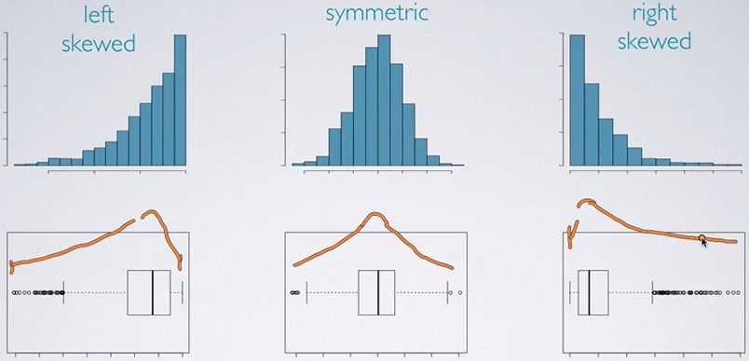
Descriptive statistics:
Continuous/numeric variables
  If skewed, median and interquartile range.
    Median: 50/50 above and below (50th percentile)
    IQR: 75th percentile – 25th percentile
http://www.bindichen.co.uk/post/Notes/data-analysis-and-statistical-inference/visualizing-numerical-data.html
Notes:
Box plot: median, 25th percentile, 75th percentile, min and max, unless min and max are outliers. Outliers are more than 1.5 x interquartile range below 25th and above 75th percentile. Then you put the whiskers at the lowest and highest non-outliers. Suspected outliers are between 1.5 and 3.0 x IQR above/below the 75th/25th percentile. They are supposed to be open circles. Outliers are > 3.0 x IQR fro, 75th/25th percentile. Use closed circles. That convention was not used here.

Slide 7
Descriptive statistics:
Categorical (dichotomous)
  Frequencies (proportion with the finding)
 | Male Patient
 | Lung Cancer | Non-cancer
Smoker | 647 | 622
Non-Smoker | 2 | 27
 | 649 | 649 | 1298
% Non-Smoker | 0.3% | 4.2%
Notes:
About the Doll-Hill study …

Slide 8
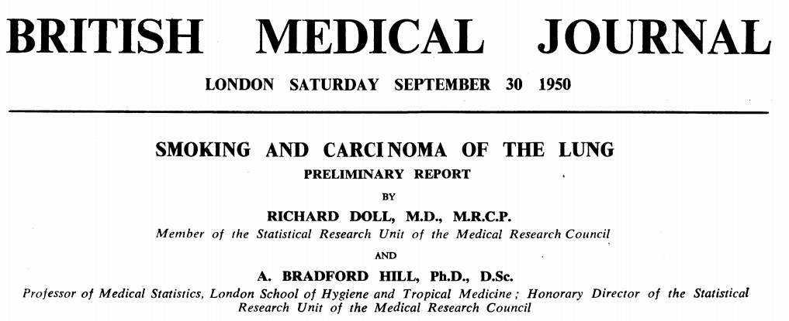
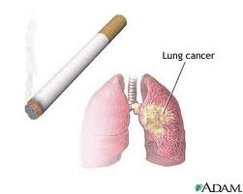
England, 1950 – Does smoking cause lung cancer? Richard Doll and Austin Bradford Hill

Slide 9
Single-Sentence Study Description
(Unless Studying a Medical Test)
“The [cute acronym] study is a [DESIGN] study of the association* between [predictor] and [outcome] in [study population].”
“Doll and Hill’s 1950 study is a case-control study of the association between smoking history and lung cancer in patients hospitalized in London”
(Cases were hospitalized with lung cancer; controls were sex- and age-matched patients hospitalized for another reason.)
* Interested in causal association.

Slide 10
Study Designs
Experimental
  -- Randomized controlled trial
Observational
  -- Cohort
  -- Double Cohort (exposed-unexposed)
  -- Case-control
  -- Cross-sectional

Slide 11
Study Design*
Not just a matter of semantics
Weaknesses and strengths associated with each study design
Different measures of association between predictor and outcome
Worth getting right or at least thinking about
*Kirsten Bibbens-Domingo Lecture 8/10

Slide 12
Measures of Association
(Dichotomous Predictor and Outcome)
 | Bad Outcome | No Bad Outcome | Totals
Predictor + | a | b | a + b
Predictor - | c | d | c + d
Totals | a + c | b + d | N = a + b + c + d
RR= Risk Ratio =
RR > 1 means presence of predictor is harmful
Null effect: RR = 1

Slide 13
Measures of Association
(Dichotomous Predictor and Outcome)
 | Bad Outcome | No Bad Outcome | Totals
Predictor + | a | b | a + b
Predictor - | c | d | c + d
Totals | a + c | b + d | N = a + b + c + d
(a/b) (a/c)
OR = Odds Ratio = ------- = -------- = ad/bc
(c/d) (b/d)
Null Effect: Odds Ratio = 1
(Best reserved for case-control studies or studies using multiple logistic regression.)
Notes:
RR is a more natural, intuitive measure. OR is always farther from 1 than RR unless both are 1.
Schulman et al. The Effect of Race and Sex on Physicians’ Recommendation for Cardiac Catheterization. N Engl J Med 1999; 340:618-626.

Slide 14
Beware of the Odds Ratio
RR is more natural and intuitive
OR is always farther from 1 than RR (unless OR = RR = 1)
Misinterpretations frequent
  Misunderstandings about the Effects of Race and Sex on Physicians' Referrals for Cardiac Catheterization. N Engl J Med 1999; 341:279-283 (Referral Rates Black = 0.85, White = 0.91, RR = 0.85/0.91 =0.93, OR = 0.85/0.15 ÷ 0.93/0.07 = 0.57)
Best reserved for case-control studies or studies using multiple logistic regression

Slide 15
Measures of Association
(Dichotomous Predictor and Outcome)
 | Bad Outcome | No Bad Outcome | Totals
Predictor + | a | b | a + b
Predictor - | c | d | c + d
Totals | a + c | b + d | N = a + b + c + d
Risk Difference = a/(a+b) - c/(c+d)
Null Effect: Risk Difference = 0
Notes:
-Risk Difference = Absolute Risk Reduction (ARR) For treatments: 1/ARR = Number Needed To Treat (NNT) to prevent 1 bad outcome

Slide 16
Measures of Association
(Dichotomous Predictor and Outcome)
Cohort
  -- relative risk (RR) or relative hazard (RH)
Double Cohort (Exposed-Unexposed)
  -- relative risk (RR) or relative hazard (RH)
Case-Control
  -- odds ratio (OR)
Cross-Sectional
  -- relative prevalence (RP)
RCTs*: RR, RH, risk difference and its inverse, number needed to treat/harm *Deborah Grady 8/12
Notes:
In a cohort study the risk is also called the cumulative hazard, so the RR could also be called the “relative cumulative hazard”(ugh).

Slide 17
Case-control study of the association between smoking history and lung cancer in patients hospitalized in London”
(Cases were hospitalized with lung cancer; controls were sex- and age-matched patients hospitalized for another reason.)
Start with “Table 1”…

Slide 18
Table 1
Randomized Trials
Compares the active treatment group to the control group on demographic and clinical characteristics
Randomization means groups should be roughly balanced

Slide 19
Table 1
Observational Studies
Cohort Study: compares the predictor positive group to the predictor negative group
  -- what else is different between these groups?
Case-Control Study: compares the cases (with the outcome) to the controls (without the outcome)

Slide 20
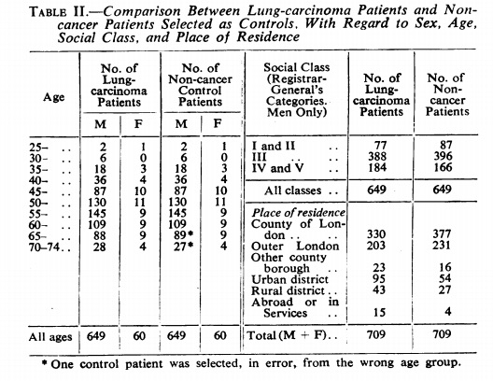
Doll/Hill – Table 1
Notes:
Sometimes a paper’s “Table 1” is actually Table 2!

Slide 21
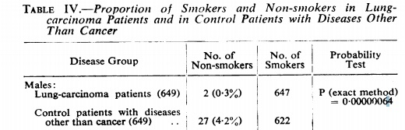
Doll/Hill – Results Table
Notes:
When reading a paper, always try to find the key results table.

Slide 22
Results Table:
Smoking/lung cancer
 | Male Patient
 | Lung Cancer | Non-cancer
Smoker | 647 | 622
Non-Smoker | 2 | 27
 | 649 | 649 | 1298
Conclusions?
Notes:
Prefer outcome as column headings with the bad outcome on the left and predictor as row labels with the positive predictor on top. Then RR or OR > 1 means positive predictor is bad (increases risk).
Smoking was very common among men in this sample. Even in non-cancer patients it was 622/649 = 96% (only 4% non smokers)
Asymmetry in number of non-smokers (2 vs. 27) (0.3% vs. 4.2%)
Is this evidence of an association between smoking and lung cancer? Or is this attributable to chance?.

Slide 23
Results Table:
Smoking/lung cancer
 | Male Patients
 | Lung Cancer | Non-cancer
Smoker | 647 | 622
Non-Smoker | 2 | 27
 | 649 | 649 | 1298
Odds | 323.5 | 23.0 | 14.0 | =OR
Notes:
Smoking was very common among men in this sample. Even in non-cancer patients it was 622/649 = 96% (only 4% non smokers)
Asymmetry in number of non-smokers (2 vs. 27) (0.3% vs. 4%)
Is this evidence of an association between smoking and lung cancer? Or is this attributable to chance?.

Slide 24
Doll/Hill – Results Table
Notes:
Where do p-values come from? That is the role of “statistical hypothesis tests” which come in may different flavors.

Slide 25
Doll/Hill – Results Table
 | Male Patients
 | Lung Cancer | Non-cancer
Smoker | 647 | 622
Non-Smoker | 2 | 27
 | 649 | 649 | 1298
 | P = | 6.40337E-07
Notes:
Where do p-values come from? That is the role of “statistical hypothesis tests” which come in may different flavors.

Slide 26
Under the null hypothesis:
P = the chance of a result at least as extreme as observed
Assume null hypothesis true
    (that lung cancer patients are just as likely to be non-smokers as non-cancer patients)
Calculate the probability of a result as extreme as or more extreme than observed
Call this the p-value.

Slide 27
Marble “Story”
Urn contains 649 red marbles and 649 green marbles.
Randomly select (without replacement) 29 marbles and put a white dot on them.
How likely is it that exactly 2 of the 649 red marbles will have a white dot?
 | Marble Color
 | Red | Green
No Dot | 647 | 622 | 1269
White Dot | 2 | 27 | 29
 | 649 | 649 | 1298
Probability = 0.000000598
https://www.youtube.com/watch?v=k2BB0p8byGA&list=EC2SOU6wwxB0uwwH80KTQ6ht66KWxbzTIo
Notes:
Isomorphic problem

Slide 28
Marble “Story”
Urn contains 649 red marbles and 649 green marbles.
Randomly select (without replacement) 29 marbles and put a white dot on them.
How likely is it that exactly 2 of the 649 red marbles will have a white dot?
 | Marble Color
 | Red | Green
No Dot | 647 | 622 | 1269
White Dot | 2 | 27 | 29
 | 649 | 649 | 1298
Probability = 0.000000598 ≠ 0.000000640 = P
https://www.youtube.com/watch?v=k2BB0p8byGA&list=EC2SOU6wwxB0uwwH80KTQ6ht66KWxbzTIo
Notes:
Why doesn’t the probability equal 0.00000064 ?

Slide 29
Marble “Story”
Urn contains 649 red marbles and 649 green marbles.
Randomly select (without replacement) 29 marbles and put a white dot on them.
How likely is it that exactly 1 of the 649 red marbles will have a white dot?
 | Marble Color
 | Red | Green
No Dot | 648 | 621 | 1269
White Dot | 1 | 28 | 29
 | 649 | 649 | 1298
Probability = 0.000000041

Slide 30
Marble “Story”
Urn contains 649 red marbles and 649 green marbles.
Randomly select (without replacement) 29 marbles and put a white dot on them.
How likely is it that exactly 0 of the 649 red marbles will have a white dot?
 | Marble Color
 | Red | Green
No Dot | 649 | 620 | 1269
White Dot | 0 | 29 | 29
 | 649 | 649 | 1298
Probability = 0.00000001
Notes:
Where do p-values come from? That is the role of “statistical hypothesis tests” which come in may different flavors.

Slide 31
P Value (at least as extreme as)
647 | 622
2 | 27 |  | 0.000000598
649 | 649
648 | 621
1 | 28 |  | 0.000000041
649 | 649
647 | 622
0 | 29 |  | 0.000000001
649 | 649
 |  | Sum | 0.000000640

Slide 32

P Values
Correct Definition: A P-value is the probability of observing a value of the test statistic at least as extreme as that observed in the study, if in fact the null hypothesis is true.
Incorrect Definition: A P-value is the probability that the null hypothesis is true (i.e., that there is no difference between the groups, no relationship between the variables, etc.), given the results of the study.
Newman and Kohn, Evidence-Based Diagnosis. Chapter 11: Understanding P Values and Confidence Intervals. Cambridge University Press 2009.

Slide 33
Small P-value
If the p-value is small, then there are two possibilities:
The null hypothesis is true and something highly unusual occurred,
OR
The null hypothesis is false, and we can conclude there is an association or difference.
Notes:
(Next slide) To give you a better feel, here is a more extreme table.

Slide 34
Interpreting p-values
McCulloch’s rules of thumb
P<0.05 is widely accepted as the cut-off point for rejecting the null hypothesis. Values less than 0.05 are commonly described as statistically significant.
P>0.10: consistent with the null hypothesis.
  But doesn’t prove it.
0.05<P<0.10: suggestive that the alternative hypothesis* is true.
0.01<P<0.05: supportive of the alternative hypothesis*. Statistically significant.
P<0.01: strongly supportive of the alternative hypothesis*. Statistically significant.
*But H_{A} = Not(H₀), so …

Slide 35
Interpreting p-values:
Chuck’s rules of thumb (with Michael’s edits)
P<0.05 is widely accepted as the cut-off point for rejecting the null hypothesis. Values < 0.05 are commonly described as statistically significant.
P>0.10: consistent with the null hypothesis.
  But doesn’t prove it.
0.05<P<0.10: suggestive that the alternative hypothesis is true null hypothesis is false.
0.01<P<0.05: supportive of the alternative hypothesis even more suggestive that the null hypothesis is false. Statistically significant.
P<0.01: strongly supportive of the alternative hypothesis. suggestive that the null hypothesis is false. Statistically significant.
Notes:
I removed all reference to an alternative hypothesis since we never calculated the probability of our results under any specific alternative hypothesis. H_{A} = Not(H₀₎

Slide 36
McCulloch’s PPPs
P-value Pet Peeve1: Authors who describe a statistically significant result as “significant” without the “statistically” qualifier.
  Statistically significant = detectable difference (of any magnitude)
  Significant difference = difference of important magnitude.
P-value Pet Peeve2: Authors who describe a lack of a statistically significant result as no effect or no association.
  Absence of evidence is not the same as evidence of absence. (Altman and Bland. BMJ 1995;311:485)
  Need to consider confidence intervals to assert the latter.
Notes:
Altman and Bland. BMJ 1995;311:485

Slide 37
Generating p-values
Statistical hypothesis tests generate p-values, sometimes via arcane calculations.
Appropriate test depends on nature of the variable studied as the outcome, and
whether adjusting for other potential predictors
Notes:
We are not going to get into the arcane calculations, like exact test vs Chi-squared or, more generally, parametric vs non-parametric.

Slide 38
Comparing Groups
 | Adjustment for Confounding
Outcome | Unadjusted | Adjusted
Binary | Chi-squared Test, (Fisher's) Exact Test | Logistic Regression
Continuous/ Numerical | t-test | Linear Regression
Surival Analysis (Time to Event) | Kaplan-Meier Curves, Log-Rank Test | Cox Proportional Hazards Regression
They all generate a p-value, so the key is to figure out what the null hypothesis is and interpret the p-value.
Notes:
We are not going to get into the arcane calculations, like exact test vs Chi-squared or, more generally, parametric vs non-parametric.

Slide 39
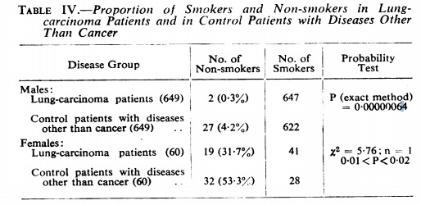
Doll/Hill – Results Table
Notes:
Moving on to the women in the Doll/Hill study.

Slide 40
Results Table:
Smoking/lung cancer
 | Female Patients
 | Lung Cancer | Non-cancer
Smoker | 41 | 28
Non-Smoker | 19 | 32
 | 60 | 60 | 120
Odds | 2.2 | 0.9 | 2.5 | =OR
P = 0.016 (Χ² test)
Notes:
Smoking was less common among women in the sample. Women without cancer 28/60 = 47%.
Asymmetry in number of smokers (41 vs. 28) 68% vs 47%
(Lung cancer was also less common. Only 60 women with lung cancer vs 649 men with lung cancer.)
Is this evidence of an association between smoking and lung cancer? Or is this attributable to chance?.

Slide 41
Results Table:
Smoking/lung cancer
 | Female Patients
 | Lung Cancer
Smoker | 41 | 68%
Non-Smoker | 19 | 32%
 | 60
41/60 = 0.68 SE=0.06

Slide 42
Standard errors – understanding the accuracy of data from samples
A key ingredient in statistics is the standard error or SE. From sample to sample, calculated statistics approximate their average value in the population, give or take a standard error or two.
By knowing the SE you can delineate reasonable or unreasonable values of the unknown population averages.

Slide 43
Using standard errors
Suppose a sample of 60 women with lung cancer gives a proportion of 0.68 (41/60) smokers with a SE of 0.06.
What can we say about the possibility that the true value (if we evaluated all hospitalized women with lung cancer) is as low as 0.50?
Range of reasonable values is 0.68 plus or minus 2×(0.06) or (0.56, 0.80).
0.50 is not reasonable for a population value.
For a binary outcome with a sample size of n and a proportion of p, the SE is given by
Notes:
So can exclude from consideration that the rate is as low as 0.5.

Slide 44
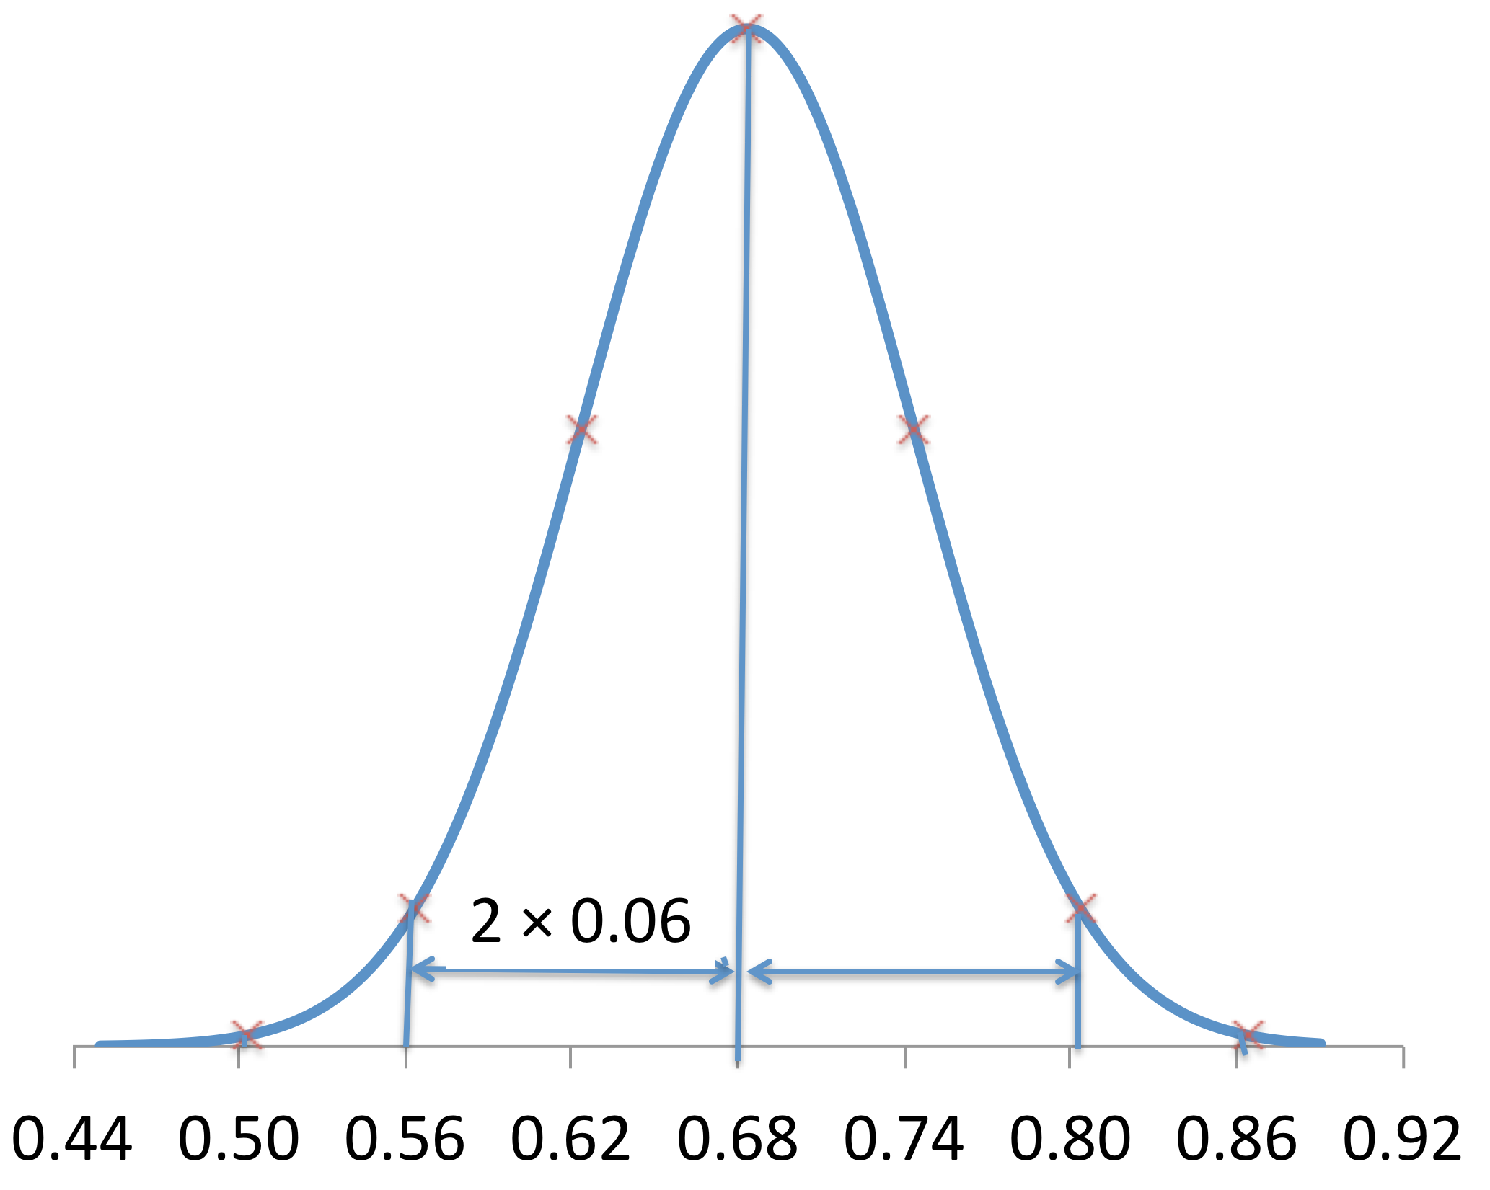
Using standard errors
Range of reasonable values: 0.68 ± 2×(0.06) or (0.56 - 0.80).
Notes:
So can exclude from consideration that the rate is as low as 0.5.

Slide 45
Standard Errors (SE) vs. SD
Tip:
Use standard deviations (SDs) to quantify the spread of data values in a sample or population.
Use standard errors (SEs) to quantify the precision of a sample estimate of a population quantity.
For example, if the purpose of a table or graph is to describe the variability of the data use SD. If the purpose is to suggest that the true average values in the population may differ use the SE (or go straight to confidence intervals).
Notes:
Standard errors are important because you will see parameter estimates (e.g., a regression coefficient) reported with a standard error sometimes in journals but especially in output from programs like Stata.
Also, standard errors are used to calculate confidence intervals.

Slide 46
Confidence Intervals
Confidence intervals do not indicate a range with a 95% probability of including the true value.
Nonquantitative definition works best:
The confidence interval indicates a range of values consistent with what was observed in the study.
CI is often given by: estimate ± 2(SE).

Slide 47
Reductio Ad Unlikely
Suppose that hypothesis H₀ is true.
It follows from H₀ that a certain outcome O is very improbable (say, less than Fisher’s 0.05 threshold).
But O was actually observed.
Therefore, H₀ is very improbable.
Ellenberg, Jordan. How Not to Be Wrong: The Power of Mathematical Thinking (p. 133). Penguin Group US. Kindle Edition.
Notes:
A Reductio ad absurdum proof is also called a proof by contradiction.
You can calculate the probability of your results under multiple different Ho’s.

Slide 48
CI: H₀s that our study results would NOT reject*
H₀: True Propotion | P-Value for 41/60 | Reject H₀?
0.50 | 0.005 | Yes
0.53 | 0.017 | Yes
0.56 | 0.054 | No
0.59 | 0.142 | No
0.62 | 0.312 | No
0.65 | 0.588 | No
0.68 | 0.956 | No
0.71 | 0.649 | No
0.74 | 0.317 | No
0.78 | 0.078 | No
0.80 | 0.024 | Yes
0.83 | 0.002 | Yes
*roughly speaking
Notes:
This isn’t quite right, because the CI goes to 0.801, but the P value for 0.80 = 0.024 < 0.025. The cutoff should be P = 0.025.
The SE that you use differs when the null hypothesis is that the true proportion is 0.50 vs. 0.53 vs. …

Slide 49
Confidence Intervals and Hypothesis Tests*
The value of 1 for a relative risk or odds ratio corresponds to the special case of equal risk.
A confidence interval for a relative risk or odds ratio contains the value 1 if the hypothesis test cannot reject the null hypothesis (using 95% confidence and p-value cutoff of 0.05).
A confidence interval for a difference contains 0 if the hypothesis test cannot reject the null hypothesis of the difference being 0 (equal values).
*Fine point: CIs must be “test-based”
Notes:
Fine point: CI must be “test-based”

Slide 50
Results Table:
Smoking/lung cancer
 | Female Patients
 | Lung Cancer | Non-cancer
Smoker | 41 | 28
Non-Smoker | 19 | 32
 | 60 | 60 | 120
 |  | Odds Ratio | 2.5
95% CI: 1.2 – 5.2
(P = 0.016 Χ² test)
Notes:
Not reporting SE for OR because it would require discussing logarithms.
SE of Ln(OR) = SQRT(1/41+1/28+1/19+1/32) = 0.38. EXP(0.38) = 1.46. CI: (OR / 1.46^1.96, OR * 1.46^1.96) = (1.2, 5.2)

Slide 51
Adjustment using multivariate models
A key reason to use multivariate models is to allow adjustment for confounders.
Doll and Hill used matching.

Slide 52
Confidence Intervals in “Negative” Studies
When H₀ is not rejected, the confidence interval gives additional information about the magnitude of the differences.
If the confidence interval is narrow and excludes clinically significant differences, then the study does provide evidence of absence.
If it is wide, the study might be uninformative.

Slide 53
Example: Harris, Bebe-Donk and Alshafie (BMC Cancer 6: 27, 2006) study the relationship of breast cancer to use of COX-2 inhibitors in a case-control study at a single hospital. They find (their Table 2) the following odds ratios and 95% confidence intervals (CI):
COX-2 OR = 0.29, CI (0.15, 0.59)
Acetaminophen OR = 1.02, CI (0.39, 2.20)
Baby aspirin OR = 0.77, CI (0.42, 1.41)
“Neither acetaminophen nor baby aspirin (81 mg) had any effect on the relative risk of breast cancer.”
Notes:
For users of COX-2 inhibitors, the odds of breast cancer were 29% that of those who did not use COX-2 inhibitors.
Over-interpretation:
Acetaminophen might have increased the odds by more than two-fold.
Baby aspirin might have reduced the risk to 42% that of non-users.

Slide 54
Excel demonstration

Slide 55
Excel demonstration

Slide 56
Summary
Roles of statistics.
Inferential: p-values, standard errors, confidence intervals.
P<0.05. Statistically significant. Detectable difference, not necessarily important.
Use confidence intervals to interpret “negative” studies and importance.
Use multivariate adjustment for confounders.

