Slide 1
Epidemiologic Methods (EPI 203): Fall 2015
Notes:
Welcome to Epidemiologic Methods. Here is our roadmap for the quarter, the next three months. Ann Schwartz from our Department of Epidemiology and Biostatistics will start us off with a series of 5 lectures. The first is a lecture on study design in which the emphasis will be on a unifying concept– the study base-- that will hopefully make it easier, rather than harder, to understand the various options we have in designing our studies. Then, Ann will focus on the most basic parameters that we estimate in human subjects studies - the measurement of disease occurrence and the relationship between certain measurements (called “exposures” or predictor variables) to disease outcomes, what we call measures of disease association. At that point, I will take over to give a series of 6 lectures about the various threats we face in getting the right answer in our work, in other words, selection bias, measurement bias, and confounding, with a major emphasis on confounding, because with the exception of randomized designs, confounding is generally our biggest opponent.
Beginning in the 2nd week, we will have our weekly small group discussion session where we will review the weekly homework. You will notice that on week 3, we begin to sprinkle in Journal Clubs where we apply what we have learned in lecture to the critical dissection of the contemporary literature. As you can see, we have several of these Journal Clubs because we feel it is critical for you to learn to read real life papers.

Slide 2
Course Administration
Format
  Lectures: Tuesdays 8:45 – 10:15 am. Available on website.
  Small Group Sections: Tuesdays 1:30 pm. Begin week 2.
    Overview of lectures, review of assignments
    Location: MH 2105, 2106, 2107, 2108 or online (see website)
  Journal Clubs: Tuesdays 3:15 to 4:15 pm. Begin in week 3.
    Application of lecture concepts to contemporary literature
Instructors
  Small Group Section Leaders:
    U.S.: Josh Demb, Natalie Engmann, Raj K., & Megha Mehrotra
    Brazil: Vivian Avelino-Silva
    Uganda: Aggrey Semeere
  Faculty Overseers:
    Kristen Aiemjoy, Trisha Hue, Ann Schwartz and J. Martin
Notes:
A few housekeeping details, all of which are listed on the course website.
All lectures will be here on Tuesdays at 8:45 am and will last 90 minutes. Note that we have a lot to cover and will start on time. Lectures will also be available online, usually within about 60 minutes of the completion of the lecture.
Each Tuesday afternoon at 1:30 pm we will have our small group sections, led by Josh Demb, Natalie Engmann, Raj. K, and Megha Mehrotra here in the U.S. in our in-person sessions, and Aggrey Semeere in Uganda and Vivian Avelino-Silva in Brazil leading small group sessions. Hence, this is truly an international course. Our section leaders are scholars who took the course in the past and who because of their exemplary performance were asked to help us teach the course this year. As has been our tradition, we always look to those who excel in understanding our material to help us in teaching the following year. These teaching assistants here in the U.S. will be joined by one of the members of the faculty, either me, Ann Schwartz, Trisha Hue, or Kristen Aiemjoy. The content of the small group sections will be to review the prior week’s lecture, review the weekly problem set, and have a dialogue about the material. You have each been assigned to one of the sections, either here, across the hall in 6601, or in conference room 5721 or 5759, on the 5th floor. Please see your group assignment on the course website. Traditionally, the small groups sections are where a lot of questions are clarified and a lot learning takes place. We are not taking attendance but given that you took the time to enroll in the course, we would very much expect that you will attend.
We will also have at 6 journal clubs throughout the course. They will be from 3:15 to 4:15 in the same room as your small group sections, beginning in two weeks. As mentioned, the purpose of these sessions is to apply the concepts learned in class to understanding and critiquing the contemporary biomedical literature. This is a big part of the course because if you cannot apply what we have learned here to actual scientific practice, we have not achieved much. Hence, we are going to practice this A LOT.

Slide 3
Resources
Textbook
  Epidemiology: Beyond the Basics by Szklo and Nieto (S & N). 3rd edition.
Other Reading
  Slide sets (and narrative notes) from each lecture (website)
    Single most important resource
    In view of the imprecision in language, our lectures trump everything else
  Selected other required and optional articles (website)
Software
  Statistical software: Stata version 13 or higher
    Beginning Week 2
    We expect that you know how to load datasets and basic command syntax
  dagitty.net – free web-based software for DAGs
Notes:
We will draw upon one main textbook. It is Epidemiology: Beyond the Basics by Szklo and Nieto (show), now in its 3rd edition. It is available from the usual vendors. In general, doing the reading before the lecture will really help you get the most out of lecture.
The book is a fine resource but it becomes less and less relevant as the course progresses. Instead, the single most important resource is our slide sets and their accompanying notes; these can be found and downloaded from the course syllabus website. I will note that whenever there is a difference between our lectures and the text (or some other reading), our lectures trump everything else. For example, there is a lot of imprecision in terminology and language in epidemiology. What we use in class trumps other terminology. In addition, we have selected several other required and optional passages, which are also posted on the website.
We will also be using statistical software, specifically Stata. Version 13 or higher will work. We expect that you understand the basics of working in Stata, namely how to load a dataset and basic command syntax. Completing our BIOSTAT 212 course easily suffices for this background.
Finally, later in the course, we will be using a web-based free software called dagitty.net, which is used to create and solve DAGs.

Slide 4
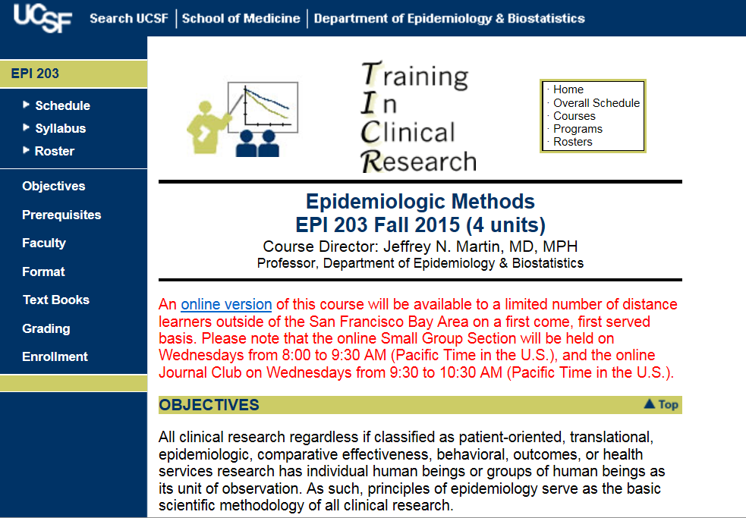
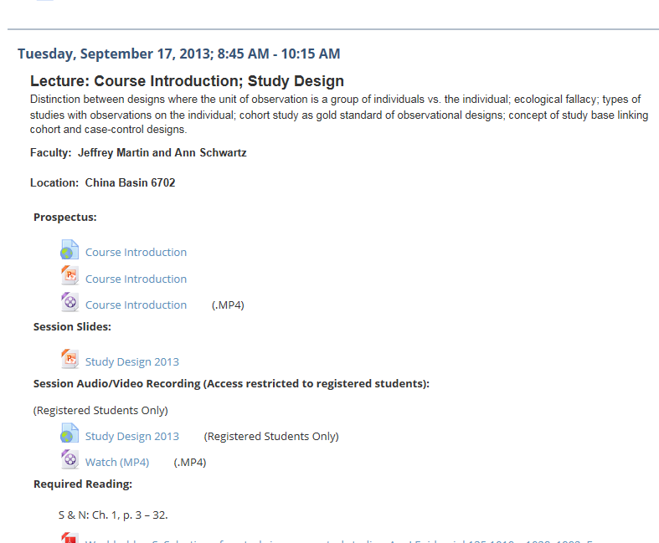
“CLE” (Syllabus)
Course Homepage
Notes:
When I say that the resources are available on the course website, what I really mean is what is called the Collaborative Learning Environment or CLE syllabus. As those of who have already taken one of our courses know, you can reach the this CLE site by clicking on Syllabus on the course’s main homepage. All of the course materials will be placed on the CLE syllabus.

Slide 5
Grading
  Based on points achieved on weekly homework (~75%, after dropping lowest score) & final (~25%).
  Late assignments are not accepted (but plenty of pts)
  Weekly Problem Sets:
    files should be pulled from website
    word process your responses (OK to handwrite some equations)
    documents are all-inclusive; no need to lookup articles
    due at start of Small Group Section
    If absent, e-mail to section leader by start of session (eg,1:30 pm)
Attendance
  Lectures: Live attendance not required. Personal choice.
  Small Groups/J. Clubs: Not required, but highly recommended.
Notes:
Grades are based on homework and the final exam. They are based approximately 75% on homework, after we allow you to drop your lowest weekly score, and 25% on the final. We have problem sets every week and they are due at the beginning of section the following week. For example, the problem sets that will be posted on the website after the first lecture will be due at 1:30 pm on the following Tuesday at the beginning of small group section. We do not accept late assignments, but because we have plenty of points in this course, missing one or two homework assignments, won’t jeopardize your passing the course, assuming satisfactory performance on the rest of the material. If you are absent, then we expect you to email your assignment to your section leader by 1:30 pm.
Regarding attendance, we don’t formally require that you attend any of the sessions. Lectures in particular are a personal choice in terms of whether you want to attend in person or watch the video or both. The Small Groups and Journal Club, on the other hand, although not required, are highly recommended. This is because it is at these sessions where we will actively discuss the material, and this is where most people really learn the material.

Slide 6
What We Do and Why We Do It
Spectrum of content
  Each week, new material is outlined via lecture & required readings
Learning the material
  Working through the weekly problem sets
  Discussing the problem sets at Small Group section
  Reading and discussing the Journal Club articles
  Many students have also benefited from student-run study groups
Philosophy
  Steadily build a knowledge base over the course of quarter
  Ample time needed between each new installment of material to optimize comprehension
  Learning is facilitated by engaging a variety of senses and motor functions (following “multiple intelligences” educational theory)
Notes:
This brings us to an what we do and why we do it?
This is why while you might think you fully understand the problem sets by working through them on your own, it is likely you can learn even the better more deeply if you attend the Small Groups and Journal Clubs and listen to your classmates and discuss the material.

Slide 7
Definitions of Epidemiology
Traditional: The study of the distribution and determinants (causes) of disease
  e.g., cardiovascular epidemiology would study frequency and risk for various heart diseases
Contemporary: Method used to conduct human subject research
  the methodologic foundation (“basic science”) of any research (experimental, observational, “translational”, etc.) where individual humans or groups of humans are the unit of observation
    This means everything that each of you are doing!
Notes:
Finally, what we really have not said is what is this course about? We should take a moment to define what we mean by epidemiology. These days, epidemiology really has two meanings. The first is the traditional definition where epidemiology means the study of the distribution or determinants of disease. For example, a cardiovascular epidemiologist would study patterns of occurrence of heart disease and the “risk factors” for heart disease. More broadly, the second definition is a more recent definition that I actually think is more appropriate today. In this definition, epidemiology stands for the body of methods used to conduct any type of research where individual humans or groups of human are the unit of observation. In other words, epidemiology is the basic science, or basic foundation, for all human subject research. I wish there was a better way to describe this basic science, but I don’t think there is one. Some people think this is what biostatistics is, but biostatistics is only a component of what I am talking about here. Our intent with this course is not to impart knowledge that is useful only for studies of the distribution or risk factors of disease. In other words, we don’t expect all of you will become epidemiologists in the traditional sense. Instead, we feel this information are the basic building blocks no matter if you think of yourself as a risk factor epidemiologist, clinical trialist, health services or policy researcher, or a meta-analyst.

Slide 8
What Kinds of Questions Does Epidemiology Answer?
Description
  What are the most frequent and serious conditions/diseases?
Causation
  The science of establishing causal relationships among biological, behavioral, environmental (etc.) factors among humans
  Does X cause Y?
Mediation
  Understanding the mechanisms of causation
  How does X cause Y?
Interaction
  When and for whom does X cause Y?
Prediction
  Do A, B, and C predict occurrence of Y? (e.g., diagnosis or prognosis)
How often does Y occur?
Notes:
So, just what does epidemiology do? What kinds of questions does epidemiology answer? The answer is many, and each of them is highly relevant.
First, is description.
Lastly, is prediction. Can we identify a factor or set of factors that predicts the occurrence of disease or some outcome in a diseased person. Doing this prediction concurrently is basically diagnosis. Using prediction to predict the future is prognosis.
I’m guessing that each of you is working at least one of these questions. If true, then this is course is for you.

Slide 9
Which of the following is the easiest to begin to perform?
Clinical practice (e.g., medicine, nursing, dentistry, pharmacy)
Epidemiologic (Clinical) research (aka human subjects research)
Laboratory research
Notes:
Let’s end with having the first quiz of the course.
Which of the following is the easiest to begin to perform? Clinical practice? Epidemiologic or clinical research (in other words, any form of research where humans are the unit of observation)? Or, laboratory research?

Slide 10
Which of the following is the easiest to begin to perform?
Clinical practice
Epidemiologic/Clinical research (aka human subjects research)
Laboratory research
Need a degree and a license
Need idea, dataset from internet, and a calculator
Need physical lab space and equipment
Notes:
The answer: Well, it is not clinical practice. This takes a degree and a license to start. It is also not laboratory research. You need physical lab space and equipment; you just cannot start this in your garage on a weekend. So, the answer is clearly epidemiologic research: all you need is an idea, a dataset (which these days you can just pull down from the web), and a calculator and you could start your project. Today. This ease of start time often gives the impression that clinical/epidemiologic research is child’s play and that anyone can easily do it.

Slide 11
Which of the following is the easiest to perform well?
Clinical practice
Epidemiologic/Clinical research (aka human subjects research)
Laboratory research
Notes:
But, the more relevant question is which is the easiest to perform well?

Slide 12
Which of the following is the easiest to perform well?
Clinical practice
Epidemiologic/Clinical research (ie human subjects research)
Laboratory research
All of the above require extensive knowledge & experience to perform well and get right answers
Notes:
This is a bit of trick question, because, in fact, each of these require extensive knowledge and experience to perform well. In particular, epidemiologic or clinical research is not where you go if you fail out of laboratory research. Indeed, what we hope to show you in this course (and for many of you, throughout our entire program) is despite how easy it is to get started in epidemiologic research, there is a quite a bit to know to do it well and to get what we want in the end – the right answer. We look forward to working with everyone throughout the course for the next step on this journey.

Slide 13
We look forward to working with everyone throughout the course on the journey towards performing epidemiologic/clinical research well.

