Slide 1
Making a Difference With
Research
Kevin Grumbach, MD
UCSF Department of Family and Community Medicine
Designing Clinical Research
September 9, 2014

Slide 2
The Translational Research Challenge
Are we as researchers making a difference in the health of the public?

Slide 3

Clinical practice
Public health practice
Behavior change
Disparities
Discovery
Application

Slide 4
Are We Focusing on the Right Problem?
Comparing health gains from improved application of an existing treatment with discovery of a more efficacious intervention

Slide 5
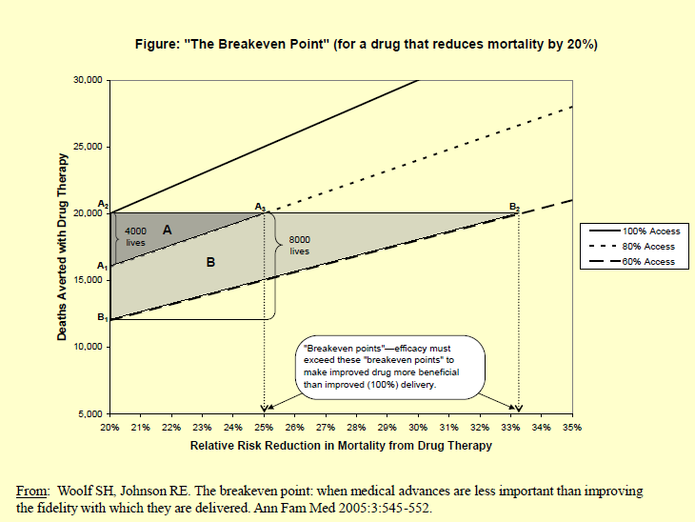

Slide 6
The Challenge to Move
From Innovation to Implementation
“All breakthrough, no follow through”
  Steven Woolf, Department of Family Medicine, Virginia Commonwealth University ; Washington Post, 2006
The classic academic model supports and rewards discovery more than application of discovery into sustained improvements in care and public health

Slide 7
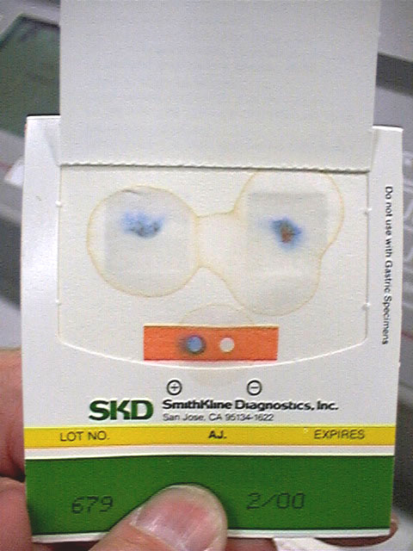
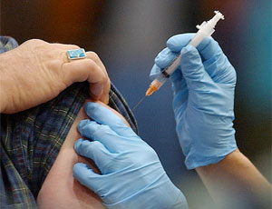
A Case Study from Primary Care

Slide 8
Mike Potter, MD
Flu Shot-Colorectal Cancer Screening Study at SF General Hospital Family Health Center
Question:
  What if everyone aged 50-75 who got a Flu Shot each year also completed a Home Fecal Occult Blood Test?
Intervention:
  Have nursing staff give hemoccult kits and education to patients during flu shot clinics

Slide 9
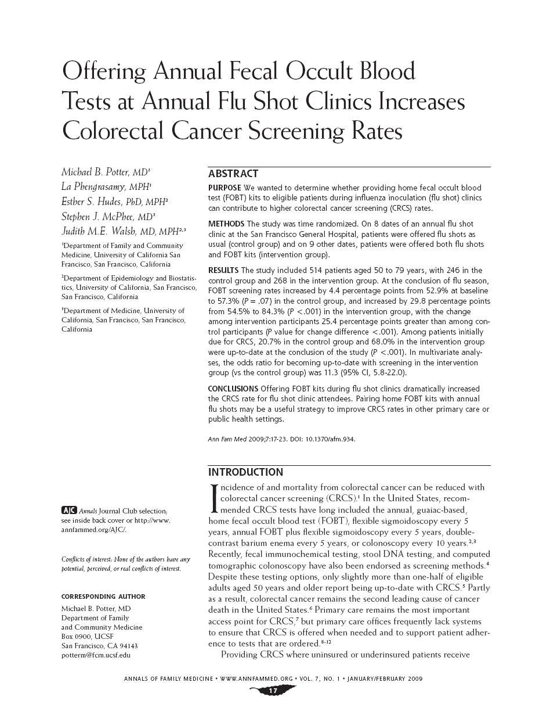
Initial Randomized Clinical Trial at FHC to Prove “Efficacy”:
Does the intervention work?
2009

Slide 10
Did the Flu shot-FOBT intervention become standard of care at FHC in 2009 after this terrific study was published?
No
Why not?
  Differences between an RCT and sustainable implementation in routine clinic operations

Slide 11
Many Factors for Translating Innovation into Sustainable, Scalable Implementation
Feasible incorporation into routine practice
Competing demands
Buy in of leadership and team
Incentives and rewards
Organization and culture
Institutionalization rather than reliance on single champion

Slide 12
“Getting a new idea adopted, even when it has obvious advantages, is often very difficult.”
  Everett Rogers, Diffusion of Innovations

Slide 13
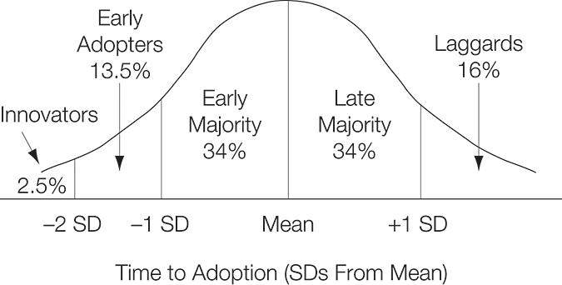
Adopter Categorization
Rogers EM. Diffusion of Innovations. New York, NY: Free Press

Slide 14

Diffusion Envy
New pharmaceutical products
  Simple, technical intervention: a discrete product
  Clear financial incentive (aka profit motive)
  Change agents (aka drug reps)
  Champions (aka academic physician prostitutes)
  Communications strategy (aka marketing)
  Induced demand

Slide 15

My World of Diffusion in Primary Care
Complex interventions
  Behavior and systems change
  Contextually sensitive
Not always clear financial incentives
Group medical visits and self-management support for your unemployed depressed diabetic men with ED are here!

Slide 16
The Research Challenge for Studying Care Innovation and Practice Improvement
Is there reason to believe an innovation actually works?
  RCT
  Quasi-experimental designs
  Other ways of knowing
Can the innovation be successfully adopted, scaled and sustained in routine practice?
  Fidelity vs adaptability
  How was it done? If not, why not?

Slide 17
Flu-FOBT Implementation and Dissemination Research Phase
Adapting to another SF DPH community clinic largely serving Asian immigrant populations
  Mixed methods
  Description of adaptive changes
  Pre-post, quasi-controlled observational study of uptake and screening completion rates
Implemented by 6 of 9 SF DPH PC clinics
  RCT similar to original design at FHC
Spread to Kaiser

Slide 18
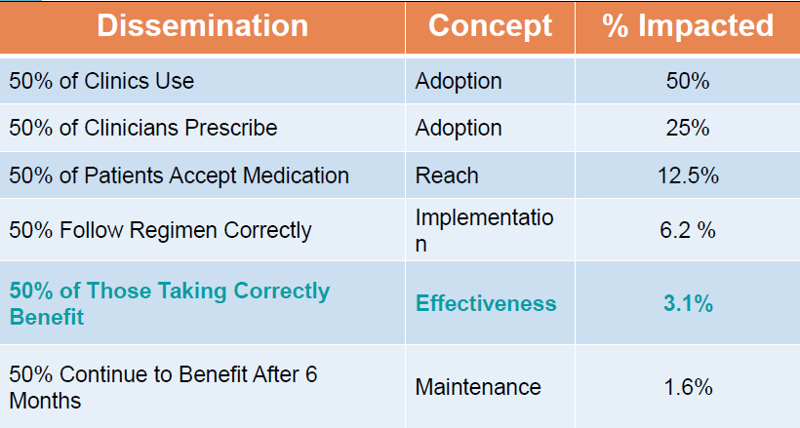
Glasgow “RE-AIM” Framework:
The Case of the Magic Pill

Slide 19
Are We Asking the Right Questions?
What are the most compelling health problems of our local communities?
What interventions would be most effective to address these problems?

Slide 20
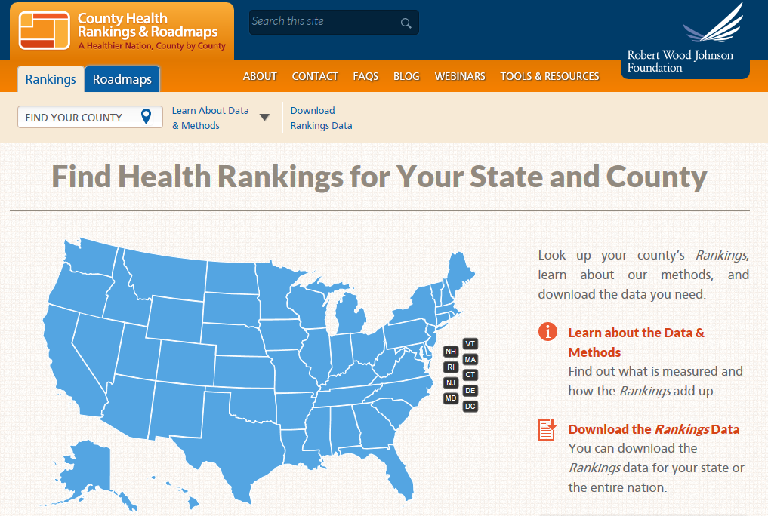
SF ranked 23 among 57 CA counties in 2012

Slide 21
Leading Causes of Premature Death for San Francisco, 2003 – 2004, Men
T. Aragon. BMC Public Health 2008, 8: 116
Rank | Underlying Cause of Death | Years of Life Lost | Average Years of Life Lost
1 | Violence/assault, all mechanisms | 2879.9 | 25.0
2 | Drug overdose, unintentional | 2908.1 | 21.7
3 | HIV/AIDS | 6464.6 | 20.3
4 | Self-inflicted injuries, all mechanisms | 3026.2 | 19.9
5 | Alcohol use disorders | 2228.5 | 17.4
6 | Cirrhosis of the liver | 1586.9 | 16.4
7 | Liver cancer | 2035.6 | 13.2
8 | Hypertensive heart disease | 3379.0 | 11.8
9 | Diabetes mellitus | 1656.5 | 11.3
10 | Lung, bronchus and trachea cancers | 4134.3 | 10.7

Slide 22
Leading Causes of Premature Death for San Francisco, 2003 – 2004, Women
Rank | Underlying Cause of Death | Years of Life Lost | Average Years of Life Lost
1 | HIV/AIDS | 823.6 | 22.9
2 | Drug overdose, unintentional | 843.8 | 22.8
3 | Self-inflicted injuries, all mechanisms | 992.9 | 20.7
4 | Breast cancer | 2975.1 | 13.4
5 | Pancreas cancer | 1122.4 | 10.7
6 | Lung, bronchus and trachea cancers | 3376.2 | 10.4
7 | Lymphomas and multiple myeloma | 852.0 | 9.9
8 | Colon and rectum cancers | 1407.7 | 9.2
9 | Diabetes mellitus | 1207.9 | 8.6
10 | Hypertensive heart disease | 2214.9 | 8.2
T. Aragon. BMC Public Health 2008, 8: 116

Slide 23
UCSF
“Advancing Health Worldwide”™
“Advancing Health Neighborhoodwide”™

Slide 24

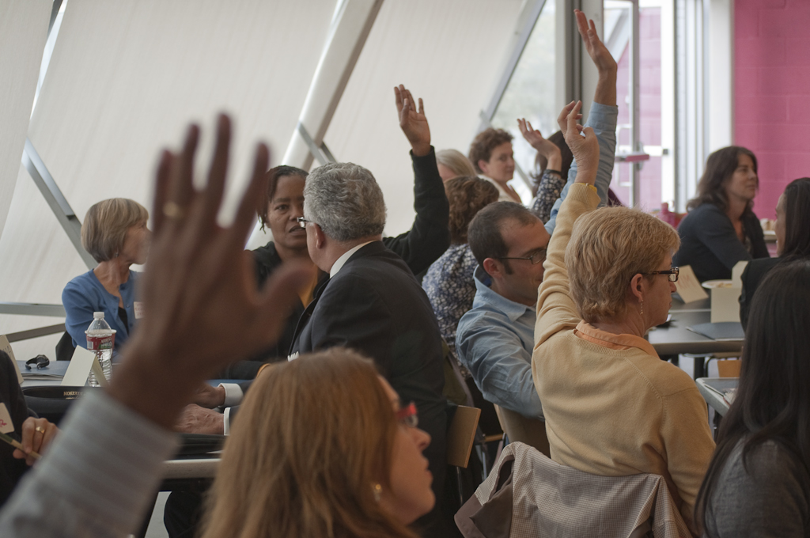
What Is SF HIP?
San Francisco Health Improvement Partnerships
www.sfhip.org

Slide 25
SF Health Improvement Partnerships:
A Cross Cutting Initiative for 5 Year UCSF CTSI NIH Grant Renewal
“The CTSI will challenge, encourage, and support UCSF researchers to take our research capital—the great wealth of clinical research discoveries, knowledge, and know-how at UCSF— and link it with our community partners’ expertise and priorities to effectively translate this research capital into interventions that can be scaled to make a measurable impact on the health of our local community and eliminate disparities.”

Slide 26
SF HIP www.sfhip.org
Collaboration between UCSF and public, private and nonprofit partners to link research with practice to improve health in San Francisco.
Provides SF communities with a coordinated way to bring academic resources and research expertise to bear on health improvement activities to address health disparities and promote health equity.

Slide 27
SF DPH
SF Gov’t
Coordinating Council
SF USD
UCSF
SFHIP
Hospitals & Health Systems
Employers
Community Clinicians
Philanthropy
CBOs, FBOs

Slide 28
SF HIP Priority Areas
Physical activity & healthy eating
Hepatitis B
Alcohol
Childhood dental caries
Mental health/youth/violence
Tobacco
HIV

Slide 29
Partnership Working Groups
Framework
Define a target population
Specify the outcomes to be changed for that population
Identify outcome metrics
Prioritize interventions
  Evidence based
  Experience based
  Feasible, scalable, sustainable
Implement and evaluate interventions

Slide 30
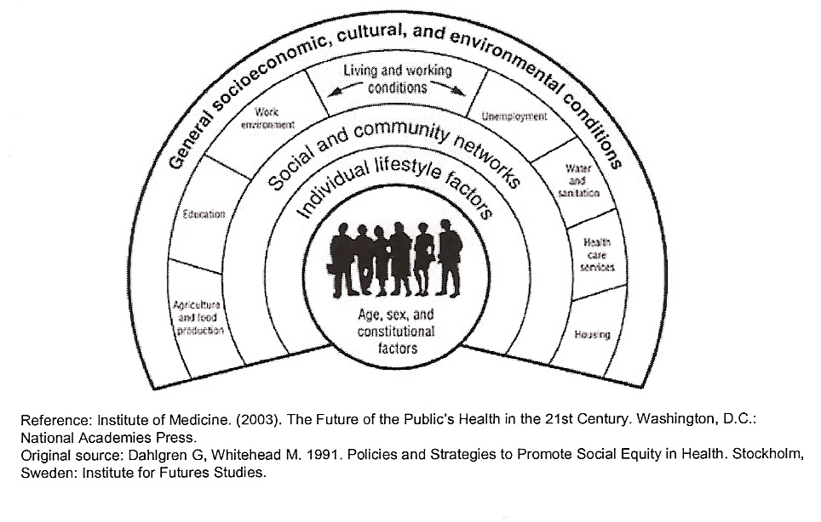
Ecological Model and Systems Perspective

Slide 31
SFHIP Conceptual Model
Socioecological Model with Multilevel Problem Analysis
Synergistic interventions at each of 3 levels:
  Policy/regulatory
  Institutional: schools, health delivery organizations, retail stores, etc
  Individuals and families
Participatory engagement
Pilot interventions for feasibility and scale up if promising

Slide 32
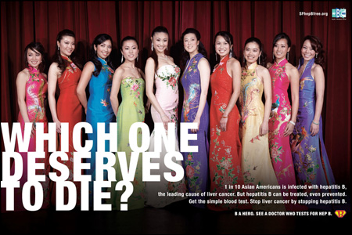
Hepatitis B
SF Hep B Free Campaign
Be tested. Be vaccinated. Be treated.

Slide 33

SF Hep B Free Campaign
Extremely successful, sustained, large scale public outreach campaign for screening
Missing link
Communicable Disease Chronic Disease
Primary Prevention Secondary Prevention
Public Health Clinical Care

Slide 34
Hepatitis B Quality of Care Gaps
Inappropriate screening tests
  HepBsAg and HepBsAb
Failure to complete Hep B immunization series for susceptible patients
Inappropriate and inadequate follow-up care for patients with chronic Hep B

Slide 35








The San Francisco Hepatitis B
Quality Improvement Collaborative

Slide 36
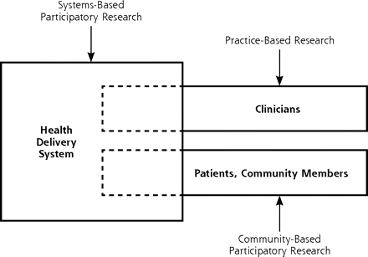
Systems-Based Participatory Research
JA Schmittdiel, K Grumbach, J Selby. Ann Fam Med 2010;8:256

Slide 37
Win-Win Strategies
Multi-group registry of patients with chronic Hep B infection
  Asset for QI projects
  Asset for clinical research

Slide 38
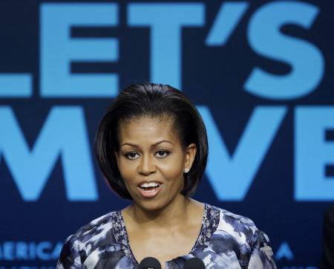


Slide 39
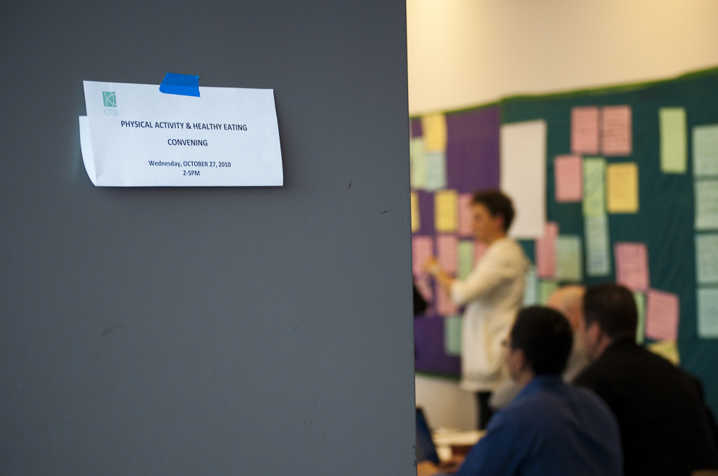

Slide 40

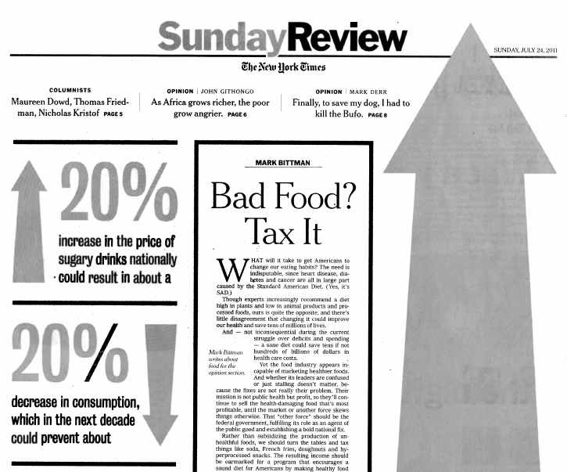
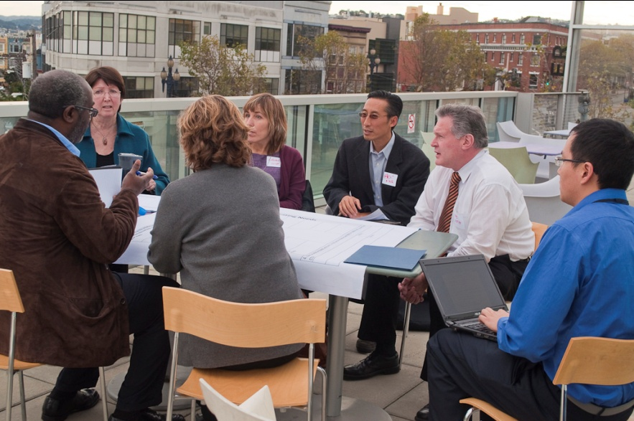
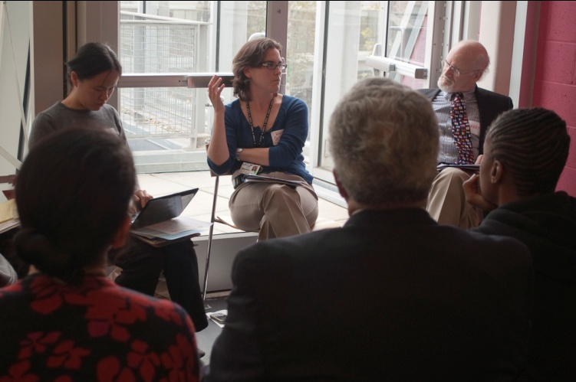
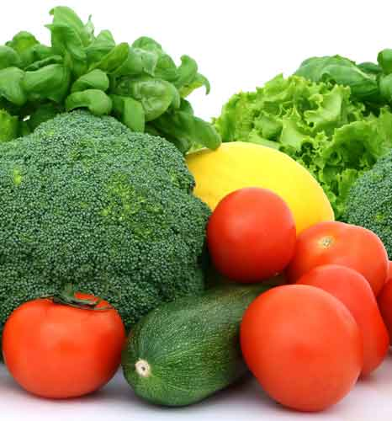
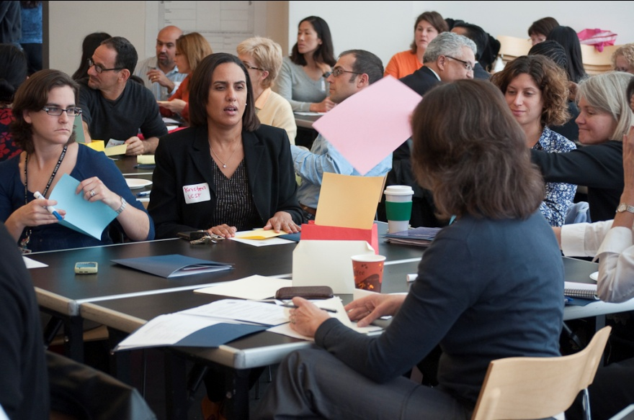
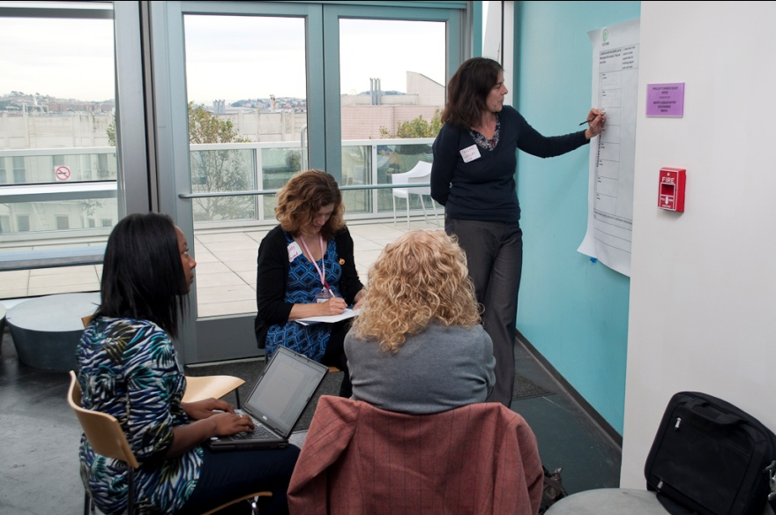

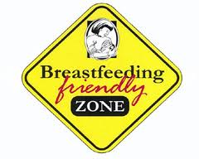

Slide 41
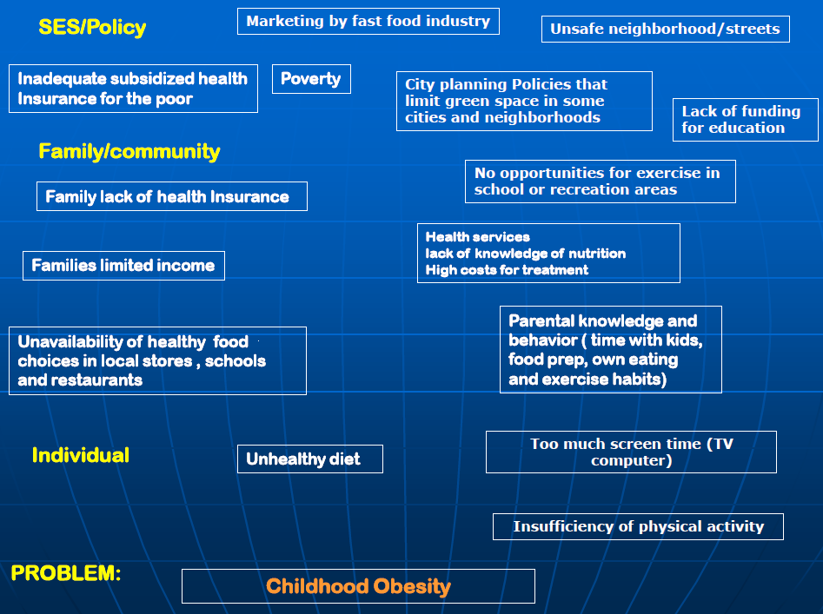
Multilevel Problem Analysis
Model courtesy of Gerry Oliva, UCSF

Slide 42


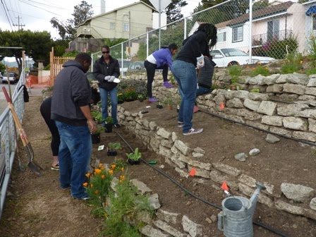
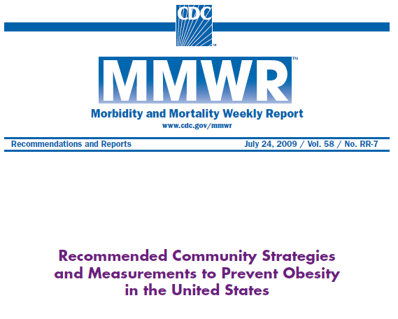
Scientific Evidence
Community Wisdom: Asset Mapping & Needs Assessment
Data and evaluation
BVHP Food Guardians

Slide 43
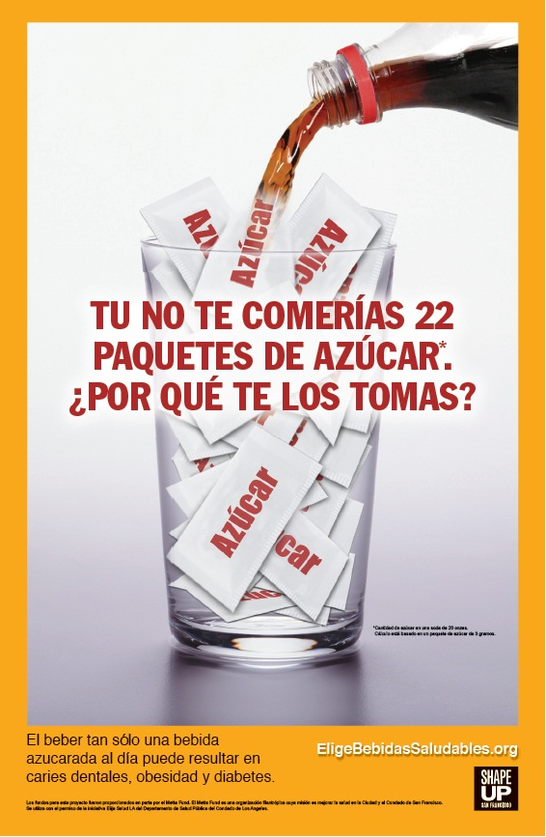
Focus on Sugary Beverages
Menu of evidence-based policy options for policymakers
Foundation-funded study of community attitudes towards regulatory policies on sugary beverages

Slide 44
The Strategic Value of the
UCSF Research Enterprise in Collaborations to Improve the Health of SF
Networking and convening
Research evidence base
Theory and conceptual frameworks
Data collection and analysis
Human and material resources
Investigation and evaluation of community interventions

Slide 45
Ingredients for Success
Patient building of long-term relationships
Core infrastructure for supporting community engaged translational research

Slide 46
Challenges
Relationships
Time
Shared governance and control
Different cultures and world views

Slide 47
Conclusions
Discovery alone not enough. We must translate into application.
Identify research questions of relevance to end-users.
Use systems and transdisciplinary thinking.
Be community engaged.

Slide 48
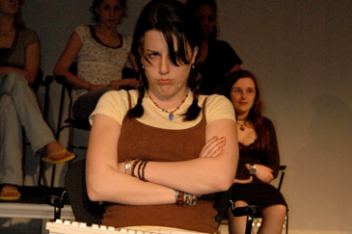
Very nice, Dr. G. But totally impractical for my career goal of a faculty research position and K award.

Slide 49
CTST Offerings
Implementation Sciences Track
Community Engaged Research course

Slide 50
Some Pragmatic Examples
Systemic literature review of scientific evidence on community-based intervention
  Good for the background section of your K proposal
  Abbreviated version potentially of value to community stakeholders
Descriptive data on a local population
  Also good for your K proposal
  Local audiences might find this enlightening, useful for a CBO grant proposal
Focus groups to help you design your clinical translational research study
  Potentially publishable qualitative data in own right
How did you do it? (not just what did you find)
  May also be publishable

Slide 51
Go Make a Difference!

