Slide 1
Introduction to Evaluation/Purpose of Evaluation/Describing the Program
Janet Myers, PhD, MPH
Janet.Myers@ucsf.edu
415-476-6336
Cell: 415-300-6836
Session 1 ● September 17, 2015

Slide 2
Session 1 Overview
Define program evaluation and understand how evaluation can support program planning, implementation and accountability.
Explore the key terms and concepts associated with program evaluation.
Understand the historical context of evaluation
Describe program theory and program logic
Identify elements of program theory/logic in selected case studies.

Slide 3
What is Program Evaluation?
DFN1: Evaluation is the systematic collection of information about a program in order to enable stakeholders:
  to better understand the program,
  to improve program effectiveness, and/or
  to make decisions about future programming.
DFN2: “Evaluation is the systematic assessment of the operation and/or outcomes of a program or policy, compared to a set of explicit or implicit standards, as a means of contributing to the improvement of the program or policy.” Weiss, page 4

Slide 4
Why Evaluate?
Ensure program effectiveness and appropriateness
Demonstrate accountability
Contribute to public health knowledge base
Improve program operations and service delivery

Slide 5
History of evaluation
Rise of the great society
What was the worth of social activities?
Primarily motivated by federal programming.

Slide 6
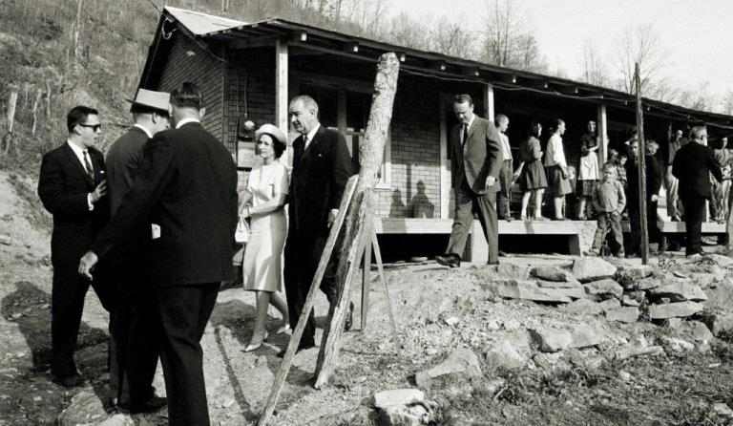
War on Poverty

Slide 7
History of evaluation
In the 60s, mental health and education
In the 80’s performance auditing (after the fact evaluations)
1993 Govt Performance and Results Act (GPRA)

Slide 8
Why the rise in interest?
Social program spending went from $23.5 billion in 1950 to $428 billion in 1979
  Head Start
  Economic Opportunity Act
In the 1960s, social science programs expanded in University settings while academic jobs decreased.
Evaluation emerged as a profession

Slide 9
Guiding Principles for Evaluators
A. Systematic Inquiry: Evaluators conduct systematic, data-based inquiries about whatever is being evaluated.
B. Competence: Evaluators provide competent performance to stakeholders.
C. Integrity/Honesty: Evaluators ensure the honesty and integrity of the entire evaluation process.
D. Respect for People: Evaluators respect the security, dignity and self-worth of the respondents, program participants, clients, and other stakeholders with whom they interact.
E. Responsibilities for General and Public Welfare: Evaluators articulate and take into account the diversity of interests and values that may be related to the general and public welfare.

Slide 10
Components of Program Evaluation
There are 4 general types or components to comprehensive program evaluation:
  Formative evaluation: What’s necessary to carry out the program in accord with the desired goals and objectives?
  Process evaluation: How was the program implemented?
  Outcome evaluation: Did the program meet its objectives?
  Impact evaluation: Was the ultimate goal of the program achieved?

Slide 11
Timing of Evaluation Relative to Planning and Implementation
1. Formative Evaluation
Program Planning
Program Implementation
2. Process Evaluation
Improvement/ Adjustment to Program
3. Outcome Evaluation
(Time)
4. Impact Evaluation

Slide 12
Formative Evaluation
Use during the development of the project to test ideas and concepts on target population.
Or, before a new phase…provides information for improvement by identifying aspects of the existing program that are successful and areas in need of improvement.
Generally focuses on the content and design of the program, with results useful to program staff in planning and design.
Also called “needs assessment”

Slide 13
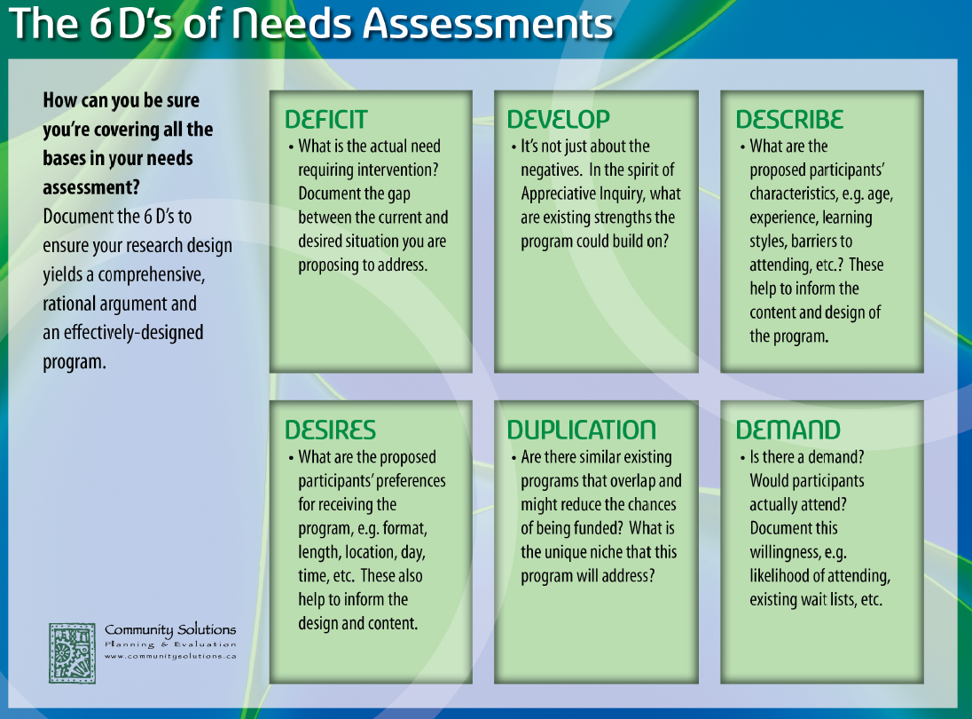

Slide 14
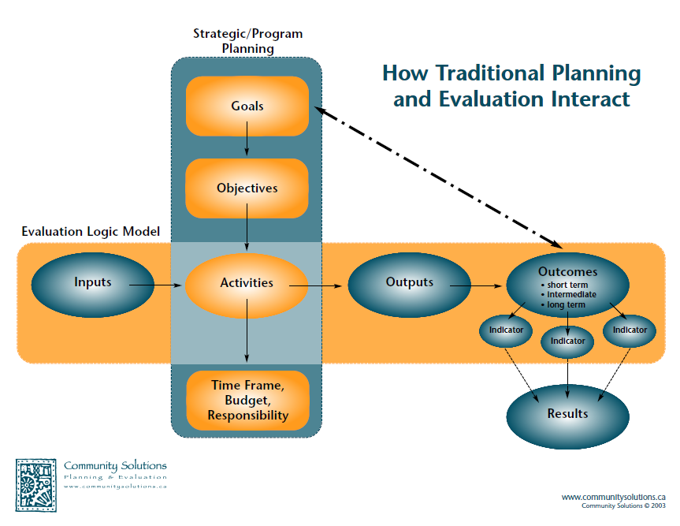

Slide 15
Program planners
typically define:
Evaluation is
conducted at each level:
Goals
Objectives
Activities
Impact
Outcome
Process

Slide 16
Process Evaluation
Assesses activities and the extent to which program has been implemented as planned.
Goals
Objectives
Activities
Impact Indicators
Outcome Indicators
Process Indicators

Slide 17
Outcome Evaluation
Gauges the extent to which a program produces the improvements it intends
Examines effectiveness, goal attainment and unintended outcomes.
In simple terms, “what is different as a result of your efforts?”
Goals
Objectives
Activities
Impact Indicators
Outcome Indicators
Process Indicators

Slide 18
Process Evaluation
Identify how a product or outcome is produced.
Create detailed description of the program.
Identify strengths & weaknesses of a program associated with:
  Design: Was the outcome due to the intervention design?
  Implementation: Was the outcome because the intervention was or was not implemented as intended?

Slide 19
Process Evaluation Questions:
Key questions in process evaluation:
  Who is served?
  What activities or services are provided?
  Where is the program held?
  When and how long?

Slide 20
Outcome Evaluation Questions
Was the desired change(s) attained?
To what degree did the desired change(s) occur?
What aspects of implementation were associated with the outcome?

Slide 21
Outcomes can be…
Immediate, intermediate or longer-term.
Measured at the consumer, provider, organization, or system level.
Notes:
21
Initial outcomes are the first benefits or changes experienced by participants, usually involving changes in knowledge, skills or attitudes.
Intermediate outcomes occur after the initial outcomes and link them to the longer-term outcomes desired for clients. Often, they involve behavior change.
Longer-term outcomes (or impacts) are measurable results that take longer to achieve, such as changes in their conditions, clinical health status or quality of life.

Slide 22
Impact Evaluation
Impact is sometimes used to mean “outcome.”
Impact is perhaps better defined as a longer-term outcome.
In global M&E, incidence or prevalence of disease.
Goals
Objectives
Activities
Impact Indicators
Outcome Indicators
Process Indicators

Slide 23
Understanding the Program
Program evaluation relies on well defined programs.
Evaluators should ask:
  What are the important program goals?
  What are the program services offered?
Objectives are specific steps that contribute to a goal. Often several objectives per goal.
Good objectives are SMART:
      S – specific
      M – measurable
      A – attainable
      R – realistic
      T – time-bound

Slide 24
Good objectives include (McKenzie & Smeltzer 2001)
  1. What will change: Outcome that will be achieved
  2. When will it change: Conditions under which the outcomes will be observed
  3. How much change: Criterion for deciding whether the outcomes has been achieved
  4. Who will change: Target population

Slide 25
Developing Program Theory
Evaluators then ask: What are the implicit and explicit assumptions about how the program services will lead to the desired outcomes?
    Key to developing a program theory, as it addresses the question of why and how the services provided are expected to lead to change.
Many different techniques, but most common method is the development of a logic model.

Slide 26
Use of Logic Models
Evaluations are usually guided by logic models, which provide a brief illustration of one’s “theory of change.”
They define progress from general values to more specific strategies, to the results or goals achieved.
Useful logic models will guide all planning and development activities.
Criteria for sound logic models:
  Practicable
    Feasible to implement given resources.
  Plausible chain
    Sequence is sensible; likely to achieve goals.
Also used to determine the design of the evaluation methodology.

Slide 27
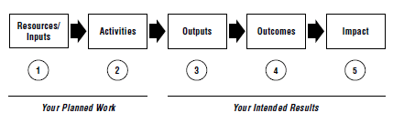
A simple version…

Slide 28
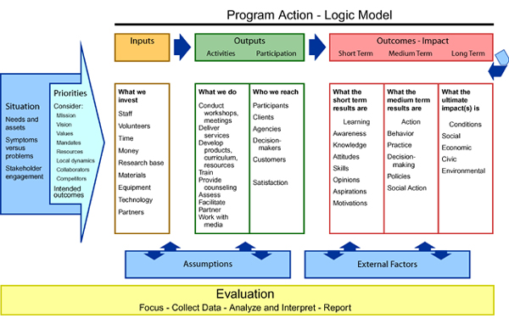
Formative Evaluation
Process Evaluation
Outcome Evaluation
Impact Evaluation

Slide 29
This quarter, for your evaluation plan:
Identify program goals and objectives (theory)
Define the scope of the evaluation including the evaluation questions & indicators
Define methods
  instruments and tools
  Evaluation procedures
  Plan for analysis
  Plan for dissemination

Slide 30
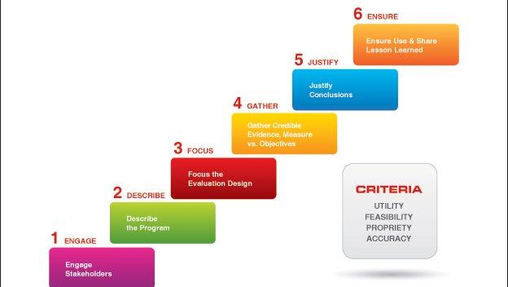
Planning an evaluation

