Slide 1
Small Group Section starts this week (Week 2)
Ackley 6702
Aiemjoy 6601 Ray 5721 Wang 5759
Semeere Online
See course website (Rosters) for your section assignment
Problem sets are due at the beginning of section. Please word process your responses and turn in paper copy.
For Problem Set due next week, we begin to use Stata
Next Week: Journal Club (immediately following Small Group Section). Article and approach to reading an article can be found on website. Be prepared to discuss.

Slide 2
Teaching Process/Philosophy
Lectures/reading define the scope of content for week
  provide the detail on the content
  regrettably, insufficient time in lecture for much interaction
Small Group Sections/Journal Clubs ARE interactive and thus a critical nidus for learning
Value in getting many senses/motor functions involved:
  Vision (slides and reading)
  Hearing (Lecture and Small Group/Journal Club)
  Kinesthetic (writing homework; using Stata)
  Speaking (Small Group/Journal Club)
Notes:
We thought it would be useful to be explicit about our teaching process/philosophy.
The lectures in particular and the required readings define the scope of content for the week. The lectures are, we recognize, insufficient on time to have enough interaction between you and us and you and your classmates. So, we really hope and expect that you will come to the Small Group Sections and the Journal Clubs because they ART interactive and thus a critical nidus for learning.
In fact, we feel this interaction is essential for learning. We very much believe in the value of getting many senses and motor functions involved in learning. In fact, empirical educational research supports this as way to facilitate learning. So, we do a lot to get your vision, hearing, kinesthetic, and speaking functions involved each week.

Slide 3
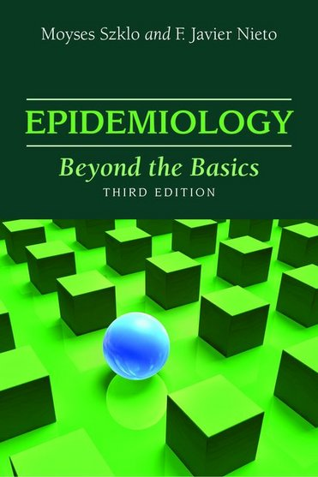
Preface
“This book was conceived as an intermediate epidemiology textbook….discusses key epidemiologic concepts and basic methods in more depth than that found in basic textbooks on epidemiology.”
It is not like reading the sports page.
It is not always correct (Lecture trumps text)
Notes:
Now that you all have had a chance to get started in our main textbook, I wanted to give you some background.
We like this book because we feel it is the most contemporary and readable coverage of the topic. Yet, we realize that it is not like reading the sports page. Specifically, it is pitched as an intermediate text. It does presume some prior experience and knowledge, which we know is where most of you are at. Many of the intro texts are just too simple and often simply incorrect. I say all of this mainly to let you know that the book does take time to read and hopefully you can plan your time accordingly. I also think it would be useful to read the book prior to the lecture.
Finally, it is not always correct and when you find a contradiction between lecture and the text, the lecture trumps the text.

Slide 4
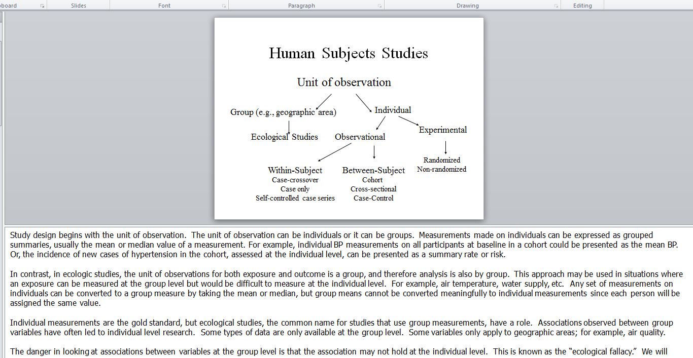
Notes:
Of course, we also wish to remind you that virtually all of our lecture panels are annotated in the Notes page in MS PowerPoint and we encourage you to use this.

Slide 5
Nature of our Problem Sets
Prototype: We give you data/scenario and ask you to comment
Complaints: too open-ended; “What am I thinking?”
  Desire for more focused questions: e.g., “Do you think this particular aspect of the data (e.g., a measurement) is wrong?”
Rationale: in the real world, you are presented with data/results from analyses, either your own or someone else’s
  They may or may not be valid
  You will need to scan the range of potential threats to validity without any focused prompting or multiple choice options.
Training your mind as a critical quantitative researcher
Not always one single best answer. If you come up with a logical / better response, you get credit (and we add it to the answer key!)
Sometimes, there is not enough data to provide an answer. If this is the case, simply state it. This, too, occurs in real-life.
Notes:
Finally, a note on our Problem Sets now that you have had the chance to experience one of them:
We get complaints every year for two many “what I am thinking questions” which are defined as questions where we give you some data or some other scenario and then ask to comment in some way as to whether it is not valid and if not, why not.
Many students complain about this and would rather have more focused questions such as “Do you think confounding is present?.
The reason we give these questions is because they mimic the real world, one in which you are presented with data, either data you collect yourself or someone else collected it, and you will need to determine if it is valid. The data won’t be in the form of a true/false question, or multiple choice, but rather you will need to think of all the possible ways the data might be invalid without any prompting. This is what we call training your mind to be a critical quantitative researcher. Hence, we won’t offer any apologies for these questions – we do believe they aid in training you to become a more critical thinker.
One last note is that there is not always one single best answer. In other words, if you come up with a different answer than we have and it is correct, then you will certainly get full credit, and indeed we will include your answer on the answer key. Hence, these questions really don’t have just one answer – guess what the instructor is thinking – but rather serve to get you thinking.

Slide 6
Observations
Virtually no one understands all of this material or gets all of the problems correct the first time
Most students get at least some points subtracted on several/many questions
Don’t be discouraged - it takes time to develop a mastery of this material
By working through this challenging homework, you will become prepared for the challenging world of research

Slide 7
TICR Professional Conduct Statement
Clarifications for this class
I will maintain the highest standards of academic honesty
I will not use answer keys from prior years
Problem Sets: I am permitted to consult with other classmates, but I will write final answers in my own words away from other classmates
Final Examination: I will neither give nor receive aid in examinations
Notes:
And finally, I want to remind you about our Professional Conduct Statement and how it applies to this class. Specifically….

