Slide 1
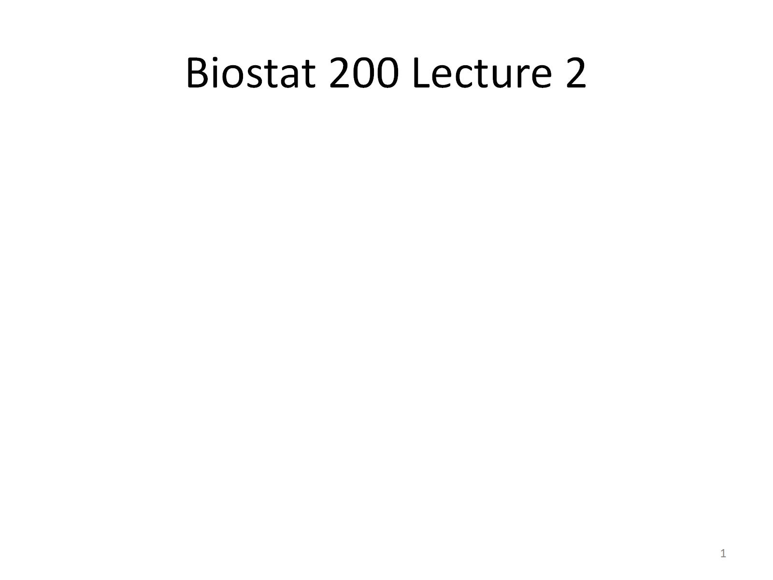
Biostat 200 Lecture 2

Slide 2
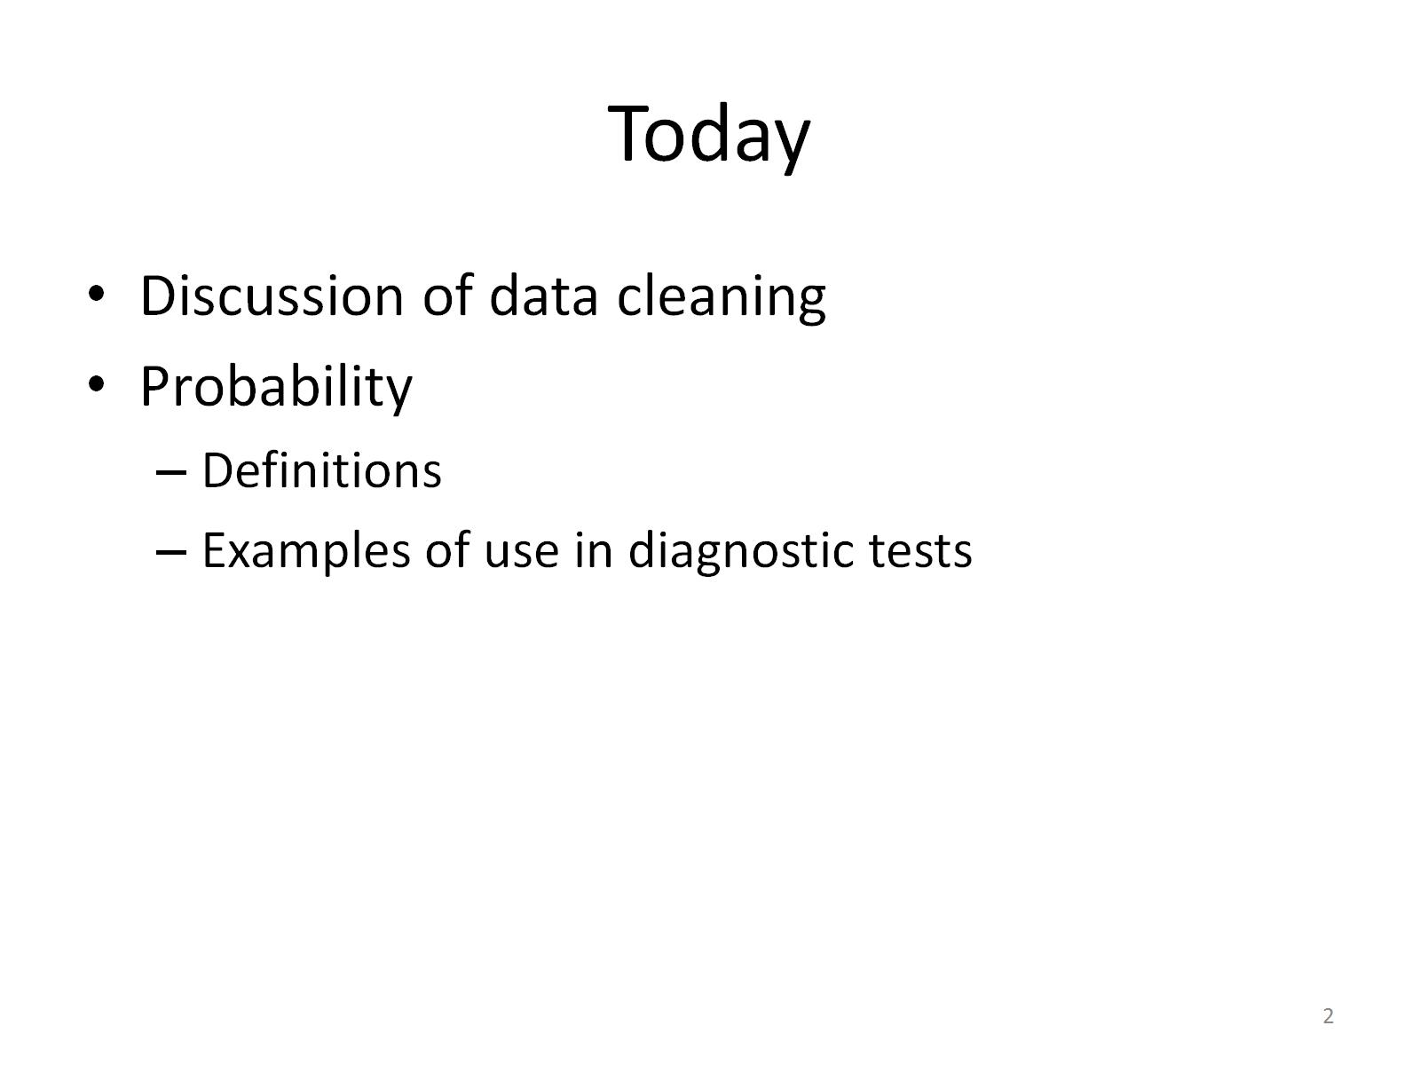
Today

Slide 3
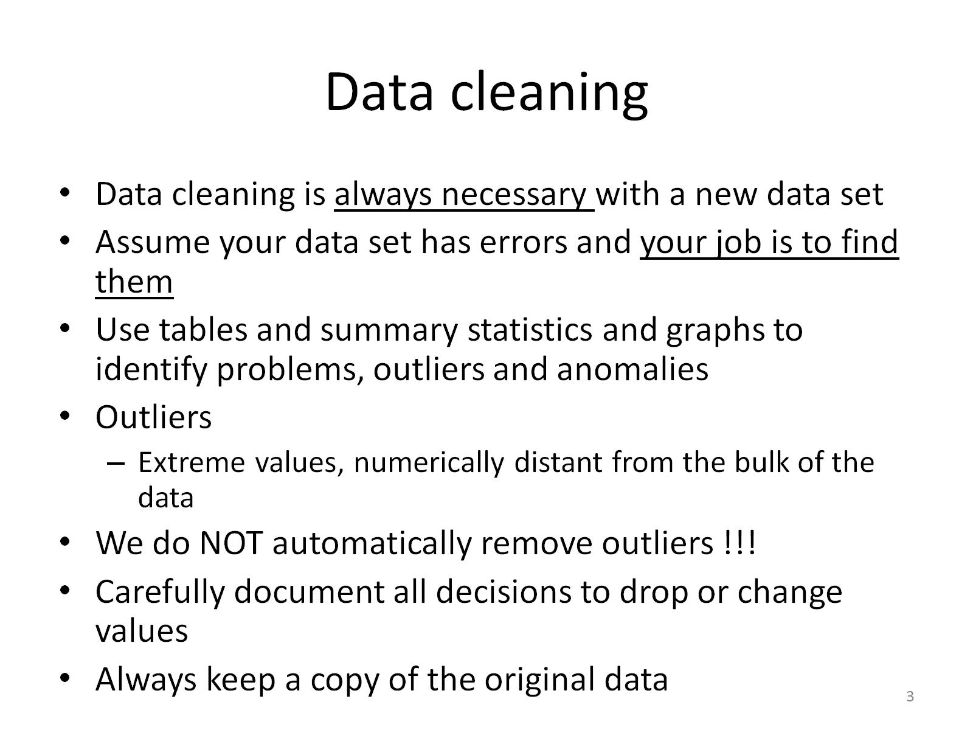
Data cleaning

Slide 4
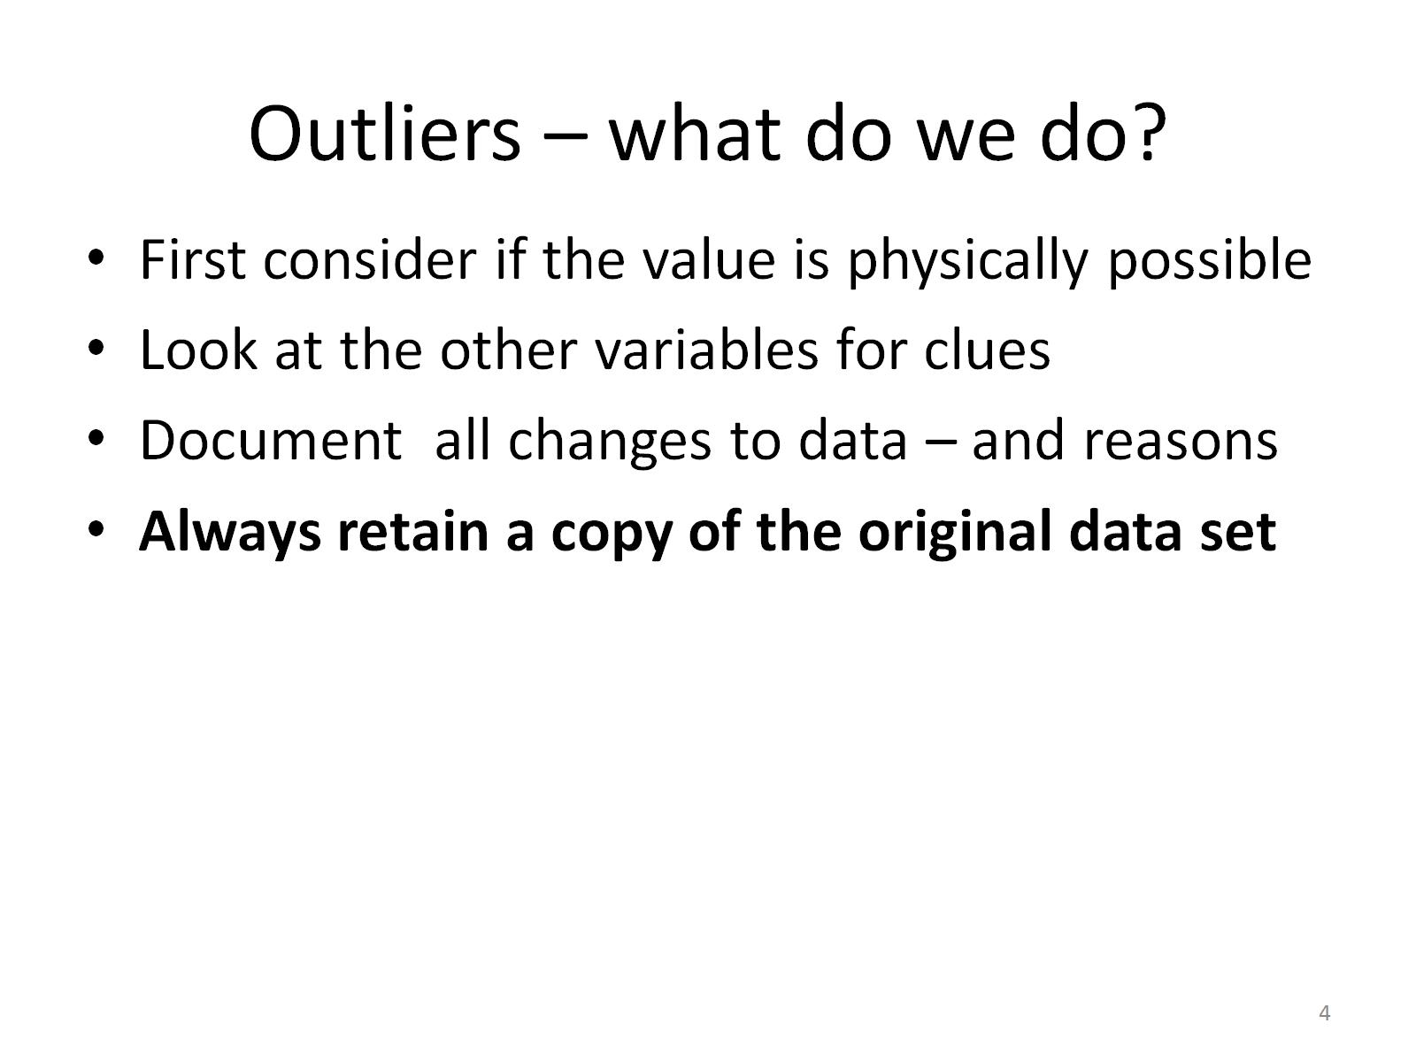
Outliers – what do we do?

Slide 5
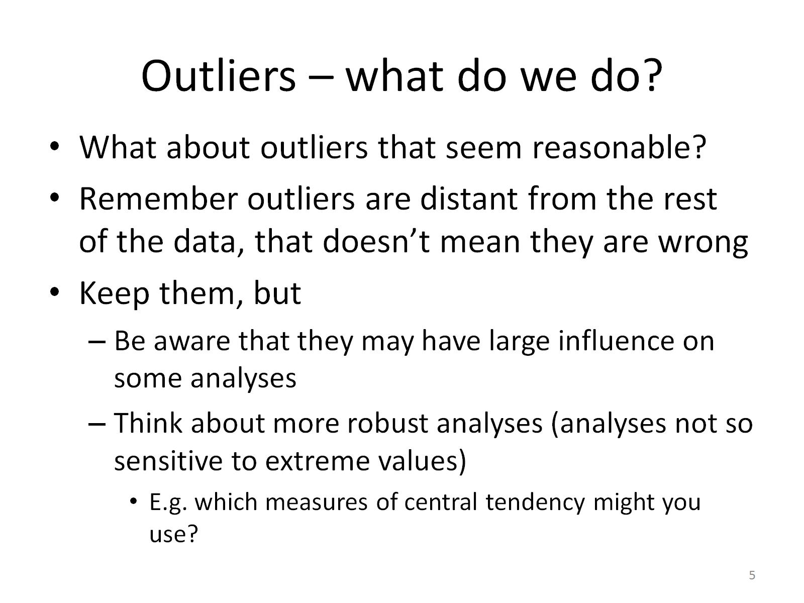
Outliers – what do we do?

Slide 6
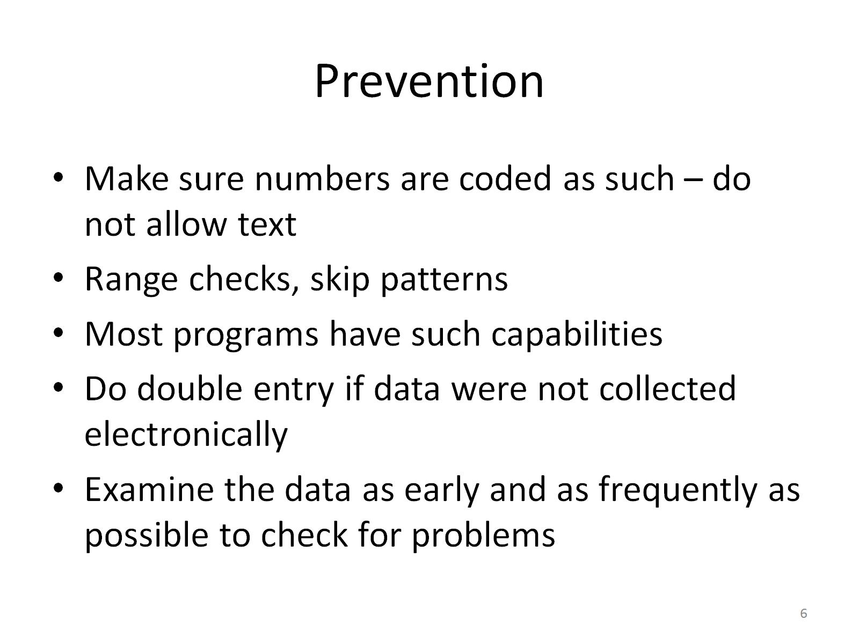
Prevention

Slide 7
Coin value?
hist coinvalue, fcolor(blue) percent
(bin=7, start=0, width=11.428571)

Slide 8
Coin value?
. summ coinvalue, detail
coinvalue
-------------------------------------------------------------
Percentiles Smallest
1% 0 0
5% 0 0
10% 0 0 Obs 55
25% 0 0 Sum of Wgt. 55
50% .67 Mean 2.932727
Largest Std. Dev. 10.9957
75% 1.25 10
90% 5 12 Variance 120.9054
95% 12 16 Skewness 6.471767
99% 80 80 Kurtosis 45.56809

Slide 9
Coin value?
. list if coinvalue>5
+------------------------------------------------------------------------------+
| sex height coinva~e cashva~e epi203 iphone6 child~yn child~_n |
|------------------------------------------------------------------------------|
17. | 2 167 12 5 2 2 2 1 |
33. | 2 63 5.3 80 2 2 1 0 |
35. | 1 72 16 41.16 2 1 1 0 |
45. | 1 6 10 . 2 2 1 0 |
50. | 2 64.5669 80 85 2 1 1 0 |
+------------------------------------------------------------------------------+

Slide 10
Coinvalue?
Histogram looked odd
Use summary command, thought about the range of values
Use list command – see other relevant variables
Back to the source documents (or study subjects) – did this person really have $80 coins?
Make a decision and document it – use a .do file

Slide 11
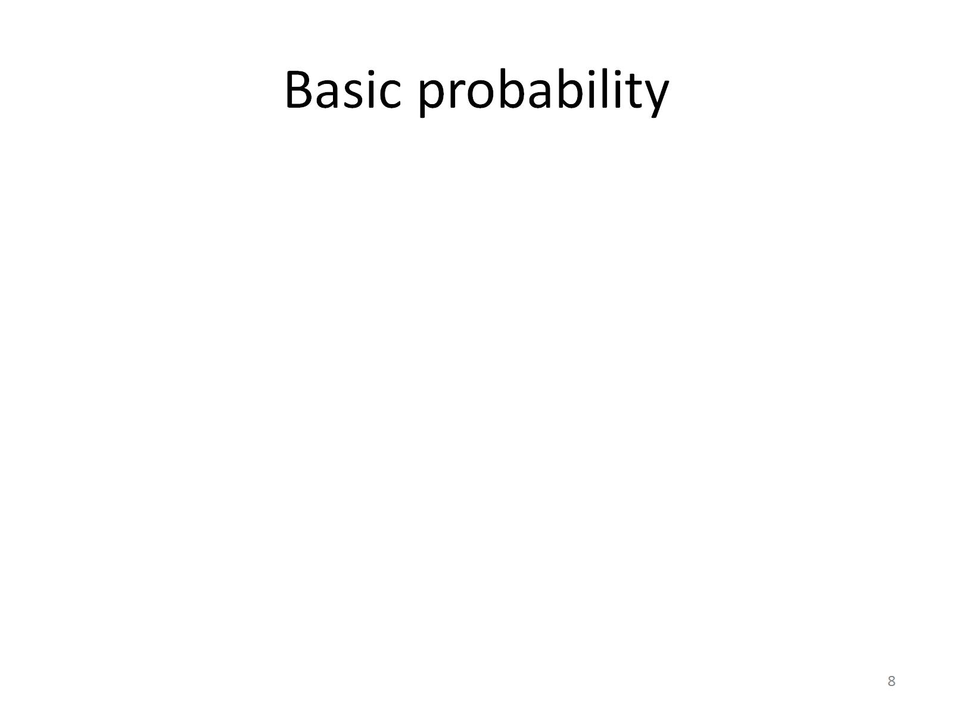
Basic probability

Slide 12
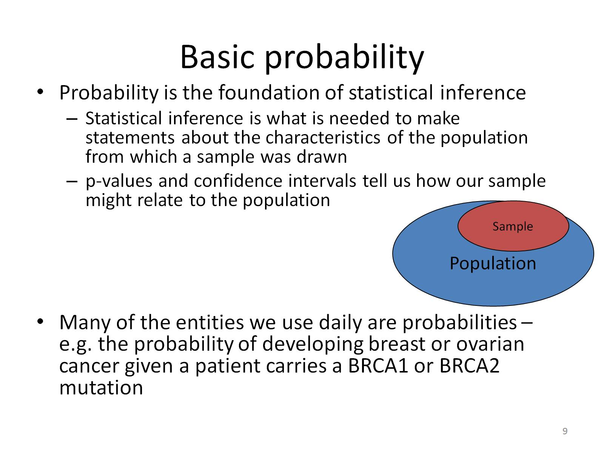
Basic probability

Slide 13
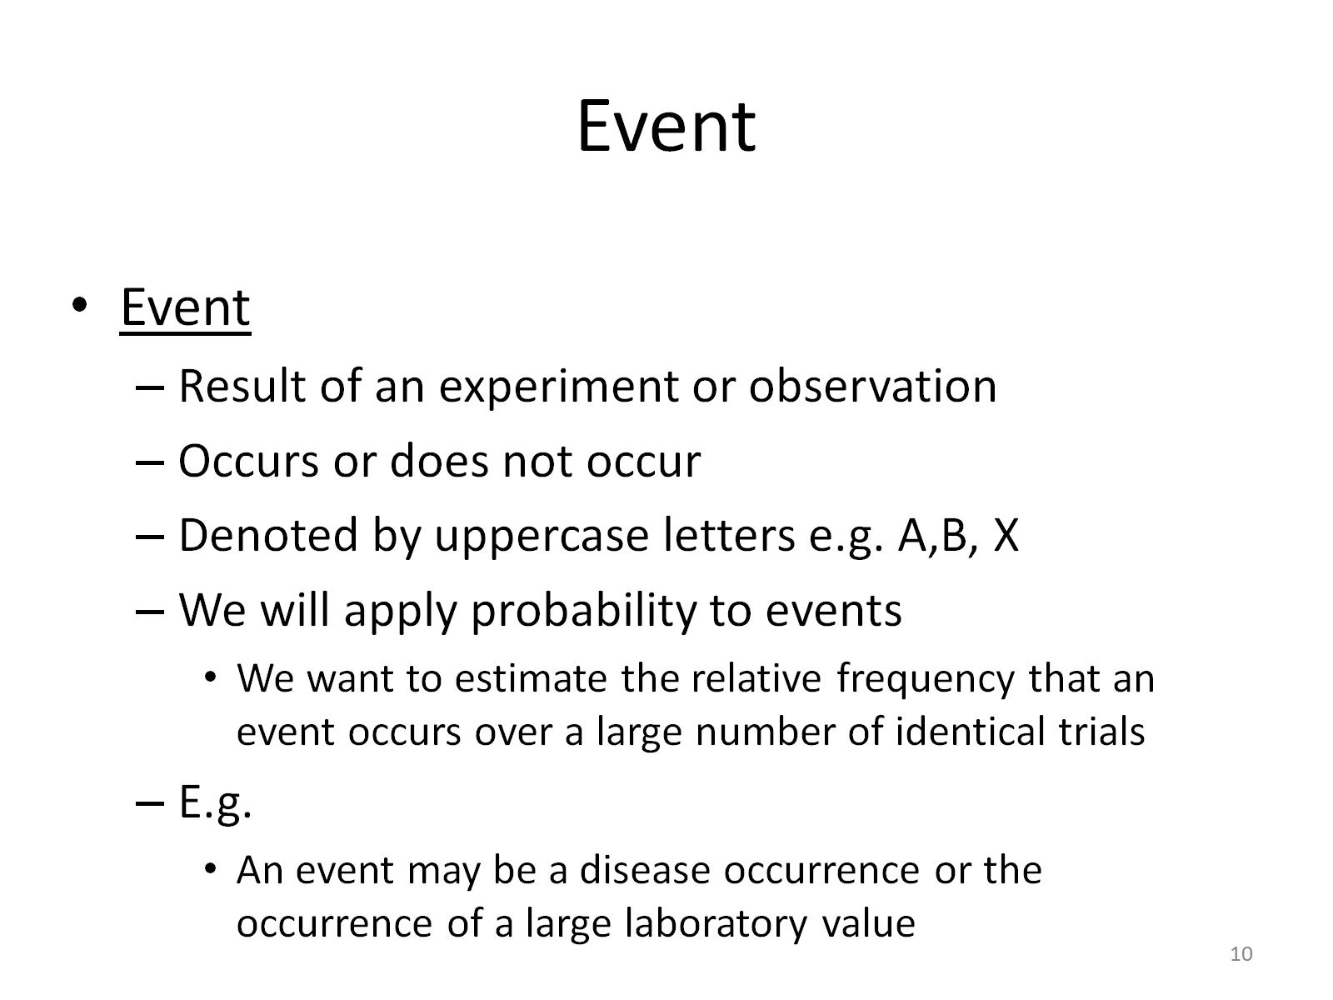
Event

Slide 14
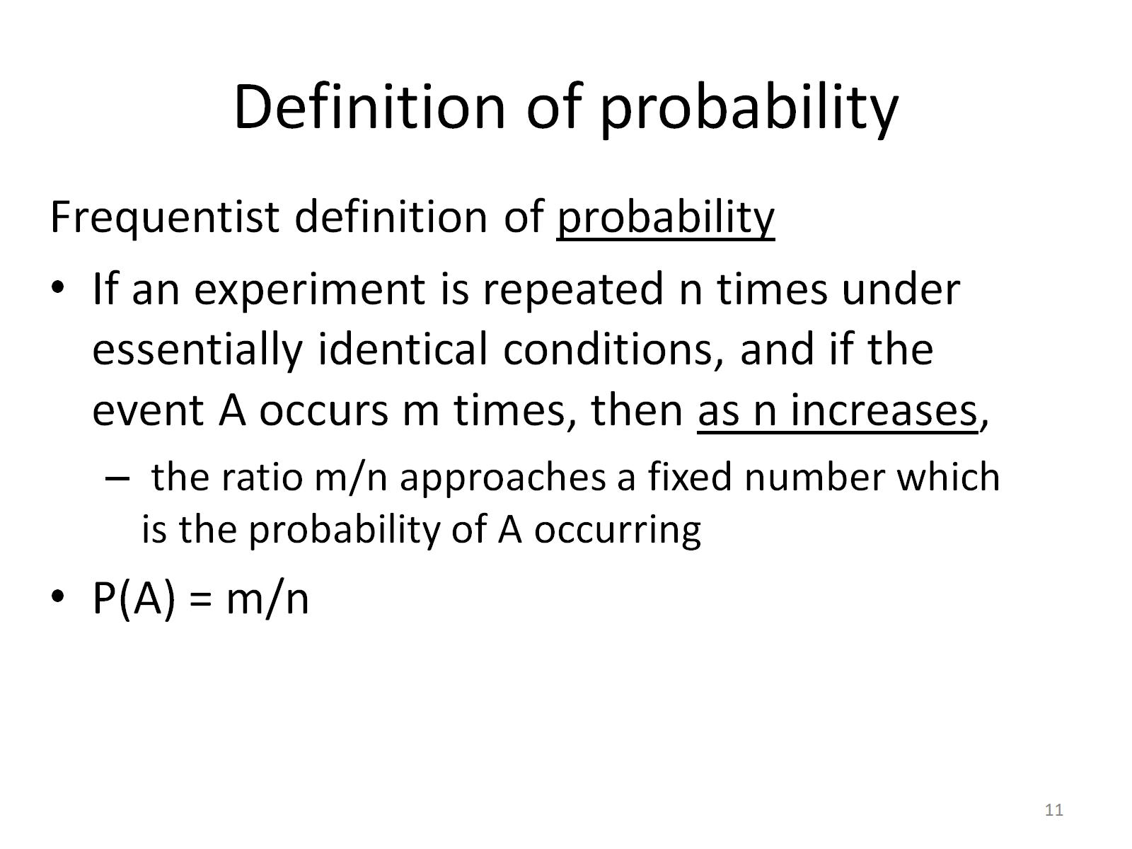
Definition of probability

Slide 15
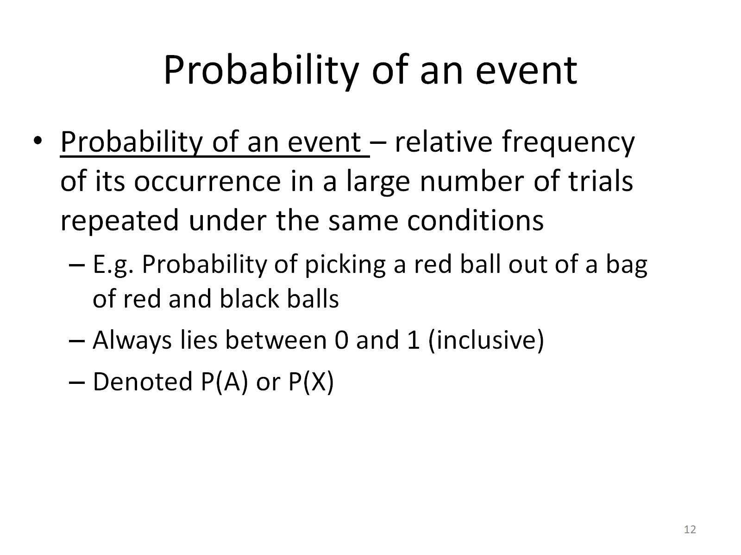
Probability of an event

Slide 16
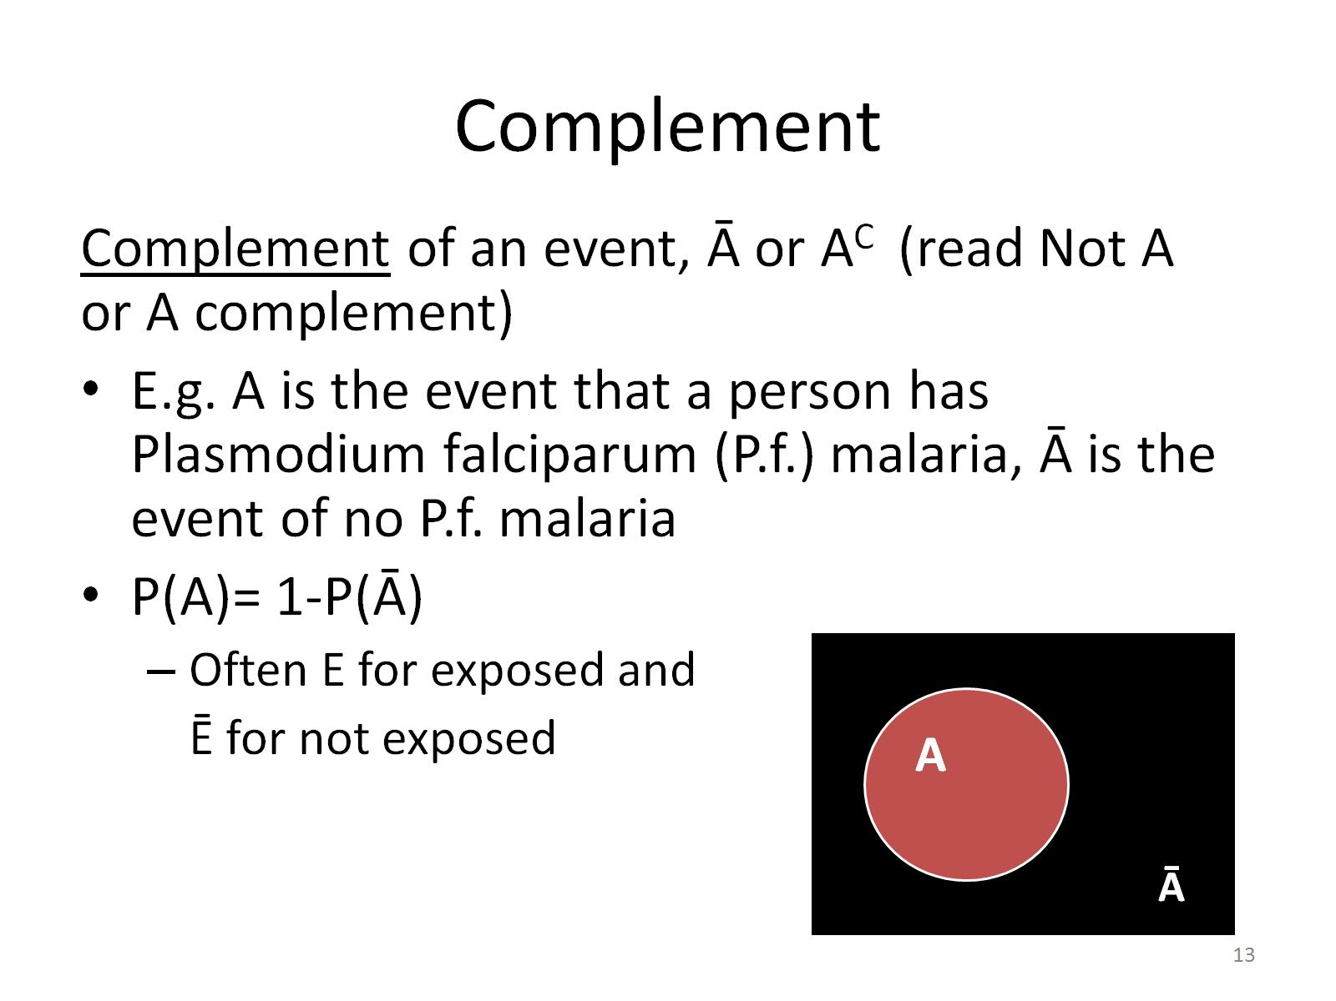
Complement

Slide 17
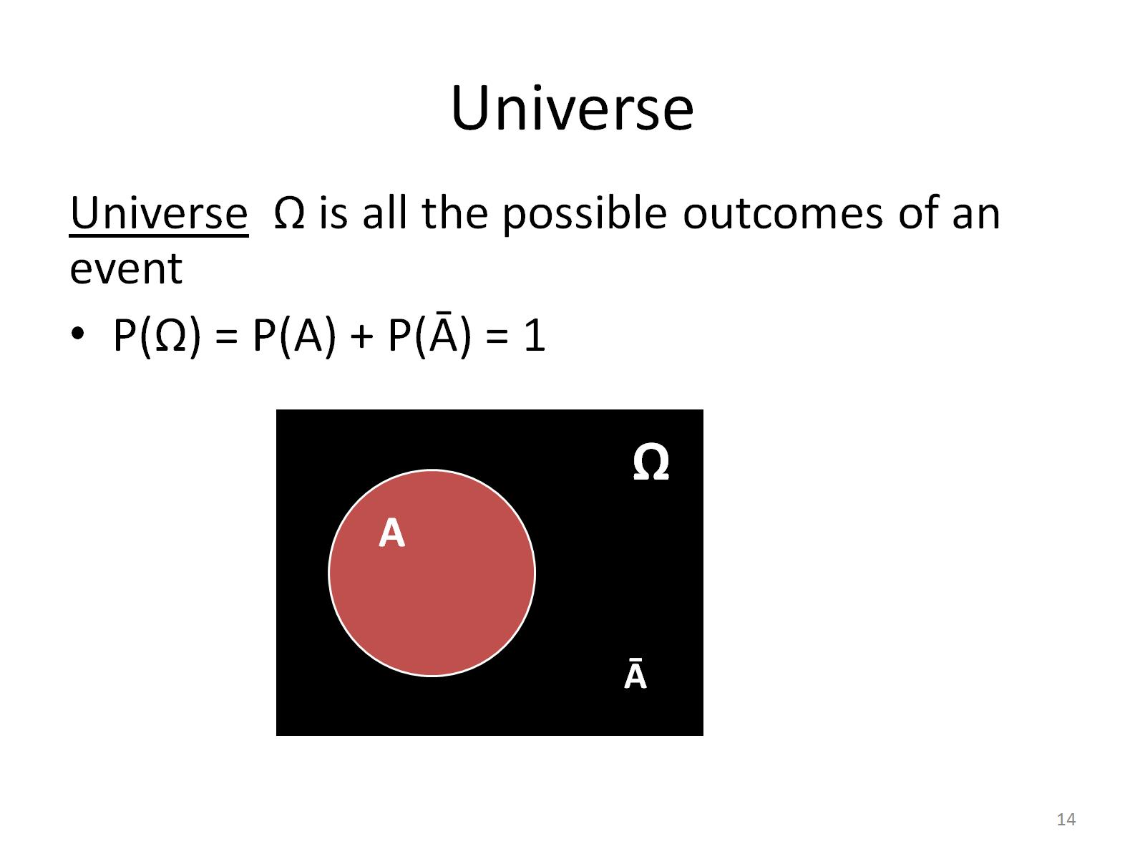
Universe

Slide 18
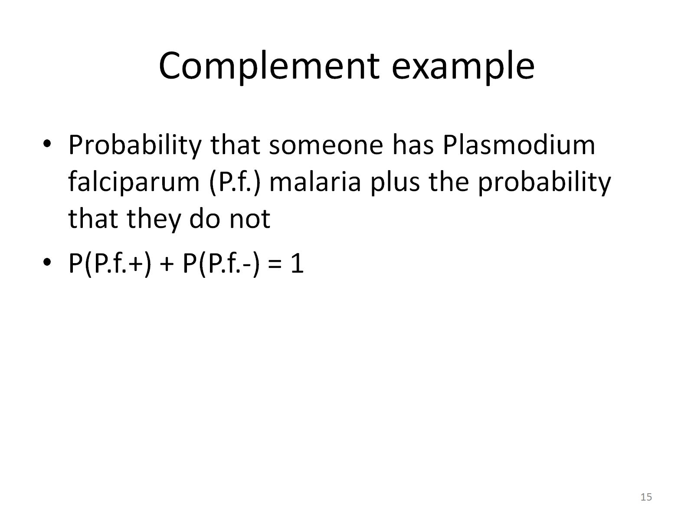
Complement example

Slide 19
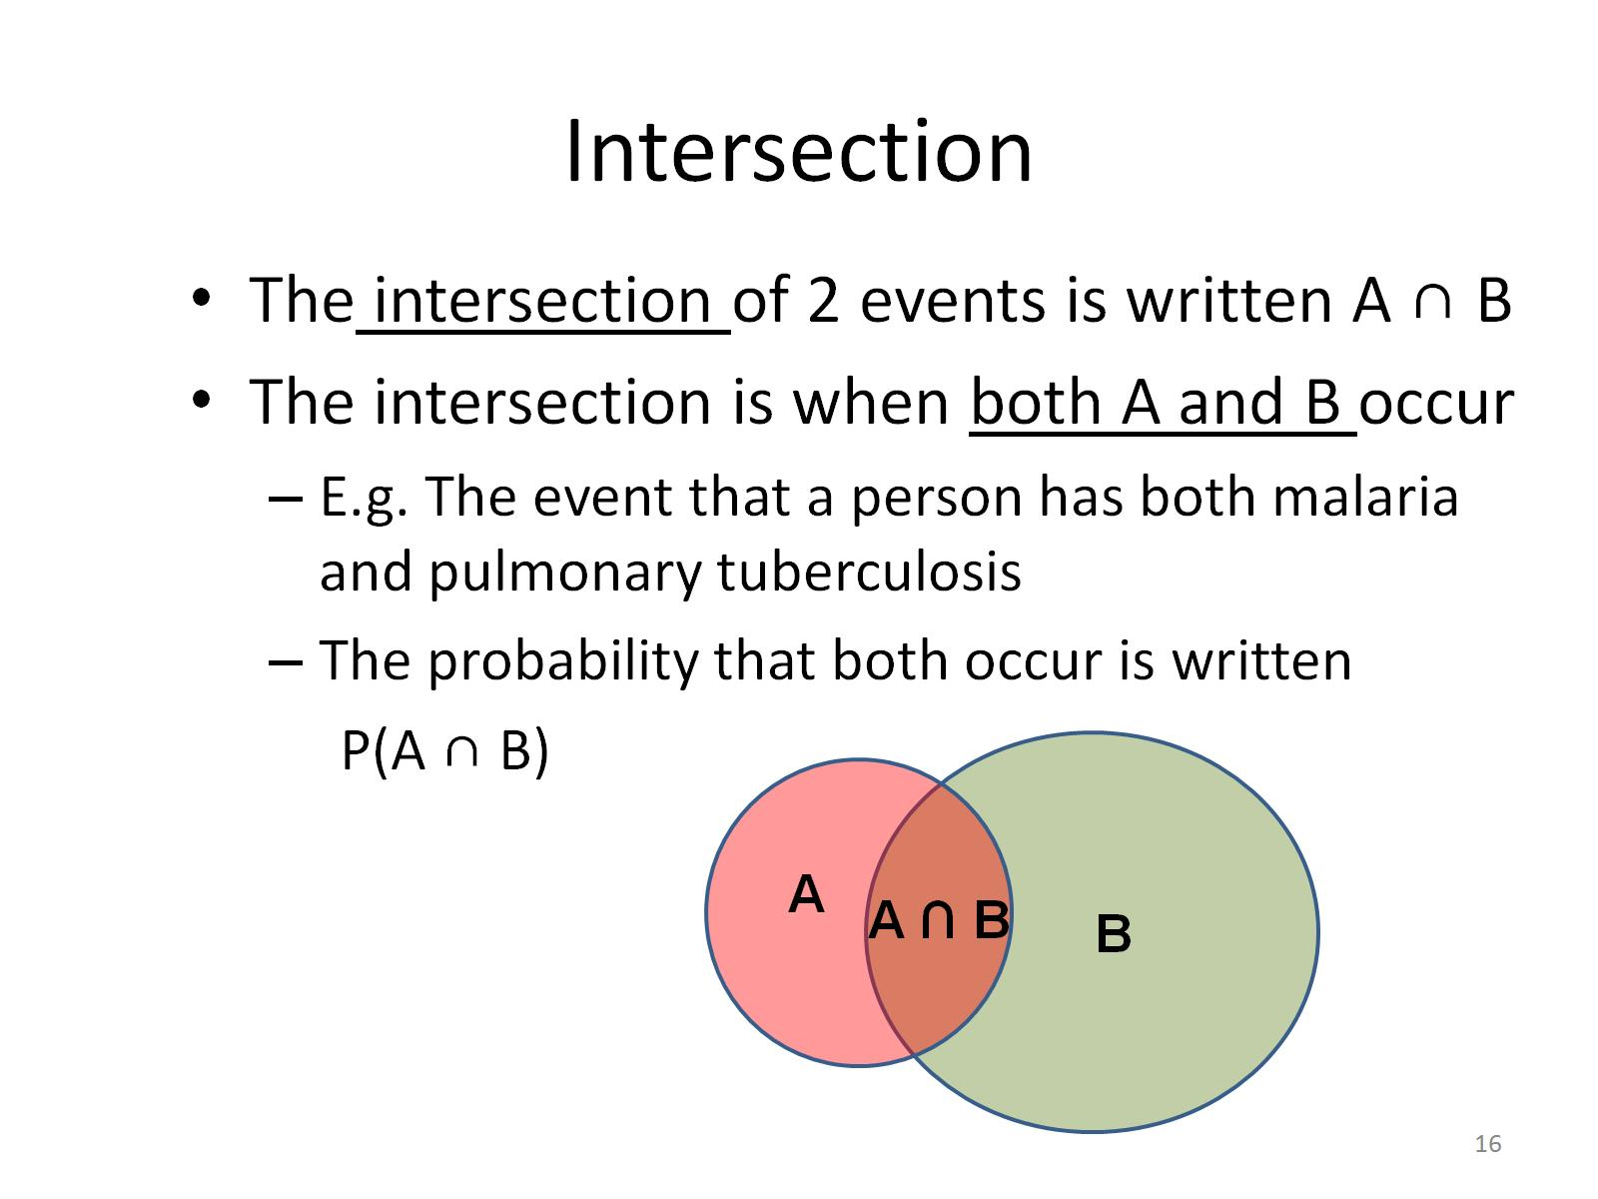
Intersection

Slide 20
Union
The union of 2 events is written A U B
The union is if either A or B or both occur
A U B
A
A ∩ B
B

Slide 21
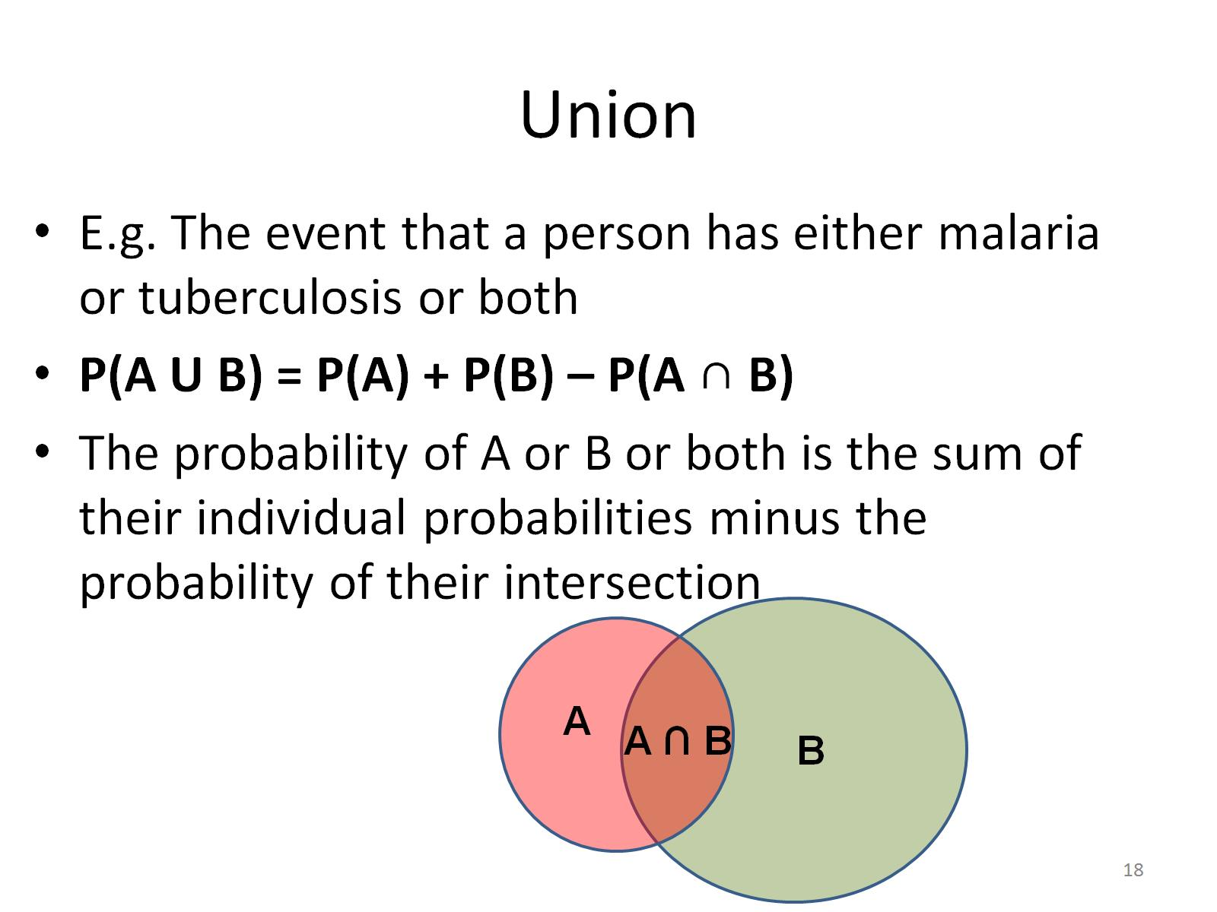
Union

Slide 22
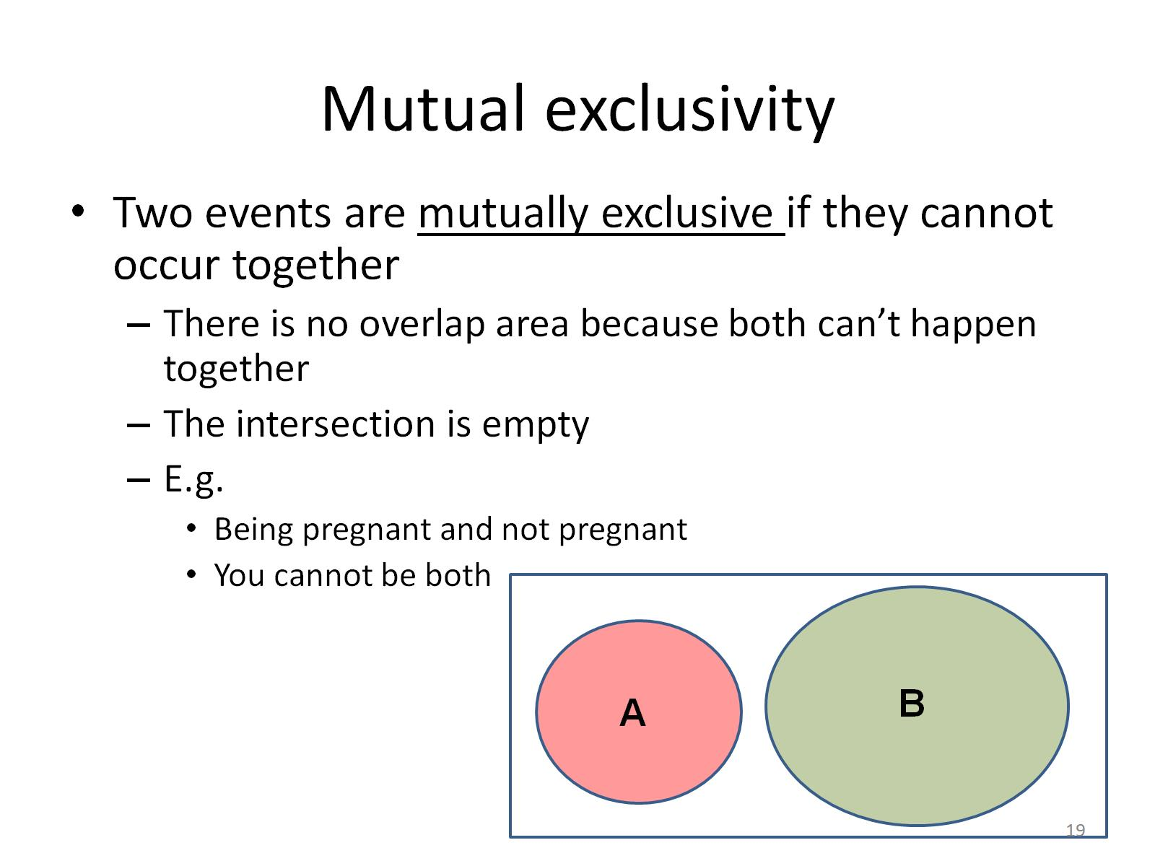
Mutual exclusivity

Slide 23
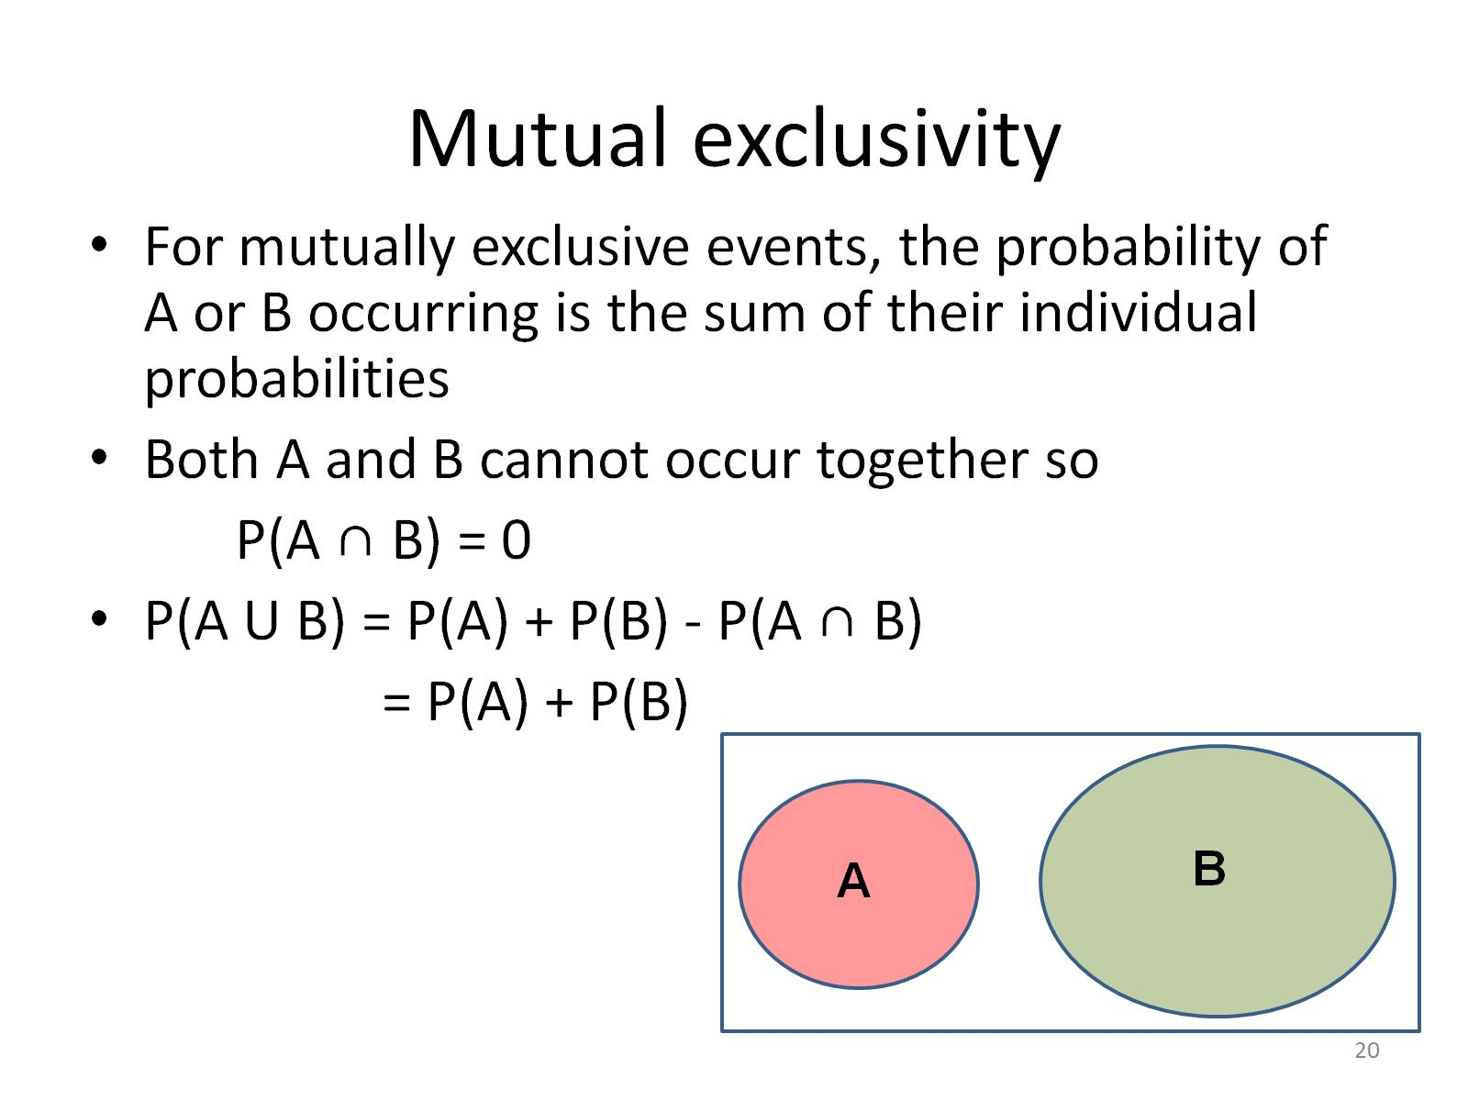
Mutual exclusivity

Slide 24
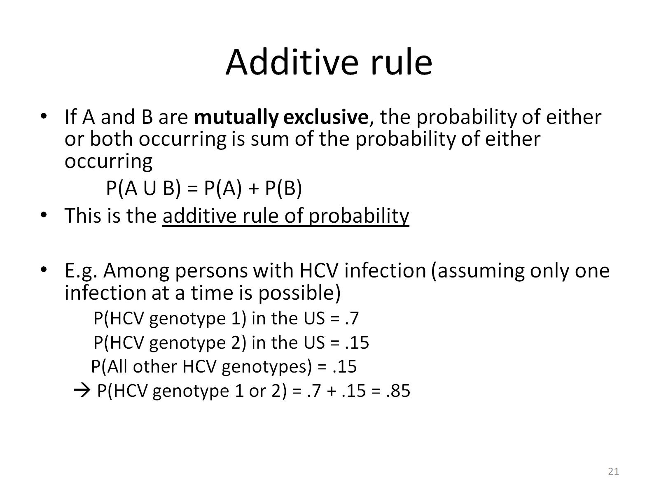
Additive rule

Slide 25
Additive rule
The additive rule of probability can be applied to several mutually exclusive events
For 3 events: If none of the events can occur together, then
P(A₁ U A₂ U A₃ ) = P(A₁) + P(A₂) + P(A₃)
For n events:
P(A₁ U A₂ U … U A_{n} ) = P(A₁) + P(A₂) + … P(A_{n})

Slide 26
Probability summary
Complement: P(A)= 1-P(Ā)
Intersection: Prob ( A and B )= P(A ∩ B)
Union: Prob ( A or B or both ) = P(A U B)
  P(A U B) =P(A) + P(B) – P(A ∩ B)
Mutually exclusive events:
P(A ∩ B) = 0
  If A and B are mutually exclusive: then
  P(A U B) = P(A) + P(B) additive rule

Slide 27
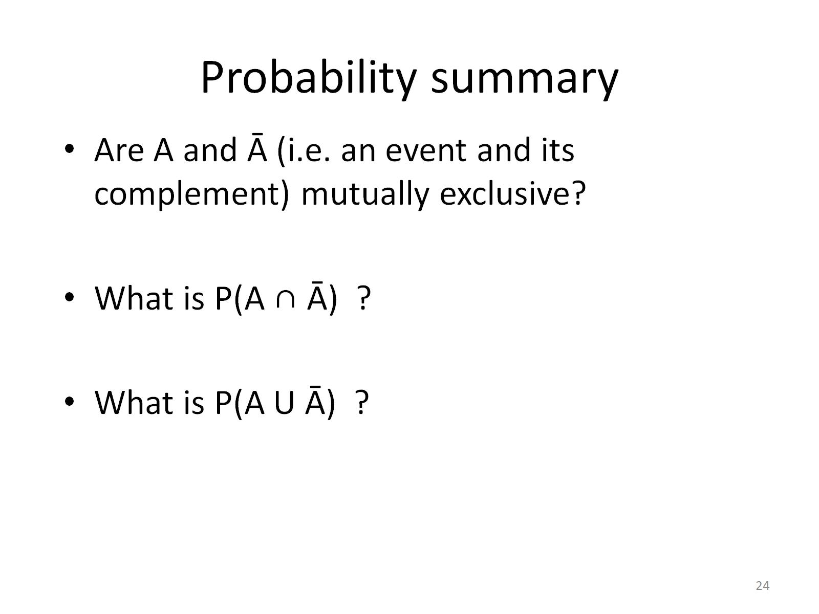
Probability summary

Slide 28
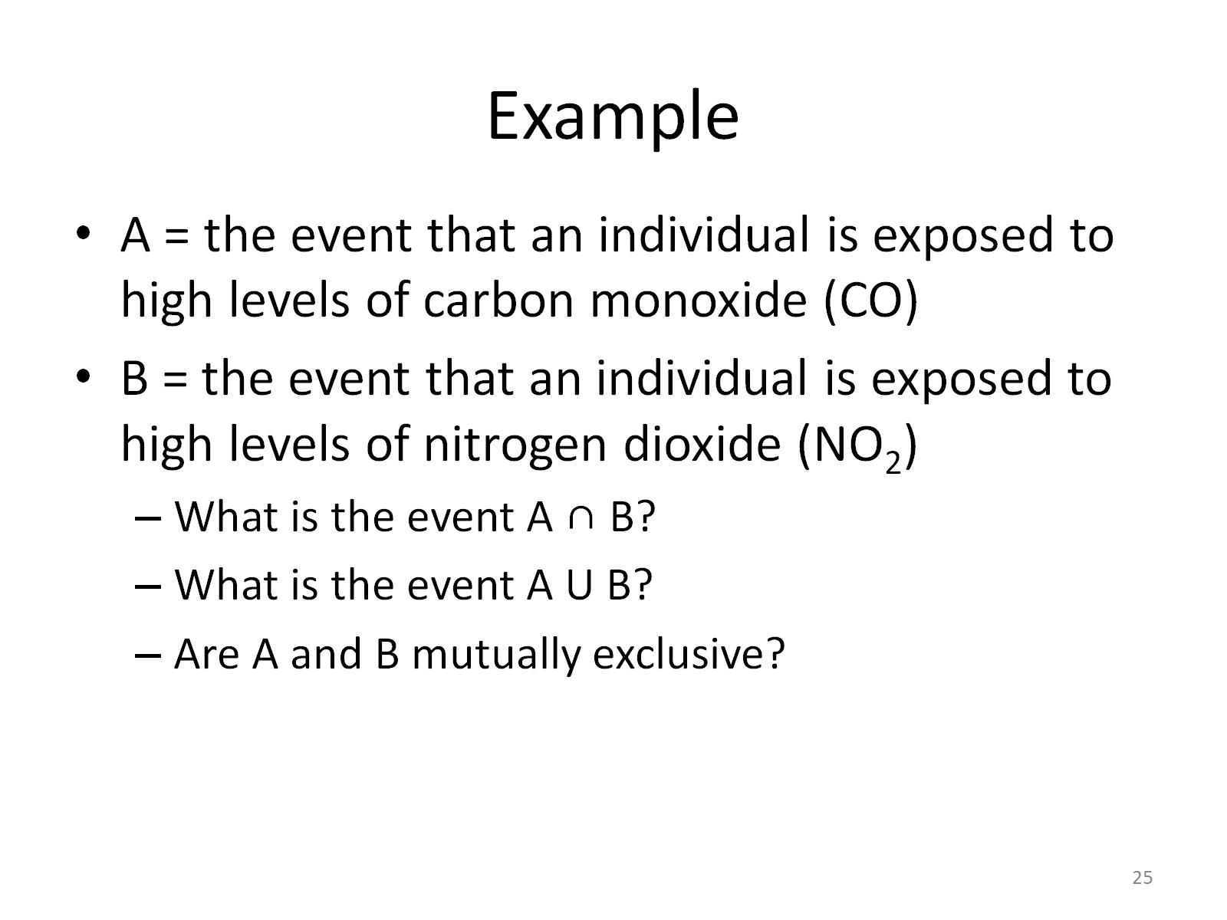
Example

Slide 29
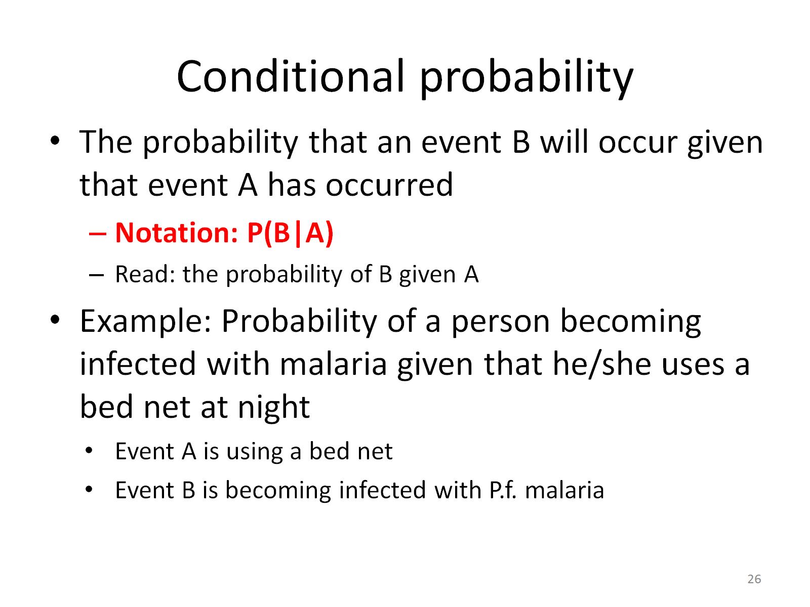
Conditional probability

Slide 30
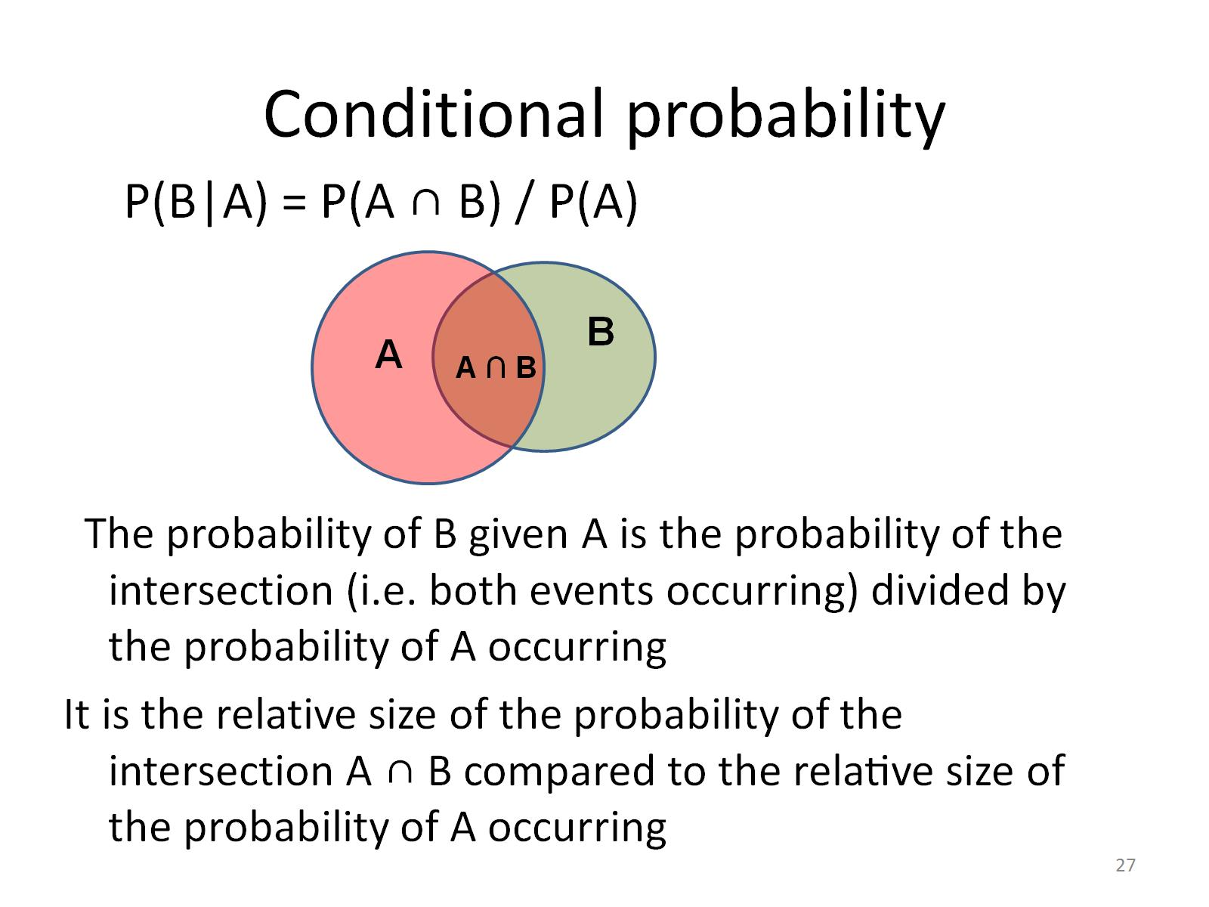
Conditional probability

Slide 31
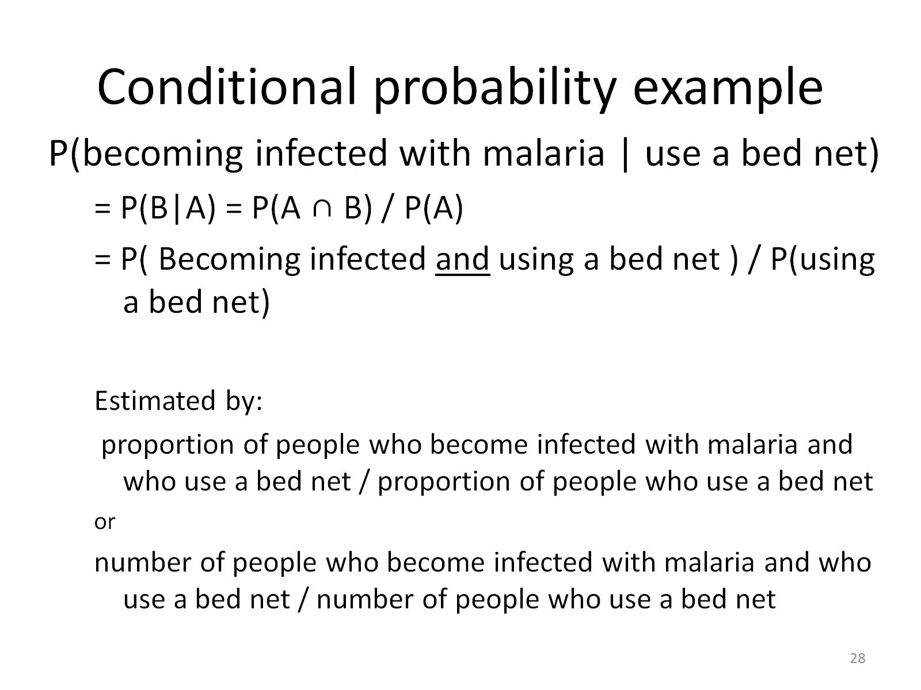
Conditional probability example

Slide 32
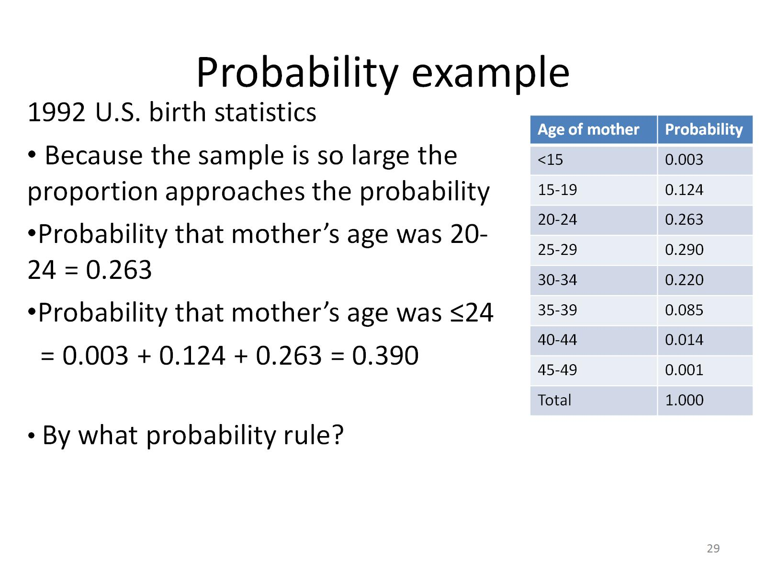
Probability example

Slide 33
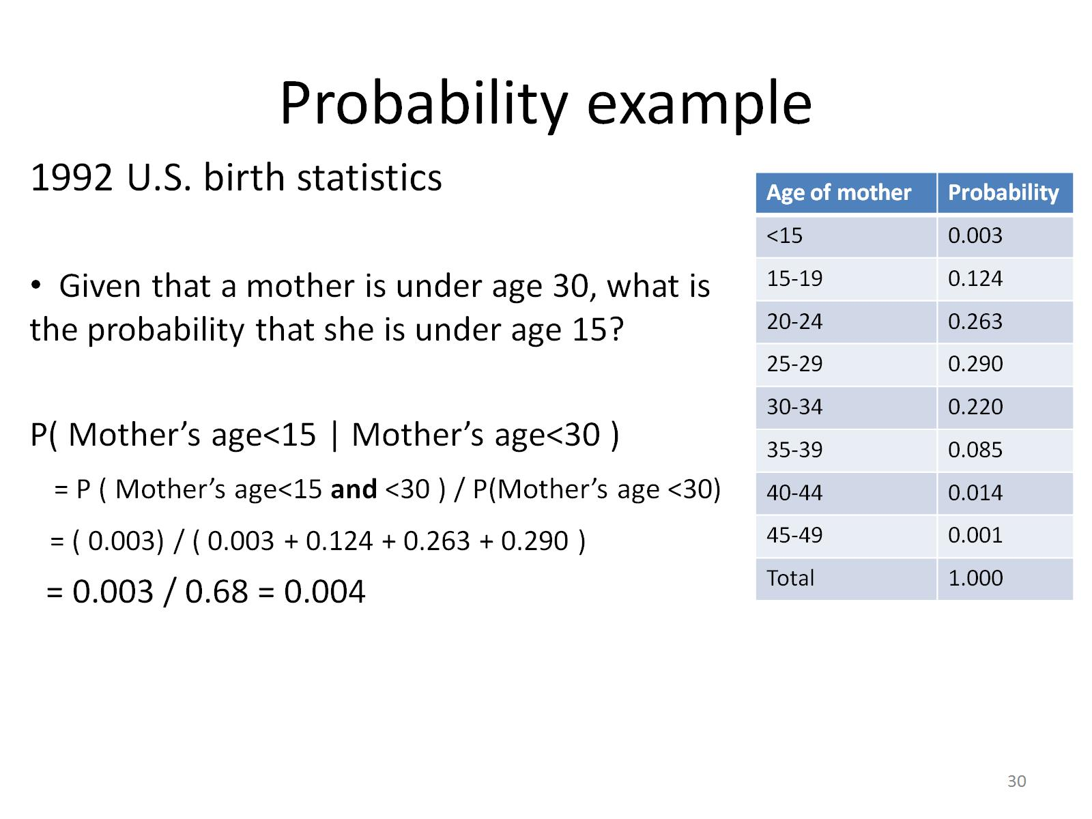
Probability example

Slide 34
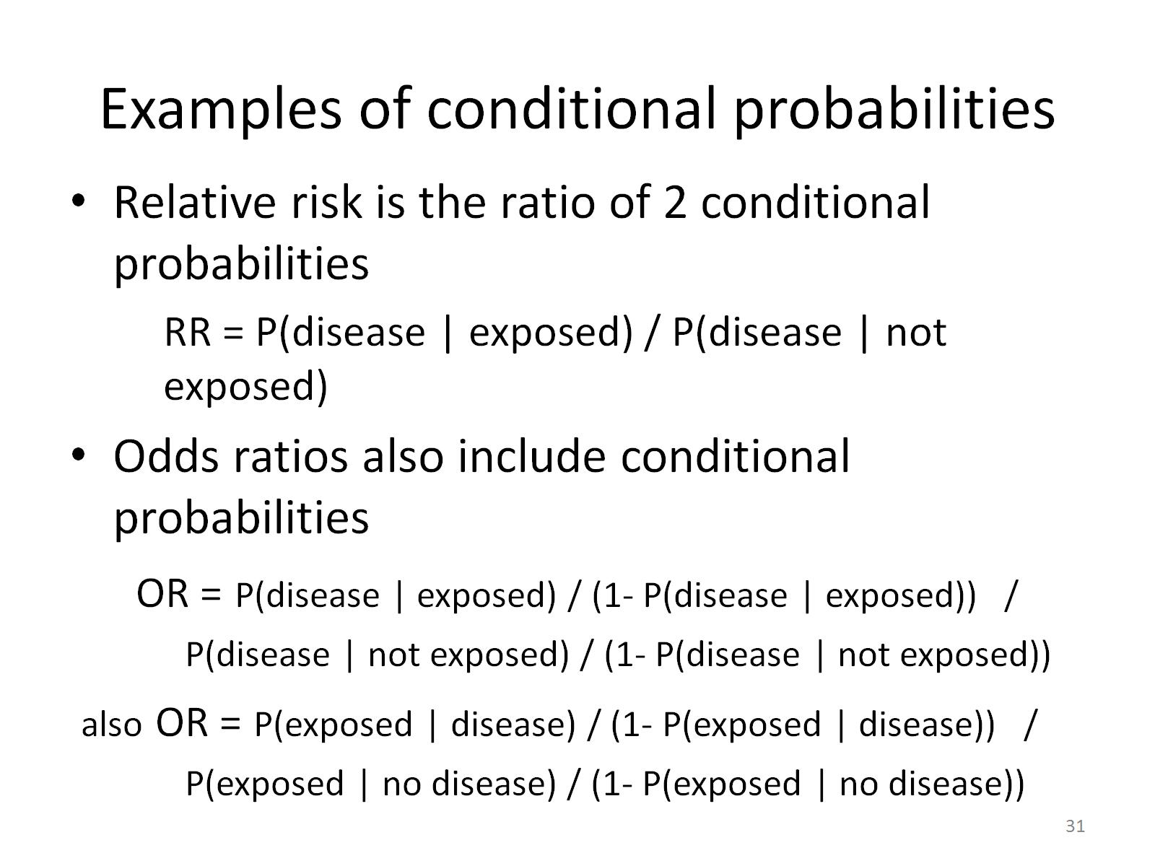
Examples of conditional probabilities

Slide 35
Independence
If the occurrence of event B does not depend on the occurrence of event A, B and A are independent.
Then P(B|A)=P(B)
Examples:
  Probability of becoming infected with malaria given that you have 2 sisters = Probability of becoming infected with malaria
  Probability of a coin toss landing on heads given that the previous coin toss was a heads

Slide 36
Multiplicative rule of probability
P(A ∩ B) = P(A) P(B|A)
  This is a rearrangement of the definition of conditional probability P(B|A) = P(A ∩ B) / P(A)
Also: P(A ∩ B) = P(B ∩ A)
= P(B) P(A|B)
If you have independence: P(B|A) = P(B)
    Then the multiplicative rule (remember, just a rearrangement of conditional probability)
  P(A ∩ B) = P(A) P(B|A) reduces to
  P(A ∩ B) = P(A) P(B)
Notes:
Check text for placement of this slide…

Slide 37
Independence
Note that independence ≠ mutual exclusivity!
  Mutual exclusivity
    2 events cannot both occur
    P(A ∩ B) =0
  Independence
    2 events do not depend on each other
    P(B|A)=P(B)
    P(A ∩ B) = P(A) P(B|A) = P(A) P(B)

Slide 38
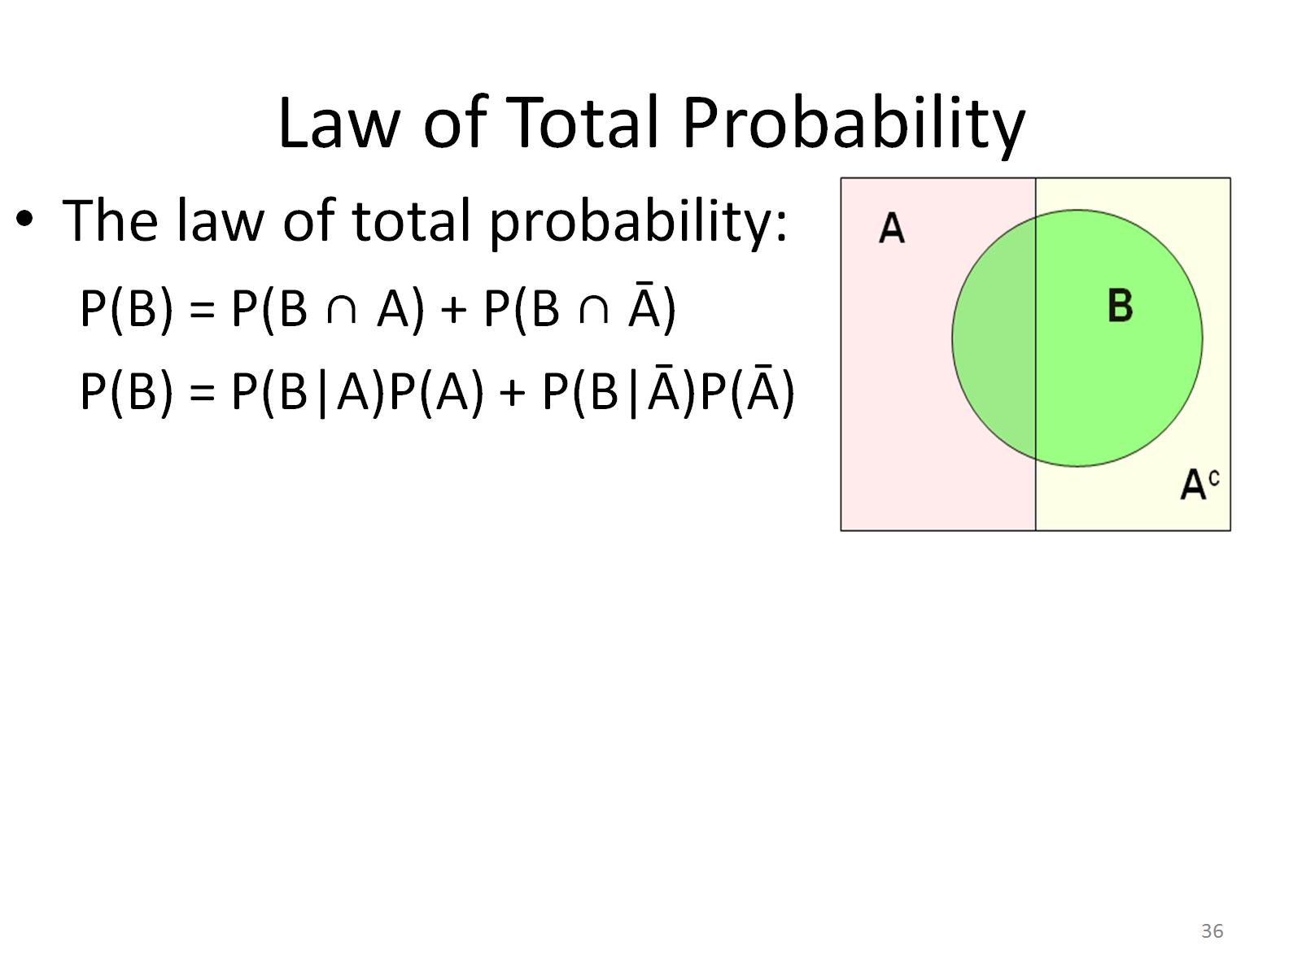
Law of Total Probability

Slide 39
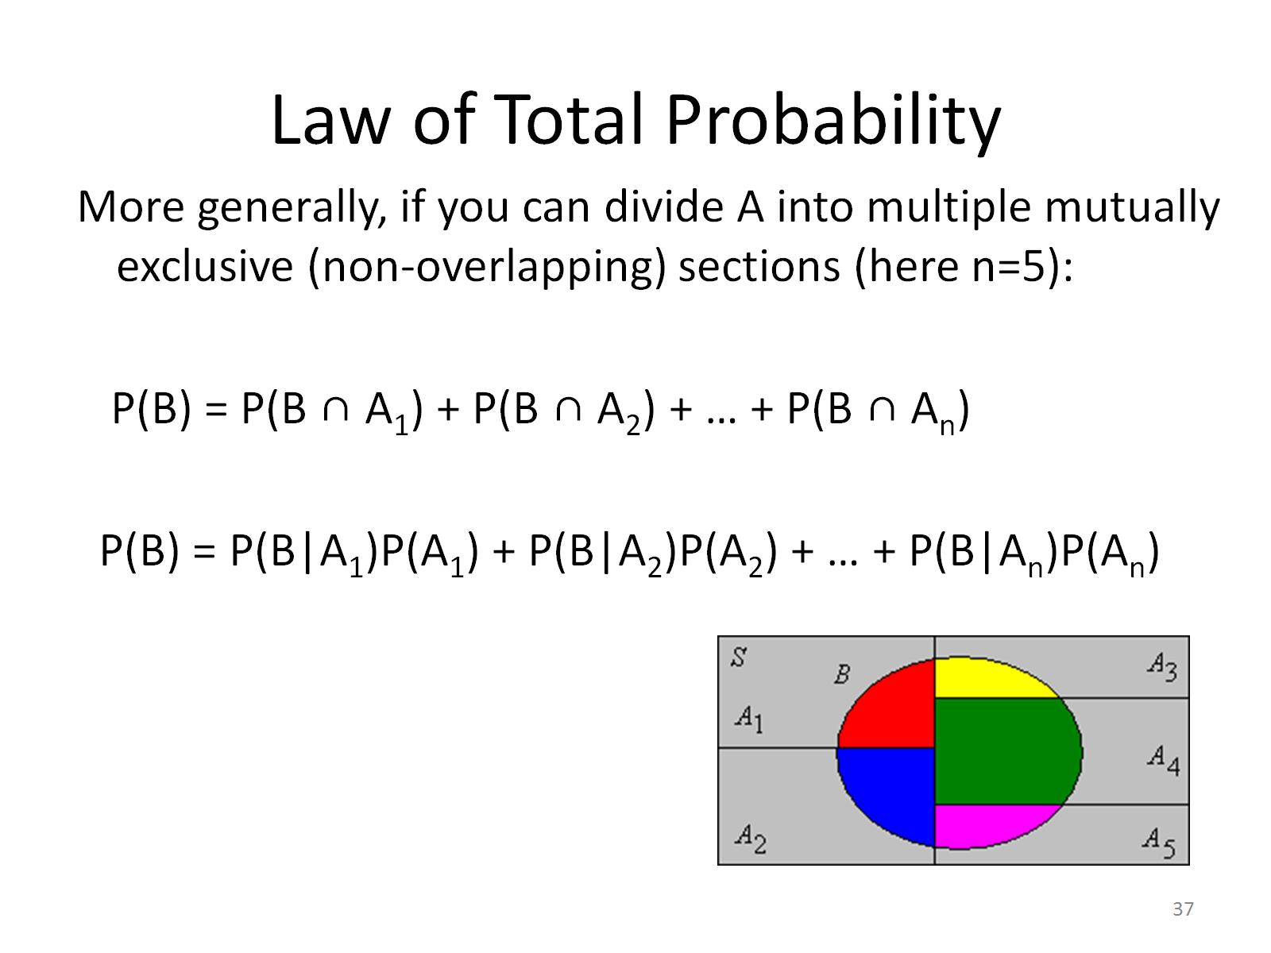
Law of Total Probability

Slide 40
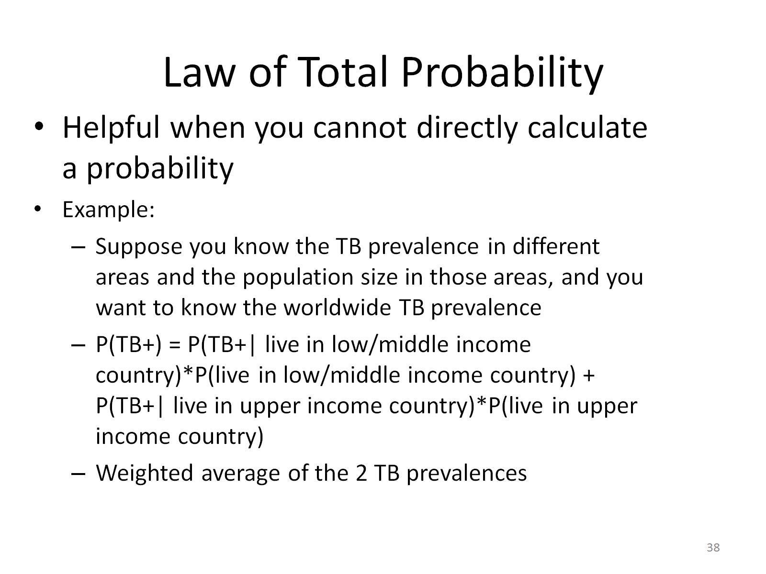
Law of Total Probability

Slide 41
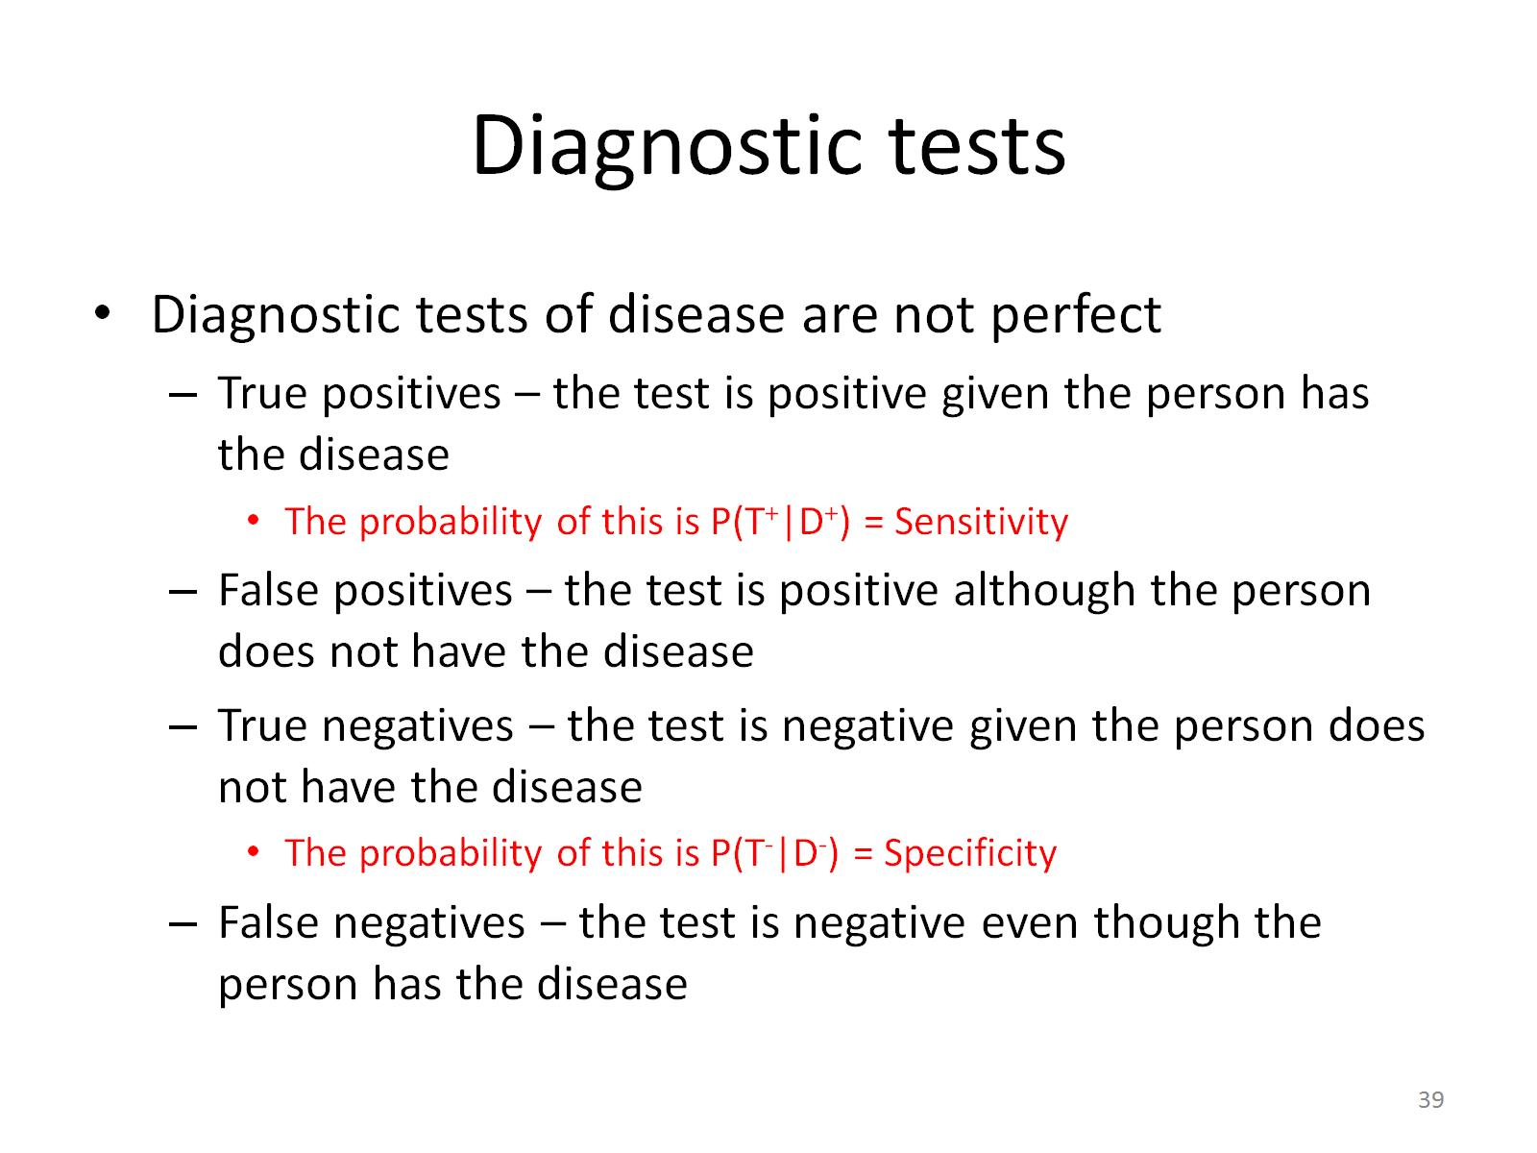
Diagnostic tests

Slide 42
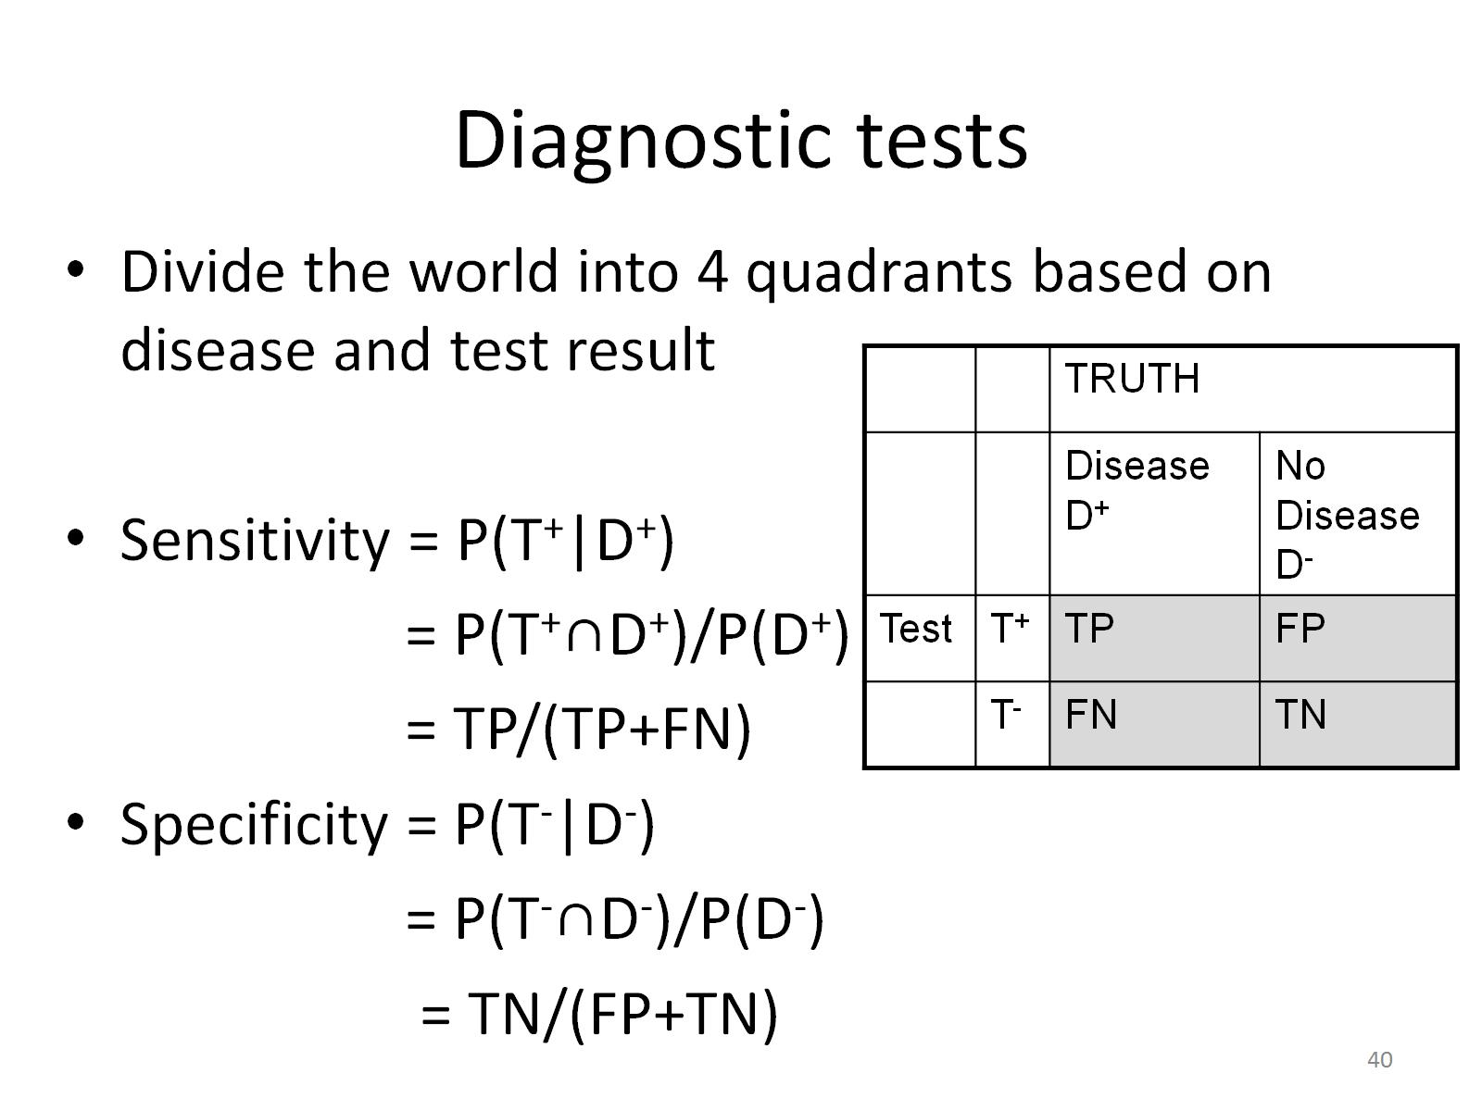
Diagnostic tests

Slide 43
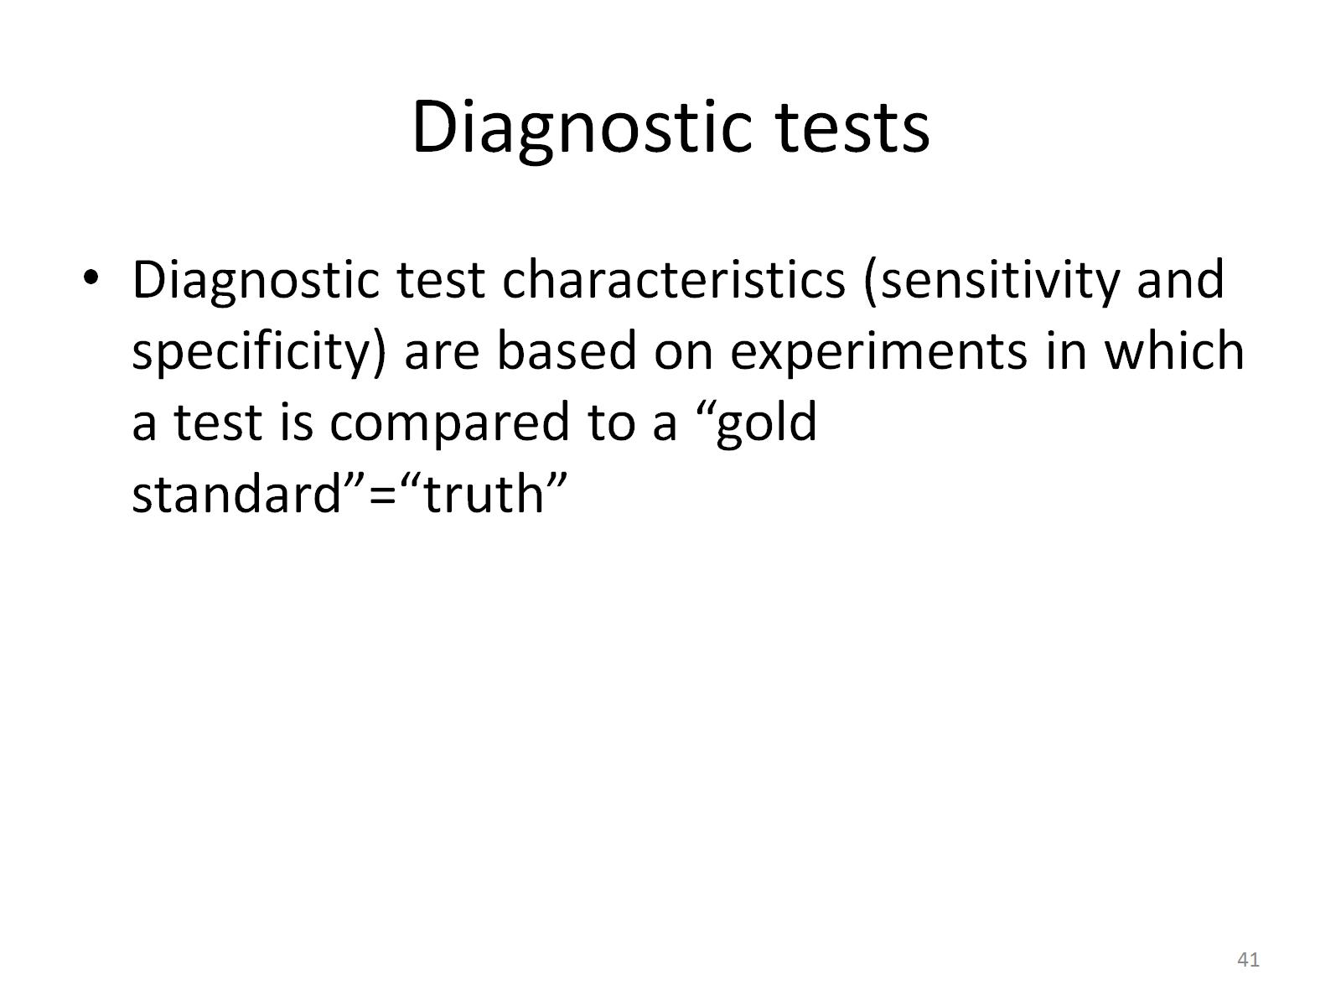
Diagnostic tests

Slide 44
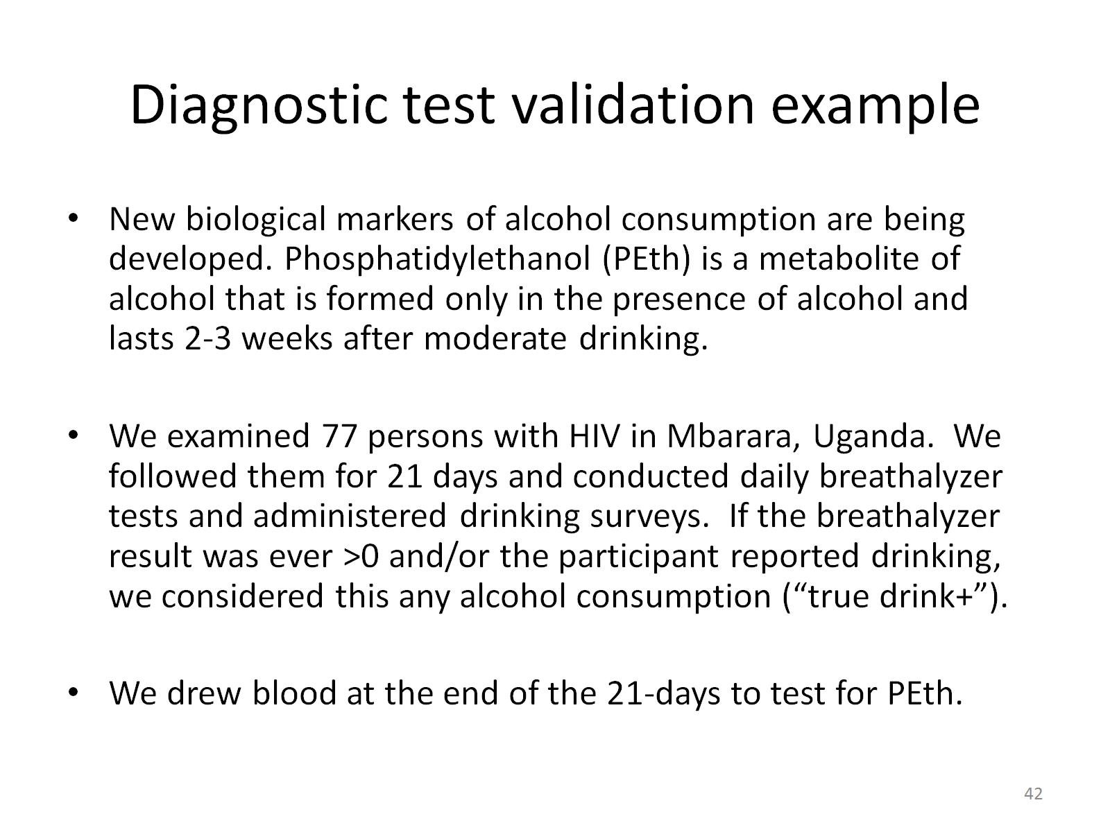
Diagnostic test validation example

Slide 45
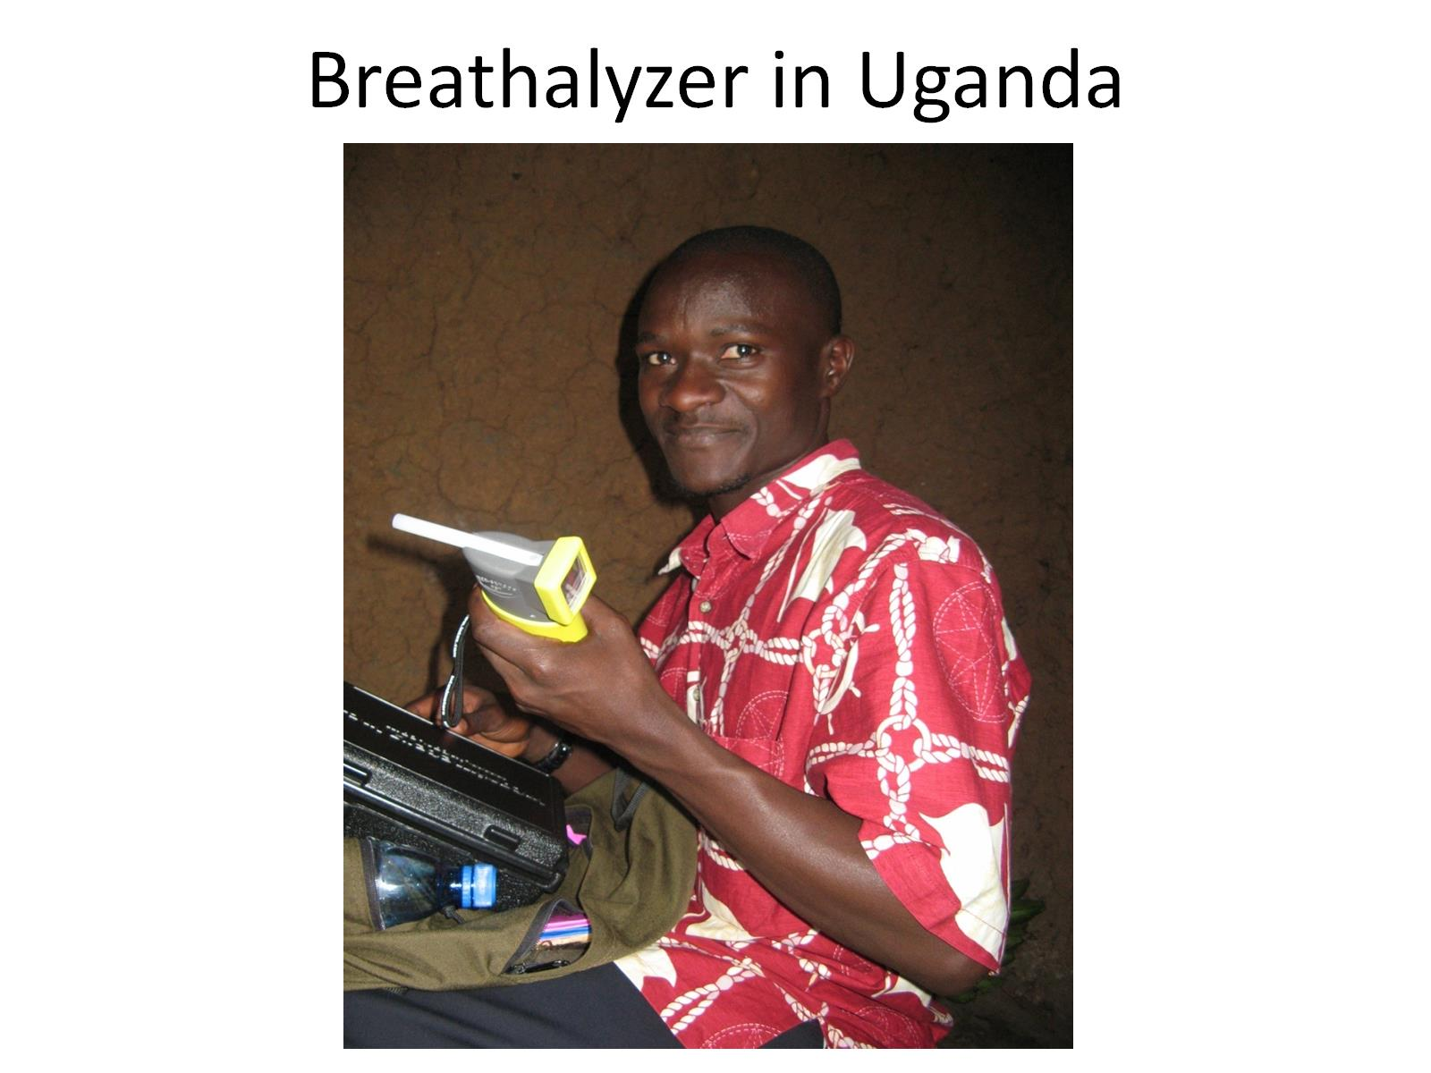
Breathalyzer in Uganda

Slide 46
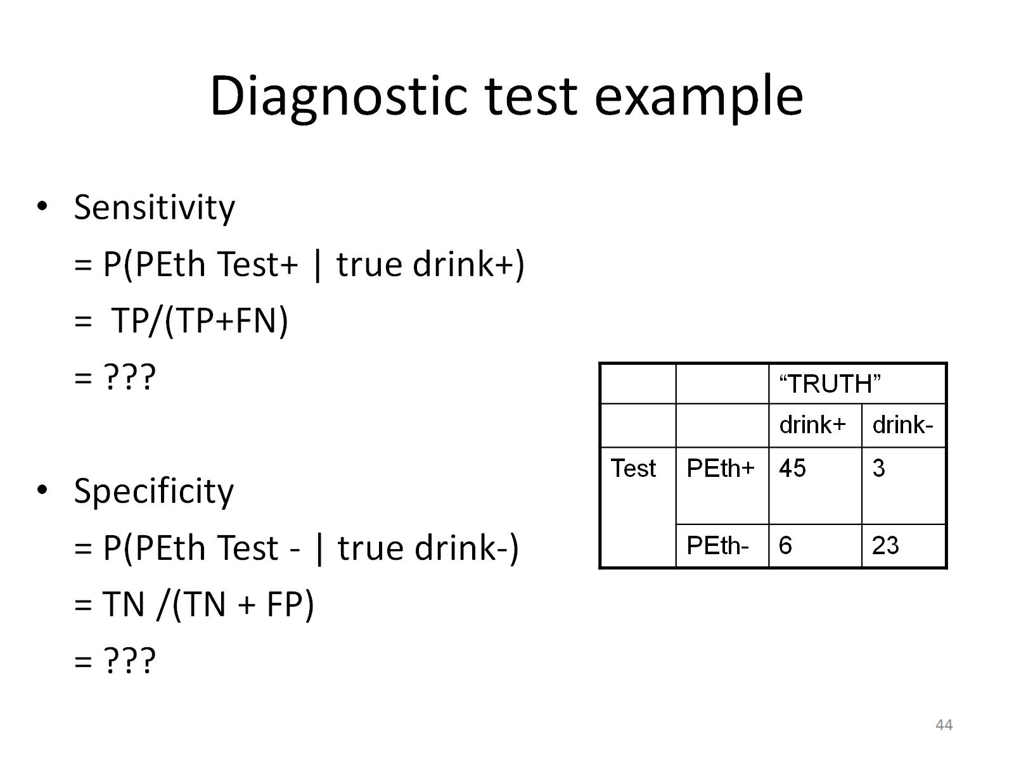
Diagnostic test example

Slide 47
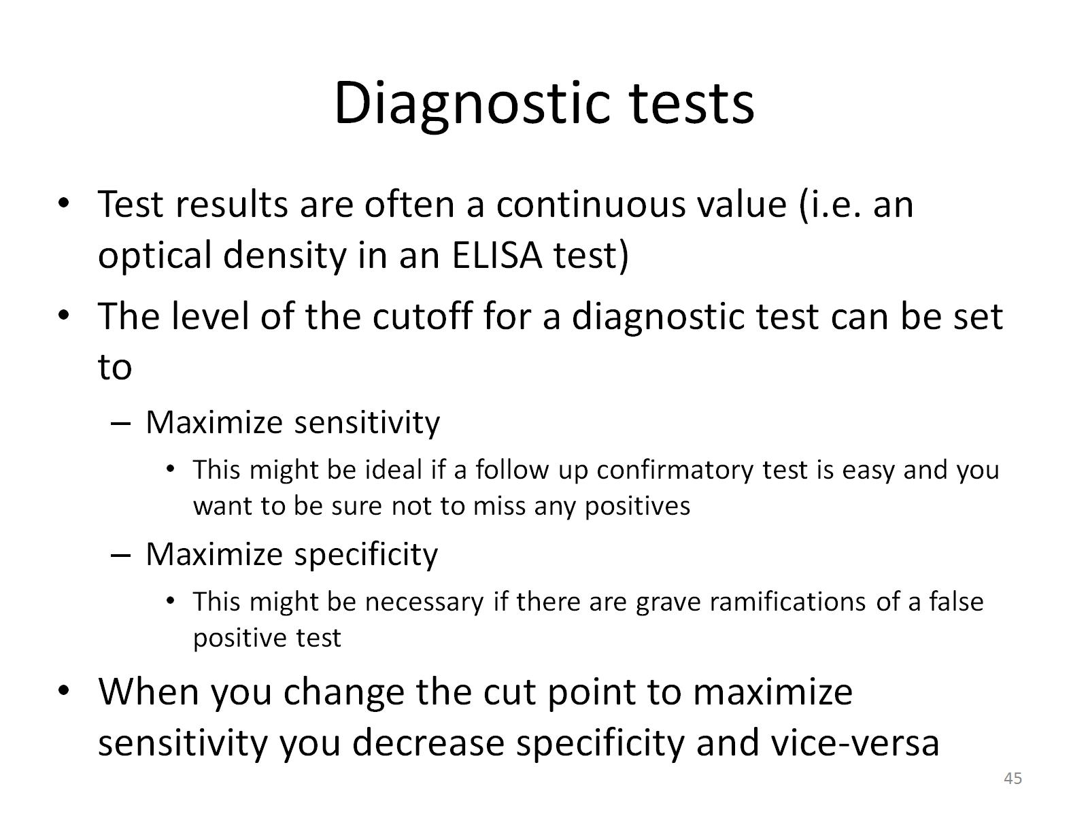
Diagnostic tests

Slide 48
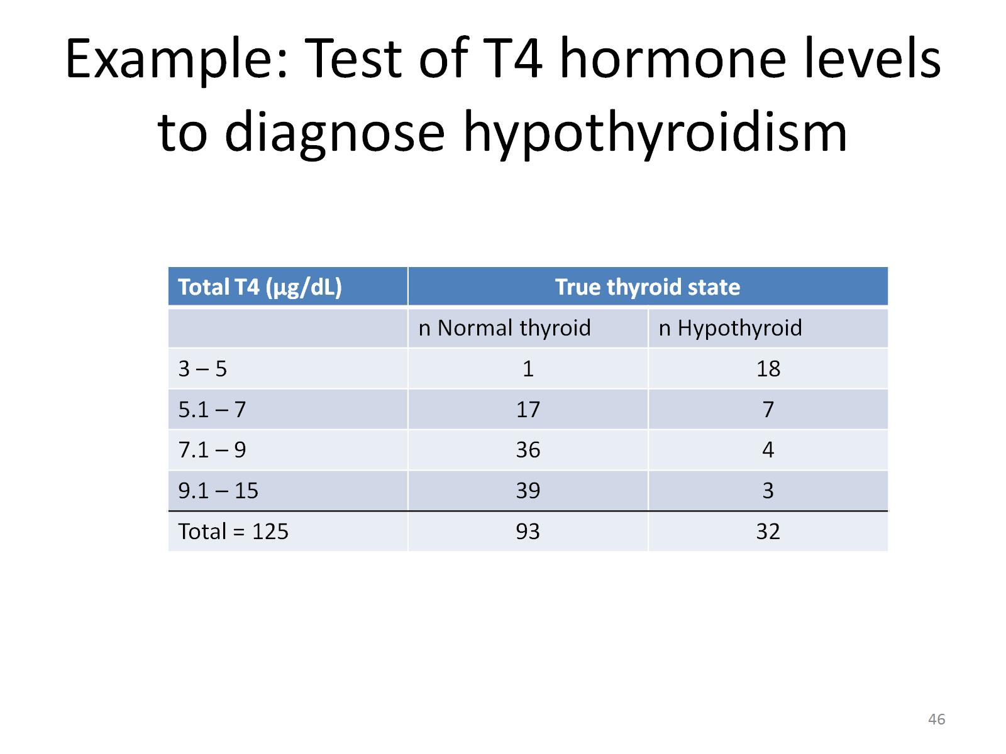
Example: Test of T4 hormone levels to diagnose hypothyroidism

Slide 49
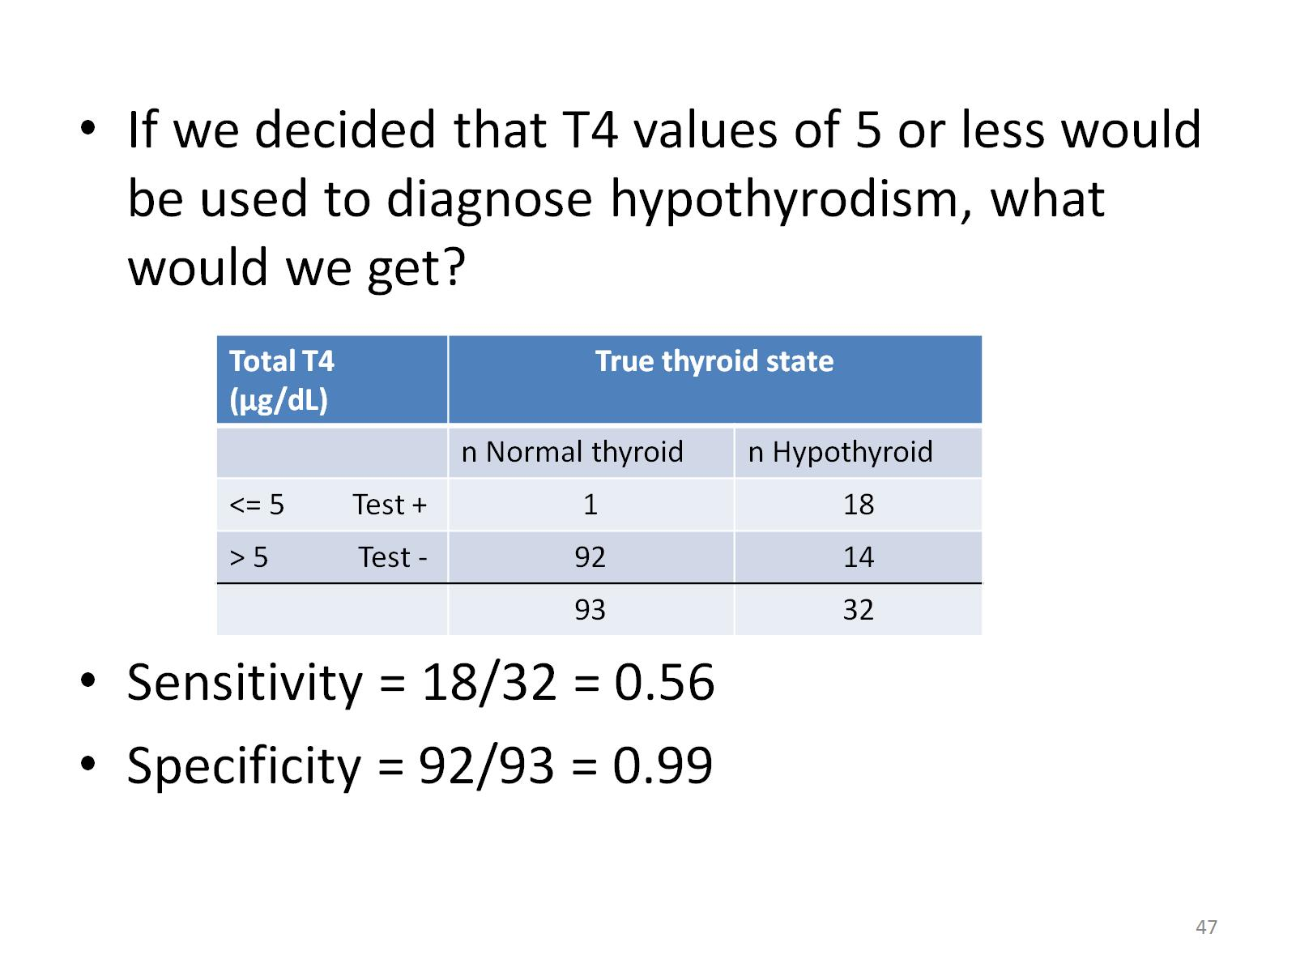

Slide 50
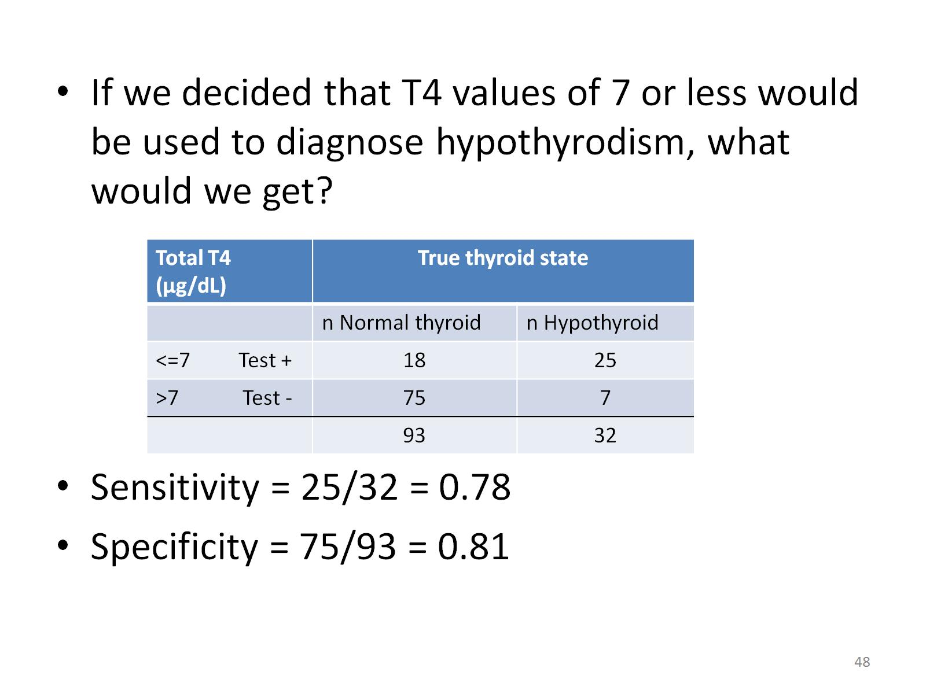

Slide 51
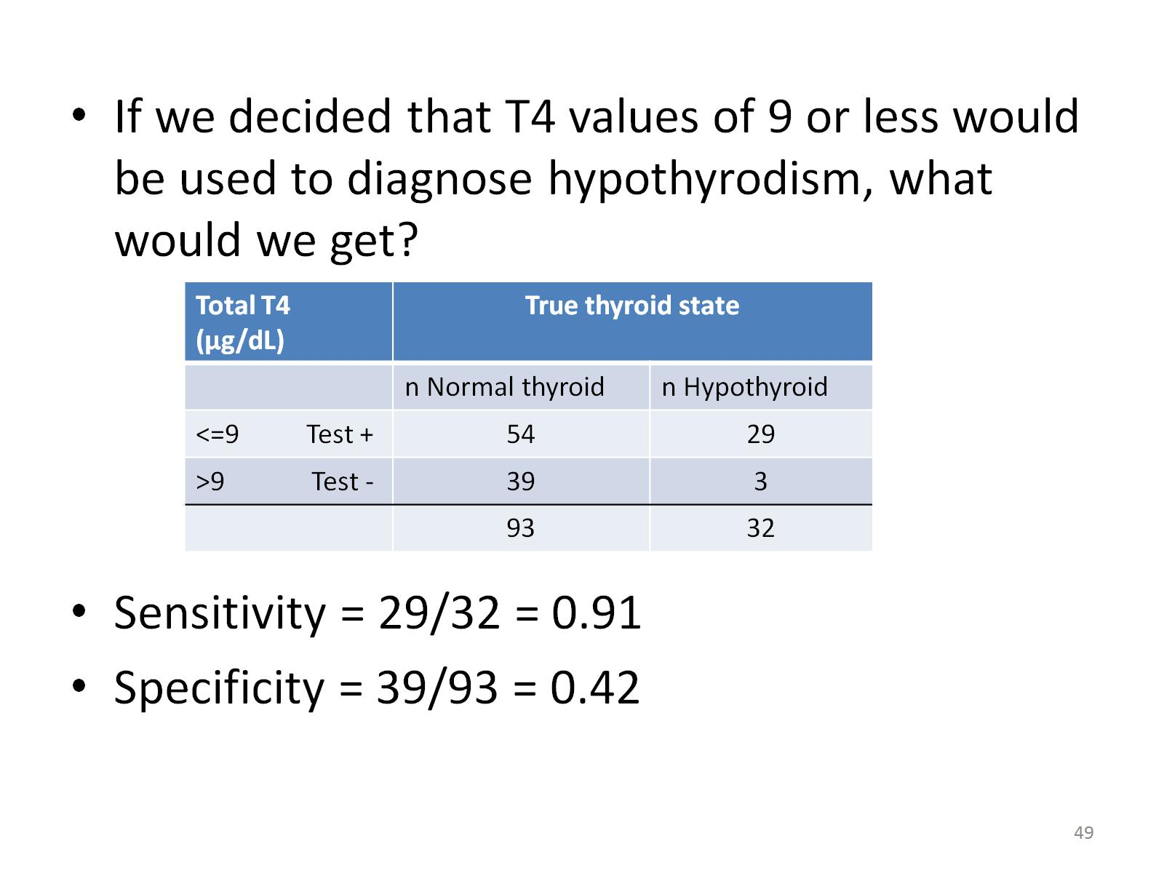

Slide 52
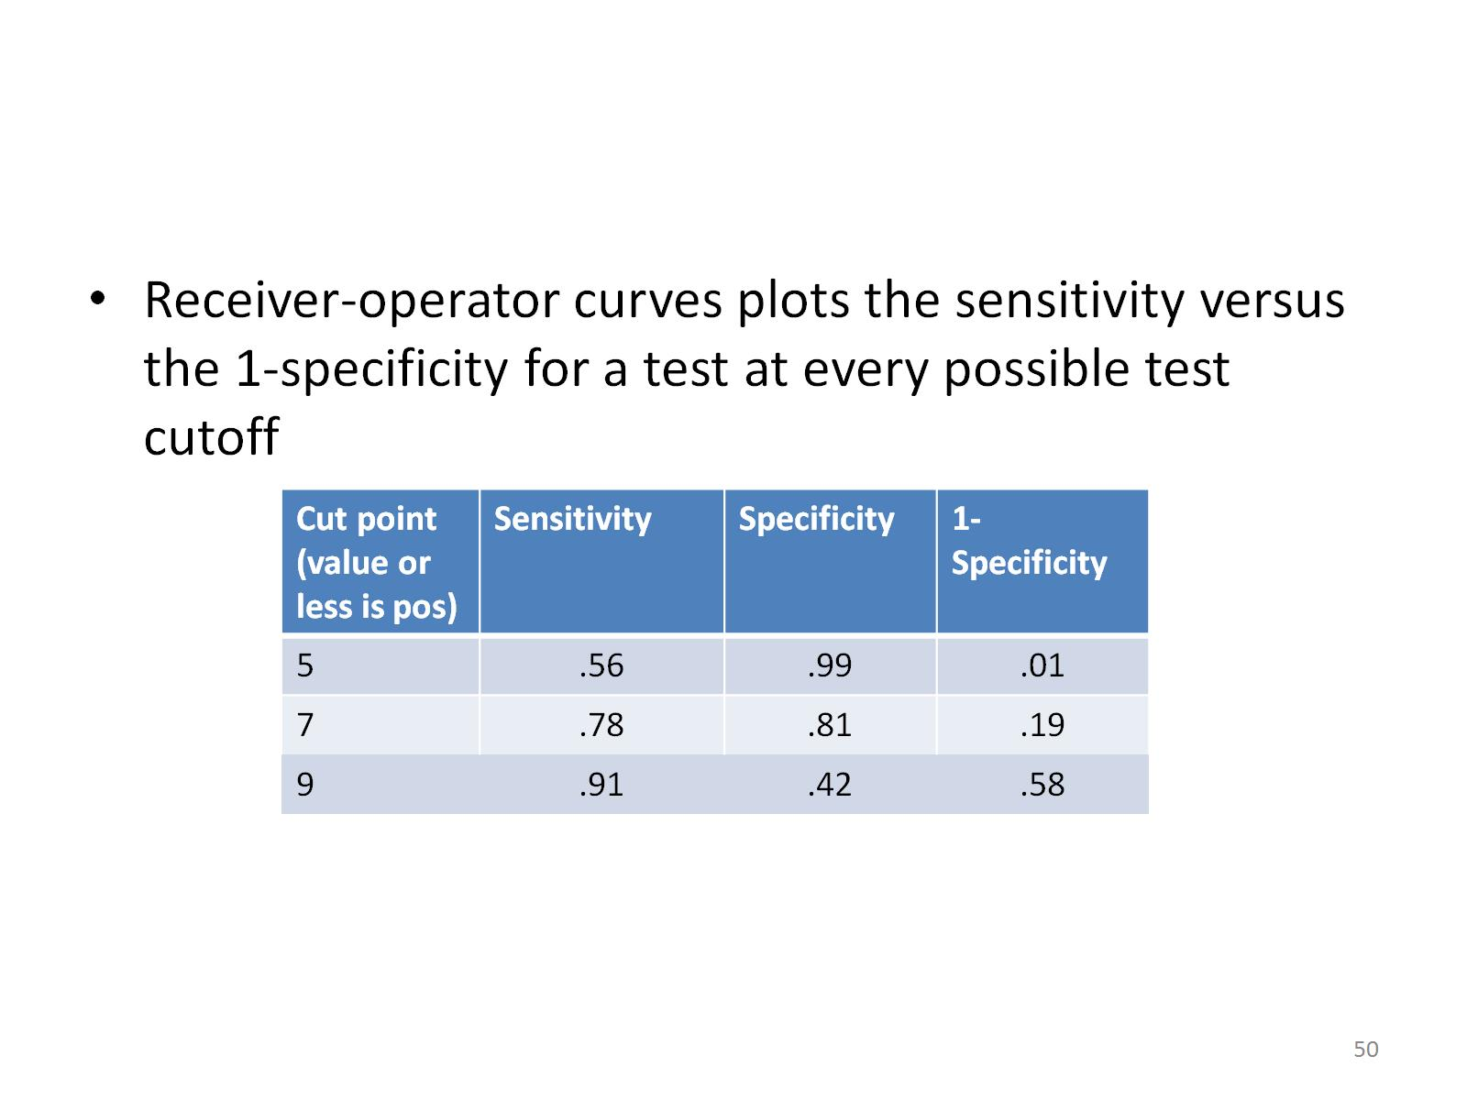

Slide 53
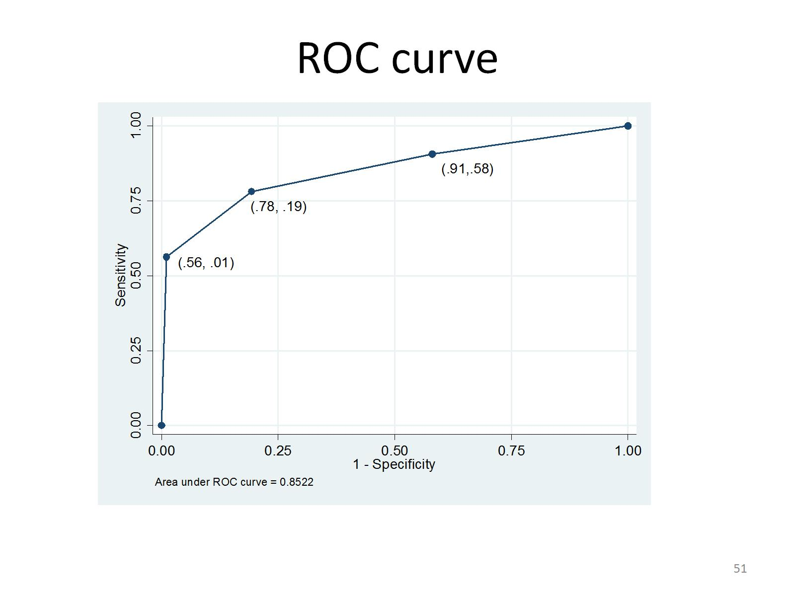
ROC curve

Slide 54
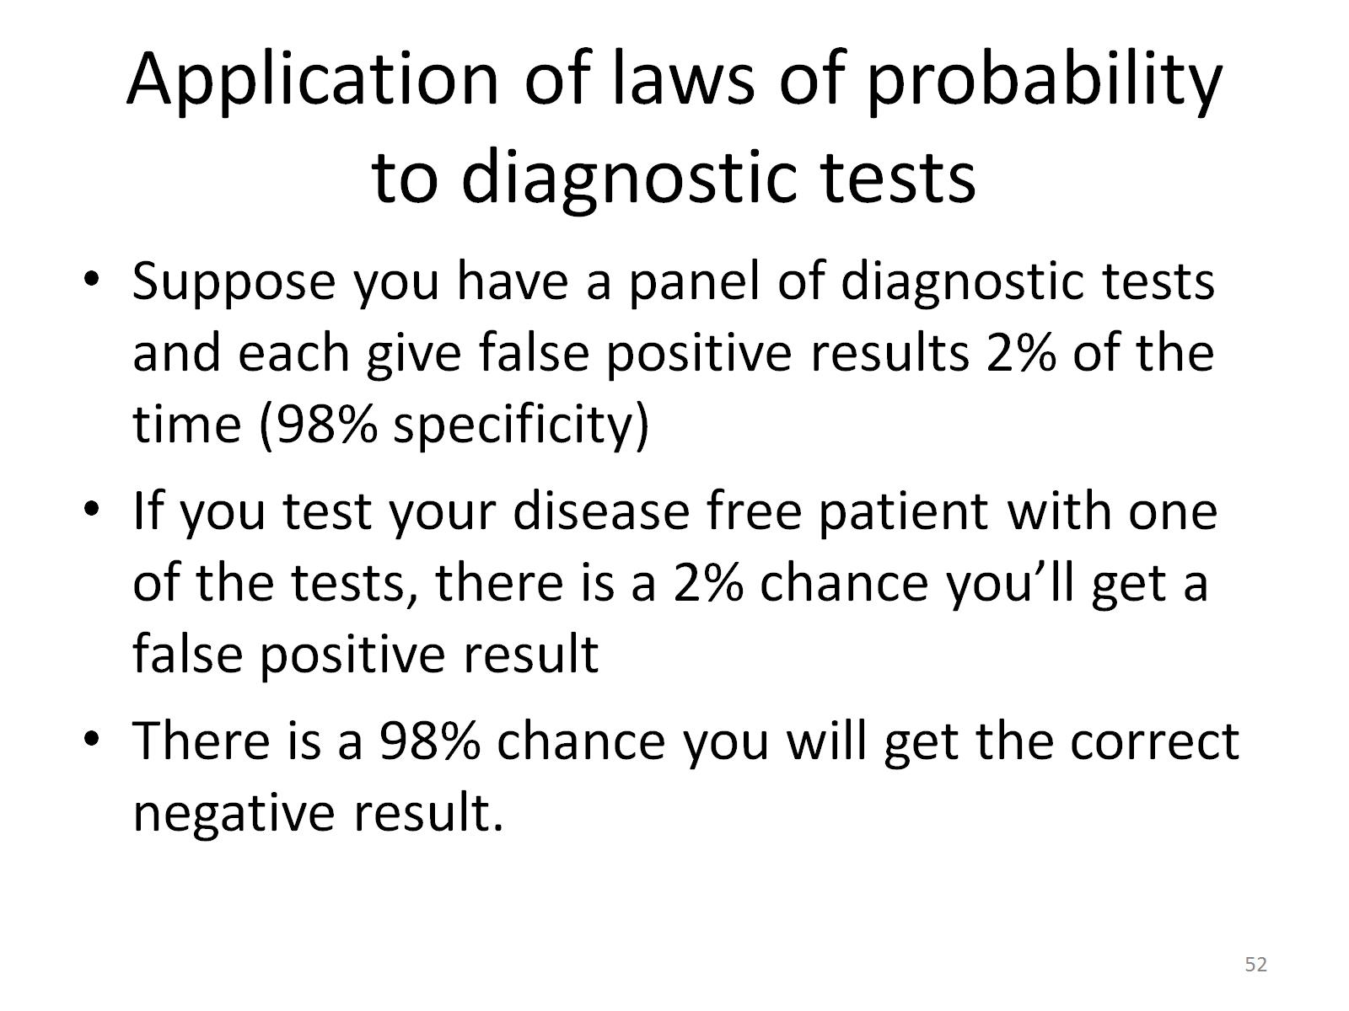
Application of laws of probability to diagnostic tests

Slide 55
Application of laws of probability to diagnostic tests
If you test a patient (without disease) with two tests, what are the possible results that you would get and what is the probability of those results?
Neg Neg
P(Neg test 1 ∩ Neg test 2) = 0.98*0.98=.9604 (why?)
Neg Pos
P (Neg test 1 ∩ Pos test 2) = 0.98*0.02=.0196
Pos Neg
P (Pos test 1 ∩ Neg test 2) = 0.02*0.98=.0196
Pos Pos
P (Pos test 1 ∩ Pos test 2) = 0.02*0.02=.0004
All 4 of these possibilities add to 1 (why?)
.9604 + .0196 + .0196 + .0004 = 1

Slide 56
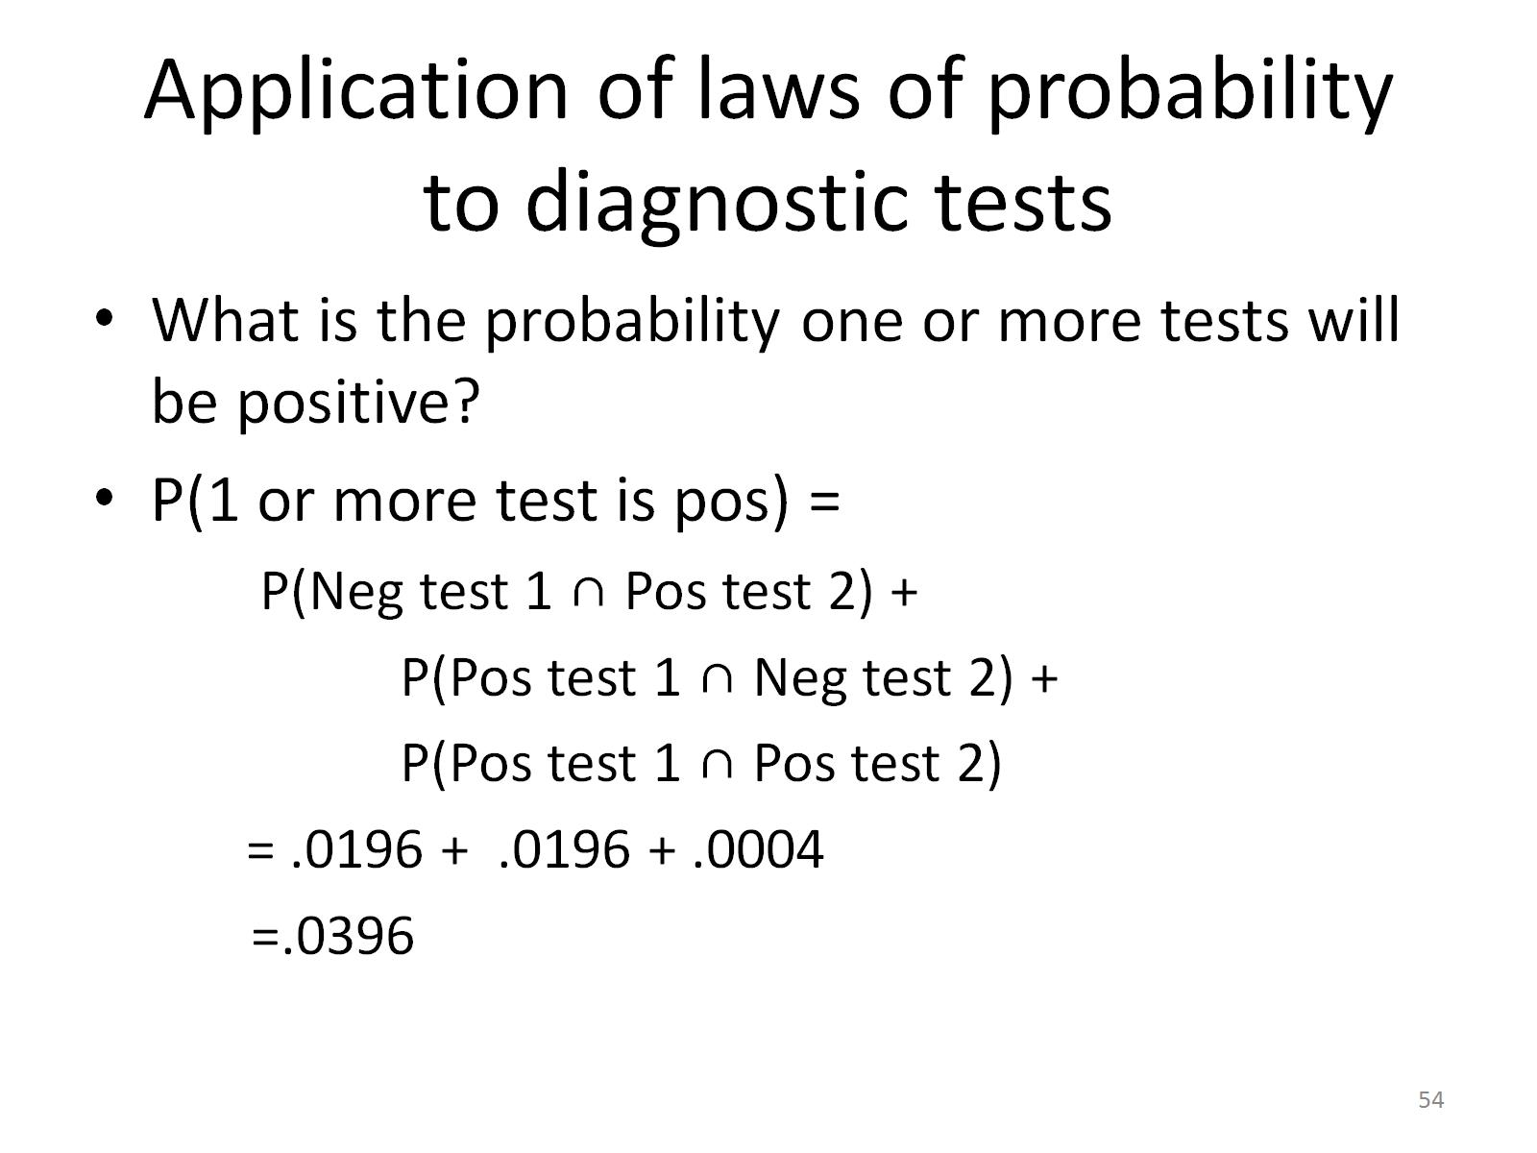
Application of laws of probability to diagnostic tests

Slide 57
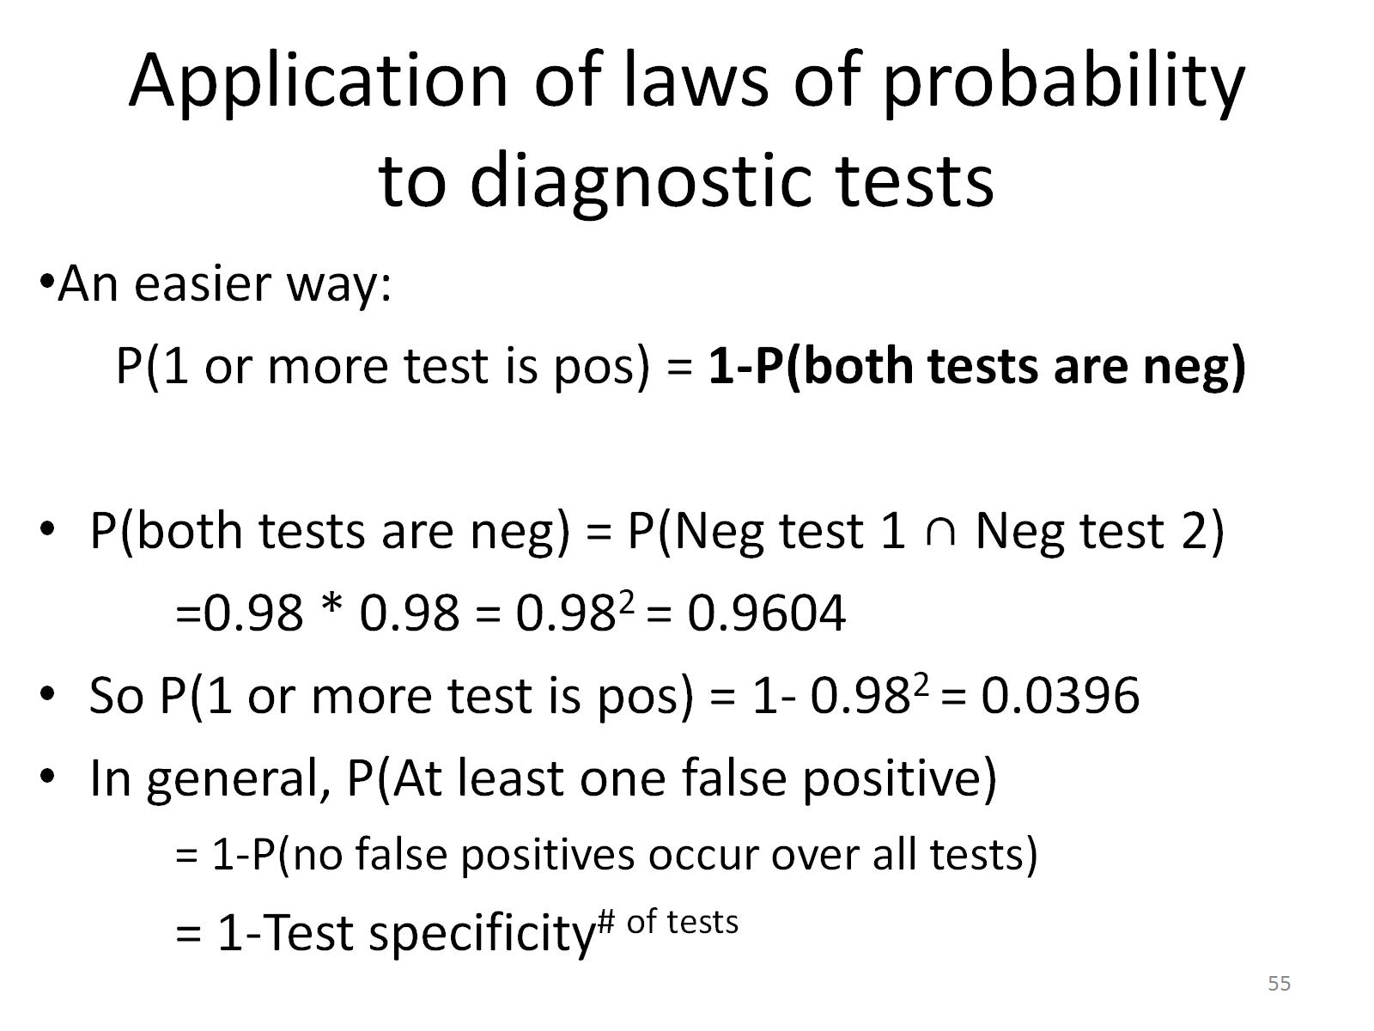
Application of laws of probability to diagnostic tests

Slide 58
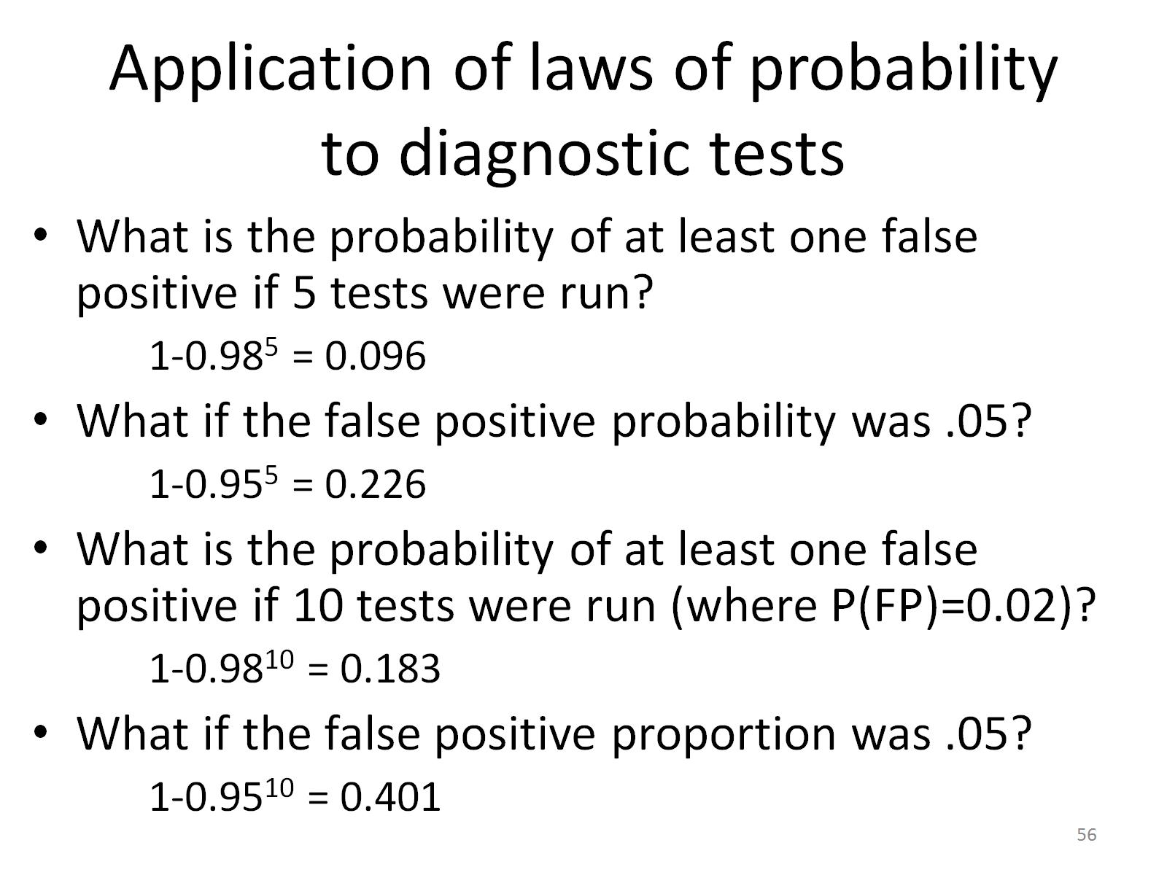
Application of laws of probability to diagnostic tests

Slide 59
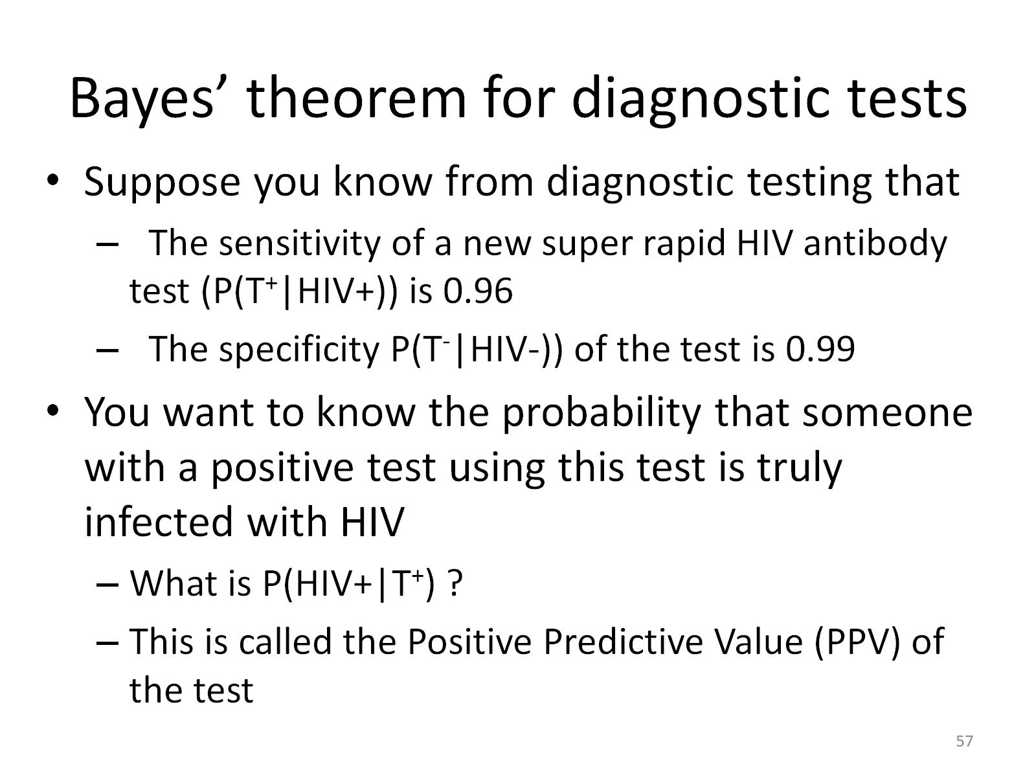
Bayes’ theorem for diagnostic tests

Slide 60
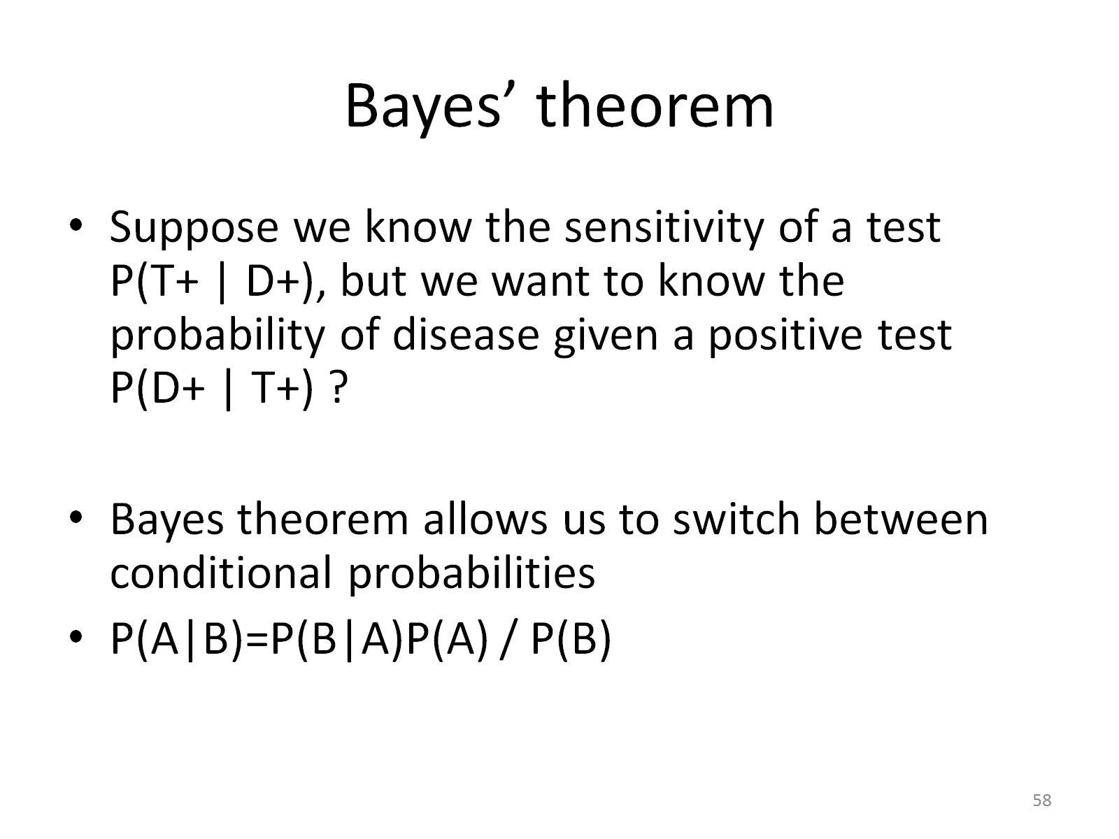
Bayes’ theorem

Slide 61
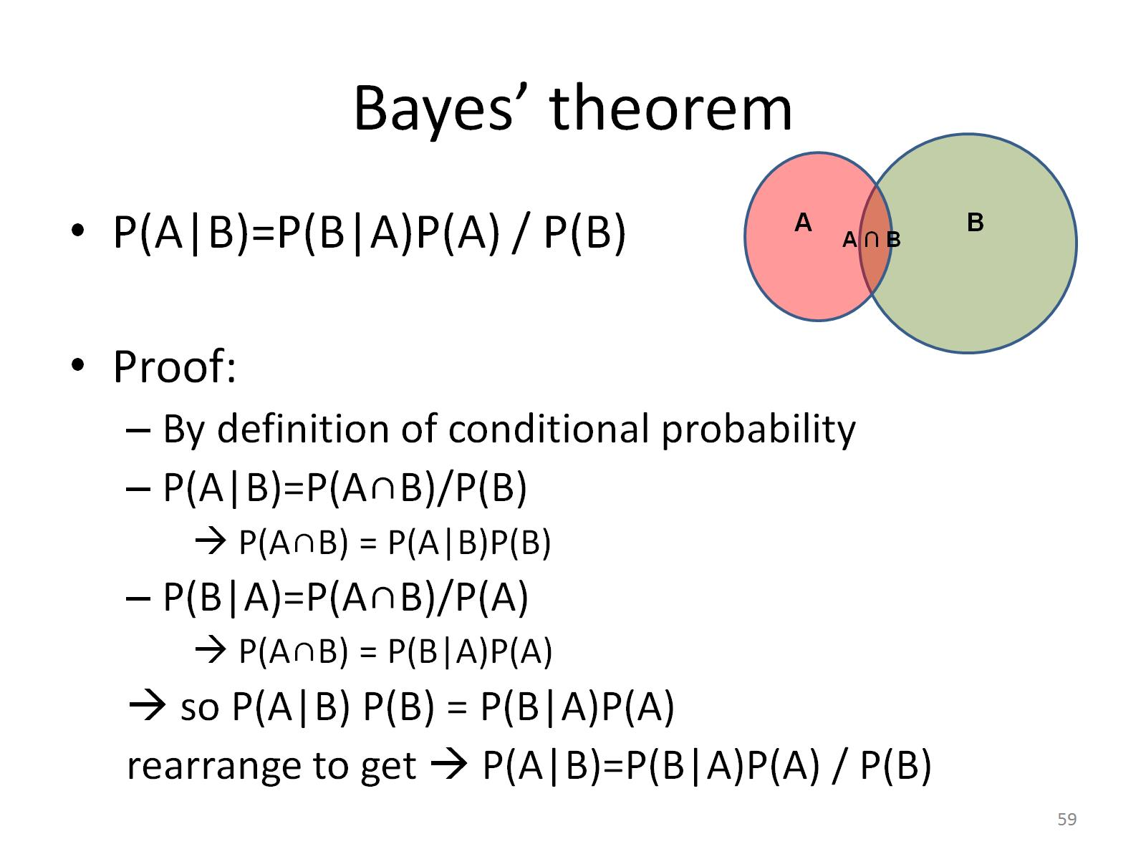
Bayes’ theorem

Slide 62

Bayes’ theorem for diagnostic tests

Slide 63


Slide 64
Bayes’ theorem for diagnostic tests
P(HIV+|T⁺) = P(T⁺|HIV+)*P(HIV+) / P(T⁺)
P(T⁺|HIV+) = 0.96 (sensitivity)
P(HIV+) in region of study is = 0.02
P(T⁺) = the overall chances of having a positive test
P(T⁺) = P(T+|HIV+) P(HIV+) + P(T+|HIV-) P(HIV-) by the law of total probability (remember slides 38-39?)
= 0.96*0.02 + 0.01*0.98 = 0.029
P(HIV+|T⁺) = 0.96*0.02/0.029 = 0.662

Slide 65

Prior and posterior probability

Slide 66

Bayes’ theorem for diagnostic tests

Slide 67

Bayes’ theorem

Slide 68

For next time

