Slide 1
Demography and Demographic Methods for Public Health
Nadia Diamond-Smith, PhD, MSc
Assistant Professional Researcher
Global Health Group, UCSF

Slide 2
Outline of Today’s Lecture
  Course information
  What is demography?
    Why is understanding demographic methods useful for epidemiologists/public health experts?
  Sources of demographic data
  Demographic Transition theory

Slide 3
Welcome: Class info
10 week course
Mondays 10:30am-12
No pre-requisites, assumed basic math skills, use of excel, knowledge of fundamentals of public health
Letter grade or pass/fail

Slide 4
General format
Lecture on topic of the week (me or guest lecturer) (~30 mins)
  Theory
  Methods
Discussion of reading (~30 mins)
  ~2-3 readings are listed in the syllabus to be read before each class.
  One person will lead a discussion of each of the readings in class, please prepare questions for the discussion. Discussion leaders can work together or prepare separately, your choice
Lab (~30 mins)
  In class time to work through labs of calculations and a few short questions, generally should be able to finish in class
  Most will be done in excel, in a shared google doc. At the beginning of the next class, everyone will share their results

Slide 5
Grading
Leading the reading discussion in class (10%)
Completion of each lab (5% each x 8=40%)
A short final paper (<=5 pages) (30%)
Presentation of the findings from labs and final project (20%)

Slide 6
Final Project
Apply one of the methods learned in class to an existing data set to explore a question of interest to you
Potential types of projects:
Use life tables to look at people’s probability of migrating from Mexico to the US by age group, and expected number of years someone of each age group will spend living in Mexico or the US
Explore changes over time in total fertility rate and cohort childlessness by age group in a country of choice using Human Fertility Database Data
Project changes in population size of sub-groups in a population (for example, ethnic groups or women with asthma in the US) under different assumptions about future changes in fertility, mortality and migration
Use Demographic and Health Survey Data to explore if there is an urban penalty or advantage for child health outcomes in a country of choice

Slide 7
Final projects
Due: Last day of class: Nov 30
5 pages, mostly focus on methods, data analysis and findings (short background/intro)
Nov 30: 10 min presentations of final project
Nov 2: present to class brief idea of project, what data source you will use (send me a few sentence description)
  Have gotten access to that data source

Slide 8
Topics covered in the course
Intro to demography (today), population pyramids and projections (today)
Fertility (10/5)
Mortality (10/12)
Family Demography (10/19)
Migration (10/26 +11/2)
Urban demography (10/26 +11/2)
Aging (11/9)
Policy and Demography/Biodemography/Economic Demography (11/16)
No class (11/23)
Final class is presentations and In-depth case study on demography and HIV

Slide 9
Introductions
A little about you (some demographics if you like)
Area of focus
Area of interest within demography

Slide 10
Outline of Today’s Lecture
  Course information
  What is demography?
    Why is understanding demographic methods useful for epidemiologists/public health experts?
  Sources of demographic data
  Demographic Transition theory

Slide 11

What is Demography?
  “Demography is the scientific study of human populations, primarily with respect to their size, their structure and their development”
  Demography =
  demos = people
  +
  graphos = study

Slide 12
Why is demography important for health?
“The everyday activities of all human being, communities, and countries are interrelated with population change, patterns and levels of use of natural resources, the state of the environment, and the pace and quality of economic and social development”
  -Programme of Action of the UN International Conference on Population and Development, Cairo, 1994
  Demographic situation Health care supply and demand

Slide 13
Differences between Demography and Epidemiology (Wallace, 2001)
Epidemiology
Demography
Historically more clinical: medicine, basic science, pathology
Somewhat less global and comprehensive
More appropriate for clinical, individual and programmatic decision making
Uses randomized experiments, tests interventions
Common Areas: Sociology, Economics, psychology
More global and comprehensive, but topically narrower
More appropriate for population policy
Relies on natural experiments, large datasets (censuses, etc.)

Slide 14
Commonalities between demography and epidemiology
Quantitative
Appreciation of role of human behavior and social institutions
  Both often consider differences in health or health related factors based on wealth, SES, urban/rural, race/ethnicity, gender, vulnerable sub-groups, etc.
Look at relationship between vital events and health and disease
Concerned with prediction

Slide 15
How Demography is used in Public Health
Comparing the health of one population with that of another
Monitoring changes in the health of a given population
Identifying and quantifying the health inequalities within populations (e.g. across social groups and geography)
Provide projections that inform priorities for health service delivery and planning
Inform debates on priorities for research and development
Analyzing the benefits of health interventions for use in cost-effectiveness analyses

Slide 16
Outline of Today’s Lecture
  Course information
  What is demography?
    Why is understanding demographic methods useful for epidemiologists/public health experts?
  Sources of demographic data
  Demographic Transition theory

Slide 17
Common Sources of Demographic Data
Vital Registration/Statistics
Population Registers (provides info about life events and population at risk)
Census
Sample Surveys
Record linkage
Other sources of demographic data
  Administrative Data: Medical claims, Hospital
  Qualitative sources
  Geographic Information Systems (GIS)
  Historical sources

Slide 18
Vital Registration Systems
Data:
  Mortality
  Fertility
  Nuptuality (marriage/divorce)
  Migration
US Vital registration/statistics:
  Death registration since 1900s (not for black population until 1968)
  Births since 1915
  1933: National Vital Statistics System started
Problems:
  Changes in cause of death classification over time
  Missing Populations
  Incomplete in many countries

Slide 19
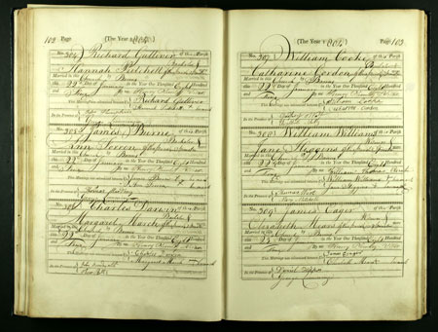
British Vital Registration:
Originally collected in church/parishes in Europe, then governments took over

Slide 20
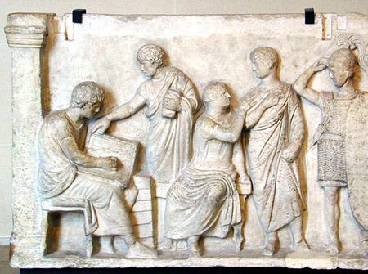
Censuses
Full count of a population at a certain point in time
  Age
  Sex
  Geographic locator
  Some have data on recent mortality
Pros: full country, most countries have them
  >90% of world population covered by census
  Cons: Only available at intervals, often 10 years

Slide 21
  Censuses: Types of errors
Sampling
Non-sampling
  Coverage
    Under enumeration; prone to missing data
      Recent births, migrants, homeless, hard to reach, minorities
      Ways to estimate using inter-censual projections
    Over enumeration: Kashmir and Jammu
  Content error:
    Prone to age-heaping
      Can use indirect estimation techniques to adjust for these
    Income notoriously hard to collet data on

Slide 22
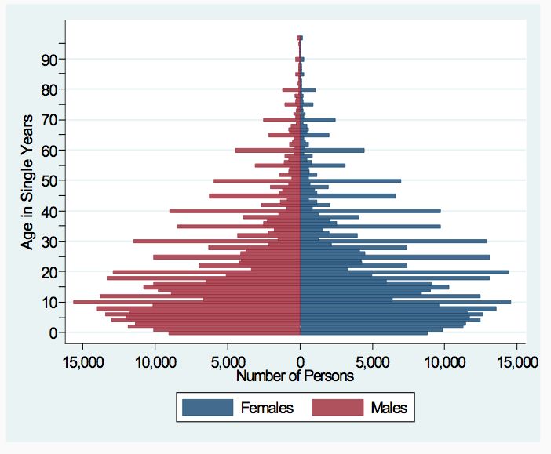
Ethiopia Census: 2007
Age attraction
Under reporting of children?

Slide 23
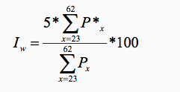

Detection and quantification of age attraction
Whipple’s Index (I_{w}):
Where Px is the population aged x, and P*x is the population of an age x ending in “0” or “5”

Slide 24

Other methods
Compare age ratios
  Ages in one 5 year group should be fairly similar (or smoothly related to) the ones before and after
Compare sex ratios
  Only works for some countries
UN: Age-sex accuracy index
Intercensal cohort comparisons

Slide 25
Sample Surveys
Used to validate vital statistics or Censuses, or provide information in inter-censual periods
Most focused on fertility and health
  Demographic and Health Surveys (International)
  Also general household surveys, labor force surveys, etc.
Pros
  Can be more in depth, ask different types of questions
  Can occur more frequently but still not continuous (compared to vital statistics)
Suffers from errors as well
  Sampling errors and biases: DHS and questionnaire length

Slide 26
Outline of Today’s Lecture
  Course information
  What is demography?
    Why is understanding demographic methods useful for epidemiologists/public health experts?
  Sources of demographic data
  Population: Age and Sex

Slide 27
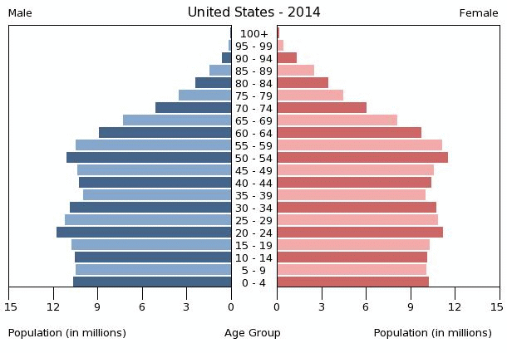
Population Pyramid: USA

Slide 28
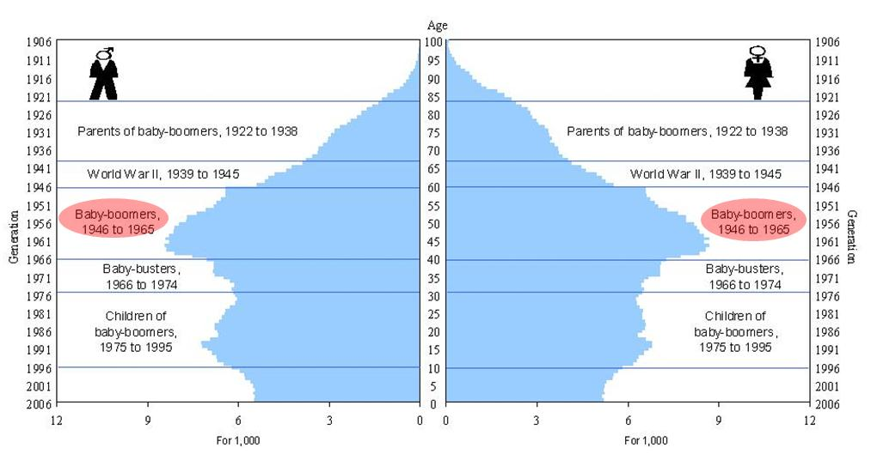
History in Pop Pyramids: US

Slide 29
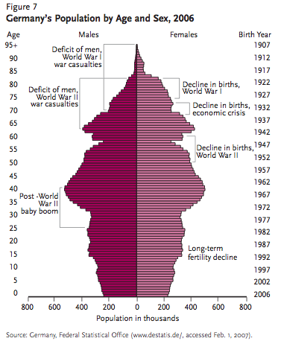
Notes:
Famine: 1866-68
15 months between two wars (1939-40 was the first one) between finland and soviet union.

Slide 30
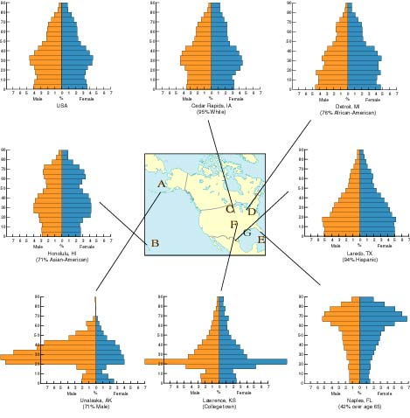
Guess the state
Alaska
Florida
Notes:
Lower right: florida
Middle bottom: kansas
Lower left: alaska
Middle right: texas
Top middle: iown
Left middle: hawaii

Slide 31
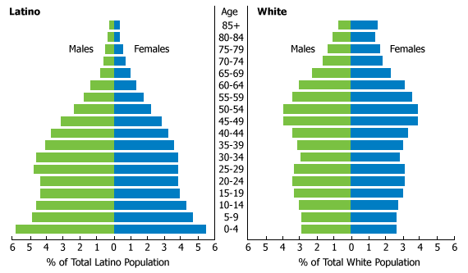
Difference by ethnic group: US

Slide 32
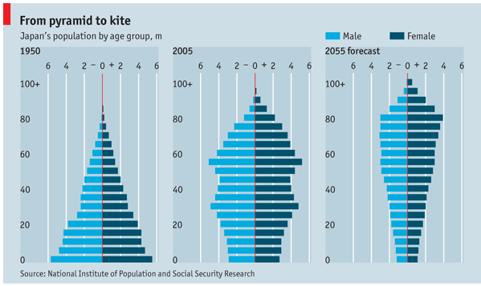
Change over time: Japan

Slide 33
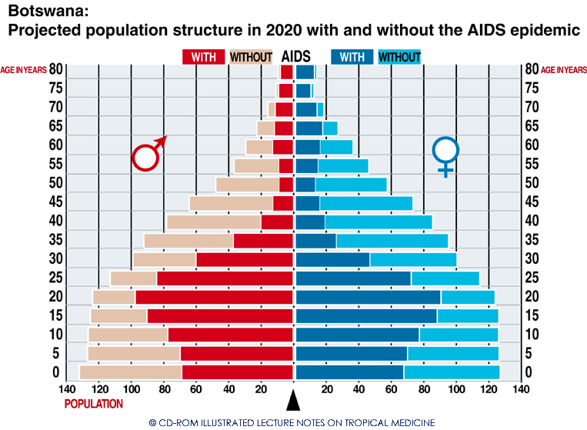
Botswana

Slide 34
Choose some countries!
For many lab assignments throughout the term, we will use data from 2 of the same countries to look at different demographic trends
Please choose two countries, on different continents, to use for the remainder of the course

Slide 35
Question 1 of Assignment
Do question 1 using 1 tab of google excel doc, so we can share our results
Data on website, or in your email, with lab assignment
~20 mins

Slide 36
Dependency Ratio
Ratio describing the number of people of working age compared to older and/or younger people of non-working age in a population
Way to describe the burden of aging populations and/or growing populations on the working age population
  Burden in care giving, financial support, government resources
Can also calculate the youth and elderly dependency ratios on their own

Slide 37
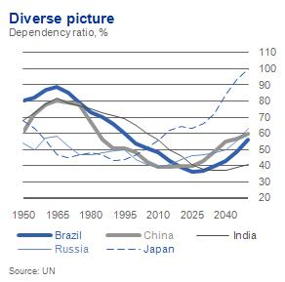
Dependency Ratios by Country

Slide 38
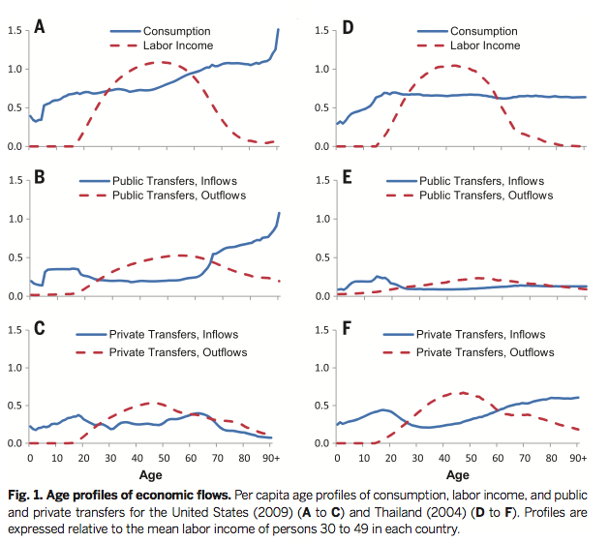
Not always so simple
Lee and Mason, Science, 2014 Vo. 346, Issue 6206

Slide 39
Demographic Dividend
A transitional period that countries go through while fertility is falling and mortality is falling
Idea that falling fertility will lead to a small youth population, while there is still a relatively small old age population
So the working aged population will grow more than the elderly or young population for a few years
Should lead to a time of increasing productivity because labor force population is growing more than the dependent population
A short period in time, lasts maybe 5 decades
  Then population aging begins
Much interest in capitalizing on the demographic dividend in Africa especially where fertility is just beginning to fall

Slide 40
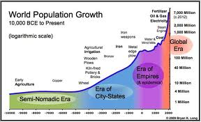
Historical Population Growth
Until about 1000 B=D
Then food supply, trade, etc. increased and B>D, slowly at first, then rapidly

Slide 41
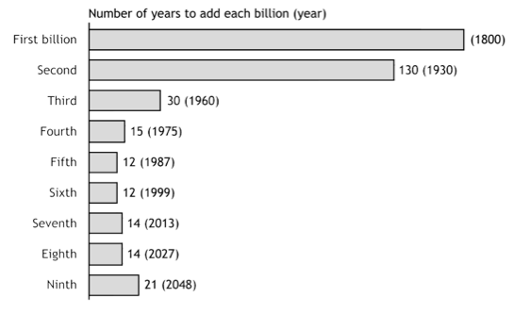
Number of years to add each billion
First and second billion: Population Reference Bureau; Third through ninth billion: United Nations.
(2005). World population prospects: the 2004 revision (medium scenario).

Slide 42
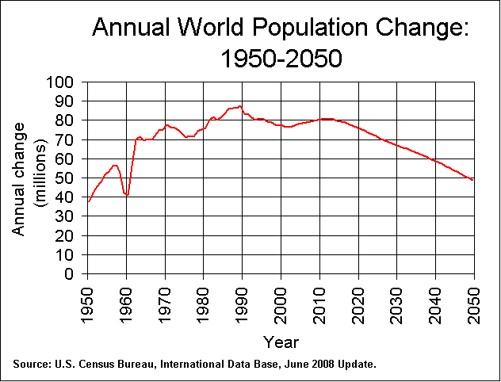

Slide 43
Population Growth: balancing equation
Demographic Balancing Equation
P=population
t=time
B=births
D=deaths
I=in migration
O=out migration

Slide 44
Exponential population growth
r=rate of growth
t=time
P= population at each time period

Slide 45
Signing up for leading the readings
Fertility
  Das Gupta, Monica and P. N. Mari Bhat. 1997. “Fertility Decline and Increased Manifestation of Sex Bias in India” Population Studies, Vol. 51, No. 3
  Morgan, S. Philip. 2003. “Is Low Fertility a Twenty-First Century Demographic Crisis?” Demography 40(4):589-603.
  Westoff, C and T Frejka. 2007. Religiousness and Fertility among European Muslims” POPULATION AND DEVELOPMENT REVIEW 33(4): 785–809
Mortality
Preston, Samuel H., Andrew Stokes, Neil K. Mehta & Bochen Cao. 2014. “Projecting the Effect of Changes in Smoking and Obesity on Future Life Expectancy in the United States” Demography 51:27-49
Anderson, Barbara A. 2002. “Russia Faces Depopulation? Dynamics of Population Decline.” Population and Environment 23(5):437-464.
FIREBUAGH et al. 2014. “Why Lifespans Are More Variable Among Blacks Than Among Whites in the United States.” Demography

Slide 46
Signing up for reading (cont)
Family Demography
Smith-Greenaway, Emily and Jenny Trinitapoli. 2014. “Polygynous Contexts, Family Structure, and Infant Mortality in Sub-Saharan Africa” Demography, 51:341-366
Stevenson, Betsey and Justin Wolfers. 2007. “Marriage and Divorce: Changes and their Driving Forces” Journal of Economic Perspectives—Volume 21, Number 2,Pages 27–52
Urbanization
1. Lee, Min-Ah. 2009. “Neighborhood residential segregation and mental health: A multilevel analysis on Hispanic Americans in Chicago.” Social Science and Medicine 88(11):1975-1984

Slide 47
Lab work: start questions 2 and 3
At home:
  Finish questions 2 and 3, use google doc so we can share at the start of class next week.
  Do the readings

Slide 48
Thank you!
Questions?
Notes:
Final boiler plate language: 2 versions
Through its singular focus on health, UCSF is leading revolutions in health.
UCSF is driven by the idea that great breakthroughs are achieved when the best research, the best education and the best patient care converge.

Slide 49
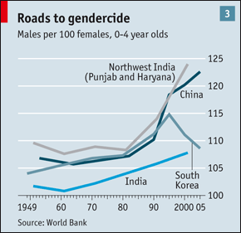
Sex ratios
Usually:
  X/X
  (India)

