Slide 1
Biostat 200 Lecture 3
1

Slide 2
Today’s topics
Review of some probability facts
Check in on what you should have learned so far
Probability distributions
2

Slide 3
From last lecture: Independence vs. mutual exclusivity
Mutual exclusivity: P(A ∩ B) = 0
  A and B cannot occur together
If A and B are independent:
  P(B | A) = P(B)
  P(A | B) = P(A)
3

Slide 4
From last lecture: Independence vs. mutual exclusivity
Mutual exclusivity: P(A ∩ B) = 0
  A and B cannot occur together
  Mutual exclusitivity gets us the additive rule
P(A U B) = P(A) + P(B) + P(A ∩ B)
= P(A) + P(B)
Independence gets us the multiplication rule
  If A and B are independent, then
P(A ∩ B) = P(A)P(B)
4

Slide 5
From last lecture: Independence vs. mutual exclusivity
Examples of non-independence of an event
  Repeat measurement of the same study participant
  Measurements of persons within the same family or some other clustering unit
We also talk about two random variables being independent, i.e. if one is related to the other. The chi-square test is often called a test of independence.
5

Slide 6
What you should have learned from the past 2 weeks
Types of variables
The ability to perform in Stata and understand:
  Basic manipulation of data, opening and saving data sets and .do files, basic data cleaning
  Basic summaries relevant to different types of variables
  Basic graphical analyses of different types of variables
Basic probability concepts, especially conditional probability, mutual exclusivity, and independence
6

Slide 7
Where we go from here
Use probability concepts to discuss theoretical distributions
Knowing (or assuming) that a variable follows a certain distribution, you can calculate the probability of observing a certain value for that variable
Next week: We will examine the probability distribution of sample means (the normal distribution)
Knowing the distribution of a sample mean allows us to calculate the probability of observing a particular sample mean
We will extend these concepts to examine other things, such as: differences in means and proportions between two or more groups, regression slopes, etc. (hypothesis testing)
7

Slide 8
Probability distributions
Variables whose outcome can occur by chance, i.e. are not fixed, are called random variables
Probability distributions describe the possible values of the random variable
8

Slide 9
Why do we care about probability distributions?
9
Many statistical tests (i.e. p-values) are based on probability distributions

Slide 10
For discrete (or categorical) random variables the probability distribution describes the probability of each possible value
For example, consider the experiment in which you flip a coin 2 times and count the number of heads.
  The possible outcomes of the experiment are: HH, TH, HT, TT.
  You want to focus on the number of heads, which could be 0, 1, or 2. The probability of each outcome is:
Number of heads | Probability
0 | .25
1 | .5
2 | .25
10
Notes:
This is the theoretical probability distribution for the number of heads in trials of 2 coin tosses
10

Slide 11
The table looks similar to a frequency table of the data, but it is actually the theoretical distribution
If you perform an infinite number of experiments, your data will look like this table
Number of heads | Relative frequency
0 | .25
1 | .5
2 | .25
11

Slide 12
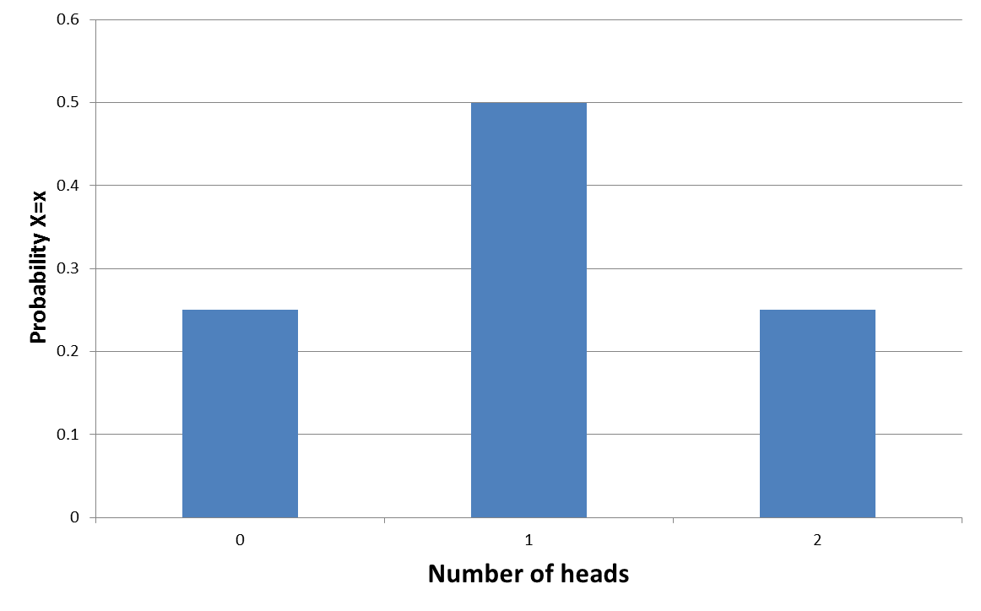
The graphical representation of the probability distribution for tossing a coin 2 times is:
12

Slide 13
Note that the probabilities add to 1. This is true of all probability distributions.
This is a theoretical probability distribution based on our understanding of coin tossing
  The probability of a head on each toss is .5
  The probability of heads on the first toss is independent of the second toss
  It’s actually the binomial distribution
13

Slide 14
We can write down a formula for the probability of observing a certain # of heads,
This is written in general form P(X=x)
  For 0 heads: P(X=0)
  For 1 head: P(X=1)
  For 2 heads: P(X=2)
  For 1 or more heads: P(X≥1)
14

Slide 15
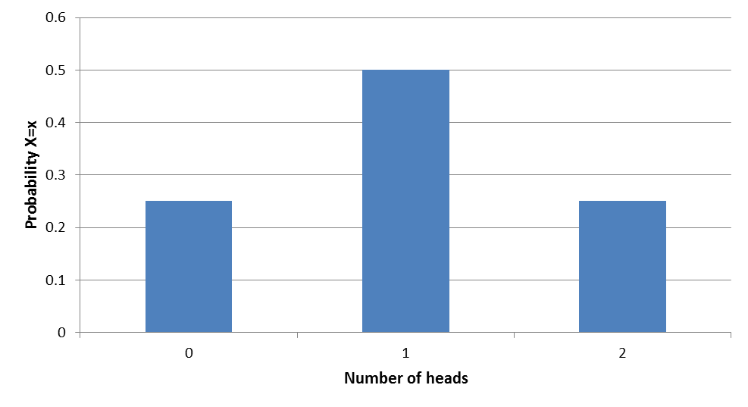
We can use this theoretical distribution to make predictions about future experiments
E.g. The probability that there will be at least 1 head in a trial of 2 coin tosses
P(X≥1) = P(X=1) + P(X=2)
(by what probability rule?)
= .5 +.25 = .75
15

Slide 16
If you performed the experiment (i.e. 2 coin tosses) once, you’d get 0,1, or 2 heads
Performing the experiment 10 times, I got: 2, 1, 1, 1, 1, 0, 0, 0, 1, 1
What if we did the experiment 100 times?
  1000 times? What would the frequency distribution for the outcomes look like?
Number of heads | Frequency (%)
0 | 3 (30)
1 | 6 (60)
2 | 1 (10)
16

Slide 17
This is the same situation as when we looked at two independent diagnostic tests with 2% false positive probability.
  2% of the time the test randomly gives a positive result when the true result is negative
The possible outcomes were NegNeg, NegPos, PosNeg, PosPos
  Calculating the probability 0, 1, or 2 positive tests:
Number of positive tests | Probability
0 | .98² = .9604
1 | .98*.02 *2= .0392
2 | .02²=.0004
17

Slide 18
The graphical representation of the probability distribution for number of false positive tests is:
18

Slide 19
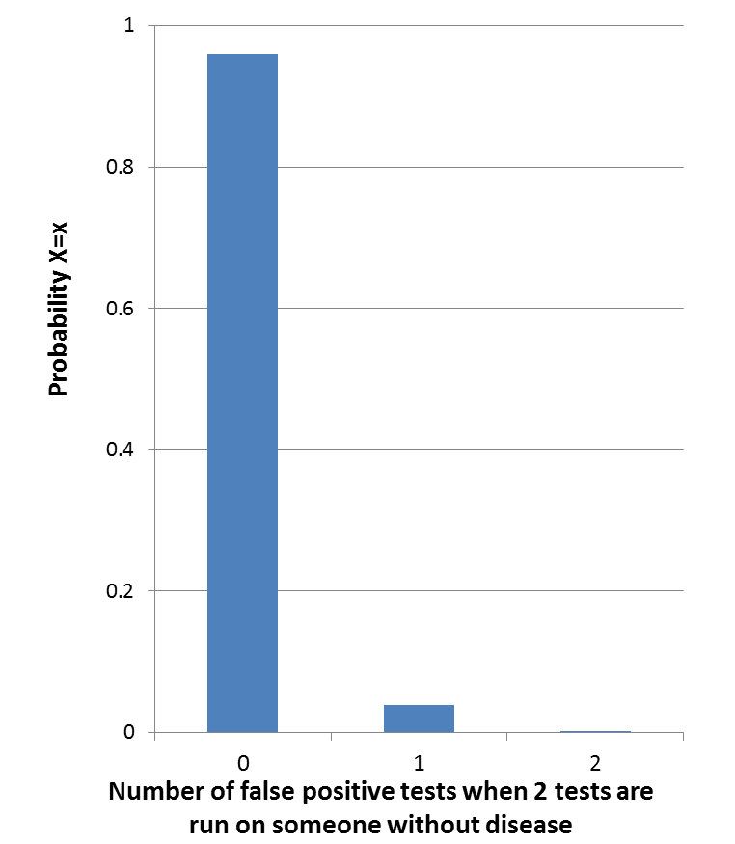
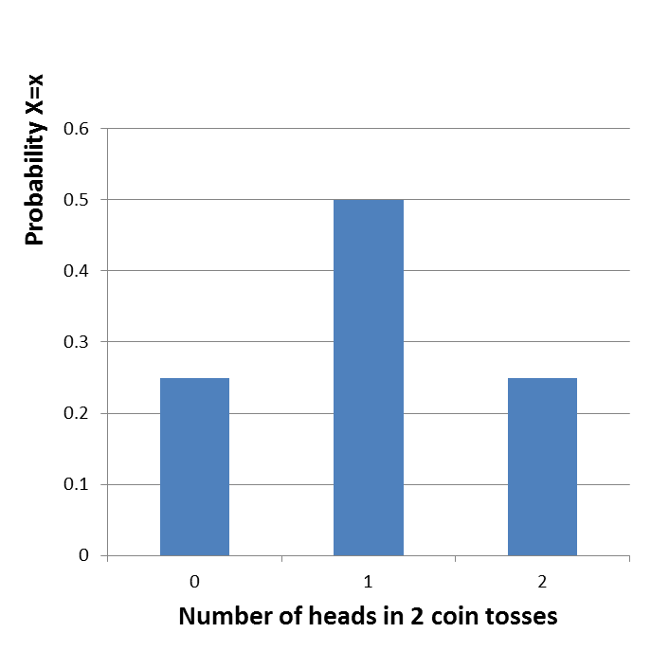
These both represent distributions that show the probability of 0, 1, or 2 events occurring in 2 independent trials. Why do they look so different?
19

Slide 20
Empirical Probability distributions
Empirical probability distributions are based on real data
They are usually based on a large sample or complete enumeration of a population
The probabilities are calculated from the relative frequencies of the data
  E.g. proportion of live births by age of mother in 1992
20

Slide 21
Probability distributions
For discrete (or categorical) variables the probability distribution describes the probability of each possible value
For continuous variables, the distribution describes the probability of a range of values
21

Slide 22
Bernoulli random variable
If you have a variable that can take on one of two values with a constant probability p, then it is a Bernoulli random variable
If the proportion of people in the population with a disease (the prevalence) is 15%, then when you randomly select one person, the probability that he/she has the disease is P(Y=1)=p= 0.15
The probability that a randomly selected person does not have the disease is
  P(Y=0)=1-p =0.85
22

Slide 23
Bernoulli distribution
A Bernoulli random variable is said to follow the Bernoulli distribution
p is the parameter that characterizes the distribution
The Bernoulli distribution is a discrete distribution – the outcome is either 0 or 1
It describes only one trial – so really is more theoretical than practical – it is the building block to describe the distribution of more than one trial
23

Slide 24
Binomial distribution
Example: The proportion of people in the population with the disease (the prevalence) is 15%, then P(Y=1)=0.15 and P(Y=0)=0.85.
One random draw will produce either 0 or 1 person with disease
If we take a random sample of 5 people from this population, there will be 0,1,2,3,4, or 5 people with the disease.
24

Slide 25
If the probability of disease in each person is independent, then we can write down the probability of each of these outcomes even before we draw the sample.
For example, the probability that ALL of them will have the disease is P(X=5):
  =P(X₁=1)* P(X₂=1)* P(X₃=1)* P(X₄=1)* P(X₅=1)
  = 0.15 x 0.15 x 0.15 x 0.15 x 0.15 = 0.00008
by the multiplication rule for independence
P(A ∩ B)=P(A)P(B)
25

Slide 26
The probability that NONE of them will have the disease is P(X=0):
  =P(X₁=0)* P(X₂=0)* P(X₃=0)* P(X₄=0)* P(X₅=0)
  =0.85 x 0.85 x 0.85 x 0.85 x 0.85 = 0.444
26

Slide 27
The probability that exactly one person P(X=1) has the disease
    = P(X₁=1)* P(the other 4=0)
    + P(X₂=1)* P(the other 4=0)
    + P(X₃=1)* P(the other 4=0)
    + P(X₄=1)* P(the other 4=0)
    + P(X₅=1)* P(the other 4=0)
    = 0.15 x 0.85 x 0.85 x 0.85 x 0.85
    + 0.85 x 0.15 x 0.85 x 0.85 x 0.85
    + 0.85 x 0.85 x 0.15 x 0.85 x 0.85
    + 0.85 x 0.85 x 0.85 x 0.15 x 0.85
    + 0.85 x 0.85 x 0.85 x 0.85 x 0.15
    = 5 * .15 * .85⁴
    = 0.392
27
Notes:
We can add these probabilities on each line because they are mutually exclusive
27

Slide 28
The probability that exactly two people P(X=2) of 5 have the disease
    = 0.15 x 0.15 x 0.85 x 0.85 x 0.85
    + 0.15 x 0.85 x 0.15 x 0.85 x 0.85
    + 0.15 x 0.85 x 0.85 x 0.15 x 0.85
    + 0.15 x 0.85 x 0.85 x 0.85 x 0.15
    + 0.85 x 0.15 x 0.15 x 0.85 x 0.85
    + 0.85 x 0.15 x 0.85 x 0.15 x 0.85
    + 0.85 x 0.15 x 0.85 x 0.85 x 0.15
    + 0.85 x 0.85 x 0.15 x 0.15 x 0.85
    + 0.85 x 0.85 x 0.15 x 0.85 x 0.15
    + 0.85 x 0.85 x 0.85 x 0.15 x 0.15
    = 10 * .15² * .85³
    = 0.138
28

Slide 29
The probability that no people P(X=0) of 5 have the disease = .444
The probability that exactly one person P(X=1) of 5 has the disease = .392
The probability that exactly two people P(X=2) of 5 have the disease = .138
The probability that exactly three people P(X=3) of 5 have the disease = .024
The probability that exactly four people P(X=4) of 5 have the disease = .002
The probability that exactly five people P(X=5) of 5 have the disease = .00008
29

Slide 30
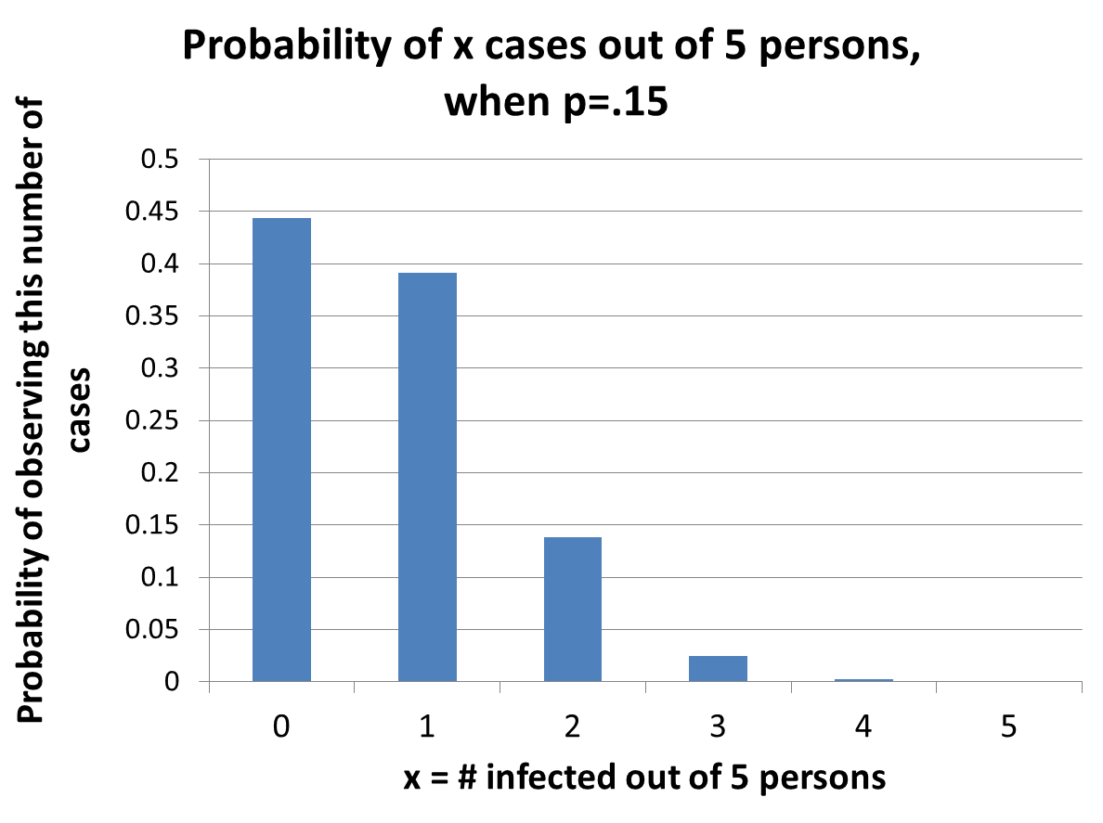
30

Slide 31
The probability that exactly one person P(X=1) has the disease
    P(X=1; n=5, p=0.15)
    = 0.15 x 0.85 x 0.85 x 0.85 x 0.85
    + 0.85 x 0.15 x 0.85 x 0.85 x 0.85
    + 0.85 x 0.85 x 0.15 x 0.85 x 0.85
    + 0.85 x 0.85 x 0.85 x 0.15 x 0.85
    + 0.85 x 0.85 x 0.85 x 0.85 x 0.15
    = 0.392
    = 5 * .15¹ *.85⁴
    = 5 * p¹ * (1-p)⁴
    5 is the number of different ways you could get one “success” in the 5 “trials”
31

Slide 32
Binomial distribution
This generalizes to:
p is probability of “success” in each “trial”
n is the number of “trials” (e.g., coin flips, persons assessed for disease status, etc.)
n and p are the parameters of the binomial distribution, i.e. the values that summarize the distribution
x is the number of “successes” (e.g. heads, numbers with the disease, etc.)
32

Slide 33
Binomial distribution
This is the formula for the binomial distribution
    Note that Stata uses the symbol k for x
33

Slide 34
Binomial distribution
Assumptions:
  There are a fixed number of trials n
  Within each trial, there are two mutually exclusive outcomes (heads vs. tails, disease vs. no disease)
  The outcomes of the n trials are independent
  The probability of success p is constant for each trial
34

Slide 35
is called “n choose x” and is the number of
different ways to get x successes in n trials
    There are 5 ways that there could be 1 success in 5 trials
    There are 10 ways there could be 2 successes in 5 trials
35

Slide 36
The formula for n choose x is
  5 choose 1 = 5! / (1! * 4!)
  = (5*4*3*2*1) / (1*4*3*2*1)
  = 5
  5 choose 2 = 5! / (2! * 3! )
  = (5*4*3*2*1) / (2*1*3*2*1)
  = 5*4/2 = 10
  5 choose 3 = 5! / (3! * 2!) = 10
  In Stata: display comb(n,k)
  . display comb(5,3)
  10
36

Slide 37
37

Slide 38
Ways to find binomial probabilities
  The previous equations
  Stata
    Binomialp(n,k,p)
    Binomialtail(n,k,p)
  Table A.1 in the textbook
38

Slide 39
The binomial formula
What is the probability of exactly 2 cases of disease in a sample of n=5 where p=0.15?
  . di comb(5,2)*.15^2*.85^3
  .13817812
39

Slide 40
  Stata binomialp()
  What is the probability of exactly 2 cases of disease in a sample of n=5 where p=0.15?
  Use binomialp(n,k,p) to get P(X=k) in n trials with probability of success in each trial=p
di binomialp(5,2,.15)
.13817813
40

Slide 41
What is the probability of 1 or more cases of disease in a sample of n=5 where p=0.15?
We want P(X≥1)
One way would be to calculate all the probabilities: P(X=1)+P(X=2)+ ... +P(X=5)
But remember P(X≥1) = 1-P(X=0)
41
Notes:
Using P(X>=1)=1-P(X=0) is an example of using the complement of an event
41

Slide 42
Binomial formula
What is the probability of 1 or more cases of disease in a sample of n=5 where p=0.15?
P(X≥1) = 1-P(X=0)
di comb(5,0)*.85^5
.44370531
So 1-P(X=0) = 1- 0.4437 = 0.5563
Or use
display 1-binomialp(5,0,.15)
.55629469
42
Notes:
Using P(X>=1)=1-P(X=0) is an example of using the complement of an event
42

Slide 43
Stata binomialtail()
The function binomialtail(n,k,p) gives us P(X≥k) so we can use it without manipulation
display binomialtail(5,1,.15)
.55629469
43

Slide 44
Example. The probability that my husband will serve an ace in tennis at each point is .05. What is the probability that he will serve a perfect game, that is serve 4 aces in a row (assume each serve independent of the previous)?
    . di .05^4
    6.250e-06
Or,
    . di binomialp(4,4,.05)
    6.250e-06
44
Notes:
44

Slide 45
Example. The probability that my husband will serve a double fault at each point is .25. Assuming each point is independent, what is the probability that he will serve 4 double faults in a row?
    . di .25^4
    .00390625
Or,
di binomialp(4,4,.25)
    .00390625
45
Notes:
45

Slide 46
What is the probability that he will serve at least 1 double fault in a game that goes on for 6 points (again, assuming each point is independent)?
n= ?
p= ?
k= ?
P(X≥1) = ?
46
Notes:
46
An application of the binomial distribution

Slide 47
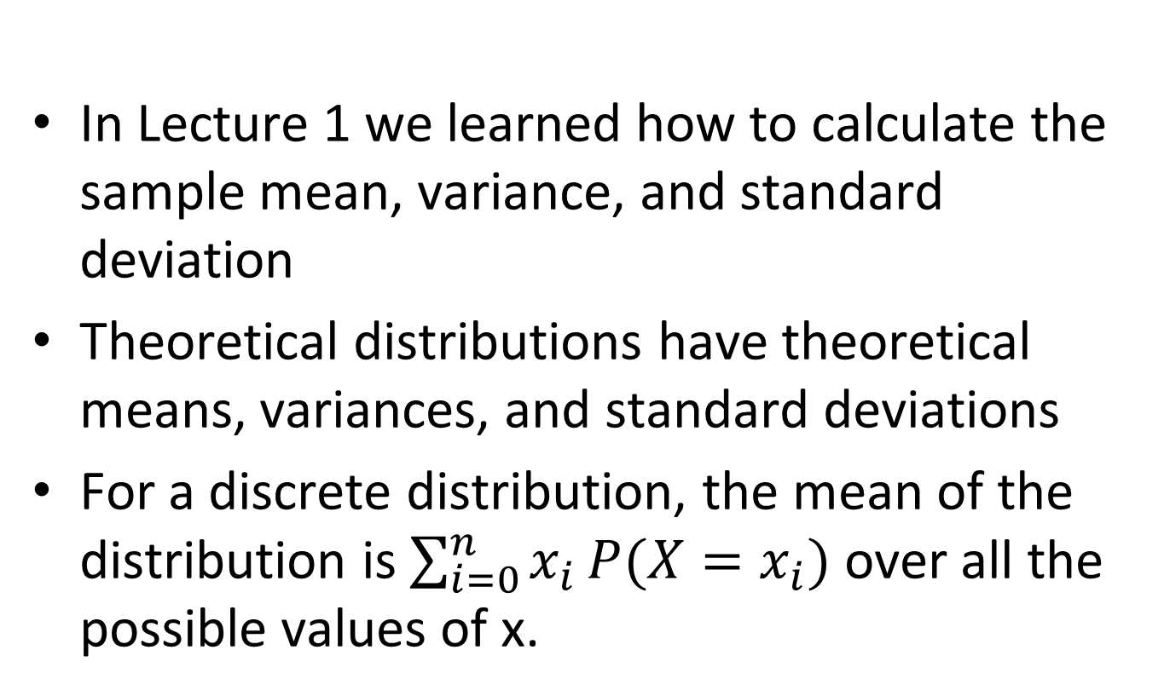
Means and Variances
In Lecture 1 we learned how to calculate the sample mean, variance, and standard deviation
Theoretical distributions have theoretical means, variances, and standard deviations
For a discrete distribution, the mean of the distribution is $\sum_{i=0}^{n}{x_{i}}P(X=x_{i})$ over all the possible values of x.
47
Notes:
47
Remember that X is the number of successes

Slide 48
Binomial distribution
The mean of a binomially distributed random variable X is np
This means that over an large number of samples of size n with probability p of success, the mean number of successes (x̅) over the samples will be approximately np
In shorthand, np is the mean of the binomial distribution
48
Notes:
48
Remember that X is the number of successes

Slide 49
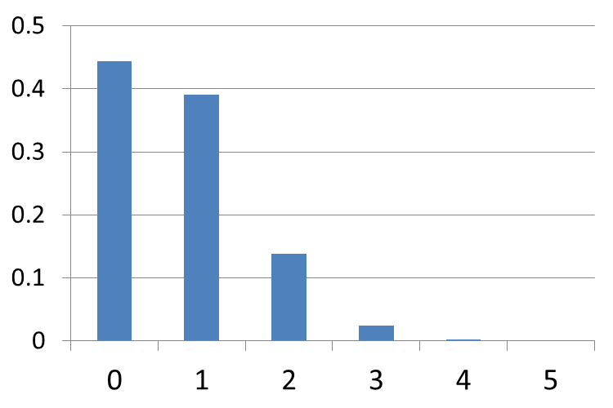
For our example with n=5 and p=P(disease)=.15
the mean of the distribution of the number of cases is 5*.15 = .75
  If you took a sample of n=5, repeatedly, the mean number of cases over these samples would be 0.75
  Does this fit with the graph of the distribution?
49

Slide 50
Binomial distribution
The variance of a binomially distributed random variable X is n*p*(1-p)
This means that over a large number of samples of size n, the sample variance of the X’s, the number of successes, will be approximately n*p*(1-p)
The standard deviation is
50

Slide 51
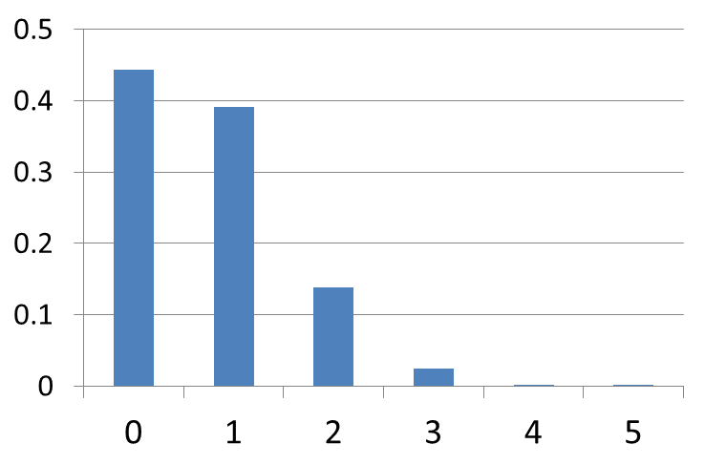
For our example with n=5 and p=P(disease)=.15, the variance is n*p*(1-p) = 5*.15 *.85
  If you took a sample of n=5, repeatedly, the sample variance in the number of cases over these samples would be this number
51

Slide 52
Binomial distribution
Binomial mean = np
Binomial variance= np(1-p)
  Variance is largest when p=0.5, smaller when p closer to 0 or 1
  The distribution is symmetric when p=0.5
  The distribution is a mirror image for 1-p
    E.g. the distribution for p=0.05 is the mirror image of the one for p=0.95
52

Slide 53
P(X=2) ?
P(X≥2) ?
53
Notes:
53
What are the means and variance of these three distributions?

Slide 54
Poisson distribution
A discrete distribution to model rare events occurring in time or space
Unlike the binomial distribution, which is based on a series of n trials, there is no theoretical limit to the number of events that can occur
However, when n is large and p is small, it does act like the binomial
The Poisson has only one parameter, λ, that is the mean number of events (and also the variance)
54
Notes:
What is a discrete distribution?
54

Slide 55
Normal distribution
55
Used for continuous variables that cover the entire range, i.e. values can take on 1.432, -72.12
Classic bell shaped curve
Values can span from -∞ to ∞
Uni-modal and symmetric, so the mean is also equal to the median and mode

Slide 56
Normal distribution
The probability density function is
μ is the mean and σ is the standard deviation of a normally distributed random variable
  They are the parameters of the normal distribution
  π is the constant that is approximately 3.14159
56
Notes:
You don’t need to memorize this formula! It should just look familiar to you!

Slide 57
Note that the left hand side of the equation is f(x) and not P(X=x)
Why?
  For a discrete distribution, the sum of the bars equals 1
  For a continuous distribution, the area under the curve equals one
  A continuous variable X can take on an infinite number of values, therefore P(X=x)=0
57

Slide 58
If X has a normal distribution with mean μ and standard deviation σ we write
X ~ N(μ, σ)
Many variables are approximately normally distributed
We can use the distribution to calculate probabilities associated with such variables
58

Slide 59
The standard deviation defines the amount of spread around the mean
  Small standard deviation – little spread around the mean (blue line SD=1)
  Large standard deviation – greater spread around the mean (red line SD=3)
59

Slide 60
60
Notes:
Blue line: Mean=0, SD=1
Green line: Mean=4, SD=1
Red line: Mean=0, SD=3
60

Slide 61
The Standard Normal Distribution
μ and σ can take on an infinite number of values so we have an infinite number of curves
For simplicity, we have a standard curve that we use as a reference
61

Slide 62
The Standard Normal Distribution
This one curve has mean μ =0 and standard deviation σ =1 (and variance σ²=1).
Denoted N(0,1)
The formula for the distribution simplifies to
62
Notes:
Don’t memorize this one either!

Slide 63
The Standard Normal Distribution
If X is a normally distributed random variable with mean μ and standard deviation σ then
Z= (X – μ)/σ
is a standard normal random variable
That is, any normally distributed random variable with its mean subtracted off, divided by its standard deviation, is a standard normal random variable with mean=0 and standard deviation=1
63

Slide 64
The Standard Normal Distribution
If X ~ N(μ, σ) then
Z= (X- μ) / σ ~ N(0, 1)
64
Notes:
A normally distributed random variable with mean=0 and standard deviation=1 is called a standard normal random variable and is often referred to as Z
64

Slide 65
We can use theoretical distributions to determine the probability of particular values of random variables
For the binomial distribution, we added probabilities of the assumed distribution to calculate the probability of observing a certain number (k) of events (or more).
Remember the probability of observing 1 or more disease cases in a sample of 5 was equal to
P(X=1) + P(X=2) + P(X=3) + P(X=4) + P(X=5)
65

Slide 66
However, for a continuous variable, because there are an infinite number of values, we can’t calculate P(X=x).
However, we can calculate P(X ≥ x), which is the area under the normal curve from x to infinity
The area under curves is calculated by taking the integral
66
Notes:
The area under the whole curve, that is from -∞ to +∞ is 1.
66

Slide 67
For Z ~ N(0,1), P(Z≥0) = 0.50
Remember that for the standard normal distribution that 0 is not only the mean but also the median of the standard normal distribution. Therefore the probability of observing the median value or more is automatically 0.5 .
67
Notes:
67

Slide 68
For Z ~ N(0,1) P(Z≥1.65) = 0.049
68

Slide 69
For Z ~ N(0,1) P(Z≥1.96) = 0.025
69

Slide 70
For Z ~ N(0,1) P(Z<-1.96) = 0.025
Z is symmetric
70

Slide 71
P(Z ≤ -1.96 or Z≥1.96) ?
P(-1.96 ≤ Z ≤ 1.96) ?
71

Slide 72
P(µ-1σ ≤ Z ≤ µ+1σ)
Remember µ=0 and σ=1, so this is
P(-1 < Z < 1) = 0.682
Therefore, approximately 68.2% of the area of the standard normal is within 1 SD of the mean.
0.159
0.159
72

Slide 73
P(µ-2σ ≤ Z ≤ µ+2σ)
Remember µ=0 and σ=1, so this is
P(-2 < Z < 2) = 0.954
Therefore, approximately 95.4% of the area of the standard normal is within 2 SD of the mean.
0.023
0.023
73

Slide 74
Stata will calculate standard normal probabilities for you
In Stata, the left portion of the curve P(Z<z) is calculated for you.
*** this gives you P(Z<1.96)
display normal(1.96)
.9750021
If you want the right hand portion of the curve, P(Z≥z), you subtract your answer from 1
** this gives you P(Z<1.96)
display 1-normal(1.96)
.0249979
If you want the middle:
display normal(1.96)
-normal(-1.96)
.95000421
74

Slide 75
Example
X is a random variable representing the distribution of systolic blood pressure in 18-74 year old U.S. males
~N(129, 19.8)
What is the proportion in the population with systolic blood pressure of over 150 mm Hg? P(X>150) ?
  Convert the variable of interest to a standard normal variable N(0,1) to get the probability. I.e., subtract off the mean and divide by the SD.
  z=(150-129)/19.8 = 1.06 This is the z-score or z- statistic
2. Find P(Z>z) = P(Z>1.06) using Stata
    . di 1-normal(1.06)
    .1445723
75

Slide 76
Example
The distribution of systolic blood pressure in 18-74 y.o. US males is ~N(129, 19.8)
What is the upper 2.5% value for SBP in this population?
  Find the z value that satisfies this, and then convert back to the original distribution.
  What is the value of z for which P(Z≥z)=0.025?
display invnormal(.975)
1.959964
Answer z=1.96
  2. Transform back to the original units
z=1.96=(x-129)/19.8
x=1.96*19.8 +129 =167.8 mm Hg
76
Notes:
The notation X~N(129, 19.8) means the variable is normally distributed with mean=129 and SD=19.8
76

Slide 77
Example
What is the lower 2.5% value for SBP?
What is the value of z for which P(Z<z)=0.025?
  1. Find the z value that satisfies this, and then convert back to the original distribution.
. display invnormal(.025)
-1.959964
z=-1.96
2. Transform back to the original units
z=-1.96=(x-129)/19.8
x=-1.96*19.8+129 = 90.2 mm HG
So 95% of the population has SBP between 90.2 and 167.8
77

Slide 78
So if you have a variable that is normally distributed and you know the mean and variance, you can find the values that comprise the middle 95% (or 99% or 90%) of the population Note that this is not a confidence interval
For the middle 95%, the interval is
    µ-1.96*σ, µ+1.96*σ
For the middle 99%, the interval is
    µ-2.58*σ, µ+2.58*σ
Note that to include a higher %age, the interval gets wider!
78
Notes:
Remember that on an earlier slide we saw that 95.4% of the distribution was between -2 and +2.
Confidence intervals are for when we have drawn a sample…
78

Slide 79
Finding z values for probabilities in Stata
To get the z value for P(Z<z) = p use
display invnormal(p)
E.g. what is the z value for P(Z<z) = 0.025
display invnormal(0.025)
-1.959964
To get the z value for P(Z≥z) = p use
display invnormal(1-p)
E.g. what is the z value for P(Z ≥ z) = 0.025
display invnormal(1-.025)
1.959964
79

Slide 80
Key points
For discrete probability distributions, you can calculate P(X=x)
The binomial distribution gives the probability of the number of successes in n trials P(X=x)
For continuous probability distributions, you can only calculate P(X>x) or P(X<x)
The normal distribution describes some continuous data – we’ll see some very useful properties next week
We transform to the standard normal distribution in order to work with the probabilities
80

Slide 81
For next time
81
Read Pagano and Gauvreau
  Chapter 7 (Review of today’s material)
  Chapter 8, 9, and 14 (pages 324-329)

