Slide 1
Disease Occurrence II
Main Points to be Covered
Incidence rates (person-time incidence)
“Average” incidence rate
  Calculating
  Uses
Instantaneous incidence rate (aka “hazard”)
Cumulative incidence and incidence rate
  different but related
Assumptions: cumulative incidence & incidence rate
Accommodating competing events in incidence estimates
Notes:
Here is what we will cover in the second lecture on disease occurrence. In this lecture, we want to emphasize that we are going well beyond the concepts presented in the textbook.

Slide 2
Disease occurrence
Prevalence
Point
Period
Incidence
Cumulative incidence
Incidence rate
Simple proportion
Kaplan-Meier
Life-table
Aalen-Johansen
Average incidence rate
Instantaneous (hazard) rate
Notes:
Here’s a flowchart of the material covered in the lectures on Disease Occurrence, including topics that we’ll cover today.

Slide 3
The Three Elements in Measures of Disease Incidence
E = an event = a disease diagnosis or death
N = number of at-risk persons in the population under study
T = time period during which the events are observed
Notes:
We introduced these three elements last week. They are the basis for any measure of disease occurrence. The difference between cumulative incidence and incidence rates lies in how time is combined with the number of persons at risk in the measure.

Slide 4
Measures of Incidence
The proportion of individuals who experience the event in a defined time period (E/N during some time T) = cumulative incidence = risk
  Formal term: cumulative incidence
  Short hand: risk
The number of events per amount of person-time observed (E/NT) = incidence rate
  Formal term: incidence rate
  Short hand: rate or hazard
Notes:
To refresh your memories on the basic difference between cumulative incidence and an incidence rate, cumulative incidence is a proportion because it has the number of events (E) as the numerator and has as the denominator the number of persons (N) at risk. Because of censoring, however, we rarely can just plug an N into the denominator. Instead, via Kaplan-Meier or life-table techniques (or the Aalen-Johansen approach), we derive an effective N by taking into account each person’s follow-up until it is censored. In any case, the proportion can be interpreted as the percentage of N persons who develop disease in a given time period.
An incidence rate also has the number of events (E) as the numerator but its denominator is different: it is the product of the number of persons x the number of time units they were observed (NT). Both measures have to account for time, but cumulative incidence accounts for it by specifying the time period during which the persons were observed. For example, 40% of subjects experienced the outcome during 3 years of follow-up. Incidence rate accounts for time by making it an element of the denominator.

Slide 5
Rate versus Risk
Two basic measures of occurrence of new events
  Cumulative incidence = incidence proportion = Risk = Probability of event in a given time period
  Incidence rate = Rate = events per unit person-time
Last week we discussed the concept of cumulative incidence
  Most commonly calculated by the Kaplan-Meier estimator. Can also use simple proportion, life-table or Aalen-Johansen method [later today].
Incidence rate of disease is less intuitive but is the more fundamental measure
Notes:
Understanding the difference between these two measures is a central concept in this part of the course. Both are important measures in clinical and epidemiologic research that are widely used. Both are used in survival analysis. Cumulative incidence is a proportion and hence very intuitive. It is familiar because of the frequent use of Kaplan-Meier analysis in studies with individual-level follow-up data. Rates are less intuitive at first but are staples in many fields, such as cancer. Rates – specifically instantaneous rates (which are known as hazards) are also what are being estimated in the commonly used proportional hazards regression model in which the derived measures of association are called hazard ratios. With more powerful computing abilities, hazards can be depicted in smoothed plots, an approach that is starting to appear in the literature. You will also encounter “average” incidence rates in a variety of other situations. Use of rates is useful in comparing two or more populations where at least one population does not have individual-level data or where exposures are changing within subjects over time. We will show examples of these situations later on.

Slide 6
Incidence Rate
Our focus this week is incidence rate
The number of events per amount of person-time observed (E/NT) = incidence rate
Two flavors of incidence rates
  Average incidence rate (“incidence rate”)
  Instantaneous incidence rate (“hazard”)
Notes:
Incidence rates come in two flavors: average incidence rate, which we discuss first, and an instantaneous hazard rate, which we will discuss a bit later.

Slide 7
“Average” Incidence Rates
The numerator is the same as incidence based on proportion of persons = events (E)
The denominator is the sum of the follow-up times for all individuals under study = person-time (NxT)
Resulting ratio of E/NT not a proportion -- may be > 1
Value depends on unit of time used
  person-days vs person-months vs person-years vs 1000 person-years vs 100,000 person-years, etc.
We like to be explicit and call this “average” incidence rate but you will not see this commonly in practice
  Rationale: 1 number summarizing incidence over some time
  When people say “incidence rate” they usually mean “average” but not always (sometimes mean instantaneous)
Notes:
We will first discuss average incidence rates. The calculation for average incidence rates are pretty simple. The numerator is the number of new outcomes/events/diagnoses of the condition under study amongst the population under study. This is the same as in the calculation of cumulate incidence. The denominator is the construct of person-time. The value of an average incidence rate is not a proportion. It is not bounded by 0 and 1. Instead, it may be greater than 1.
If the incidence rate of the event was 35 per 100 person-years, remember that 100 person-years could mean 100 persons followed for 1 year or 50 persons followed for 2 years or 200 persons followed for 6 months or many other combinations of persons and years whose product equals 100. All 3 give 100 person-years of time at risk. And in this example the time units are person-years but person-years could be replaced by person-days, person-months, and so forth and the rate would change accordingly. So the absolute value of the rate is determined by the units used in the denominator.
We like to be precise and refer to this calculation as an “average” incidence rate. Why? This is because it is summarizing or averaging incidence over some period of time. By labeling it as “average” we are reminded ourselves that it is looking at an average over the sea of person-time. Our use of “average” contrasts with the form of incidence which is an instantaneous incidence rate. While you will see the term instantaneous incidence rate (or hazard) commonly, you will not typically see “average” incidence rate. However, we encourage you to be precise in language and use “average” incidence rate.

Slide 8
Calculating an Average Incidence Rate: Obtaining the Denominator of Total Person-Time
Method 1: Individual-level data available
  If have exact entry, censoring, and event times for each person, can sum person-time for each person for denominator
Method 2: No individual-level data available
  Variety of approaches to get aggregate person-time, some with assumptions (“group method”); for example:
    Have: population size at one time
      Assume steady state or steady change in population over interval
    Have: no. at-risk at beginning and end of time interval
      Assume uniform entry/drop-out over time interval
Notes:
The numerator in the calculation of average incidence rates is straightforward. It is simply the number of events in the population under study. The denominator typically takes more thought, and there are two basic approaches. The first should be used if you have individual-level data on everyone in your population. If you do, you just simply sum up the person-time for each person. If you don’t have individual-level data on everyone, then there are a variety of approaches to make your best estimate of the aggregate person-time in the population. Collectively, these are called “group”, “group-level”, “grouped data”, or “average population” methods. Some of them have more stringent assumptions than others.
Let’s say you just have the size of a population at one time. If you assume steady state population size, you can multiple time x population size to get aggregate person-time. If you have the number of persons at risk at the beginning and number at the end of the interval, you can, as we show in a few slides, estimate aggregate person-time. To do this, you will need to assume that losses and/or additions occur uniformly throughout the period.

Slide 9
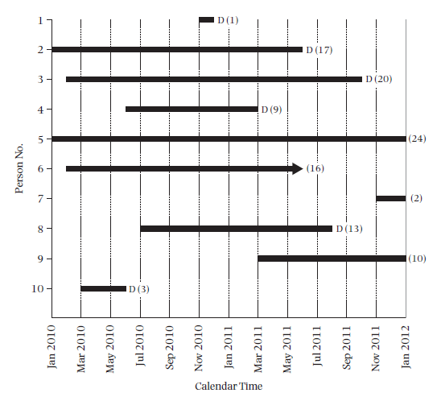
Fixed Cohort with available individual-level data
Notes:
This is the hypothetical example of a 10 person cohort study given in your text book. This has “Calendar Time” on the x-axis. This illustrates the ways that follow-up time can differ among individual participants in a fixed cohort study even when the study has one “end date.”
9

Slide 10
Calculating an Average Incidence Rate: Obtaining the Denominator
Person Number | Months of follow-up
1 | 1
2 | 17
3 | 20
4 | 9
5 | 24
6 | 16
7 | 2
8 | 13
9 | 10
10 | 3
Total | 115 person-months
Incidence rate = E/NT
6 deaths (events)
6/115 person-months
6/9.583 person-years
= 0.626 per person-year
= 6.26 per 10 person-years
= 62.6 per 100 person-years
“Person-time” sometimes a source of confusion, but it need not be.
Why called person-time instead of just time?
To distinguish it from more common meaning of time, e.g., 115 months in a row
Notes:
Here are the calculations from the text’s example using individual level data to calculate the person-time rate. Note that the person-time in months is just the sum of the number of months from the previous graphic showing how long each person was observed in the study. The text example shifts participants to the left but this is not necessary for the calculation of incidence rates. The text also calculates incidence rates separately for the first year of follow-up and then for the second year of follow-up, but this is also not necessary if the rate is constant over time.
Since we want to present the rate in the more conventional manner of person-years and having integers greater than 1 to the left of the decimal point, we converted to person-years. The numerator is, as always, just the number of events; here, 6 deaths. The decimal point is then moved for the fraction 6/9.583 to give the rate per 10 person-year or per 100 person-years.
The concept of person-time is sometimes a source of confusion but it need not be. It looks like we are just adding up time to get our sum of 115 in this example, and thus why do we call this person-time instead of just time. We do this to distinguish it from the more common meaning of time, for example here, 115 months in a row. In our example, we cannot say that our rate has any meaning over 115 months in a row in any single person.

Slide 11
Cohort Study Design (Dynamic Cohort)
New Members
CE
CE
Observation begins
Observation ends
Time
Notes:
How about in a dynamic cohort?

Slide 12
Example: Calculating Incidence Rate
in a Dynamic Cohort (Kaiser)
Individual-level follow-up available
HIV infection and incidence of ischemic stroke
 | HIV-infected | HIV-uninfected
N | 24,768 | 257,600
Person-years | 120,588 | 1,516,250
Events (stroke) | 151 | 1128
Average incidence rate (per 100,000 person-years) | 125 | 74
Marcus et al. AIDS 2014
Notes:
To calculate average incidence rate in a dynamic cohort, the approach depends on whether we have individual-level follow-up on the cohort members. In this example from Kaiser, individual-level data are available. The investigators know the dates of Kaiser membership, the occurrence and dates of the outcome (stroke in this study), and the occurrence and dates of any competing events, such as mortality. With this information, the calculation of an average incidence rate is similar to the example that we just reviewed in a fixed cohort. The investigators identify the number of events (incident stroke) in each group (HIV-infected and HIV-uninfected). They then add up the follow-up time on each individual member to obtain total person-years in each group. Considering the HIV-infected participants, there were 151 incident strokes. The total follow-up time was 120,588 person-years on 24,768 individuals. The incidence rate is 151/120,588 = 125 per 100,000 person-years.

Slide 13
Method 2: Calculating Incidence Rate
Without Individual-level Follow-up:
Most often seen & best exemplified in dynamic cohorts
Research question: What is the incidence rate of diagnoses of pancreatic cancer in San Francisco (SF) County in 2010?
Numerator: All new pancreatic cancer diagnoses are reported to the SEER cancer registry
How to obtain a denominator for a rate?
Notes:
How about if we do not have individual-level data? This situation is seen most commonly in dynamic cohorts and the solutions are best exemplified there. For example, in the field of cancer the SEER registry does an excellent job of capturing all of the new cancer diagnoses (E) for a large population. California now has a statewide cancer registry. But, how will an investigator determine the denominator for this rate?
The SEER registry is a program of the National Cancer Institute, which is one of the institutes of the National Institutes of Health. It covers particular areas of the country. See the web page for detailed information on what areas are covered by SEER registries, what data are available, etc. In California, the SF Bay Area registry has been established the longest (since 1973). There is now a state-wide cancer registry (since 2001).

Slide 14
Large Population Incidence Rates
The study base for the pancreatic cancer cases is the population of SF County during the year(s) that cases were diagnosed (i.e., a dynamic cohort).
To get an incidence rate person-time denominator for a particular year by the group method requires only an estimate of the “average population” size during the year
  If assume steady state: need population size at any point
  If linear increase/decline: mid-point population provides the average but with some math, other points also work
  If non-linear, then more math is needed
  With small time intervals, steady state typically assumed
Average population size (N) x time (T) = person-time
Fortunately, SF population is enumerated in U.S. census.
Notes:
Clearly, an investigator with access to the California cancer registry data is not going to have individual level data on when every new arrival entered San Francisco and when every departure or death took place, so the problem is to obtain information that will allow calculation of a denominator. The approach is to obtain an estimate of the average population size during the time period. The average population size (N) multiplied by the time period (T) gives the aggregate person-time denominator for the rate. This method of estimating incidence rate is sometimes called the “group method” or “average population method.”
There are several ways to get the average population size for an interval, in this case a year (2010). If you assume that the population is at steady state, then you can use the population as counted at any during the year. If it is believed that the population is experiencing a linear increase or decline, then an estimate at the mid-point tells you the average population size. If change is felt to be non-linear, then average population size can be calculated with more sophisticated, which we won’t get into in this course. Estimating population size is really the purview of demography. Epidemiologic and clinical researchers need to borrow facts from demography but do not have to know such to obtain these facts in detail.
Fortunately, in the U.S. the government sponsored census provides what is believed to be very accurate population counts. This is one of the underappreciated benefits of the massive census process. A census is often done over a long time, sometimes spanning a year. The incidence rates calculated with these populations are sometimes called “annual rate”, but this term should be avoided in that it is easily confused with a one year cumulative incidence.
A further advantage of using census data for forming rates from case counts collected by registries is that rates can be formed for any of the grouping variables recorded in the census, such as age groups, gender, ethnicity, income, geographic sub-regions, and many others. This assumes such information is also collected on the cases.

Slide 15
Pancreatic Cancer Rate – SF County
Pancreatic cancer cases in SF 2010 = 123 (SEER)
Population in SF 2010 = 805,340 (U.S. census)
  Assume that population is steady state for 2010
  Thus, person-time is 805,340 person-years.
Incidence rate for pancreatic cancer in SF
  123 cases/805,340 person-years
  = 15.3 cases per 100,000 person-years
Notes:
Number of pancreatic cancer diagnoses in SF County in 2010 was obtained from SEER. The population of SF County in 2010 available from census data. With this information, the incidence rate can be calculated. We assume that the size of the population is in a steady state for 2010. In other words, although we know people are leaving and entering SF County during the year, at any time point during the year these changes average out. We can therefore assume that the total person-time for the year is 805,340 people x 1 year = 805,340 person-years. The total number of people who contributed to this time is likely greater than 805,340 but some people contributed less than a year.

Slide 16
Method 2:
Full individual-level data not available
Example in Fixed Cohort
The average population method can also be used in a fixed cohort if individual information is, for some reason, not fully available.
To do this, just need to know:
- Number of events (E)
- Starting and ending population
Notes:
This second method of calculating incidence rate (the “group method”) is mainly needed with dynamic cohort, when it is not practical to enumerate everyone. This is because fixed cohorts typically are entirely enumerated in terms of when all participants are under observation. However, in a pinch, if you had a fixed cohort without detailed individual-level data, this method could be used. With the starting N, the final N, and the number of events (E), and a few assumptions, you can use the group-level method to estimate the incidence rate.

Slide 17
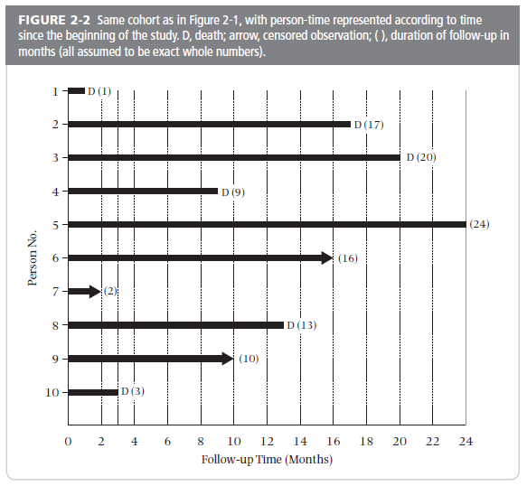
Example of Fixed Cohort
N_{begin} = 10
N_{end} = 1
E = 6
Notes:
Here again is the hypothetical example of a 10 person cohort study given in your text book. In this graphic the cohort has been “shifted to the left.” Imagine for this example that you only know how many people entered the study (N=10) and how many were remaining at the end of the longest follow-up time (N=1). In addition, you know the number of events (E=6).
17

Slide 18
Method 2: Example in Fixed Cohort
Numerator: 6 events (deaths)
Denominator: 10 persons at beginning; 1 person at end. Average of (10 + 1)/2 = 5.5 persons at any point in time, each followed for 2 years = 11 person-years.
Rate = 6/11 = 0.545 per person-year
or 54.5 per 100 person-years
Average population method assumes uniform occurrence of events and of censoring during the interval
- like the life-table method
Notes:
The numerator is 6 events.
The average person-time for the denominator is calculated by our knowledge that there were 10 persons available at the beginning and 1 person at the end. This equals 5.5 persons (derived from: (10 + 1)/2 ) available at any point in time. If we assume that they are followed for two years, on average, this equals 11 persons-years. This assumption of them each being followed for 2 years, on average, is based on the assumption of uniform occurrence of events and of censoring over the two year interval. This is the same assumption that is used in the life-table method.
The rate calculation is therefore 6/11, which is equal to 0.545. The rate calculated this way is 54.5 per 100 person-years. In this example with only 10 persons the rate calculated by the average population method differs more from the rate calculated from individual data (62.6 per 100 person-years) than it will in larger datasets where the methods are usually very close. As with the text book illustration of the life table method of calculating cumulative incidence, the text uses an example with very small numbers of persons for which they do have individual level data in order to make showing the calculations simple. It has the effect, however, of making the method appear not very good as the assumption of uniform censoring during the interval clearly doesn’t hold. In very large data sets, such as census data for large geographical areas, it is usually a good assumption.
Note that this method is described as using “grouped data.” That phrase should not be confused here with an ecological study.

Slide 19
Average population (Group data) rates versus individual-level approach
If losses and events are perfectly uniform, total person-time calculation for denominator (and thus the rate) is the same whether based on average population size or individual-level data
In this example, estimates slightly differ: 62.6 per 100 person-yrs vs 54.5 per 100 person-yrs.
  Reason: small sample without uniform losses or events.
Notes:
In the text book example, calculating the rate by individual-level data and by average population size approaches results in slightly different rates (62.6 versus 54.5 per 100 person-years). This is because this is an artificial small sample example, which did not have uniform occurrence of events or censoring. In practice, the rates will differ very little for the large populations typically used to calculate rates from grouped data.

Slide 20
Average incidence rate based on group vs. individual data
Szklo and Nieto use:
  incidence rate when based on group data (average population at risk)
  incidence density when based on individual-level data
This terminology distinction not followed by most, and we don't favor this distinction.
  We call them both average incidence rate.
Notes:
This distinction made by the text book is a refinement that we do not think is necessary, and it is not typically done in practice. It is sufficient to know the difference between an incidence rate (for which we consider incidence density an equivalent term) and a cumulative incidence and to know that the rate can be calculated using individual-level data or the average size of the population at risk during a time period.

Slide 21
Incidence rate value depends on time units
Incidence rate of 8 cases per 100 person-years:
Could report as cases per 100 person-months:
(8/100 person-yrs) * (1 yr/12 mos) =
0.67 cases per 100 person-months
Or as cases per 100 person-weeks:
(8/100 person-yrs) * (1 yr/52 weeks) =
0.15 cases per 100 person-weeks
All estimates identify the same incidence rate, but person-years most common
Usually presented with at least one non-zero integer to the left of the decimal point
Notes:
An illustration of how the rate value changes when the time units are changed even though the data remain the same and the interpretation remains the same. Person-years are the most conventionally used person-time denominator and are likely to be most familiar to reader, but other time units are possible. Rates are usually presented in units that leave at least one integer to the left of the decimal points. So 9 per 1,000 person-years would usually be preferred over 0.9 per 100 person-years.
Cumulative incidence does not have units since it is always between 0 and 1, and it therefore is not subject to this kind of alternative formulation. But, contrary to incidence rates, the time period of observation has to be specified to make cumulative incidence meaningful (e.g., 34% at two years of follow-up). In other words, you need to be explicit over which time period it is “cumulative”.

Slide 22
Reporting Average Incidence Rate
Person-time concept often erroneously described as “annual rate” or “annual rate per 100,000 persons” or “per 100,000 persons” (i.e., person-time denominator not explicit)
Example: Incidence of pediatric cardiomyopathy in two regions of the United States (NEJM, 2003)
  Described as: “overall annual incidence of 1.13 per 100,000 children.” Not correct: Instead, need person-time in denominator.
  What was done: Numerator = 467 cases of cardiomyopathy in registry of 38 centers for 1996 - 1999
  Denominator “population estimates…1990 census with an in- and out-migration algorithm” ages 1 - 18
Good practice: Give substantive context & make person-time explicit:
  “Measured from 1996 to 1999, incidence among children was 1.13 per 100,000 person-years”
Notes:
You will see the term “annual rate” commonly in practice, but it is one to be avoided. You see the term because many rates are gathered over the course of a calendar year and are repeated from year. However, the term annual rate might make naïve readers think that they are proportions as they are frequently described as per some number of persons without making explicit that it is really per some number of person-years. Also, not all “annual” rates were measured just over one year, as this example of pediatric cardiomyopathy shows. Here, the study measured disease over a 4 year period but they reported “annual incidence”. There is nothing annual about this. More careful investigators are more precise and will specify rates as per person-years; they do not use the term annual rate.
The choice of the denominator is usually determined by a desire to have at least one integer to the left of the decimal point. So events that are relatively rare, such as the example of pediatric cardiomyopathy above, are often reported per 100,000 person-years. For the same reason cancer rates are usually reported per 100,000 person-years.

Slide 23
Average Incidence Rate - Examples
  Magnitude of incidence rates are not immediately intuitive but you can develop a feel for them
  Examples
  Prostate Cancer (most common cancer in US)
  140 cases per 100,000 person-years (in men)
  Breast cancer (most common cancer in women)
  120 cases per 100,000 person-years (in women)
  Heart Attack
  50 cases per 10,000 person-years (in men)
  25 cases per 10,000 person-years (in women)
  HIV infection in men who have sex with men
  4 per 100 person-years
Notes:
You can begin to get a feeling of the magnitude of incidence rates when looking at actual values for diseases that are already have a feeling for their relative frequency. Cancer is less common than heart disease which is less common than HIV infection in men who have sex with men. With this relative context in mind, you can now begin to get a feeling of the incidence rates of these conditions.

Slide 24
Waiting Time Property of Incidence Rates
“Waiting time” to an event is reciprocal of the incidence rate (1/rate)
  e.g., if rate 20 per 100 person-years, reciprocal is 1
  (20/100 person-years) = 5.0 person-year
Average waiting time between events is 5.0 person-year. Or, on average, an individual will develop event every 5 years.
Average life expectancy is waiting time for outcome of mortality.
Notes:
The waiting time property of incidence rates is useful in quantifying the average time until a new occurrence of the outcome. It follows from the assumption that the incidence rate is constant during the time interval under consideration. If there are 20 events per 100 person-years and the events are occurring at a constant rate, then a new event must occur, on average, depending on how exactly the constant rate assumption is met, every 5 years. So waiting time = 1/ person-time rate. This is a useful property to keep in mind. From the individual perspective, a waiting time of 5 years indicates that an individual, on average, will develop the event in 5 years. A special case is the outcome of mortality (i.e., mortality rate). In this case, the average waiting time, which is the inverse of mortality rate, is what is known as average life expectancy.

Slide 25
Assumption for meaningful interpretation of average incidence rate i.e., what do we need for average incidence rate to be relevant?
Average incidence rate is an attempt to have 1 number represent the incidence rate over a period of time
Therefore, average incidence rates have the most relevance and utility if they represent rates that are constant over time in the interval they were measured
Whether or not rates are constant or not over time requires direct assessment of instantaneous rates (see later in slides)
  Can only be done when we have complete individual-level data
  If we just have “group” data, we cannot directly assess how rate changes over time. We can only speculate if it is constant.
    The longer the time period, the more doubtful the rate can be assumed to be constant.

Slide 26
When to suspect that the rate is not constant over time?
Any time you are studying a fixed cohort
  Susceptible participants are depleted over time and not replenished
  Participants age and progressively are at greater risk for condition
  Similar to age, cumulative effects of exposures build over time
    When there are secular trends in environment
      Known as period effects
      e.g., natural disasters
In a dynamic cohort, when period of observation is long
  How long is too long depends upon the condition being studied
Notes:
When should you suspect that the underlying rate in your study population is not constant over time? You should be concerned about this any time you are studying a fixed cohort. This is because of the possible that the susceptible participants are limited in number and may then get depleted over time as they the disease in question. Recall that in a fixed cohort, they are not replenished. On the other hand, in a fixed cohort, participants will age and generally this means there are at greater risk for the outcome. Increasing age is responsible for increased rate of disease in many conditions. Similar to age, with time, the cumulative effects of exposures may begin to build and these cumulative effects may confer greater risk.
In both fixed and dynamic cohorts, whenever there are secular trends in the environment, one must be concerned about non-constant rates. Such secular trends are known as period effects. Natural disasters are one obvious disaster.
Finally, in a dynamic cohort, when the period of study is long, there is more opportunity for the incidence rate to vary. This is simply the nature of the people (even though they are replenished) may change over time and so does the environment.

Slide 27
Average incidence rate is particularly well suited to express incidence rate in a steady state dynamic cohort
When period of observation in a dynamic cohort is not too long and everything appears to be in steady state:
  We feel more confident that rate is constant
  Thus, average incidence rate is the natural way to express incidence
  e.g., most cities in a particular year (barring natural disasters)
Notes:
This discussion about the need for the underlying rate to be constant for an average incidence rate to be interpretable should be ringing a bell in our minds for what situation is most likely to have this. This situation is one of a dynamic cohort in which the period of observation is not too long and everything appears to be in steady state. In these situations, although we cannot look at instantaneous rate, we feel more confident that rate is constant. In these situations, average incidence feels like the natural way to best express incidence.
Most cities in a particular year fit this description, barring natural disasters or other secular upheavals.

Slide 28
Provide context to help readers interpret average incidence rate
If individual-level data are available
  Describe distribution of individual-level follow-up time used to calculate the average incidence rate
    e.g., “participants were followed for median 3 years; interquartile range: 1 to 5 yrs; absolute range: 0.2 yr to 7 yrs”)
If individual-level data NOT available (e.g., dynamic cohort in large population)
  Give the duration of time and calendar period observed when calculating the average incidence rate
    e.g., “rate as measured from 1996-1999”

Slide 29
Example: Children with End Stage Renal Disease
Mortality rate changes over time
Calendar years | Incidence rate per 100 patient-yrs
1963-72 | 11.0
1973-82 | 4.4
1983-92 | 2.0
1993-2002 | 1.8
McDonald et al. NEJM 2004
Notes:
These are average incidence rates for mortality among children with end-stage renal disease, taken from a paper that we’ll discuss later in today’s presentation [McDonald et al. (NEJM 2004)]. As is obvious from the quite different incidence rates of mortality by increasingly more recent calendar years, a single average incidence rate for all of these children would be very misleading because it would ignore how strong the temporal trends toward improved survival have been. These kind of secular trends should always be considered whenever treatment may have changed over time for the disease in question.
Note: Rates are based on time from the start of renal-replacement therapy to death or the date on which the data were censored. Patients were included who were <20 y.o. at start of renal-replacement therapy and whose first treatment occurred before April 1, 2002. Patients were followed until March 31, 2002.

Slide 30
Now That We Have Discussed Their Calculation, Why Use Average Incidence Rates?
To calculate incidence in a dynamic population (cohort)
      A descriptive objective: rates give fundamental understanding of disease burden
        Cumulative incidence would be impossible to calculate unless you had individual-level data
      Earlier example earlier of pancreatic cancer incidence rate in SF County
Notes:
There are a number of advantages of rates. The first is that rates are essential to describe disease/event burden in a dynamic population. Rates tell us the pace of disease onset that is occurring in a population which, although at steady state, is constantly evolving in its composition of people.
For example, disease registries capture the events in a defined geographic region, and a good registry will capture nearly all the events. Indeed, one of the reasons these registries are created is to estimate disease burden in DYNAMIC populations. So the numerator (E) for disease outcomes with registries is readily available. But how would those events be applied to the population covered by the registry if you tried to calculate a cumulative incidence at one year? Individuals are entering and leaving the population throughout the year, but you have no ready way to record all that and link it with an outcome variable of diseased or censored, as you need to do for a Kaplan-Meier analysis. Thus, cumulative incidence would be impossible to calculate directly unless you had individual-level data, which you often do not in a dynamic cohort. We gave the earlier example of estimating the incidence of pancreatic cancer in San Francisco County.

Slide 31
Potential Weakness of Census Data
Calculating rates from US census population data is very useful but caution is required as a full census is only done every 10 years
Interim estimates of population change are made by the Census but over 10 years denominators may become inaccurate
Other countries may conduct a census at different intervals, or may not have a reliable census
Notes:
Census data are a major resource for population-based dynamic cohorts. Researchers using census data should be aware that the possibility of bias increases with time from the last census even though estimated adjustments using the current population survey are made annually by the U.S. census. In some cases this has resulted in incorrect rates.

Slide 32
Invasive Breast Cancer Incidence Rates for Marin County versus Other California Counties, 1995-2000
Year | Marin County | Other California*
1995 | 162.1 | 145.9
1996 | 187.8 | 145.4
1997 | 176.6 | 150.9
1998 | 176.6 | 155.9
1999 | 190.7 | 157.8
2000 | 157.5 | 153.9
White, non-Hispanic women. Rates per 100,000 person-years
*Excluding 5 Bay Area Counties
Notes:
A very good example of how census data can affect inferences is seen in the rates of breast cancer in Marin County compared to the rest of California. Based on 1990 census data and extrapolations of the 1990 census the rates steadily became substantially higher in Marin than the rest of California. Then, in 2000, when the next census occurred, the rate of breast cancer in Marin County went back down to that of the rest of California. What happened? It now appears that the population grew faster in the 1990’s in Marin County than the Census estimated with its between census extrapolations. Hence, the denominators used were too small and the rates higher than they should have been. The rate for 2000 using the new census is not very different from the rest of California outside the Bay Area. Note: Rates were age adjusted to the 2000 census to account for any age differences in the underlying populations. We will discuss this technique later in the lecture.

Slide 33
Census Denominators for
Incidence Rates are Estimates
The estimates of breast cancer incidence (number of new cancers per year) most recently reported for Marin and other areas of the country were based on 1990 census information. Data from Census 2000 have enabled researchers to recalculate rates for Marin. Preliminary results show that revised incidence rates for Marin County based on the 2000 census are substantially lower than the rates calculated using 1990 census information. The discrepancy between using the 1990 and 2000 census data is due to projected population growth differing considerably from actual population growth.
Clarke et al. Report from No. Calif. Cancer Center 2001
Notes:
This and previous slide from a report published in 2001 by investigators at the Northern California Cancer Center.
Clarke C, et al. “Update on breast cancer incidence patterns in Marin County and the San Francisco Bay Area, California”
Available online: http://www.nccc.org/ResearchandTraining/studies/pdf/bcr_marin2001_0904.pdf 1

Slide 34
Why Use Average Incidence Rates?
To calculate incidence in a dynamic cohort
To compare disease incidence in a fixed cohort (individual-level data) with rate from a dynamic cohort (e.g., the general population)
  OR
  to compare incidences between 2 or more dynamic populations (e.g., two countries)
    These comparisons are “analytic” objectives
    Rates are like a universal language or a handy jackknife. You can bring them everywhere.
Notes:
Another common use of average incidence rates is to allow a comparison between incidence in a fixed cohort and a dynamic cohort (such as the general population). This allows investigation of whether the events in the fixed cohort are more or less frequent than would be expected from a sample of the general population. We’ll go through an example of this next.
Incidence rates can also be used to compare disease occurrence in two or more different populations where you don’t have individual-level data. Say you want to compare mortality in two different countries. In this sense, rates are like a universal language or a handy jackknife; they are metrics which you can take with you everywhere for comparison with other rates.
Note: if you were to compare two different countries for the incidence of a certain outcome, you would probably want to account for differences in age and sex distributions. A straight comparison of incidence rates could be misleading. The rates for each country can be age-adjusted to an external standard population distribution (such as the 2000 US census). These two rates can then be compared as a rate ratio.

Slide 35
(2a) Comparing a rate from a fixed cohort to the rate in the general population
Cohort study of petroleum refinery workers followed subjects for 36 years and found 765 deaths.
Research question: Was the mortality in these persons high, low, or just average? (i.e., is working in this industry dangerous?)
  Answer: need a comparator group
How would you calculate the mortality incidence in the cohort?
Austin & Schnatter J Occup Med 1983
Notes:
It is easy enough to calculate the cumulative incidence from the cohort data since you will have follow-up on each person, but the question of what to compare it to is difficult. Clearly survival is related to the original age distribution of the cohort as well as the 36 years of follow-up and there is no source from public data that would give individual level data with up to 36 years of follow-up.
Abstract: “A historical prospective cohort mortality study was conducted for a cohort of 6,588 white male employees of a Texas petrochemical plant because of a suspected increased incidence of malignant brain tumors. Mortality experience from 1941 to 1977 was determined and compared with that of the general U.S. white male population adjusting for age and time period.“

Slide 36
Example of Using Incidence Rates for Cohort Comparisons (Fixed vs Dynamic)
Cohort of petrochemical workers [fixed cohort]
  6,588 white male employees of Texas plant
  Enrolled if employed 1941-50
  Mortality from 1941-1977 from National Death Index
  137,745 person-years of follow-up time
  765 deaths
Overall death rate = 765 / 137,745 person-years =
5.6 per 1000 person-years
Question: Is this a high death rate?
Notes:
This is a typical cohort study in which it is relatively easy, by searching the National Death Index, to determine mortality over a long period of time in the cohort. Enrollment was limited to 1941 to 1950 and then follow-up occurred to 1977. The problem is how to interpret the findings. Is the observed death rate high or low? A comparison is needed and one possibility is to compare it to national mortality data.

Slide 37
Cohort of petrochemical workers
Could also calculate K-M estimate of cumulative incidence (for 36 years of follow-up), but for what comparison group could you derive a 36 year K-M estimate?
Solution: compare rate of death in this population to rate of death in a reference population (e.g., US population)
  Although could compare rates directly, you will first want to account for differences in age, sex, and race between groups
  Operationally: observed number of deaths in petro workers can be compared to number of deaths that would be expected if rate from reference population (e.g., US population) is applied to the petro workers
Notes:
The approach of calculating cumulative incidence in the cohort is not so helpful because there is no clear comparison group with cumulative incidence at 36 years. Instead, the solution is to use the universal language/currency of rates to make the comparison. Specifically, you can compare the rate of death in petrochemical worker population to the rate of death in the U.S. general population. Although you could compare the average incidence rates of death directly between the two groups, you will want to first account for some obvious differences between the two populations, such as age, sex, and race. These factors are known as confounders. Otherwise, any apparent differences between the two groups (say, if the petro workers had a higher death rate) may be because of differences in say, age, or sex.
Operationally, to conduct this comparison, age-sex-race-calendar period person-time rates from U.S. population data can be applied to the amount of person-time follow-up by those groups in the petrochemical cohort cohort to produce an expected number of deaths as if the petro workers had experienced the rate of death in the general U.S. population. These expected number of deaths are then compared with the observed number of deaths in the cohort. U.S. population data are available from the National Center for Health Statistics. This method of applying rates from a reference population to a study population is called indirect standardization, and the measure is the ratio of observed to expected outcomes, called the Standardized Mortality Ratio when the outcome is death.

Slide 38
Standardized Mortality Ratio
The comparison can be done with an SMR. (This is a measure of association - to be covered in more detail in later lectures - but we skip ahead here to illustrate usefulness of incidence rates.)
If U.S. death rates for age-sex-race-calendar period groups applied to the cohort, 924 deaths were expected in the cohort versus the 765 observed.
Illustrated on next slide
Notes:
The Standardized Mortality Ratio (SMR) is formed by the ratio of the observed number of events in the cohort and the number of events that would be expected applying age-sex-race-calendar period-specific rates from the U.S. population to the distribution of the cohort by those variables. Applying the U.S. rates gives an overall mortality that would be expected if the U.S. rates were operating in the petrochemical worker cohort.
This is metric is called the Standardized Incidence Ratio (SIR), when it is applied to incident events other than death.
The SMR is a measure of association, and we will cover measures of association in much more detail in the next several weeks. We include SMR here to illustrate that incidence rates allow for certain measures of association to be estimated. At this point, our focus is not on the SMR per se, but rather on the use of rates to make a comparison.

Slide 39
Obtaining an expected # deaths for comparison
Group (Race, sex, age, yrs) | Workers pers-yrs in group | US death rate | Expected N deaths | Observed N deaths
W, M, 40 - 45, 1941-45 | 1,234 | 0.11/ 100 pers.-yrs | 1.36 | 1
W, M, 45 - 50, 1941-45 | 2,312 | 0.15 / 100 pers.-yrs | 3.47 | 3
---etc. | --- | ---- | --- | ---
Total | 137,745 |  | 924 | 765
Notes:
The table illustrates how U.S. population race/sex/age/calendar period-specific rates are used to produce a comparison rate to the cohort rate. For simplicity, only 2 age-sex-race-calendar groups are shown and the person-years in the groups are hypothetical as that detail is not available in the paper. Since the cohort has a different age-sex-race composition from the U.S. population, one cannot just use the overall U.S. mortality rate for comparison. In addition, the U.S. mortality rate has changed over time, albeit very slowly, and thus calendar time also must be accounted for. One cannot simply use U.S. death rates as of today. By using U.S. mortality rates specific to groups defined by those variables and applying them to the person-years at risk in each comparable group in the petrochemical workers cohort, the expected number of deaths that would have been seen if the U.S. rates applied can be calculated. For example, the rate of 0.11 per 100 person-years applied to 1234 person-years yields an expected 1.36 deaths. The actual cohort deaths seen among cohort individuals gives the observed number of death. Now, we are left with two rates: 924 in 137,745 person-years and 765 in 137,745 person-years. Since both have the same total person-time denominator, it cancels out in division and the ratio of the rates is just the ratio of the observed and the expected number of deaths. This is called a Standardized Mortality Ratio (SMR), which is a measure of association relating petrochemical work to death.
This is an example of indirect standardization, also discussed in Additional Slides at the end of this lecture.

Slide 40
Standardized Mortality Ratio
Ratio of 765 observed/924 expected deaths [Or, ratio of observed rate of 765 deaths/137,724 person-years and expected rate of 924 deaths/137,724 person-years] = 0.83.
  This is called a Standardized Mortality Ratio (SMR).
Conclusion: After taking account of age-sex-race-calendar period:
  lower mortality rate in petro cohort compared with general population
Notes:
The Standardized Mortality Ratio (SMR) is formed by the ratio of the observed number of events in the cohort and the number of events that would be expected applying age-sex-race-calendar period-specific rates from the U.S. population to the distribution of the cohort by those variables. Applying the U.S. rates gives an overall mortality that would be expected if the U.S. rates were operating in the cohort. So the ratio is an observed number of deaths compared to an expected number of deaths. Similarly, it can also be viewed as comparison between the observed rate and the expected rate. The observed rate is 765/137,724 person-years; the expected rate is 924/137,724 person-years. For the SMR, the denominators cancel out, reducing to 765/924 = 0.83.
Note: One problem with this analysis is what is known as “the healthy worker effect.” In this example, the observed rate in the cohort of petrochemical workers was actually lower than expected if the U.S. mortality rates had been present. This is a common outcome of cohort studies of employed workers when they are compared to the general U.S. population because workers need to have a level of health in order to work which makes them generally healthier than the entire U.S. population in the same age groups. Hence, if the real question is what is the causal effect of petrochemical exposure on mortality, the use of petrochemical workers brings in some bias because of the healthy worker effect.

Slide 41
Example of using both cumulative incidence and incidence rates in the same report for different purposes
End stage renal disease:
Cumulative incidence
of mortality
within cohorts
defined by age at diagnosis
Standardized mortality
ratios:
Children with renal disease
compared with Australian children in
general population
Age | 5 yr | 10 yr | 15 yr
5 - 9 | 13% | 21% | 27%
10 - 14 | 12% | 21% | 30%
15 - 19 | 14% | 21% | 28%
Therapy began | 5 - 9 yrs | 10 - 14 yrs | 15 - 19 yrs
1963 - 72 | 236 | 111 | 52
1973 - 82 | 122 | 71 | 20
1983 - 92 | 30 | 37 | 19
McDonald et al., NEJM 2004
Notes:
In this paper from the New England Journal of Medicine, the authors reported cumulative incidence of mortality after 5, 10, and 15 years of follow-up among children with end-stage renal disease in Australia. The age groups are the ages at which the children were diagnosed with end-stage renal disease. Because this is a cohort for which they have individual-level data on each child and the focus was on the long-term probability of survival, cumulative incidence is a natural presentation (here shown as cumulative probability of death in the top table).
In order to compare their data with a relevant reference group, they chose the general Australian population of children. They calculated person-time incidence rates for mortality in their cohorts because they could easily obtain age-specific person-time incidence rates for comparison from general population data. The values in the bottom table are the ratios of the age/period-specific mortality rates in the cohort with the population rates, so they are the Standardized Mortality Ratios we just examined from the petrochemical workers cohort study. Because these are children at very high risk of dying, the ratios are very much greater than 1, but they show that the rates have declined substantially relative to national rates over several decades. Thus both methods of calculation disease incidence are useful in the presentation of these data.

Slide 42
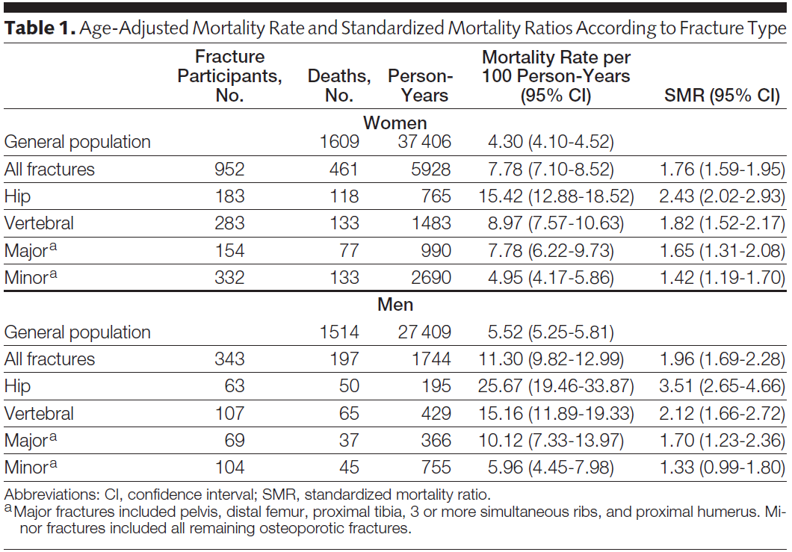
Another example of SMR:
Is mortality higher after a fracture?
SMR: Observed mortality rate in Dubbo research population after fracture/expected rate calculated using mortality rates in general population in Dubbo, Australia
Bluic et al. JAMA 2009
Notes:
This is another example of a study comparing mortality rates in a research cohort with mortality in the general population. The investigators have data on mortality incidence after a fracture in the Dubbo Osteoporosis Epidemiology Study, a longitudinal study of 60+ year old residents of Dubbo, Australia. To determine if mortality incidence is increased post-fracture, they compare the cohort rate of mortality with incidence of mortality in the general population (60 and older) in Dubbo. In the entire Dubbo population 60 years and older, 1609 deaths were recorded in women and 1514 in men in 37,406 and 27.409 person-years respectively. This yielded mortality rates of 4.3 per 100 person-years (95% CI, 4.1-4.5) and 5.5 per 100 person-years (95% CI, 5.3-5.8) in women and men, respectively. Among the fracture participants, 461 deaths were observed in women and 197 in men, yielding mortality rates of 7.8 per 100 person-years (95% CI, 7.1-8.5) and 11.3 per 100 person-years (95% CI, 9.8-13.0) in women and men, respectively. SMRs were calculated using 5-year age groups, and yielded SMRs of 1.96 and 1.76 in men and women respectively. These SMRs >1 mean that the fracture group have higher rates of death.
Note that these SMR are only as good as the factors that they are standardized for. That is, we have to be concerned about residual confounding, a topic we will cover later in the course. In other words, we can’t address whether the fracture per se is causally responsible for the increased mortality if we have not accounted for all of the ways that the fracture group is different than the general population. It’s possible that those who fracture are more frail in general and this frailty is the underlying cause of both more frequent fractures and increased mortality. In this case, reducing fractures would not translate into reduced mortality.
Mortality Risk Associated With Low-Trauma Osteoporotic Fracture and Subsequent Fracture in Men and Women Bluic et al. JAMA. 2009;301(5):513-521

Slide 43
(2b) Comparing hip fracture incidence in different dynamic populations
WOMEN Age-specific incidence rates per 100,000 person-yrs
Age group (yr) | Beijing† | Budapest† | Hong Kong‡ | Reykjavik
20-29 | 1.0 | 3.4 | 2.5 | 6.0
30-39 | 3.1 | 5.7 | 3.8 | 0.0
40-49 | 7.6 | 24.5 | 9.0 | 24.1
50-54 | 17.9 | 38.7 | 27.9 | 36.1
55-59 | 32.4 | 46.1 | 49.2 | 186.0
60-64 | 56.2 | 84.4 | 75.0 | 199.1
65-69 | 91.2 | 193.0 | 194.0 | 402.5
70-74 | 164.1 | 288.1 | 438.8 | 838.0
75-79 | 141.0 | 564.8 | 823.6 | 1311.1
80-84 | 224.2 | 1100.5 | 1588.1 | 1945.3
85-89 | 219.2 | 1652.6 | 2572.9 | 3791.9
90-94 | 401.0 | 2217.3 |  | 3732.9
95+ |  |  |  | 5300.4
20 and older, age-adj¶ | 39.6 | 128.2 | 168.3 | 274.1
50 and older, age-adj¶ | 96.0 | 316.0 | 428.3 | 696.6
¶ Standardized to 1990 US non-Hispanic white population
Notes:
These are incidence rates among women for hip fracture for 5- or 10-year age groups in different countries. For each row, hip fracture events over a specific time period (one or two years) in the designated age group were ascertained for the numerator. The denominator was based on census data. The rates shown are age-specific incidence rates, calculated as the number of events in the specific age group divided by the number of person-years in the same age group.
How to derive one number to compare across populations? The answer is to estimate age-adjusted incidence rates for each country. These are shown at the bottom for age 20+ and age 50+. In both cases, fracture incidence in Reykjavik is higher than the other countries.
These age-adjusted incidence rates were calculated using direct standardization to a reference population (in this study, the US non-Hispanic white population in 1990). The age-adjusted rates are a weighted average of stratum-specific rates, where the weights came from an external reference population. See the Extra Slides for a description of direct and indirect standardization, and an explanation of how to perform direct standardization. One issue with this approach is that you can see how you might get slightly different answers depending upon the weight structure (i.e., the population structure) in the external population. Standardization is a technique you should be aware of as a means of contending with confounding, although we won’t focus on it in this class.
Schwartz et al. Osteoporosis Intl 1999.

Slide 44
Comparing Two Dynamic Populations
WOMEN | Beijing | Budapest
No. hip fx (1 yr) | 808 | 284
Total popn | 2,650,400 | 180,904
Unadjusted rate* | 20 | 157
Age-adjusted rate* | 39.6 | 128.2
* per 100,000 person-years
Unadjusted rates do not take into account the different age structures of the populations in Beijing and Budapest. Used “direct standardization” to calculate rate adjusted for age (see Extra Slides). Measure of association, comparing rates in Beijing and Budapest, goes from 7.8 to 3.2.
Notes:
We can calculate unadjusted rates of hip fracture for these populations. But, the unadjusted rates do not take into account the different age structures of the populations in Beijing and Budapest. If we want to compare these rates, we need to adjust for the age structure. We can do this with direct standardization, described in extra slides at end of lecture slides. Note that when we do this age adjustment the rate ratio goes from 157/20= 7.8 using the unadjusted to 128.2/39.6 = 3.2, which is a substantial change.

Slide 45
Why Use Average Incidence Rates?
To calculate incidence from a dynamic cohort
To compare disease incidence in a fixed cohort with a rate from a dynamic population OR to compare incidence in 2 or more dynamic populations
To estimate incidence of outcomes associated with exposures that change over time in given individuals
Notes:
Let us move on to the third reason to use average incidence rates.

Slide 46
(3) To estimate incidence of outcomes associated with exposures that can change over time in individuals
Research question: In a Medicaid database, is there an association between use of non-steroidal anti-inflammatory drugs (NSAIDs) and coronary artery disease (CAD)?
How would you study the relationship between NSAID use and CAD?
Notes:
This is a common type of problem in cohort studies that examine exposures which can change over time, such as smoking, changes in diet, exercise, medications, etc. A database records time periods when medications were being used and time periods when they were not used. Some persons will never use the medications and some will use it continuously, but there is a large group who either initiate or discontinue use during the time under study and another group who change in both directions. The same person can go on and off the medication multiple times. It is difficult to see how you would analyze such data using the cumulative incidence approach.

Slide 47
Calculating stratified average incidence rates in cohorts
For persons followed in a cohort some exposures may be fixed (time-invariant) but some are changing (time-variant, time-varying, time-dependent)
  Biologic sex is fixed
  Taking medications or getting regular exercise are behaviors that can change over time
Adding up person-time in each exposure category to get a denominator of time at risk accommodates exposures that change over time
Notes:
For exposures that are time-varying, adding up the total person-time of exposure and non-exposure to form two denominators is a very useful way of dealing with the problem of changing exposure groups. The numerators for each denominator then become the number of events that occurred among persons at times when they were exposed and similarly for the events among the unexposed. This approach assumes that the exposure’s effect on the event is predominately or solely during the time the exposure is occurring. It therefore makes sense for exposures whose association with the outcome quickly disappears when the exposure is removed. This assumption would not work very well for exposures which have lasting effects long after the actual exposure is removed. For an exposure like smoking with known long-term health risks, linking events to time periods when an individual was and was not smoking would have little utility because it would be very contaminated by the long term effects of smoking.
Of course, we sometimes don’t know if the effect of an exposure is long lasting or ephemeral.

Slide 48
Analysis of changing exposure and disease incidence
Tennessee Medicaid data base, 1987-1998:
  are NSAIDs associated with CAD?
Same person could both use and not use NSAIDs at different times over the 11 years
  A cumulative incidence approach to the analysis does not seem correct
Ray, Lancet 2002
Notes:
Here is an example from a manuscript that analyzed Medicaid recipients in Tennessee over an eleven-year period. In a cohort with an exposure that can vary over time, subjects cannot be classified in groups according to their exposure over time because at baseline their future medication use cannot be known in advance. To place persons in baseline exposure groups in order to calculate and compare cumulative incidence, the changes in use that happen after baseline would have to be ignored, an obviously unsatisfactory approach for this research question.
Instead, calculating incidence rates by putting times of use and non-use into the appropriate person-time bins account for time of time-varying exposure; this is the solution to deal with the problem of changing exposure over time. There is an assumption, however, and it is that whatever effect NSAID use has on CAD risk will occur during NSAID usage but that this effect will “wash out” when use is stopped. If the “wash out” is not thought to be immediate, a time period that approximates whatever the wash out time is thought to be can be added to avoid attributing time to non-exposure person-time before the exposure effect has been removed.

Slide 49
A given patient can contribute exposed and unexposed follow-up time
No NSAID use
NSAID use
Notes:
Here is a graphical representation of how an individual patient can contribute person-time as unexposed, then exposed, and then (after a wash-out period) as unexposed.

Slide 50
Analysis of changing exposure with average incidence rates
Person-time totaled for using and not using NSAIDs; CHD outcomes tallied
A person can contribute to the denominator both for use and non-use but only after a 365 day “wash out” period between use and non-use
 | Person-yrs | No. CHD | Rate per 1000 pers-yrs
Users | 275,565 | 3,313 | 12.02
Non-users | 257,069 | 3,049 | 11.86
Ray, Lancet 2002
Notes:
The study endpoint event was hospitalization for myocardial infarction or death from coronary artery disease. Patients with no history of prior NSAID use who began use after having been enrolled in the database for 365 days (in order to have data on prior illnesses) were compared with subjects not using NSAIDS. A subject who stopped using was eligible to be in the non-using group later, but to avoid any carryover effect, only after 365 days of non-use had elapsed. In this study design, the choice of the washout period is a key substantive decision and should be varied in sensitivity analyses.
Substantive note: Ideally, this is a question that would be resolved by a randomized trial, but a clinical trial of this question will likely never be done. In the absence of a randomized trial, observational data is all we have to make a decision. Again, an entirely newly performed cohort with dedicated measurements of all the potential confounders, in particular aspirin use, would be preferable, but to get the numbers required would mean a very large cohort followed for a number of years. Possible but very expensive. Analyzing existing data, such as a Medicaid database, is less desirable in terms of measurement quality, but it does provide an opportunity to conduct a cohort analysis on a large number of patients over many years at minimal expense. The question that remains is whether the authors were able to get adequate control of confounders, a topic we will cover later in the course.

Slide 51
Calculating Average Incidence Rates in Stata
Declare data set survival data:
. stset timevar, fail(failvar)
.strate (gives person-time rate)
Example: Biliary cirrhosis time to death data
.use biliary cirrhosis data, clear
.stset time, fail(d)
.strate
D Y Rate Lower Upper
96 747.04 0.1285 0.1052 0.1570
Incidence rate = 12.8 deaths per 100 person-years
Person-time (not always years!! Y represents whatever native units the data are in)
No. of Events
Notes:
Whether you are using Kaplan-Meier, life-table, or calculating average incidence rates, you still begin with the Stata command that declares your data to be survival data (also known as “failure time data” or “time to an event data”), and this command tells Stata the name of the time variable and the name of the failure (=outcome/censoring) variable.
The command strate will calculate the rate and 95% confidence interval. Following use of the command “strate” with the name of the variable for an exposure variable that has categories, such as treated vs. not-treated, will give the rates within each category of the predictor.
To illustrate this, we go back to the biliary cirrhosis dataset that we worked with last week. Typing in the strate command produces the following output. The incidence rate in the cohort is 0.1285 per person-year. By convention, we typically express rates such that they have a non-zero integer to the left of the decimal point. In this case, 12.8 cases per 100 person-years. You could also say 1.28 per 10 person-years but this is a bit less conventional.

Slide 52
Immediate Commands in Stata
Stata has an option to use it like a calculator for
various computations without loading in a data set.
Termed “immediate” commands.
Example: to calculate the person-time rate and confidence interval from events and follow-up time:
. cii #person-time units #events, poisson
e.g., 6 events occur in 10 person-years of follow-up:
    . cii 10 6, poisson
    Rate = 0.6 per person-year
    95% CI = 0.220 – 1.306
Notes:
The immediate commands in Stata obtain data not from a dataset stored in memory but from numbers that you type in. So they use Stata like a calculator. They have no effect on anything you have stored in memory. All immediate commands end in “i”.
The “cii” command can also be used to calculate other means and confidence intervals. Here it is specifying “, poisson”, referring to the Poisson distribution which is what is used for standard error generation of rates. By specifying “poisson”, that tells STATA you have count data and want the mean and 95% confidence interval of a rate.

Slide 53
Assumptions in Calculation of
Average Incidence Rate
So far, we have considered the “average” incidence rate
  calculated over a discrete period of time
  assumed to be constant over that period of time
However, this assumption may not be met

Slide 54
Constant Rate
Example: Mortality in biliary cirrhosis cohort
Average incidence rate, calculated previously, was 0.13 deaths per person-year. If we plot this constant rate, we get:
*deaths per person-year
Notes:
This is a plot of the incidence rate, assuming that it is constant throughout the study of mortality in the biliary cirrhosis cohort.

Slide 55
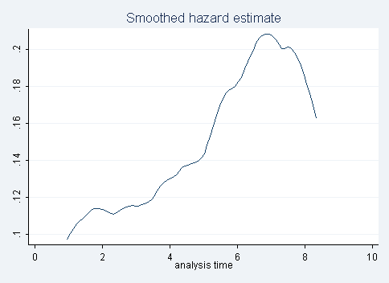
Constant Rate
Mortality in biliary cirrhosis cohort
Assuming a constant rate
Reality: Incidence rate is not constant
Notes:
In fact, the incidence rate of mortality during the follow-up period in the biliary cirrhosis cohort was not constant. On the right is the graph of the instantaneous incidence rate (hazard rate) in reality, estimated directly from the data and without assuming a constant incidence rate. It’s clear from this plot that the incidence rate of mortality in this cohort was not a constant rate throughout follow-up.

Slide 56
Instantaneous Incidence Rate
The previous plot (on the right) has as y axis the “instantaneous incidence rate,” aka “hazard.”
  This is the instantaneous potential per unit time for the event to occur, given that the individual has not had the event up to time t
Plot is showing the hazard function, h(t)
  how hazard changes over time
  allows for change in incidence rate over time
Notes:
This leads us to other form of incidence rate, which is known as the instantaneous incidence rate or more commonly as the hazard. You may be aware of this term, hazard, from the regression technique called the proportional hazards model.
A hazard is defined as each individual’s instantaneous probability of the event at time t, given that the person was at risk at time t. Or, in other words, conditional on the person being still at risk at time t.
The hazard function, h(t), is the relationship of the hazard across time.

Slide 57
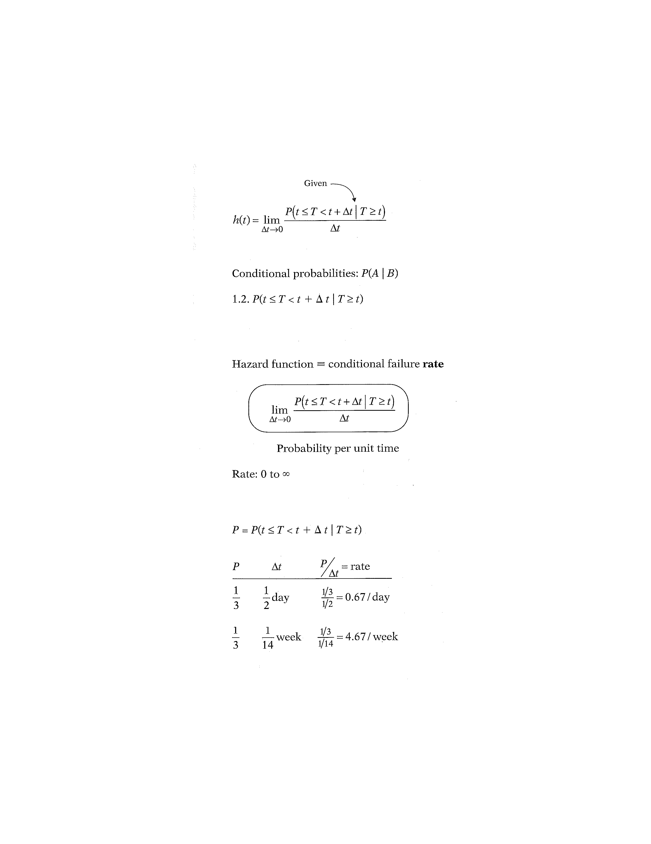
Hazard Function
(Conditional Failure Rate)
Probability of the event (T) occurring in the interval between t and (t + Δt)
Numerator is a conditional probability, of the form:
Probability that the event will occur in the time interval between t and t + Δt, given that the survival time, T, is greater than or equal to t. Or, the probability that if you survive to t, you will succumb to the event in the next instant (Δt).
Notes:
Here is the general formula for a hazard function. In mathematical terms, the “given” part of the formula for the hazard function is found in the probability statement-the numerator to the right of the limit sign. This statement is a conditional probability because it is of the form, P of A, given B, where the P denotes probability and where the long vertical line separating A from B denotes “given”. In the hazard function formula, the conditional probability gives the probability that the event (T) will occur in the time interval between t and t + Δt, given that the survival time, T, is greater than or equal to t. Because of the given sign here, the hazard function is sometimes called a conditional failure rate.

Slide 58
Denominator is time
Notes:
We now explain why the hazard is a rate rather than a probability. Note that in the hazard function formula, the expression to the right of the limit sign gives the ratio of two quantities. The numerator is the conditional probability we just discussed. The denominator is Δt, which denotes a small time interval. By this division, we obtain a probability per unit time, which is no longer a probability but a rate. In particular, the scale for this ratio is not 0 to 1, as for a probability, but rather ranges between 0 and infinity, and the value depends on whether time is measured in days, weeks, months, or years, etc.

Slide 59
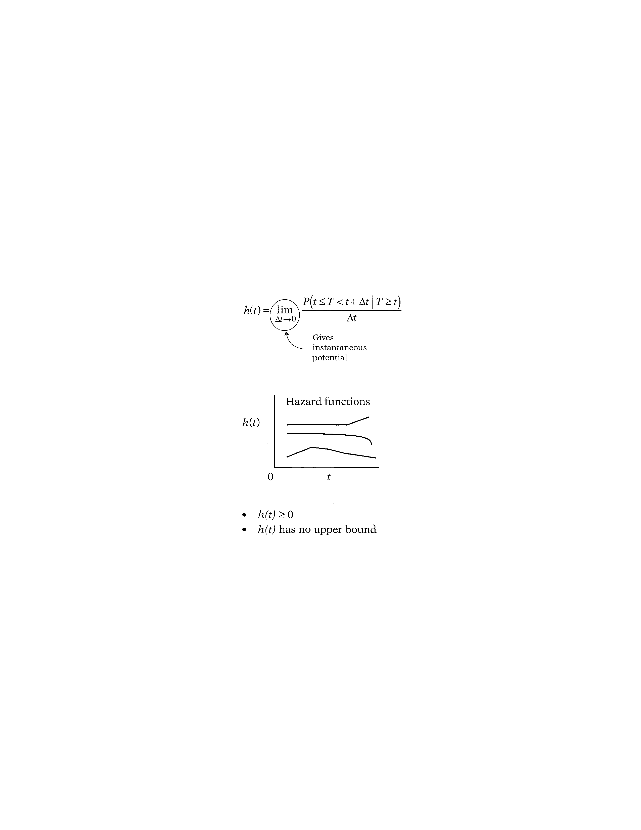
Hazard Function
(Instantaneous probability of some event)
Notes:
When we take the limit of the right-side expression as the time interval approaches zero, we are essentially getting an expression for the instantaneous probability of failing at time t per unit time. Another way of saying this is that the conditional failure rate or hazard function h(t) gives the instantaneous potential for failing at time t per unit time, given survival up to time t. As you can see from this formula, estimating the hazard rate at a given point in time requires calculus and cannot be easily hand calculated directly from the data – as we did for the average incidence rate.

Slide 60
Properties of Hazard Function
Notes:
As with a survivor function, the hazard function h(t) is graphed as t ranges over various values. The graph above illustrates two different hazards. In contrast to a survivor function, the graph of h(t) does not have to start at 1 and go down to zero, but rather can start anywhere and go up and down in any direction over time. In particular, for a specified value of t, the hazard h(t) has the following characteristics:
° it is always nonnegative, that is, equal to or greater than zero;
° it has no upper bound.
These two features follow from the ratio expression in the formula for h(t), because both the probability in the numerator and the Δt in the denominator are non-negative, and since Δt is a very small non-zero number.

Slide 61
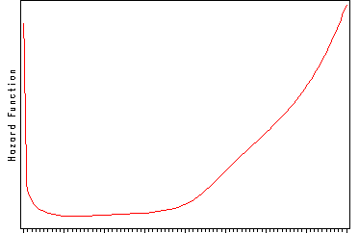
Hazard function for mortality in general U.S. population
0 Age (years) 100
Compare information provided here versus depicting this with an average incidence rate. The average is not wrong; just less useful.
Notes:
This graph illustrates a hazard function with a 'bathtub shape'. This graph is depicting the hazard function for death in the general U.S. population. Hazard is high shortly after birth but drops rapidly and remains at a relatively low level during youth and middle age. Hazard starts to rise later in life and increases steadily.
Other indicators of interest, such as the survival function, can be derived from the hazard. Once we have modeled the hazard we can easily obtain these other functions of interest. The hazard function is the basis for proportional hazards regression model. It is useful to be able to interpret the shape of a hazard function.
Note how much more this tells you than can be understood from an average incidence rate. An average incidence rate gives you one number – by definition. Does one number adequately depict what is going on in this plot? No. This one number is not wrong; it is just that it is not very useful. This illustrates how when the underlying hazard function is not constant, the average incidence rate falls short of being informative.

Slide 62
Assumption for meaningful interpretation of average incidence rate i.e., what do we need for average incidence rate to be relevant?
Average incidence rate is an attempt to have 1 number represent the incidence rate over a period of time
Therefore, average incidence rates have the most relevance and utility if they represent rates that are constant over time in the interval they were measured
Whether or not rates are constant or not over time requires direct assessment of instantaneous rates (hazard)
  Can only be done when we have complete individual-level data
  If we just have “group” data, we cannot directly assess how rate changes over time. We can only speculate it is constant.
    The longer the time period, the more doubtful the rate can be assumed to be constant.
Notes:
We are now in a better position to understand what we said earlier about average incidence rates. That is, average incidence rates attempt to have 1 number represent the incidence rate over a period of time. Such an average rate will be most relevant and meaningful if it is applicable over the entire time period, in other words, if the hazard is constant over time.

Slide 63
Stata: Smoothed hazard function
Example: Mortality in biliary cirrhosis cohort
Using dataset identified as survival data, Stata command is
sts graph, hazard
Notes:
Here’s the plot we showed earlier showing the instantaneous incidence rate (hazard) of mortality in the biliary cirrhosis cohort. The Stata command to generate this plot is provided. The drop-down menu can also be used: Graphics, Survival analysis graphs, Smoothed hazard estimate.
Generating this plot requires calculus and smoothing. The plot can be easily derived in Stata but not readily by hand calculation.

Slide 64
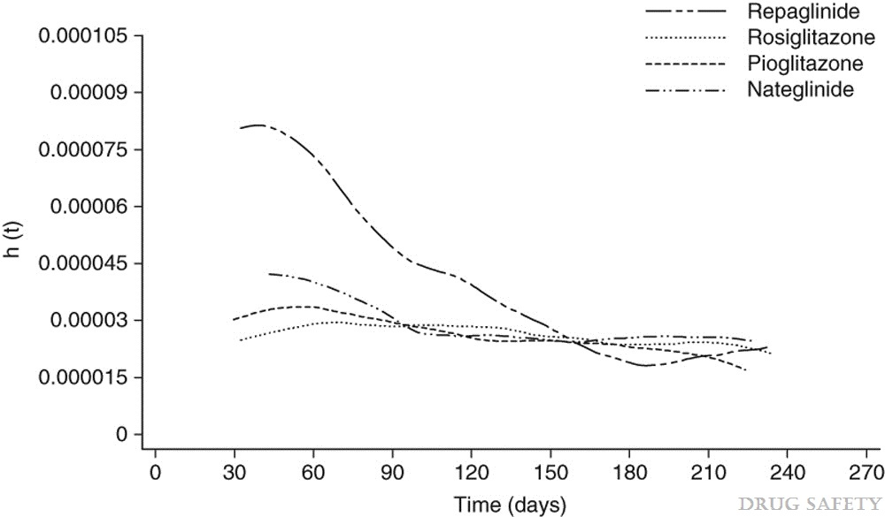
Hypoglycemia with Oral Antidiabetic Drugs
Methods: …Observation time for each patient and incidence rate (IR) per 1000 patient-years of treatment for hypoglycaemia was calculated for each drug cohort. Smoothed hazard estimates were plotted over time...
Smoothed hazard of hypoglycemia over time, by drug
h(t) = hazard at time t.
Vlckova et al. Drug Safety. 32:409-418, 2009.
Notes:
Here is an example of a published report that included a plot of the hazard. Use of these plots is growing in the literature now that software has caught up to the computationally heavy procedure of doing the calculation and then the smoothing that is required to make it readable.
The aim of this study was to quantify the incidence of hypoglycemic events and to describe the pattern of these incident events during the first 9 months of treatment with four oral antidiabetic drugs, rosiglitazone, pioglitazone, nateglinide and repaglinide, prescribed in general practice in England.
“The smoothed hazard plot depicted in figure 1 shows that the incidence of hypoglycaemia in patients treated with rosiglitazone was approximately constant over time. A slight decrease in hazard over time is observed in patients receiving pioglitazone. Patients treated with repaglinide experienced more hypoglycaemic episodes at the beginning of their treatment. Similarly, patients treated with nateglinide tended to have more hypoglycaemic episodes after starting the treatment but the difference was not as pronounced as it was for repaglinide.“

Slide 65
Measures of Incidence
The proportion of individuals who experience the event in a defined time period (E/N during some time T) = cumulative incidence = risk
The number of events per amount of person-time observed (E/NT) = incidence rate
  Average incidence rate (“incidence rate”)
  Instantaneous incidence rate (“hazard”)
Notes:
Going back to these broad definitions of incidence measures from the beginning of the lecture, we’ve looked at cumulative incidence (last week) and now at incidence rates (average and instantaneous). Next, we examine the relationship between cumulative incidence and incidence rate.

Slide 66
Cumulative incidence and
Incidence rate (average and hazard)
K-M cumulative incidence
Estimate of hazard
Can summarize as 10 yr cum incidence = 0.76
Can’t summarize in one number
Same underlying data, presented 3 ways
Average incidence rate = 0.13 deaths per person-year
Notes:
We have now covered three ways of measuring incidence, illustrated on this slide using the example of mortality in biliary cirrhosis cohort.
On the left is the KM cumulative incidence curve that we saw last week for the same data. This can also be summarized as “Cumulative incidence over 10 years was 0.76.”
The plot on the right is the hazard function that we showed earlier today for mortality in biliary cirrhosis cohort.
We can also report the average incidence rate which we calculated earlier as 0.13 deaths per person-year.
How are these 3 measures – derived from same dataset - related?

Slide 67
Difference between Hazard and Cumulative Incidence
Hazard can be thought of as how likely an event is to happen at any moment in time (“force of morbidity”)
Cumulative incidence is the result of applying that hazard to a fixed cohort for a specified duration
Analogy: Velocity of a car vs distance traveled in a certain time
Hazard can be constant or changing over time. Can vary from 0 to infinity
Cumulative incidence can only increase or stay steady
Notes:
It may help in understanding the difference between the hazard and cumulative incidence to think of the hazard as how likely an event, such as death or a disease diagnosis, is to occur at any given moment in time (the moment-to-moment instantaneous risk) and to think of the cumulative incidence as the result of applying that instantaneous rate to a fixed number of persons for a longer period of time. The longer the time period, the more the cumulative incidence will differ from the rate. The higher the rate the more quickly this difference appears. So the rate can be thought of as the most fundamental measure of disease incidence, something captured rather metaphorically by older more colorful descriptions of a rate as the “force of morbidity” or the “force of mortality.”
The cumulative incidence can only be constant as long as no new event occurs, but every time an event occurs, the cumulative incidence has to increase. Remember, cumulative incidence applies to some fixed group of people who are followed for a specified time period.
As an analogy, consider the difference between the velocity of a car (analogous to rate) and the distance traveled within a certain time period (analogous to cumulative incidence).

Slide 68
Relationship between Constant Hazard and Cumulative Incidence
A constant hazard (rate) produces an “exponential” cumulative incidence (or survival) distribution
If know the constant incidence rate, can derive the cumulative incidence/survival function or vice-versa from the “exponential formula”
where S(t) = cumulative survival and
F(t) = cumulative incidence
e= 2.71828; λ = rate; t = time units
Assumes no competing events
Notes:
There is a formal mathematical relationship between rate and cumulative incidence. For the special situation of a constant rate, it is represented by this formula. If the rate is constant, applying that rate to a given number of persons for a given time period produces a cumulative incidence that follows an exponential distribution given by the formula above, where F(t) = the cumulative incidence, e = 2.71828, λ = the rate per the person-time units, and t = the number of time units. This formula is called the “exponential formula.” The proof for this can be found in advanced textbooks. Please note that this assumes no competing events.

Slide 69
Constant Rate Results in Exponential Survival
Hazard Rate
Cumulative incidence
Cumulative survival
1 2 3 4 5 6 7 8 9 10
Notes:
These figures illustrate different relationships between a CONSTANT incidence rate and cumulative survival. A constant incidence rate (top panel) produces an exponential survival curve (lower left panel) and exponential cumulative incidence curve (lower right panel).

Slide 70
Illustration of Incidence Rate versus Cumulative Incidence
The mortality rate in the U.S. in 2001 was 855 per 100,000 person-years
This is an “average incidence rate” for 2001
If a fixed cohort of US citizens was followed for 5 years (and had this constant rate of death), the cumulative incidence of death can be shown to be 4.2% at 5 years; at 10 years it would be 8.2%.
Notes:
In 2001 the mortality rate in the U.S. was estimated at 855 per 100,000 person-years. Part of the confusion around rate is that it is often described with the use of the word “annual”, as the U.S. mortality rate is in “the annual U.S. mortality rate.” The use of the word “annual” suggests that the rate is per one year, but this is misleading. The word “annual” comes in because we calculate the rate for 2001 by using data from an entire year, but the estimate of the rate is based on the assumption that it was constant throughout the year (a reasonable approximation to reality for something that changes as slowly as the mortality rate). This assumption is saying that mortality rate is the same at any moment in time in 2001. If the rate remains constant, applying that rate to a given number of persons for a given time period produces a cumulative incidence that follows an exponential distribution.
Another observation here is that the incidence rate and cumulative incidence diverge more over longer time periods. For a short time period, the rate (expressed per 100 person-years) and the cumulative incidence will be very close, but not identical. For a 1 year period mortality rate of 0.855 per 100 person-years produces a cumulative incidence = 0.851%, very slightly different numerically from the rate. But if the U.S. mortality rate of 0.855 per 100 person-years applies to everyone alive at this moment and stays constant for five years, the cumulative incidence of mortality at five years would be 4.2%. At 10 years the cumulative incidence would be 8.2%, both quite different from the rate. And if the rate is high the cumulative incidence will differ significantly faster. A rate of 30 per 100 person-years gives a 1-year cumulative incidence of 25.9%. Of course, in a closed cohort the mortality rate would increase over time as the cohort ages. This does not pose a problem. There are other mathematical formulas for dealing with an increasing rate. Increasing rate would cause the cumulative incidence to increase faster.

Slide 71
Relationship between hazard function and survival function with a constant hazard
where h(t) = λ
Assumes no competing events
Notes:
Here is the relationship between the hazard function and survival function, shown again, when the hazard is constant. If the hazard function is constant, i.e., h(t) = λ, for some specific value λ, then it can be shown that the corresponding survival function is given by the following formula: S(t) equals e to the power minus λ times t.
Of note, this also assumes no competing events. If we think of this constant hazard rate being applied to a population to produce cumulative incidence, then those who experience a competing event are removed from the population and this rate is no longer being applied to everyone. In other words, if there are competing events, the relationship no longer holds because there is no where in the formula where these losses are being accounted for. By not accounting for competing events, cumulative incidence is going to be overestimated.
With this formula, you can take an average incidence rate from an article and turn it into a cumulative incidence (which is typically more understandable by readers). Two examples follow.

Slide 72
From average incidence rate to cumulative survival/incidence
Previous example: Biliary cirrhosis time to death data
Average incidence rate = 0.1285 deaths per person-year
S(t) = ℮(-0.1285 deaths/person-yr * 10 yr)
= 0.277 = cumulative survival over 10 yrs
Cumulative survival (10 yrs) from K-M: 0.237
Values are close but not identical. Why?
Notes:
The average incidence rate = 0.1285 deaths per person-year. We are interested in a time interval of 10 years. The estimated cumulative survival over 10 years with this equation is 0.277, close to the value based on Kaplan Meier calculations (0.237).
The reason that the result from the exponential formula does not exactly match the K-M estimate is because the hazard is not truly constant (as shown on an earlier slide).

Slide 73
Survival and Hazard Functions
cumulative hazard
Don’t require constant hazard
Notes:
More generally, the relationship between S(t) and h(t) can be expressed equivalently in either of two formulae shown here. The first of these formulae describes how the survivor function S(t) can be written in terms of an integral involving the hazard function. The formula says that S(t) equals the exponential of the negative integral of the hazard function between integration limits of 0 and t.
The second formula describes how the hazard function h(t) can be written in terms of a derivative involving the survivor function. This formula says that h(t) equals minus the derivative of S(t) with respect to t divided by S(t). We are not surprised to see a derivative here for the calculation of hazard. That is, we are looking for the essentially how the survival function is changing in a very small time period when restricted to those who have survived up to that time.
Note that this general formula no longer requires the hazard to be constant.
The quantity in the integral is what is called the "cumulative hazard", an entity that is used in other survival analysis contexts. We won’t discuss it more other than to say …

Slide 74
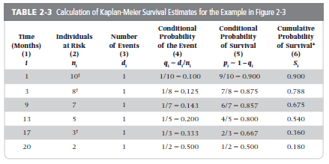
Sum these to get cumulative hazard
Cumulative survival calculated by multiplying survival probabilities for
each prior failure time: e.g., 0.9 x 0.875 x 0.857 = 0.675 and
0.9 x 0.875 x 0.857 x 0.800 x 0.667 x 0.500 = 0.180
Notes:
We have actually seen how to get this quantity of the cumulative hazard. At any point in time, the cumulative hazard is just the sum of all the conditional probabilities of the event, which is the column circled in red.
74

Slide 75
Cumulative incidence and hazard function: Which is best to show?
K-M cumulative incidence curve
Hazard
10 yr cum incidence = 0.76
Average incidence rate = 0.13 deaths per person-year
Notes:
Back to the 3 ways that we can express incidence for this example of mortality in a cohort with biliary cirrhosis. The plot on the right is the hazard function. On the left is the KM cumulative incidence curve for the same data – which can also be summarized as “Cumulative incidence over 10 years was 0.76” And we could also report the average incidence rate of 0.13 deaths per person-year.
As discussed earlier, the plot of the hazard rate provides much more information than the average incidence rate.
The KM curve also provides substantially more information than the cumulative incidence expressed as one number (e.g. 0.24). The KM curve and plot of the hazard function are based on the same data but presented quite differently. For most of us, it is difficult to make the mental leap from this cumulative survival curve to the underlying hazard rate, or vice versa.
Which plot to show in a manuscript? If space allows, showing both plots would be the best solution since they provide different information. If that is not possible, the best approach will depend on the particular subject matter and study design.

Slide 76
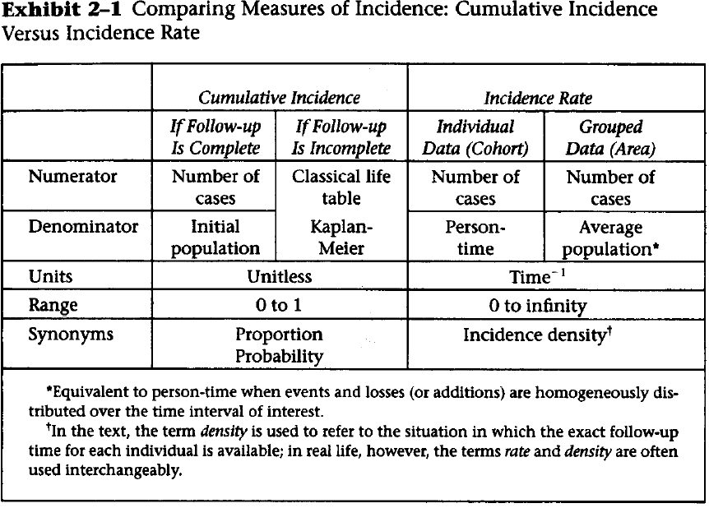
Notes:
This is a useful table from your text that summarizes the characteristics of cumulative incidence versus incidence rate. You should thoroughly familiarize yourself with this.
Note that 'incidence proportion' is a reasonable synonym for cumulative incidence.

Slide 77
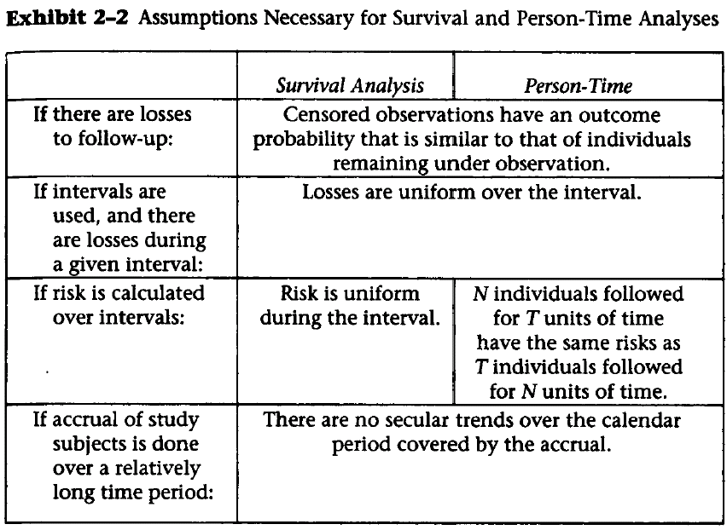
Cumulative incidence
Incidence rate
Notes:
Note that the text is here using the headings “Survival Analysis” and “Person-time” for the cumulative incidence and incidence rate approaches, respectively, to analyzing data that features time to an event. This is the graphic from the text that gives the assumptions of both methods. Note that they have the same assumptions with the exception of how the risk is calculated over intervals. Thus, the issues of informative censoring and of secular trends are important to keep in mind with both of these approaches.
Note: in rows 2 and 3 of the table, the phrase if “intervals” are used, in the context of survival analysis, refers to the specific use of life-tables

Slide 78
Rates: What to do about
Drop-out and Competing Events
In the calculation of rates, subjects contribute person-time until they either have the event of interest (E) or:
  drop out
  are administratively censored (i.e., study ends)
  have a competing event
Thus, without any special assumptions, rates have a specific interpretation
  “Rate of the event E given that something else (drop-out; admin censoring, or competing event) has not happened first”
  This interpretation is inherently accommodating (i.e. specifically recognizing and allowing for) the presence of drop-out; admin censoring; and competing events
Notes:
Let’s talk more about the assumption that censored observation have an outcome probability that is similar to that of individuals remaining under observation. More generally, when calculating rates, how should we handle losses to follow-up and competing events.
If we step back for a moment, remember that in our calculation of rates thus far, subjects contribute person-time until they either have the event of interest or they drop out, are administratively censored (i.e., the study ends) or they have a competing event. Thus, without making any special assumptions, rates have a specific interpretation. That is, the interpretation is: “Rate of the event (E) given that something else (drop-out; administrative censoring, or the competing event) has not happened first.
We say that this interpretation is inherently accommodating for drop out, administrative censoring, and competing events. That is, this interpretation recognizes that these events occur and allow for them.

Slide 79
Is native interpretation of rate satisfying & meaningful?
i.e., Do we want to accommodate (allow for) administrative censoring; competing events; and drop-out?
  Or, would we prefer if they never happened (were eliminated)?
Threat | Discussion | Conclusion
Administrative censoring a) those followed for entire period of study b) those with delayed entry; not followed for entire period | All studies must end, and end of a study unrelated to substance of study itself (i.e., just an artifact) Preferable to have followed everyone throughout entire time | a) Appropriate to accommodate b) Prefer elimination accept accommodation
Competing events | A fact of life Difficult to envision a reality without such events | Appropriate to accommodate
Drop-out | Unfortunate manifestation of studying humans Concern about how often the event occurs after drop-out Have a sense that harder work could have prevented | Prefer to eliminate (Exception: descriptive studies in dynamic cohorts)
Notes:
Is this native interpretation of rate satisfying and meaningful? In other words, how do we feel about accommodation? Or, would we prefer if these things never happened, in other words, if they were eliminated?
Let’s look at all 3 of them individually. First, administrative censoring. We recognize that all studies must end, and the end of a study really has typically nothing to do with the events of the disease process itself. It is just an artifactual end. Given this, it is appropriate to accommodate administrative censoring. This is especially true when the subject has been followed for the maximum duration of the study. For a person with delayed entry, it would have been nice if we had a chance to follow them for the entire duration, but, even in this case, we are typically fine with accommodating this situation.
Second, competing events. We recognize that competing events are a fact of life. It is difficult to envision a reality without such events. Thus, we are willing to and it is appropriate to accommodate competing events.
Finally, how about drop-out? Drop-out is an unfortunate manifestation of studying humans. We are always wary about how often the event occurs after drop out. We also have a sense that a harder work on our part could have prevented drop-out. Because of this, we wish we could eliminate drop-out and are not willing to accommodate for it. Note: the exception to this is a dynamic cohort where we are only interested in a descriptive objective, such as incidence. This is because dynamic cohorts are typically defined as being “open to the right” with drop-out to be expected. Thus, we really only care about estimating incidence amongst those who remain. Drop-outs do not hurt us; we expect them. On the other hand, when analytic objectives are in play (relating exposures to outcomes), drop-outs may be a source of bias and we hope to eliminate them.

Slide 80
In a rate calculation, what does it mean to prefer elimination of drop-out?
Means that you are not satisfied with:
  “Rate of the event E given that drop-out has not happened first”
  Wise to be unsatisfied because we are wary about the drop-outs. It is hard to be sure that those who remain are representative of all who started observation.
You prefer to say:
  “Rate of the event E assuming drop-outs don’t occur”
But because drop-outs, in reality, often do occur, we typically assume that we know what is happening to them
  We assume that the rate of the event of interest in the lost is the same as those who remain
  This is origin of the assumption of “non-informative censoring”
Notes:
Let’s discuss elimination of drop-out a bit more. What does it mean in a rate calculation to hope for elimination of losses to follow-up (drop-outs)? It means that you are not satisfied with the native interpretation of a rate, which is that “Rate of the event E given that drop-out has not happened first”. If you are unsatisfied with this interpretation of rate, you should be because it is a messy statement. It means that you are comfortable with calculating incidence using just those who remain in the analysis. We are rarely comfortable with this, however. Therefore, what you would prefer to be saying is that it is the rate of event assuming drop-outs don’t occur (an elimination approach0.
Yet, in reality, drop-outs do occur and we cannot assume that they will not. One way to deal with this is to assume that we know what is happening to these losses. The most expedient assumption is to say that the event of the interest in the lost is the same as those who remain. And, so this is the origin of the assumption:
censored observations have an outcome probability that is similar to that of individuals remaining under observation.
This is the assumption of non-informative censoring.

Slide 81
In a rate calculation, what does it mean to accommodate competing events?
Means that you are satisfied with:
  “Rate of the event E given that a competing event has not happened first” e.g., accept that death due to MI will occur in study of cancer.
  This is a reasonable scenario.
Thus, without any effort (i.e., do our usual calculation), rates naturally account for competing events
  Don’t need to assume competing events do not occur
In contrast, recall that we had to assume no competing events (or independent ones) in a K-M estimation
Another reason to appreciate fundamental nature of rates
Notes:
Now, let’s talk about competing events in a rate calculation. We said we were willing to accommodate competing events. What does it mean to accommodate competing events?
It means that you are satisfied with the native interpretation of a rate which is the rate of the event E given that a competing event has not happened first.
Given that competing events are a fact of life, this is a reasonable scenario. When there are competing events and we censor observation when the competing event occurs, we refer to this as a “cause-specific” rate (or hazard).
Thus, the good news is that without any effort – i.e., just the usual rate calculation, rates naturally account for competing events. We don’t have to live in a make believe world where competing events do not occur.
Recall this is in contrast to what we discussed last week in the calculation of the K-M estimator, where we had to assume either no competing events or independent competing events.
This more natural handling of rates is another reason to like rates and appreciate why they are so fundamental.

Slide 82
Why not just censor (i.e., eliminate) competing events in Kaplan-Meier calculation?
If competing events are independent of outcome
  (Recall that independence of the CE means:
    Those who leave the analysis because of the CE are destined to have the same rate of the primary event as those who remain)
  censoring means you believe in a reality where competing events don’t occur
  inferences do not pertain to our world’s reality
Non-independent competing events
  Must believe in a world where competing events don’t occur
  Must be able to state what the new rate of the event E would be if the competing event was eliminated
    An act of pure speculation
Notes:
Let’s think back to the calculation of cumulative incidence with the Kaplan-Meier estimator. Last week we said that we typically do not censor competing events in Kaplan-Meier estimation. We spoke about other techniques being preferable. Why cannot we just censor individuals at the time of the competing event, like we perform censoring in cause-specific rate calculations?
Censoring in Kaplan-Meier would be an elimination approach, in which we perform the calculation under the assumption that competing events could be eliminated.
The answer to this can be given for each of the two flavors of competing risk events. For competing risk events that are you believe are independent of the event of interest (e.g., death by being struck from lightening), when you censor you first must say that you believe in a world where these competing events don’t occur (or, you could also pitch this as believing in a world where the event of interest can occur after death). But, of course, this does not pertain to our world’s reality.
What if you have a non-independent competing event? Again, to censor means you want to know what happens to your event of interest assuming that competing events don’t occur. So, again, you must believe in a world where competing events don’t occur. Even if you could get your head around this altered reality, you would then need to state what the new rate of the event E would be if the competing event was eliminated. This is typically just an act of pure speculation.
So, in both scenarios – independent competing events and non-independent events – censoring does not look to be appropriate when trying to calculate cumulative incidence by the Kaplan-Meier technique.

Slide 83
Disease occurrence
Prevalence
Point
Period
Incidence
Cumulative incidence
Incidence rate
Simple proportion
Kaplan-Meier
Life-table
Aalen-Johansen
Average incidence rate
Instantaneous (hazard) rate
Notes:
This inability to appropriately deal with competing events in Kaplan-Meier analysis brings us to our last estimator for incidence, which is the last one of the list for cumulative incidence. This is one we said we would be getting to this week, and finally we have.

Slide 84
Solution for Competing Events in Cumulative Incidence Estimation
Instead of censoring, account for competing events explicitly as additional separate outcomes in the analysis
Technique called: “Aalen-Johansen estimator”, “cumulative incidence estimate” or “cumulative incidence function”
Key technical computation is simple. In successive time intervals:
  calculate joint probability of a) experiencing none of the events (either event of interest or any of competing events) up through beginning of interval and b) experiencing event of interest during the time interval
  add up these joint probabilities within successive time intervals to get cumulative incidence of the event of interest
An argument could be made that this technique is all you need for cumulative incidence. It does everything that K-M can do & more.
Explained in detail in Satagopan et al. Brit. J. Cancer 2004
Notes:
Hence, the solution, instead of censoring, is to account for the competing risk events explicitly as additional separate outcomes in the analysis. This technique is most often called the cumulative incidence estimate (or estimator) or cumulative incidence function, but it is increasingly being called the Aalen-Johansen estimator after the two statisticians who developed it in the 1970’s. (Interesting local note: Aalen did his Ph.D. work at UC, Berkeley in the early 1970’s). It is sometimes also called the cumulative incidence approach, cause-specific risk, the crude incidence curve, and the cause-specific failure probability. The term “cumulative incidence function” is is a somewhat unfortunate name because it does not give you much to remember it by (as compared to the Kaplan-Meier or life table approaches, which are more distinctive and less generic.) For this reason, we are promoting the more memorable and distinctive name, Aalen-Johansen estimator.
Generally, the technique involves calculating, in successive time intervals throughout the course of follow-up, the joint probability of a) experiencing none of the events (either the event of interest or any of the competing events) up through the beginning of the time interval and b) experiencing the event of interest during the time interval. Then, one adds up the joint probabilities within the successive time intervals to get the cumulative incidence of the event of interest. This is explained in more detail in the Satagopan article, which is required reading for this week. We’ll walk through one of the examples from the article.
One of the original references for this technique is:
Aalen, O.O. and Johansen, S. (1978). An empirical transition matrix for non homogeneous Markov chains based on censored observations. Scandinavian Journal of Statistics 5, 141-150.

Slide 85
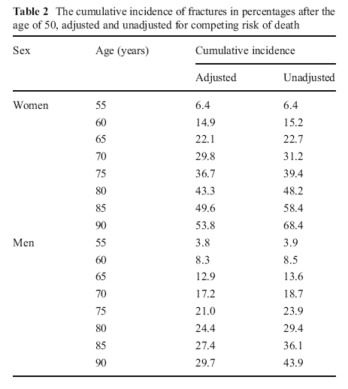
Example: Cumulative incidence of fracture in Iceland after age 50
Aalen-Johansen
Kaplan-Meier
Siggeirsdottir et al 2013
Notes:
This is an example of a paper that reported cumulative incidence calculated with the Aalen-Johansen estimator with death as a competing event and with the Kaplan-Meier method. The first column (that the authors call “adjusted”) shows the Aalen-Johansen approach, and it presents the cumulative incidence with death treated as a competing event. We don’t like this word “adjusting”; we would rather say “accounting for the competing event of death”. The last column provides the incidence based on the Kaplan-Meier method. The authors likely show the Kaplan-Meier estimate to illustrate the need to account for competing risk but it is not interpretable. We would not typically recommend including KM when the cumulative incidence calculated with the Aalen-Johansen method is provided. The follow-up period starts at age 50 and is then reported for intervals to age 55, to age 60, etc. This nicely illustrates the difference in the estimate using Aalen-Johansen versus KM when there are a substantial number of competing events. For example, at age 90 for women, the cumulative incidence estimates vary by almost 15 percentage points (53.8% versus 68.4%).

Slide 86
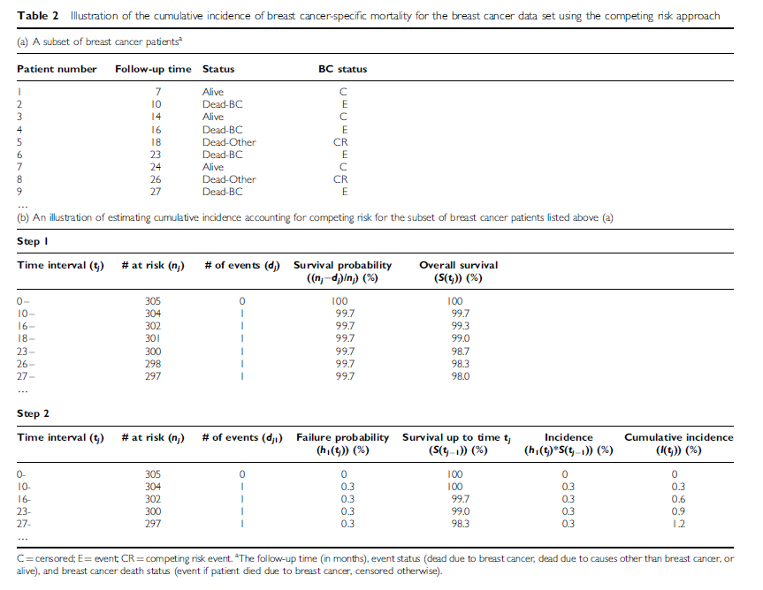
Cumulative incidence – Aalen-Johansen method
Satagopan et al 2004
Notes:
We are going to walk through an example of calculating cumulative incidence taking into account competing events, taken from the Satagopan et al. article in your reading for this week.

Slide 87
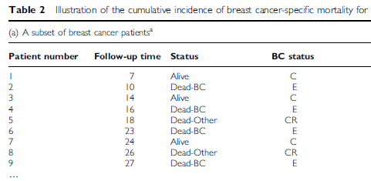
Final status of first 9 patients
Pt 1 alive at end of follow-up (C=censored);
Pt 2 had event of interest (BC death; E=event);
Pt 5 had competing event (Other death; CR = competing risk event)
Notes:
This provides the status at the end of follow-up for the first 9 participants, i.e. those with the shortest follow-up times. The first participant was followed for 7 months and was alive at that time. The subject is called a “C” for censored. The second participant was followed for 10 months until death from breast cancer. The subject is called E for event. Patient number 5 experienced a competing event – death due to a cause other than breast cancer – at 18 months. The notation is CR.

Slide 88
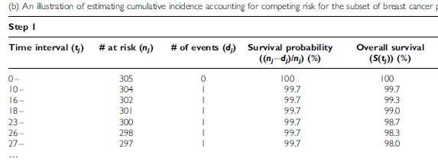
Survival without event or competing event
K-M way of thinking is used to calculate overall (cumulative) survival without event or competing event. Events column includes all deaths.
Notes:
The first step in the Aalen-Johansen method is to calculate the cumulative survival (overall survival) for each time interval that an event or competing event occurs. The KM method of thinking is used to calculate the cumulative survival.
For example, at time interval 10-, there was one event (BC death – Pt #2). The survival probability for that interval is 303/304 = 99.7%. At time interval 18- there is a competing event (Other death – Pt #5). For time interval 18- the overall (cumulative survival without developing any of the outcomes) is 1.00*0.997*0.997*0.997 = 99.0%

Slide 89
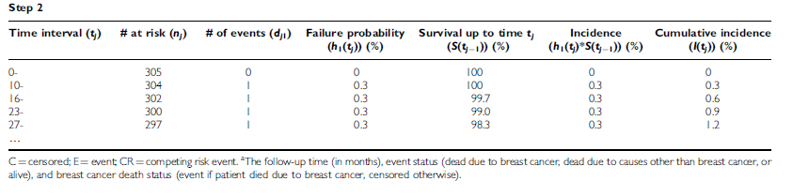
Cumulative incidence of primary event of interest
F
S
1. Failure (BC death) probability for “10-” is 1/304. Survival to 10 mos is taken from previous KM calculation (overall survival) = 100%.
Failure probability for “16-” is 1/302. Survival to 16 mos is 99.7%. Etc.
2. Incidence (of BC death) in interval: F * S
For “16-”, 0.003 * 0.997 = 0.3%
3. Cumulative incidence of BC death is sum of incidence in time intervals.
At “23-” cumulative incidence is 0+0.3+0.3+0.3 = 0.9%
Notes:
Failure probability is now calculated for each time interval when an event of interest (Breast cancer death) occurred. In our example, there were 4 BC deaths so failure probability is calculated for each of those intervals.
Probability of survival up to the beginning of each time interval is taken from the table on the previous slide (“Step 1”) where we calculated cumulative survival without an event or a competing event.
Now we can calculate the incidence of the event of interest in each time interval as the product of the failure probability for that interval and the probability of survival to that time interval (i.e. F * S). This is the joint probability of experiencing the event of interest in the interval given survival without the event or any competing event(s) through all previous intervals.
The cumulative incidence is just the sum of the incidence in each interval up to any given point in time.

Slide 90
Implementing Aalen-Johansen Estimator in Stata
Download user-written file “stcompet” from internet
  command: ssc install stcompet, replace
Within survival analysis dataset, instead of failure variable having only two values (0 = censor; 1=event), make sure there are additional values for each competing event type
  e.g., 0=censor; 1=event of interest; 2=competing event
stset data, with special attention towards telling Stata which is the event of interest (e.g., if “outcome” is failure variable)
  command: stset time, failure(outcome=1)
Declare the competing events & calculate cumulative incidence
  command: stcompet cif=ci, compet1(2)
Tease out event of interest-specific cumulative incidence
  command: gen cuminc1 = cif if outcome==1
Notes:
The Aalen-Johansen method of calculating cumulative incidence can also be implemented in Stata, but it is inexplicably not included in the base software. One has to add the function by downloading a free file that has been written by a Stata user. We won’t have time to go over this in detail now, but we provide all of the command syntax here.

Slide 91
Implementing Aalen-Johansen Estimator in Stata
List the cumulative incidence for event of interest
  command: sort time
  list time cuminc1 if outcome==1
Graph the cumulative incidence for event of interest
  command: twoway line cuminc1 _t, connect(J) sort
  ytitle(Cumulative incidence) xtitle(Time)
For details
  command: help stcompet
Notes:
We won’t have time to go over this in detail now, but these notes are provided for reference. You will get a chance to work through this in your homework this week.

Slide 92
How well are these techniques being practiced in the literature?
Review of articles published between 2007-2010
  In 6 “high impact” clinical journals (NEJM, JAMA, BMJ, Lancet, Ann Int Med, and PLoS Medicine)
  Containing populations likely to have competing events
  Choose 50 most recent articles
37 of 50 studies actually had competing events in the data
  24 of 37 (65%) used conventional K-M analysis to depict cumulative incidence (censoring upon the competing event)
  Only 2 of 37 used the Aalen-Johansen estimator
Koller et al. Statistics in Medicine 2012
Notes:
How well are these techniques being practiced in the literature?
Not very well. Almost 2/3’s censored competing events in K-M analyses, which we know is biased and which will produce an overestimate of the cumulative incidence. Only two studies correctly used the Aalen-Johansen estimator.
Incorrect practices are indeed the rule. They are so prevalent that it is very unlikely that a reviewer will spot them.

Slide 93
Competing Events in Incidence Estimation
Type of incidence estimate desired | Philosophy: Accommodate or eliminate competing event? | What estimator to use?
Cumulative incidence | Accommodate | Aalen-Johansen (not K-M)
Incidence rate/hazard | Accommodate | Usual rate calculation (in the face of competing events, it is called “cause-specific” rate/hazard
Notes:
Here is a summary of how to handle competing events when calculating incidence, depending upon our goal is cumulative incidence estimation or rate estimation. And, let’s assume our philosophical goal is to accommodate the competing event, in other words, recognize that it occurs and accept it. This is most often our philosophical goal. We don’t try to pretend that competing events don’t occur. To accommodate for them, we use the Aalen-Johansen estimator when we seek to estimate cumulative incidence. Note: this is a different technique than K-M estimation, where natively we are calculating cumulative survival and take the complement to get cumulative incidence.
When the goal is to estimate incidence rate, there is actually nothing special to do from what we have already learned. We just perform our usual rate calculation. In the face of competing events, these rates are sometimes given the special name of “cause-specific” rates or hazards.
Note: Last week we briefly discussed situations where we seek to eliminate competing events, although such situations are not the main focus of this class. The Grunkemeier et al. article in the Optional Reading section illustrates one such situation, in which the research question is: How long do heart valve replacements last? In this case, things like death in the human host are a real nuisance that we would seek to eliminate.

Slide 94
Incidence in Clinical Research/Epidemiology
Making the measurements
Recruitment
Sensitive and specific detection of event onset
Retaining subjects
Manipulating and summarizing the incidence data
Practical field work
Not covered in this course
Best learned by working with experienced colleagues
Notes:
This concludes our discussion of the measurement of incidence in clinical research/epidemiology. It is important to step back and remember that we have been discussing the manipulation and summarization of data pertaining to incidence. Yet, this is only half the story. The other half is actually making the measurements, i.e., collecting the data. This means recruitment, sensitive and specific detection of event onset, and retaining subjects. We note that we ARE NOT covering this in much detail in this course. This is the important discipline of practical field work. While enormously important, we don’t especially think it can be taught in a course. In part, this is because it is very study-specific. Instead of getting this knowledge in courses, we suggest that this is best learned by working with experienced colleagues.

Slide 95
Summary
Incidence rate (or density)
  E/NT
  Not a proportion; denominator has person-time
Average incidence rate can be calculated with individual-level or group-level average population data. Uses include:
  Incidence estimates in dynamic populations, especially those that are not fully enumerated
  Comparison with other populations, both fixed and dynamic
  Accumulation of time at risk for different exposure strata
Average incidence rate most meaningful when constant
Instantaneous incidence (hazard) rate
  Hazard function – insight into changes in rate over time
  Basis for proportional hazards regression
Just like K-M, all rates assume non-informative censoring
Competing Events
  Rates natively accommodate competing events
  For cumulative incidence: Use Aalen-Johansen estimator

Slide 96
Extra Slides

Slide 97
Direct and Indirect Standardization
Purpose is to make two or more populations comparable in terms distribution of one or more factors (typically confounding factors)
  We wish to “standardize” (i.e., make uniform) the distribution of 1 or more factors across populations
  Age standardization is a very common goal
Direct standardization applies age stratum-specific incidence rates of the study population(s) of interest to the age structure of a reference external population.
  Akin to weighting age-specific incidences in study populations by age distribution in external population
  Useful for comparing more than 2 populations.
Indirect standardization applies rate experience of reference population to age structure of study population.
Notes:
Standardization is typically for age but can also include gender, race and calendar time.
These two approaches to standardization of incidence rates are discussed more fully in the Szklo and Nieto text, pages 234-242.
In today’s lecture we briefly covered an example of direct standardization, comparing hip fracture rates across countries. More detail on those calculations is provided in the next slide. We also covered an example of indirect standardization, comparing mortality in petroleum refinery workers with the general population, accounting for race, sex, age, and calendar period.

Slide 98
Direct Age Standardization
External “standard” population
55062/total US popn
Notes:
This illustrates how direct standardization calculations were made for previous example comparing hip fracture rates across countries.
Direct standardization will give an overall age-standardized (“age-adjusted”) rate for each population. We apply the age stratum-specific rates from the 5-year age groups in Beijing, Budapest, etc. to the age distribution of an external population, in this case the 1990 non-Hispanic white population in the US census. This gives the number of “expected” hip fractures if the Beijing rates had occurred in a population with age distribution like the US. The number of “expected” hip fractures is totaled and divided by the US population to give the age-adjusted incidence rate. This is done for each population. For Beijing, the expected number of hip fractures (in women) in one year was 55,062. Divide by the total population of the U.S. (138,908,682) to get the age-adjusted rate of 39.6 per 100,000 person-years. Follow the same procedures to calculate the age-adjusted rate for women in Budapest. Then, these age-adjusted rates can be compared as a rate ratio. A rate ratio of 1.0 would mean there was no difference in the hip fracture rates in two areas, once age differences are adjusted. In this example, the age-adjusted rates for Beijing and Budapest appear different and a rate ratio comparing these two age-adjusted incidence rates (Budapest/Beijing rates) would be > 1.00.
The actual value of the age-adjusted rate depends on the age structure reference population. The rate is not meaningful in isolation but is intended to allow comparisons across populations with different age structures.
The unadjusted rates that we calculated on the previous slide are also shown here. For Beijing the unadjusted rate is lower than the age-adjusted rate. This is because the underlying age structure of the Beijing population is younger than the US population that was used as the “standard” population. For Budapest, the unadjusted rate is higher than the age-adjusted rate; this is because the age structure of Budapest is older than the US population.

Slide 99
High and low constant incidence rates and cumulative incidence
The relationship between constant incidence rate and cumulative incidence is exponential
When rates are low, the exponential formula converges to simple multiplication: cumulative incidence ~ rate x follow-up time.
However, when rates are higher, as illustrated in the 3rd row in the next slide, this falls apart.

Slide 100
Effect of high and low constant incidence rates on cumulative incidence
 | Cumulative Incidence at:
Inc. Rate (per pers-yr) | 1 year | 2 years | 5 years | 20 years
0.01 | 0.0100 | 0.0198 | 0.0488 | 0.1813
0.25 | 0.2212 | 0.3935 | 0.7135 | 0.9933
Notes:
Applying the formula from the earlier slide, gives these values for cumulative incidence for a low and a high constant incidence rate over 4 time periods. Note that at one-year neither cumulative incidence differs that much from the rate (when the rate is expressed per 100 person-years), but that the high rate rapidly gives a quite different cumulative incidence while the low rate takes longer to diverge.
The reason for the mismatch in the high rate situation is that as the high rate is being applied to the fixed population, it is being depleted of people. As there are fewer and fewer at risk persons, applying the same high rate of event does not result in the same percentage of the original population having experienced the event. Hence, the issue is that the number of persons at risk is shrinking and becoming much different than the number of people in the original fixed cohort.

Slide 101
Competing Events
Definition: In a study of incidence of some event of interest, a “competing event” (aka “competing risk”,“competing risk event”):
  precludes the occurrence of the event of interest (e.g., death precludes all outcomes)
  or
  substantially impacts incidence of event of interest (e.g., prophylactic ovary removal in study of ovarian cancer)
“Competing” because it occurs prior to event of interest
Two flavors:
  Independent: Occurs independent of event of interest (e.g., accidental deaths in study of brain cancer incidence)
  Non-independent: Related to event of interest (i.e., occurrence influenced by factors which influence event of interest; e.g., death from COPD in study of lung cancer incidence)
Notes:
Let’s now talk about competing risks some more in the estimation of cumulative incidence. Recall that we said last week that we would return to this. This slide simply reviews the definition of competing risks, also known as competing events.
As you recall, in a study of incidence of some primary event of interest, a competing risk event is one which either precludes the occurrence of the event of interest (and the best example of this is death, which precludes all outcomes) or one which substantially impacts incidence of the event of interest. An example of this would be prophylactic ovary removal in the study of ovarian cancer. (Incidence is greatly diminished although does not go to zero).
We call these events “competing” because they occur prior to the event of interest that we are studying. They are competing with the occurrence of our events of interest.
Competing events come in two flavors. One is a competing event that occurs independent of the event of interest. When studying brain cancer incidence, accidental deaths (say from drowning) would be considered by most persons as occurring independently of the occurrence of brain cancer. The other type of competing event is actually related to the event of interest. In other words, its occurrence is influenced by factors which influence rate of event of interest. An example would be death from obstructive lung disease in a study where primary event of interest is lung cancer incidence.

