Slide 1
Fertility

Slide 2
Show population pyramids

Slide 3
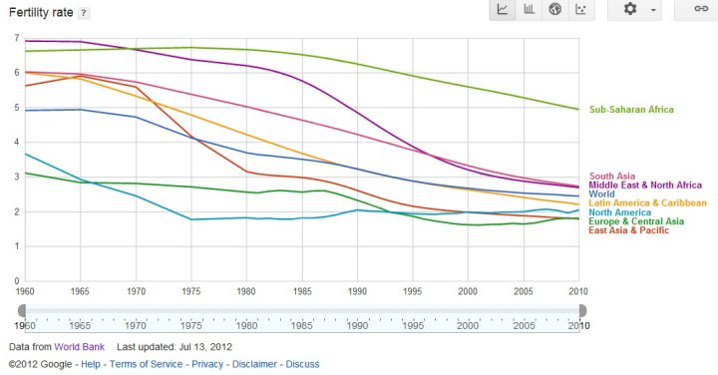
Fertility Decline: Global Differences

Slide 4
Theories of fertility decline
Why has fertility declined?
Modernization theory
  Less developed countries will eventually look like developed countries
    Assumes that today’s developed countries looked like today’s developing countries in the past
  Based in assumptions about economic development
    Family change:
      Move from extended to nuclear households
        What was it like in the past?
      Change from high to low fertility
        What was Europe like in the past?

Slide 5
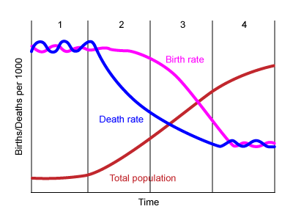
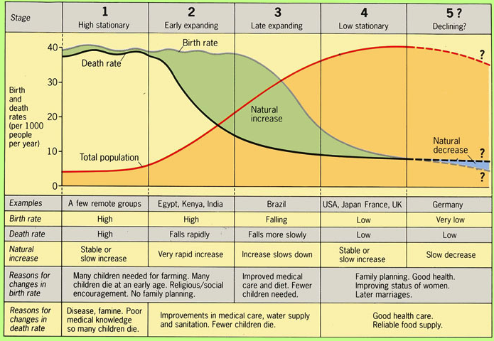
Demographic Transition Theory

Slide 6
Demographic Transition Theory and Ideational Theory
European Fertility Project: Collected data on fertility by province in Europe back as far as possible
Tried to test Demographic Transition Theory
  Looked at economic development and fertility
Found little evidence of Demographic Transition Theory
  Instead evidence of cultural, mostly linguistic, lines
Led to idea of Ideational theory
  All people want to have smaller families, once knowledge about how to do so is out, it spreads quickly
  Scientific rational for family planning programs

Slide 7
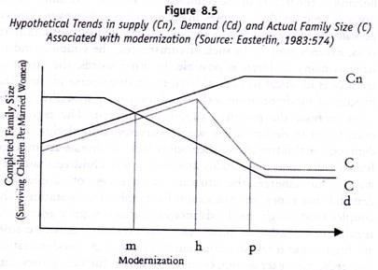
Other theories of fertility decline
Supply/Demand (Becker)
  Demand: (for children) ideal family size
  Supply: (of children) ability to control fertility

Slide 8
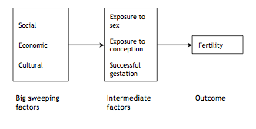
What makes fertility change?

Slide 9
Proximate determinants of Fertility (Bongaarts)
Proportion of married women/in a sexual union among all women of reproductive age
Contraceptive use and effectiveness
Duration of postpartum infecundability (or postpartum insusceptibility)
Induced abortion
Fecundability (including frequency and timing of intercourse)
Prevalence of permanent sterility
Spontaneous intrauterine mortality

Slide 10
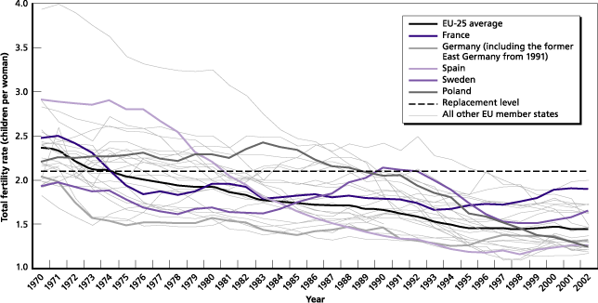
Lowest low fertility
Replacement level fertility: ~2.1
  Many countries in Europe and East Asia have fertility below replacement level

Slide 11
Why has fertility fallen so low?
Becker continued (rising cost of children)
Risk aversion
  High divorce, employment instability
Materialistic values
Changes in gender equity
  Women entering the workplace,
  Division of labor in the home

Slide 12
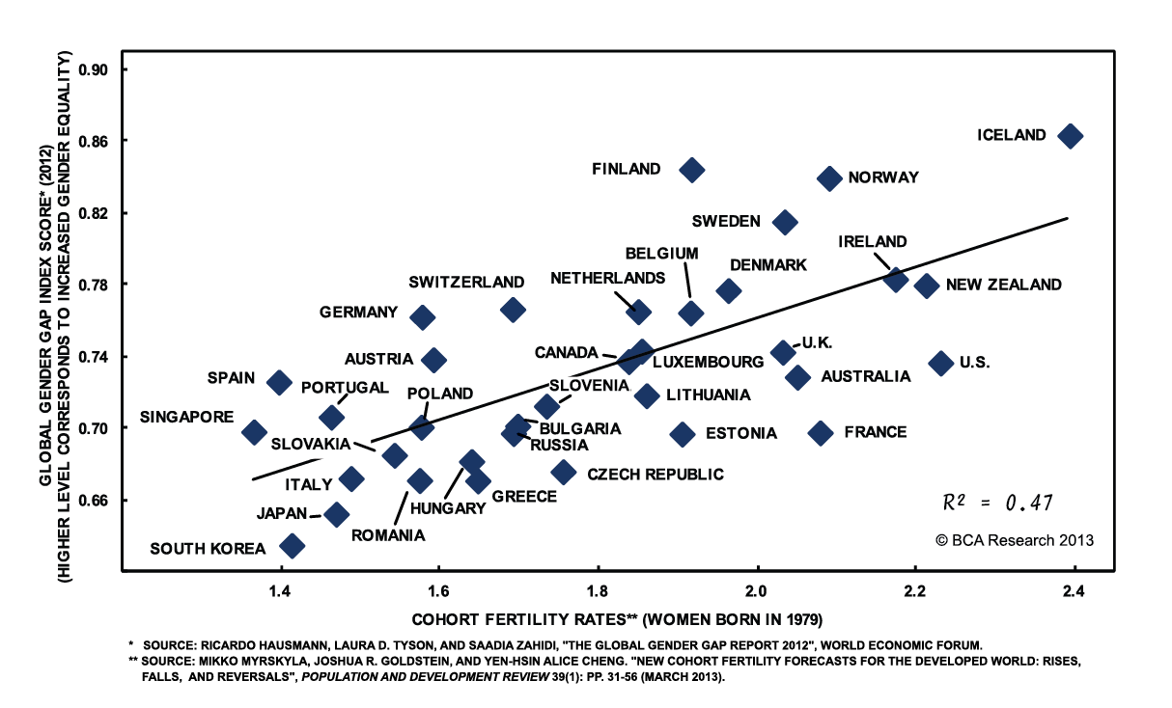
Fertility and gender inequality

Slide 13
Is low fertility a problem?
Three issues
  Negative growth
    Is negative population growth associated with negative economic growth
  Aging population
  Countries with strong sex preferences

Slide 14
Aging population
Burden on taxpayers
  If you have a strong welfare state
Burden on children to care for elderly
  Especially with low fertility, there are fewer kids to care for each aging parent
Recent data suggests that supporting the elderly is not as big of a deal as people worry it is

Slide 15
Solution to aging: Migration?
Migrants have higher fertility…at first…
Can help take pressures off other countries with higher fertility and not enough jobs
Problem with assimilation, acceptance
  An increasingly controversial issue
Plus, there are some places that people don’t want to move to (Russia?)

Slide 16
Sex Ratio
Most of the world (including China), over 1 or over 100 favors boys
India: under 1000 favors boys

Slide 17
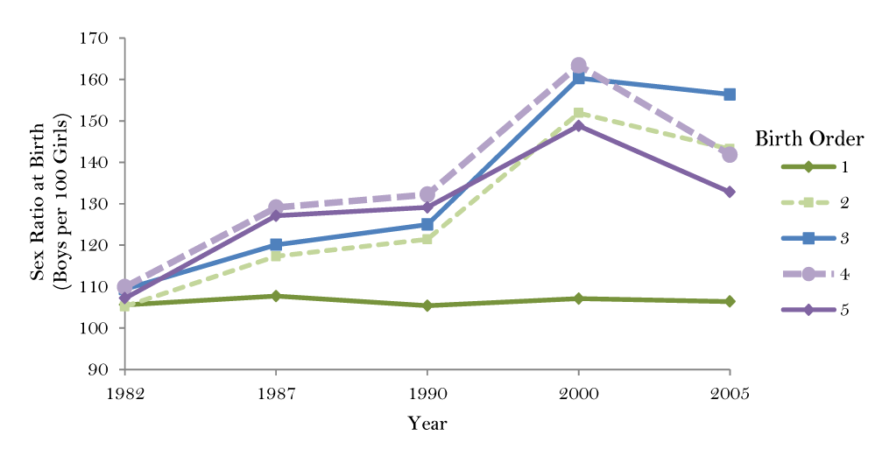
Sex ratios
Falling fertility in India and China especially associated with increasingly imbalanced child sex ratios
  Son preference +
  Falling fertility +
  Ultrasound and
  abortion

Slide 18
Three measures of Fertility:
Crude birth rate:
  Number of births during t/mid-year population in t
General fertility rate:
  Number of births during t/mid-year population of women aged 15–49

Slide 19
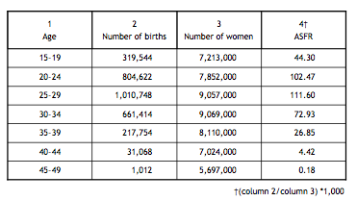
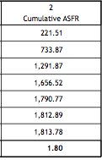
Age-specific fertility rate: A synthetic Measure
Number of births to women aged x during t/mid-year population of women aged x

Slide 20
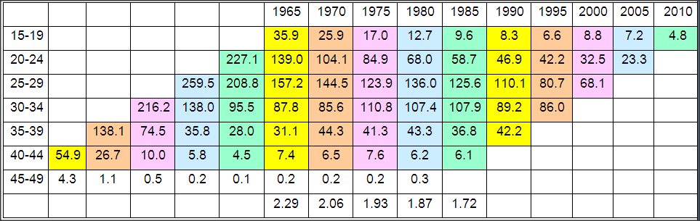
ASFR
The number of children a woman would have if she experienced the ASFR of a certain year for her whole life time
No woman actually actually experiences the ASFR of a certain year

Slide 21
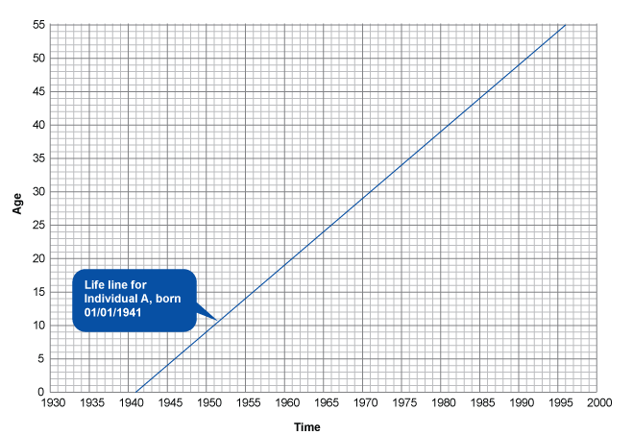
Lexis Diagrams: An individual

Slide 22
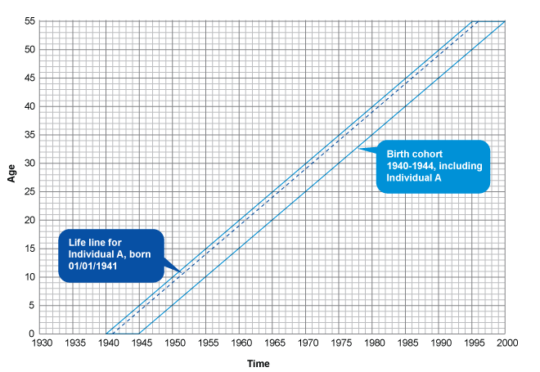
Cohort

Slide 23
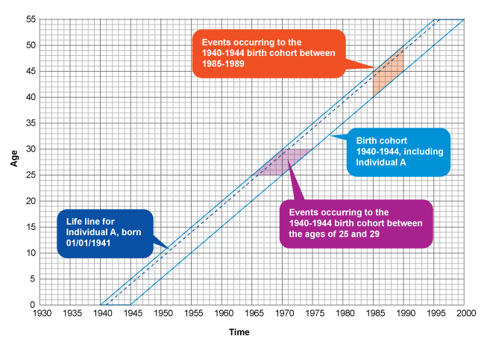
Cohort experiences

Slide 24
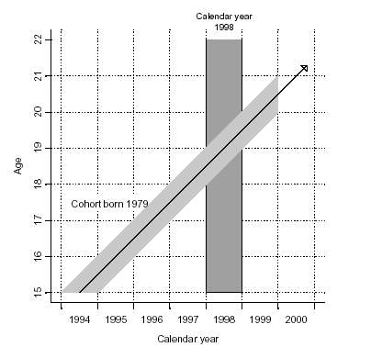
Lexis Diagram: Period vs Cohort

Slide 25
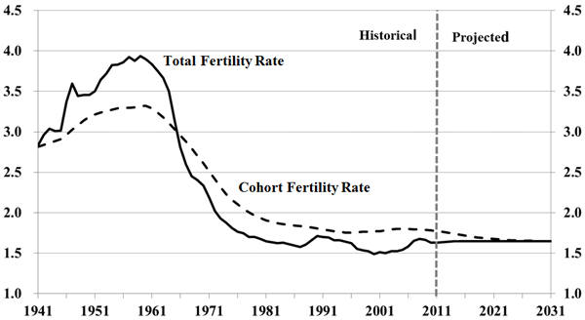
Cohort vs. Period fertility: Canada

Slide 26
Cohort vs. Period fertility: Why?
What might make this difference?
Hint: mean age at childbirth

Slide 27
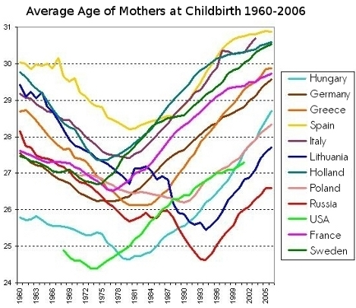
Average age of mothers over time

Slide 28
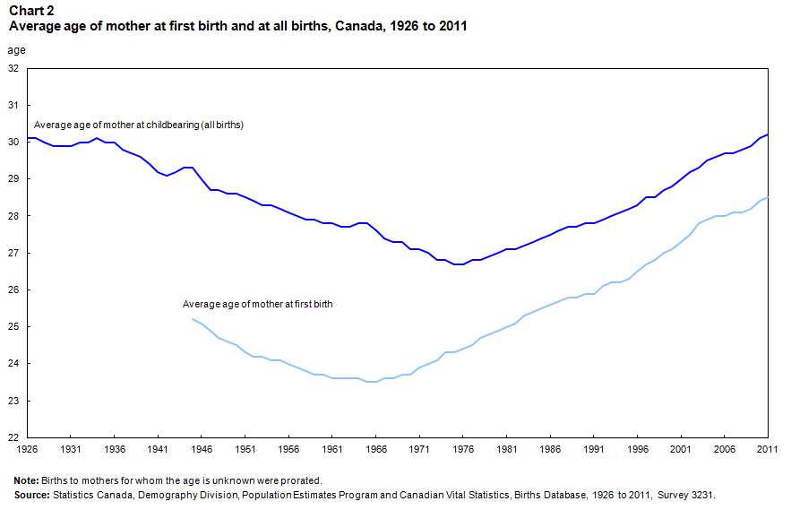
Mean age at childbirth: need to look at parity

Slide 29
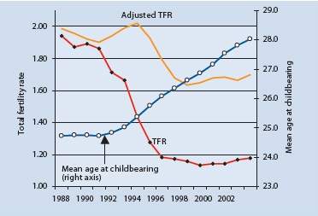
Tempo effect: Czech Republic

Slide 30
Parity Progression Ratios
Cohort measures, free of tempo effects
Proportion of women with n children who go on to have n+1 children

Slide 31
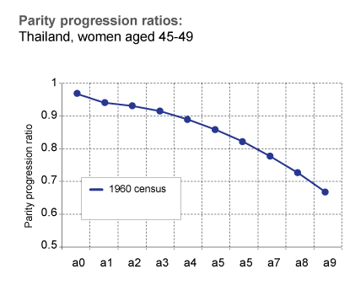
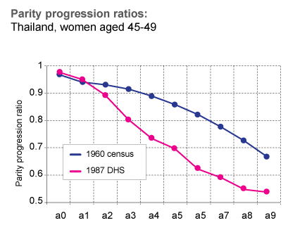
Parity Progression ratios
a0 = proportion of women with 0 children who go on to have 1
a1 = proportion of women with 1 child who go on to have 2
a2 = proportion of women with 2 children who go on to have 3
Etc….
UNFPA)

Slide 32
Period vs Cohort
Period
  Easy to collect
  Use up to date info
  Rapid changes
  CONs
    Does not reflect real life life experiences of individuals
    Tempo effects
Cohort
  Tells us about real lived experiences
  CONS
    Takes decades to collect

Slide 33
Fertility differentials

Slide 34
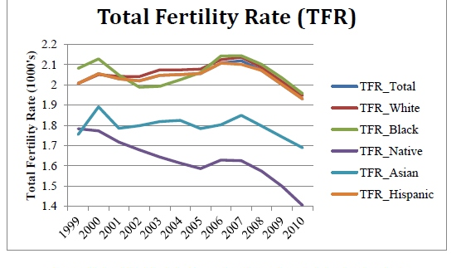
Fertility Decline: Ethnic Groups: US

Slide 35
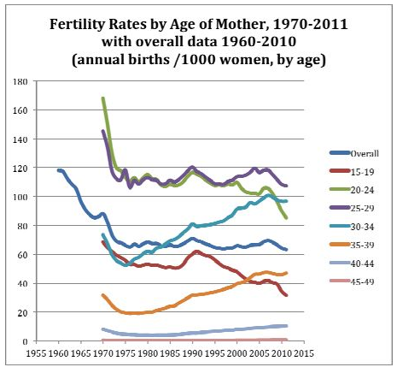
Fertility Decline: Age Groups

Slide 36
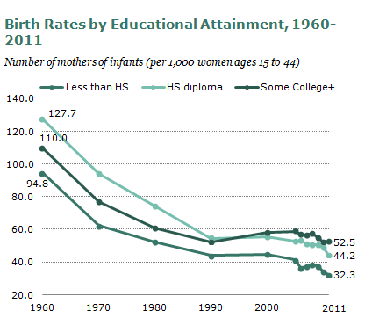
Fertility Decline: Education (US)

Slide 37
Fertility and Policy

Slide 38
Policies to decrease fertility
Family planning programs
1 child policy: china
Forced sterilizations: India, Columbia
Women’s education
Women’s labor force opportunities
Laws about age at marriage
Women’s empowerment

Slide 39
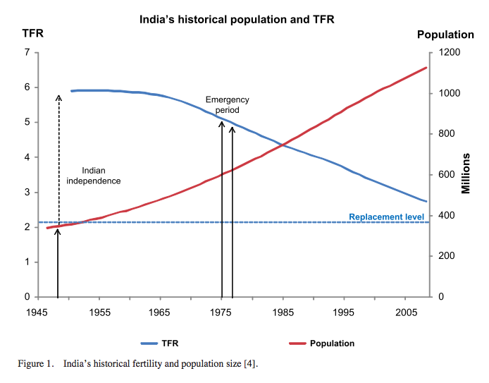
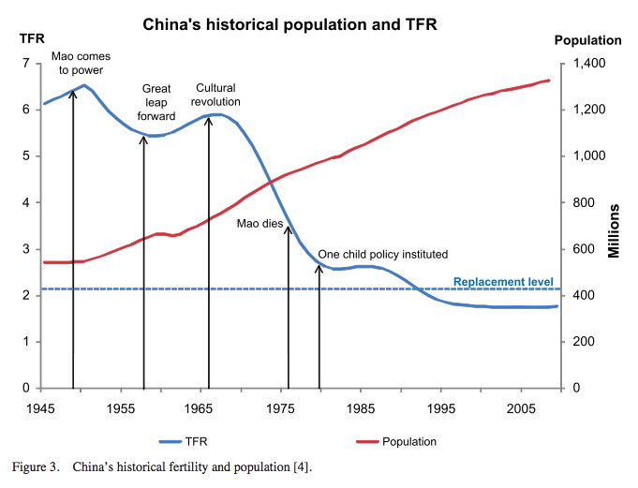
Population policies and fertility in India and China

Slide 40
Policies to increase fertility
Financial incentives
  Lump sums, periodic
  Tax rebates, credits, etc.
  Free/subsidized goods for children
Work/family incentives
  Maternity and paternity leave
  Flexible hours
  Childcare
  Anti discrimination laws
Social change to be more supportive of children and parents
  Gender equity in household, marriages
  Child friendly environments

Slide 41
Evidence on policies to increase fertility
Systematic Review (Gauthier, 2007) found
  Little conclusive evidence, some policies had positive effect, many none
  Evidence that when they did work, they mostly seemed to affect timing rather than overall completed fertility

Slide 42
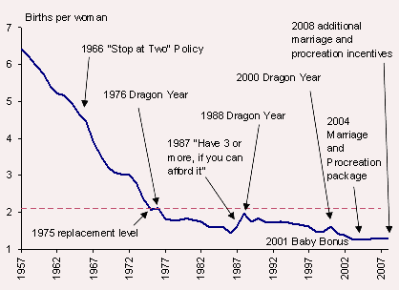
How culture and policy shape fertility: Singapore

Slide 43
Thank you!
Questions?
Notes:
Final boiler plate language: 2 versions
Through its singular focus on health, UCSF is leading revolutions in health.
UCSF is driven by the idea that great breakthroughs are achieved when the best research, the best education and the best patient care converge.

