Slide 1
Lecture 4

Slide 2
Today
Review of binomial and normal distribution
Sampling
Central limit theorem
Confidence intervals for means
Normal approximation to the binomial distribution
Confidence intervals for proportions

Slide 3
Recap of binomial distribution
The binomial distribution describes the probability of x successes in n independent trials, each with probability p of success
The distribution will be symmetric when p=0.5, skewed right when p<0.5, and skewed left if p>0.5
The possible number of “successes” will be 0 to n, because there are n “trials”
Often “successes” are number of people with a disease, “number of trials” is the number of people in the sample

Slide 5
Binomial distribution
P(X=x)
X represents the random variable X that follows a binomial distribution
x represents what you actually get (number of successes) when you draw your sample
In statistics, the mean of a theoretical probability distribution is also called the “Expected value”.
The expected value or mean of the binomial distribution is n*p
For the binomial distribution, if you know the underlying p in the population, then you know that if you take your sample over and over, then the mean number of successes will be n*p

Slide 6
Example 1
P(X=x) = P(exactly x successes occurring)
e.g. n=20, p=.05, x=2 P(X=2)?
** using comb(n,x)*p^x*(1-p)^(n-x)
di comb(20,2)*.05^2*.95^18
.1886768
** using binomialp(n,k,p) (order matters!!!)
di binomialp(20,2,.05)
.1886768
*** NOTE: ****************************************
** binomial(n,k,p) will give you something different!!! **

Slide 7
Example 2
P(X≥x) = P(of x or more successes occurring)
e.g. n=20, p=.05, x=2
P(X≥ 2) =1 - ( P(X=0) + P(X=1) )
** using binomialp(n,k,p)
di 1 - binomialp(20,0,.05) - binomialp(20,1,.05) .26416048
*** using binomialtail(n,k,p)
di binomialtail(20,2,.05)
.26416048

Slide 8
Example 3
P(X>x) = P(More than x successes occurring)
e.g. n=20, p=.05, x=2
P(X>2) = P(X ≥ 3) = 1 - ( P(X=0) + P(X=1) + P(X=2) )
** using binomialp(n,k,p)
di 1- binomialp(20,0,.05) - binomialp(20,1,.05) - binomialp(20,2,.05)
.07548367
*** di binomialtail(n,k+1,p)
di binomialtail(20,3,.05)
.07548367
Whether you are looking at P(X≥x) vs P(X>x) matters for discrete distributions!!!

Slide 9
Recap from the normal distribution
We do not calculate P(X=x) or P(Z=z)
  Probability of individual values are 0
We do calculate P(X>x) or P(X<x) or the probability of a range of values (e.g. -1.96, 1.96)
It does not make a difference if we use the notation P(X>x) or P(X≥x) because we just said P(X=x)=0

Slide 10
Normal distribution
Z~N(0,1) is a normal distribution with mean 0 and standard deviation 1
P(Z > a big z) is small, e.g. P(Z>3)
di 1-normal(3)
.0013499
P(Z < a big z) is close to 1
di normal(3)
.9986501
But if z is negative, it is the converse
P(Z>-3)
di 1-normal(-3)
.9986501
P(Z<-3)
di normal(-3)
.0013499

Slide 11
Normal distribution
Remember:
Using di normal() in Stata
for P(Z>z) use di 1-normal(z)
for P(Z<z) use di normal(z)

Slide 12
Recap from the normal distribution
The normal distribution may be used to describe cutoffs for some continuous random variables with mean µ and standard deviation σ
  We calculate z statistics (x- µ)/σ just so we can use standard probability values
How do you know if your data are normally distributed?
    Histograms (stata: hist varname, normal)
    QQ plots – next Biostat class
    Other statistical tests
What to do if your data are not normal?
    Transformations – like taking the log, or the inverse 1/x …

Slide 13
A bit more about theoretical means and variances
The mean of a random variable X is the long run average of the X’s and another name is the “Expected value of X”.
The variance of a random variable describes the long run spread of the possible values around the mean.
Both are calculated based on the theoretical distribution function P(X=x) or f(x).

Slide 14
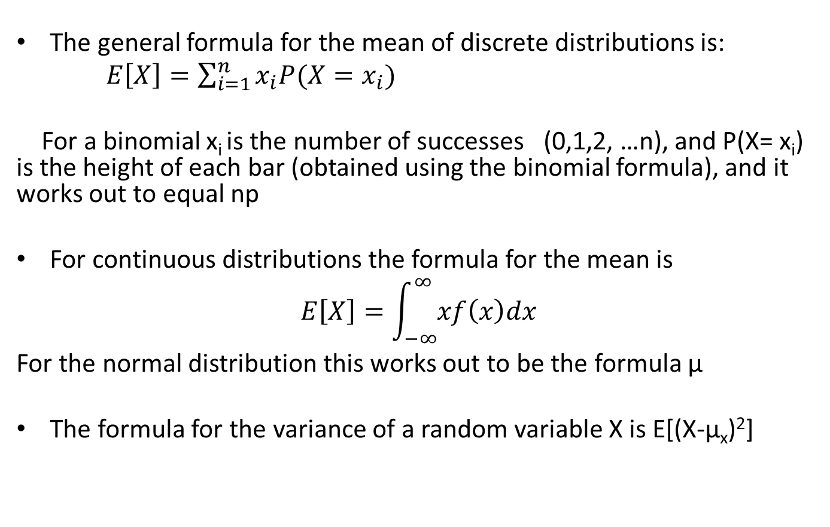
The formulae (just fyi)
The general formula for the mean of discrete distributions is:
$E\left[X\right]=\sum_{i=1}^{n}{x_{i}P(X=x_{i})}$
For a binomial x_{i} is the number of successes (0,1,2, …n), and P(X= x_{i}) is the height of each bar (obtained using the binomial formula), and it works out to equal np
For continuous distributions the formula for the mean is
$$E\left[X\right]=\int_{−∞}^{∞}{xf\left(x\right)dx}$$
For the normal distribution this works out to be the formula μ
The formula for the variance of a random variable X is E[(X-μ_{x})²]

Slide 15
Sample means and variances
The formulae presented in lecture 1 are used for calculating sample means and variances, using your sample data.
They are estimates of the mean and variance of the underlying population distribution from which the sample was chosen.

Slide 16
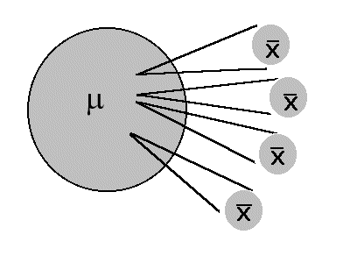
Sampling
When we cannot measure the entire population we take a sample
We estimate the population characteristics, i.e. the mean and variance of our data, using the sample mean and variance (formulae in Lecture 1)
We use statistical inference to draw conclusions about the how the estimates from the sample relate to the population values
Timothy Shortell http://www.shortell.org/book/chap10.html

Slide 17
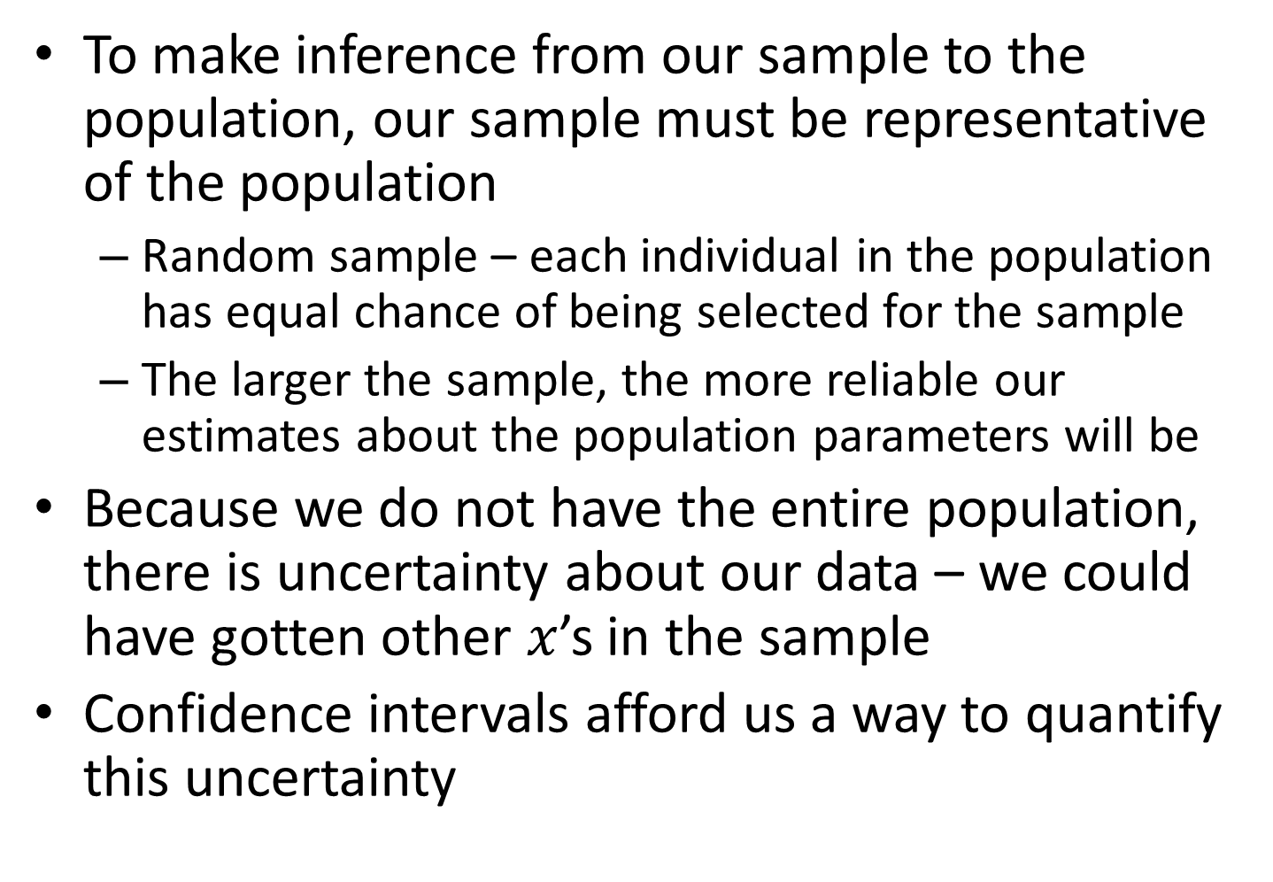
To make inference from our sample to the population, our sample must be representative of the population
  Random sample – each individual in the population has equal chance of being selected for the sample
  The larger the sample, the more reliable our estimates about the population parameters will be
Because we do not have the entire population, there is uncertainty about our data – we could have gotten other $x$’s in the sample
Confidence intervals afford us a way to quantify this uncertainty

Slide 18
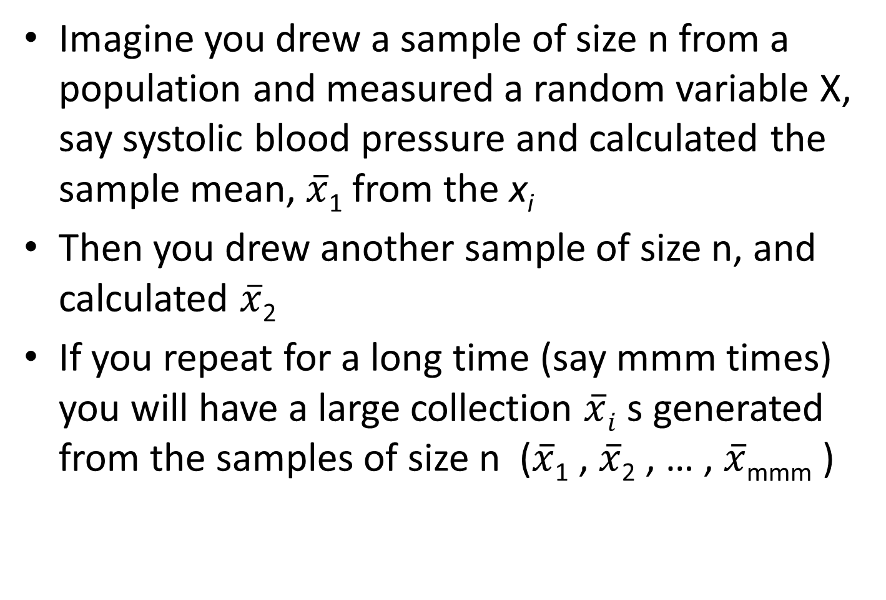
Sampling distributions

Slide 19
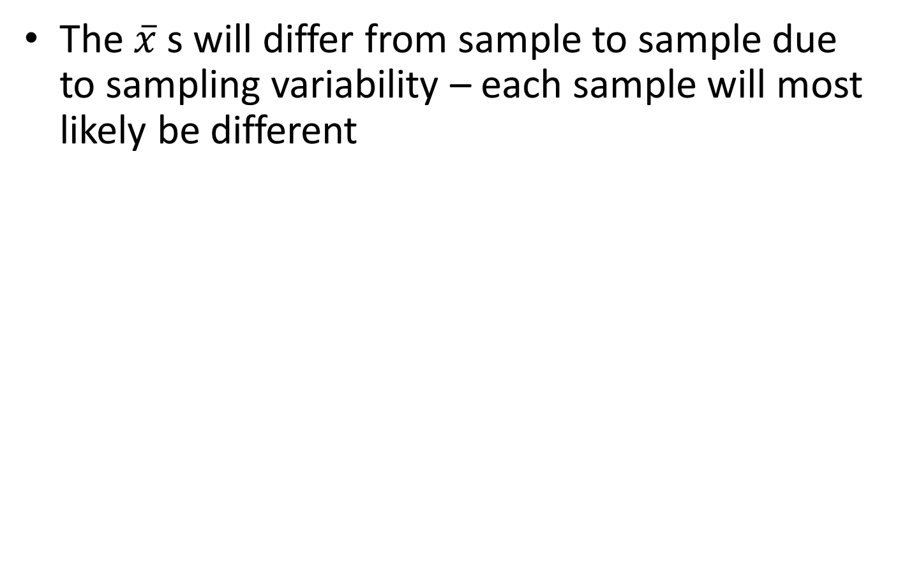
Timothy Shortell http://www.shortell.org/book/chap10.html

Slide 20
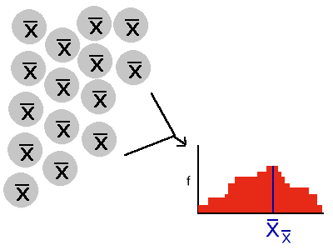

You could treat all the $\overline{x }$s as a sample and calculate their mean and sample variance, and you could make a histogram to look at their distribution
Timothy Shortell http://www.shortell.org/book/chap10.html

Slide 21

The collection of all the $\overline{x}$ s that can be obtained can be thought of as a random variable$\overline{X }$that follows some distribution
The distribution of all the possible $\overline{x}$ s is called the sampling distribution
Timothy Shortell http://www.shortell.org/book/chap10.html

Slide 22

The larger the sample size within each sample is, the more the distribution of the $\overline{x}$s will look like the normal distribution. Regardless of the underlying distribution of X.
Timothy Shortell http://www.shortell.org/book/chap10.html

Slide 23
Central limit theorem
If you have a random variable that comes from a distribution with mean=µ and standard deviation=σ, the following is true for the sampling distribution (i.e. the distribution of all possible sample means) from samples of size n
  If n is large enough, the shape of the sampling distribution will be approximately normal
  The mean of the sampling distribution is µ
  The standard deviation of the sampling distribution is σ/√n

Slide 24
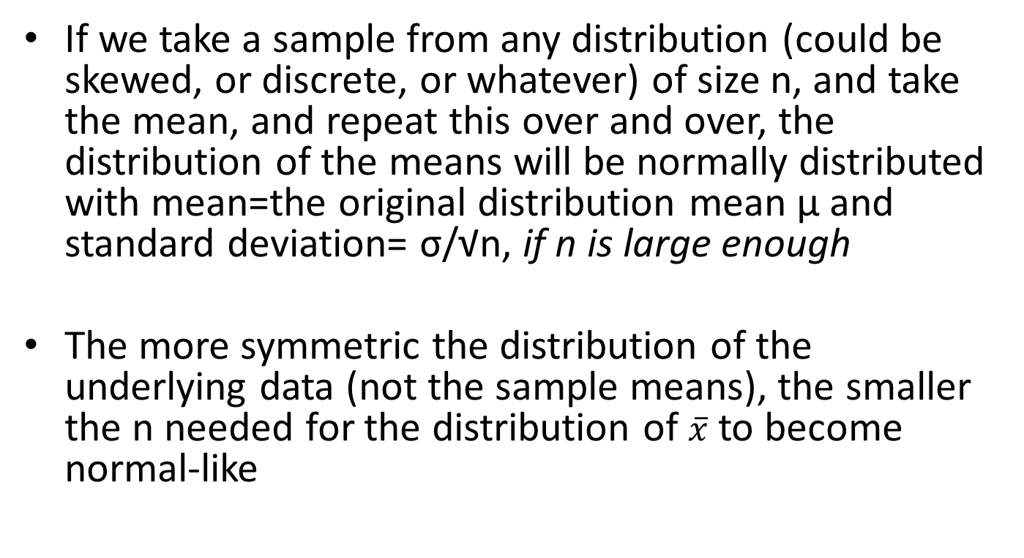
Central limit theorem

Slide 25
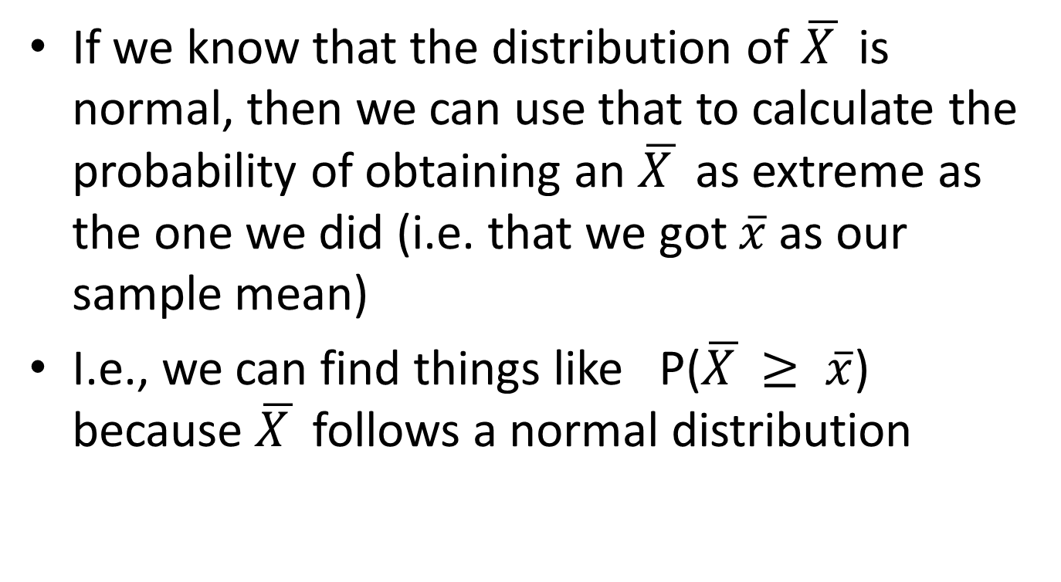
Why do we care?
If we know that the distribution of $\overline{X }$ is normal, then we can use that to calculate the probability of obtaining an $\overline{X }$ as extreme as the one we did (i.e. that we got $\overline{x}$as our sample mean)
I.e., we can find things like P($\overline{X }≥ \overline{x}$) because $\overline{X }$ follows a normal distribution

Slide 26
Does this make sense?
  It makes sense that the distribution of means would cluster around the population mean
  It makes sense that the variability in the means is smaller than in the raw data because the extreme values are already averaged out (remember σ/√n)
  The part about the distribution being normal if n is large enough? Mathematical proof … But we can demonstrate it for several examples

Slide 27
Note
σ is the standard deviation of the original distribution
σ/√n is called the standard error, or more precisely, the standard error of the mean, and it is the standard deviation of the distribution of the sample mean.

Slide 28
Central limit theorem examples
In Stata, type
findit clt
Pick
clt from http://www.ats.ucla.edu/stat/stata/ado/teach
Click on “click here to install”
Then in Stata type
clt

Slide 29
Distributions of the means of uniformly distributed random variables

Slide 30
Distributions of the means of chi-square distributed random variables

Slide 31
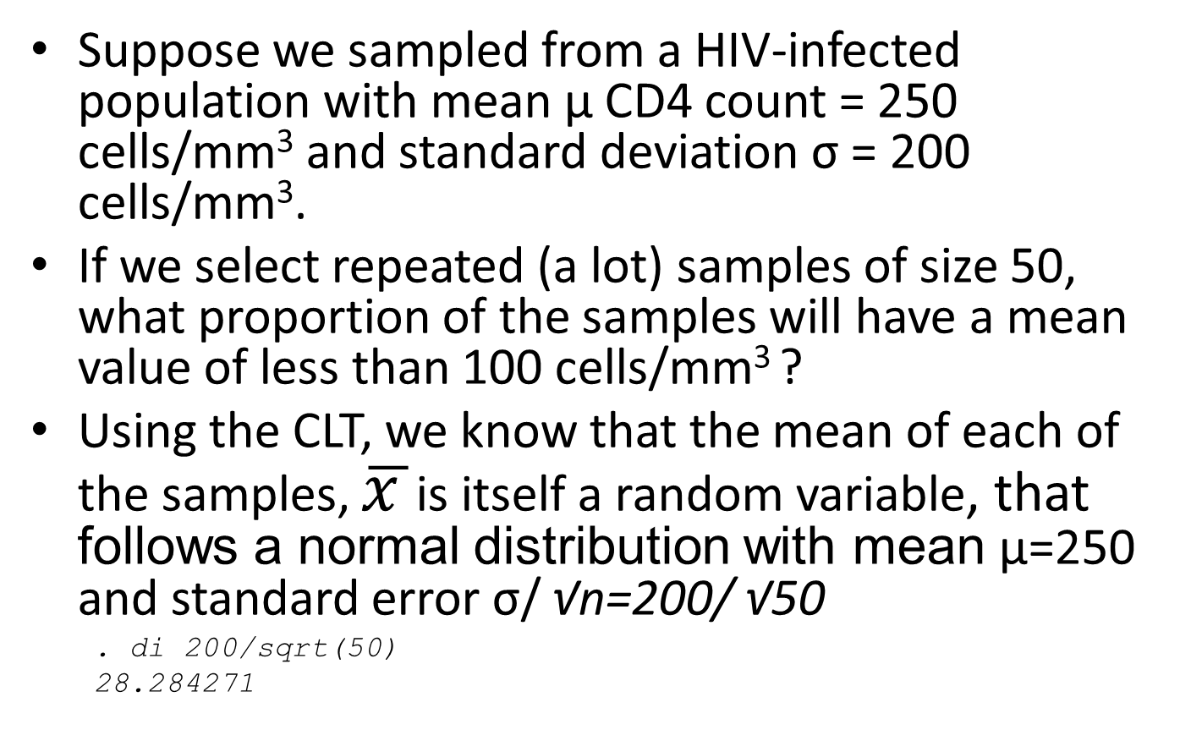
Using the CLT

Slide 32
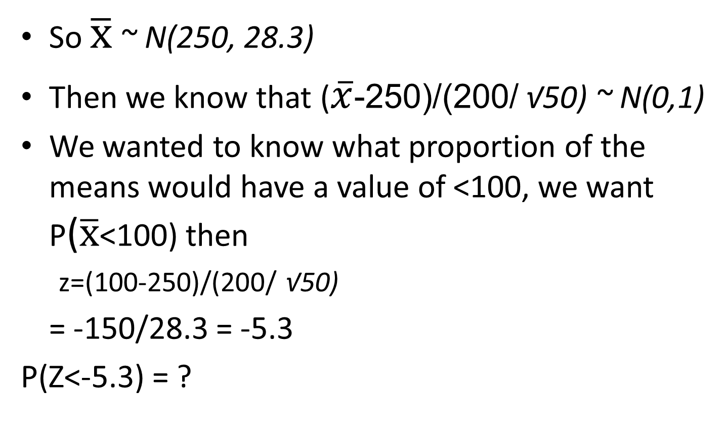
Using the CLT
Notes:
200/sqrt(50) = 28.3

Slide 33
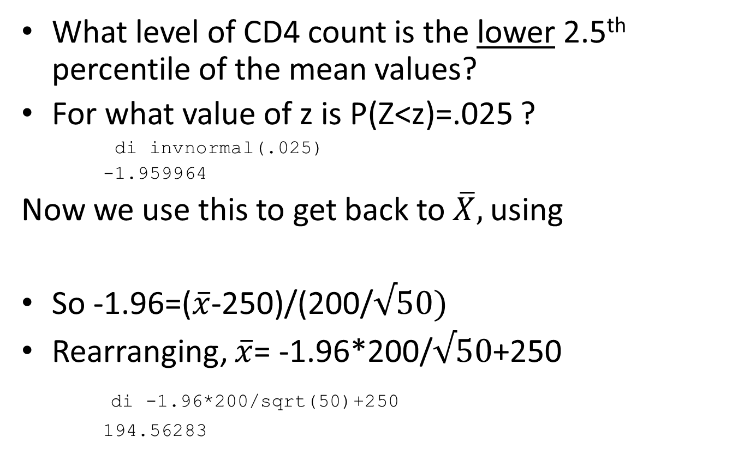
Using the CLT
What level of CD4 count is the lower 2.5th percentile of the mean values?
For what value of z is P(Z<z)=.025 ?
di invnormal(.025)
-1.959964
Now we use this to get back to $\overline{X},$using
So -1.96=($\overline{x}$-250)/(200/$√50)$
Rearranging, $\overline{x}$= -1.96*200/$√50$+250
di -1.96*200/sqrt(50)+250
194.56283

Slide 34
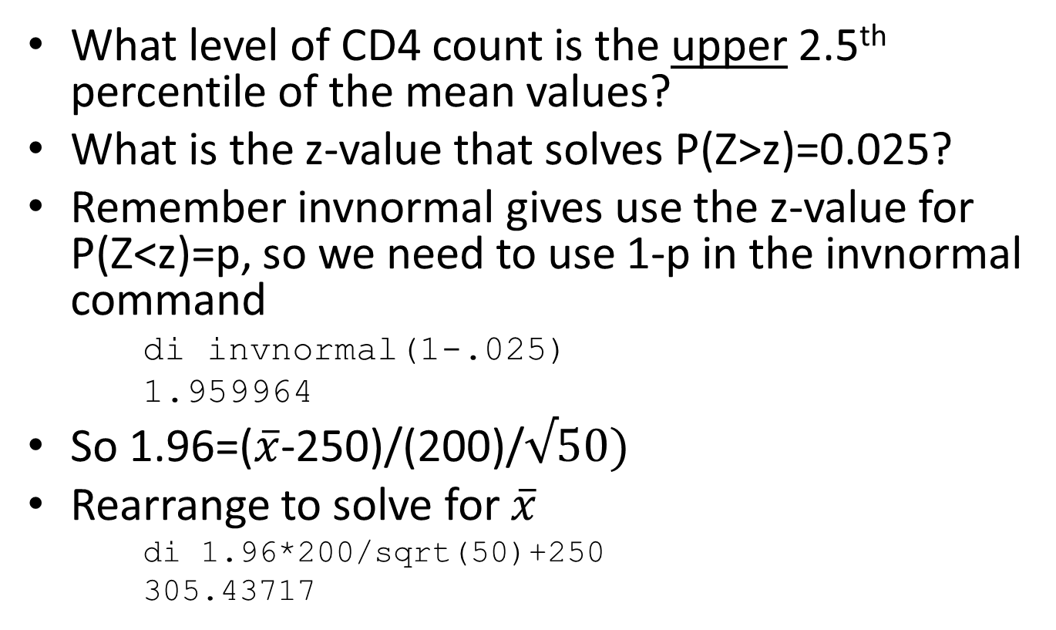
Using the CLT
What level of CD4 count is the upper 2.5th percentile of the mean values?
What is the z-value that solves P(Z>z)=0.025?
Remember invnormal gives use the z-value for P(Z<z)=p, so we need to use 1-p in the invnormal command
di invnormal(1-.025)
1.959964
So 1.96=($\overline{x}$-250)/(200)/$√50)$
Rearrange to solve for $\overline{x}$
di 1.96*200/sqrt(50)+250
305.43717

Slide 35
Now we have the lower and upper 2.5% percentiles of the distribution of the sample means.
The interior area contains 95% of the sample means.
95% of the means from samples of size 50 that come from the underlying distribution ~N(250,200) will lie within this interval (194.6, 305.4)

Slide 36
If we selected just one sample of size 50 (what you usually do in reality) and the sample mean was outside these limits (e.g. 315), we might suspect it came from an underlying population with a different population mean and standard deviation (250, 200), or that a rare (<5% probability) event had occurred.
  Because we had said that 95% of the time the sample mean will be in the range of 195-305
  We could say this because the central limit theorem told us that the distribution of the sample means is approximately a normal distribution with mean 250 and standard deviation 200/ √50

Slide 37
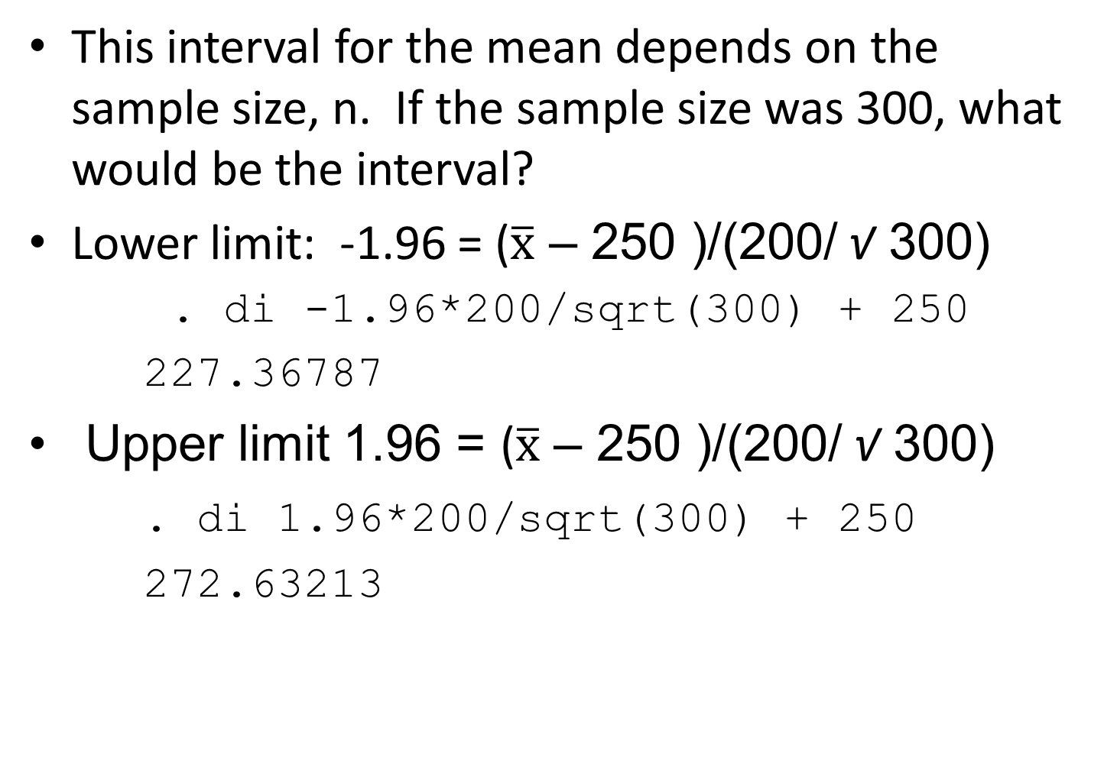

Slide 38
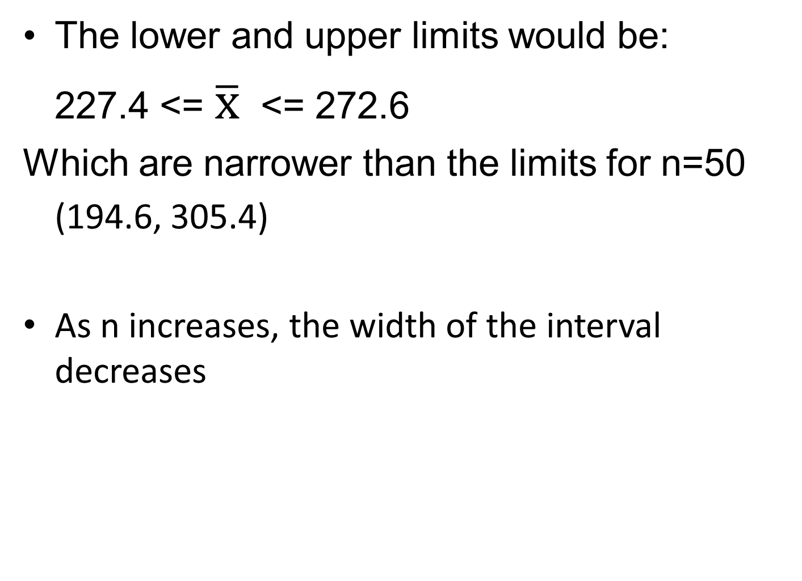

Slide 39
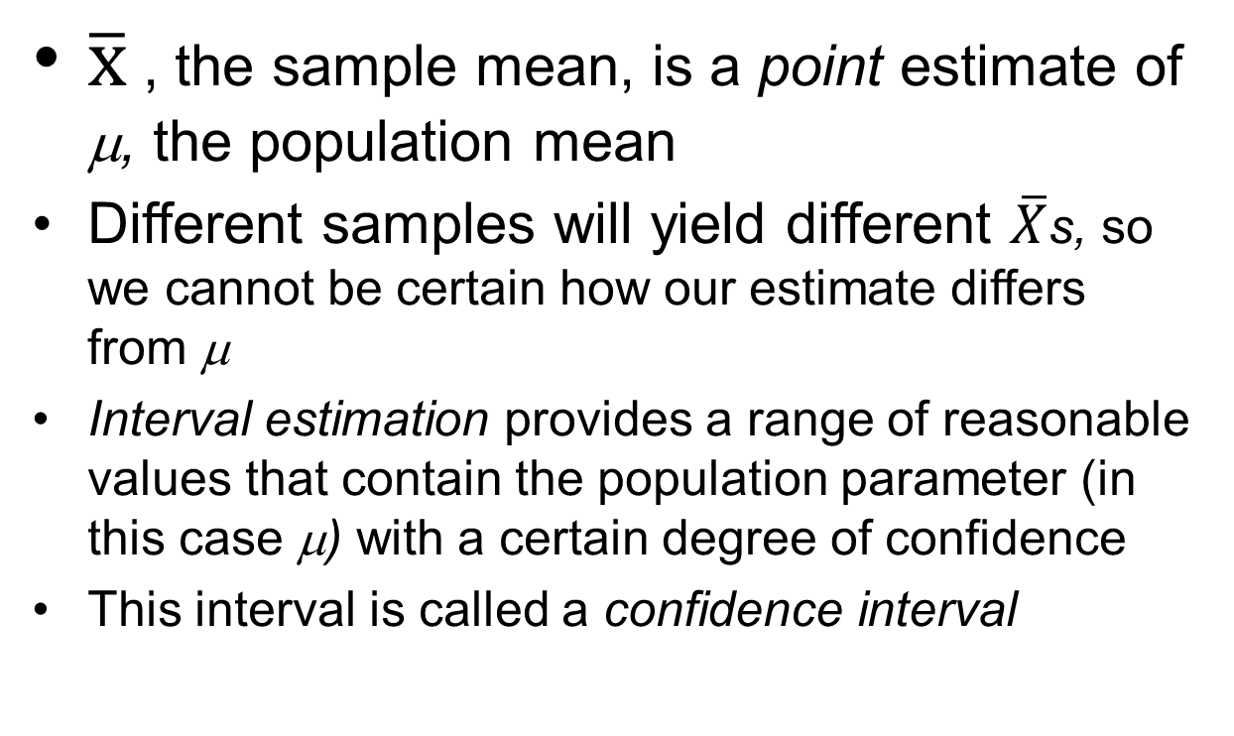
Confidence intervals for means

Slide 40
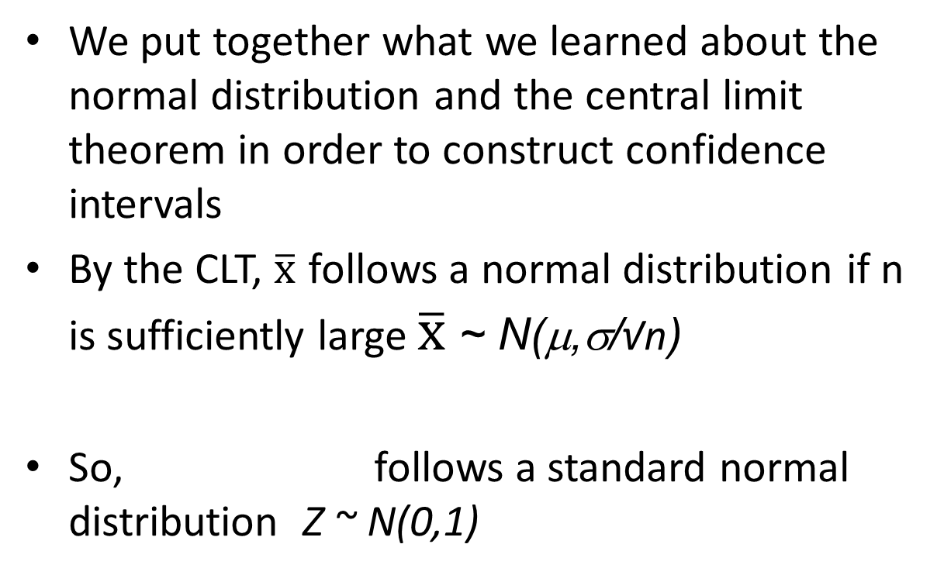
Confidence intervals for means

Slide 41
Confidence intervals for means
We use what we know from the CLT to calculate confidence intervals for means in general
We know from examining the standard normal distribution that P(-1.96 ≤ Z ≤ 1.96) = 0.95
95%
2.5%
2.5%

Slide 42

Confidence intervals for means
P(-1.96 ≤ Z ≤ 1.96) = 0.95
We also know by the CLT that $\overline{X}$ ~ N(μ,σ/√n) so
Substituting the formula for Z into the above we get
Rearranging and multiplying by -1 within the parentheses we get:
Notes:
Remember that the standard deviation of x bar is sigma / square root (n) . It is not sigma, which was the standard deviation of X.

Slide 43
Confidence intervals for means
Thus the lower 95% confidence limit for µ is
And the upper 95% confidence limit for µ is
We say we are 95% confident that the interval we calculate using the above formulae includes μ

Slide 44
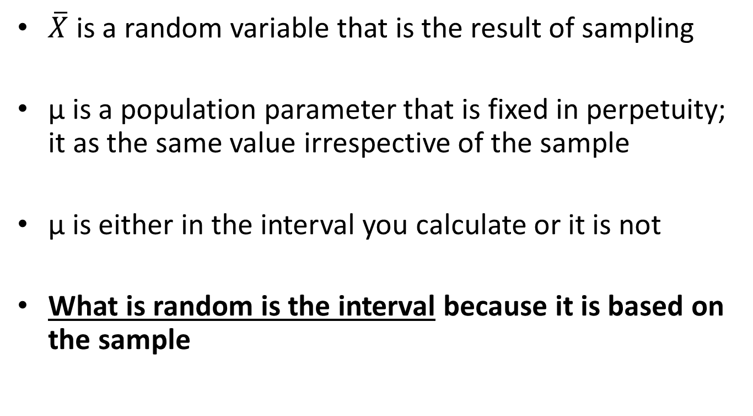
An important subtlety
$\overline{X}$ is a random variable that is the result of sampling
μ is a population parameter that is fixed in perpetuity; it as the same value irrespective of the sample
μ is either in the interval you calculate or it is not
What is random is the interval because it is based on the sample

Slide 45
Interpreting confidence intervals for means
So we say that the probability that the interval contains the true population mean is 95%
If we were to select 100 random samples from the population and calculate confidence intervals for each, approximately 95 of them would include the true population mean µ (and 5 would not)

Slide 46
Confidence intervals for means
90% confidence interval
  Replace 1.96 in the formula with 1.64
99% confidence interval
  Replace 1.96 in the interval with 2.58
  Generic formula:
  Where 100%*(1-α) is the % of the confidence interval
  E.g. for a 95% confidence interval, α=0.05, and we use z_{0.025} =1.96

Slide 47
Confidence intervals for means
How to get a tighter interval?
  Decrease the confidence level
Confidence level | α | Z_{α/2}
99% | .01 | 2.58
95% | .05 | 1.96
90% | .10 | 1.64
80% | .20 | 1.28

Slide 48
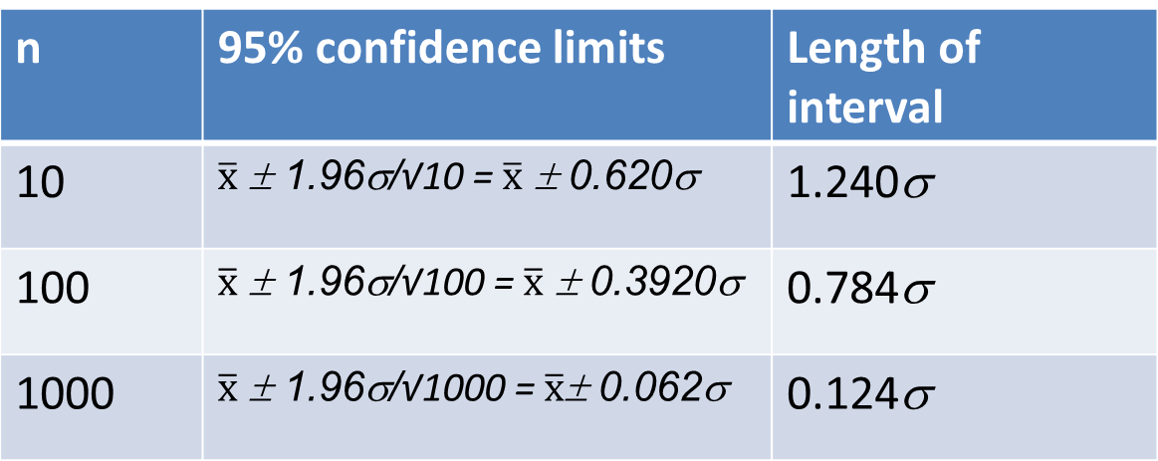
Confidence intervals for means
How to get a tighter interval?
  Increase n
n | 95% confidence limits | Length of interval
10 |  | 1.240σ
100 |  | 0.784σ
1000 |  | 0.124σ

Slide 49
Confidence intervals for means
What to do when σ is not known? (In practice, always)
By the Central Limit Theorem, follows a normal distribution, if n is sufficiently large
Can we substitute s, the sample standard deviation
for σ?
s is not a reliable estimate of σ if n is small

Slide 50
Confidence intervals for means
If X is normally distributed, and a sample of size n is chosen, then follows a Student’s t distribution
with n-1 degrees of freedom
This is denoted t_{n-1}
Notes:
The t-distrubution is very robust, so if n is large, say >30, and the distribution isn’t too far from normal, it’ll work.
See http://people.virginia.edu/~rwm3n/pdf/When%20do%20you%20use%20the%20t%20distribution.pdf for a discussion of this.

Slide 51
Student’s t distribution
The mean of the t distribution is 0 and the standard deviation is 1
The t distribution is symmetric and bell-shaped, but has heavier tails than the standard normal – extreme values are more likely to occur
For small n, the tails are fatter
For large n, the t distribution approaches (i.e. becomes indistinguishable from) the standard normal distribution

Slide 52
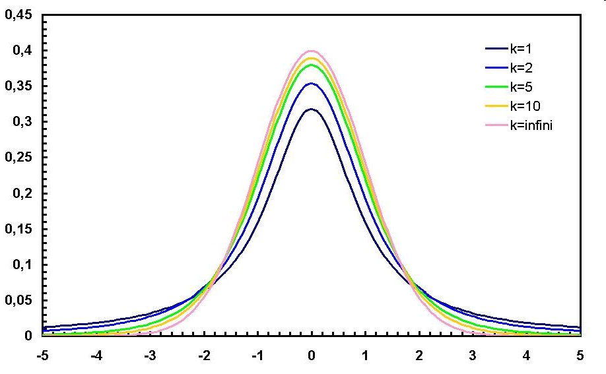
The t-distribution

Slide 53
Student’s t distribution
There are separate curves for each degree of freedom (df)
  Table A.4 gives t value for selected P(T>t) and selected df
Better to use Stata:
P(T≥t) is calculated using ttail *****
**** note that normal() gives P(Z<z)!!!
The code is ttail(df,t)
E.g., P(T>1.96) n=20
  display ttail(19,1.96)
  .03241449
  USE n-1 for the df

Slide 54
Student’s t distribution
To find the value for which P(T>t)=p use invttail(df,p)
For example, for what t is P(T>t)=.025 for a sample of size 20?
The answer for this t cutoff value is denoted t_{19,.05}
  display invttail(19,.025)
  2.0930241

Slide 55
95% confidence intervals for means when σ is not known
So using the t-distribution, the formula for a for a 95% confidence interval for a mean is:
Where df =n-1

Slide 56
Confidence intervals for means
Remember that when n is large, the t distribution approaches the normal distribution
  E.g. z_{0.025} = 1.960
  While t_{n-1,0.025} = →
n | t_{n-1,0.025}
2 | 12.706
3 | 4.303
5 | 2.776
10 | 2.262
50 | 2.010
100 | 1.984
200 | 1.972
300 | 1.968
500 | 1.965
1000 | 1.962
1500 | 1.962

Slide 57
Confidence intervals for means
Example
CD4 cell count among HIV positives diagnosed at Mulago Hospital
  N=999
  Sample mean = 329.2
  Sample SD = 266.1
  t cutoff?
      . di invttail(998,.025)
      1.9623438
  95% CI
    = ( 329.2 – 1.962*266.1/√999, 329.2 + 1.962*266.1/√999)
    = (312.7-345.7)

Slide 58
Confidence intervals for sample means in Stata
. . summ cd4count
Variable | Obs Mean Std. Dev. Min Max
-------------+--------------------------------------------------------
cd4count | 999 329.2332 266.1177 1 1932
. mean cd4count
Mean estimation Number of obs = 999
--------------------------------------------------------------
| Mean Std. Err. [95% Conf. Interval]
-------------+------------------------------------------------
cd4count | 329.2332 8.419592 312.7111 345.7554
--------------------------------------------------------------
. ci cd4count
Variable | Obs Mean Std. Err. [95% Conf. Interval]
-------------+---------------------------------------------------------------
cd4count | 999 329.2332 8.419592 312.7111 345.7554
Notes:
Note that summ does not give you confidence intervals for the mean.
Mean does, and print out the standard error of the mean. The ci command does the same.

Slide 59
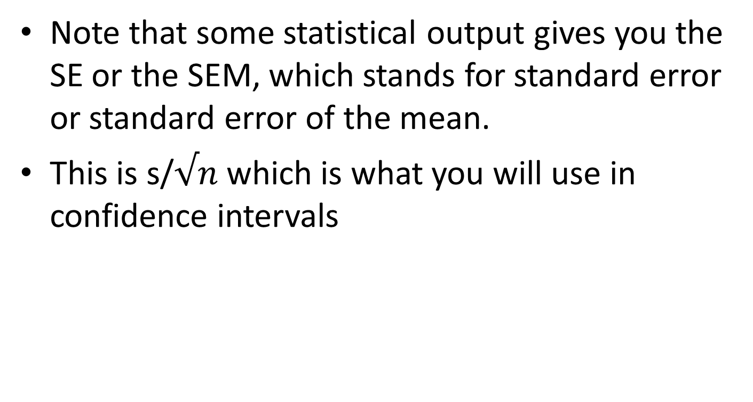
Note that some statistical output gives you the SE or the SEM, which stands for standard error or standard error of the mean.
This is s/$√n$ which is what you will use in confidence intervals

Slide 60
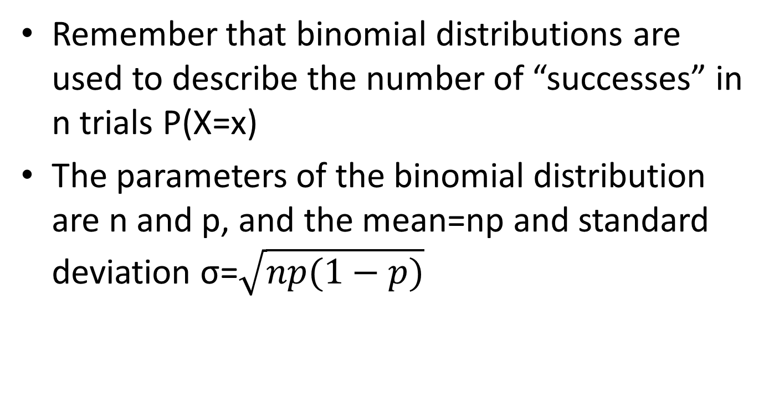
Normal approximation to the binomial distribution
Remember that binomial distributions are used to describe the number of “successes” in n trials P(X=x)
The parameters of the binomial distribution are n and p, and the mean=np and standard deviation σ=$\sqrt{np(1−p)}$

Slide 61
Normal approximation to the binomial distribution
As n, the number of “trials”, increases, the binomial distribution more closely resembles the normal distribution
Note that the binomial distribution approaches normality at smaller sample sizes when p is closer to 0.5

Slide 63
Notes:
The difference here is that p=0.35, which is closer to .5 than the p=.05 on the previous slide

Slide 64
Binomial approximation to normal distribution
Therefore you could use the normal distribution to look up the probability of observing X or more (or less) successes
  You would use n*p as the mean
  You would use np(1-p) as the variance
  You would use √[np(1-p)] as the standard deviation

Slide 65
Using the Binomial distribution
What is the probability of 30 or more successes in a sample of size 50 where p=0.45?
Using the binomial distribution for P(X>=30; n=50, p=.45)
    . di binomialtail(50,30,.45)
    .02353582

Slide 66
Binomial approximation to normal distribution
Using the normal approximation
  Mean=n*p= 50*.45=22.5
  SD= √(np(1-p)) = √(50*.45*.55) = 3.518
  Then Z=(30-22.5)/3.518 = 2.132, and we find P(Z>2.132)
    . di 1-normal(2.132)
    .01650342
  Using the continuity correction (subtracting .5 from X)
    . di 1-normal( (29.5-22.5)/3.518)
    .02330831
Notes:
Continuity correction – subtract .5 from X if you are trying to find P(X>x); add .5 to X if you are trying to find P(X<x). The reasoning behind this is somehow it makes up for the fact that we are using a continuous distribution to approximate a discrete distribution. Don’t worry too much about this…

Slide 67
Binomial distribution, now=100
Using the binomial distribution for P(X>=60; n=100, p=.45)
    . di binomialtail(100,60,.45)
    .00182018
Notes:
The approximation works better when n is larger

Slide 68
Binomial approximation to normal distribution, now=100
Using the normal approximation
  Mean=100*.45=45
  SD= √(100*.45*.55) = 4.975
  Then Z=(60-45)/4.975 = 3.015, and we find P(Z>3.015)
    . di 1-normal(3.015)
    .0012849
  Using the continuity correction (subtracting .5 from X)
    . di 1-normal( (59.5-45)/4.975)
    .00178088
Notes:
The approximation works better when n is larger

Slide 69
Binomial approximation to normal distribution
Considered valid when np≥5 and n(1-p) ≥5
Why use it?
  It is easier to use the normal distribution than to use Table A.1.
  Although in Stata the binomialtail function does actually give you P(X≥x)
Notes:
For some purposes, it is a vestige of computing speed

Slide 70
Sampling distribution of a proportion
Previous slides were about estimating X, the number of successes
We often are more interested in the proportion of successes, rather than the number of successes
The true population proportion p is estimated by
x = the number of successes or events
n=the number of trials or people or observations

Slide 71
Sampling distribution of a proportion
If we take repeated samples of size n from a variable that follows the Bernoulli distribution (i.e. the outcome is 0 or 1), and calculate p̂=x/n for each of the samples (x=total count of successes), if n is large enough, then p̂ will follow a normal distribution (by the central limit theorem)
  The mean of this distribution is p
  The standard deviation is which is also called the standard error
Notes:
remember earlier in the lecture we determined the sampling distribution for x bar

Slide 72
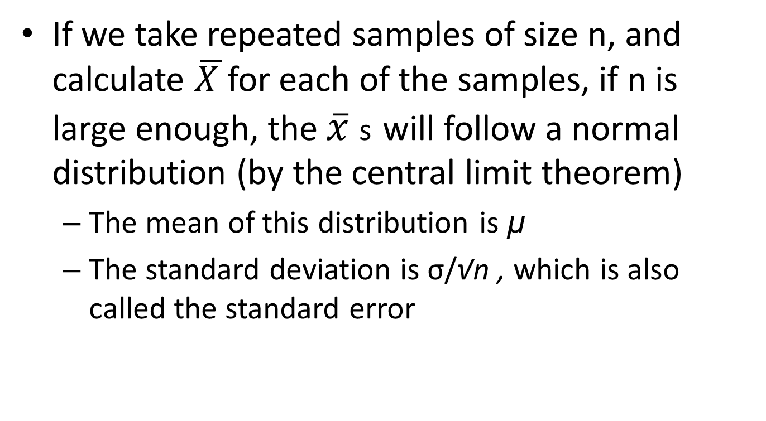
Reminder: Sampling distribution of a mean
Notes:
remember earlier in the lecture we determined the sampling distribution for x bar

Slide 73
Sampling distribution of proportions
So if p̂ follows a normal distribution with mean p and standard deviation
Then ~ N(0,1)
This holds true by the CLT
Considered valid when the expected number of successes np is ≥5 and the expected number of failures n(1-p) is ≥5

Slide 74
Sampling distribution of proportions
So now we can use the normal distribution to calculate probabilities of observing certain proportions in a sample
E.g. What proportion of samples of size 50 from a population with p=.10 will have a p̂ of .20 or higher?
What is P(p̂ ≥ 0.20)?
  Mean=0.10
  SE = √(.10*.90 )/√50 = 0.0424
  P(Z ≥ ((.20-.10)/.0424)) = P(Z ≥ 2.36)
  . display 1-normal(2.36)
  .00913747

Slide 75
Confidence intervals for proportions
~ N(0,1)
  So
Rearranging, we get
→
Lower 95% confidence limit:
Upper 95% confidence limit:

Slide 76
Confidence intervals for proportions
However we don’t know p (if we did we wouldn’t be calculating these intervals). So we substitute p̂ into the formula for the SEM.
Lower 95% confidence limit:
Upper 95% confidence limit:
With repeated sampling, 95% of such intervals would include the true population parameter p

Slide 77
Confidence intervals for proportions
Proportion of iPhone 6 users in graduate med school biostats class
  N=55
  n with iPhone 6s = 25
  Proportion with iphones = 22/55 = .455
  Standard error estimate = sqrt [ .455*(1-.455)/55 ] = 0.067
  95% CI : (.455 – 1.96*.067, .455 + 1.96*.067)
    = (.324, .586)
Data are in Biostat 200 class coindata_v2.dta on class web site
Notes:
Here we use the normal distribution rather than the t distribution…

Slide 78
Confidence intervals for proportions in Stata
CI using the binomial option for exact CIs
ci iphone6_01, binomial
-- Binomial Exact --
Variable | Obs Mean Std. Err. [95% Conf. Interval]
-------------+---------------------------------------------------------------
iphone6_01 | 55 .4545455 .0671408 .3197007 .5944551
Note: Not exactly the same
______________________________________
CI by itself uses a different SE and uses the t distribution
ci iphone6_01
Variable | Obs Mean Std. Err. [95% Conf. Interval]
-------------+---------------------------------------------------------------
iphone6_01 | 55 .4545455 .0677596 .3186956 .5903953
Notes:
Note that if you leave off the binomial, you do NOT get the normal approximation formula – it assumes you are using the t-distribution, so you get a wider interval.

Slide 79
Confidence intervals for proportions in Stata
Another way…
proportion iphone6_01
Proportion estimation Number of obs = 55
--------------------------------------------------------------
| Proportion Std. Err. [95% Conf. Interval]
-------------+------------------------------------------------
iphone6_01 |
0 | .5454545 .0677596 .4096031 .67486
1 | .4545455 .0677596 .32514 .5903969
--------------------------------------------------------------
Notes:
This one is the closest to what we got by hand using the normal approximation.

Slide 80
Key points
It is not practical or feasible to study an entire population, so we take a sample
We need to make inference from our sample to the population
We use the properties of repeated samples to do so
For any random variable X with mean µ and standard deviation σ, if the sample n is large enough, the distribution of the sample mean is normally distributed with mean µ and standard deviation σ/ √n
We use this to calculate intervals with known probability of containing the population mean or proportion

Slide 81
For next time
Read Pagano and Gauvreau
  Chapter 8, 9, and 14 (pages 324-329) (Review of today’s material)
  Chapter 10 and 14 (pages 329-330)

