Slide 1
Mortality
October 12, 2015

Slide 2
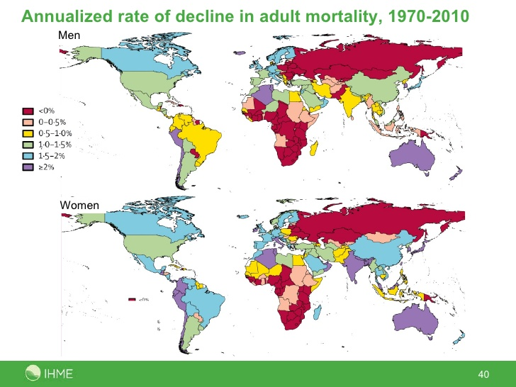
Adult Mortality Decline

Slide 3
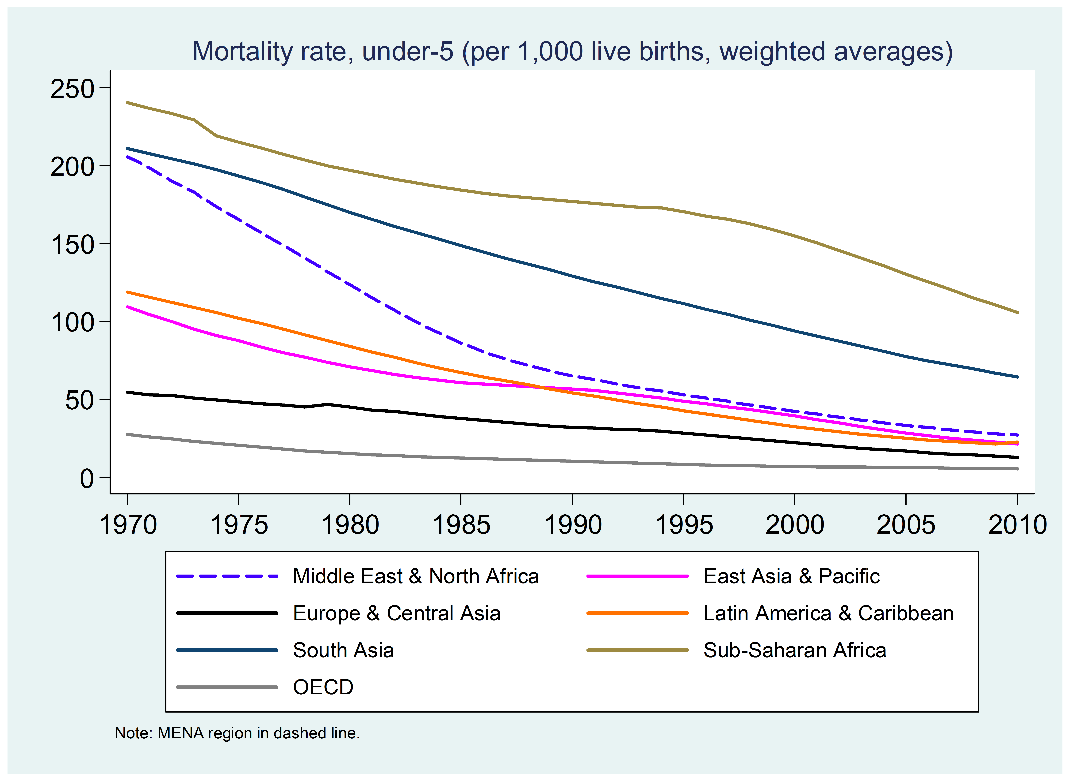
Under 5 mortality rate

Slide 4
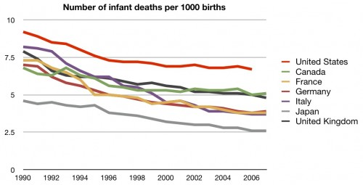
Neonatal mortality

Slide 5
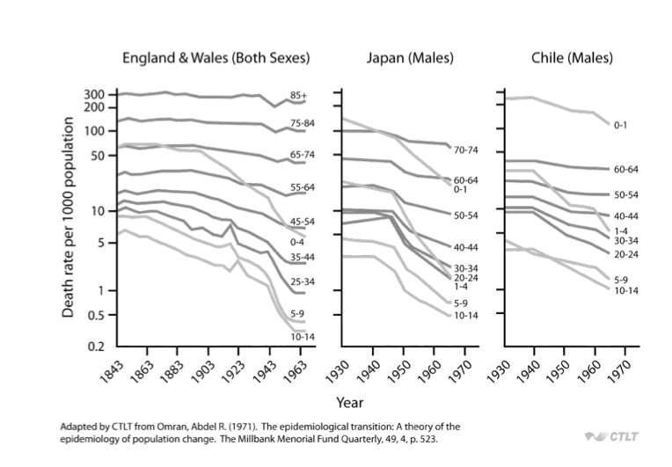
How does mortality differ by age group over time?

Slide 6
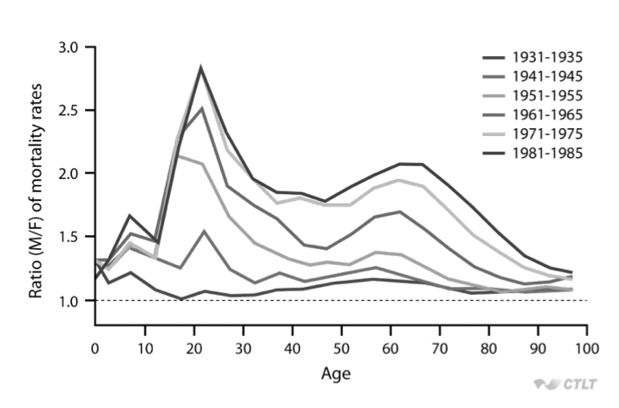
How does mortality differ by sex and age over time? (Sweden)

Slide 7
India: Age contribution to the sex gap in mortality (M/F)

Slide 8
India: Cause contribution to sex gap in mortality (M/F)

Slide 9
Why did mortality decline?
Improved therapeutic medical interventions
Increased living standards, nutrition, hygiene (McKeown, 1976)
Improved water and sanitation (Preston and van de Walle, 1978)
Improved preventive medical interventions (Razzell)
Spread of knowledge to public concerning disease prevention (Preston and Haines, 1991)
  Evidence in differences in child mortality by mother’s education level, etc.

Slide 10
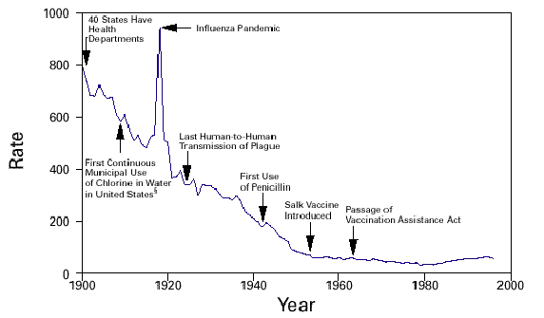
Mortality decline in the US

Slide 11
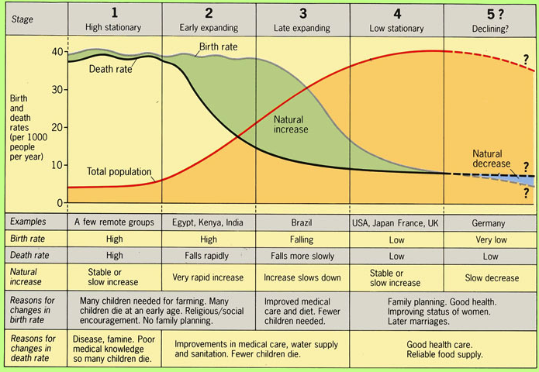
Changes in Fertility + Changes in Mortality: Demographic and Epidemiologic Transition Theory

Slide 12
Measures

Slide 13
Measuring Mortality
Crude Death Rate=
  Number of deaths in year X, in country Y
  ____________________________________________________________________________________
  Mid-year population in year X, country Y
Age specific death rate=
  Number of deaths at age Z, in country Y
  ________________________________________________________________________________________________
  Number of people age Z, in country Y

Slide 14
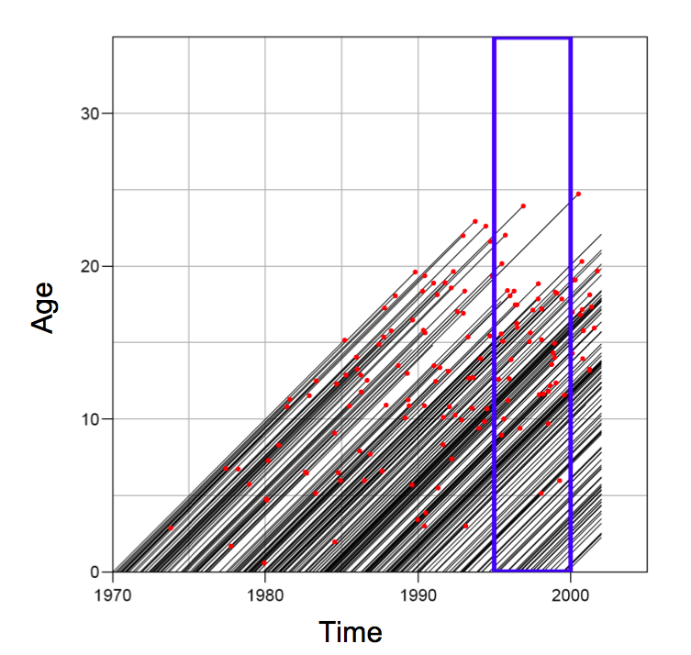
Crude death rate: why is it problematic?
Think about lexis diagrams from the other day

Slide 15
Rate vs probability
Rate:
  Measure of the frequency with which an event occurs in a defined population during a given length of time
  Numerator: Count of events that occur during a period
  Denominator: Midpoint population, or person-years, or other person-time units of exposure for the same period as the numerator
Probability:
  In demography, indicates the likelihood that some event will (or will not) occur to some group of exposed persons during the course of some period of time
  Similar to rates except that they consider the number of people exposed to risk at the start of a time interval

Slide 16
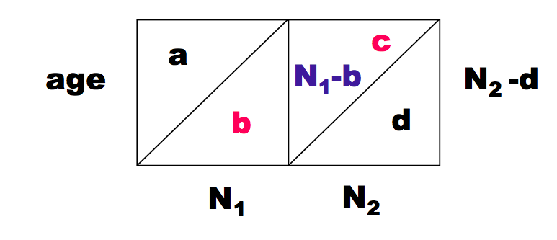
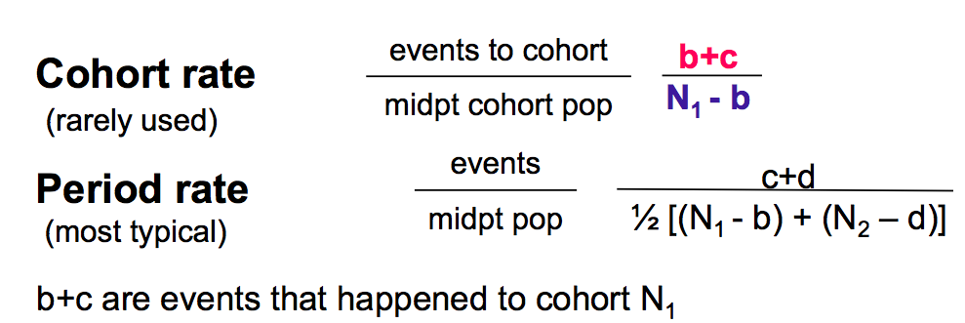
Cohort vs period rates

Slide 17
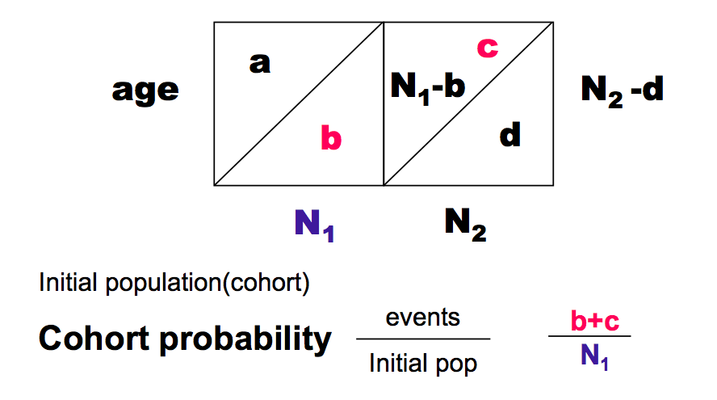
Rates vs probabilities
We often think in terms of probabilities in demography (the probability of dying)
  Life tables next week

Slide 18
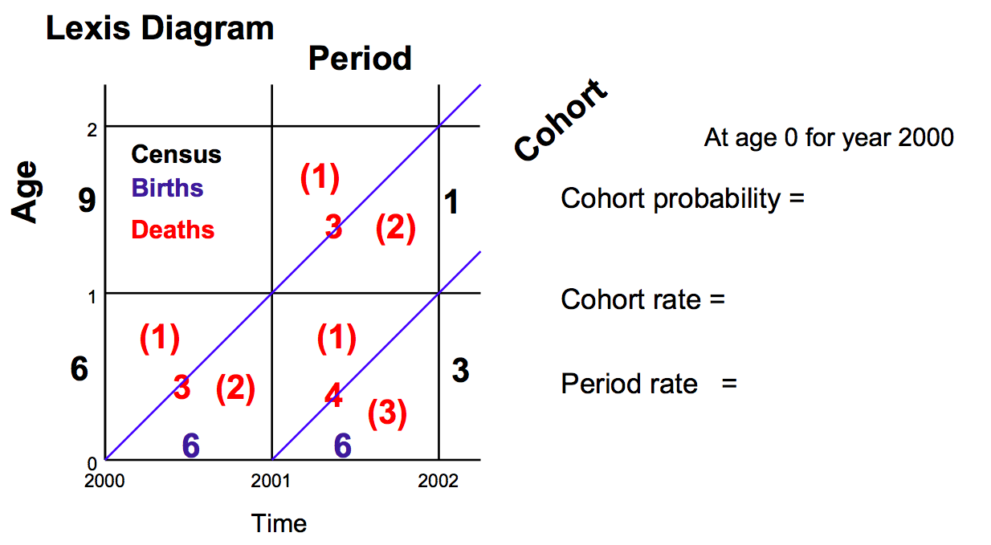
Try to calculate!

Slide 19
Try to calculate!

Slide 20
Try to calculate!
3/6
3/4
3/5

Slide 21
Problem with crude death rates
Populations differ in terms of age distribution
  Cannot really compare
Need to remove the effects of the population distribution on crude death rates to compare

Slide 22
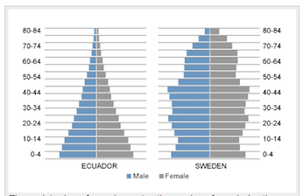
Ecuador vs Sweden
Crude death rate
Ecuador: 5.6/1000
Sweden 10.5/1000
Why?
Age Structure:
More old people in Sweden

Slide 23
How to address: Standardization
Direct
Apply age specific death rates of both countries to a standard population age distribution
Problem: what population to choose?
  Can get very different results depending on the population
  Some options
    Middle between the two populations
    Region specific fake populations (Africa, European, etc.)
    WHO in 2001 made a “world” population

Slide 24
Standardization: Direct continued
Usually calculate the Comparative Mortality Figure (CMR), which is the ratio of the age adjusted rate to the rate of the other country

Slide 25
How to address: Standardization
Indirect
Calculate the expected number of deaths if each country had real age structure, but apply a standard set of death rates
Usually calculate a Standardized Mortality Ratio (SMR)
Can use one countries death rates and apply to the other country
Only need to know # deaths, and age structure, not rates, so sometimes more feasible to calculate
Preferable when small numbers in some cells

Slide 26
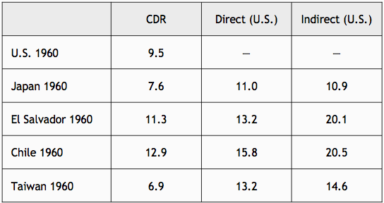
Comparison

Slide 27
Thank you!
Questions?
Notes:
Final boiler plate language: 2 versions
Through its singular focus on health, UCSF is leading revolutions in health.
UCSF is driven by the idea that great breakthroughs are achieved when the best research, the best education and the best patient care converge.

