Slide 1
Biostat 200
Lecture 6

Slide 2
Recap
We calculate confidence intervals to give the most plausible values for the population mean or proportion – upon repeated sampling, 95% of the intervals contain the population mean
We conduct hypothesis tests of a mean or a proportion to make a conclusion about how our sample mean or proportion compares with some hypothesized value for the population mean or proportion. P-values give you the probability of rejecting the null in the case that it is true.

Slide 3
Recap
You can use 95% confidence intervals to reach the same conclusions as hypothesis tests
  If the null value of the mean is outside of the 95% confidence interval, that would be the same as rejecting the null of a two-sided hypothesis test at significance level 0.05.

Slide 4
Recap
We make these conclusions based on what we observed in our sample -- we will never know the true population mean or proportion
  If the data are very different from the hypothesized mean or proportion, we reject the null
    Example: Phase I vaccine trial – does the candidate vaccine meet minimum thresholds for safety and efficacy?
  Statistical significance can be driven by n, and does not equal clinical or biological significance
  On the other hand, you might have a suggestive result but not statistical significance with a small sample that deserves a larger follow up study

Slide 5
Types of error
Type I error = significance level of the test
α=P(reject H₀ | H₀ is true)
Incorrectly reject the null
We take a sample from the population, calculate the statistics, and make inference about the true population. If we did this repeatedly, we would incorrectly reject the null 5% of the time that it is true if α is set to 0.05.

Slide 6
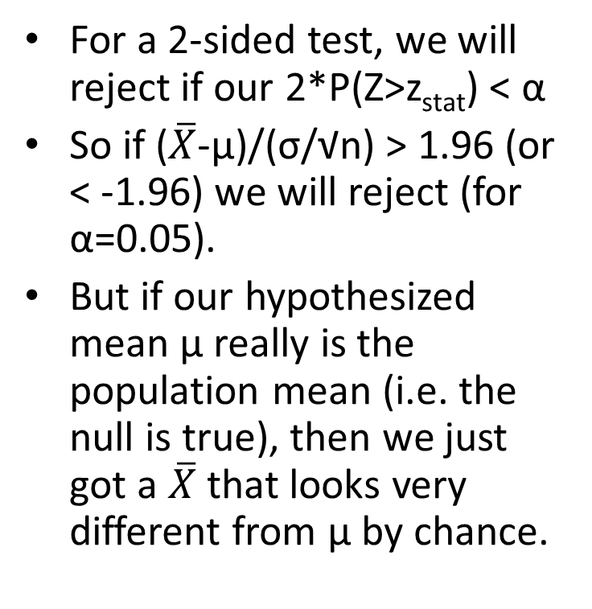
How do we know we will sometimes mistakenly reject the null?
For a 2-sided test, we will reject if our 2*P(Z>z_{stat}) < α
So if ($\overline{X}$-µ)/(σ/√n) > 1.96 (or < -1.96) we will reject (for α=0.05).
But if our hypothesized mean µ really is the population mean (i.e. the null is true), then we just got a $\overline{X}$that looks very different from µ by chance.

Slide 7
Types of error
Type II error –
β = P(do not reject H₀ | H₀ is false)
Incorrectly fail to reject the null
This happens when the test statistic (z_{stat} or t_{stat}) is not large enough, even though the null is false

Slide 8
Types of error
Remember, H₀ is a statement about the population and is either true or false
We take a sample and use the information in the sample to try to determine the answer
Whether we make a Type I error or a Type II error depends on whether H₀ is true or false
We set α, the chance of a Type I error, and we can design our study to minimize the chance of a Type II error
 | True state
Decision | H₀ is true | H₀ is false
Do not reject H₀ | Correct | Type II error=β
Reject H₀ | Type I error=α | Correct
Notes:
Remember that alpha is the probability we reject the null when it is true.
It is NOT the probability that we have made a mistake (that the null is true) when we reject the null.

Slide 9
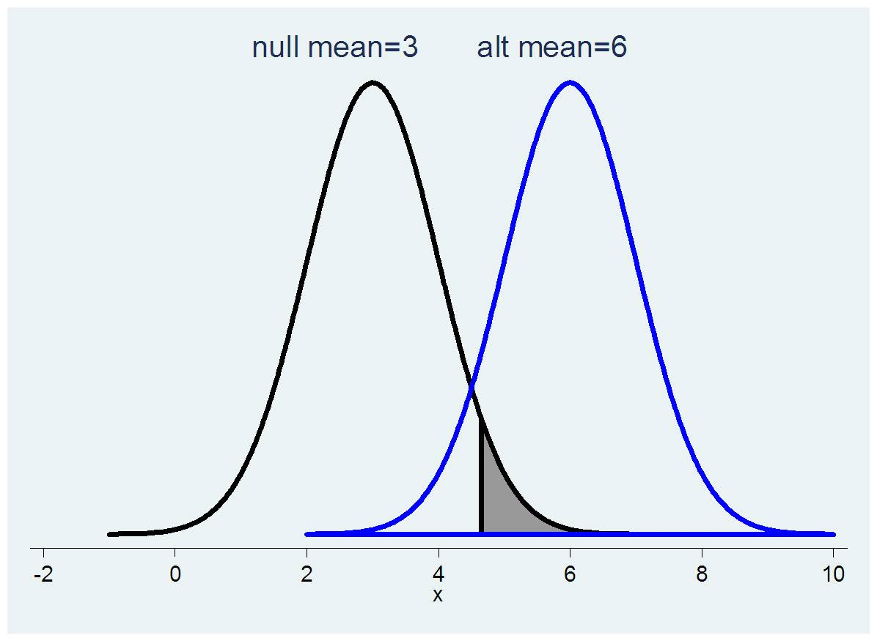
Chance of a type II error
β, chance of failing to reject the null if the alternative is true
Notes:
Note that this alternative mean that we are talking about is only in theory. We are still testing to see if the data are consistent with the null hypothesis, but the alternative mean gives us an idea of how different things must be from the null for a difference to show up in our data.

Slide 10
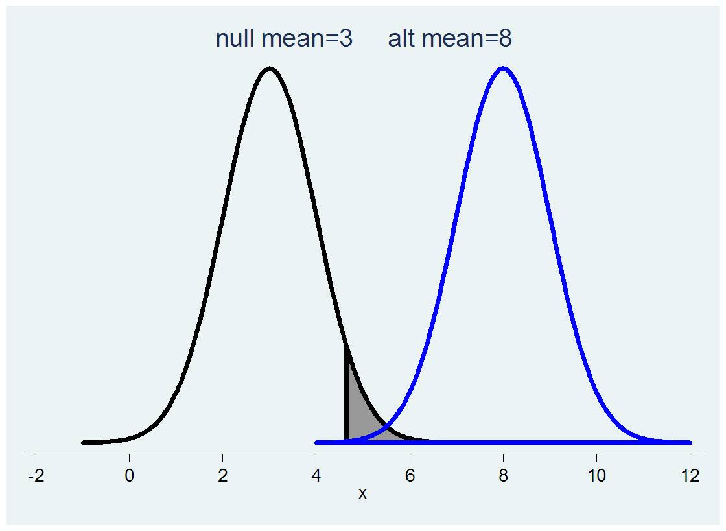
If the alternative is very different from the null, the chance of a Type II error is low
β, chance of failing to reject the null if the alternative is true

Slide 11
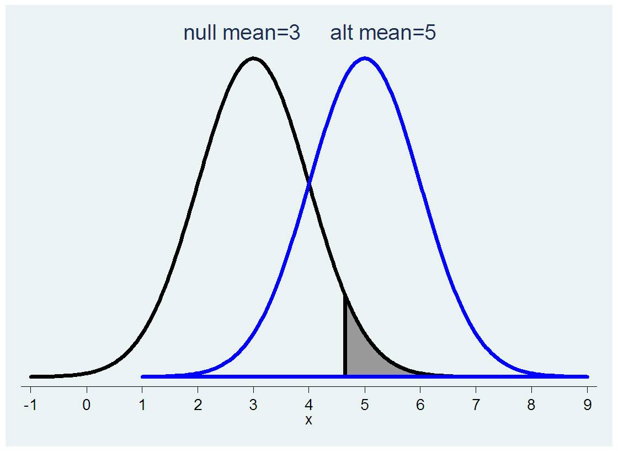
If the alternative is not very different from the null, the chance of a Type II error is high
β, chance of failing to reject the null if the alternative is true

Slide 12
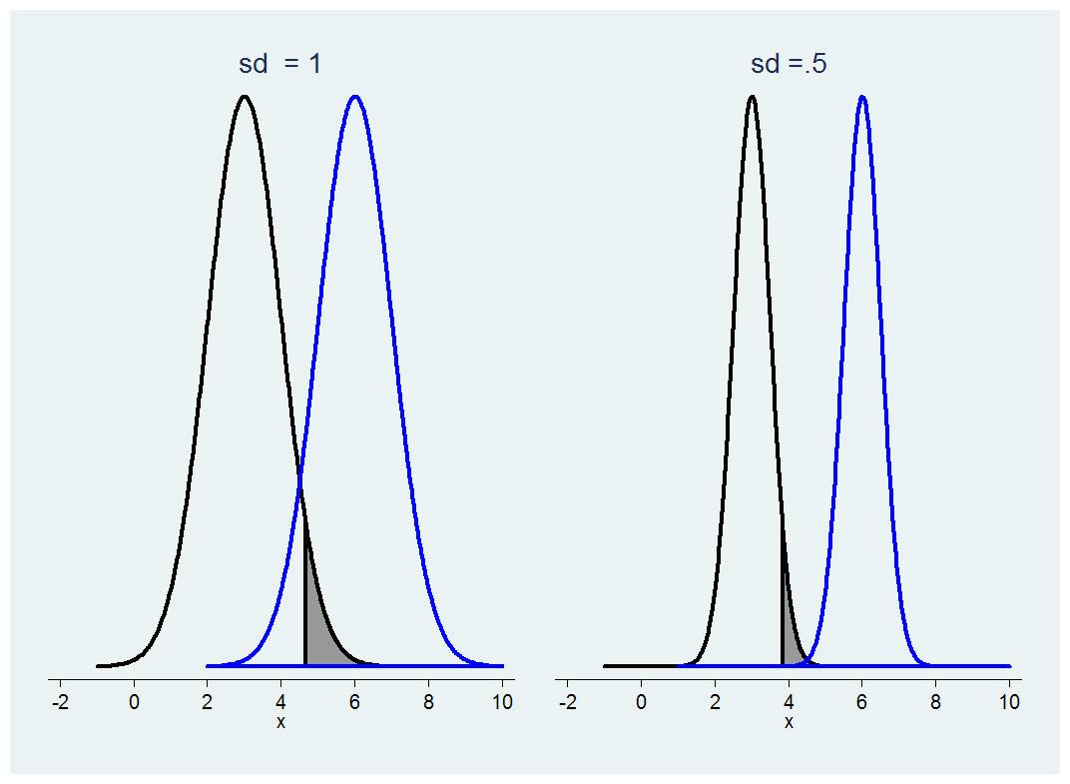
Chance of a Type II error is lower if the SEM is smaller
This is relevant because the SD for the distribution of a sample mean is σ/√n
So increasing n decreases the SD of the mean. Also σ/√n (or s/√n) is in the denominator of your test statistic, which if large means you will reject.
Notes:
You can’t change the variability in the population, but you can impact the variability in the sampling mean

Slide 13
Criminal justice
A person is accused of a crime, say stealing bread, and is on trial.
The null hypothesis is:
The alternative hypothesis is:
The evidence against him/her is the data.
If the data is very clear, then it is easy to convict. If the data are not very clear, then the jury needs to err on the side of caution.
  The data may be made stronger by multiple witnesses saying the same thing (thus reducing σ)
  The data may be made stronger by evidence that itself is strong (like a large effect size), even if not replicated (e.g. fingerprints in the flour)

Slide 14
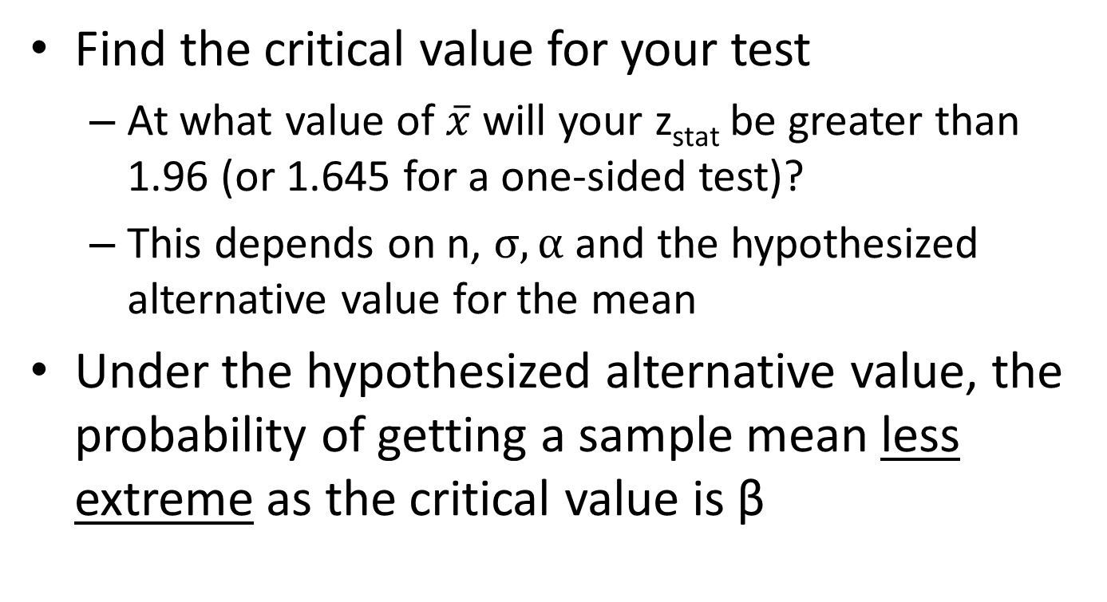
Finding β, P(Type II error)

Slide 15
Power
The power (i.e. 1-β) of a statistical test is lower for alternative values that are closer to the null value (the chance of a Type II error is higher) and higher for more extreme alternative values.
  The jury is more likely to convict with stronger evidence.
It is standard to fix α=0.05 and β=0.20 (for 80% power) and determine n for various alternative hypotheses

Slide 16
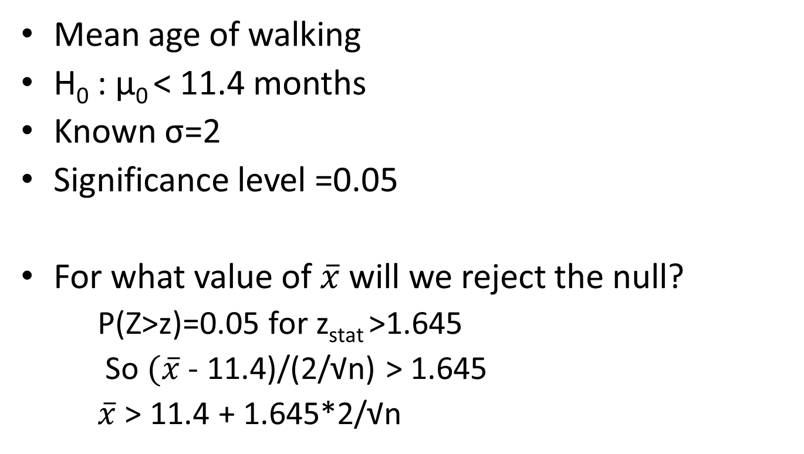
Sample size calculation

Slide 17
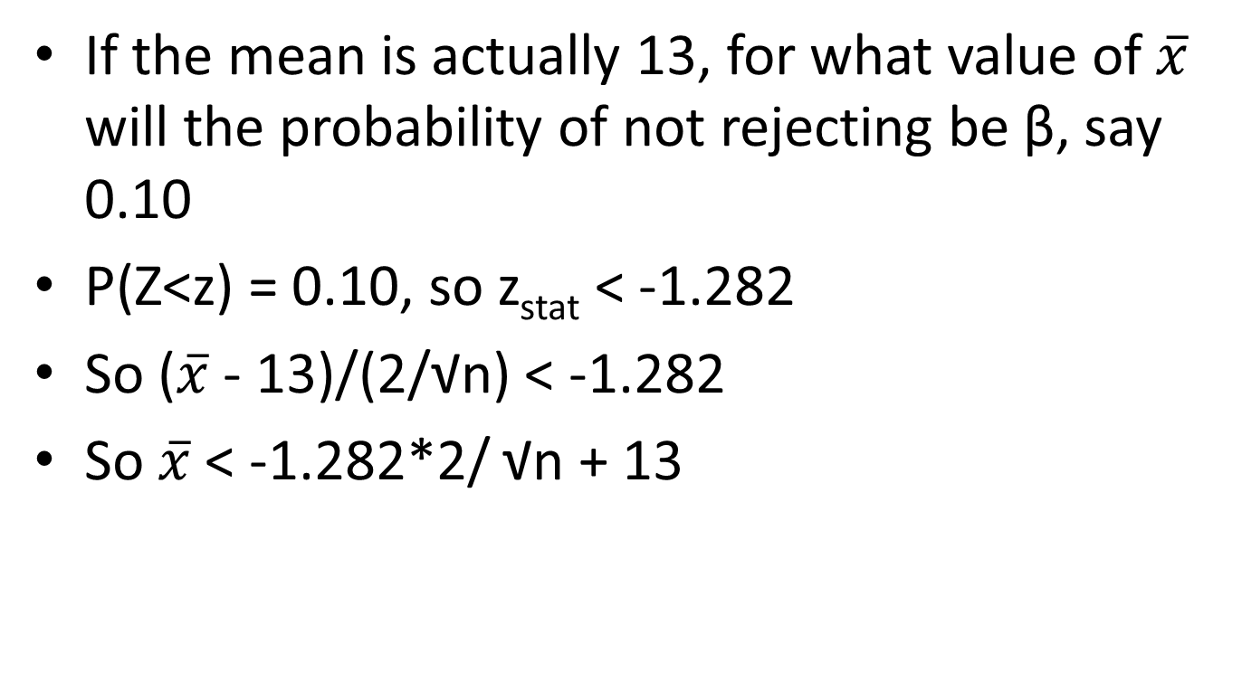
Sample size calculation, con’t

Slide 18
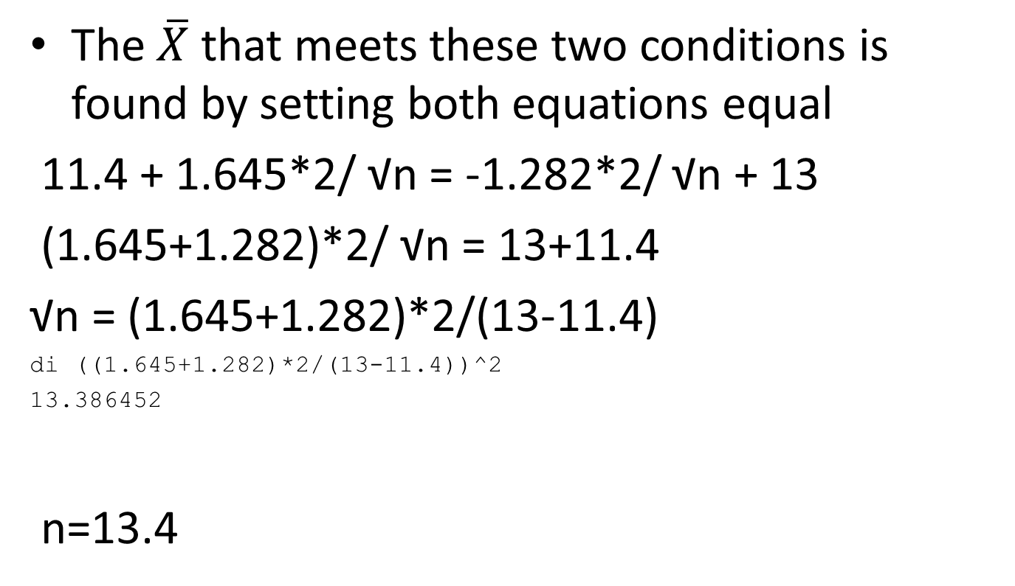
The $\overline{X}$ that meets these two conditions is found by setting both equations equal
11.4 + 1.645*2/ √n = -1.282*2/ √n + 13
(1.645+1.282)*2/ √n = 13+11.4
√n = (1.645+1.282)*2/(13-11.4)
di ((1.645+1.282)*2/(13-11.4))^2
13.386452
n=13.4

Slide 19
In Stata
. power onemean 11.4 13, power(0.9) sd(2) knownsd onesided
Estimated sample size for a one-sample mean test
z test
Ho: m = m0 versus Ha: m > m0
Study parameters:
alpha = 0.0500
power = 0.9000
delta = 0.8000
m0 = 11.4000
ma = 13.0000
sd = 2.0000
Estimated sample size:
N = 14

Slide 20
Sample size calculations
  In practice, you often have your n fixed by cost
  Then you can calculate how big the alternative has to be to reject the null with 80% probability assuming the alternative is true
  The difference between this alternative and the null is called the minimum detectable difference
    In epidemiology when wanting to estimate an odds ratio it is called the minimum detectable odds ratio
  So if the minimum detectable difference is large, that is a bad thing – you will only have statistical significance if the alternative is very far from the null (very large effect sizes)

Slide 21
Comparison of two means: the paired t-test
Paired samples, numerical variables
  Two determinations on the same person (before and after) – e.g. before and after intervention
  Matched samples – measurement on pairs of persons similar in some characteristics, i.e. identical twins (matching is on genetics)
  Matching or pairing is performed to control for extraneous factors
Each person or pair has 2 data points, and we calculate the difference for each
Then we can use our one-sample methods to test hypotheses about the value of the difference

Slide 22
Comparison of two means: paired t-test
Step 1: The hypotheses (two sided)
Generically H₀: μ₁-μ₂ =δ
H_{A}: μ₁-μ₂ ≠δ
Often δ=0, no difference
So H₀: μ₁-μ₂ =0, i.e. H₀: μ₁=μ₂
H_{A}: μ₁-μ₂ ≠0, i.e. H_{A}: μ₁≠μ₂

Slide 23
Comparison of two means: paired t-test
Step 1: The hypotheses (one sided)
Generically H₀: μ₁-μ₂ ≥δ or H₀: μ₁-μ₂ ≤δ
H_{A}: μ₁-μ₂ <δ H₀: μ₁-μ₂ <δ
Often δ=0, no difference
So H₀: μ₁ ≥ μ₂ or H₀: μ₁ ≤ μ₂
H_{A}: μ₁ < μ₂ H_{A}: μ₁ > μ₂

Slide 24
Comparison of two means: paired t-test
Step 2: Calculate the test statistic

Slide 25
Comparison of two means: paired t-test
If δ=0, a null of no difference, the formula for t_{stat} is

Slide 26
Comparison of two means: paired t-test
Step 3: Reject or fail to reject the null
  Is the p-value (the probability of observing a difference as large or larger, under the null hypothesis) greater than or less than the significance level, α?

Slide 27
Example: BREATH Study
We have found that self-reported alcohol consumption decreases after ART initiation, however we suspect a high degree of under-report. We use the biomarker PEth to obtain a biological measure of alcohol use in a one-year prospective study. Looking at baseline and 3 months…

Slide 28
Example
We think participants may be decreasing their alcohol use over time. The null hypothesis is that they are drinking the same amount.
  H₀: μ₂-μ₁ =0 → μ₂=μ₁ H_{A}: μ₁-μ₂ ≠0 → μ₂ ≠ μ₁
Significance level=0.05

Slide 29
Paired data – PEth at 0 and 3 months
** print out 1st 10 observations
. list studyid peth0_log10 peth3_log10 peth_diff in 1/10
+-------------------------------------------+
| studyid peth0_log10 peth3_log10 peth_diff |
|-------------------------------------------|
1. | MBB2001 2.054766 1.950681 -.104085 |
2. | MBB2002 .30103 .30103 0 |
3. | MBB2006 .30103 .30103 0 |
4. | MBB2007 .30103 .30103 0 |
5. | MBB2008 1.388012 1.575477 .1874642 |
|-------------------------------------------|
6. | MBB2011 .30103 .30103 0 |
7. | MBB2013 .30103 .30103 0 |
8. | MBB2016 2.122216 .30103 -1.821186 |
9. | MBB2021 1.341533 1.348207 .0066741 |
10. | MBB2022 .30103 1.111766 .8107364 |
+-------------------------------------------+
These data from BREATH wide data.dta"

Slide 30
Graphs of the data

Slide 31
. summ peth_diff
Variable | Obs Mean Std. Dev. Min Max
-------------+--------------------------------------------------------
peth_diff | 177 -.101553 .5782935 -1.929419 1.685742
*** calculate the t statistic
di -.101553/.5782935*sqrt(177)
-2.3363133
*** calculate the p-value
. di 2*ttail(176,2.336133)
.02061082
→ So we reject the null

Slide 32
Using the ttest command
. . ttest peth_diff==0
One-sample t test
------------------------------------------------------------------------------
Variable | Obs Mean Std. Err. Std. Dev. [95% Conf. Interval]
---------+--------------------------------------------------------------------
peth_d~f | 177 -.101553 .0434672 .5782935 -.187337 -.015769
------------------------------------------------------------------------------
mean = mean(peth_diff) t = -2.3363
Ho: mean = 0 degrees of freedom = 176
Ha: mean < 0 Ha: mean != 0 Ha: mean > 0
Pr(T < t) = 0.0103 Pr(|T| > |t|) = 0.0206 Pr(T > t) = 0.9897
Note that mean>0 here is mean difference
Notes:
What if we wanted to use the immediate command ttesti?

Slide 33
Another way without calculating the difference
The command is
ttest var1==var2
. . ttest peth3_log10==peth0_log10
Paired t test
------------------------------------------------------------------------------
Variable | Obs Mean Std. Err. Std. Dev. [95% Conf. Interval]
---------+--------------------------------------------------------------------
peth3~10 | 177 1.426734 .0686534 .9133744 1.291244 1.562224
peth0~10 | 177 1.528287 .0690468 .9186077 1.392021 1.664553
---------+--------------------------------------------------------------------
diff | 177 -.101553 .0434672 .5782935 -.187337 -.015769
------------------------------------------------------------------------------
mean(diff) = mean(peth3_log10 - peth0_log10) t = -2.3363
Ho: mean(diff) = 0 degrees of freedom = 176
Ha: mean(diff) < 0 Ha: mean(diff) != 0 Ha: mean(diff) > 0
Pr(T < t) = 0.0103 Pr(|T| > |t|) = 0.0206 Pr(T > t) = 0.9897
.

Slide 34
Another example
Breast cancer tumor volume

Slide 35
Comparison of two means: t-test
The goal is to compare means from two independent samples
Two different populations
  E.g. vaccine versus placebo group
  E.g. women with adequate versus in adequate micronutrient levels

Slide 36
Comparison of two means: t-test
Two sided hypothesis
H₀: μ₁=μ₂
H_{A}: μ₁≠μ₂
One sided hypothesis
H₀: μ₁≥μ₂
H_{A}: μ₁<μ₂
One sided hypothesis
H₀: μ₁≤μ₂
H_{A}: μ₁>μ₂

Slide 37
Comparison of two means: t-test
Even though the null and alternative hypotheses are the same as for the paired t-test, the test is different, it is wrong to use a paired t-test with independent samples and vice versa

Slide 38
Comparison of two means: t-test
By the CLT, if X₁ and X₂ are normally distributed, then is normally distributed with mean μ₁-μ₂ and standard deviation
In one version of the t-test, we assume that the population standard deviations are equal, so σ₁ = σ₂ = σ
Substituting, the standard deviation for the distribution of the difference of two sample means is

Slide 39
Comparison of two means: t-test
So we can calculate a z-score for the difference in the means and compare it to the standard normal distribution. The test statistic is

Slide 40
Comparison of two means: t-test when σ is unknown
T-test test statistic
  The formula for the pooled SD is a weighted average of the individual sample SDs
  The degrees of freedom for the test are n₁+n₂-2

Slide 41
Comparison of two means: t-test
As in our other hypothesis tests, compare the t statistic to the t-distribution to determine the probability of obtaining a mean difference as large or larger as the observed difference
Reject the null if the probability, the p-value, is less than α, the significance level
Fail to reject the null if p≥ α

Slide 42
Comparison of two means, example
Study of non-pneumatic anti-shock garment (Miller et al)
Two groups – pre-intervention received usual treatment, intervention group received NASG
Comparison of hemorrhaging in the two groups
Null hypothesis: The hemorrhaging is the same in the two groups H₀: μ₁=μ₂
H_{A}: μ₁≠μ₂
The data:
External blood loss after entry:
  Pre-intervention group (n=83) mean blood loss =340.4 SD=248.2
  Intervention group (n=83) mean blood loss =73.5 SD=93.9

Slide 43
Calculating by hand
External blood loss:
  Pre-intervention group (n=83) mean=340.4 SD=248.2
  Intervention group (n=83) mean=73.5 SD=93.9
First calculate s_{p}²
s_{p}² = (82*248.2² + 82*93.9²)/(83+83-2)
= 35210.2
t_{stat} = (340.4-73.5)/sqrt(35210.2*(2/83))
= 9.16
df =83+83-2=164
. di 2*ttail(164,9.16)
2.041e-16

Slide 44
Comparison of two means, example
* ttesti n1 mean1 sd1 n2 mean2 sd2
ttesti 83 340.4 248.2 83 73.5 93.9
Two-sample t test with equal variances
------------------------------------------------------------------------------
| Obs Mean Std. Err. Std. Dev. [95% Conf. Interval]
---------+--------------------------------------------------------------------
x | 83 340.4 27.24349 248.2 286.204 394.596
y | 83 73.5 10.30686 93.9 52.99636 94.00364
---------+--------------------------------------------------------------------
combined | 166 206.95 17.85377 230.0297 171.6987 242.2013
---------+--------------------------------------------------------------------
diff | 266.9 29.12798 209.3858 324.4142
------------------------------------------------------------------------------
diff = mean(x) - mean(y) t = 9.1630
Ho: diff = 0 degrees of freedom = 164
Ha: diff < 0 Ha: diff != 0 Ha: diff > 0
Pr(T < t) = 1.0000 Pr(|T| > |t|) = 0.0000 Pr(T > t) = 0.0000

Slide 45
Remember that when conducting a hypothesis test that a mean is equal to or less than or greater than some value (a one-sample t-test), use
.ttesti n mean sd hypothesizedmean
When testing the equality of two means, use
ttesti n1 mean1 sd1 n2 mean2 sd2
Stata will know which one based on how many numbers you enter (4 vs. 6)

Slide 46
You can calculate a 95% confidence interval for the difference between the 2 means
If the confidence interval for the difference does not include 0, then you can reject the null hypothesis of no difference

Slide 47
This is NOT equivalent to calculating separate confidence intervals for each mean and determining whether they overlap

Slide 48
Comparison of two means: t-test
This t-test assumes equal variances in the two underlying populations
If we do not assume equal variances we use a slightly different test statistic
    Variances not assumed to be equal, so you do not use a pooled estimate
    There is another formula for degrees of freedom
Often the two different t-tests yield the same answer, but you should not assume equivalence unless you have a good reason for it
  If the sample sizes are equal, you will get the same test statistic, just the df changes

Slide 49
The t statistic is
Round up to the nearest integer to get the degrees of freedom

Slide 50
Comparison of two means, example
ttesti 83 340.4 248.2 83 73.5 93.9, unequal
Two-sample t test with unequal variances
------------------------------------------------------------------------------
| Obs Mean Std. Err. Std. Dev. [95% Conf. Interval]
---------+--------------------------------------------------------------------
x | 83 340.4 27.24349 248.2 286.204 394.596
y | 83 73.5 10.30686 93.9 52.99636 94.00364
---------+--------------------------------------------------------------------
combined | 166 206.95 17.85377 230.0297 171.6987 242.2013
---------+--------------------------------------------------------------------
diff | 266.9 29.12798 209.1446 324.6554
------------------------------------------------------------------------------
diff = mean(x) - mean(y) t = 9.1630
Ho: diff = 0 Satterthwaite's degrees of freedom = 105.002
Ha: diff < 0 Ha: diff != 0 Ha: diff > 0
Pr(T < t) = 1.0000 Pr(|T| > |t|) = 0.0000 Pr(T > t) = 0.0000

Slide 51
Test of the means of independent samples
When you have the data in Stata, with the different groups in different columns, use
  ttest var1==var2, unpaired
  or ttest var1==var2, unpaired unequal

Slide 52
Test of the means of independent samples
More commonly you will have the data all in one variable, and the grouping in another variable. Then use
  ttest var, by(groupvar)
  or ttest var, by(groupvar) unequal

Slide 53
Alcohol study example
Testing whether log PEth at 6 months differs by study arm
Null hypothesis: Log PEth for cohort arm = Log PEth for comparison arm
. ttest peth_log10, by(studyarm)
Two-sample t test with equal variances
------------------------------------------------------------------------------
Group | Obs Mean Std. Err. Std. Dev. [95% Conf. Interval]
---------+--------------------------------------------------------------------
Cohort a | 181 1.406739 .0709392 .9543891 1.26676 1.546718
Min asse | 106 1.490502 .0897145 .9236671 1.312615 1.668389
---------+--------------------------------------------------------------------
combined | 287 1.437676 .0556285 .942407 1.328183 1.547169
---------+--------------------------------------------------------------------
diff | -.0837633 .1153577 -.3108244 .1432978
------------------------------------------------------------------------------
diff = mean(Cohort a) - mean(Min asse) t = -0.7261
Ho: diff = 0 degrees of freedom = 285
Ha: diff < 0 Ha: diff != 0 Ha: diff > 0
Pr(T < t) = 0.2342 Pr(|T| > |t|) = 0.4684 Pr(T > t) = 0.7658
Notes:
BREATH cohort and comparisons_v2.dta

Slide 54
.
ttest peth_log10, by(studyarm) unequal
Two-sample t test with unequal variances
------------------------------------------------------------------------------
Group | Obs Mean Std. Err. Std. Dev. [95% Conf. Interval]
---------+--------------------------------------------------------------------
Cohort a | 181 1.406739 .0709392 .9543891 1.26676 1.546718
Min asse | 106 1.490502 .0897145 .9236671 1.312615 1.668389
---------+--------------------------------------------------------------------
combined | 287 1.437676 .0556285 .942407 1.328183 1.547169
---------+--------------------------------------------------------------------
diff | -.0837633 .1143724 -.3091369 .1416103
------------------------------------------------------------------------------
diff = mean(Cohort a) - mean(Min asse) t = -0.7324
Ho: diff = 0 Satterthwaite's degrees of freedom = 225.846
Ha: diff < 0 Ha: diff != 0 Ha: diff > 0
Pr(T < t) = 0.2324 Pr(|T| > |t|) = 0.4647 Pr(T > t) = 0.7676

Slide 55
Confidence interval for the difference of two means from independent samples, when unequal variances are assumed

Slide 56
Comparison of two proportions
Similar to comparing two means
Null hypothesis about two proportions, p₁ and p₂, H₀: p₁= p₂
H_{A}: p₁≠ p₂
If n₁ and n₂ are sufficiently large, the difference between the two proportions follows a normal distribution.

Slide 57
Comparison of two proportions
So we can use the z statistic
to find the probability of observing a difference as large as we do, under the null hypothesis of no difference

Slide 58
Comparison of two proportions
Example: Proportion with PEth>=50 ng/ml
  . tab peth_50
  peth_50 | Freq. Percent Cum.
  ------------+-----------------------------------
  0 | 155 54.01 54.01
  1 | 132 45.99 100.00
  ------------+-----------------------------------
  Total | 287 100.00
  . bysort studyarm: tab peth_50
  -----------------------------------------------------------------------------------> studyarm = Cohort assessed
  peth_50 | Freq. Percent Cum.
  ------------+-----------------------------------
  0 | 97 53.59 53.59
  1 | 84 46.41 100.00
  ------------+-----------------------------------
  Total | 181 100.00
  ----------------------------------------------------------------------------------
  -> studyarm = Min assessed
  peth_50 | Freq. Percent Cum.
  ------------+-----------------------------------
  0 | 58 54.72 54.72
  1 | 48 45.28 100.00
  ------------+-----------------------------------
  Total | 106 100.00
  .

Slide 59
Comparison of two proportions
Null hypothesis: The proportion with PEth>=50 is the same in both groups
  H₀: p₁= p₂ (so p₁ – p₂ = 0)
Z statistic is calculated:
    p̂ = 0.460 (overall proportion)
    z_{stat} = (.464-.453)/sqrt( .460*(1-.460)*(1/181+1/106))
    =.18045468
    . di 2*(1-normal(.18045468))
    .85679563

Slide 60
Comparison of two proportions
prtesti n1 p1 n2 p2
. . prtesti 106 .453 181 .464
Two-sample test of proportions x: Number of obs = 106
y: Number of obs = 181
------------------------------------------------------------------------------
Variable | Mean Std. Err. z P>|z| [95% Conf. Interval]
-------------+----------------------------------------------------------------
x | .453 .0483493 .3582372 .5477628
y | .464 .0370683 .3913476 .5366524
-------------+----------------------------------------------------------------
diff | -.011 .0609238 -.1304084 .1084084
| under Ho: .0609565 -0.18 0.857
------------------------------------------------------------------------------
diff = prop(x) - prop(y) z = -0.1805
Ho: diff = 0
Ha: diff < 0 Ha: diff != 0 Ha: diff > 0
Pr(Z < z) = 0.4284 Pr(|Z| < |z|) = 0.8568 Pr(Z > z) = 0.5716

Slide 61
Comparison of two proportions
. prtest peth_50, by(month)
Two-sample test of proportions 6: Number of obs = 181
88: Number of obs = 106
------------------------------------------------------------------------------
Variable | Mean Std. Err. z P>|z| [95% Conf. Interval]
-------------+----------------------------------------------------------------
6 | .4640884 .0370687 .391435 .5367418
88 | .4528302 .0483477 .3580704 .5475899
-------------+----------------------------------------------------------------
diff | .0112582 .0609228 -.1081483 .1306647
| under Ho: .0609564 0.18 0.853
------------------------------------------------------------------------------
diff = prop(6) - prop(88) z = 0.1847
Ho: diff = 0
Ha: diff < 0 Ha: diff != 0 Ha: diff > 0
Pr(Z < z) = 0.5733 Pr(|Z| < |z|) = 0.8535 Pr(Z > z) = 0.4267
.
.
Notes:
Stata didn’t accept by(studyarm) because studyarm is a character variable… odd.

Slide 62
Statistical hypothesis tests
Data and comparison type | Alternative hypotheses | Parametric test Stata command
Numerical; One mean | H_{a}: μ≠ μ_{a} (two-sided) H_{a}: μ>μ_{a} or μ<μ_{a} (one-sided) | Z or t-test ttest var1==hypoth val.*
Numerical; Two means, paired data | H_{a}: μ₁ ≠ μ₂ (two-sided) H_{a}: μ₁ >μ₂ or μ<μ_{a} (one-sided) | Paired t-test ttest var1==var2*
Numerical; Two means, independent data | H_{a}: μ₁ ≠ μ₂ (two-sided) H_{a}: μ₁ >μ₂ or μ<μ_{a} (one-sided) | T-test (equal or unequal variance) ttest var1, by(byvar) ttest var1, by(byvar) unequal
Numerical, Two or more means, independent data
Dichotomous; One proportion | H_{a}: p≠ p_{a} (two-sided) H_{a}: p>p_{a} or p<p_{a} (one-sided) | Proportion test prtest var1=hypoth value* bitest var1=hypoth value
Dichotomous; two proportions | H_{a}: p₁≠ p₂ (two-sided) H_{a}: p₁ >p₂ (one-sided) | Proportion test (z-test) prtest var1, by(byvar)
Categorical by categorical (nxk)
Notes:
*Can be written =

Slide 63
For next time
Read Pagano and Gauvreau
  Pagano and Gavreau Chapters 11, and 14 (pages 332-338)
  Pagano and Gavreau Chapter 12-13

